Slide 1

Recall Performance For High Value Words Correlates With White Matter Integrity
Presented by nicco reggente for Cognitive Forum (Data Blitz) on 9/27/13
Notes:
----- Meeting Notes (9/20/13 13:46) -----
no memory or recall
make title shorter

Slide 2
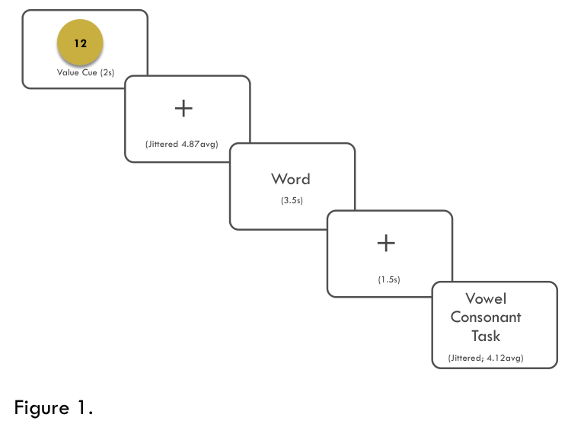
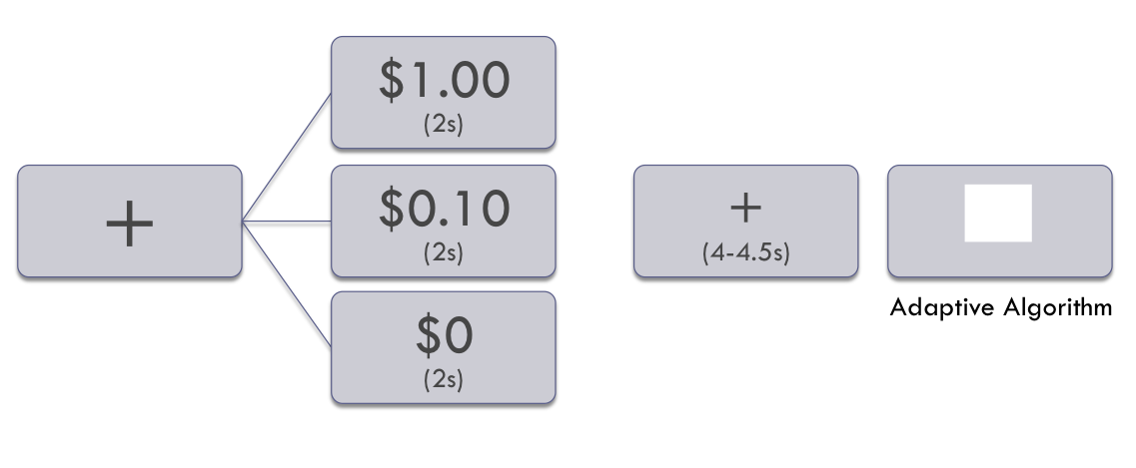
Tasks
Value Directed Remembering Task
Monetary Incentive Delay Task
Notes:
----- Meeting Notes (9/20/13 13:46) -----
redo title
alan castel

Slide 3
Behavioral Results
Value Directed Remembering Task
Monetary Incentive Delay Task

Slide 4
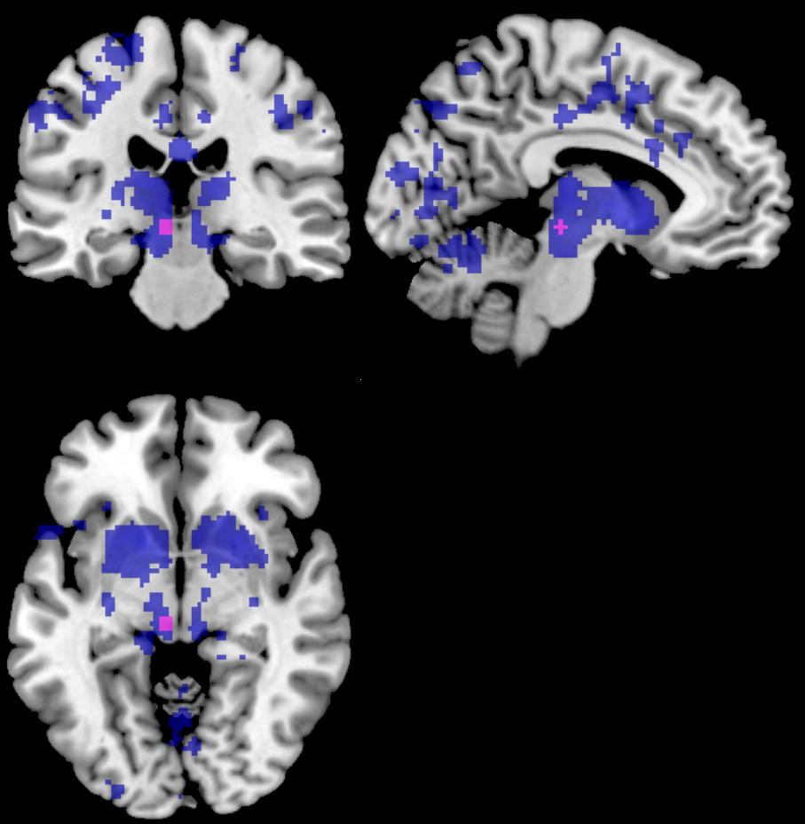
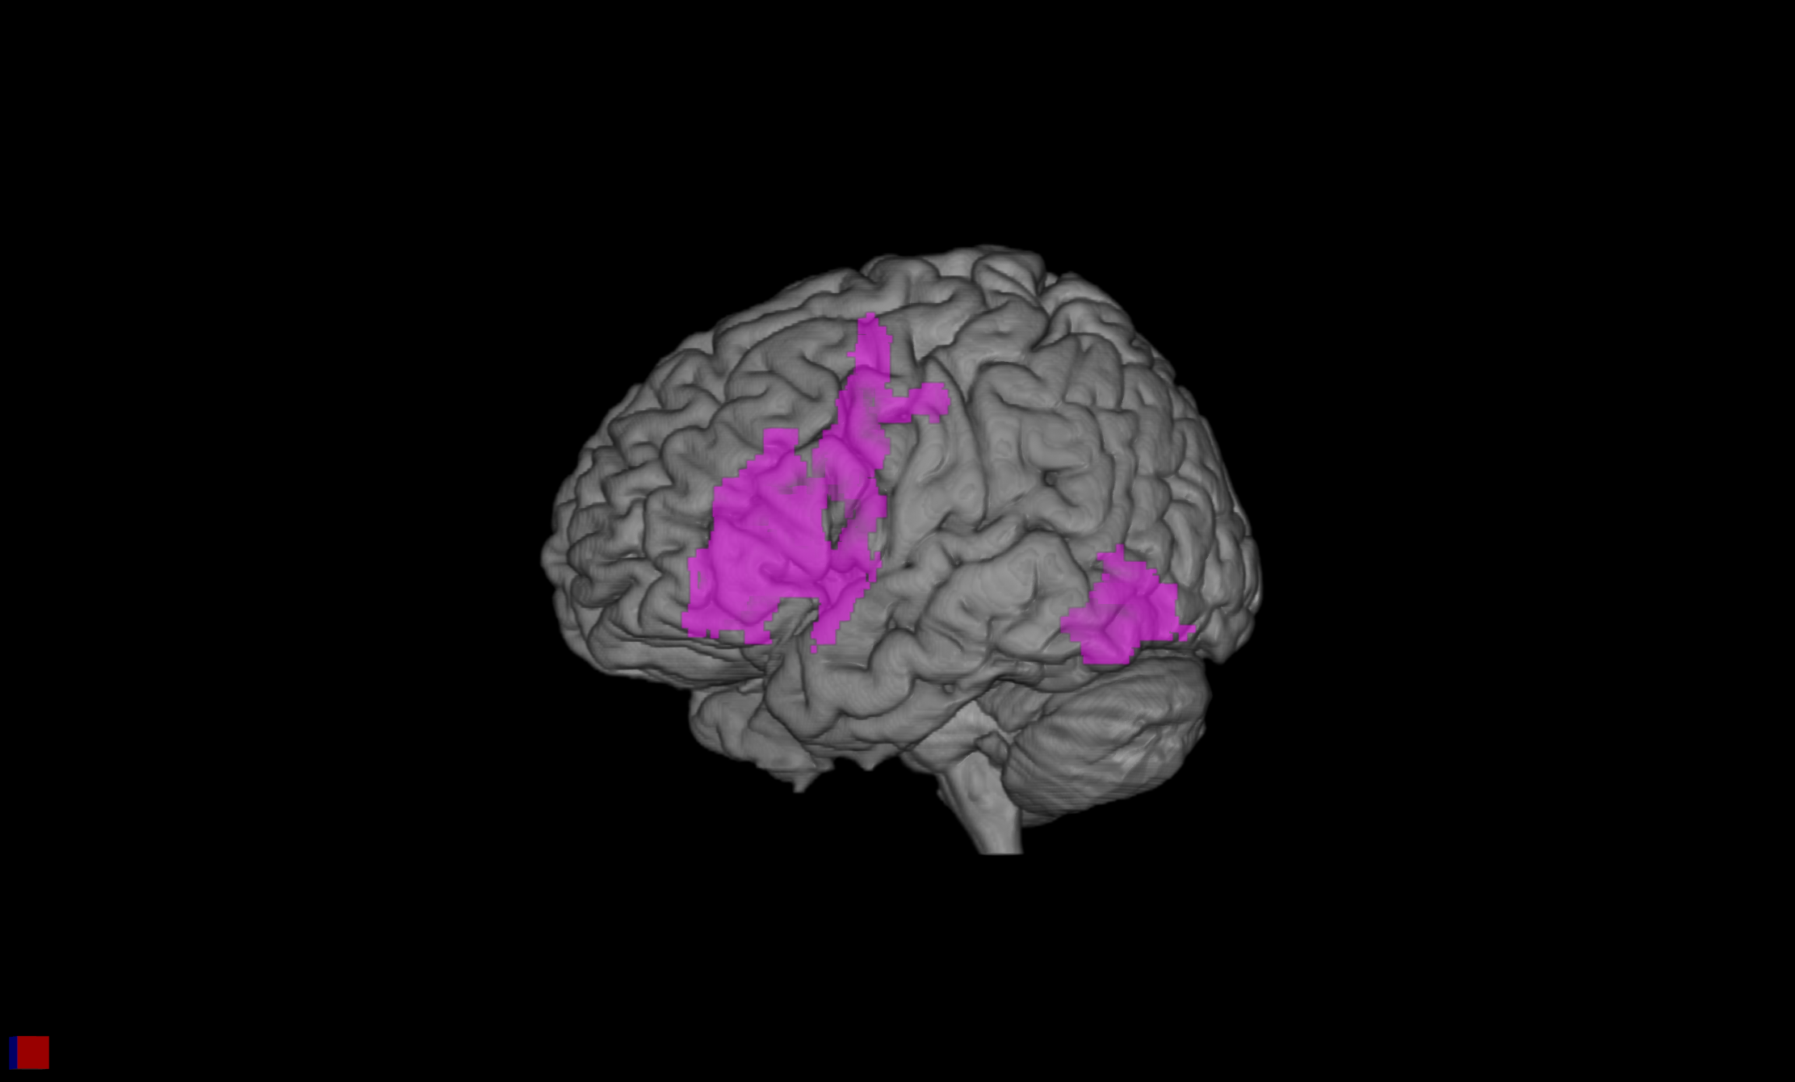
fMRI Results
Value Directed Remembering Task
Monetary Incentive Delay Task
Cue Period: Classic VTA localizer

Slide 5
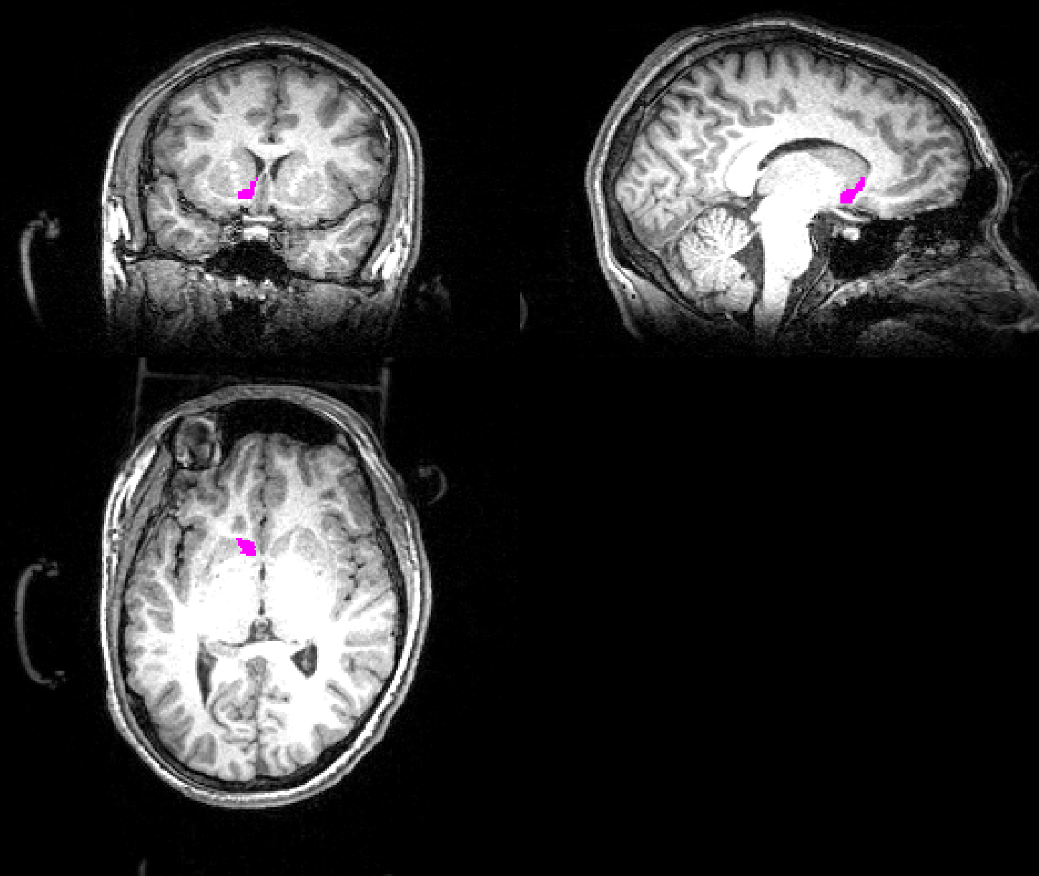
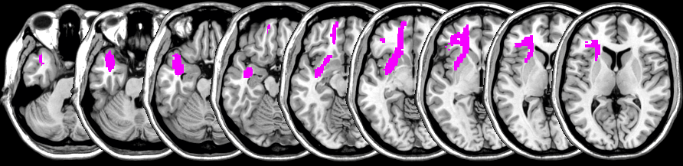
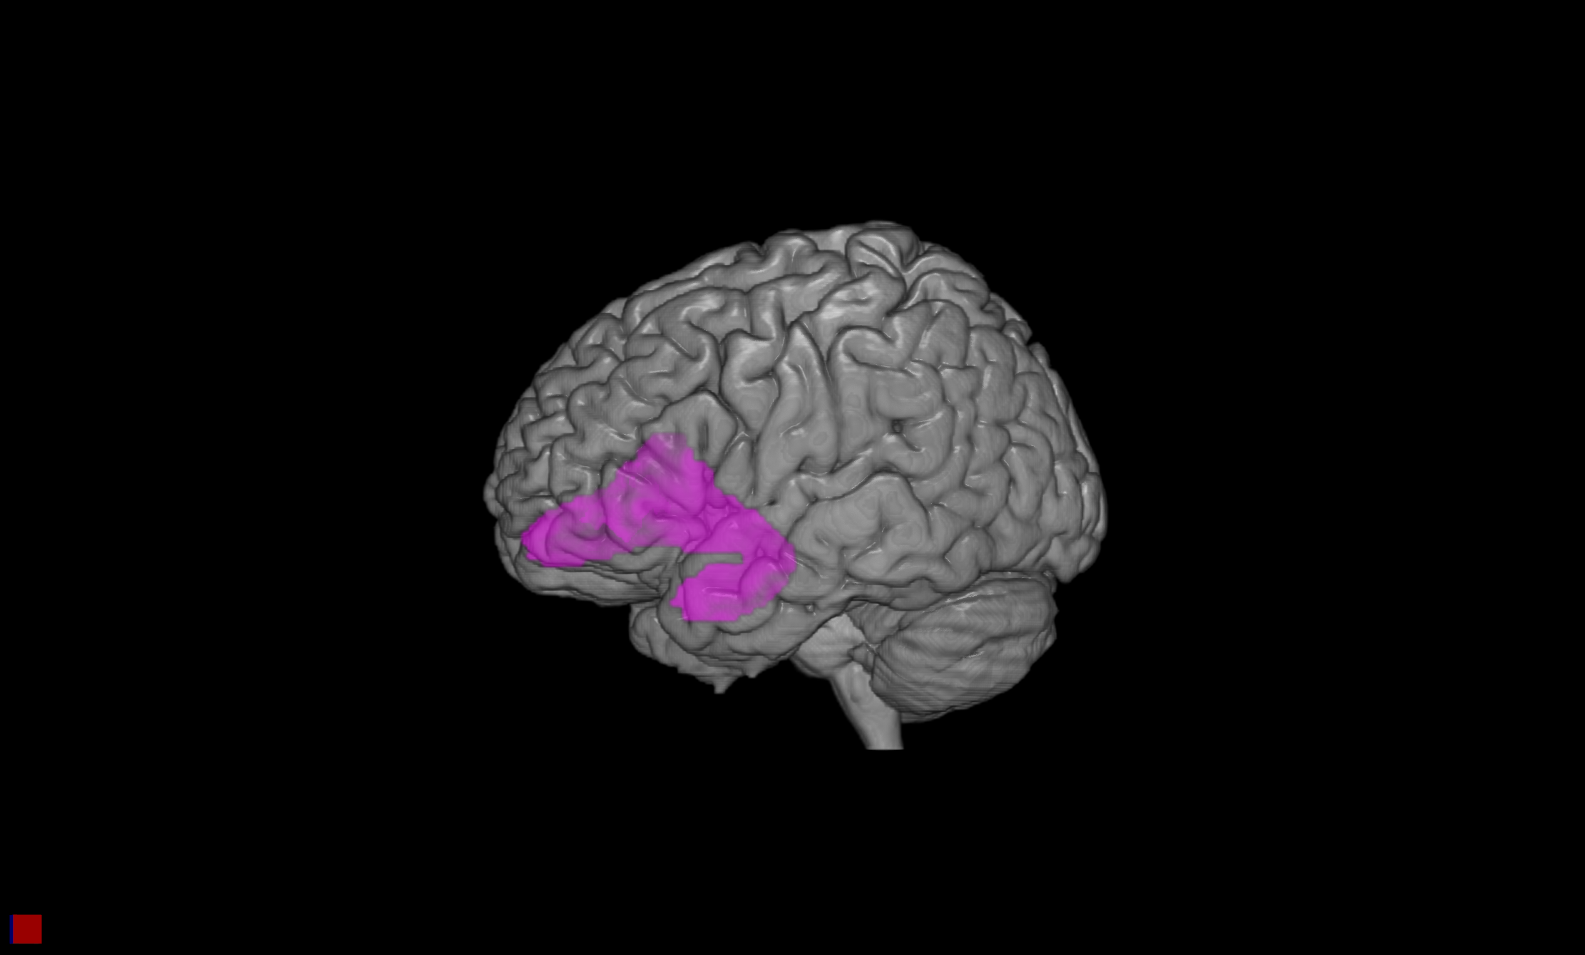
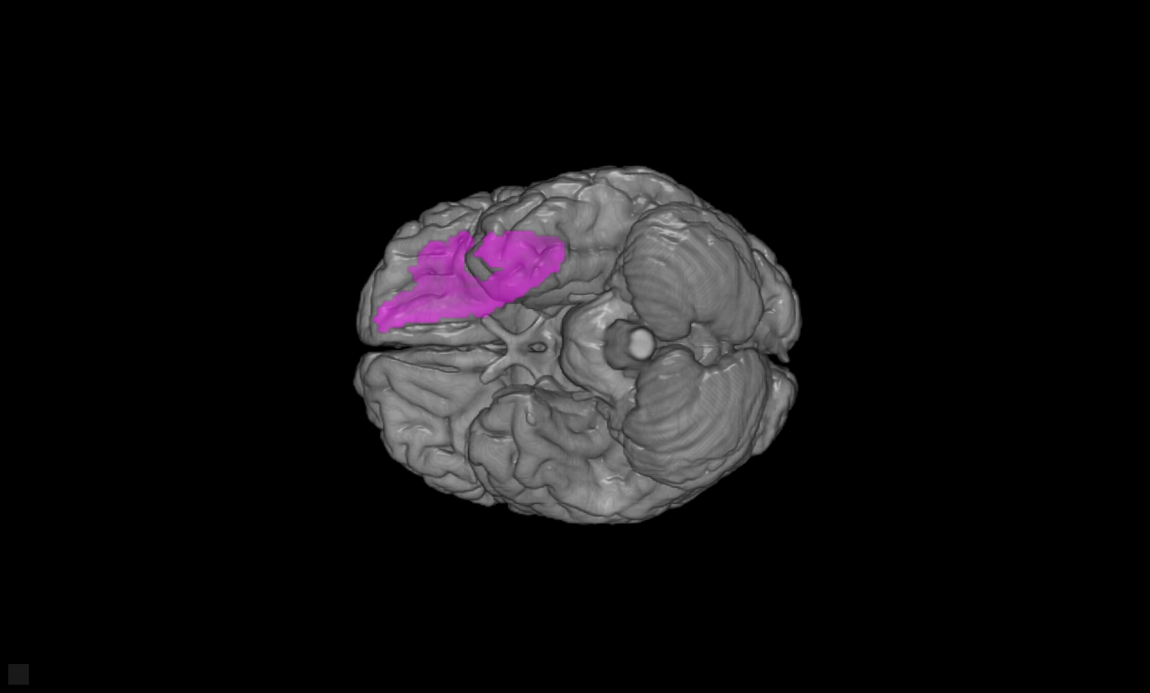
ROIs
VTA, Nucleus Accumbens, Uncinate Fasciculus

Slide 6
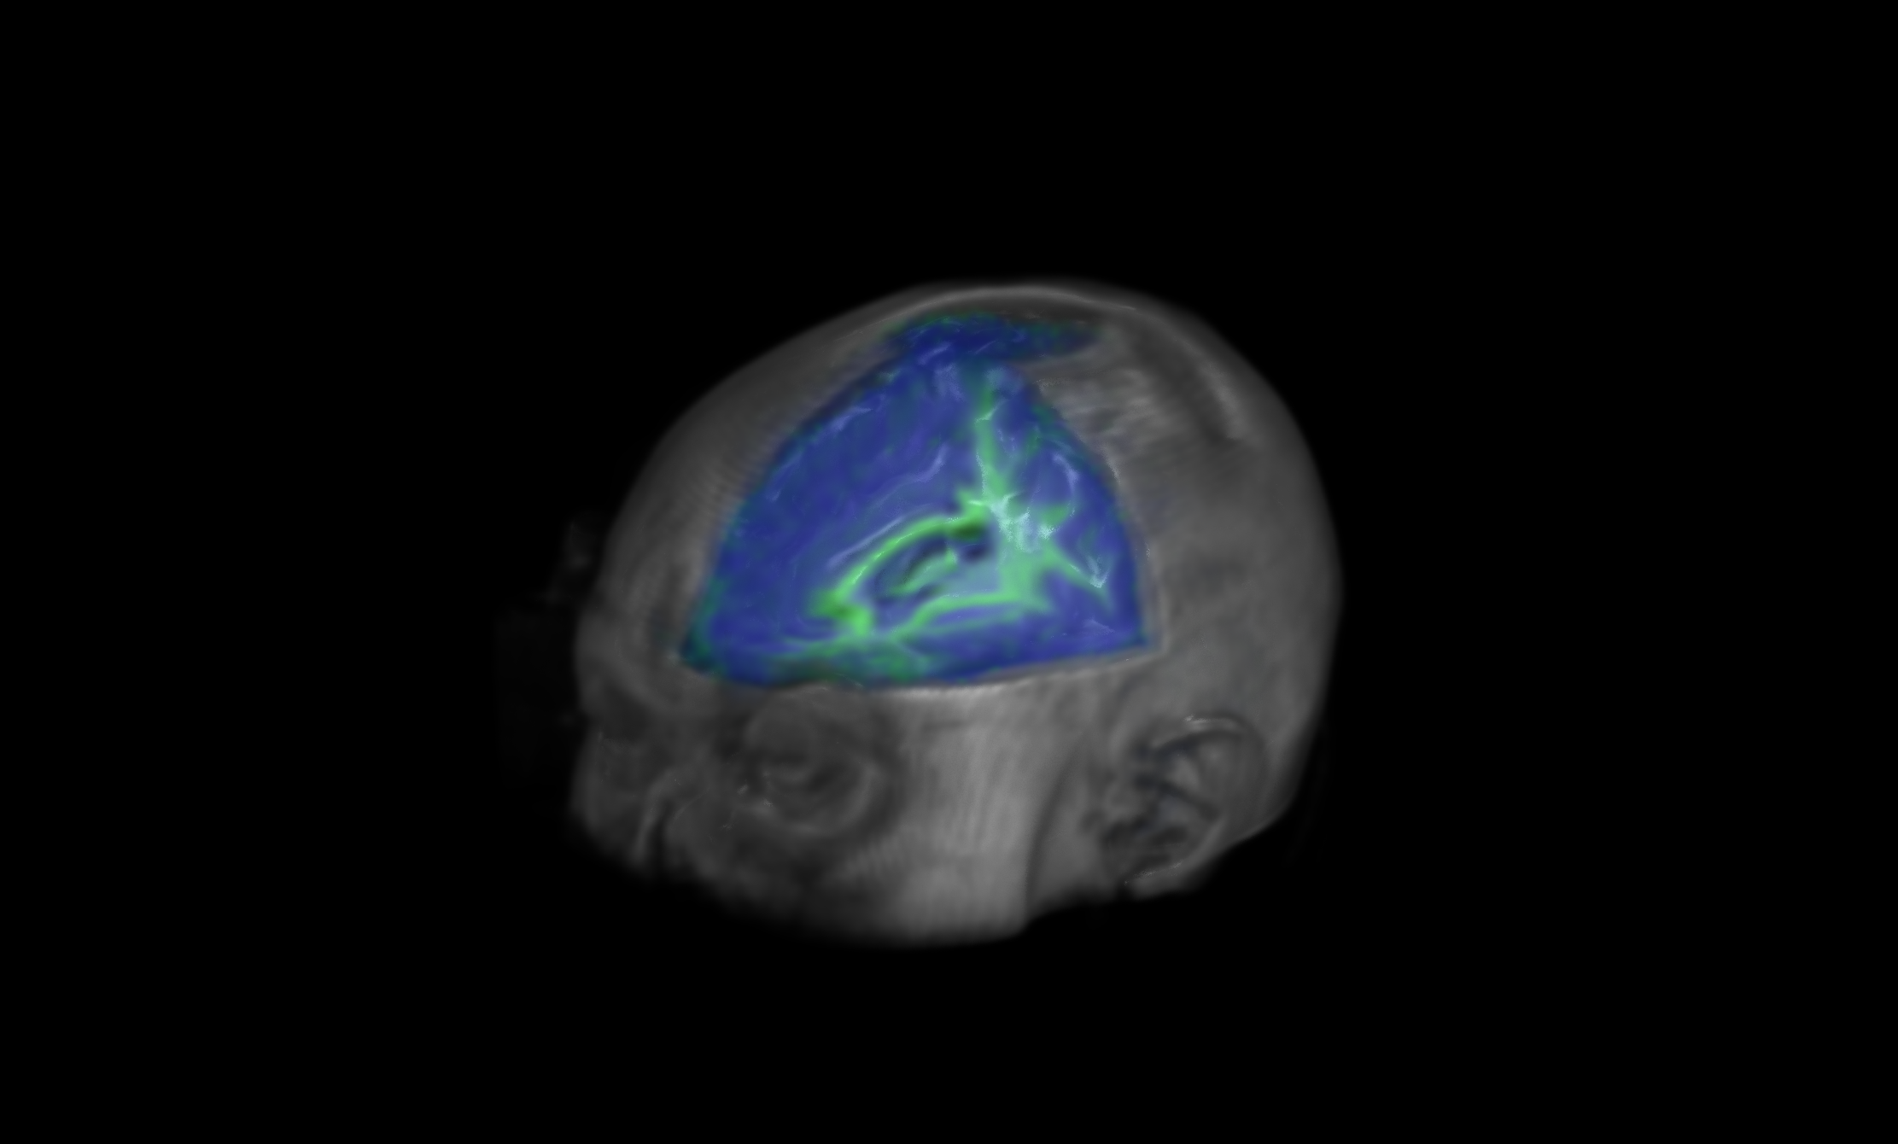
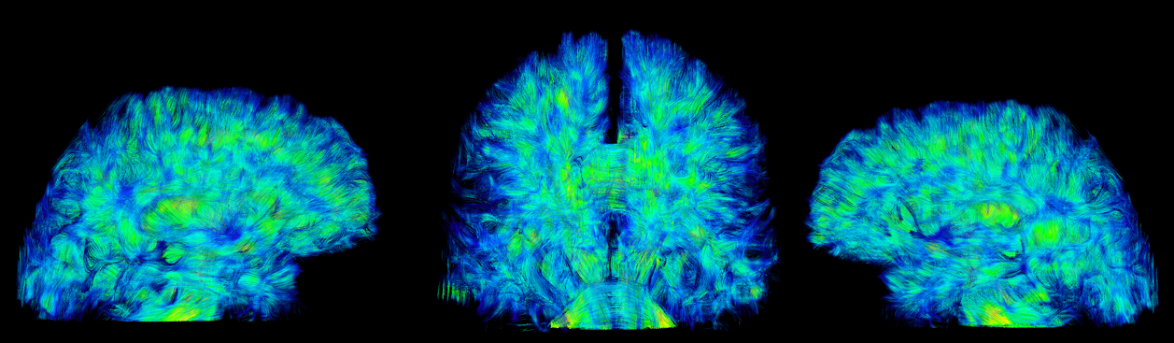
Methodology
Fractional Anisotropy
  Indicative of white matter integrity
Probabilistic Tractography
  Nucleus Accumbens → VTA
Notes:
----- Meeting Notes (9/20/13 13:46) -----
boost size
connectivity structural segway from michael.

Slide 7
Uncinate Fasciculus Results
High Value Recall vs. UF FA
Notes:
----- Meeting Notes (9/20/13 13:46) -----
increase legend size.
put up axes first, and then display individual data.
emphasize that it is memory for valuable items.
Y-Axis Labels High Value Score.

Slide 8
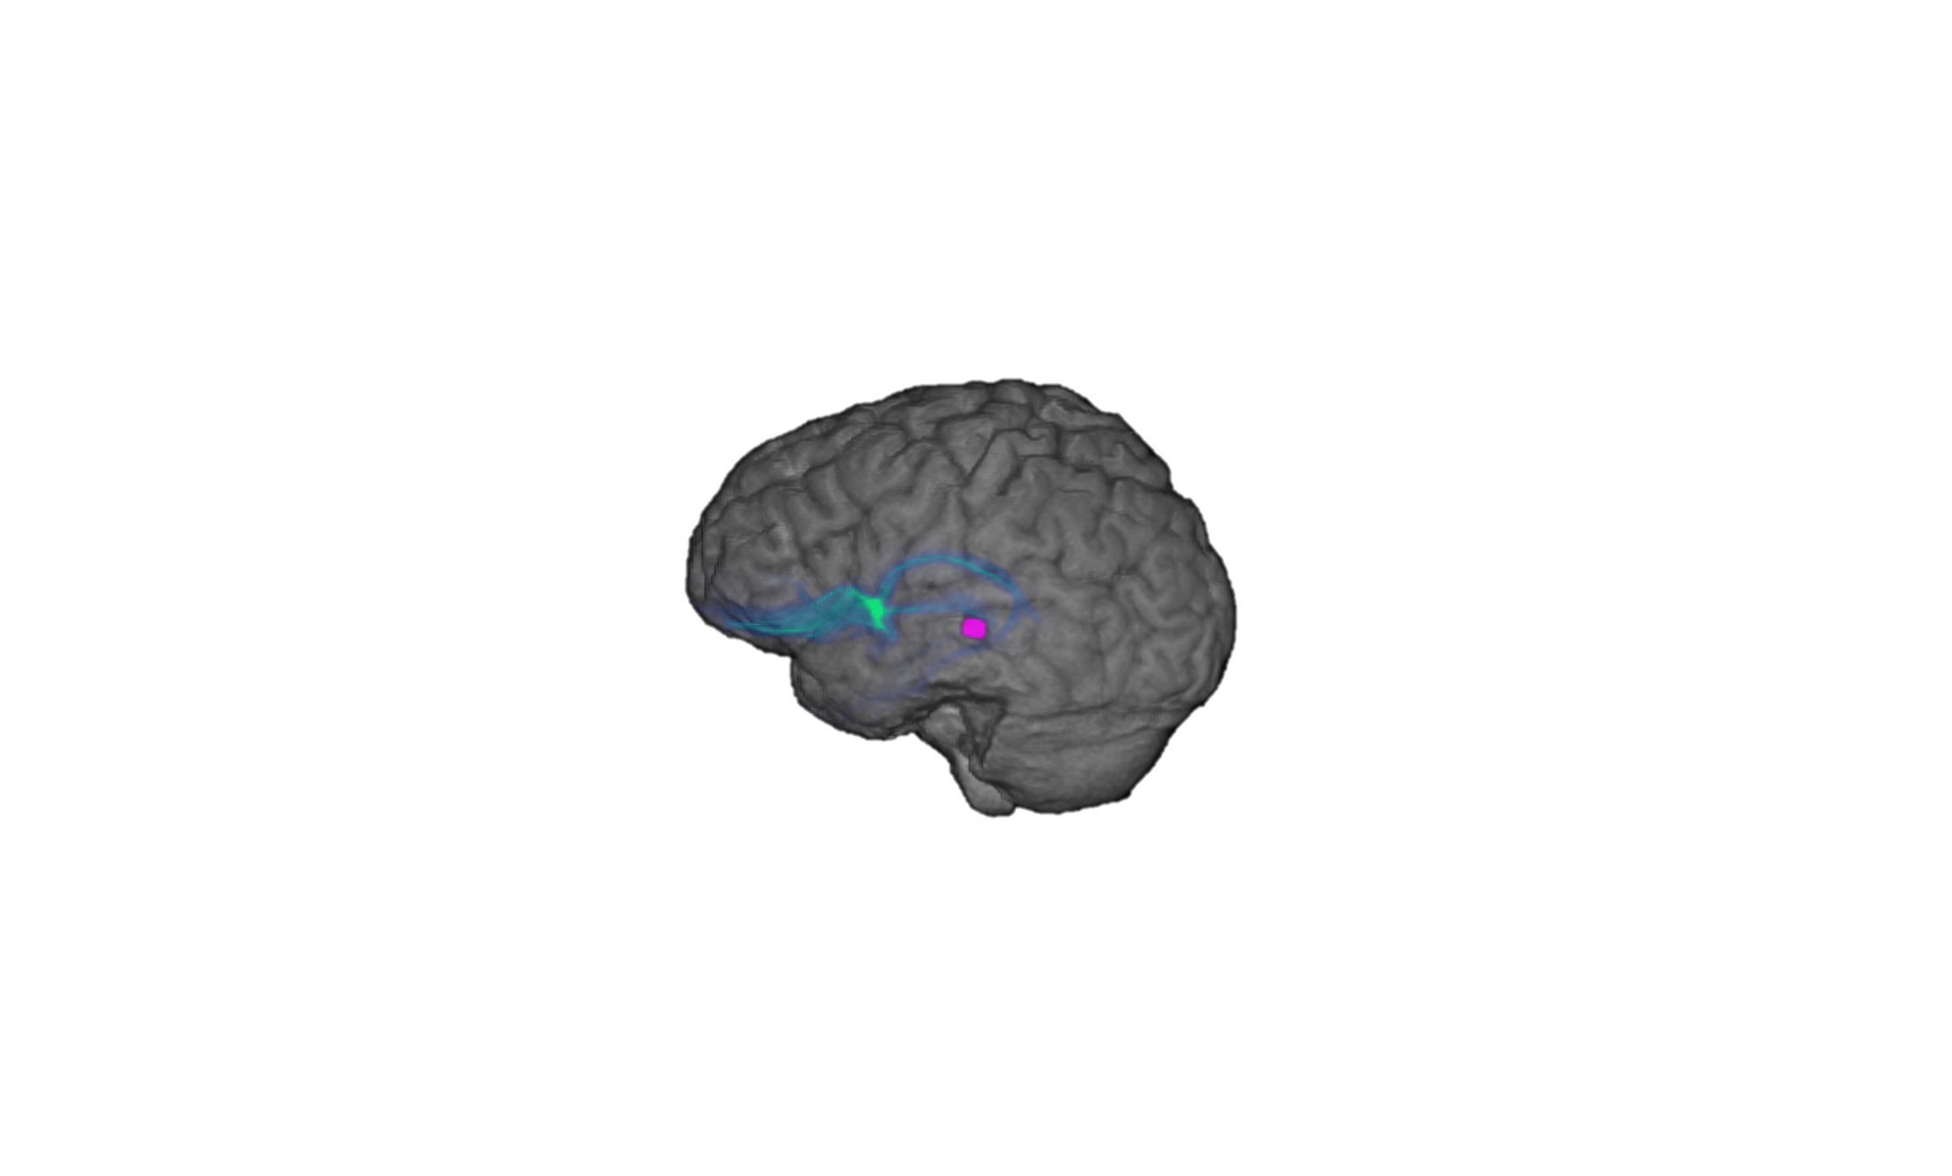
Nacc → VTA Results
Tractography vs. Selectivity
Participants Score – Chance Score
“Selectivity Index” = _____________________________________
Optimal Score – Chance Score
Left Nacc
Left VTA
Notes:
----- Meeting Notes (9/20/13 13:46) -----
chenge to Index
show formula
text in same color labels

Slide 9
The Authors:
Memory recall for high value words correlates with individual differences in white matter pathways associated with reward processing and fronto-temporal communication
Michael S. Cohen
(Amy) Zhong Sheng Zheng
Natalie G. DeShetler
Alan D. Castel
Barbara J. Knowlton
Jesse Rissman

