Slide 1
A High-resolution study of hippocampal and medial temporal lobe correlates of spatial context and prospective overlapping route memory
--T. Brown, M. Hasselmo, C. Stern (Boston University)
Presented by Nicco Reggente
for Rissman Lab Meeting on 7/2/14

Slide 2
Background
Contextual information combines with sequential associations in the hippocampus to allow retrieval of specific episodes despite interference from overlapping representations.
Hopfield Model: W(I,j)=M(i)*M(j) or M*M’
You can add multiple representations into the same “weight matrix” and if you activate part of a memory, then you can retrieve the whole memory without confusing it with previous memories.

Slide 3
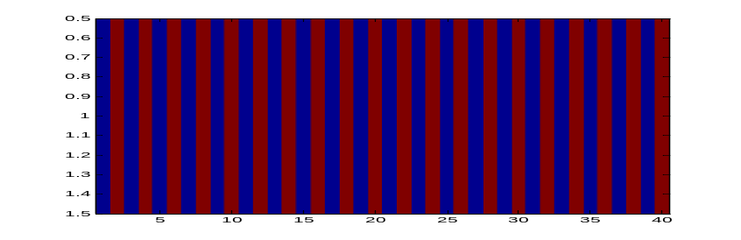
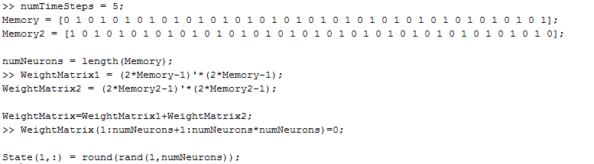
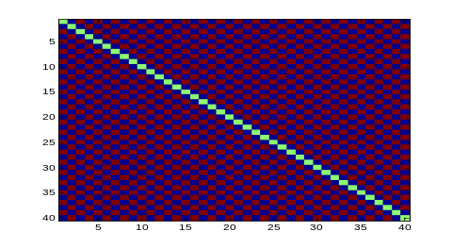
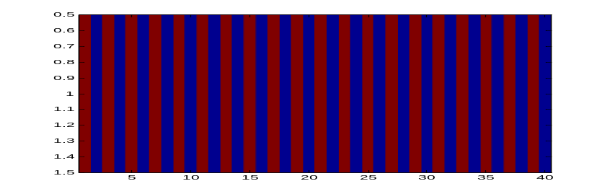
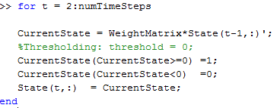
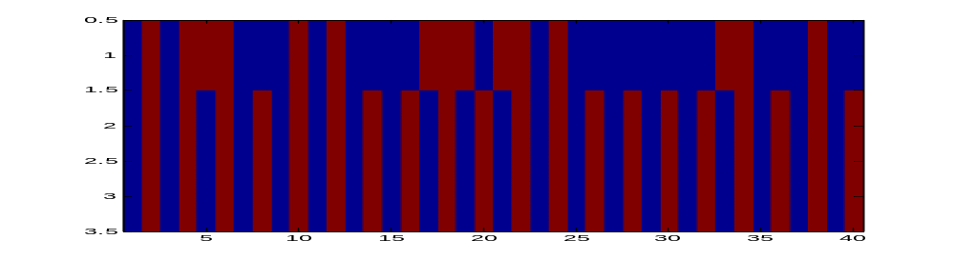
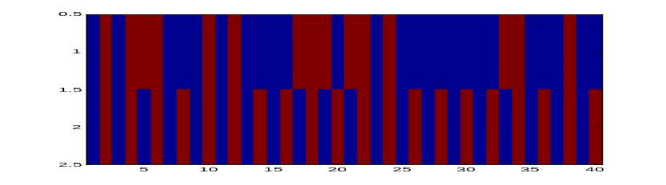
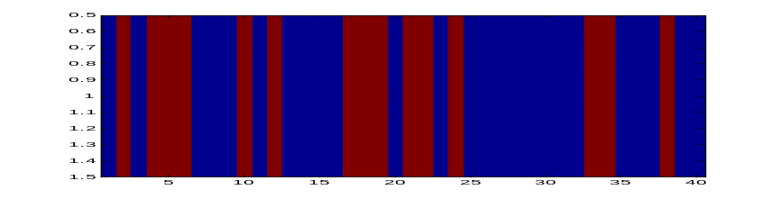
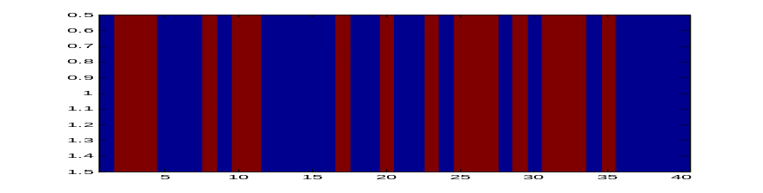
Background
Memory 1
Memory 2

Slide 4
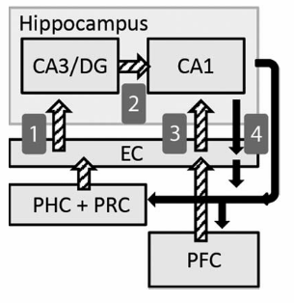
Background
DG neurons receive spatial and item information.
DG projects to CA3, which has recurrent collaterals.
CA3 is auto associative and forms arbitrary associations and retrieves sequential associations from cues.
CA3 neurons show rapid sequential replay of locations along a route.
…Pattern completion

Slide 5
Background
We would expect CA3/DG activity to be elevated for initial contextual retrieval.
CA3 and ERC converge onto CA1 to compute precise estimations of location and compare incoming information with predictions.
If CA1 converts CA3/DG signals into predictive expressions of distinct mnemonic episodes, then its activity would correlate with decision making with overlapping route decision making.

Slide 6
Background
CA1 disambiguates memories.
CA1 is important for prediction of future states.
CA1 shows context-dependent firing for locations along overlapping navigational routes based on the prospective path.
CA1 activity can influence and be influenced by goal states from orbitofrontal cortex (critical for planning)
CA1 could thus integrate memory and its optimal “appropriateness” for the current situation.

Slide 7
Background
Spatial contextual information may be represented by the PHC and go on to cue associative retrieval for the current environment in CA3/DG while simultaneously providing context signals to ERC, which can then gate activity in CA1.
Since CA1 projects back to PHC, mnemonic output of the hippocampus may support visualization of upcoming states in the environment during planning.

Slide 8
General Questions
Which areas modulate prospective planning for routes that overlap with other learned routes?
  Basically: Where is Imagining a route > actually traversing that route?
  Hypothesis: CA3/DG (and also PHC) would be important for processing spatial contextual signals and then go on to pattern complete by imagining a route associated with the current contextual signals (cue).
Are the contextual retrieval demands during early learning greatest for overlapping routes?
Where does the disambiguation occur when there are overlapping routes?
  Hypoethsis: CA1 activity will correlate with subsequent performance on overlapping decision points.

Slide 9
General methods
N=18
20 Outdoor Labyrinth mazes
  3 hallways
  3 intersections
  10 trained to criterion (pre-scan)
    5 overlapping (share a common hallway)
  10 novel (in scanner)
    5 overlapping
Scanner Params
32-Channel Head Coil
TR=2s; TE=34ms
FA = 90
Slices =22 (parallel to long axis)
Voxel Size = 1.5mm isotropic
Preprocessing
Motion correction (realigned to first functional)
ART
ROI-ANTS (Stark: template space and hand-drawn ROIs)

Slide 10
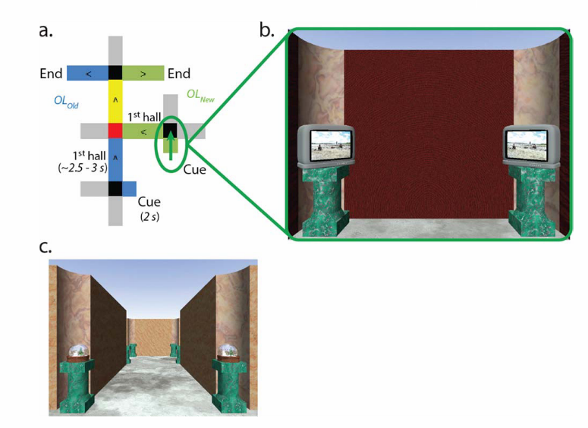
Design
3 decisions.
Overlapping in Yellow.
10 runs; 10 Old 10 novel in each run.
2nd intersection is the “Critical Decision”
Conditions (4) :
  Overlapping (old and new)
  Non-Overlapping (old and new)
  50 trials per condition.
Turns took 1s.
Movement down hallways took 2s.
Cue period was 2s
Used the button box to make turning choices.

Slide 11
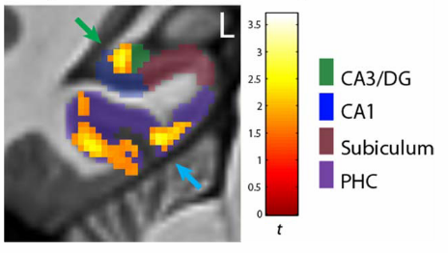
Spatial contextual cue-specific activity
Examine the effects that distinguish contextual cue processing and initial prospective retrieval from active navigation and their sensitivity to learning.
Maze-Component (Cue period vs. subsequent first hallway) ANOVA
End goal: Which regions were more strongly active specifically during processing of spatial contextual cues?
Notes:
OVERLAPPING
cue-specific activity common to both newly- learned (OLNew) and well-learned (OLOld) mazes: within the hip- pocampus, a region of the left CA3/DG subfield had activity specific to the spatial contextual Cue period
When this was just OLD, the cluster extended into CA1 and subiculum (peak)
These effects were somewhat modulated by Task phase – Right perirhinal cortex became more strongly active for the cue period than for subsequent navigation during the late task phase.
no instances of the first hallway leading up to the primary context-dependent decision point having greater activity than the Cue period
NON-OVERLAPPING
Parahipp and perirhinal
Ask Jesse : “counterpart regressors”
The onsets of the Cue period regressors were sepa-
rated from the onsets of the First Hallway regressors by an
average of 4 s due to the intervening First Intersection choice
point and feedback

Slide 12
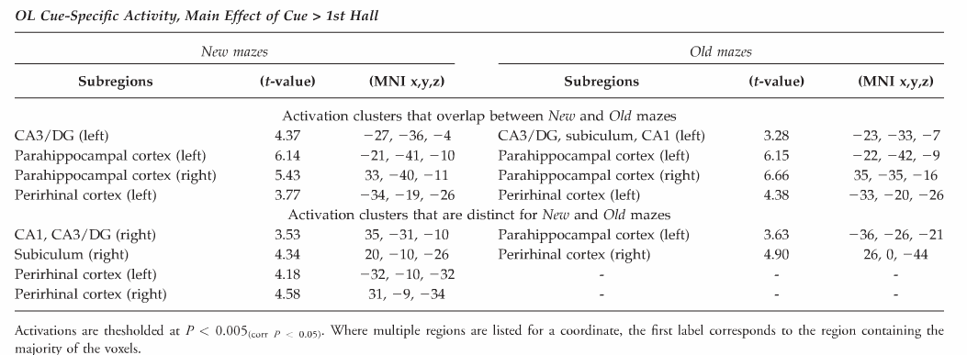
Spatial contextual cue-specific activity
Notes:
OVERLAPPING
cue-specific activity common to both newly- learned (OLNew) and well-learned (OLOld) mazes: within the hip- pocampus, a region of the left CA3/DG subfield had activity specific to the spatial contextual Cue period
When this was just OLD, the cluster extended into CA1 and subiculum (peak)
These effects were somewhat modulated by Task phase – Right perirhinal cortex became more strongly active for the cue period than for subsequent navigation during the late task phase.
no instances of the first hallway leading up to the primary context-dependent decision point having greater activity than the Cue period
NON-OVERLAPPING
Parahipp and perirhinal

Slide 13
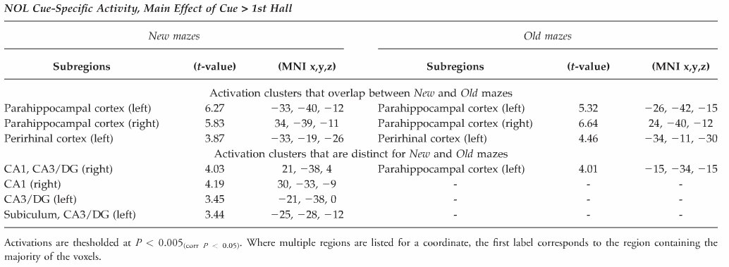
Spatial contextual cue-specific activity
Notes:
OVERLAPPING
cue-specific activity common to both newly- learned (OLNew) and well-learned (OLOld) mazes: within the hip- pocampus, a region of the left CA3/DG subfield had activity specific to the spatial contextual Cue period
When this was just OLD, the cluster extended into CA1 and subiculum (peak)
These effects were somewhat modulated by Task phase – Right perirhinal cortex became more strongly active for the cue period than for subsequent navigation during the late task phase.
no instances of the first hallway leading up to the primary context-dependent decision point having greater activity than the Cue period
NON-OVERLAPPING
Parahipp and perirhinal

Slide 14
Prospective disambiguation-related activity
Contrasting the level of overlapping maze Cue activity with that for nonoverlapping counterpart mazes
Overlapping maze performance would most directly benefit from explicit look-ahead retrieval of upcoming overlapping choice points.
Subjects can use associative memory to distinguish between the Cue periods of the two conditions.
The question: Is CA1 more strongly active for overlapping than non-overlapping mazes during the cue period?
Notes:
Subjects can think to themselves “hey..i know where I am and I know what I need to do. I also know that I’m going to traverse a route that overlaps with another route”.

Slide 15
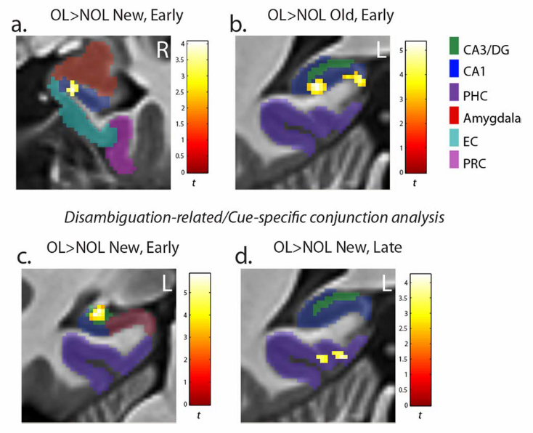
Prospective disambiguation-related activity
Notes:
A) Rostral CA1 was more strongly active for overlapping than non (NEW) during the initial cue period in the early task phases
B) Posterior CA1greater for overlapping than non (OLD)
C) Conjunction of cue-specific activity and (NEW overlapping > NEW non) EARLY
D) Conjunction of cue-specific activity and (NEW overlapping > NEW non) LATE
Same region of the left CA3/DG that had cue specific activity across all phases of the task was more strongly active for overlapping than non overlapping during the early portions of the task (only cue-specific region to show this). Consistent with a greater amount of previously learned information about the upcoming overlapping environment to retrieve from a contextual cue.
OL> NOL activation differences became non-significant in the Late task phase. Is it the case that cued contextual retrieval becomes greater in Late phases for non-overlapping mazes as the unique representations stabilize, allowing for greater prediction of subsequent states during the initial Cue period?
YES(for hippocampus) – OL was only slightly attenuated from early to late. NOL increased.
NO(for parahipp) – OL increased and NOL attenuated

Slide 16
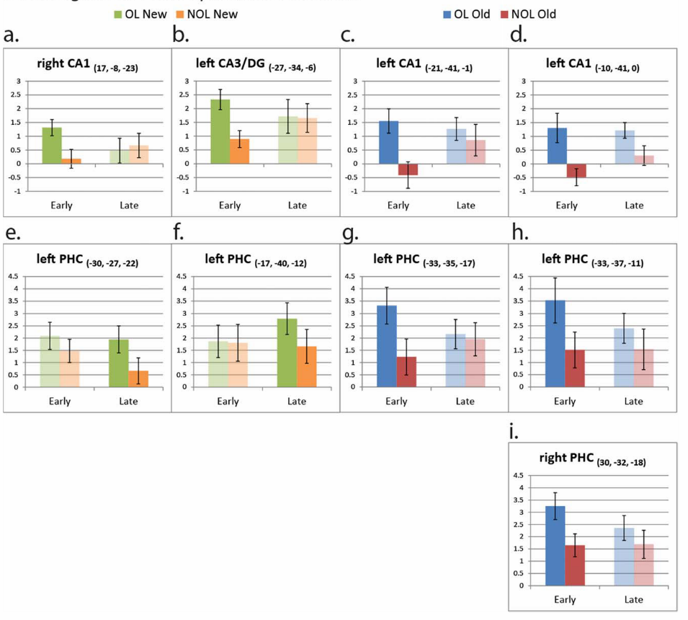
Prospective disambiguation-related activity
Notes:
OL> NOL activation differences became non-significant in the Late task phase.
Is it the case that cued contextual retrieval becomes greater in Late phases for non-overlapping mazes as the unique representations stabilize, allowing for greater prediction of subsequent states during the initial Cue period?
YES(for hippocampus) – OL was only slightly attenuated from early to late. NOL increased.
NO(for parahipp) – OL increased and NOL attenuated

Slide 17
Prospective cue activity correlated with critical decision performance
Measuring the degree to which trial-by-trial Cue period activity in CA1 correlates with subsequent context-dependent navigational decision performance.
Critical Decision RT might be indicative of the degree to which prospection was used during the Cue period.
Parametric modulation analysis to test if trial-by-trial recruitment of CA1 during the Cue period relates to how fast participants respond on subsequence correct context-dependent navigational choices.
Trial-by-Trial cue periods with subsequent overlapping routes had CA1 activity that correlated with context-dependent performance at subsequent overlapping intersections.

Slide 18
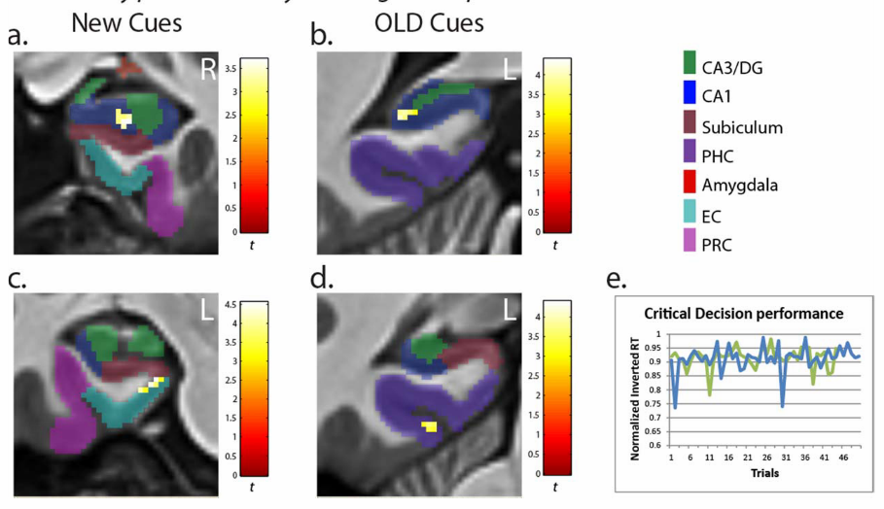
Prospective cue activity correlated with critical decision performance
Same region of Posterior CA1 that showed overlapping preference during early trials was more strongly active on trials where the subsequent critical decision was correctly navigated more quickly.
Thus…trial-by-trial processing in CA1 relates most directly to prospective disambiguation and look-ahead success of overlapping routes during the Cue period.
  Parahipp and medial entorhinal showed this effect as well.

Slide 19
Conclusions
CA3/DG and PHC and PRC are active for the initial spatial-cued forward trajectory “look-ahead” period relative to subsequent overlapping route navigation.
CA3/DG and CA1 and PHC are sensitive to disambiguation demands of the task (OL>NOL)
CA1 cue activity correlated with measures of subsequent decisions in regards to overlapping routes.

Slide 20
Discussion
CA3/DG, PHC, PRC activation is specific to the spatial contextual cue period
CA3/DG even more selective for overlapping maze planning (old and new)
  Same region as spatial contextual cue period.
  With new mazes, CA3/DG increased for non overlapping to the same level as overlapping.
    Retrieval processes for NOL may occur earlier in navigational trials with increasing familiarity.
CA3/DG has a persistent role in processing associations of spatial contextual cues across various stages of experience.
  Consistent with pattern completion…
  CA3/DG could help rapidly bind novel cue locations with previously learned information about the environment for overlapping routes.

Slide 21
Discussion
PHC shows OL > NOL (new) only during late
  The same regions that was specific to overlapping during the cue period.
  PHC has an important role in the initial retrieval and disambiguation of navigational events
CA1 tracks prospective disambiguation.
  CA1 more active cues that indicated there would be an overlap.
  Activity predictive of critical decision performance.
  Anterior for New (gist)
  Posterior for Old (stable)
CA1 has been shown to play a role in prediction of future states and pattern completion…
CA1 shown to be associated with learning allocentric representations of space, facilitating navigation to goals from different starting points.
“Place recognition in our task is intimately tied to recognition of the distinct landmark objects at each location”

Slide 22
Discussion
Robust cue period activity observed in the CA3/DG subfield could support encoding incoming contextual cue signals from the MTL cortex and non-specific pattern completion of associated environment features.
  Critical to retrieving an overlapping route, but their relationship to performance is expected to be indirect – mediated by downstream computations in CA1.
    Then further sent to PFC and PHC for decision-making and visualization, respectively.
Only through the convergence of CA3/DG and ERC cortex information on CA1 that the hippocampal system is able to compute precise estimates of location and retrieve representations that are most congruent with current context.
If responses in CA1 pyramidal cells are gated by context, then BOLD signal measured in CA1 will vary as a function of the number cells active for associative retrieval in CA3/DG, and the strength of contextual input.
CA1 and CA3 connections and feedback from PFC could facilitate preferential expression of appropriate goal-relevant memory.

Slide 23
Discussion
PHC also correlates with critical decision for old mazes. The specific region overlaps with cues for overlapping.
ERC showed the same, but for new mazes.
  Grid cells and spatial memory for disambiguation?
  ERC may play an important role in learning and retrieval of novel context-dependent memories.

