Slide 1
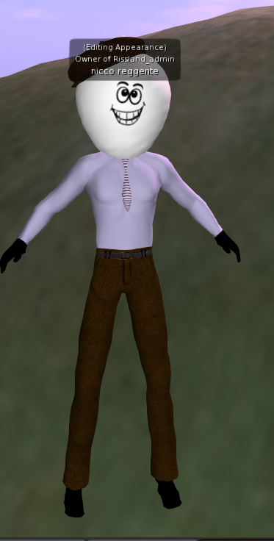
The Method of Loci
&
Virtual Environments
Prepared for Rissman Lab Meeting on 1/23/14 by Nicco Reggente

Slide 2

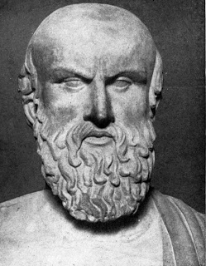
The Method of Loci
(a.ka The Journey Method, The Roman Room, The Memory Palace)
Simónides de Ceos
“Joshua Foer
In this technique the subject memorizes the layout of some building, or the arrangement of shops on a street, or any geographical entity which is composed of a number of discrete loci. When desiring to remember a set of items the subject literally 'walks' through these loci and commits an item to each one by forming an image between the item and any distinguishing feature of that locus. Retrieval of items is achieved by 'walking' through the loci, allowing the latter to activate the desired items.”
-O’Keefe and Nadel (The Hippocampus as a Cognitive Map)

Slide 3
The Method of Loci
(a.ka The Journey Method, The Roman Room, The Memory Palace)
Seven-fold increase in ordered retention (Bower 1970)
Short exposure, Long retention
  13s, 38/40 items remembered, in order, next day (Ross & Lawrence 1968)
A more engaging exposure to stimuli (Osberg 1997)

Slide 4
Why it works
Hippocampal evolution from the medial pallium paralleled navigation into novel terrain. (Jacobs, 2003)
  Where we are now in relation to where we were before is the essential precursor to spatial orientation and navigation.
Place cells, grid cells, boundary cells, head-direction cells…
  Memory and space are relatively intertwined (Doeller 2013)
  We subconsciously build mental images of the space we are in (Down 1976)
MoL exploits the remarkable vividness of our visuospatial memory by using spatial environments as scaffolding for memorizing non-spatial content.
Notes:
The medial pallium in other animals with more simple brains seems to be responsible for spatial navigation. If the pallium is a precursor to the hippocampus, then it follows that the hippocampus initially served as a navigational tool.
The first thing an organism must concern itself with is where it is in space and how it is moving and where it has been (memory) in relation to where it is now.

Slide 5
Why it works (fMRI)
MCI patients show increased activity in left hippocampus when using mnemonic techniques (Hampstead 2012)
During encoding: signal increase in IFG, MFG, left fusiform , lingual gyrus, and posterior cingulate (Kondo 2004)
During retrieval: signal increase in left parahipocampal gyrus, retrosplenial cortex, cingulate, lingual, left precuneus, left fusiform (Kondo 2004)
Enhanced activity along tempo-parietal pathways and prefrontal cortex (Burgess 2001)
Stay tuned ☺

Slide 6
Why VR?
In this technique the subject memorizes the layout of some building, or the arrangement of shops on a street, or any geographical entity which is composed of a number of discrete loci. When desiring to remember a set of items the subject literally 'walks' through these loci and commits an item to each one by forming an image between the item and any distinguishing feature of that locus. Retrieval of items is achieved by 'walking' through the loci, allowing the latter to activate the desired items.”
-O’Keefe and Nadel (The Hippocampus as a Cognitive Map)

Slide 7
Why VR?
Operationalize
  Environments and Stimuli
Enhance Compliance (Legge 2012)
Best to envision the objects and not the words themselves (Bower 1970)
Bizarre, associative scenes are better than familiar ones (Bower 1970)
Vestibular/Kinesthetic cues are important for developing spatial knowledge (Presson & Montello 19994)
  Oculus / Treadmill
No one believe in mental imagery, anyway….

Slide 8
Design(Pilot) – Proof of Concept
Can we predict which Virtual Environment(VE) the subject is mentally traversing?
Can we predict trajectories?
  As a follow up to Hassabis et al.(2009) where they decoded quadrants.
4 Distinct VEs

Slide 9
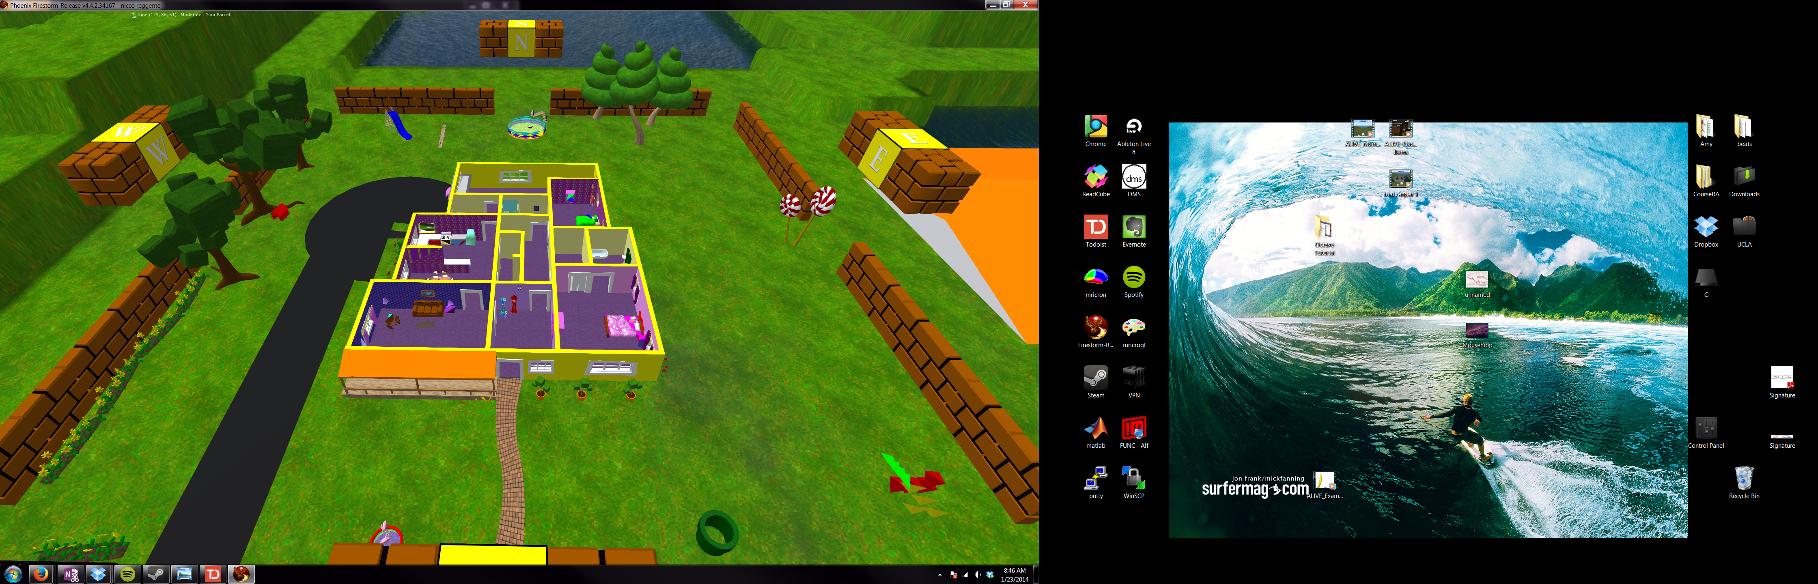
Toon World

Slide 10
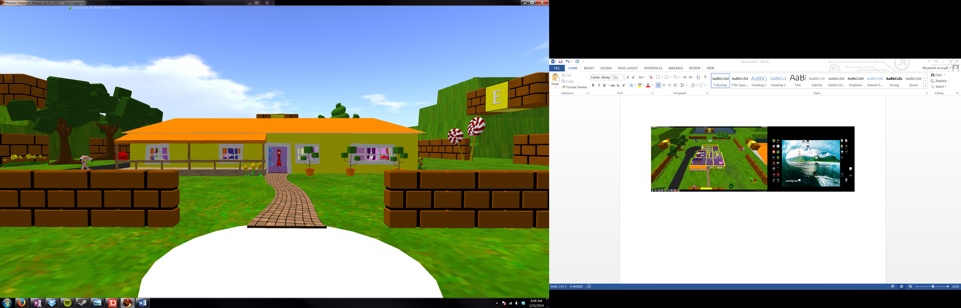
Toon World

Slide 11
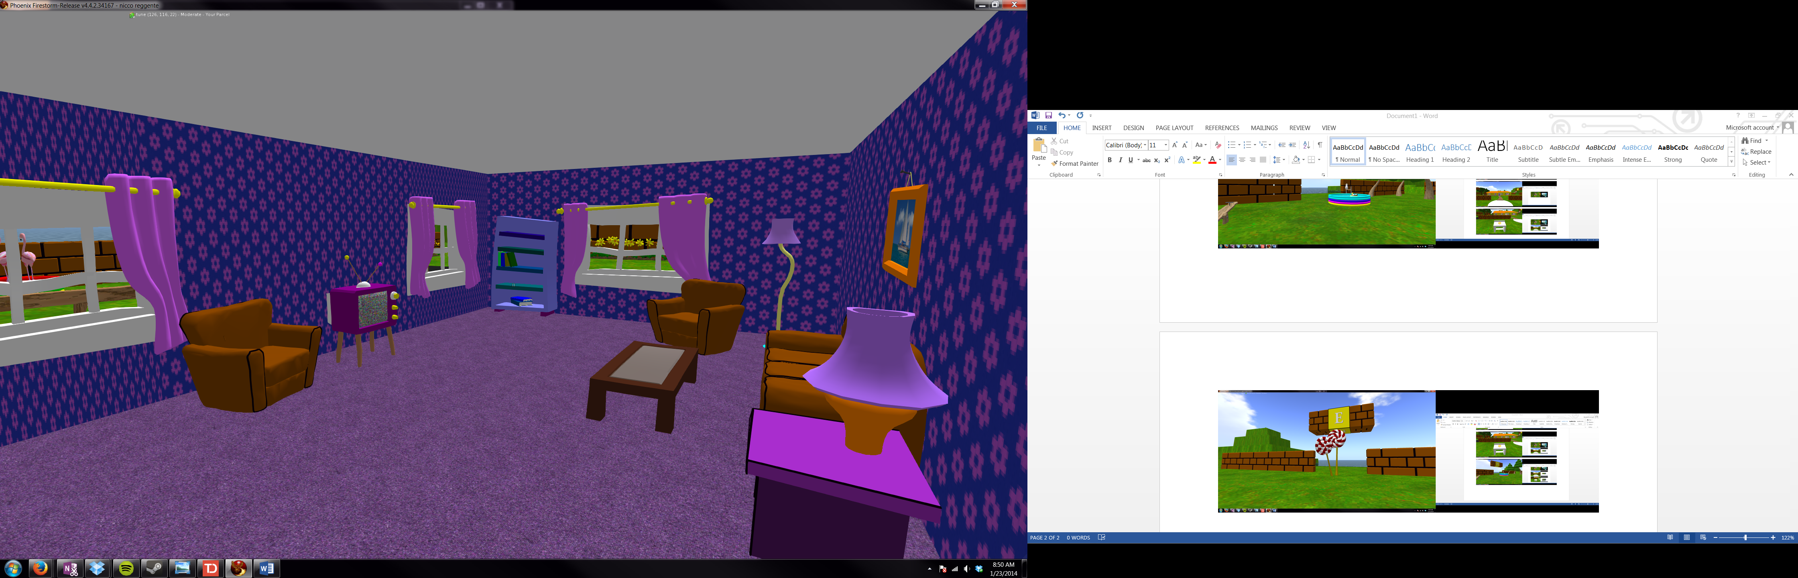
Toon World

Slide 12
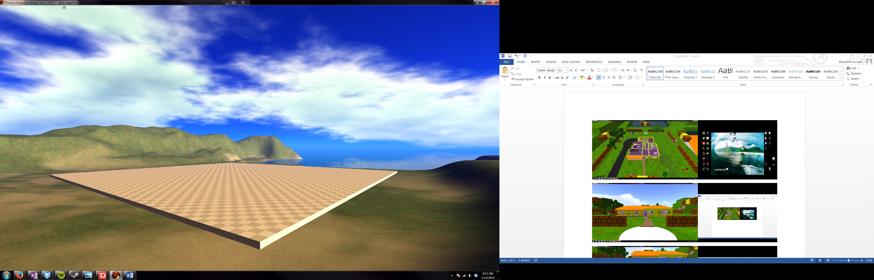
Lagoon World

Slide 13
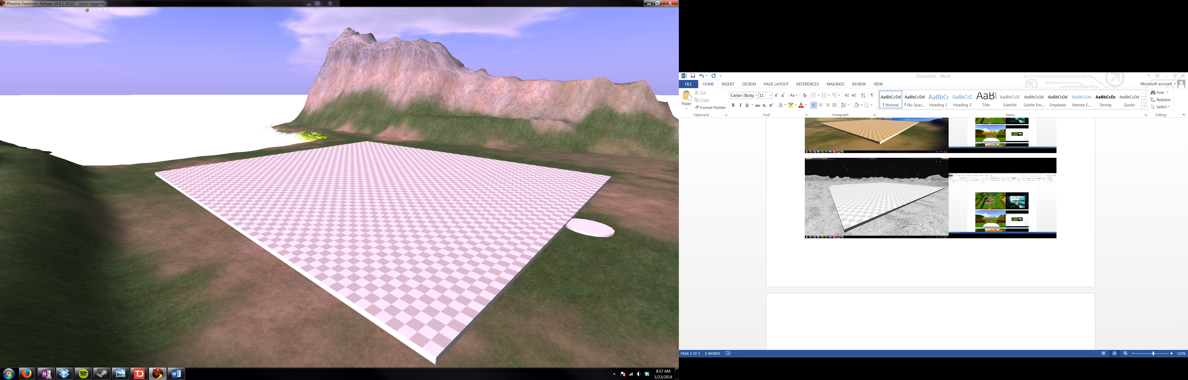
Ruin World

Slide 14
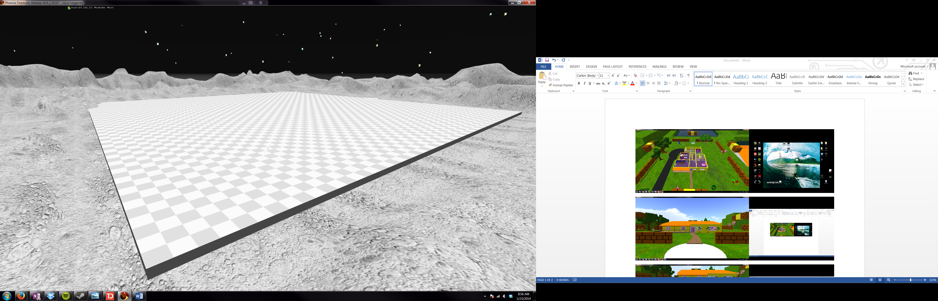
Moon World

Slide 15
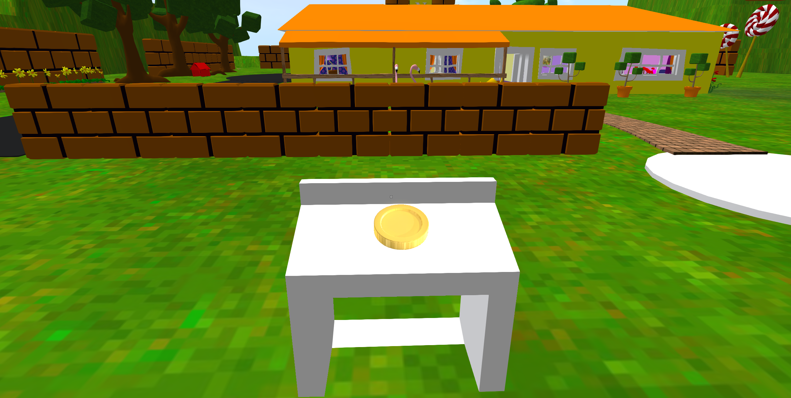
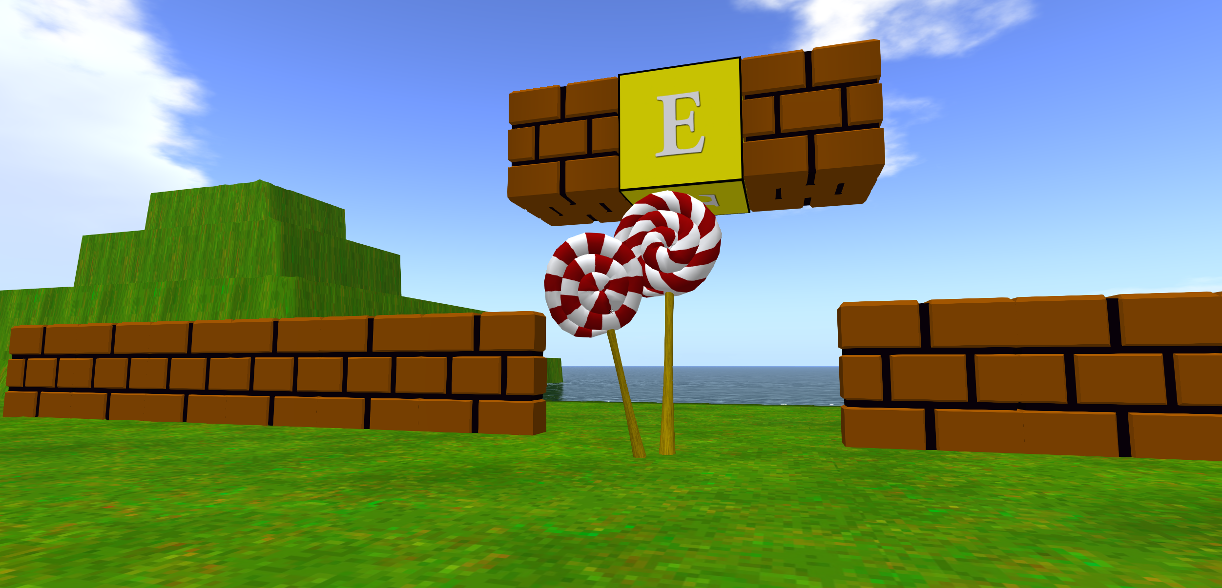
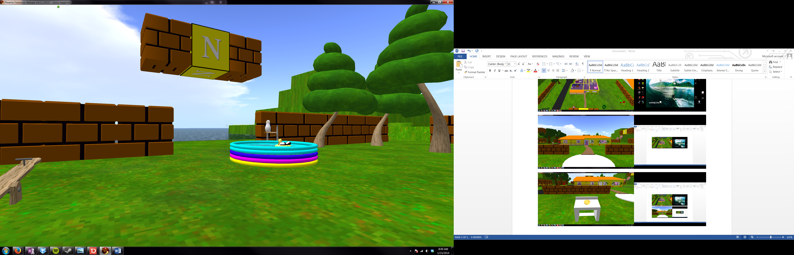
Design(Pilot) – Proof of Concept
Subjects will “coin-collect”
The coins will be scattered throughout the environment & nearby (4) prominent landmarks that are at the cardinal locations in the environment.

Slide 16
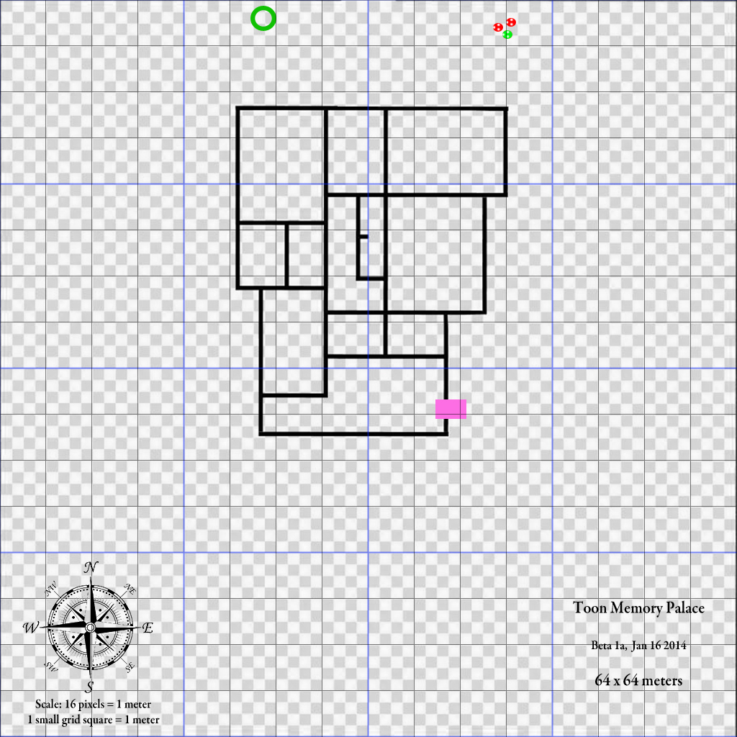
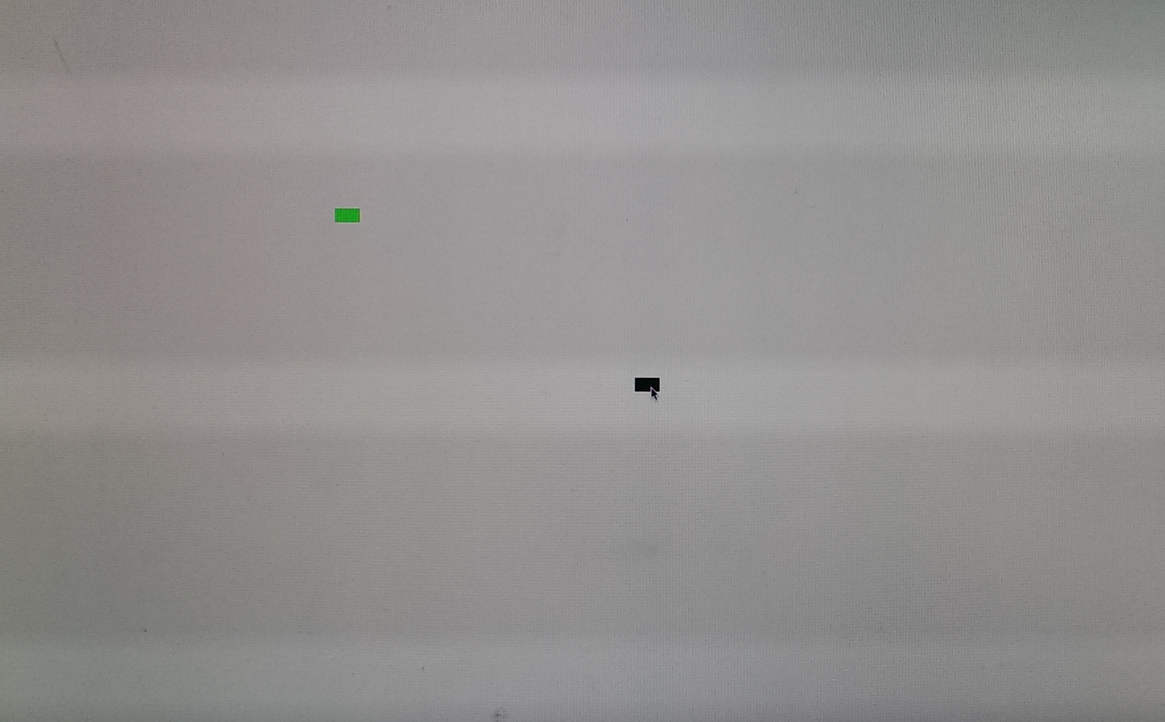
Design(Pilot) – Proof of Concept
Behavioral Metrics
  Difference in coin-time acquisition between Time 1 and Time 2.
  Euclidian Distance between locations of objects and user-selected locations of said objects.

Slide 17
Design(Pilot) – Proof of Concept
fMRI
  Show (8) video clips of 30(s) each of navigation through the environment from 8 different starting locations to enforce an allocentric sense of space (Suthana et al. 2009)
  Ask subjects to mentally imagine themselves in the environment.
    Also traversing from Landmark to Landmark
  Also mentally imagine real-world environments (UCLA and their home) and made-up fantastical environments.
MVPA and RSA
  MVPA within subjects across mental environments
  RSA Videos to Mental Imagery. (environment and trajectory(landmark→ landmark))
  Real World RSA → Real World > Virtual World > Fantastical-Imagined World (across subjects as well)

Slide 18
Design
Encounter 3D Rendering of objects within a virtual environment
Group 1
  View rotations of the stimuli either in a PTB manner or through volitional interaction
Group 2
  Same as group 1 but with a second list repetition
    An attempt to classically strengthen memory
Group 3
  Instructed on MoL technique and encourage navigate around the environment and volitionally place objects.
  Matched stimulus exposure time with Group 1

Slide 19
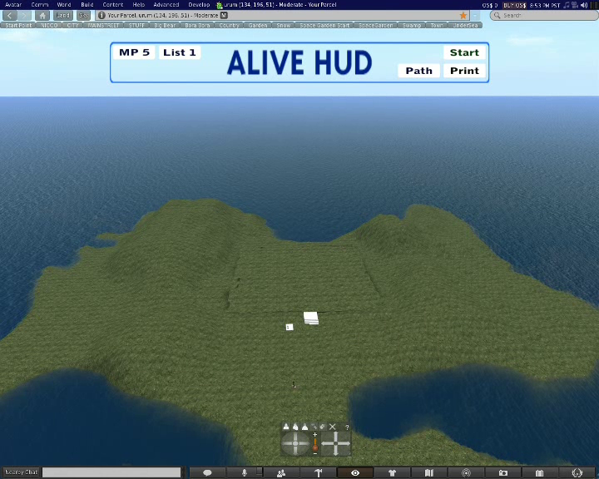
Virtual Environment Example

Slide 20
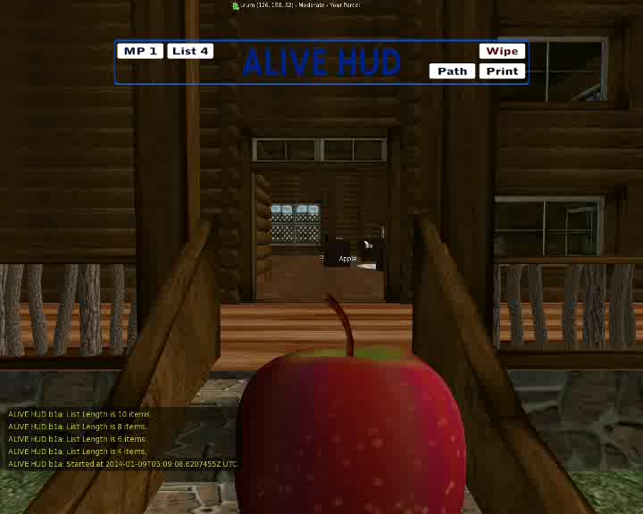
MoL Placement Example

Slide 21
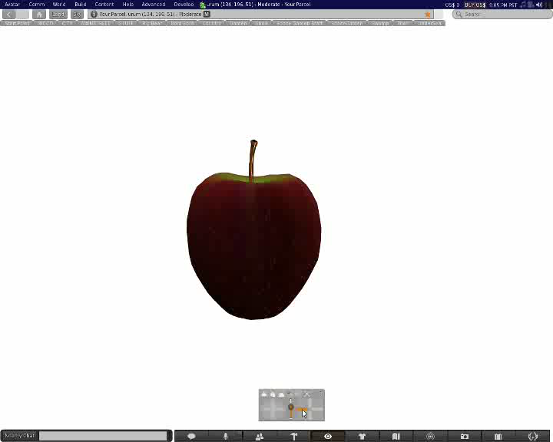
Control Presentation Example

Slide 22
Behavioral Assessment
Recall items in order
64 x 64 environmental grid underlay
  Records locations of each placed object
  Subject clicks on an allocentric representation of the environment (bird’s eye view) of where they believe each object was placed.
  Measure Euclidean distance.

Slide 23
fMRI Investigations
Across subject functional-connectivity MVPA
  Classify recall as labelled by encoding stratagem
  Which hippocampal-cortical connections are highest weighted?
    Recursive elimination
  Ridge Regression – Predict error on behavioral assessment
Within Subject Comparison
  Get from Location A to Location B in 30 seconds
  Compare to recall using MoL in that environment

Slide 24
fMRI Investigations
Neural tagging
  When subjects recall items that were placed in a room with portraits/landscapes on the wall do we get FFA/PPA?
    Pilot to determine decodability of mentally imagined environments.
Time compression
  How does the Euclidean distance between landmarks scale in accordance with subject-reported positions while mentally traversing an environment?

Slide 25
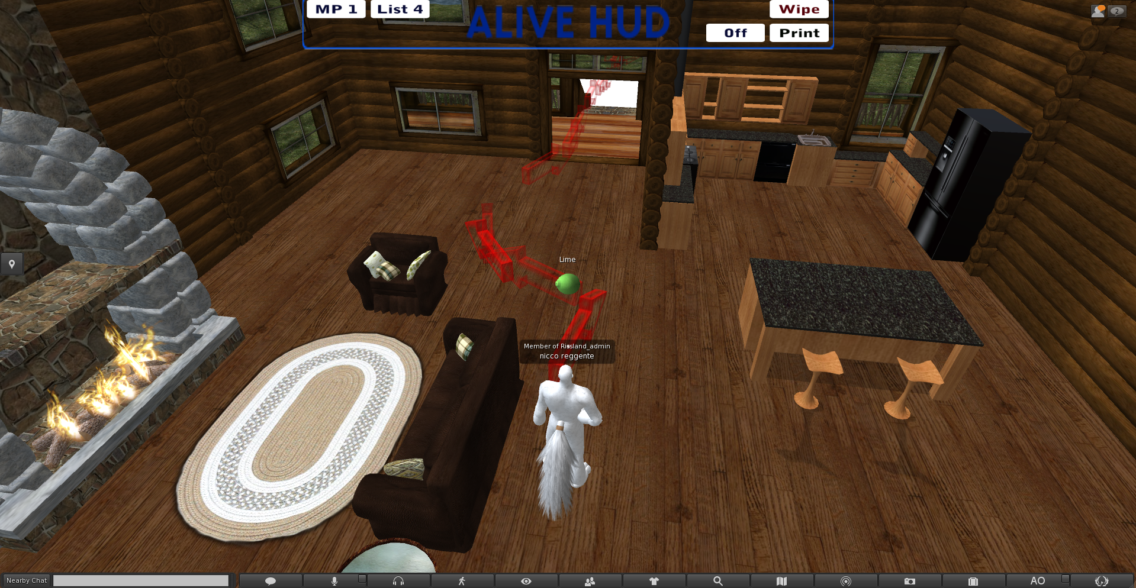
Other potential effects
Comparing volitional vs. non volitional
  Subjects would passively traverse a path created by a previous subject
  Volitional should increase the effect (Appleyard 1970)

Slide 26
Other potential effects
Compare to mental implementation of MoL using familiar environments (e.g childhood home) and the virtual environments as templates.
Effect of environment type (indoor vs. outdoor / fantastical vs. realistic)
Oculus vs. No Oculus - Treadmill vs. No Treadmill
Suggestions?

