Slide 1

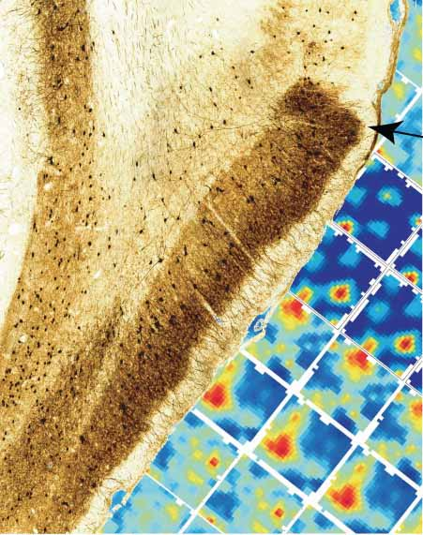
Microstructure of a spatial map in the entorhinal cortex
Rokel Hafting, Marianne Fynh, Sturla Molden, May-Britt Moser & Evard I. Moser
Presented on 10/10/13 by Nicco Reggente for Psych205F

Slide 2
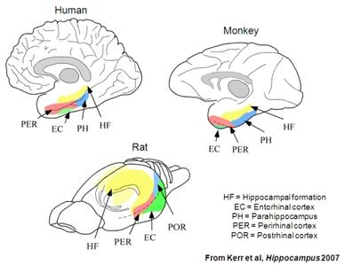
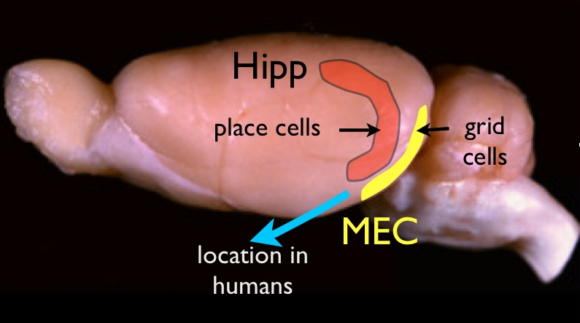
Anatomical Orientation
Layer II
Kerr et al. Hippocampus, 2007 / brainfacts.org

Slide 3

Conceptual Intro
Youtube Users: Florentine Marty/John Kubie

Slide 4
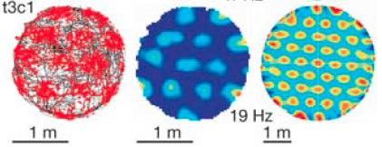
Autocorrelograms
60 degrees
6 equidistant (low s.d) peaks

Slide 5
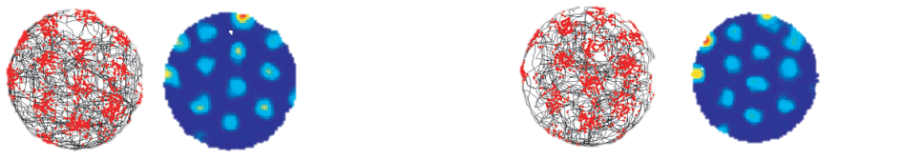




Grid Cell Paramaters
Same Cell
Different Cell
Spatial Phase
Time 1
Time 2
Orientation
Field Size
Spacing
Notes:
They fire immediately. If you correlate final firing map with initial one, you get a nice correlation. But if you measure the first block and the last block, it is slightly less correlated suggesting that stabilization requires a small bit of time.
Orientation of the grid was expressed in the autocorrelogram as the angle between a camera-defined reference line (0 degrees) and a vector to the nearest vertex of the inner hexagon in the counterclockwise direction
The size of the individual fields was estimated as the area covered by the central peak of the autocorrelogram, using a threshold of r . 0.2.
Size and spacing are quadratically proportional
Density remains the same

Slide 6
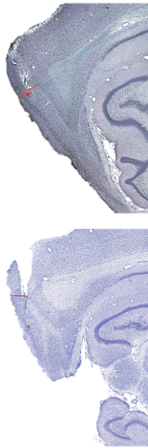
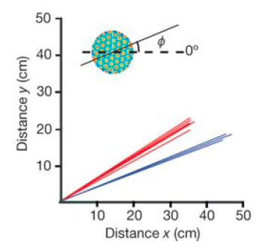
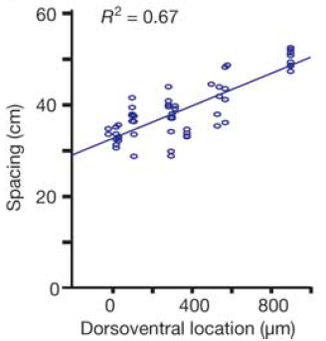
Parameter Mapping
Dorsal → Ventral
More Dorsal
Orientation
N.S
Field Size
Spacing
More Ventral
Notes:
The entire range of orientations was represented in the population as a whole (from 1 to 59 degrees), but among cells recorded on the same tetrode, orientation varied minimally
unable to detect any systematic change from dorsal to ventral in dMEC
.67 correlation with field size and spacing

Slide 7
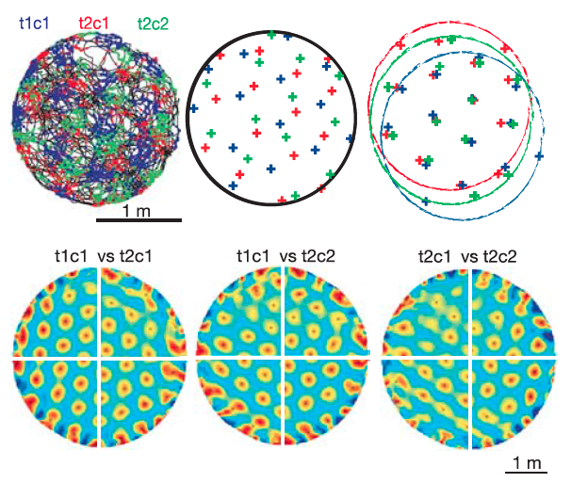
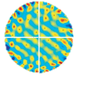
Parameter Mapping
Neighboring
Disparate
Notes:
Phase shifts were not significantly different in any case.

Slide 8
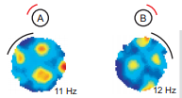
Environmental Effects
Landmarks
Notes:
As we saw in 1st slide….phase of a cell should be similar within 2 timepoints. This suggests an idiothetic cue (rat’s own movement is determining firing)
we rotated a cue card on the wall of a circular test box while recording from grid cells in dMEC
The correlation between the rate maps of the initial baseline trial and the rotation trial was substantially lower than between trials with the cue card in the same position
no changes in spacing or field size.
Counter rotating it got the correlations back up.
Maintain after cue removal?

Slide 9
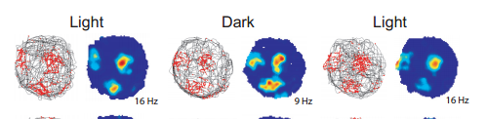
Environmental Effects
Landmarks
Notes:
In darkness….grid cells remain.
majority of the cells, the onset of total darkness caused a weak dispersal or displacement of the vertices, expressed as a moderate decrease in the spatial correlation of the rate maps
Put in a familiar room, goes back. Changes orientation in new room.

Slide 10
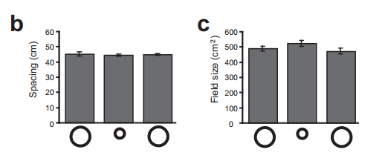
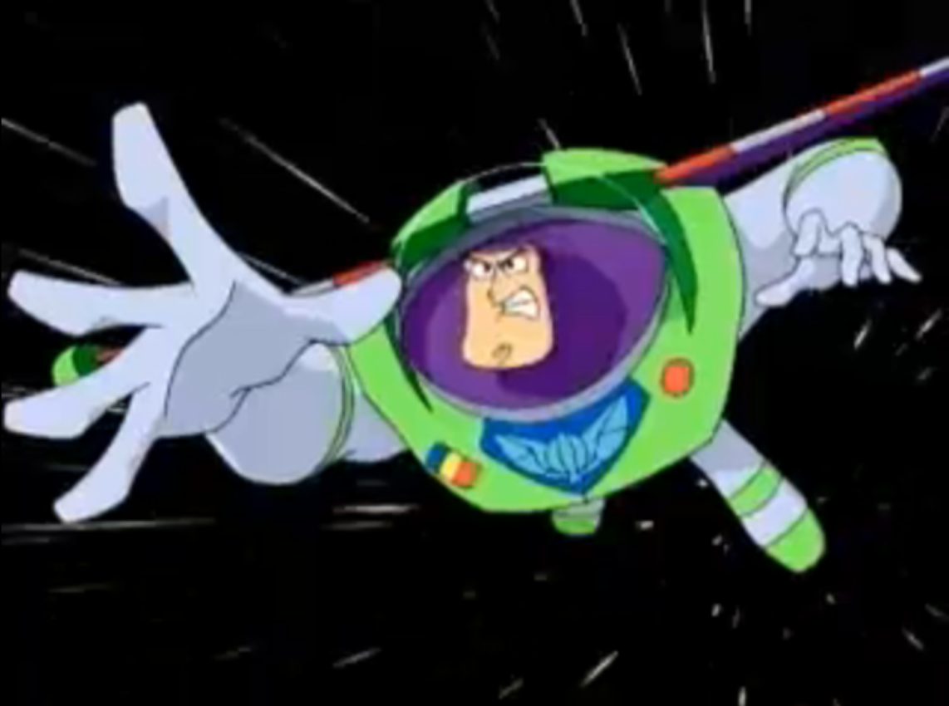
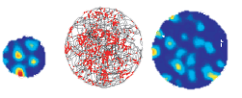
Environmental Effects
Scaling

Slide 11
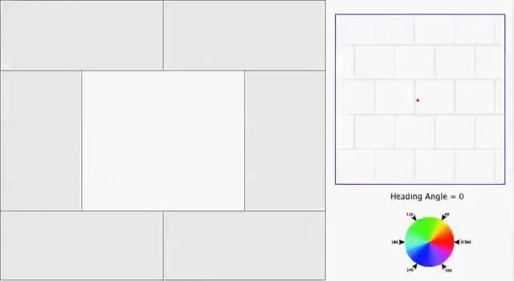
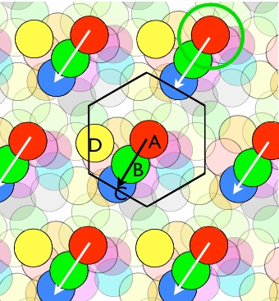
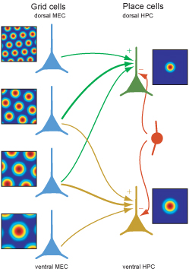
Uses of Grids

