Slide 1
Neuroenhancement for national security?
Discussion led by Nicco Reggente
Psychology 269: Neuroethics
May 22, 2014

Slide 2
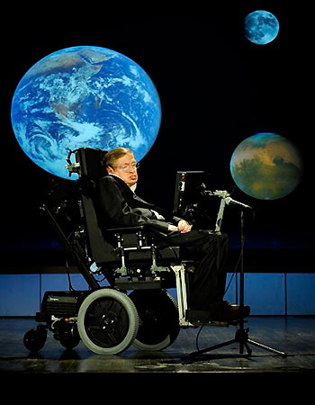
Motivation
“we are now entering a new phase called “self designed evolution…I am sure that during the next century, people will discover how to modify both intelligence, and instincts like aggression”
-Stephen Hawking 2009

Slide 3



Motivation and Current Attempts
When it comes to our safety, we demand the best.
Ideally, want someone with otherworldly intelligence and memory. We want them to be averse to deception.
  We want Spock.
Furthermore, we value physical strength for protection alongside mental aptitude.
  We want the Hulk.
We want Iron Man.

Slide 4
Motivation and Current Attempts
Soldiers are already readied for combat with the Army Physical Fitness Test / Boot Camp
  This program is aimed at training multimodal aspects of motor performance (endurance, mobility, strength, and flexibility)
There are a plethora of training programs to enhance cognitive functions
  Training to detect threatening stimuli
  Airport security screening staff are trained with computer-based-training programs to improve their attentional skills in order to enhance their abilities to detect threatening objects in X-ray images.
  Soldiers are trained to enhance the “pop-out” effect for enemies vs. friendlies.
    Developing automatic behavior to reduce the aversions of stressful situations by “drilling” behaviors until they are routine.
The development of attention, planning, memory, and appropriate risk-taking are all vital skills we want to improve in our soldiers.

Slide 5
Motivation and Current Attempts
In 2009, the National Research Council recommended to the US Army that neuromodulation be a part of further research on central nervous system fatigue.
Cognitive Cockpit
  Recording brain activity to customize individual’s needs in real time
Cognitive Technology Threat Warning System
  Convert subconscious, neurological responses into consciously available information.
Deception Detection
  Cephos, No Lie MRI, , P300, polygraph, blood pressure.

Slide 6
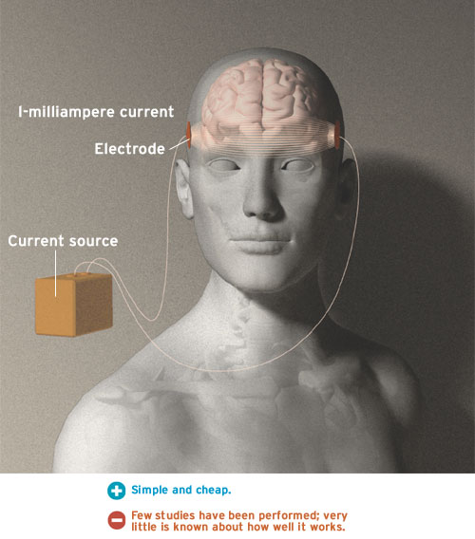
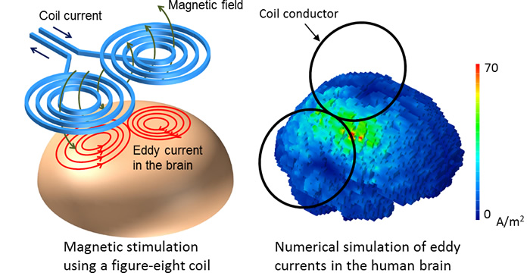
Quick Recap of Neuromodulation
Thanks to Lianne for a thorough review of neuromodulation
tDCS = transcranial Direct Current Stimulation
  ~2mA of current. USB charging is roughly 1500mA
  Anode increases excitability (changes resting neuronal membrane potential)
  Cathodes decrease excitability
rTMS = repetitive Transcranial Magnetic Stimulation
  Low Frequencies (~1Hz) decrease activity
    Theta burst stimulation (cTBS) known to decrease excitability
      Elevates concentration of GABA
  High Frequencies (~>3Hz) increase activity
    Intermittent theta bust stimulation (iTBS) increases excitability.
      Elevates concentration of glutamate/glutamine

Slide 7
Mechanistic Theories
Entrainment
  “the brain can be brought into an oscillatory natural state that is known to be associated with a particular function”
Stochastic Resonance
  “small amounts of noise injected into a system promote low-level signals leading to enhanced functions within this system”
    Increased non-linearity?
Zero-Sum Theory
  The brain has finite power processing. Detriments arise to make up for enhancements – Paradoxical facilitation.
Other
  Neuromodulation devices such as low intensity focused ultrasound pulsation (LIFUP) have been theorized to operate by “massaging” neuronal membranes and mechanically opening ion-gated channels.

Slide 8
Efficacy of Neuromodulation - General
Since 1990 we’ve known that a right hemisphere lesion can result in shorter RTs than healthy subjects during attentional tasks.
Low frequency rTMS (suppression) over parietal cortex enhances target detection in the ipsilateral hemi-field and worsened in contralateral.

Slide 9
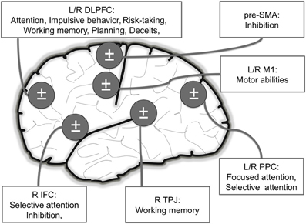
Efficacy of Neuromodulation - Motor
Daily Motor Task
  Jebsen Taylor Hand Function Test
  Non-dominant hand use was faster with anodal tDCS over M1. No effect for dominant hand.
  Motor training increased overall performance
Muscle Might
  Anodal tDCS on R M1 and cathodal L Supraorbital displayed greater strength (Pinch force test). Cathodal on right shoulder increases endurance.
  iTBS on M1 increased peak acceleration of thumb abduction.

Slide 10
Efficacy of Neuromodulation - Motor
Precision
  Anodal tDCS to M1 displays greater precision of non-dominant hand-movement
  Only for tasks that demand high precision.
  Lasts up to 30min.
Learning
  Anodal tDCS to M1 increases speed in execution of implicitly learned sequences.
    Low-frequency rTMS over M1 improves ipsilateral performance.
      Lasts up to 30min
    Same accuracy
  High Frequency rTMS improves contralateral use of hand in complex motor tasks.
  tDCS anodal on R M1 and cathode on L M1 enhances performance in L hand.

Slide 11
Efficacy of Neuromodulation - Attention
“The capacity to sustainably focus cognitive resources on information while filtering or ignoring non-salient endogenous or extraneous information”
Sustained Attention (hold)
  Anodal tDCS to L DLPFC (cathodal to R DLPFC) enhanced accuracy in air traffic control simulation.
    Increase correctly identified targets, decreased false alarms, but slower RT.
Focused Attention (specific)
  Low frequency rTMS over PPC improved detection of stimuli presented ipsilaterally and impaired detection contralateraly.
  Low frequency rTMS over right dorsal PPC enhanced target detection in right visual field (shorter RT).
  Anodal tDCS to R PPC (cathodal to L deltoid) improved attention to auditory stimuli presented in L auditory field.

Slide 12
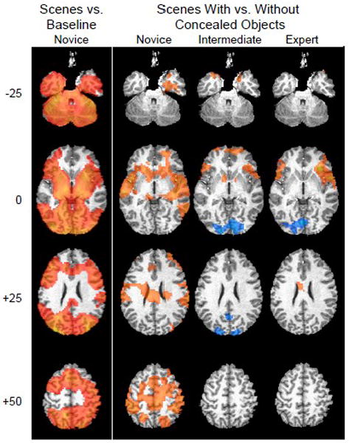
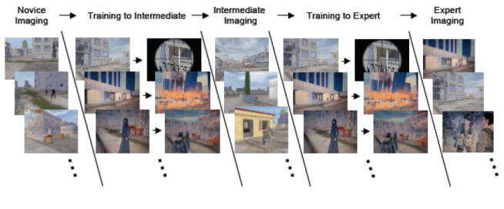
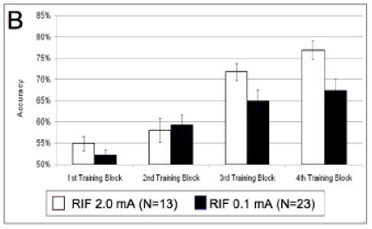
Efficacy of Neuromodulation - Attention
fMRI and Dynamic Bayesian Network Analysis have been used to identify brain loci whose activation parallel expertise in a concealed object learning paradigm served as an effective tDCS localizer for enhancement in selective attention.
Not due to variations in skin sensation.
Remained for 24 hours.
Notes:
Greater number of correct threatening targets and reported a smaller number of false alarms and were increasingly faster.
Concealed object were selected that were ambiguous on first viewing but could be identified after training. (DAWARS Ambush! Task)
Published lit + activation + BN they stimulated right inferior frontal(biggest GLM effect) and right parietal brain areas (DBN)
26.6% increase in accuracy immediately after training (as compared to before. This was an 87% greater increase than the low-current tDCS
Not due to skin sensation differences.
Performance sustained for 24hr after.

Slide 13
Efficacy of Neuromodulation - Attention
Attentional Switch
  High frequency rTMS to R DLPFC allowed subjects to benefit from faster attention switching (visual to auditory stimuli)

Slide 14
Efficacy of Neuromodulation - Control
Inhibition
  High frequency rTMS to L DLPFC decreased RT on incongruent trials on Stroop task.
    Anodal tDCS to L DLPFC (cathodal to R supraorbital) showed the same result.
  Anodal tDCS to right IFC reduces RT in the Stop Signal Task (interrupt already-initiaed motor responses)
    Anodal tDCS to pre-SMA will increase the total number of correct inhibited responses.
  Less commission errors on the Conners’ Continuous Performance Task after high frequency rTMS to L DLPFC
  Anodal tDCS to L Supraorbital and Cathodal to R PPC allowed for better target detection in the Flanker task.
Impulsive Behavior
  cTBS(decreases excitability) over R DLPFC increased larger, delwayed reward choices over smaller, immediate rewards in the Delayed Discounting Task.
    iTBS did not have an effect.
  Anodal tDCS to DLPFC (cathodal contralateral DLPFC) displayed more careful (less impulsive) drive behavior.

Slide 15
Efficacy of Neuromodulation - Control
Risk Taking
  Anodal tDCS to R or L DLPC (cathodal to contralateral supraorbital) shifted subjects to be more conservative and risk-averse in the Balloon Analog Risk Task (BART).
    When it was alternating current, subjects shifted to engaging in more risky behavior.
  Low frequency rTMS to R DLPFC make riskier decisions in the Risk Task compared to stimulation of L DLPFC.
  tDCS with Anodal to R DLPFC (cathodal to L DLPFC) suppressed risk-taking and decreased sensitivity to reward in Risk Task.
  All around, subjects were faster at making their choice.
Planning
  Tower of London and L DLPFC
    Cathodal – faster
    Anodal – more accurate
    cTBS diminishes preplan time without changing performance
  Analogic Reasoning and L DLPFC
    Faster at detecting analogies without affecting error rates.

Slide 16
Efficacy of Neuromodulation - Control
Deception
  Deceitful answers are associated with longer context and more guilt when answering questions about their deceit.
  Low frequency rTMS L DLPFC caused participants to produce less truthful answers.
    More psychopathic. In line with decreased activity in prefrontal regions?
  tDCS with Cathodal over R aPFC (anodal over L parietal) were better at deceiving in a Guilty Knowledge Test (similar to an interrogation after a crime-simulation).
    Faster to lie.
    Reported less guilt.
      Also very psychopathic.
  Anodal tDCS to L DLPFC (cathodal to R DLPFC) were faster at recalling memorized untruthful answers.

Slide 17
Efficacy of Neuromodulation - Memory
Slow oscillatory tDCS during sleep can induce an increase in slow wave sleep and promote memory.
Working Memory
  Anodal tDCS to L DLPFC (cathodal to R DLPFC) increased RT, but not accuracy, in the Sternberg Task (recognize previous item amidst distractors)
    Replicated with high frequency rTMS.
  tDCS over L DLPFC enhanced working memory as measured by backward digit span.
  Accuracy improved with anodal tDCS to R TPJ (cathodal to L supraorbital) in an object-location learning paradigm.
    Effects lasted for 1 week.
    Mainly elderly (mean age 62).

Slide 18
Magnitude and Application
  Increases performance, but also induces a liberalization in the decision criterion.
  Improved visual discrimination comes at the cost of an increase in false alarm rate
    In a military setting, this could be disastrous.
Are the results meaningful?
  With motor RT, the mean reduction has shown to be 32milliseconds
    Speed shooting performance: ~13ms would be the difference between elite and rookie police officers.
Results Vary
  tDCS mA / rTMS Hz
  Brain State Dependency (sleep, mood, stage in training)
  Subject’s Baseline and gender, age, etc.
    More effects for low performing subjects
    Age negatively correlates with duration of NIBS-induces neuropsych effects
  Combining cognitive training
Notes:
NIBS can improve inhibition while subjects perform a task, but not before.

Slide 19
Magnitude and Application
  Lab ≠ Real World
  A computer simulation cannot perfectly mimic the extreme situation whose emotional effects may attenuate and even negatively affect the behavioral outcomes.
    DAWARS Ambush! Task comes close…
  We need to promote the “ecological value of laboratory settings without compromising methodological rigor.”
  Virtual Reality may aid this.

Slide 20
National Security Ethics
Healthy subjects vs. Clinical Population
  Raises ethical questions whether induction of long-lasting brain changes in healthy individuals should be an aim or even just a tolerated “side effect” of neuroscientific research.
    Seizures, mood alterations, etc.
    Stimulation is not exactly “focal” due to functional/structural connectivity
    Reduction in other behaviors (zero-sum).
Soldiers are required to accept medical interventions that make them fit for duty.
  - Uniform Code of Military Justice
  The US government has shown a tendency to defer to commanders in a combat situation if they think some treatment is likely to do more harm than good.
  Risk of coercion is more pronounced and autonomy of individuals receiving NIBS could be virtually nonexistent.
    Does this aggravate safety issues?
  Pentagon is a bit reckless
    Aboveground testing of atomic bombs, Agent Orange, Gulf War Syndrome
Notes:
Safe to administer NIBS for depression.
Effects known to help depression but hinder mood in healthy subjects
We face the zero sum problem in cognitive programs as well. Novice aircraft inspectors use virtual scenarios to detect. They increase accuracy but also increase RT.

Slide 21
National Security Ethics
Who’s accountable?
  If soldiers are both (a) not autonomous in the decision to apply NIBS and (b) responsible for other lives, then who is to blame?
    The brain simulation parameters? The soldier? The doctor? The researchers?
Encouragement of use of Dexedrine resulted in two American pilots accidentally killing four Canadian soldiers and injuring eight others in Afghanistan
Addiction?
  Animals can develop an addiction to auto-electrical stimulation.

Slide 22
Potential / Sci-Fi Applications
NIRS – TMS feedback device that detects deficiencies in neurological processes and simultaneously enhances/suppresses brain function
Ultrasound helmets that can promote nerve regeneration and stimulate neural circuits

