Slide 1

Learning In the fast lane: new insights into neuroplasticity
A study by Yaniv Sagi(et al.) at Tel Aviv University
Prepared by Nicco Reggente for Rissman Lab Meeting (April 12, 2012)

Slide 2
Long Term Potentiation And Neuroplasticity
What They Are Looking For.
Neuroplasticity
  The capacity of the nervous system to modify its organization.
    A complex, multistep process that includes numerous time-dependent events occurring at the molecular, synaptic, electrophysiological, and structural organizational levels.
    Basically, as you change…so does your brain
Long Term Potentiation
  Neuroplasticity has typically been seen in neuroscience research in this form.
    The appropriate strengthening(and weakening) of synapses, so that repeated tasks can excited, and execute with quicker neuronal speeds.
  This study is attempting to show what could be called SHORT Term Potentiation.
    Leading research points to days/weeks of training, typically. This study plans to show significant neuroplasticity within two hours of training.

Slide 3
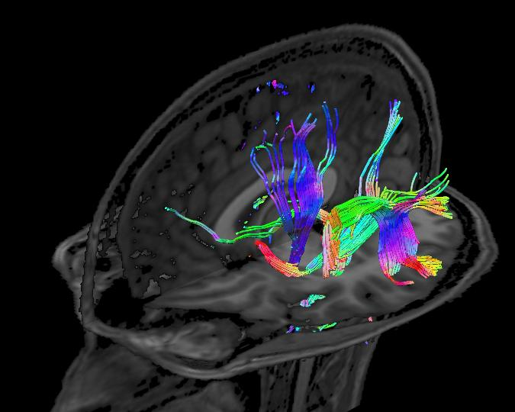
Methods Building Blocks
How They are Finding It.
What is Diffusion Tensor Imaging (DTI)?
  Measure of Water Diffusion In Tissues
    Architecture Based
  Tensors Reveal Linear Relations
    Excitement by magnets
  Done Per Voxel → Sensitive To Subtle Pathology
    Direction and Density denoted by Colors and Brightness
How Are Mean Diffusivity (MD) and Fractional Anisotropy(FA) Measures Of White Matter Connectivity Changes?
  DTI can measure the rate of diffusion and the angles that it prefers(directional)
    As compared to a Brownian Motion
    The preferred alignment of diffusion is the Degree of Anisotropy
  Fractional Anisotropy (FA) is thought to reflect fiber density, axonal diameter, and myelination.
    An “effect” would be an increase in FA (similar to LTP)
  Mean Diffusivity (MD) is thought to be a measure of concentration (less randomization/spread in space)
    An “effect” would be a decrease in MD (less diffusivity), insinuating greater, more precise concentration
Take Home Point: Because DTI can be considered to be a marker of tissue microstructure, structural remodeling will lead to a change in its water-diffusion properties, which we can detect.
Notes:
If there is more space between obstacles, then water diffuses more freely.
----- Meeting Notes (4/11/12 11:45) -----
Diffusion changes are likely to be manifested as an increase in tissue density (due to reshaping of neuronal or glial proceses), or enhancement of tissue organization (strenghtening of axonal or dendritic backbones and surrounding tissues)
Diffusion indices change as a result of structural changes.
reduction in MD after stroke and transient MD reduction following neuronal depolorization.

Slide 4
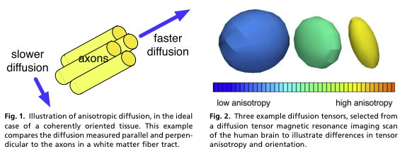
Methods Building Blocks Cont.
How They are Finding It.
  What could be causing these changes? Possible Structural Manifestations Include:
    Myelin
    Changes in the extracellular matrix
    Synaptogenesis
    Changes in the morphometry of axons/dendrites/glial processes
    Alterations in cell bodies and shapes.
  Histological Evidence might suggest that tissue (cellular) swelling or changes in the ratio between intra/extracellular volumes following long episodes of neural activation may be the base of MD reduction.
Take Home Point: Because DTI can be considered to be a marker of tissue microstructure, structural remodeling will lead to a change in its water-diffusion properties, which we can detect.
Notes:
----- Meeting Notes (4/11/12 11:45) -----
Diffusion changes are likely to be manifested as an increase in tissue density (due to reshaping of neuronal or glial proceses), or enhancement of tissue organization (strenghtening of axonal or dendritic backbones and surrounding tissues)
Diffusion indices change as a result of structural changes.
reduction in MD after stroke and transient MD reduction following neuronal depolorization.

Slide 5

Task Setup
How They Looked For It
Procedural Learning Group (spatial learning +memorization)
  Learn a single (1) virtual track.
    Race the track in a video game.
      Same track over and over
    At the end, put scrambled snapshots of the track into the correct, sequential order.
    Learn = Decrease Lap Times and Know Spatial Positioning
Active Control (Spatial without Memorization)
  Raced Multiple Track(s), without repeats and without the snapshot arrangement task as completed by the Procedural Learning Group.
Control Group
  No racing
Each group has a DTI Scan Before And Immediately After The Task.
Notes:
Similar driving experience, but did not learn any specific spatial information

Slide 6
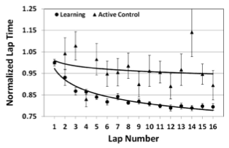
Behavioral Findings
What They Found
All subjects in the Procedural Learning Group showed improvement in the task.
  Decrease in normalized lap time.
  (no improvement in the Active Control Group(no repeat tracks))
Main Effect: “We discovered that 2hr of training on a spatial navigation task results in MRI changes indicative of structural plasticity in specific brain regions.”

Slide 7
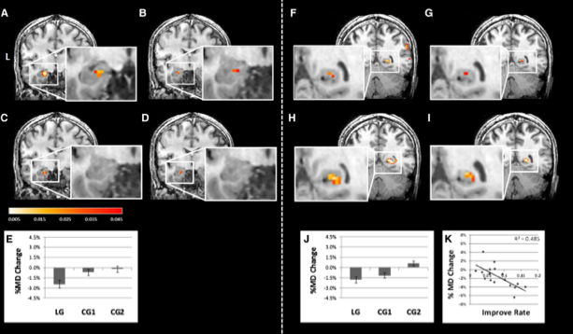
Imaging Findings
What They Found
Patterns of DTI Changes In The Procedural Learning Group:
  Reduction in MD in the left hippocampus.*
  Reduction in MD in the L/R parahippocampus.*
  Increase in FA in the left parahippocampus and:
    Right supramarginal/angular cortex
    Right superior temporal gyrus
    Right amygdala
    Left pulvinar
Patterns of DTI Changes In The Active Control Group
  Moderate differences(reduction in MD) in parahippocampus as compared to the passive group.
* Negatively Correlated With Improvement Rates In Lap Times
Main Effect: “We discovered that 2hr of training on a spatial navigation task results in MRI changes indicative of structural plasticity in specific brain regions.”
Notes:
Indicative of improvement alongside the reduction in MD and FA
The actual cause of the MD is unknown without histological evidence, which

Slide 8
Proof Check + Causes For MD
Was it “Actual” ?
Could the diffusion changes be due to volumetric or residual blood flow/activity traces?
  Typical univariate analysis overlapping into white matter areas?
  Voxel-Based Morphometry (VMB) eliminated this possibility, leaving the effect to true, white matter changes.
    Basically checked for potential difference in everything that could have varied between T1 and T2, aside from matter effects, allowing for a default on the main effect.
Supporting Rat Experiment
  Modified the experiment to allow for the same inferences, but on rats.
  Water-Maze, not virtual. Had to find the location of a platform.
  Same scanning.
  Active Control group didnot need to memorize the location of the platform, as it was clearly marked
    The second group was experimentally controlled to allow for less “memory reliance”
  Effects Similar With Same Time
    MD Decrease in the posterior parts of the hippocampus.
    Due to spatial knowledge of the smaller rat brain, further precise details were able to be formed:
      With tracers, it was found that in areas of MD decrease:
        An increase was found in the number of synaptic vesicles, astrocyte activation, as well as increase in BDNF expression (indicative of LTP)
Why The Effects? What’s going on behind the scenes?
  The rat experiment gives histological insight into the cytoarchitecture rearrangements.
Main Effect: “We discovered that 2hr of training on a spatial navigation task results in MRI changes indicative of structural plasticity in specific brain regions.”
Notes:
Voxel-based morphometry (VBM) is a method for finding regional differences in concentration of gray matter
With VBA, they could see:
The significant cluster is not seen at the edges of the hippocampus and thus cannot be viewed as a misregistration artifact. Also showed no “overflow” as I like to call it by doing an ROI on the left hippocampus.
The rat experiment allowed for them to have histological experiments in which they found:
More synaptophisin(a marker of synaptic vessicles)
More GFAP (glial fibrillary acidic protein)
BNDF (neuronal growth marker in hippocampus)
These all give clues as to what is actually occurring to cause for MD effects
Probably not just dendrites since they only account for 10% of neuropil volume
Authors say that the MD reduction is most liekly due to the ratio of extra to intra cellular space changing.
Other complicated processes like proteins that lead to swelling could be to blame as well.
“new” cells and connections take longer than 2 hours, so this is probably not the cause. However, it could be slowing the death of cells, which could have an effect.
Microsopy studies in rodents reveal increases in the number of dendritic spines in Motor Cortex with just 1hr of training.

Slide 9
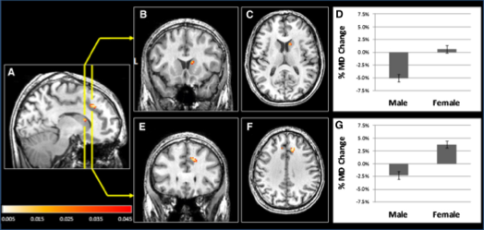
Interesting Gender Effect
What Confuses Them. And The World. Women.
MD is decreased in the right caudate head in males, but not females.
MD Increased (opposite of the expected effect) in the superior frontal gyrus in females, but not males.
The authors lay possible blame to the different functions , in genders, in the dopaminergic system, which has been shown to be responsible decision making and error prediction. However, they are largely unsure.

Slide 10
Discussion / Interpretations
What does it all mean?
The overarching significance here is that neuronal changes can be so profound in only a 2 hour period of training that imaging methods can reliably detect differences.
Adds to the overwhelming support that the hippocampus plays a central role in short-term memory processes.
  In addition to the parahippocampus, amygdala, and other temporal regions.
Very Important To Note:
  Just as with BOLD, DM and FA is merely inferential.
    Not feasible to identify EXACTLY what’s going on in a human study.
They are showing what can lead to gross volumetric changes in the future.
  “it is possible that the structural changes obtained by DTI are related to long-lasting electrophysiological effects, such as LTP.”
Future studies: Why the insula? Why the parietal?

