Slide 1







The importance of mixed selectivity in complex cognitive tasks
Mattia Rigotti - Omri Barak - Melissa R. Warden - Xiao-Jing Wang - Nathaniel D. Daw - Earl K. Miller - Stefano Fusi
Presented by Nicco Reggente for BNS Cognitive Journal Club – 2/18/14
Notes:
The heterogeneous responses of pfc

Slide 2
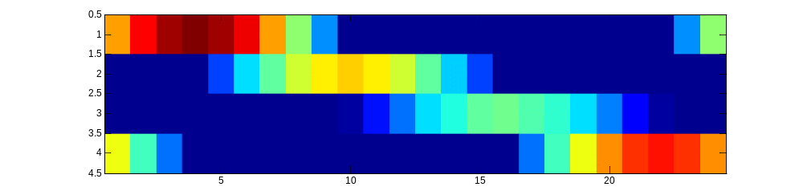
Background
Population Matrix
Rows are mean neuron firing rate(over 100-150 trials)
Columns are Time points
Neuron 1
Neuron 2
Neuron 3
…
Neuron 237
Any 1 column(1 Time bin) serves as 1 point in N-Dimensional Space
We know the “onsets” of each condition. C=24, here.
Notes:
If each neuron was encoding the same task-relecant variable, the dimensionality would be low because each vector would be correlated.

Slide 3
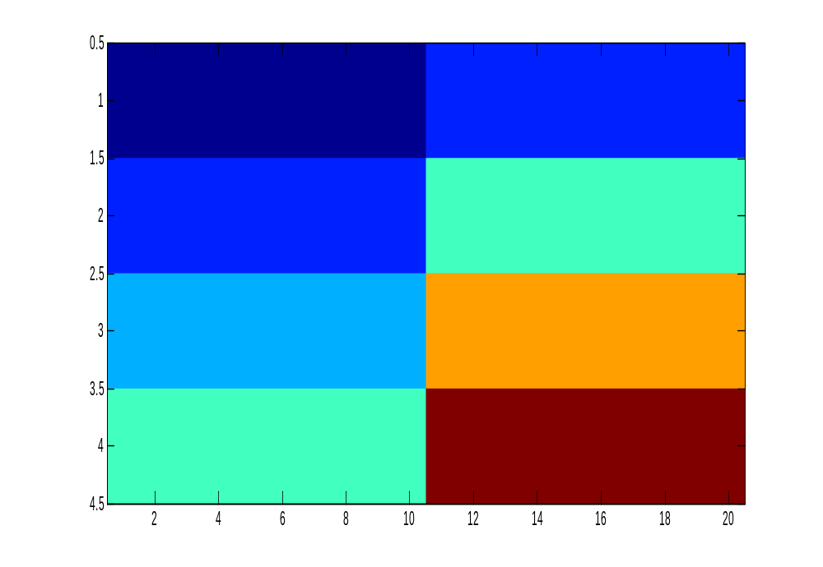
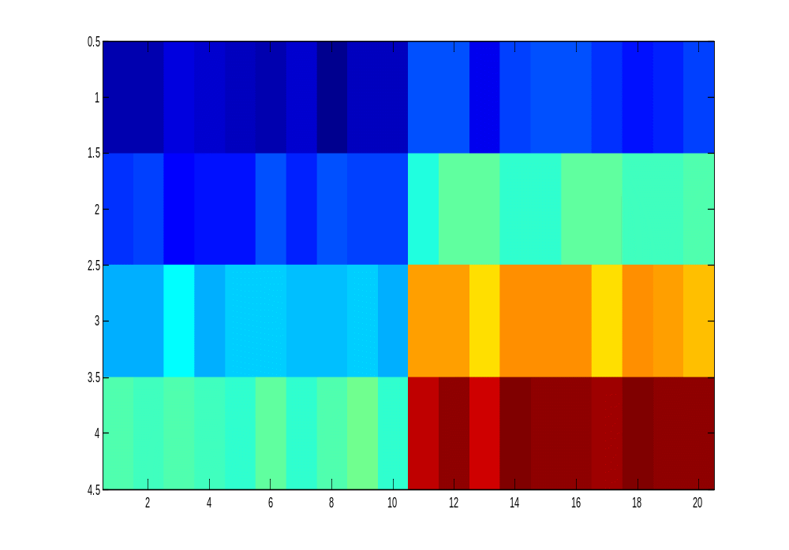
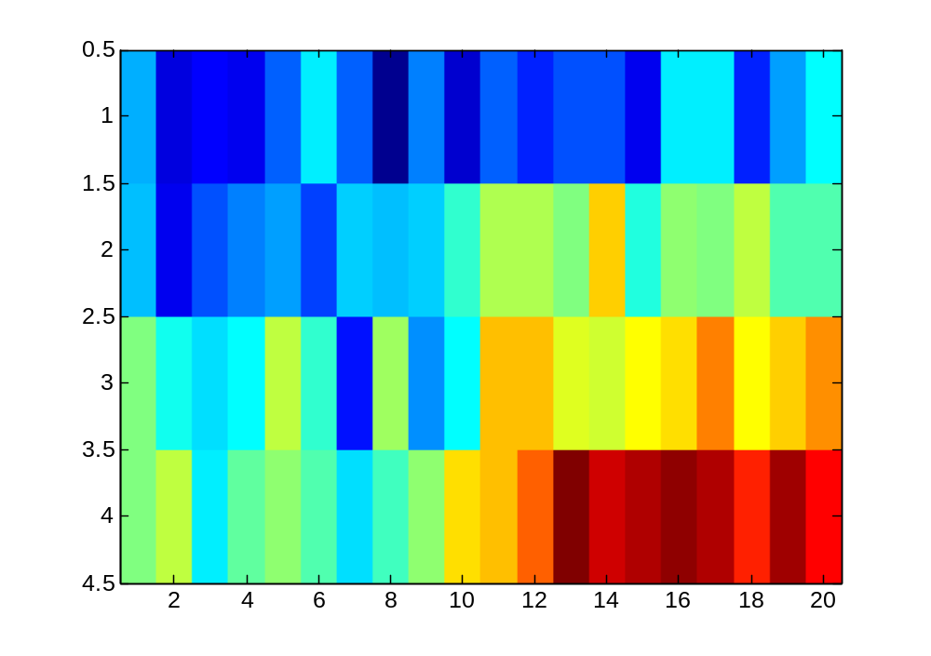
The importance of noise
Neuron 1’s noiseless vs. noisy , consistent vs. inconsistent firing across all instances of Task A
Task A
Task B
Neurons
neuron_differentiation=[1:4];
no_noise=[repmat([ones(4,1).*neuron_differentiation'],1,10) , repmat([ones(4,1).*neuron_differentiation'*2],1,10)];
noiseamp = .2;
with_noise=no_noise + noiseamp*randn(size(no_noise));
Notes:
As many distinct vectors as there are conditions. Each vector is represented by a point in N dimensional space.
The dimensionality of no-noise would be 4 x 2 since the features are redundant. “algebraic dimension of the vector space spanned by these points)
Pure selectivity cells that exclusively encode task type will span a one-dimensional space that is given by the line going through the two N-dimensional points that correspond to the average activity patterns representing the recall and the recognition task.

Slide 4
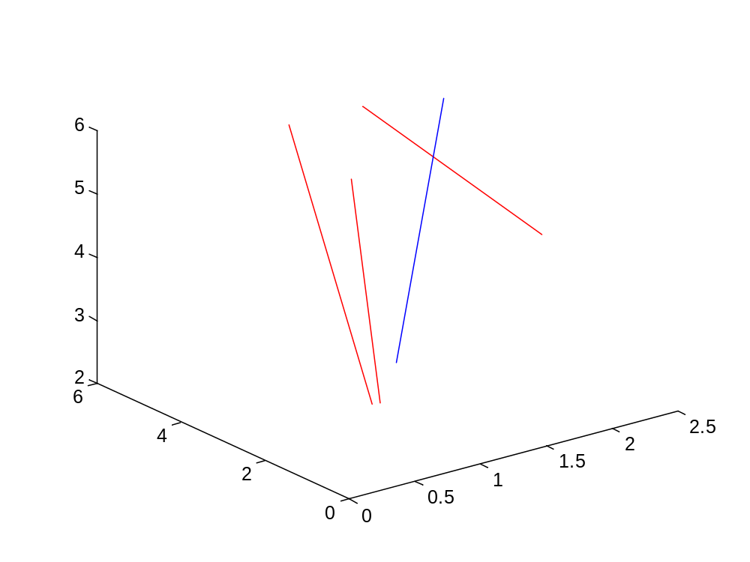
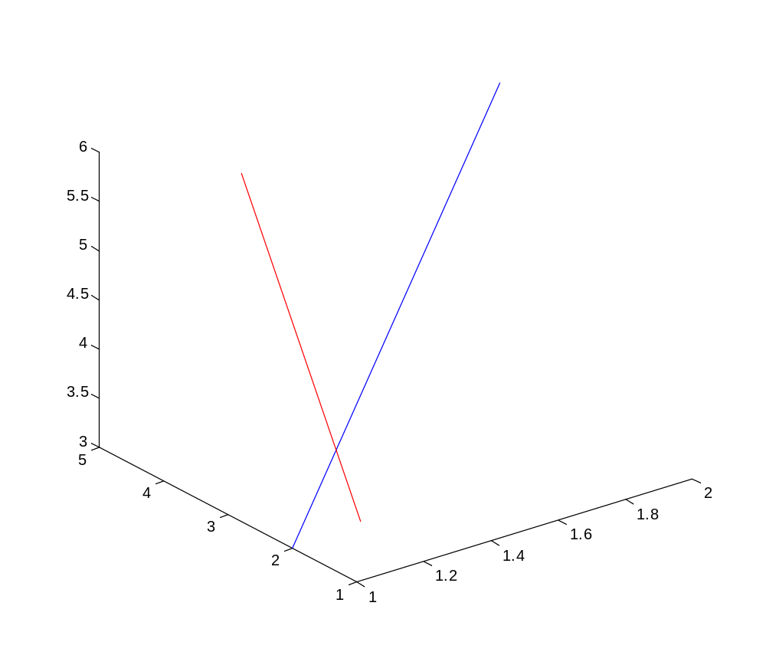
The importance of “noise”
A point in N(3)-dimensional space that illustrates 3 neurons’ representation of Task A
Task B
plot3([no_noise(1,1:3),no_noise(1,11:13)],[no_noise(2,1:3),no_noise(2,11:13)],[no_noise(3,1:3),no_noise(3,11:13)])
plot3([with_noise(1,1:3),with_noise(1,11:13)],[with_noise(2,1:3),with_noise(2,11:13)],[with_noise(3,1:3),with_noise(3,11:13)],'r')
Notes:
If we visualize the difference of firing for Task A and Task B for 3 neurons, we can see they are linearly discriminable in the no noise condition, but not so much in the noise condition.
One point is the 3-neurons response to task A, another point is task B. If we plot this as a vector, we see that multiple points exist if our reading is unstable. And, as such, we lost our abilitiy to linearly discriminate.
We are bounded by c (number of conditions. Here =2). If the neurons are not mixed in their selectivity, we can reduce the dimensionality to just 1(a straight line)
Each pair of dots that are joined by a line would be a training discrimination. We could leave on out cross-validate. It would get blue right every time.
We would need a 2D plane in order to bisect all the pairs of red dots.
The dimensionality of a neural representation recorded during an experiment is the dimensionality generated by the patterns of activity observed in each of the different experimental conditions.
We could just average the responses for each trial type and get some linear discriminable lines.
However, this reduces our dimensionality and perhaps this mixed selectivity was more multivariate in nature, incorporating subsets within task A and task B while simultaneously representing task A and task B.

Slide 5
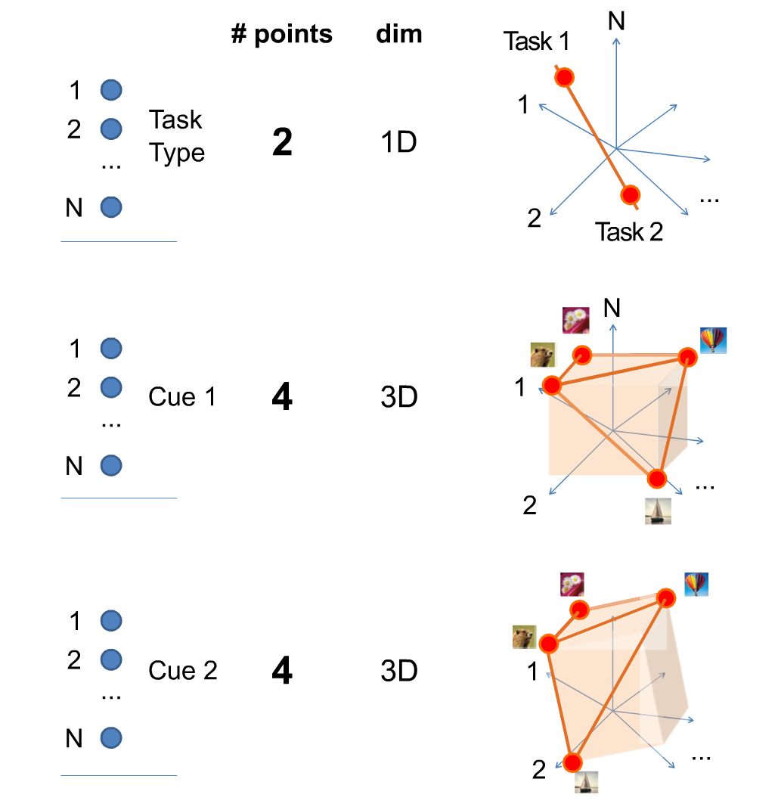
Populations and Space
Notes:
Each population of neurons is in a pure-selectivity situation is encoding only 1 task-relevant aspect.
With 2 points (classes), we can find that there is a dimensionality of 1 (1 vector) – If all points are on a line, then their dimensionality is one (as one appropriately aligned axis is sufficient to determine their position).
With 4 points (classes), we can find a dimensionality of 3.
The dimensionality they refer to is defined as the minimal number of coordinate axes that are needed to specify the positions of all points.

Slide 6
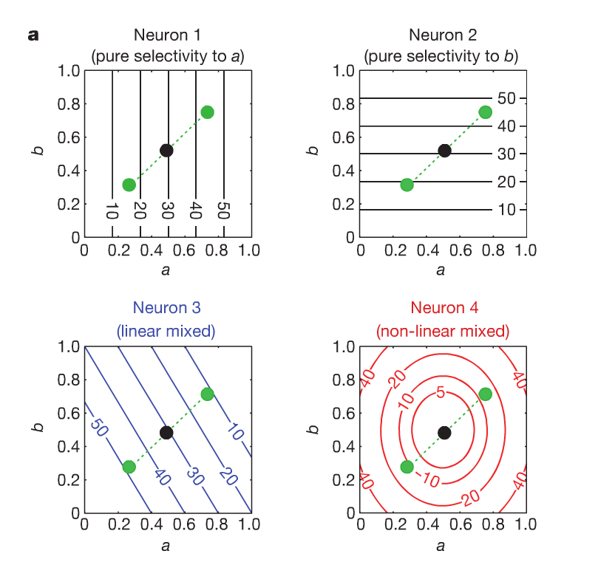
Pure vs. Linear-Mixed vs. Non-Linear Mixed Selectivity
Neuron 1 will increase firing only when parameter A increases. Keeping A fixed and modulating B will not change the response. Vice versa for Neuron 2.
Neuron 3 can be thought of as changing its firing rate as a linear function of A and B together.
Neuron 4 changes its firing rate as a non-linear function of A and B together. That is: the same firing rate can be elicited by several difference A/B combintations.
Notes:
Neuron 1 – by knowing the firing rate of the neuron, we can tell the stimulus intensity of A, but not B. Opposite for Neuron 2.
Neuron 3 – we can know the parameter of both A and B by knowing the firing rate.
Neuron 4 – the same firing rate can be elicited by several different combinations of A and B.
Green circles = the responses to 3 sensory stimuli

Slide 7
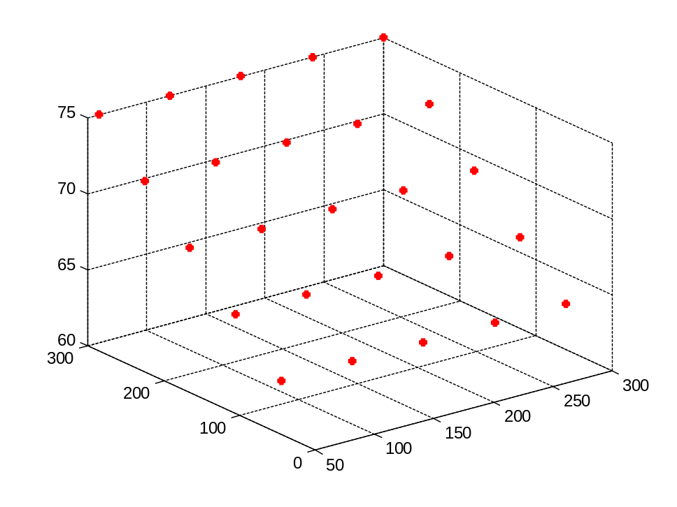
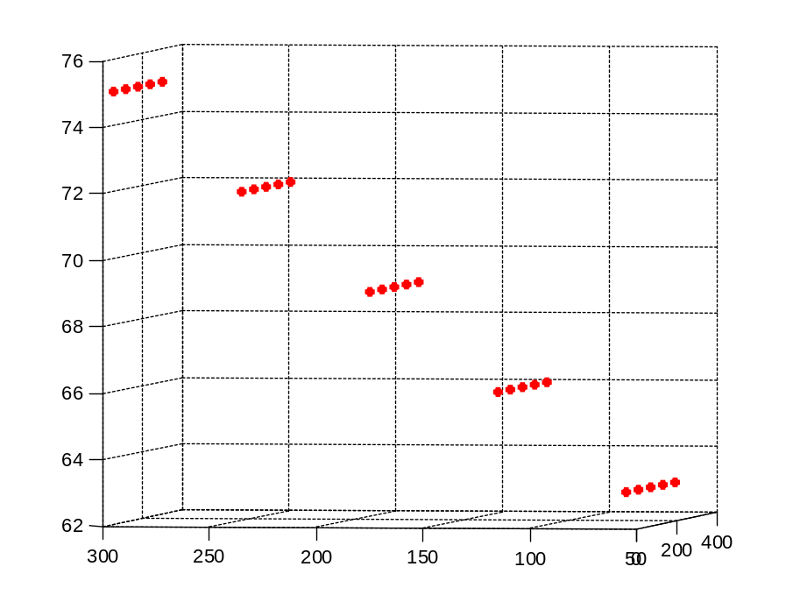
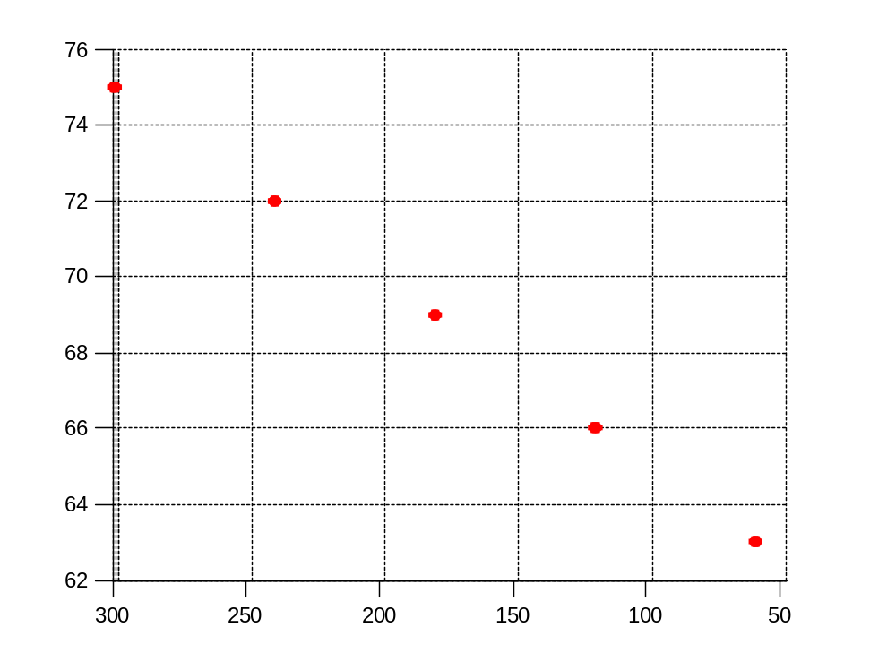
A Population of “pure selectivity” neurons
Low Dimensionality
x=[];
y=[];
z=[];
for a=1:5
for b=1:5
neuron_1_function=60*a + 0*b;
neuron_2_function=60*b+0*a;
neuron_3_function=60+3*b;
x=[x neuron_1_function];y=[y neuron_2_function]; z=[z neuron_3_function];
end
end
scatter3(x,y,z,'r','fill')
We only need a two-coordinate axis to specify the position of these points. The points do not span all 3 dimensions.

Slide 8
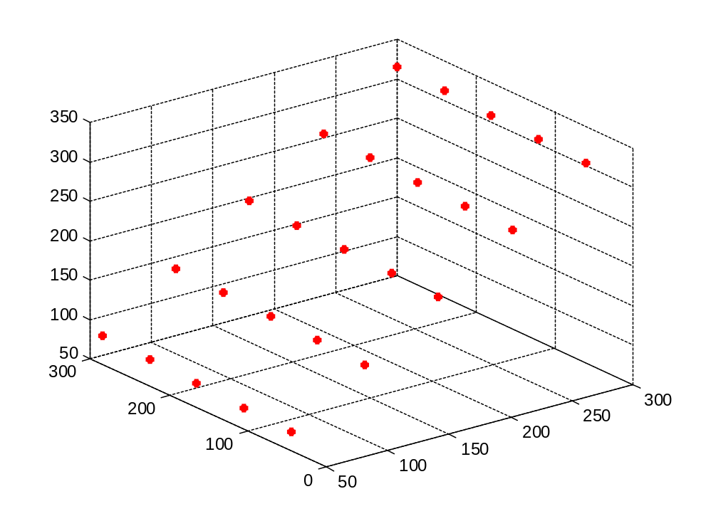
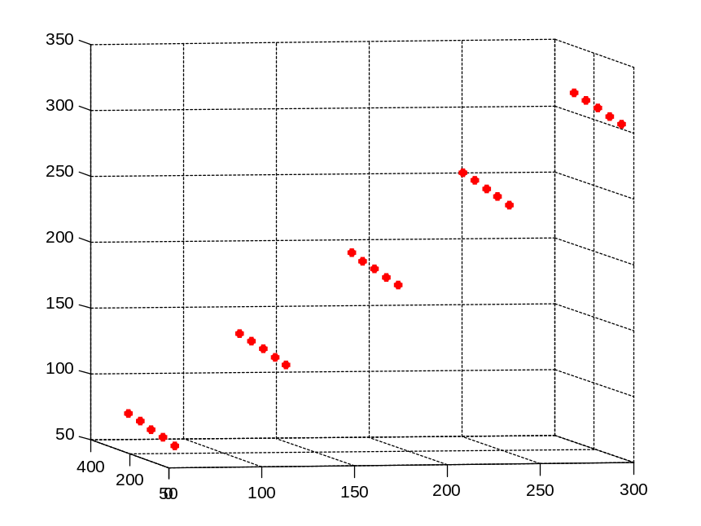
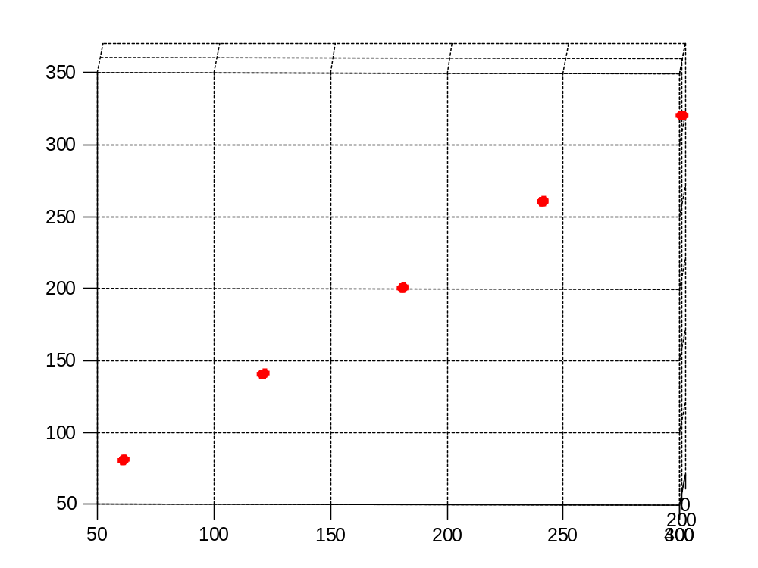
A Population of “pure and linear mixed selectivity” neurons
Low Dimensionality
x=[];
y=[];
z=[];
for a=1:5
for b=1:5
neuron_1_function=60*a + 0*b;
neuron_2_function=60*b+0*a;
neuron_3_function=60*a+3*b;
x=[x neuron_1_function];y=[y neuron_2_function]; z=[z neuron_3_function];
end
end
scatter3(x,y,z,'r','fill')
Still….We only need a two-coordinate axis to specify the position of these points. The points do not span all 3 dimensions.

Slide 9
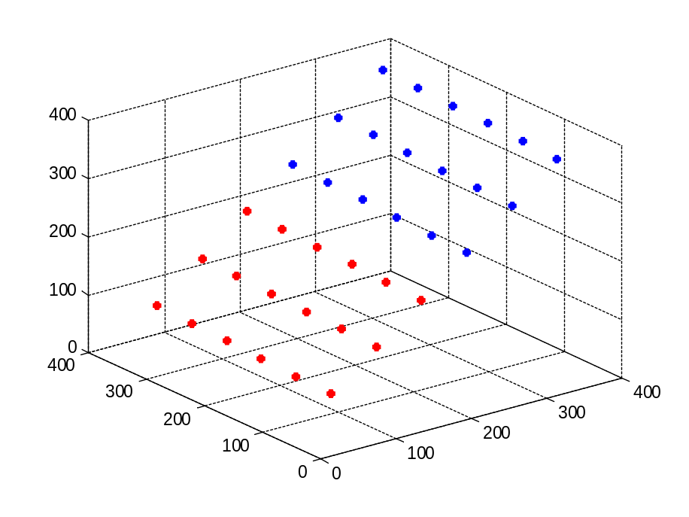
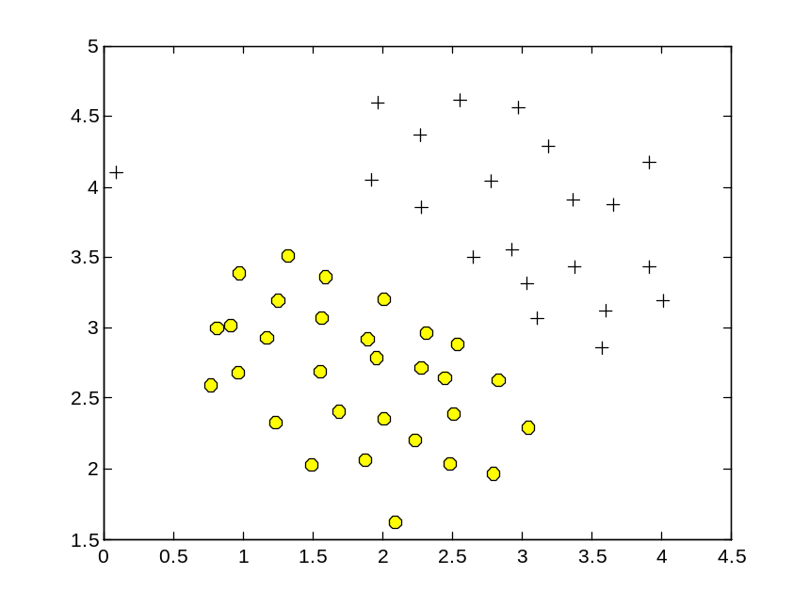
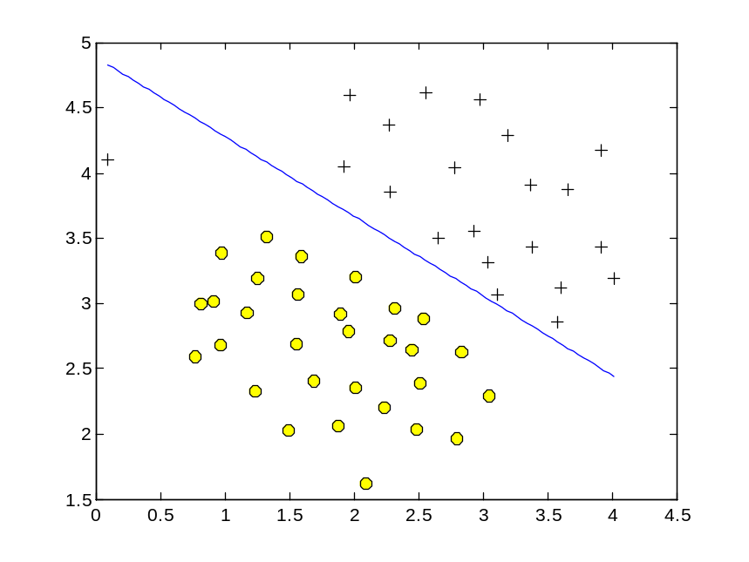
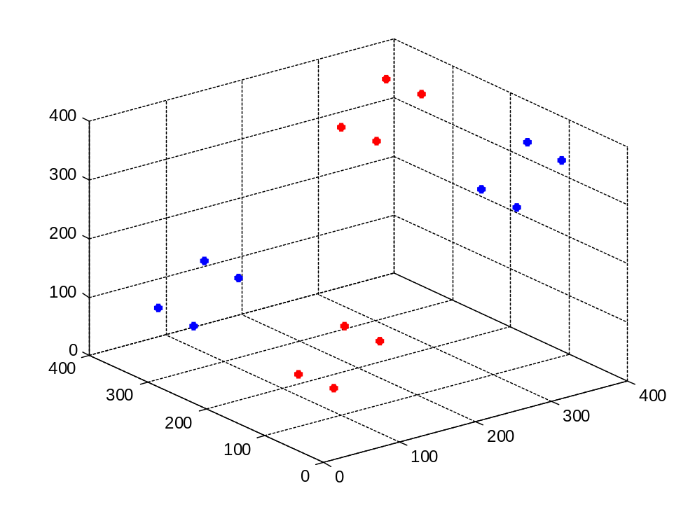
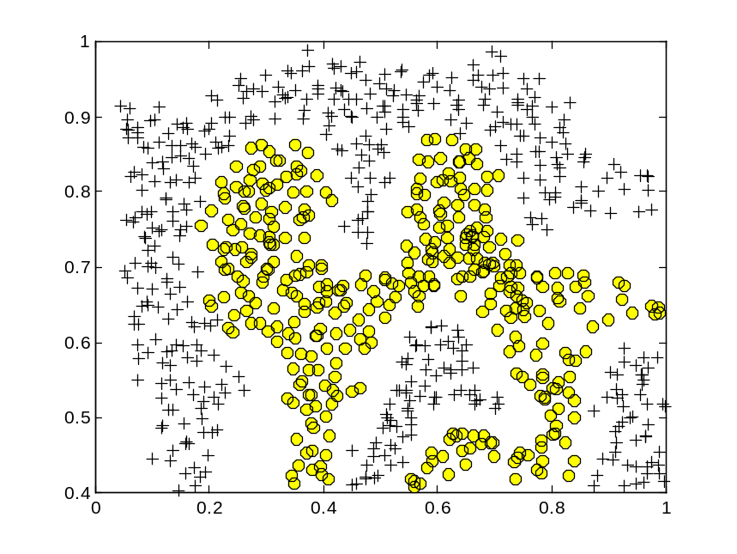
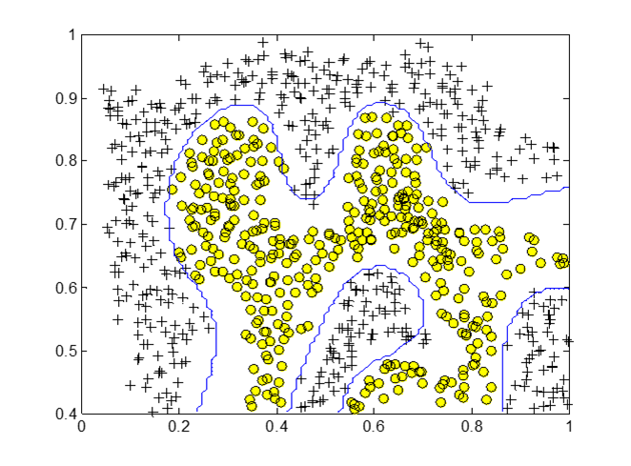
Linear classifier
The “Exclusive Or” Problem
Non-Linear classifier?
Notes:
If we want to “classify” points that are on this plane, we can plot a decision boundary using classic machine-learning techniques.
We want to be responsive to Red only and silent to blue. This is impossible to do with 1 plane. So, how do we get the classification?
A curvilinear surface could read it out.

Slide 10
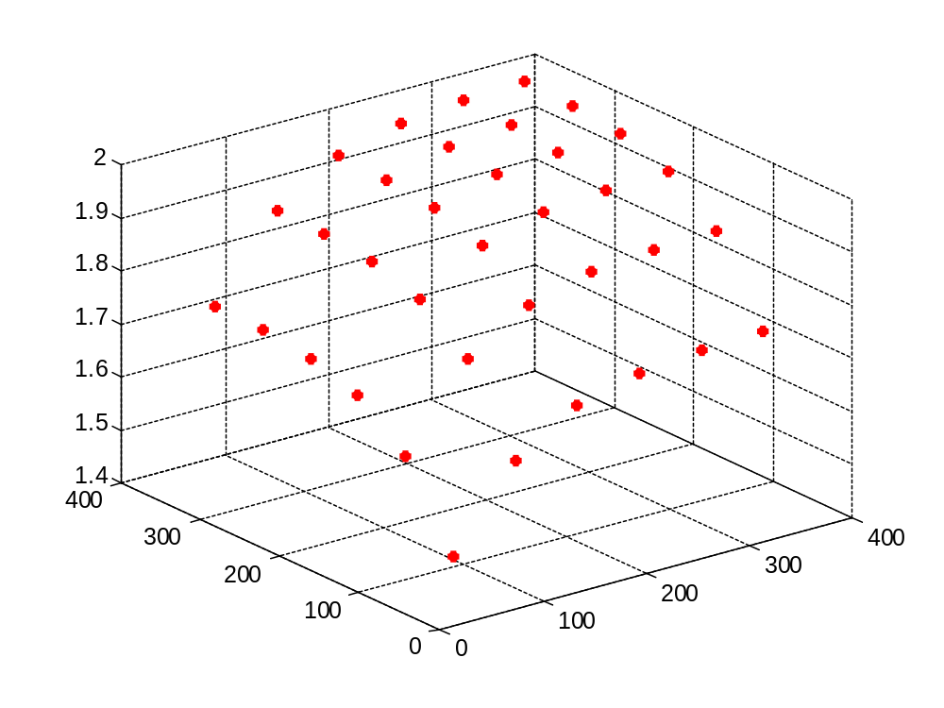
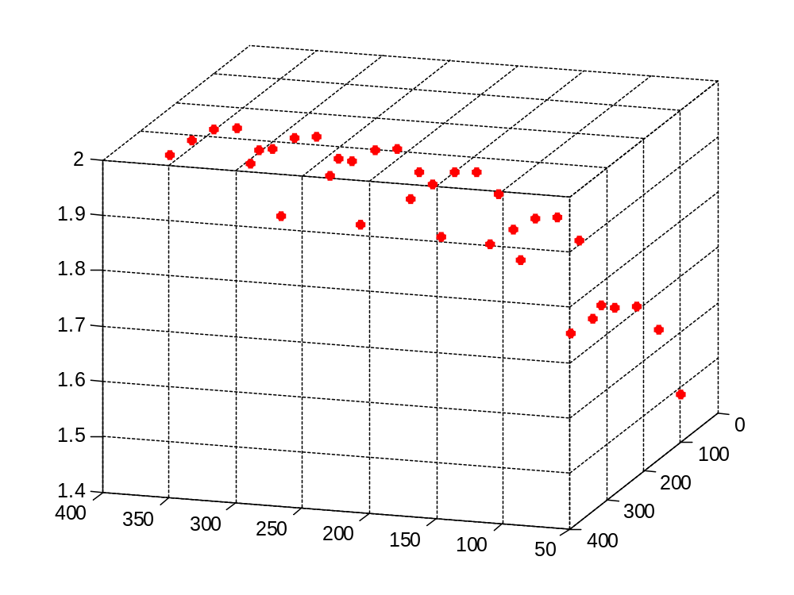
By adding a neuron that exhibits “mixed” selectivity”, we increase the dimensionality of our population code.
High Dimensionality
x=[];
y=[];
z=[];
for a=1:6
for b=1:6
neuron_1_function=60*a + 0*b;
neuron_2_function=60*b+0*a;
neuron_3_function= 1/(1+(exp(-a)))+ 1/(1+(exp(-b)))
x=[x neuron_1_function];y=[y neuron_2_function]; z=[z neuron_3_function];
end
end
scatter3(x,y,z,'r','fill')
Notes:
If we want to “classify” points that are on this plane, we can plot a decision boundary using classic machine-learning techniques.
We want to be responsive to Red only and silent to blue. This is impossible to do with 1 plane. So, how do we get the classification?
A curvilinear surface could read it out.

Slide 11
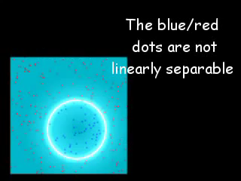
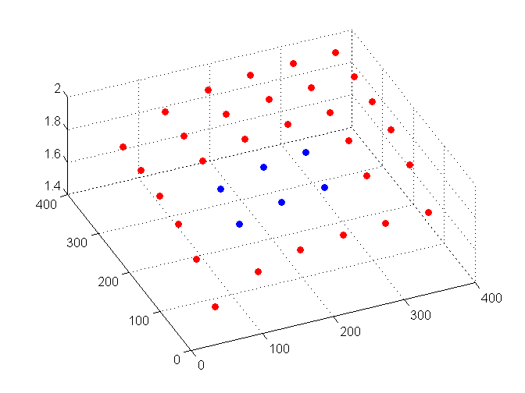
By adding a neuron that exhibits “mixed” selectivity”, we increase the dimensionality of our population code.
Known as the “kernel trick”, this advantage(Cover’s Thereom) is artificially exploited by Support Vector Machine Classifiers
Notes:
kernel trick = computing inner products between feature vectors that are non-linearly projected to a higher dimensional space, without having to first perform the non-linear projections.

Slide 12
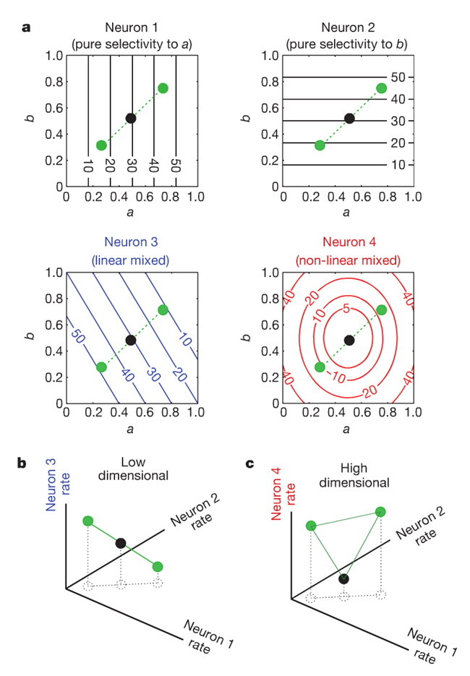
Quick Summary:
If we have pure and linear-mixed selectivity, then we have low-dimensionality and require a “complex”(curvilinear) readout
If we have non-linear mixed selectivity neurons included, then we can utilize a “simple” (linear) readout.
Why?

Slide 13
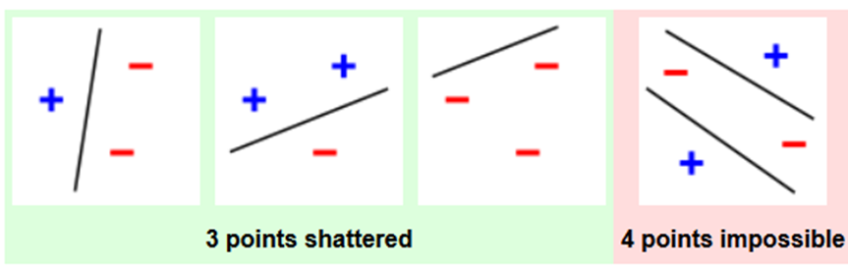
Dimensionality
“The number of binary classifications that can be implemented by a linear classifier grows exponentially with the number of dimensions of the neural representations of the patterns of activities to be classified.”
Ideally, we’d want a “readout” mechanism to be able to take activity of a population (as a sum weighted inputs) and classify based on a threshold (make a decision). This becomes easier and easier with more and more dimensions.
Number of dimensions is bounded by C -- d=log2N_{c}
The number of classifications possible, then, is capacitated by dimensionality.
  If our dimensionality is maximum, then we can make all possible binary classifications(2^{c})
They will be using a linear classifier to asses the number of linear classifications(above 95% accuracy) that are possible.
  This represents a hypothetical downstream neuron that receives inputs from the recorded PFC neurons and performs some kind of “linear readout”

Slide 14
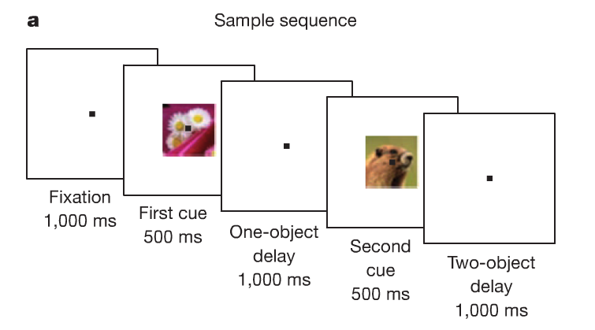
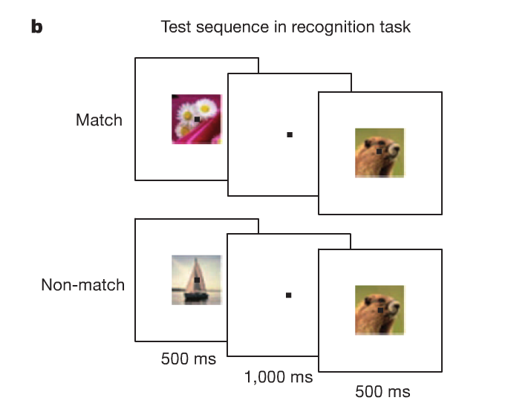
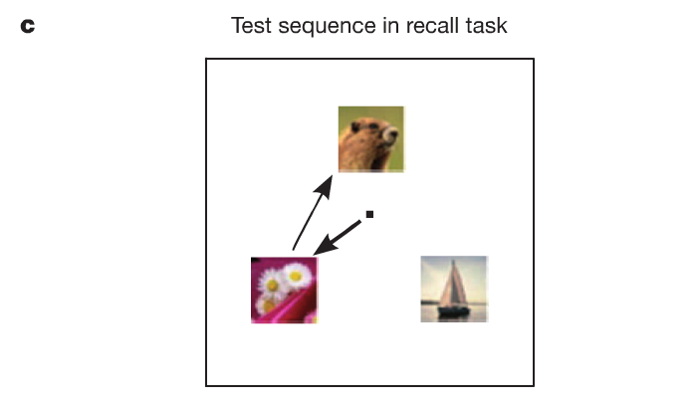
Task
Sequence of 2 Visual Cues
12 different cue combinations (4 objects)
2 different memory tests
C=24
Notes:
Trials were in blocks.
Non-matches could appear in succession until a match was shown.
We could have 24 possible

Slide 15
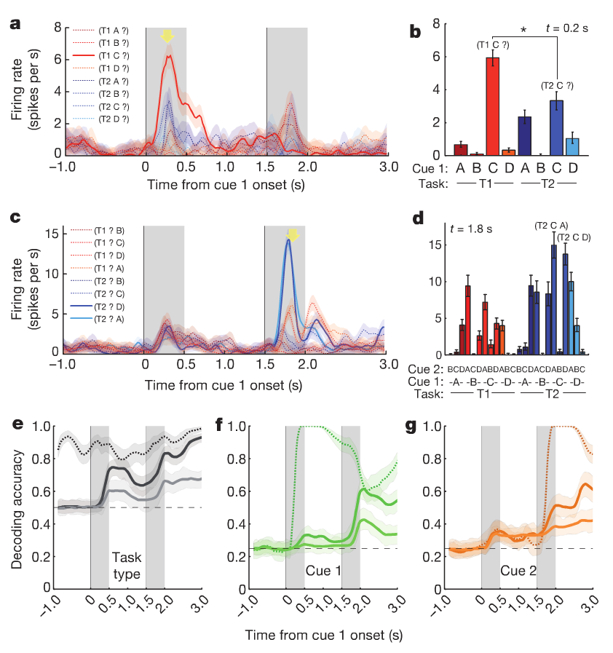
Pure, Preliminary, peri-condition-histogram(PCH) Results
A majority of neurons are selective to at least 1 of the 3 task relevant aspects in 1 or more epochs.
A large proportion also showed nonlinear-mixed selectivity
a/b – a cell that is selective to a mixture of Cue1 identity and task-type. It responds to object C when presented as a first cue(more strongly so when C was the first cue in the recognition task)
c – mostly selective to objects A and D when they are presented as second stimuli, preceded by object C, and only during recall-task-type
Notes:
A Neuron was said to have classical selectivity to task type at time t whenever the average activity measured at time t during recognition is significantly different from the average activity measures at time t during the recall task.

Slide 16
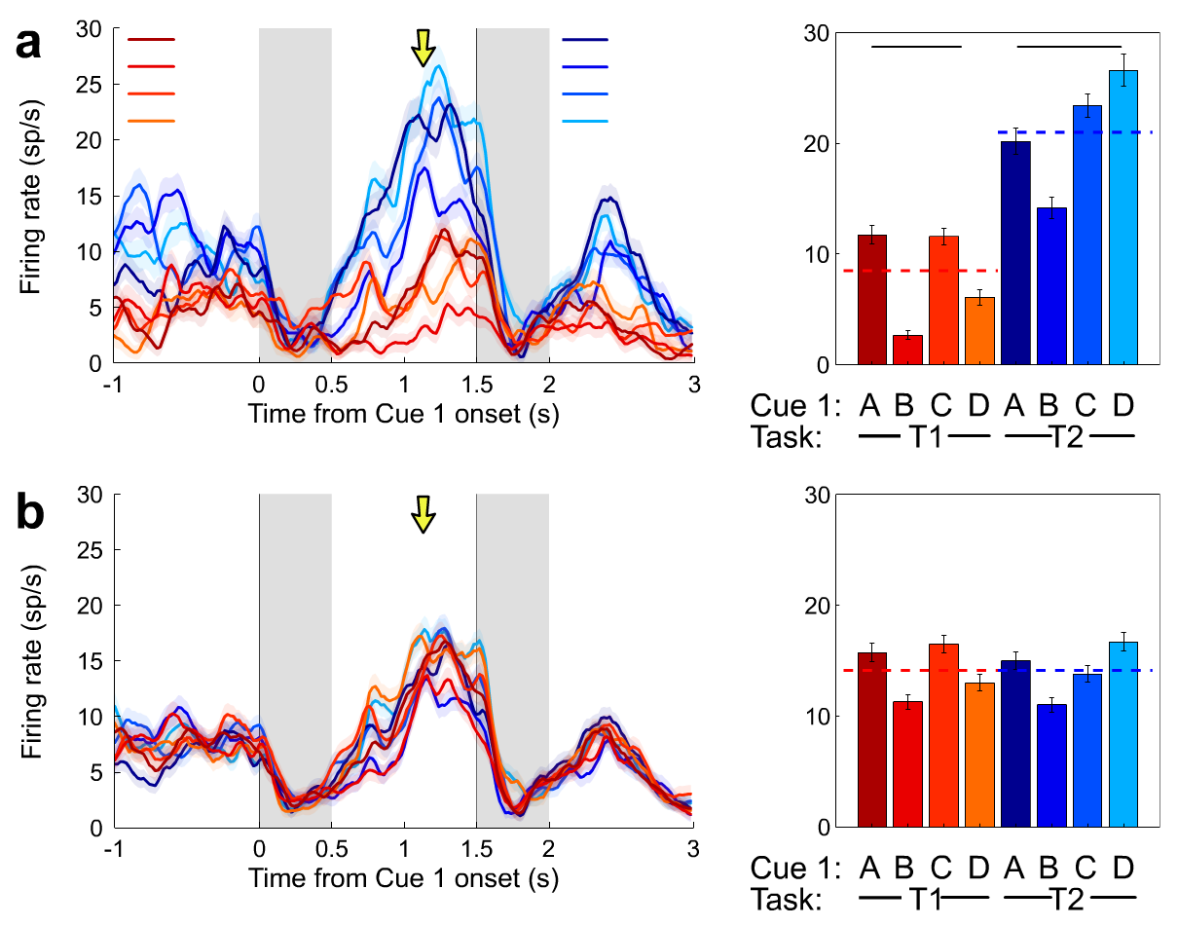
Removing Classical Selectivity / Reverse Feature Selection
Mean firing rate during recall task was greater than mfr during recognition for this neuron.
Use a two-sample t-test to identify neurons that are selective to task(p<.001).
1) Take a spike count from each Recall Task sub-condition at time t
2) Superimpose that with a random sub-condition Recognition Task at time t.
3) Repeat Vice Versa
This removes task-selectivity, but the PCH shows that the neuron maintains some information about specific combinations.
Allows us to start asking the question:
Do the responses in individual conditions encode information about task-type through nonlinear interaction between the cue and the task-type?
Notes:
Information could be distributed across the neural population even when it is not present in individual cells.

Slide 17
Resampling
We could fail to classify the 17million(2²⁴) possible classifications because:
We are restrained by geometry
Because of noise (standard classification detriment)
In order to discriminate between these situations, you need to look at number of classifications you can perform with an increase in neurons.
An increase in neurons(towards infinity) should decrease the noise(at an asymptote).
Goal: Increase neuron number + maintain statistics.
Within task type: If the label was A,B,C,D – make it B,D,A,C
Yield: 24 neurons per neuron that has at least 8 trials per condition(185) = 4440 neurons
Notes:
The total number of binary strings of length 24 id 2^24 = 17million possible different classifications “Y is the as or different from X”
Estimated the decoding accuracy for larger neural populations by resampling the recorded neurons and randomly labelling the identities of the visual objects, so as to obtain responses whose activity have the same statistics as the recorded ones.
For example, a new neuron could be obtained by assigning the activity of a recorded neuron in response to objects A,B,C,D to the trials in which the objects were B,D,A,C
Assignments of the cue labels is anyway arbitrary as in different experimental sessions, different stimuli were used.

Slide 18
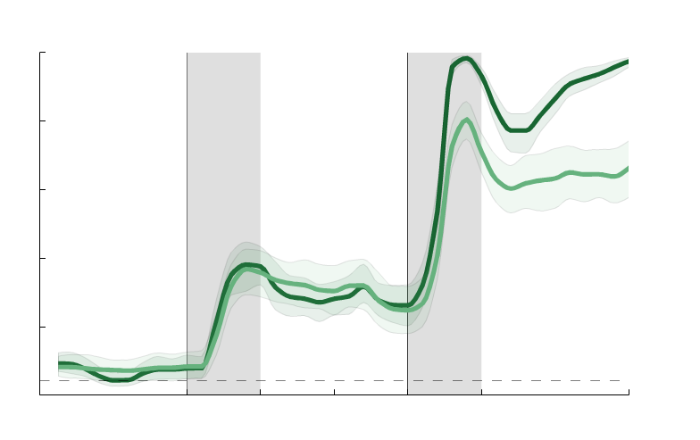
Removing Classical Selectivity + Resampling Classification Results
e – population decoding accuracy for task-type
f – population decoding accuracy for cue 1
g – population decoding accuracy for cue 2
Dashed lines denote accuracy before removing classical selectivity neurons
Bright solid lines denote accuracy after removal
Dark solid lines denote 1,000 re-sampled neurons
Sequence decoding was possible as well
Notes:
A Neuron was said to have classical selectivity to task type at time t whenever the average activity measured at time t during recognition is significantly different from the average activity measures at time t during the recall task.
Note that the decoding ability of task-type increases with time because the task is becoming more and more complex and by the time the animals needed to make the decision, they have almost all the information they need.

Slide 19
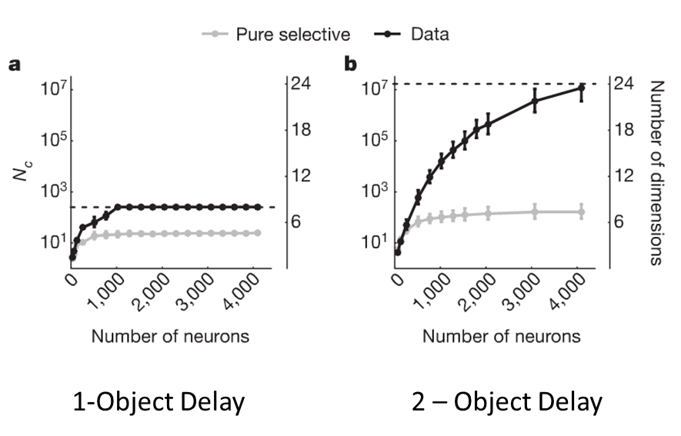
Dimensions as a function of Classifications
Max(d)=log2N_{c}
Log2(17M)=24
Just pure selectivity neurons alone, when increased in number does not increase the number of possible classification.
The dimensionality remains low.
Notes:
Dimensionality stays at 8.

Slide 20
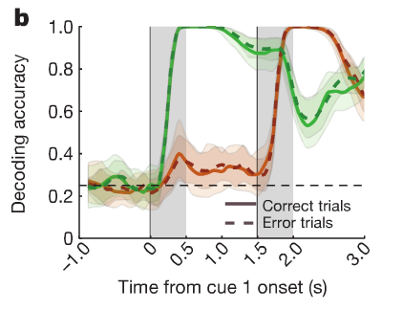
Behavioral Relevance
They wanted to compare Correct to Error trials.
Only enough data from the recall, so our max dimensionality is now 12
Decoding Cue Identity (No difference)
Notes:
They ruled out that this difference in decidability was due to a number of trials, a change in firing rate, in the variability of single neuron activity, or in the coding level of the activity.
When monkey’s make mistakes, the cue identities are still encoded with exactly the same strength as in the correct trials.
The collapse in dimensionality is not due to a failure in coding or remembering the sensory stimuli.
The non-linear mixed selectivity component was the residuals of the linear mixing model. So, removing the residuals resulted in no difference between correct and error trials. But just running on the residuals did show that difference.
Linear model accounts for 80% of the variance.

Slide 21
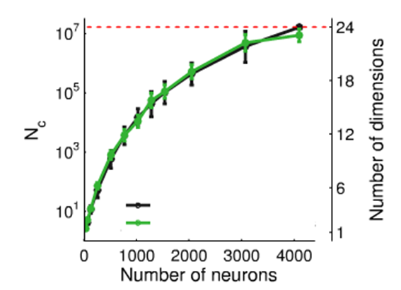
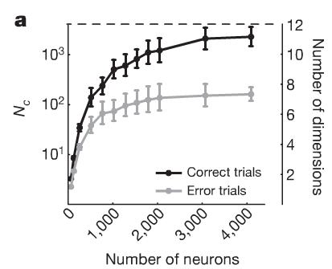
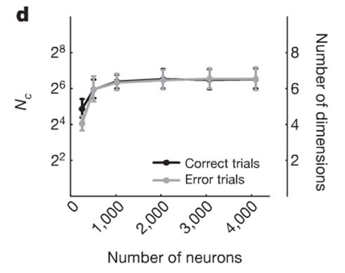

Behavioral Relevance (Best part!)
Removing the sparsest representations doesn’t change dimensionality
They wanted to compare Correct to Error trials.
Only enough data from the recall, so our max dimensionality is now 12
Dimensionality(number of classifications) for error vs. correct trials
Removing the non-linear component (Y-hat)
Removing the linear component(using residuals)
Notes:
They ruled out that this difference in decidability was due to a number of trials, a change in firing rate, in the variability of single neuron activity, or in the coding level of the activity.
When monkey’s make mistakes, the cue identities are still encoded with exactly the same strength as in the correct trials.
The collapse in dimensionality is not due to a failure in coding or remembering the sensory stimuli.
The firing rate of the neuron is predicted by coefficients assigned to the cues + error/non-linearity/interaction
How is it, though, that we do so well on being able to classify the Cue but also have this collapse in dimensionality?
In the error trials, the neurons that are most affects are those that had a strong non-linear mixed selectivity. The more specialized will be less sensitive.
So, we can know Cue 1 and Cue 2 and have the representation, but not be able to complete the task.

Slide 22
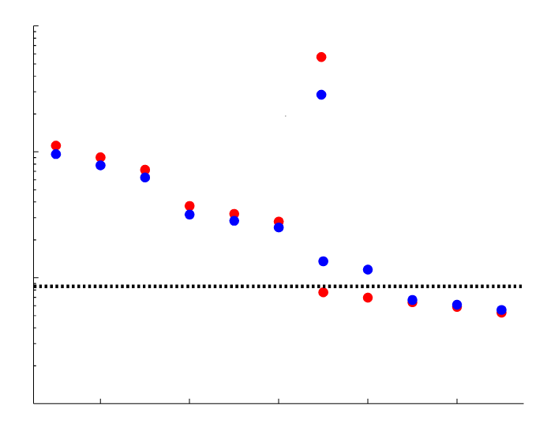
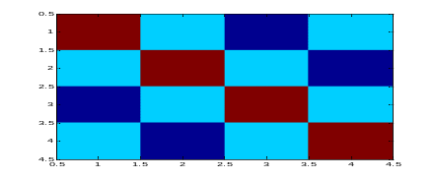
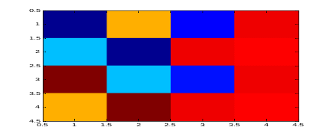
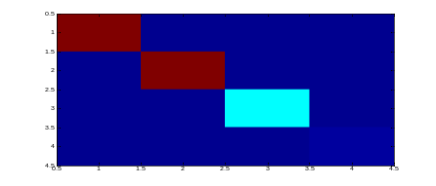
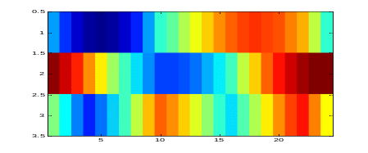
PCA Confirmation
The first 6 principle components are cue encoders and do not vary between error(red) and correct(blue) trials. Pure Selectivity.
7,8,9 (even though they account for less of the variance) represent mixed terms due to the variability induced by simultaneously changing two cues. They are different in the error and correct trials.
Mini-PCA Background
Demean
Calculate covariance
Obtain eigen-vectors/values and rank according to value.
Form a matrix of P eigenvectors
Transpose
Multiple by original dataset
z_n_by_c_population_matrix=zscore(n_by_c_population_matrix');
covariance_of_population_matrix=cov(z_n_by_c_population_matrix);
[U,S,V]=svd(covariance_of_population_matrix);
top_3_components=U(:,1:3);
new_dataset=top_3_components' * n_by_c_population_matrix;
Notes:
Components explain variance
When they ran a correlation, they saw that the first 6 PCs were affected by altering the inputs (i.e changing the data to modulate the cues only changed the first 3 pairs of PCs and not 7,8,9).
The first 6 PCs are not different between error and correct. This is why trial can still be decoded during error trials.

Slide 23
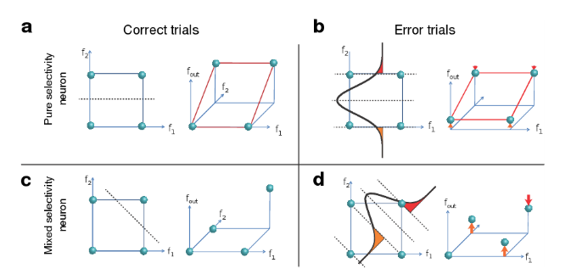
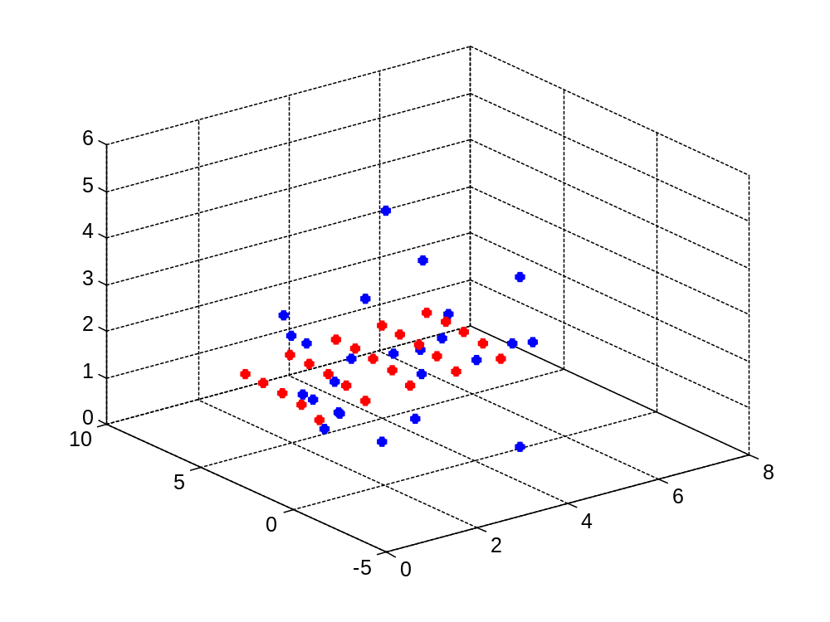
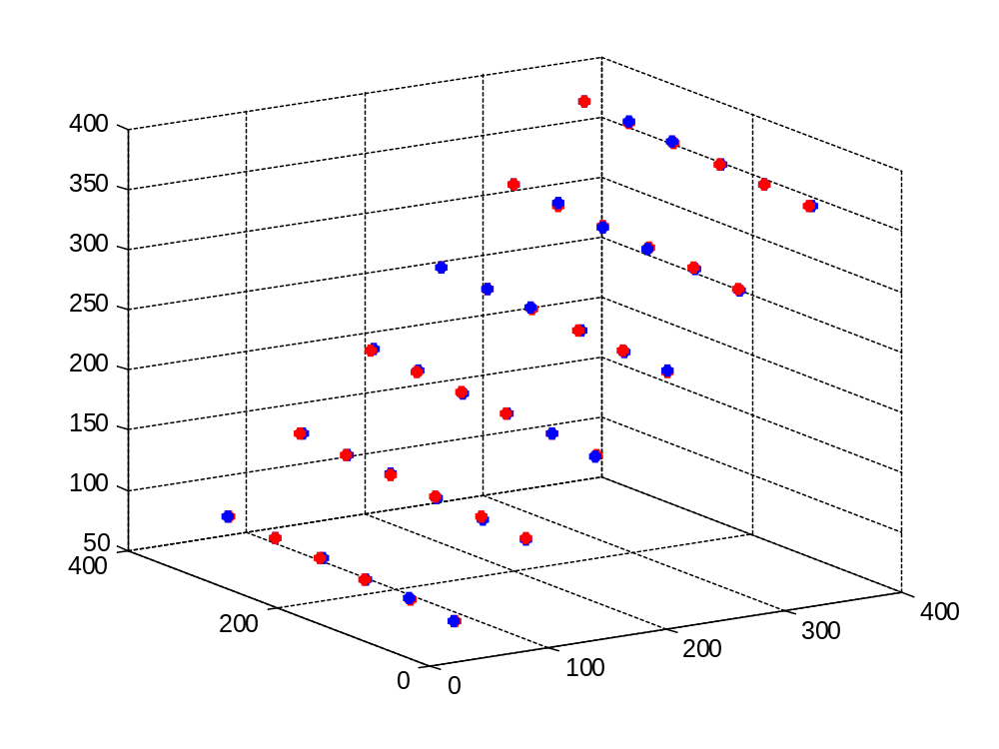
The Downside
Model with a non-linear mixed selective neuron. Red= no noise, Blue = added Gaussian noise.
Model with a linear mixed selective neuron.
Notes:
Non-linear mixed selectivity neurons are more sensitive to noise(mental state changes)
Our read-out is either determined by
Geometry (able to classify)
Noise
Neurons that are not task-relevant could come in and disrupt this system.

Slide 24
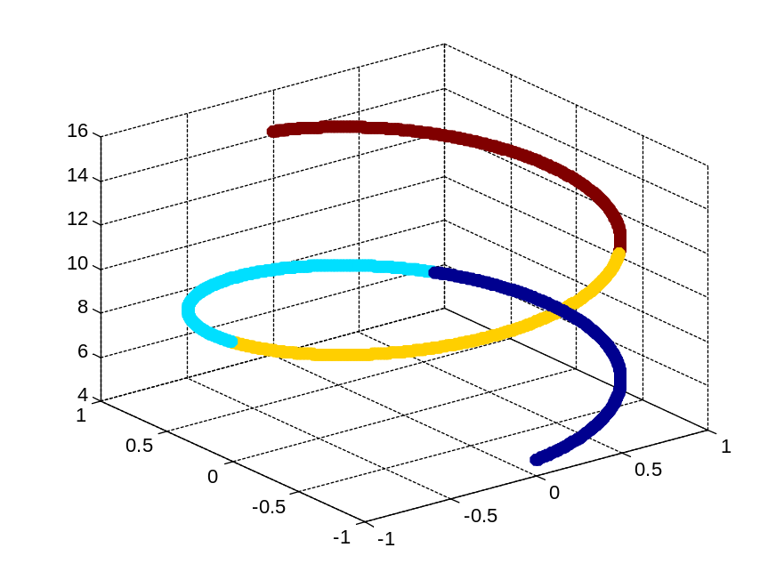
Conclusions
With high dimensionality, information about all task-relevant aspects and their combinations is linearly classifiable(by readout neurons).
Nonlinear mixed selectivity neurons are important for the generation of correct behavioral responses, even though pure/mixed selectivity can represent all task-relevant aspects.
A breakdown in dimensionality (due to non-task relevant, variable sources –noise) results in errors.
Consequently, nonlinear mixed selectivity neurons are “most useful, but also most fragile”
This non-linearity, ensemble coding comes bundled with an ability for these neurons to quickly adapt to execute new tasks.
Is this similar to the olfactory system and grid cells (minus modularity)?
Does this necessitate that we are using a linear-readout?
Are they measuring distraction?
Do we use this to decode relative time?
Notes:
High dimensionality simplifies the design of local neural circuits
Dimensionality of the neuronal representations is expanded by mixing in a nonlinear way the different sources of information in a population of randomly connected neurons
Does this prove that we are using

Slide 25
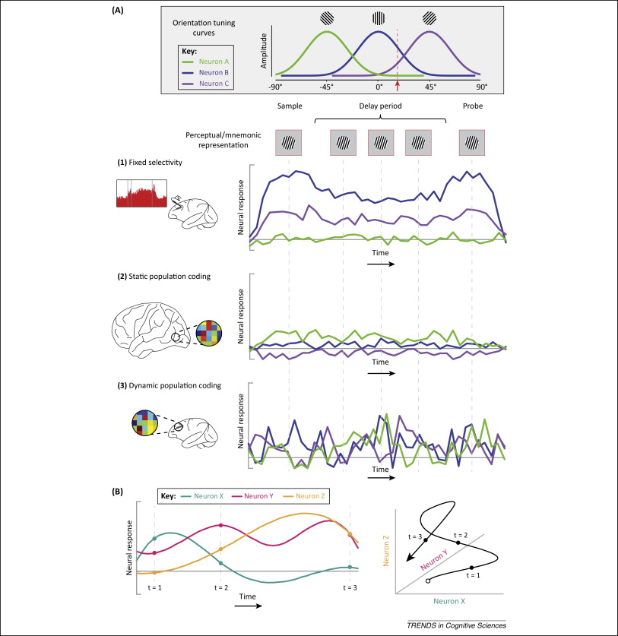
Sreenivasan, Curtis, D’Esposito 2014

Slide 26
More on PCA
A matrix multipled by a vector is treating the matrix as a transformation matrix that changes the vector in some way.
The nature of a transformation gives rise to eigenvectors
  If you take a matrix, apply to it some vector and the resulting vector lays on the same line as the applied vector, then it is a reflected vector.
  A vector that causes the transformation matrix to have this reflected vector would be considered an eigenvector of that transformation matrix (so would all multiples of it.)
Eigenvectors can only be found for square matrices.
  Not every square matrix has eigenvectors
  For an nxn matrix that has eigenvectors, there are n of them.
    E.g if a mtrix is 3x3 and has eigenvectors…it has 3 of them.
  All eigenvectors of a matrix are perpendicular to each other no matter how many dimensions you have.
    Orthogonality.
  Mathemiticians prefer to find eigenvectors whose length is exactly one.
    The length of a vector doesn’t affect it, but direction does.
      So, we want to scale it to have a length of 1.
  We can find the length of an eigenvector by taking the square root of the summed squares of all the numbers in the vector.
    If we divide the original sector by the above value, we can make it have a length of 1.
  SVD will return the eigenvectors in its U. Each column will be an eigenvector of the supplied matrix.
Eigenvalues
  The value that can be multiplied to the eigenvector that will yield the resulting vector after a matrix has been multiplied by its eigenvector.
    E.g if A is a matrix and v is its eigenvector and B is the resulting vector of their multiplication, then the eigenvalue times v will result in B as well.
  SVD will give us the eigenvalues in the S column.

Slide 27
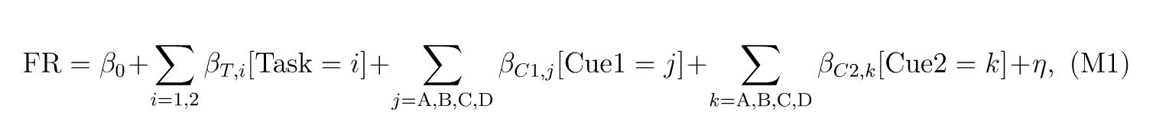
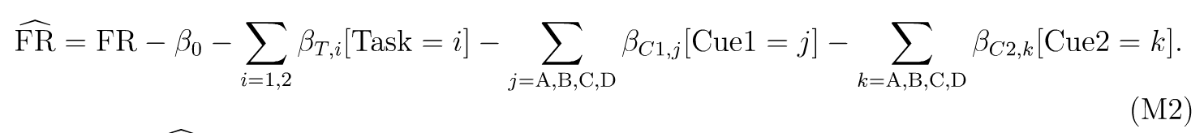
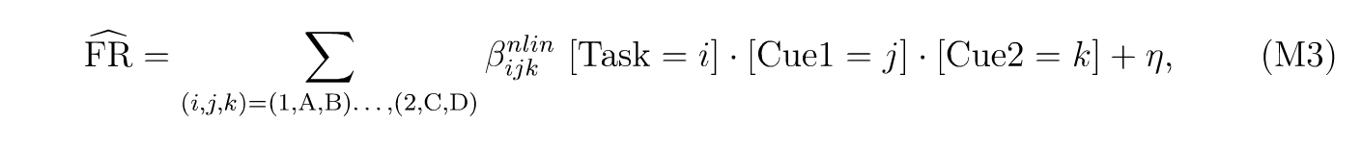

Slide 28



In rule based, sensory-motor mapping tasks:
PFC cell responses represent sensory stimuli, task rules, and motor responses and combine such facets.
Neural activity can convey impending responses progressively earlier within each successive trial.
Assad, Rainer, Miller 2008
Notes:
4 neurons to each of 4 possible cue-saccade combinations. Bar chart shows mean level of delay activity.
A&L Boolean Conjunction.
M mental states required by a task.
R random transitions between the mental states
We want a network that is able to learn and trigger transitions.
Make them resistant to noise.
An optimal coding level is .5

