Slide 1

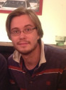
Reappraising the relationship between working memory and conscious awareness
A Trends in Cognitive Science publication by David Soto and Juha Silvanto
Presented on Tuesday, February 2nd by Nicco Reggente

Slide 2
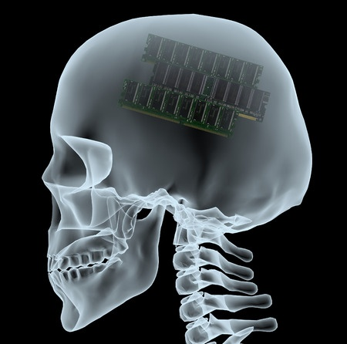
Working Memory
Conscious Awareness
Attention supervisory system
Cognitive Control
information routing
goals
Maintenance
Phonological loop
Manipulation
Visuospatial sketchpad
Episodic buffer
binding information
Long term memory “direct access” zone
Qualia
Subjective experience
What it is like.
Reportable
IIT (intrinsic existence, composition, information, integration, exclusion.)
Notes:
Slave systems within working memory like a rehearsal loop like when we maintain a phone number as we repeat it to ourselves. Another slave is visuo-spatial sketchpad in constructing and manipulating imagges.
Intrinsic existence;. in essence, this recapitulates Descartes’ famous saying, cogito ergo sum – I think (or rather, I experience), therefore I am.
Composition: experience is structured, being made up of multiple “features” that are often bound together (a red book on the left side of the table).
Information: every experience is what it is by differing in its particular way from an immense repertoire of other possible experiences (thin of all the frames of every possible movie)
Integration: Every experience is unified, in that it cannot be decomposed into independent “pieces” (the book without its color, the left side without the right side, and so on).
Exclusion: At any given time, there is only one experience, flowing at a particular speed.
Pertubational complexity index is not what we’ll be discussing. Not consciousness in general.

Slide 3
Working Memory
Conscious Awareness
Consciousness is associated with a global workspace where information is broadcasted to multiple nonconscious specialized networks, and globally available for cognitive function. Consciousness is a consequence of global ignition of large-scale frontoparietal systems.
Working memory contents need not be conscious, but can instead be seen as a superstructure dependent on the fundamental features of consciousness.
Block – phenomenal consciousness may remain shielded from the processes that enable access consciousness. Information may be held in visual short-term memory before being consciously accessed through WM. Access may need neural frontoparietal recurrency.

Slide 4
Working Memory
Conscious Awareness
Are we fully conscious of our working memory operations?
Can working memory operations be deployed over nonconscious input?
If the operational definitions that characterize working memory are met,
it follows that working memory may operate outside awareness.
Can neuroimaging dissociate working memory and conscious awareness?

Slide 5

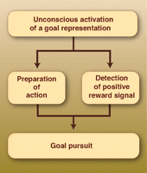
Maintenance and manipulation without conscious awareness
Hassin’s “Yes it can” principle: unconscious processes can perform the same fundamental, high-level functions that conscious processes can perform.
Extracting spatial sequences
Pursuit of goals
Unconsciously exposing participants to keywords deviates their behavior.
Notes:
Working memory’s operations would not be left out.
Five empty or full circles were presented in sequence in pattern or broken. Recognizing the pattern would help with performance. This was accomplished implictly.
Subliminally exposed to have a goal of socializing. This encouraged people to finish a task quickly where if they did they would have more time to participate in a lottery to get a ticket to a big social event.
Libet finger moving read out before acted on.

Slide 6
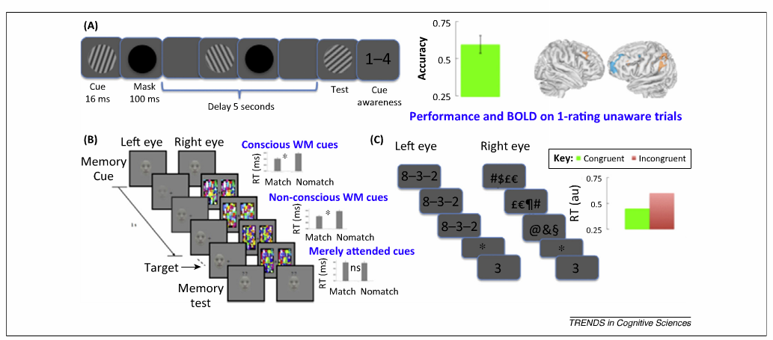
Maintenance and manipulation without conscious awareness
- above chance performance on delay discrimination despite negated visual experience.
- suppressed eye will allow awareness of matching face to cue even if cue was nonconscious only when instructed to keep the cue in working memory
- reaction times are faster when probe digit is congruent with solution to primed equation
Notes:
If WM operates on conscious information, then can only conscious items gain access to the faculties of WM?
Had distractors. Even when the task was to take two masked cues and bind their grating orientations, subjects still performed above chance.
memory cue presented to both eyes for 2s at the beginning of the trial. Then a target was face was gradually presented to the suppresed eye. Contrast was linearly ramped up within 1s. Remained full until response or 10s passed. Were asked to report which side the face appeared on before the memory test.
Functional operations of arithemetic and reading fall in line with the repertoire of working memory.

Slide 7
Maintenance and manipulation without conscious awareness
…if a cognitive task can be performed without awareness then it follows that the task did not require working memory.
Circular reasoning-- assumes that working memory must necessarily be linked to conscious states.
If the operational definitions that characterize working memory are met, it follows that working memory may operate outside awareness.
Notes:
If WM operates on conscious information, then can only conscious items gain access to the faculties of WM?
(A) Had distractors. Even when the task was to take two masked cues and bind their grating orientations, subjects still performed above chance.
Functional operations of arithemetic and reading fall in line with the repertoire of working memory.

Slide 8
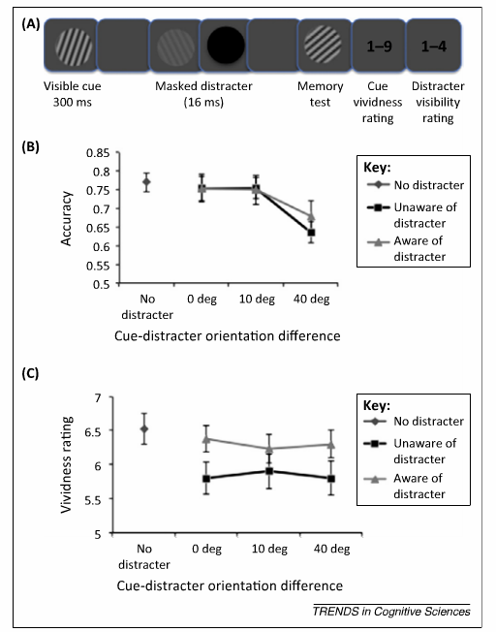
Affects on introspective and metacognitive judgments
Highly dissimilar content impairs working memory accuracy regardless of conscious awareness.
Introspection measures are reduced by all distracters, but only when presented nonconsciously
Notes:
Introspection of WM content is malleable by factors that do not influence the actual WM accuracy.
Our conscious memory experience does not reflect the actual memory content.

Slide 9
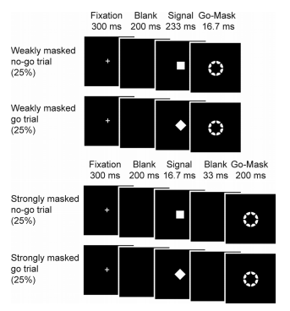
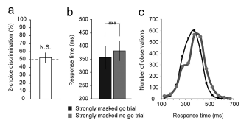
Cognitive control without conscious awareness
Nonconscious ‘no-go’ cues influenced stop rate and slowed RT.
Notes:
The executive component of working memory should monitor the correspondence between goals and action and engage in control processes if needed.
Strongly masked no-go signals slow down responses.

Slide 10
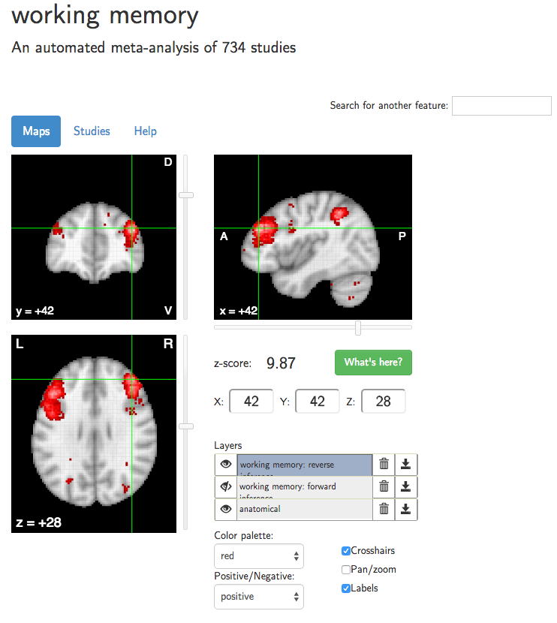
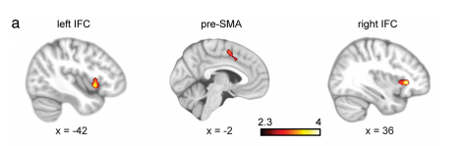
Prefrontal cortex
PFC and working memory
  Activity and performance correlated
    Void of awareness
  TMS delays performance
    Nonconscious cues only.
PFC activity during detection of nonconscious signals in patients with awareness deficits.
neurosynth
unconscious no-go

Slide 11

Prefrontal cortex

Slide 12
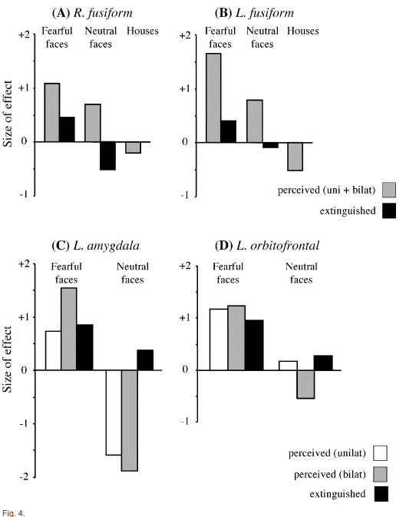
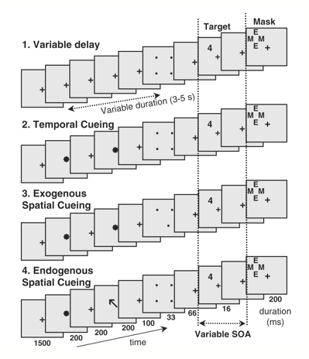
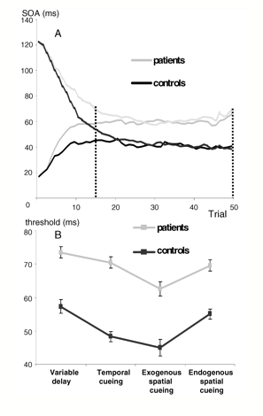
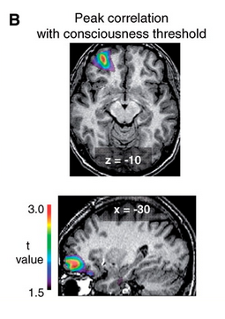
Prefrontal cortex
Is there a threshold?
Do nonconscious processes merely reflect ‘attenuated’ PFC activity that is otherwise enhanced in the conscious state?
Notes:
Authors say no.
Variable delay – masked stimulus appear at a random location afte unpredictable delay
Temporal – subjects could predict time but not place
Exogenous – reflexive orienting of spatial attention by red dot in location
Endogenous – black arrow pointing to correct location.
PFC makes a causal contribution to conscious visual perception of masked stimuli, and outline a dual-route signal detection theory of objective and subjective decision making.
Threshold not correlated with volume.
15 patients conscious access threshold as a predictor.

Slide 13
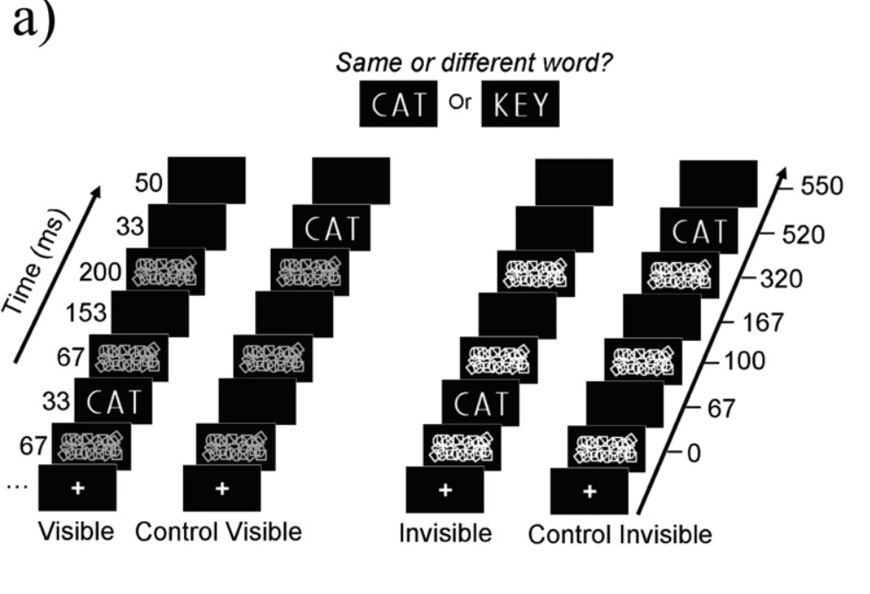
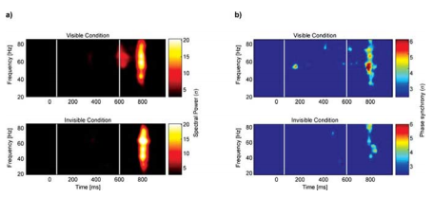
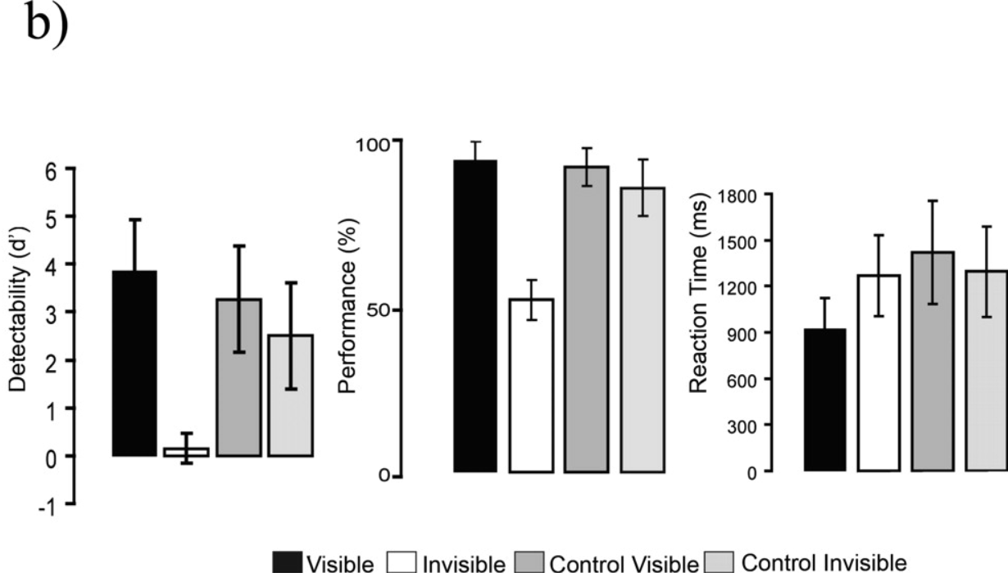
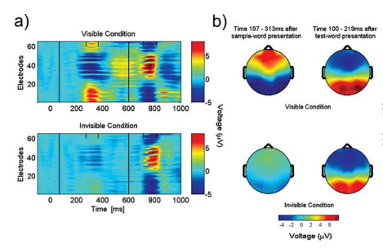
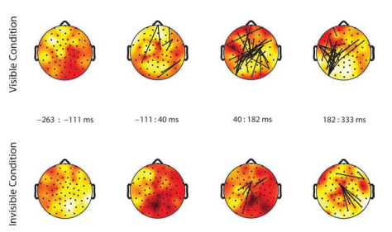
Neural recurrency
The communication and synchronization of distinct (and distant) brain regions.
Causal role in conscious vs. nonconscious processes?
Confounds: engagement in voluntary action, sensory feature binding, maintenance of information, attention control, arousal, etc.
Processing in general?
Similar increases in EEG oscillations with conscious and nonconscious information processing.
Gamma selective to conscious.
Notes:
Both perceived and nonperceived words caused a similar increase of local gamma oscillations in EEG, but only perceived words induced a transient long-distance synchronization of gamma oscillations across widely separation regions which then led to further divergence.
80 to 130ms after sample-word presentation. Mean synchrony at 50-57Hz was higher for visible than invisible.
Perceived
1) enhanced theta oscillations over frontal regions
2) Increase of P300 ERP
3) Increase in power and phase synchrony of gamma oscillations before anticipated presentation of test word.

Slide 14
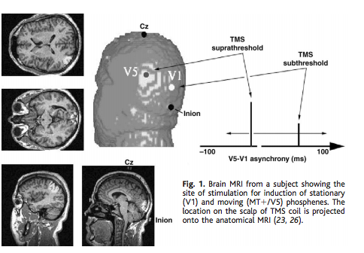
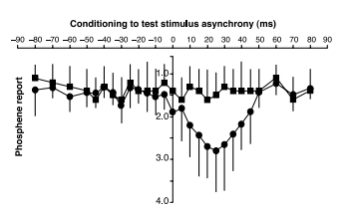
Neural recurrency
Fast backprojections from the motion to the primary visual area are necessary for visual awareness.
TMS on V1 after V5 (not vice versa) stopped perceived movement of phosphene.
Notes:
TMS to V5 and V1 with variable delays.
Stationary phosphenes evoked from V1 and moving phosphenes from V5 would overlap in visual space.
Stimulated V1 at 80% threshold for phosphene and MT at 100% for moving phosphene.
Stopped moving of the phosphene, but was visible.
V1 before V5 no effect but V1 after V5 there was a change in quantity and quality.
If V5 to V1 back projections is critical for awareness, disruption of activity in V1 at time of arrival of feedback should interfere with the perception of attributes encoded in the extra striate area.

Slide 15
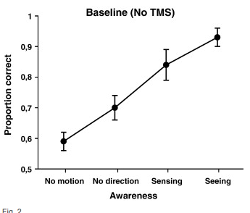
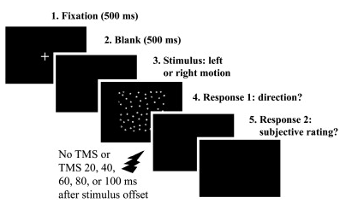
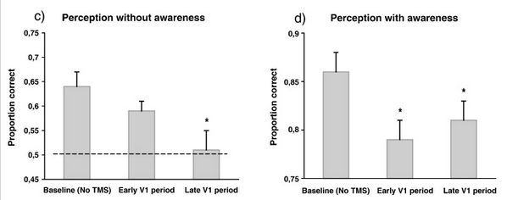
Neural recurrency
Forced-choice direction discrimination performance on unaware trials was above chance, but was impaired by TMS over V1/V2 during “late” time windows (i.e after V5/MT processing) .
Notes:
Forced-choice direction discrimination judgement on a coherently moving random-dot display and additionally rate their subjective awareness of the stimulus.

Slide 16
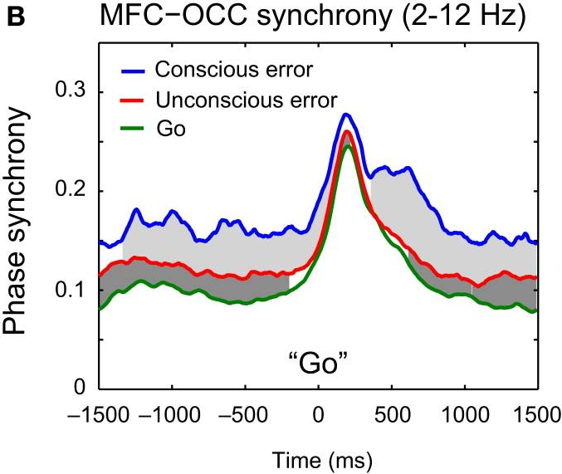
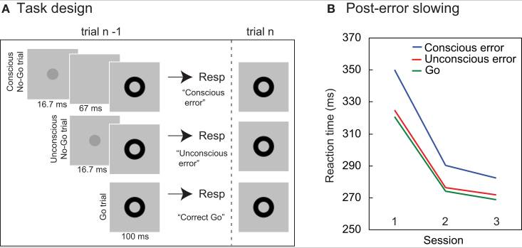
Neural recurrency
Post-error slowing can be triggered nonconsciously across delays of seconds, coinciding with a boost in oscillatory coupling between prefrontal and sensory cortices.
Notes:
Response errors enhanced tonic oscillatory synchrony between MFC and occipital leaduing up to and during subsequent trials.
MFC → OCC directional synchrony was enhanced during trials following both conscious and unconscious errors.
Strength of pre trial MFC-OCC synchrony predicted individual differences in task performance.

Slide 17
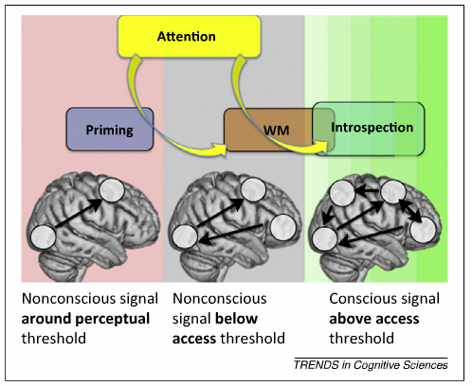
Discussion
Notes:
WM can operate on nonconscious signals, engage PFC, and trigger interareal communication.
Whether this process is associated with global neural “ignition” in large-scale networks is an open question.
What is it like for an individual to retain something in WM that is nonconscious?
Attention can act as a “spotlight” to bring working memory processes into awareness. Since unconscious processes can also affect reports of introspection, some of introspection must also be unconscious.

Slide 18
Discussion
Perhaps we should “reappraise” our intuitions as to the relationship between working memory and conscious awareness.
Working memory can be a set of brain functions that can be carried out with or without our attention. Like breathing.
What benefit do we get from consciousness in regards to working memory functions if the “yes it can” principle holds?

Slide 19
Discussion
Studies focusing on recurrent processes don’t mandate a motivation to code information from masked displays.
Doesn't make unconscious input available for other cognitive operations if it doesn’t have a predisposed purpose.
Striate cortex damaged monkeys.
Shift in the pattern of activity from neocortex in the aware mode to subcortical structures in the unaware mode.

