Slide 1
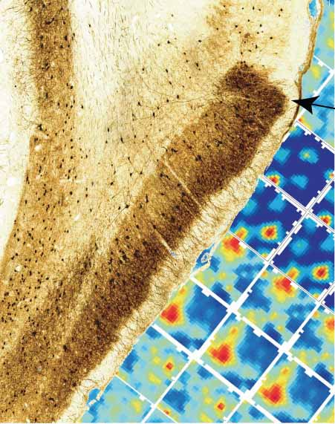
Neural systems supporting navigation
A 2014 Current Opinion in Behavioral Science publication by
Hugo J Spiers and Caswell Barry at UCL
Presented for Rissman Lab Meeting
Monday January 26, 2015
Nicco Reggente

Slide 2
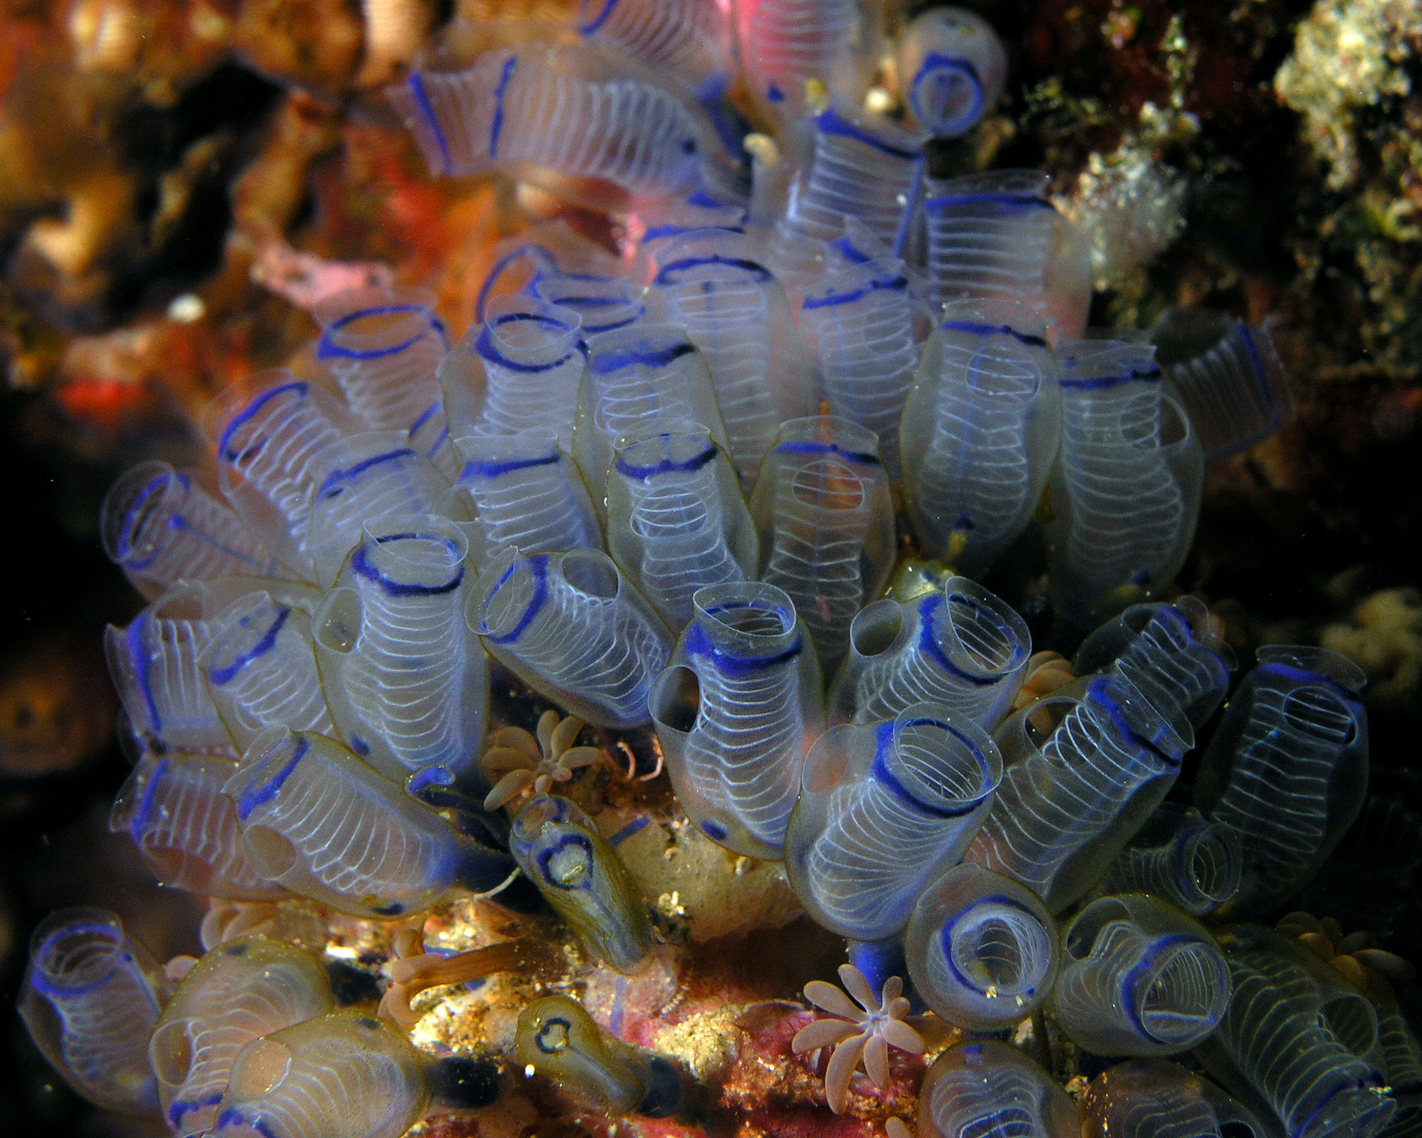
Navigation
We have a brain for one reason and one reason only-- to produce adaptable and complex movements…movement is the only way you have of affecting the world around you.
-Daniel Wolpert
the bluebell tunicate

Slide 3
Navigation
An internal representation of position in space.
A representation of “goals” in space.
An internal representation of speed and direction of movement.
A mechanism for shifting the encoded position by the right amount.
Where am I?
Where am I going?
How do I get there?

Slide 4
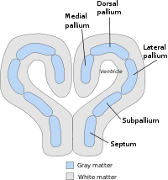
Brain Mapping
The medial pallium, whose allocortex forms the hippocampal formation, evolved alongside human navigation into novel terrain. (Jacobs, 2003)

Slide 5
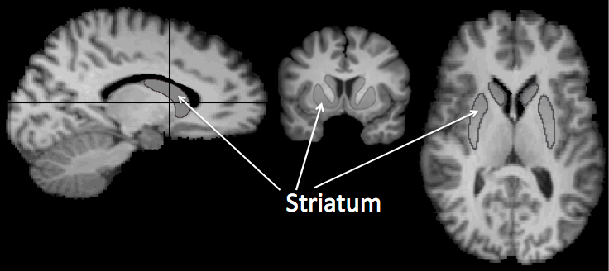
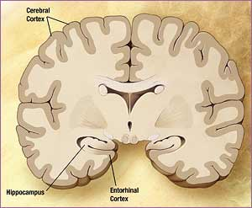
Brain Mapping
Stimulus-response associations stored in the dorsal striatum allow an animal to determine in which direction to proceed and when they have travelled far enough to arrive at the goal.
Determine self-location in an environment and compute the spatial relationship to the goal required MTL regions such as the hippocampus and entorhinal cortices.

Slide 6
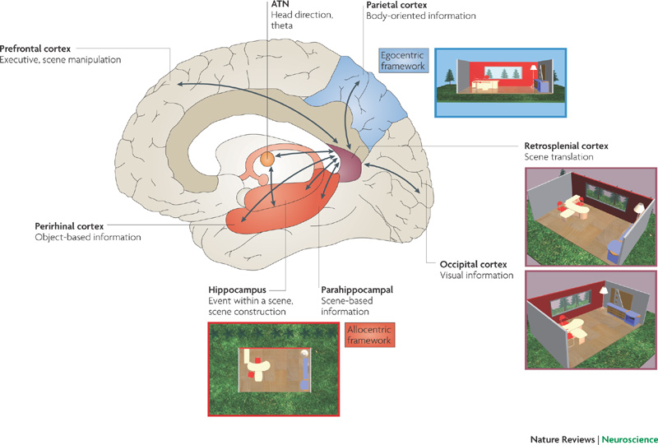
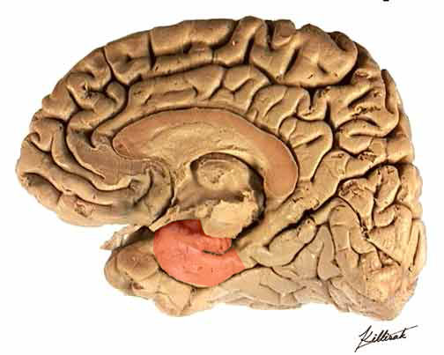
Brain Mapping
Retrosplenial cortex converts between allocentric (environment-bound) representations in hippocampal-entorhinal regions to egocentric representations in posterior parietal cortex.
Parahippocampal cortex supports the recognition of specific views

Slide 7
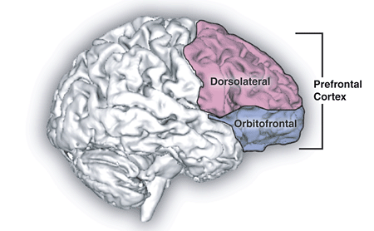
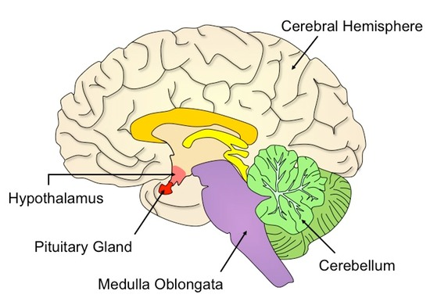
Brain Mapping
Prefrontal cortex is thought to aid route planning, decision-making and switching between navigation strategies.
The cerebellum is required when navigation involves self-monitoring motion.

Slide 8
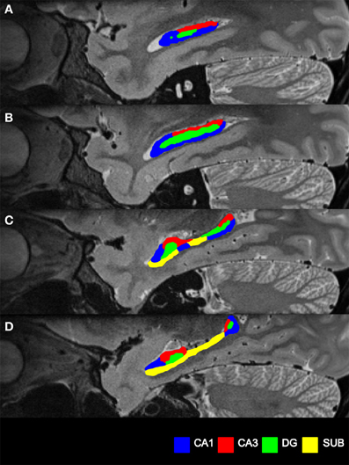
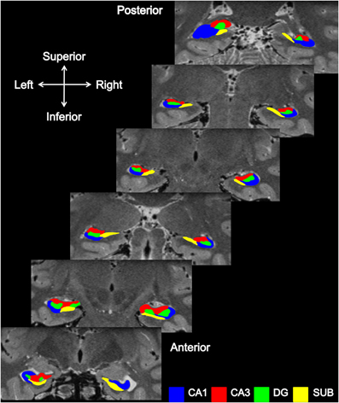
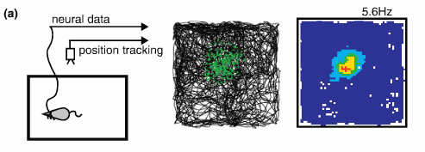
Neural Representations
Place cells found in hippocampal regions CA3 and CA1 signal an animal’s presence in particular regions of space.
Notes:
SfN poster about how place cells fire regardless of distance travelled– they fire in the same spot even in the presence of a valley. This allows one to posit that place cells are operating in allocentric space.

Slide 9
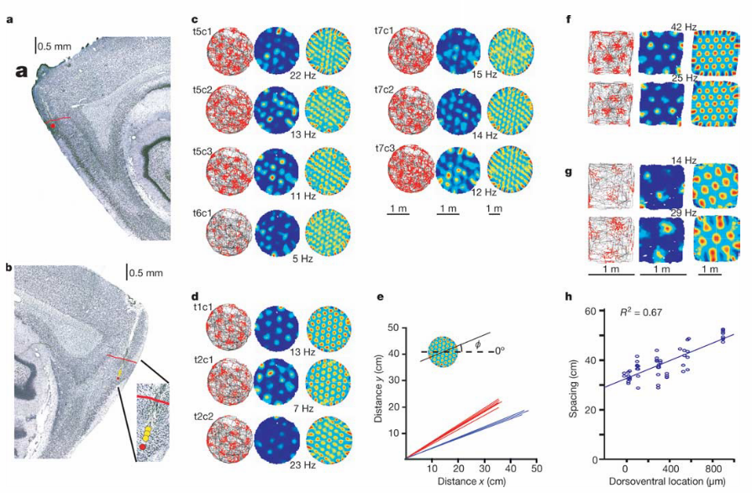
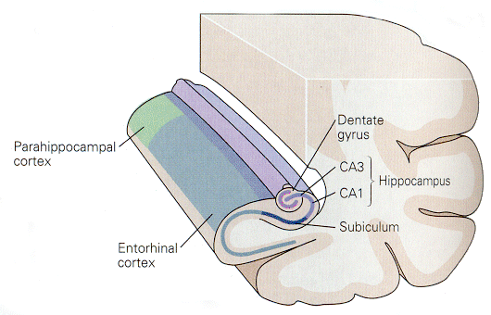
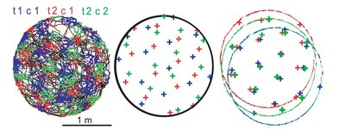
Neural Representations
Grid cells, identified in entorhinal, pre-subiculum, and para-subiculum signal self-location, but repeatedly in hexagonal arrays across an environment.

Slide 10
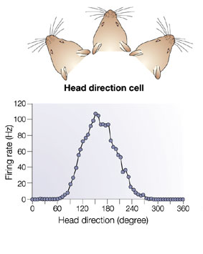
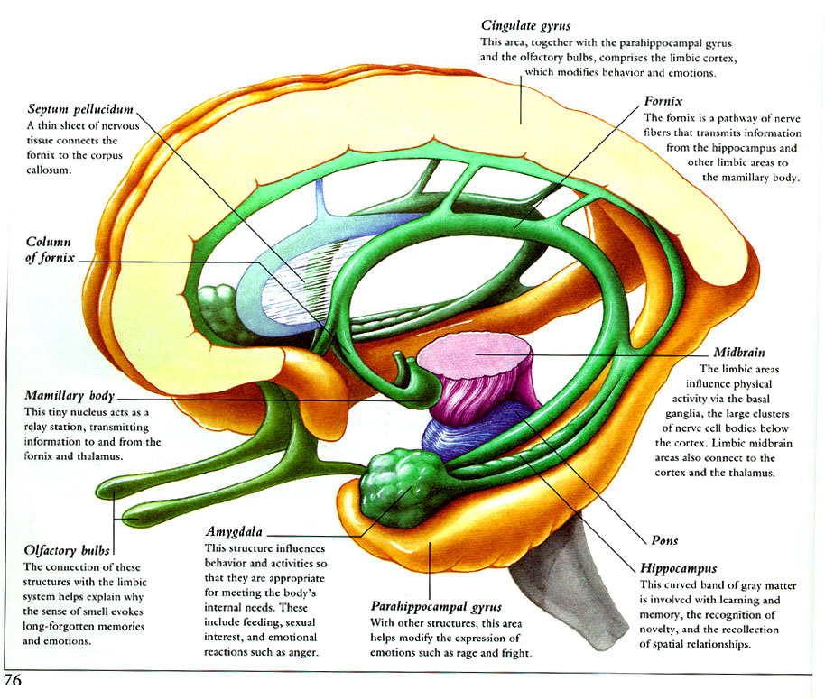
Neural Representations
Head Direction cells found in the post-subiculum, retrosplenial, thalamus, mammillary nuclei, striatum, and entorhinal cortex provide a signal facing direction, where each cell responds only when an animal’s head is within a narrow range of orientation in the horizontal plane.

Slide 11

Neural Representations
Boundary Cells are found in the subiculum and entorhinal cortex and respond only when an animal is in the presence of an environmental boundary.

Slide 12
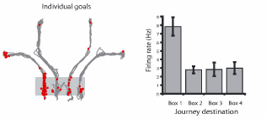
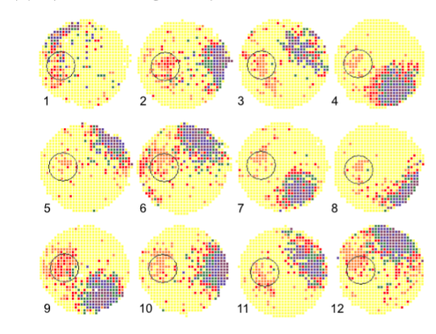
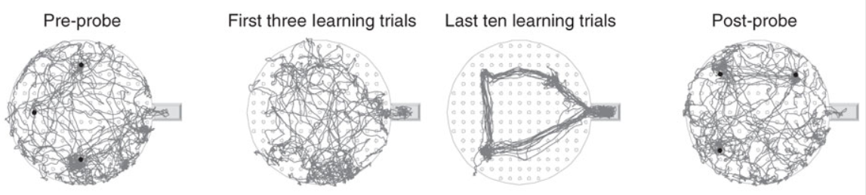
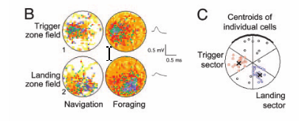
Reaching Goals
Error in the head-direction and place cell systems predict the bearing rats take when attempting to reach a goal.
Place cells can also encode intended destination while at a starting location
CA1, but not CA3 showed shifts in firing towards newly learned goal locations.
Ainge, 2007
Dupret, 2010
Hok, 2007
Pre-limbic frontal cortex shows activity clustered around goal locations in open areas when void of visual cues.
Hok, 2004
Notes:
How do these mechanisms and brain regions allow us to actually accomplish something? In the case of navigation, it’s reaching goals.

Slide 13
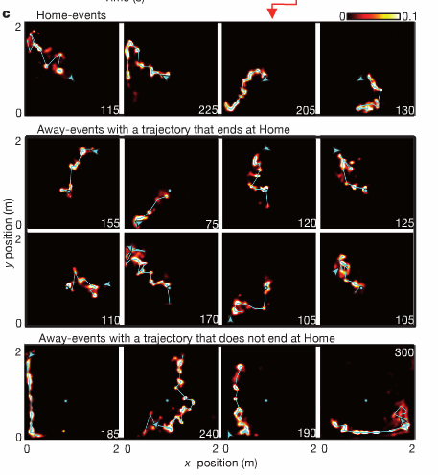
Reaching Goals
Before goal-directed navigation, the rat hippocampus (CA1) generates brief sequences encoding spatial trajectories strongly biased to progress from the subject’s current location to a known goal location. This could be seen as a “trajectory finding mechanism”.
Notes:
Hippcampus is identifying important places and relevant behavioural paths
We identified candidate events as brief increases in population spiking activity during periods of immobility while the rat performed the task (Fig. 2a) and applied the decoding algorithm to the population spike trains (Fig. 2b). During many candidate events, decoded position revealed temporally compressed, two-dimensional trajectories across the environment

Slide 14
Computation
Path integration / dead-reckoning uses recent motion, expressed as a vector, to update an allocentric representation of self-location.
Navigation requires the calculation of the vector between two allocentric locations.
Notes:
How can we take where we are, where we know our goal is and get there….updating along the way.

Slide 15
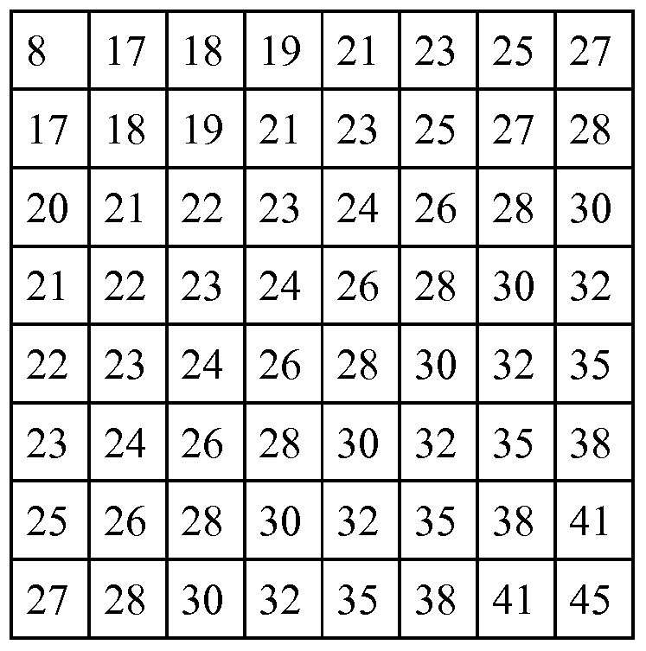
Computation
Perhaps CA3’s recurrent collaterals allow for place cells with nearby fields to strengthen connections. This could aid in path-integration.
Hebbian Plasticity Likely
Hebbian Plasticity Impossible
Notes:
minimizing the sum of the synaptic resistances along a path in neural space yields the shortest (optimal) path in unobstructed two-dimensional space, so long as the connectivity of the network is great enough
But what about short-cuts?

Slide 16
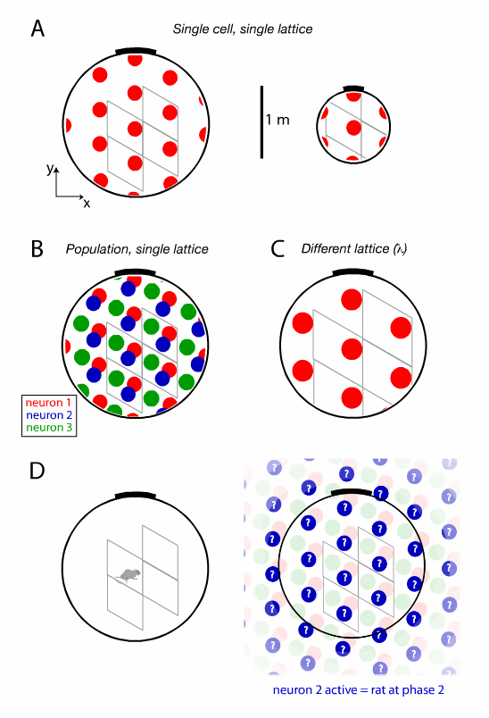
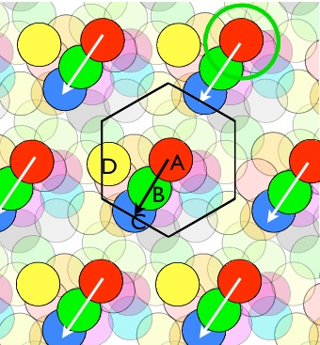
Computation
Grid cells’ repetitive firing fields are a cumulative representation of self-motion cues.
Entorhinal cortex has a unique combinations of fields and the contribution of head-direction cells.
Notes:
minimizing the sum of the synaptic resistances along a path in neural space yields the shortest (optimal) path in unobstructed two-dimensional space, so long as the connectivity of the network is great enough
But what about short-cuts?

Slide 17
Computation
The Hippocampal Map receives two streams of information from the MEC about the animal’s location in its surrounding
fixed landmarks
self-motion signals
The hippocampus can be viewed as a “final-common-pathway” for signals arriving along the two streams.
MTL should compute allocentric direction then send off for conversion to egocentric direction to guide body movement through space
ERC should contain allocentric spatial parameters
Hippocampus should reflect route based variables.

Slide 18
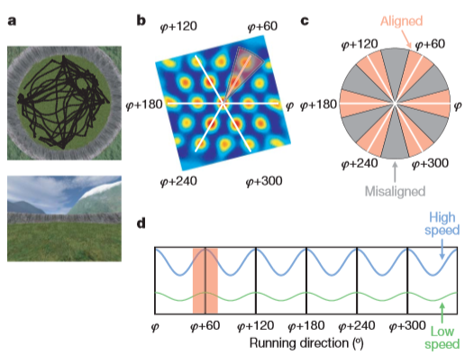
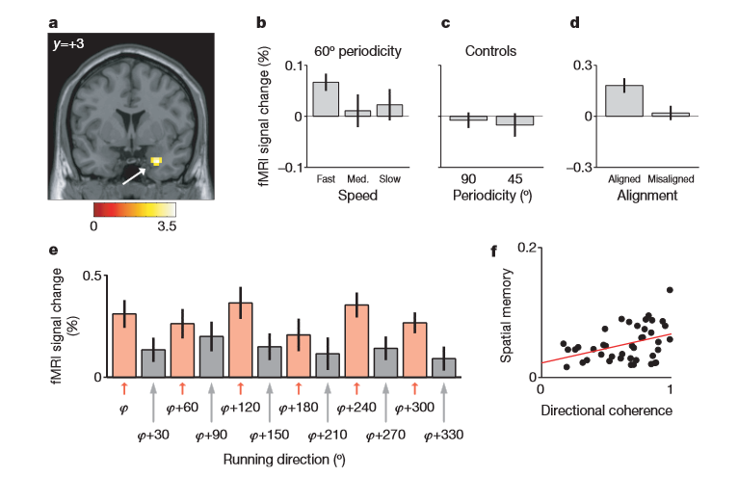
Insights from fMRI
At the neural level, it is still too early to predict how the activity of individual grid cells might be modulated during navigation. However, with the population level accessible to fMRI, it seems plausible that metabolic activity in [brain areas necessary for navigation should correlate with specific spatial parameters].
Notes:
Directionally modulated grid cells. Angular orientation of grids relative to the environment appears to be constant across ells, whether they are neighboring or further apart and rotate coherently when salient distal cues are rotated.
Faster speed = more time to align during a single TR

Slide 19
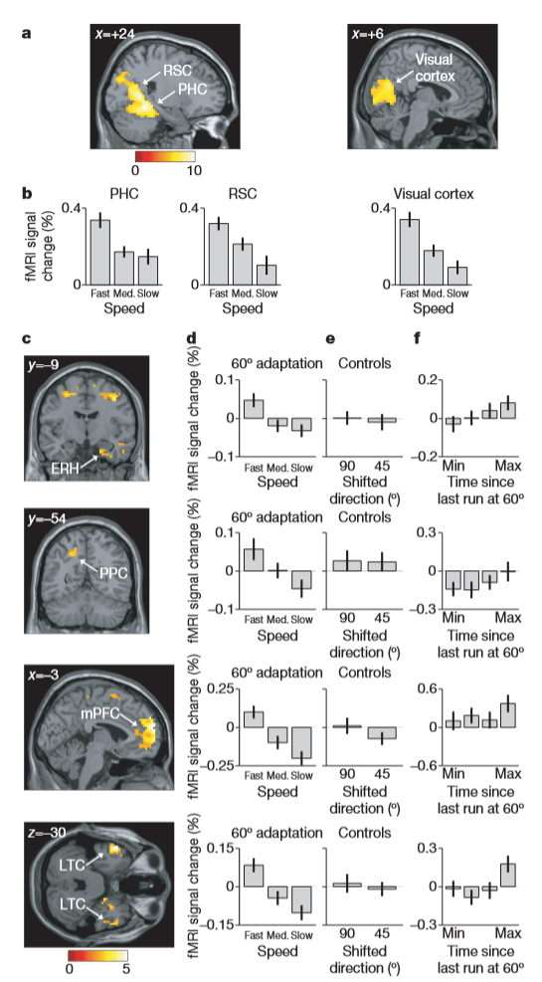
Insights from fMRI
Notes:
regressor: log[time since last run in current direction]

Slide 20
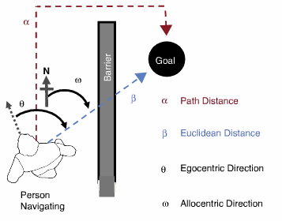
Insights from fMRI
Mid to anterior hippocampus increases activity at the start of navigation when route planning was required.
Posterior hippocampal activity is correlated with path distance
ERC activity of London taxi drivers was positively correlated with the Euclidean distance to the goal during virtual navigation.
  ERC codes an allocentric vector to the goal.
Notes:
regressor: log[time since last run in current direction]

Slide 21
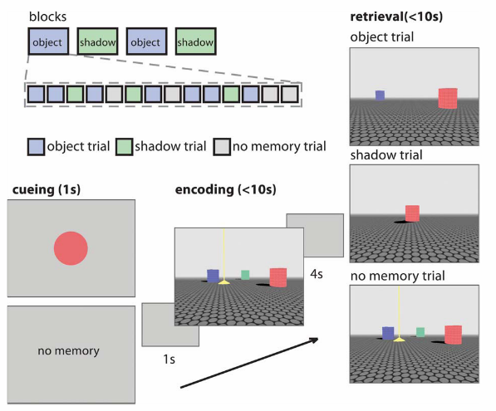
Insights from fMRI
Caudate activity when only one landmark
Hippocampal activity with a configuration of objects
Wegman, 2014

Slide 22
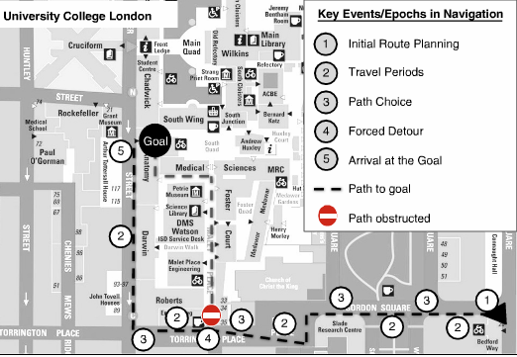
Insights from fMRI
At path “choice points”, hippocampal activity is negatively correlated with the distance to the goal.
  Increased place cell activity clustered near goals?
  Time Cells?
During “travel”, hippocampal activity was positively correlated with distance to the goal.
  Updating distance is harder when further?
    More retrieval demands.
  More population firing from “trajectory finding mechanism”
      Does Hippocampus only retrieve stored knowledge of an environment?
*effects only seen during goal-directed navigation. Simply being led to the goal does not elicit these effects.
Notes:
Time cells code for time elapsed during navigation
Hipocampal cell firing is modulated by rewards.

Slide 23
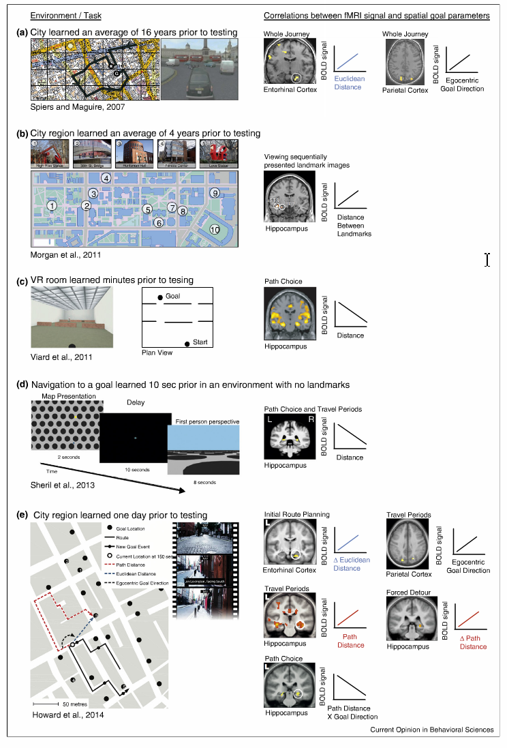
Insights from fMRI
Activity patterns in posterior parietal cortex is associated with the egocentric direction to the goal during travel periods.
Notes:
Time cells code for time elapsed during navigation
Hipocampal cell firing is modulated by rewards.

Slide 24
Insights from fMRI
Novel vs. Familiar
Learning a virtual environment activates different hippocampal areas than those activated during recall when learning is fully established.
Hippocampal formation – recently acquired spatial knowledge*
Extra-hippocampal – engaged in recall of remote spatial knowledge
Patients with hippocampal / MTL damage cannot learn to navigate in a novel environment, but are able to navigate in environments learned before damage.
*not limited to recent.
Notes:
*maquire showed that bilateral hipp damage was still able navigate by means of main or principal routes

Slide 25
Insights from fMRI
Egocentric (Online and Offline) vs. Allocentric
A specific representation depends on task requirements. Is navigation guided or free? Are they replaying a route? Are there obstacles? Shortcuts needed?
Anterior hippocampus – more active when participants acquired allocentric representations.
Posterior hippocampus – more active when participants used the learned allocentric representation.
Parahippocampus (PPA most likely) – egocentric navigation related to landmark knowledge.
Parietal (precueneus, cuneus, IPL) – egocentric spatial representation.
Retrosplenial – Egocentric heading direction (heading vectors).
Notes:
Offline – judge order of two landmarks along a street. Recognie appearance.
Online – requires navigation along habitual routes by means of mental imagery.

Slide 26
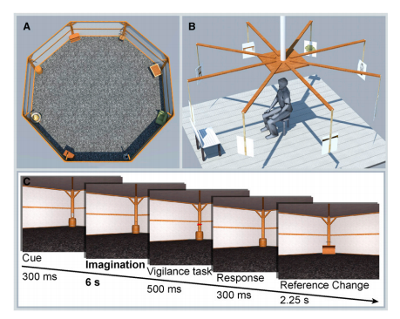
Insights from fMRI
Egocentric (Online and Offline) vs. Allocentric
Egocentric unseen space (head direction) is represented by patterns of voxel activity in parietal cortex, independent of visual information.
Schindler, 2013
Notes:
Offline – judge order of two landmarks along a street. Recognie appearance.
Online – requires navigation along habitual routes by means of mental imagery.

Slide 27
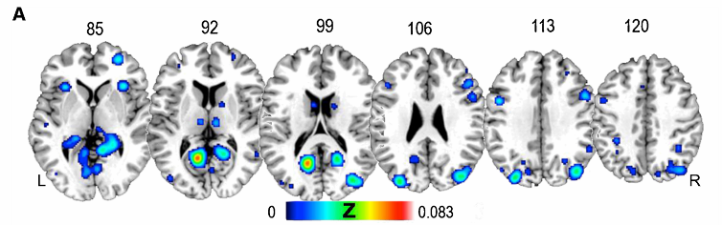
Insights from fMRI
Widespread areas subtending to the human ability to orient navigation.
MTL, parietal, occipital, cerebellum, frontal lobe.
parahippocampus, anterior cerebellum, precuneus, SPL, IPL, superior/middle occipital gyrus, medial and middle frontal gyrus, IFG, precentral, lingual, caudate
Notes:
META ANALYSIS

Slide 28
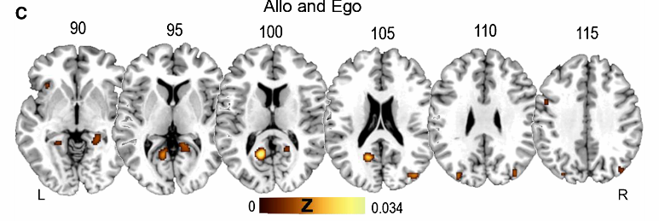
Insights from fMRI
Activation for both familiar and recently learned environments.
Parahippocampus, Precuneus, Superior Parietal Lobule
Hippocampus, cuneus, middle occipital, lingual gyrus, IFG, SFG, MFG
Notes:
META ANALYSIS

Slide 29
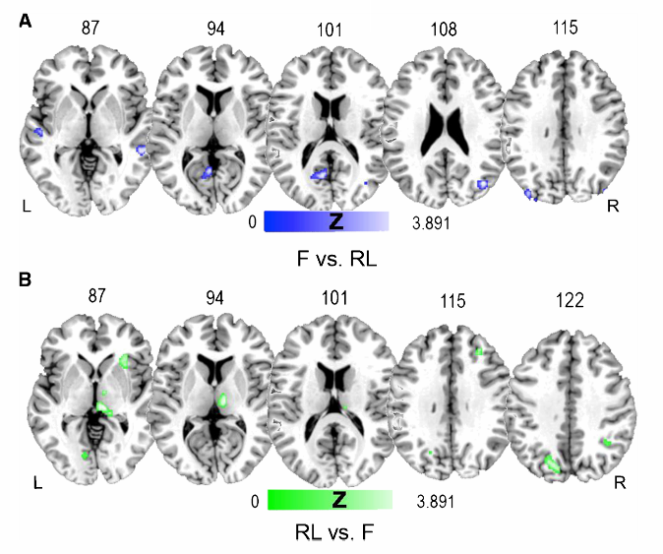
Insights from fMRI
Activation contrasting familiar and recently learned environments.
Familiarity – middle temporal gyrus, posterior cingulate, MFG, superior temporal gyrus.
Novel – parahippocampus, precuneus, insula, IPL, cuneus, precuneus, lingual.
Notes:
META ANALYSIS

Slide 30
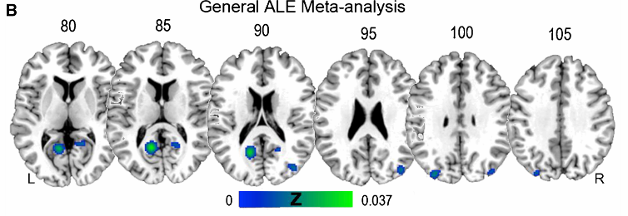
Insights from fMRI
Activation for both egocentric and allocentric spatial strategies.
Parahippocampus, Occipital, Posterior Cingulate
Superior middle gyrus, superior temporal gyrus, cingulate gyrus, precuneus, middle frontal, anterior cingulate, MFG, IFG, IPL, Superior occipital gyrus.
Notes:
META ANALYSIS

Slide 31
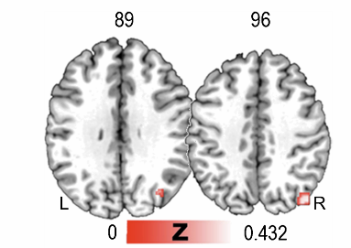
Insights from fMRI
Activation contrasting egocentric and allocentric spatial strategies.
Egocentric – parieto-occipital network that includes R superior occipital gyrus, angular gyrus, and precuneus.
Allocentric – nothing.
Superior temporal gyrus makes use of allocentric representations through the processing of categorical spatial relations.( van Asselen, 208).
Notes:
Allocentric recruits a subset of areas also used by egocentric, but egocentric has a dedicated network. This may be driven by heading direction.
Imitation in that ecological egocentric navigation should depend heavily on internally generated cues (idiothetic cues– proprioception, vestibular, optic flow). Could account for the lack of a more widespread dissociation.

Slide 32
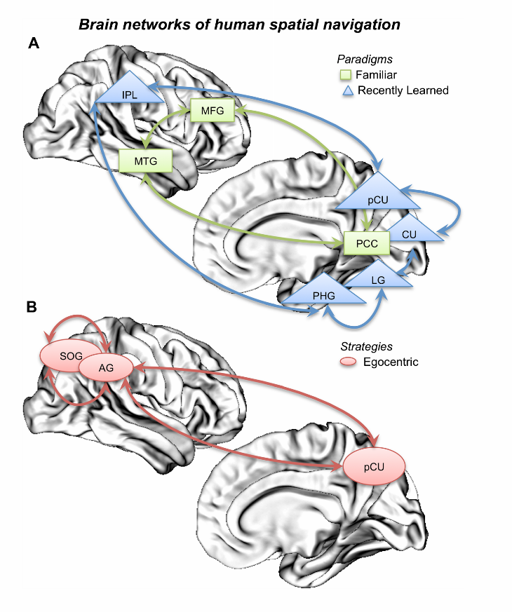
Brain Mapping
Notes:
Parahipp, fusiform, and lingual code and store environmental information.
MFG, posterior cingulate, and superior temporal gyrus recall the stored information.
Posterior cingulate transforms information from allo to ego during navigation attempts.
Frontal areas involved in planning routes.

Slide 33
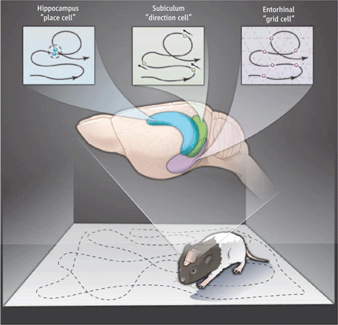
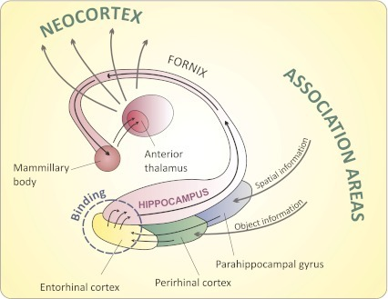
Brain Mapping

Slide 34
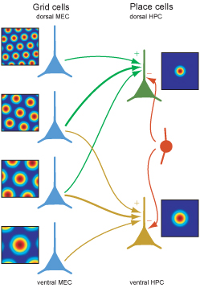
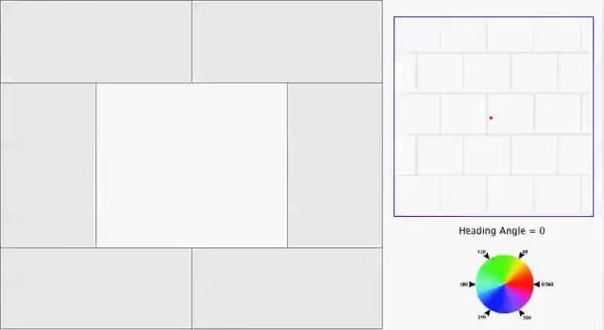
Grid Theories

