Slide 1





The structural scaffolding of functionally defined networks predicts individual differences in cognitive function
Nicco Reggente & Jesse Rissman
University of California, Los Angeles

Slide 2
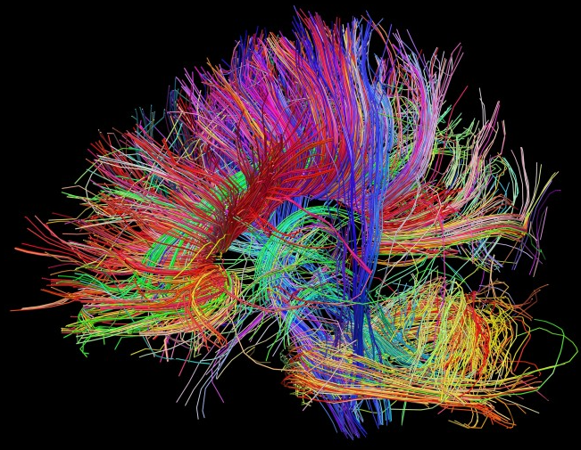
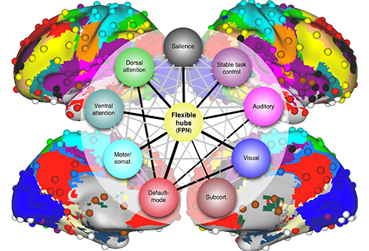

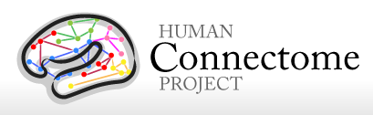
Overview
Notes:
Use DTI data –click-
From the human connectom project –click-
To recreate structural equivalents of functionally defined networks –click-
To predict individual differences in cognitive function

Slide 3
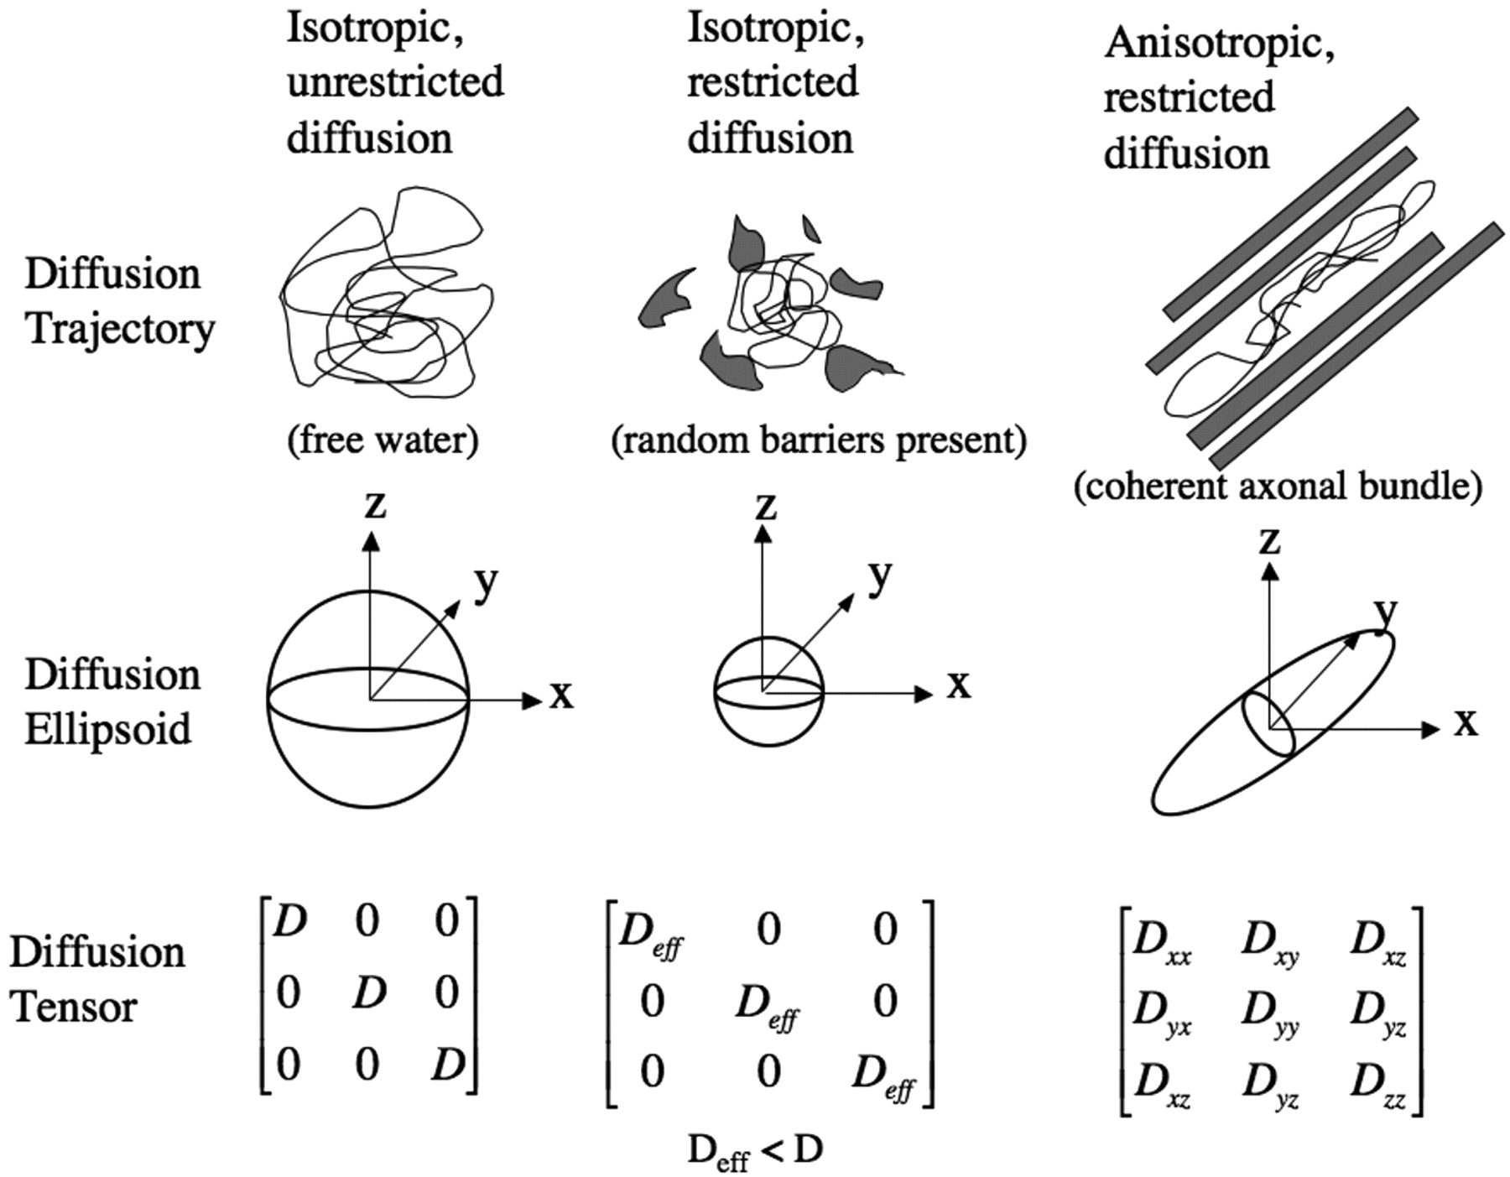
Diffusion Tensor Imaging
Calculates the preferred directionality of water diffusion within each voxel
Indicative of the structural makeup of that voxel.
Mori & Tournier, 2014
Notes:
DTI measures the preferred diffusion of water within a voxel …which allows us to make inferences regarding the underlying structural makeup of that voxel.
By looking at the inter-voxel relationship of preferred directionality, we can use –click--

Slide 4
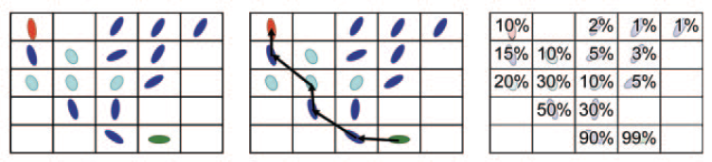
Probabilistic Tractography
Examining the inter-voxel relationship of preferred directionality, we can asses each voxel’s structural connectivity with every other voxel in the brain.
Nucifora et al., 2008
Notes:
probabilistic tractography algorithms to determine the structural connectivity between voxels.
In this study, we used probabilistic tractography to examine patterns of anatomical connectedness of voxels within select ROIs
The end product of a probabilistic tractography algorithm is a whole-brain anatomical connectivity map for relative to each ROI..-click-

Slide 5
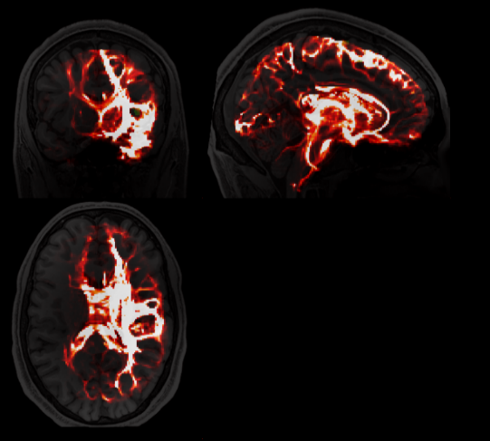
Probabilistic Tractography
Each voxel’s value reflects the Anatomical Connectivity Index
of that voxel with the seed ROI
Whole brain probabilistic tractography maps from a seed region (circled in blue)
Notes:
If we overlay ROIs onto this resulting map, we can then asses the degree to which that region (a “target”) is anatomically connected with the “seed” that was used to create the map.

Slide 6
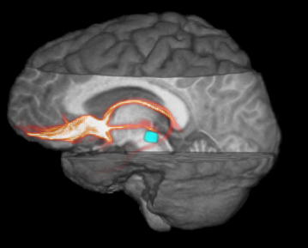
Motivation
Reggente et al., 2013
Notes:
For instance, we see here the anatomical connectivity of the Nucleus Accumbens with the VTA, key nodes in the dopaminergic reward system.
At SfN last year, I showed that the varying strength of connectivity between these regions served as a significant predictor of a subject’s ability to implement a reward based memory encoding strategy.
However, in the current study, we aimed to use a similar structural connectivity workflow to explain individual differences in…-click-

Slide 7
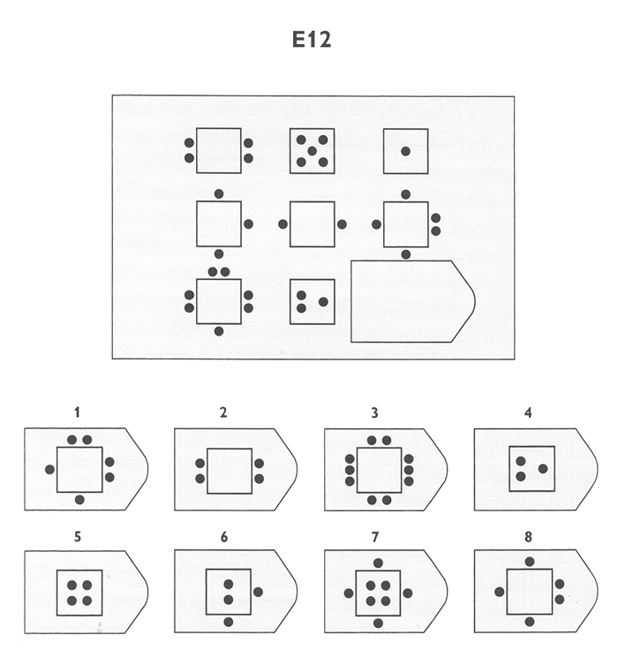
Fluid Intelligence
Raven’s Progressive Matrices
Bilker WB, et al. (2012)
Notes:
Fluid intelligence is typically regarded as a domain-invariant measure of one’s ability to quickly reason and think in an abstract manner.
The Raven’s Progressive Matrices has been widely cited as a respectable measure of fluid intelligence. This task involves identifying abstract patterns and exemplifying your ability to extrapolate that pattern to its next logical step.
HCP gathered Raven’s scores for each subject for whom they provided DTI data for.
--
Scientists and psychologists have been in long pursuit of finding the correlates of individuals on tasks such as Raven’s that measures Fluid Intelligence.
Genetics, cortical thickness, cortical volume, functional connectivity, socioeconomic upbringing, and many other factors have all been used to try and predict individual differences in intelligence.
In this study, we will be making use of the integrity of an individual’s structural connectivity to account for those differences.
Particularly we will not be looking at the connectivity across just two nodes, but instead within prominent brain networks.

Slide 8
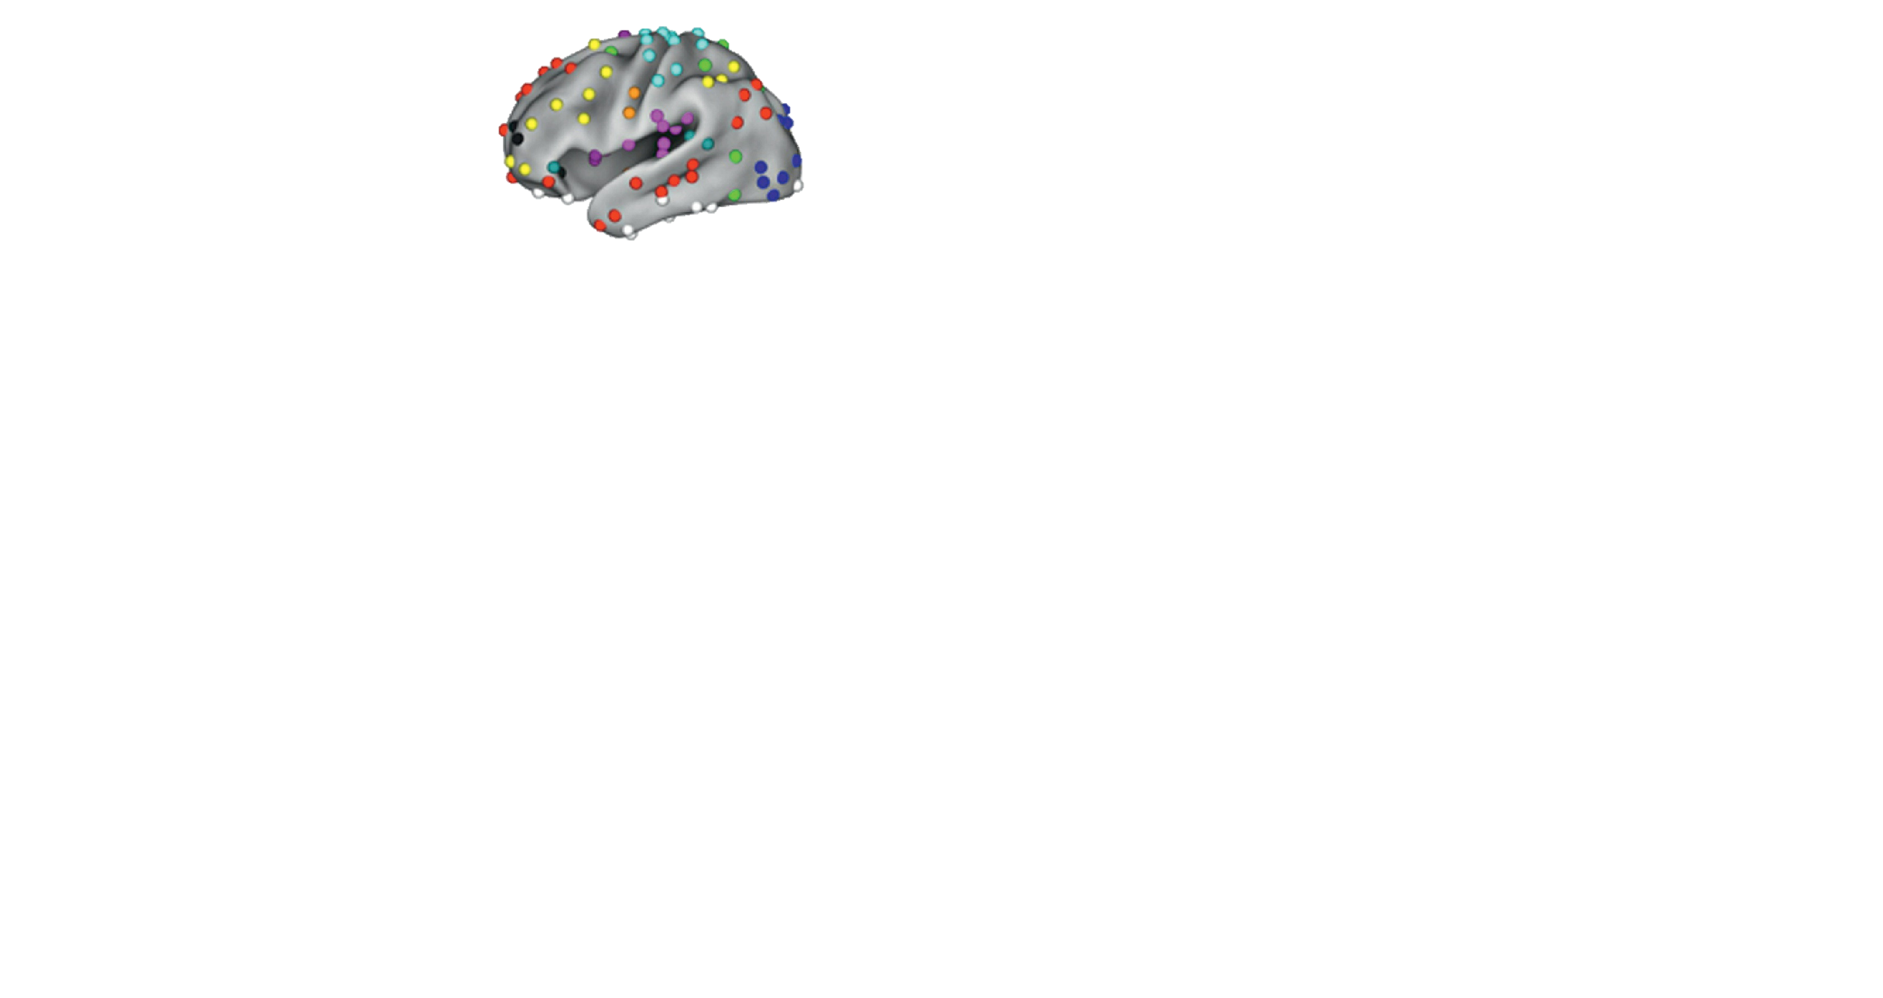
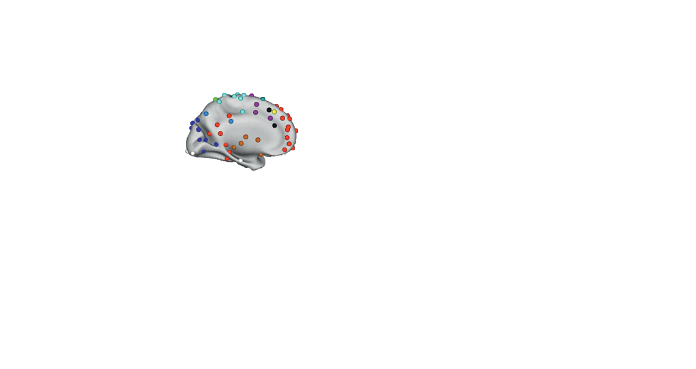
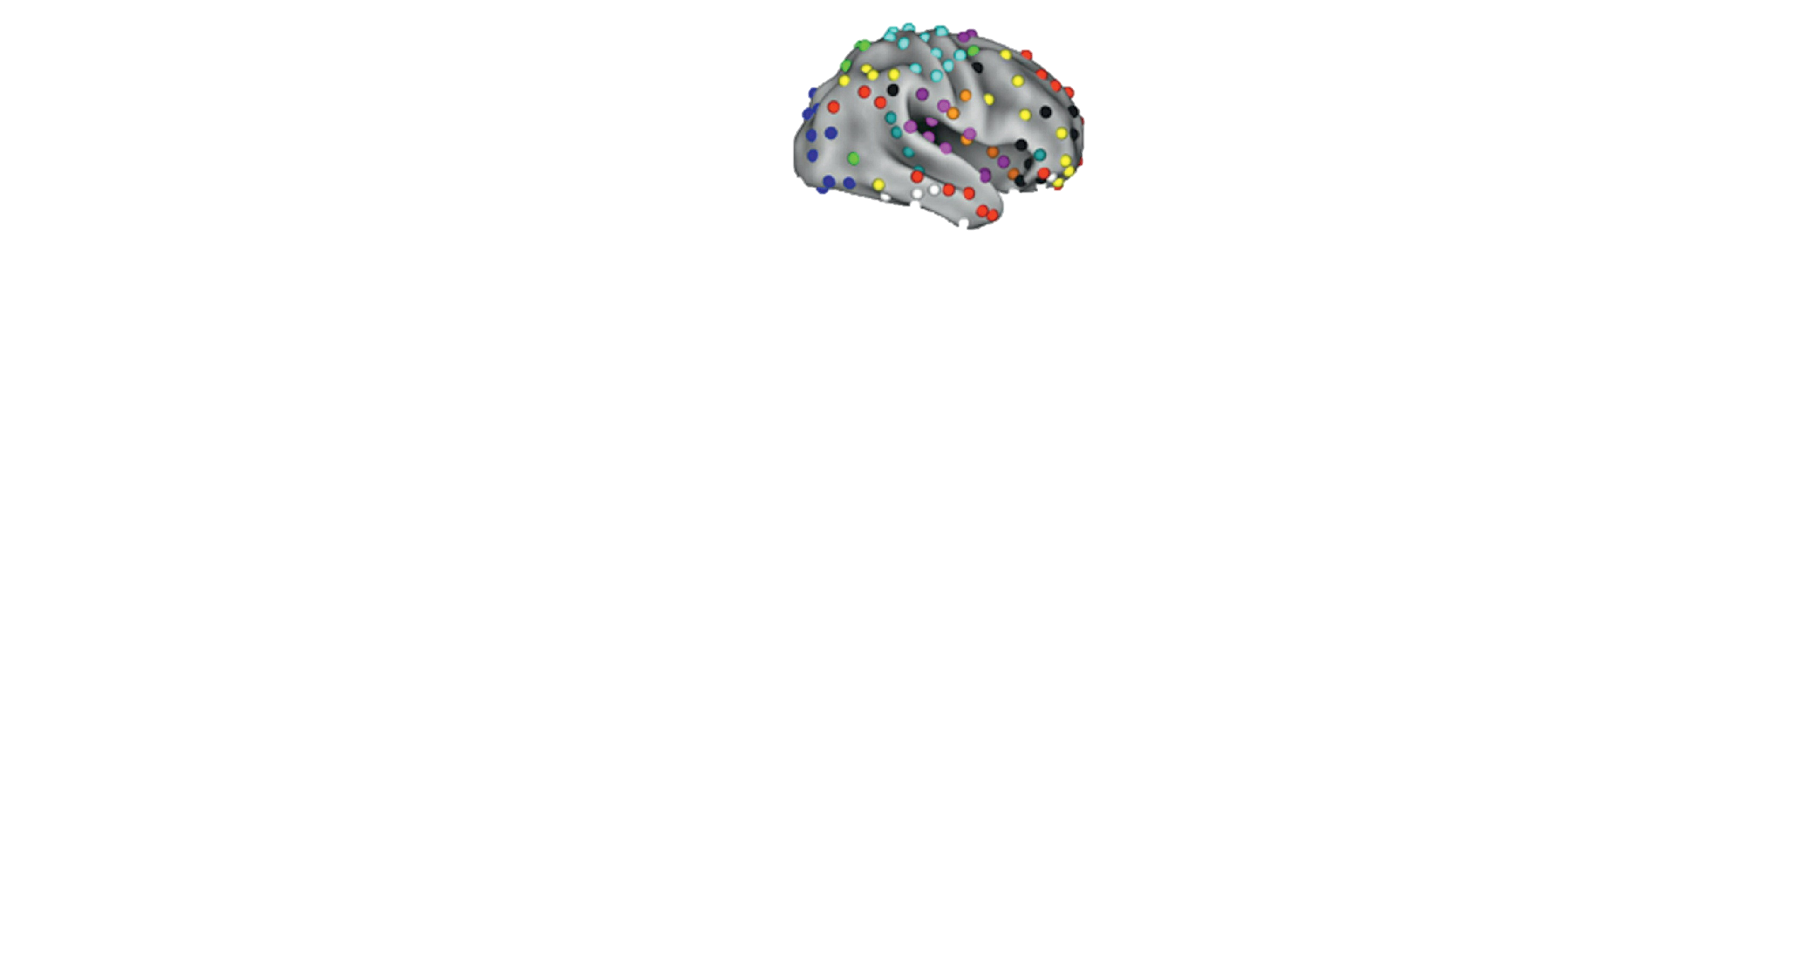
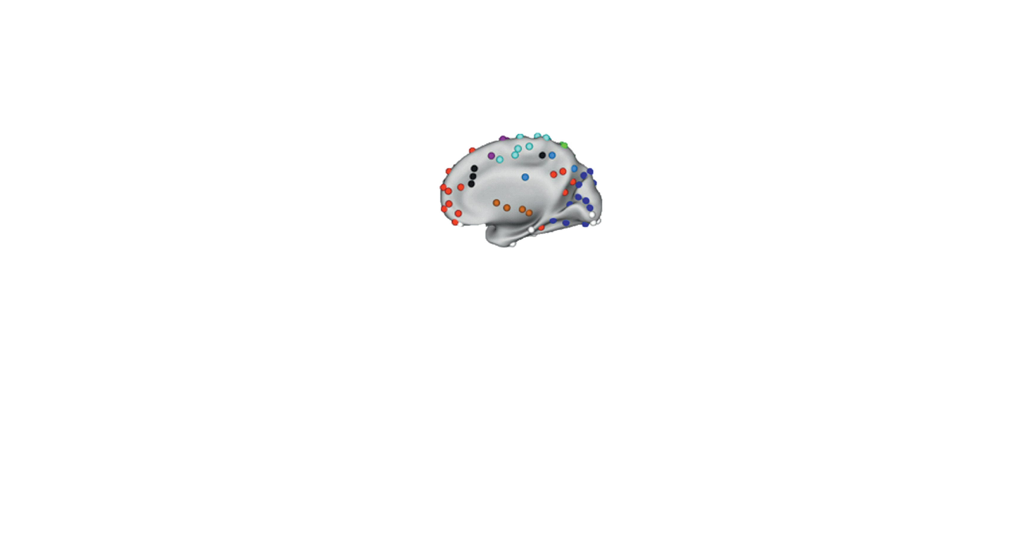
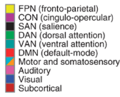
Networks of Interest
Power, J.D, et al. (2011)
Notes:
We examined the structural connectivity between 264 distinct nodes based on a meta-analysis conducted by the Petersen lab and his team at Washington University.
They have classified these nodes into a distinct set of networks based on their task-based functional-connectivity properties.
We hypothesized that the structural connectivity within these networks could represent the ease with which the composite nodes could be recruited for their respective cognitive tasks.
Particularly, we suspect that structural connectivity within networks responsible for executive cognitive control such as the Cingulo Opercular Network (shown here in purple) and the Fronto Parietal Task Control Network (shown here in Yellow) would play a significant role in accounting for a behavioral measure like Fluid Intelligence.

Slide 9

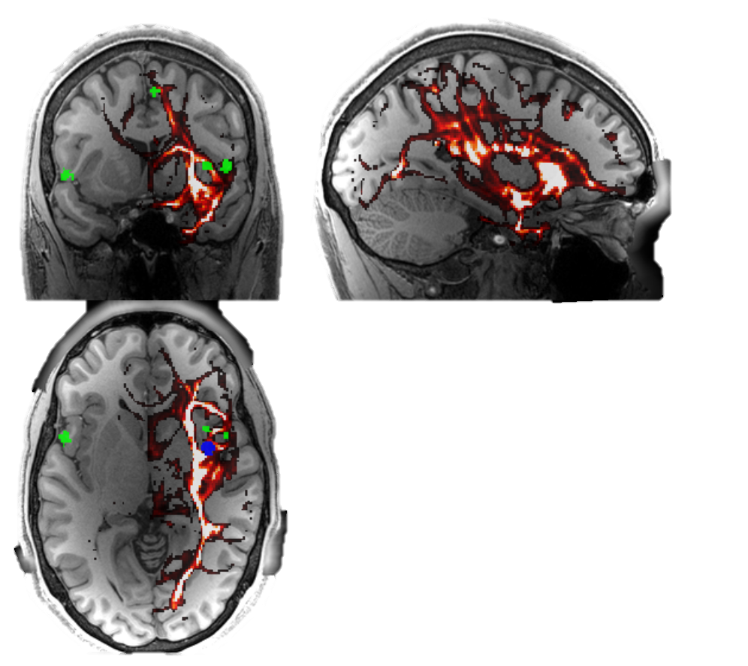
Computing Structural Connectivity within a Network
Seed in the Cingulo-Opercular Network
Targets in the
Cingulo-Opercular
Network
Low
High
Anatomical Connectivity Index
Notes:
In order to compute a network’s connectivity, we iteratively used each node in the network as a seed and computed its anatomical connectivity index with every other node in its network.

Slide 10
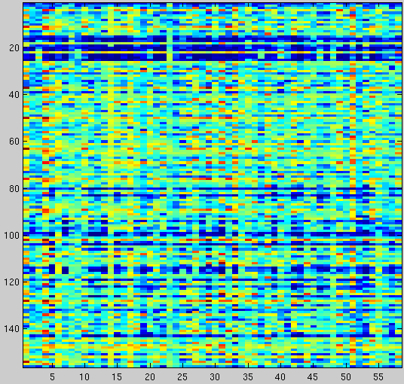
Methodology
Pairwise structural connectivity values
LASSO Regression with Elastic Net regularization
Leave-one-subject-out cross-validation
Each predicted left-out subject (Ŷ) correlated with actual (Y)
Cingulo-Opercular Feature Set
Pairwise Anatomical Connectivity Values
Subjects (N=60)
Notes:
By implementing the procedure described on the previous slides for each node in a network, we built a feature set for each subject that consisted of the pairwise anatomical connectivity values for nodes within each network.
Reshaped into a single vector for each subject, this feature set is illustrated to the right for all 60 subjects.
We then used these values as features to build a LASSO regression model with Elastic net regularization.
To asses the predictive power of this model, we implemented a traditional leave-one-subject-out-cross-validation where the model was trained on all but one subject and then that model was used to predict the left-out subject’s fluid intelligence score.
Exhaustively, this yields a vector of predicted fluid intelligence which can then be correlated with the actual fluid intelligence scores and squared to yield an R² value which asseses how much of the variance across subjects the model was able to account for.

Slide 11
Results
Which Network?
**
* <.005
** <.0005
Notes:
For something as all encompassing as fluid intelligence, it’s plausible that connectivity across all nodes would serve as a potent predictor.
However, as we see here, when using the all 264 nodes as one network, the classifier can't differentiate signal from noise.
only nodes that belong to a network that shows classic functional connectivity allow for an informative prediction.
The numbers next to the networks reflect the number of nodes in that network.

Slide 12
Results
Across Network Connectivity
***
**
**
*
* <.005
** <.0005
***<.0001
Notes:
The Cingulo Opercular Network has been shown to modulate recruitment of the Default Mode Network, so we decided to examine the degree to which structural connectivity across nodes in these networks predicted the variance in fluid intelligence.
If we just concatenate the features, no more predictive power. If we just look at the connections between, no more predictive power.
Sure enough, when creating a feature set that consisted of structural connectivity values within the CON, within the DMN, and across the two networks, our model predicts 27% of the variance in fluid intelligence, our statistic with the lowest p-value.
This allows us to

Slide 13
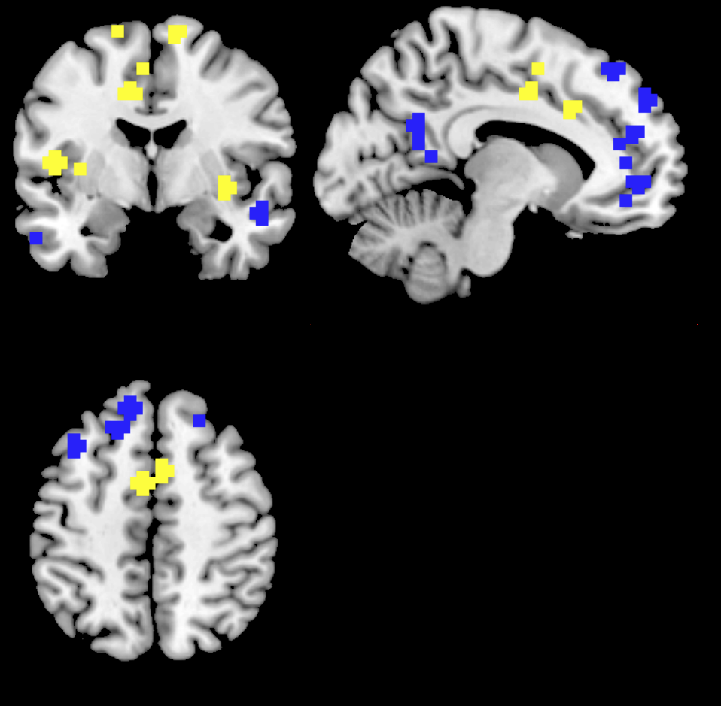
Cingulo-Opercular network‘s structural connectivity with the Default Mode Network accounts for 27% of the variance in individual differences in Fluid Intelligence
Default Mode(DMN)
Cingulo Opercular(CON)
Actual Fluid Intelligence Scores (Y)

Slide 14
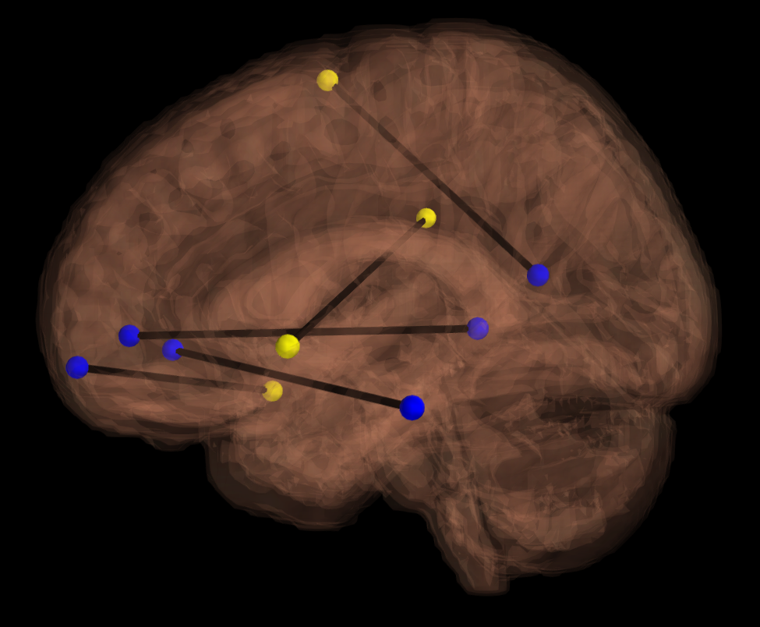
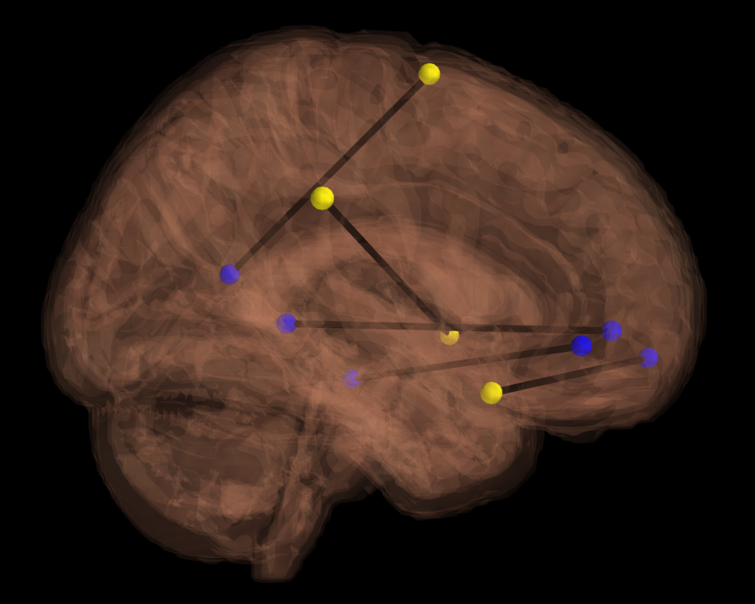
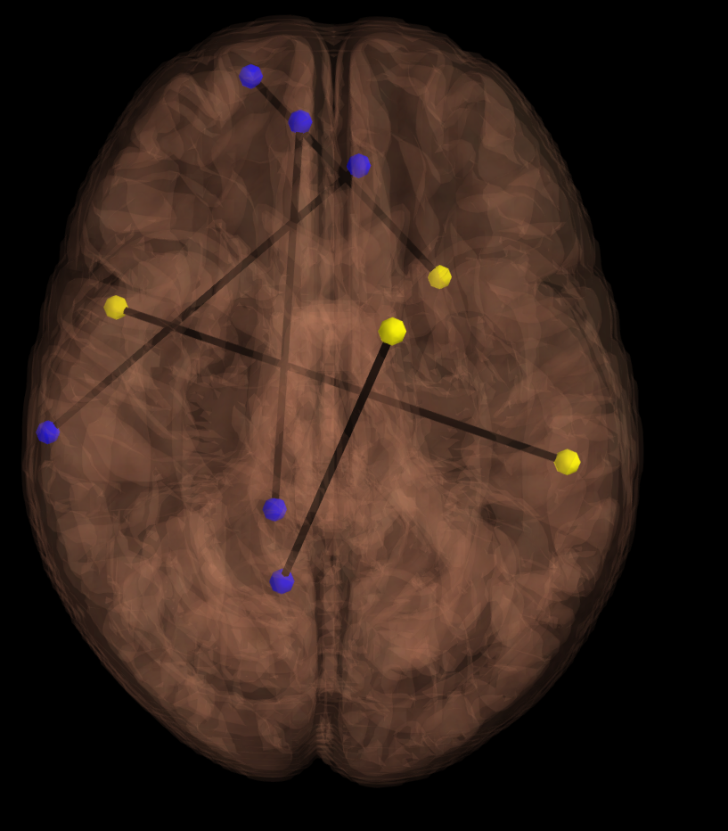
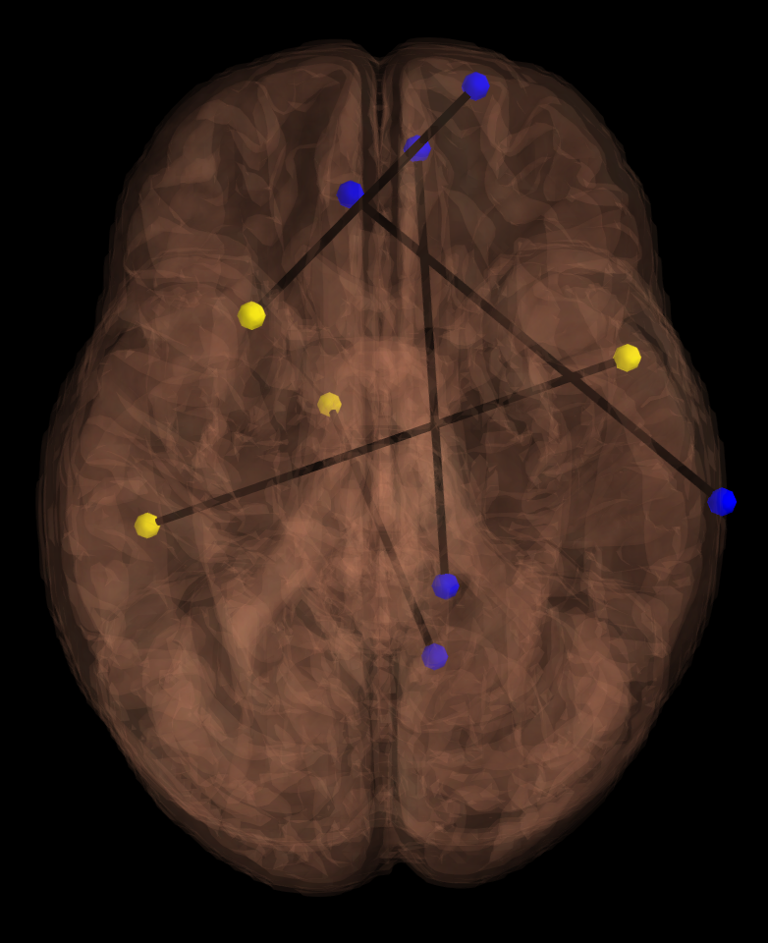
Most important connections
within and across DMN and CON
Notes:
Effect remains for a spearman correlation
----- Meeting Notes (11/12/14 11:18) -----
photoshop the nodes to be color matched
find and label actual regions that were most common
and label which network they were a part of.

Slide 15
Discussion
Cingulo-Opercular Network (CON) has been shown to support a basic domain-independent and externally directed “task mode” (e.g., Dosenbach et al., 2007)
  Fluid intelligence is also inherently “domain independent”
CON is characterized by its function in maintaining cognitive faculties to be available for task-demanded processing requirements (Sadaghiani & D’Esposito, 2014)
Notes:
First, let’s discuss the role of the CON, itself, in the brain.
Read slide
What does this mean? Well…the literature seems to posit the CON as having this role of a “switchboard” in the brain.
When attention is required for external tasks that are demanding in nature, such as abstract thinking about visuospatial patterns….
the CON not only recruits the proper networks (most likely to be the dorsal attention network), but also deactivates non-necessary networks…
Such as the aptly named “task-negative network”. Also known as the Default Mode Network.
In fact…

Slide 16
Discussion
High IQ has been associated with an improved ability to shut down the DMN in a difficult verbal working memory task (Basten et al., 2013)
Recent theories have emerged that posit dysfunctional interplay between cingulo-opercular networks and default mode network to be the cause of most psychiatric disorders (Menon, 2011)
Notes:
Read first bullet point.
So… perhaps subjects who have robust anatomical connectivity between CON and DMN are more efficient at regulating the DMN in accordance with their goals and, in turn, more capable in regards to complex cognitive tasks

Slide 17

Conclusions
The pattern of structural connectivity within and across functionally defined brain networks may predict the ease with which individuals can efficiently engage these networks during cognition.
Multivariate classification of diffusion tractography data revealed a significant relationship between fluid intelligence and the structural connectedness of the Cingulo-Opercular and Default-Mode Networks
Thanks to HCP, Dr. Jesse Rissman and Amy Zheng!
"Data were provided [in part] by the Human Connectome Project, WU-Minn Consortium (Principal Investigators: David Van Essen and Kamil Ugurbil; 1U54MH091657) funded by the 16 NIH Institutes and Centers that support the NIH Blueprint for Neuroscience Research; and by the McDonnell Center for Systems Neuroscience at Washington University."

Slide 18
Conclusions
  Default Mode reduced activity in individuals with ASD.(Washington, 2014)
    IQ in children with ASD reveals an intellectual disability. (Charman 2011).
    White matter damage in the CON predicts attenuated DMN deactivation and reduced performance in inhibitory control tasks (Bonnelle et al., 2012)
Notes:
----- Meeting Notes (11/12/14 11:18) -----
dorsal ACC for intelligence.
performed on data from 60 subjects but released upwards of 500 subejcts. want to replicate in independent sample.

Slide 19
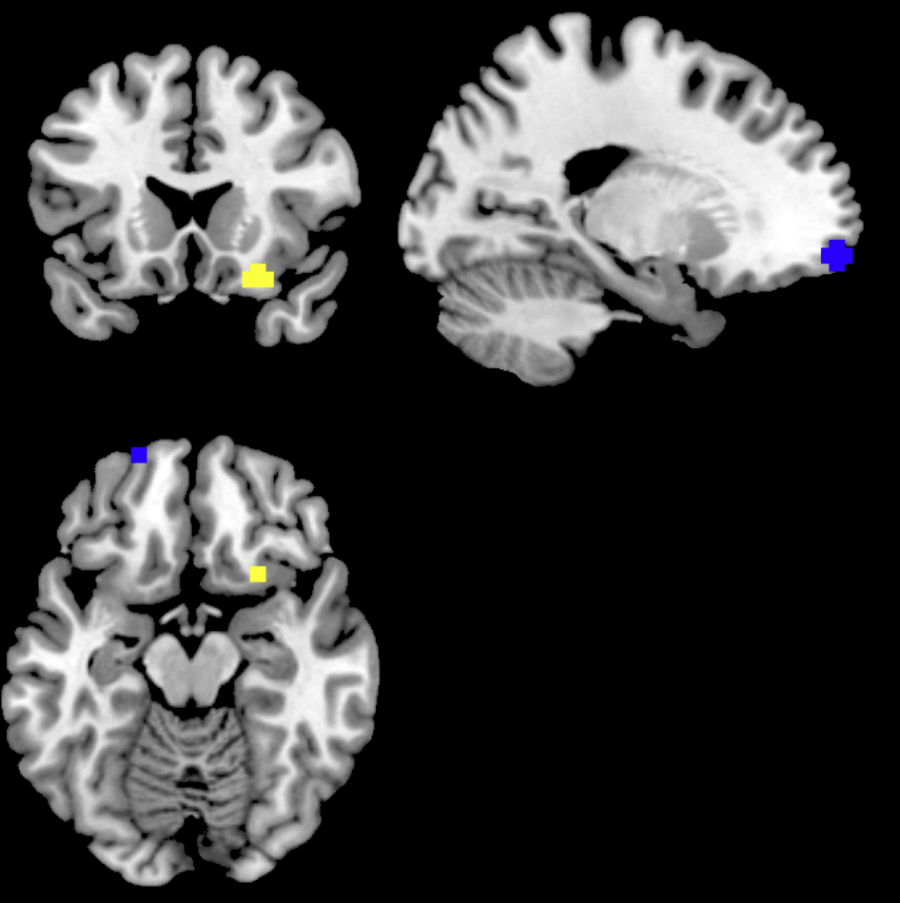
Most important connections
within and across DMN and CON

Slide 20
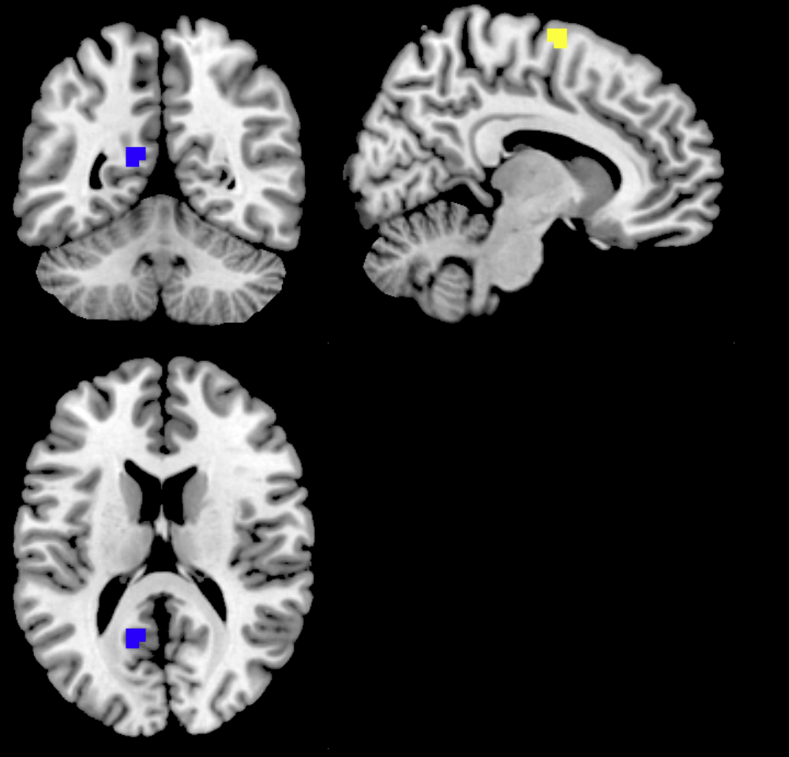
Most important connections
within and across DMN and CON
Notes:
Effect remains for a spearman correlation
----- Meeting Notes (11/12/14 11:18) -----
photoshop the nodes to be color matched
find and label actual regions that were most common
and label which network they were a part of.

Slide 21
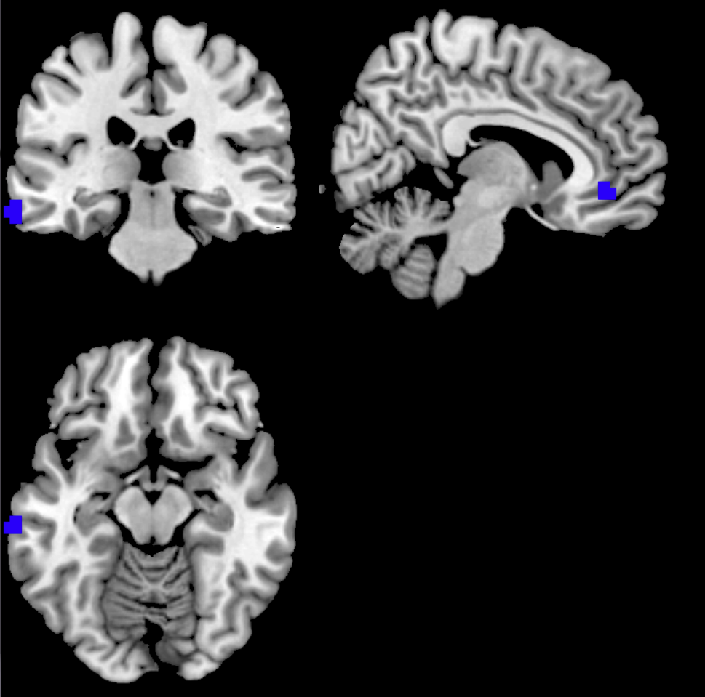
Most important connections
within and across DMN and CON
Notes:
Effect remains for a spearman correlation
----- Meeting Notes (11/12/14 11:18) -----
photoshop the nodes to be color matched
find and label actual regions that were most common
and label which network they were a part of.

Slide 22
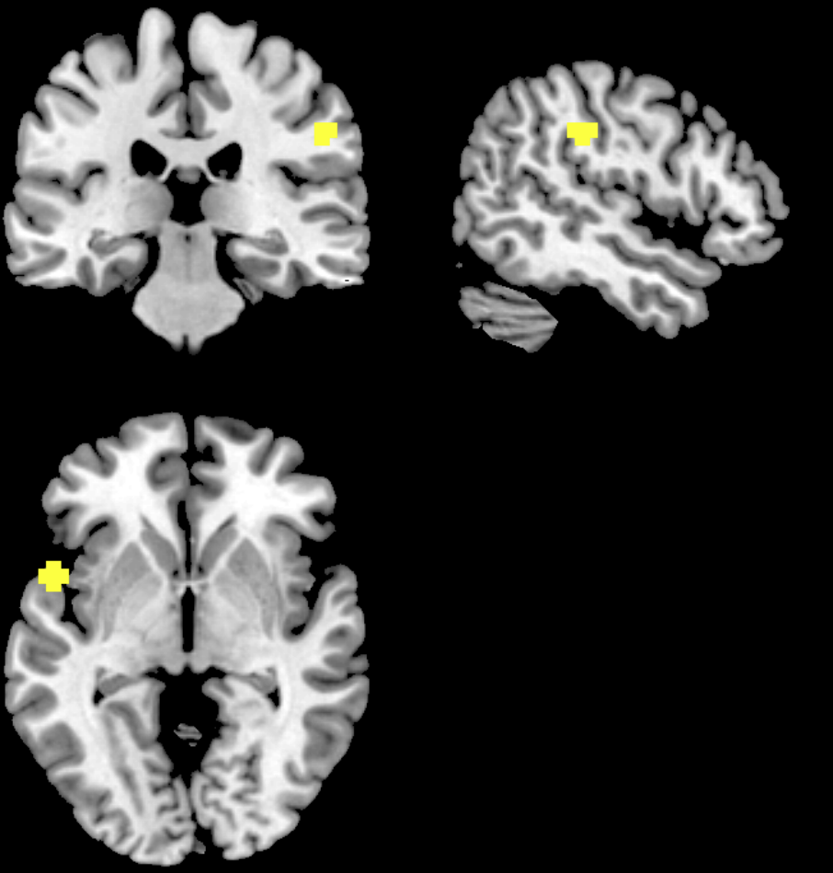
Most important connections
within and across DMN and CON

Slide 23
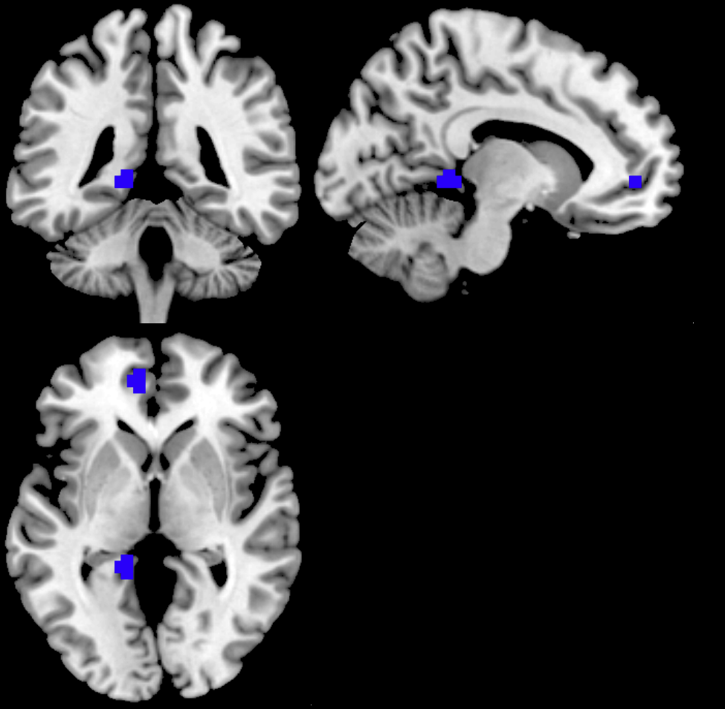
Most important connections
within and across DMN and CON

Slide 24
Results
Which Nodes Within A Network?
*
* <.005

Slide 25
Results
For those who came looking for a talk on reward
Delayed Discounting of 200K
Delayed Discounting of 40K
Notes:
That’s a high r-value of .52

Slide 26
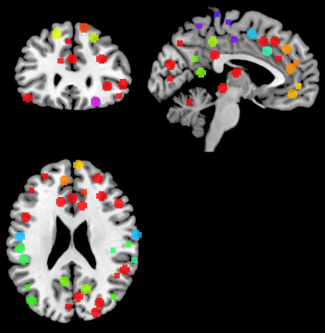
Networks of Interest
Power, J.D, et al. (2011)
Notes:
It seemed fitting that to predict something as domain-invariant as IQ, we need to use not just the connection between two nodes, but instead look at the connectivity within and across networks.
This approach involved looking at the structural connectivity between 264 distinct nodes based on a meta-analysis conducted by the Petersen lab and his team at Washington University.
They have classified critical nodes in the brain [ “hubs” ] into a distinct set of networks based on their task-based functional connectivity properties.
We posited that the structural connectivity within these networks could represent the ease with which the composite nodes could be recruited for their respective cognitive tasks.
Our initial hypotheses were that structural connectivity within networks responsible for executive cognitive control such as the Cingulo Opercular Network (shown here in purple) and the Fronto Parietal Task Control Network (shown here in Yellow) would play a significant role in accounting for a behavioral measure like Fluid Intelligence.

Slide 27
Network Name (# of nodes) | Behavioral Measure | SVR, Ridge, Lasso R²
Cingulo Opercular (14) | IQ | .029,.045,.1431
Cingulo Opercular Left Only (13) | IQ | .007,.00005,.025
Cingulo Opercular Right Only (13) | IQ | .004,.0001,.005
Cingulo Opercular (IntraHemispheric Only) | IQ | .032,.028,.0142
Default Mode (60) | IQ | .05,.01,.21
Default and Cingulo (74) | IQ | .09,.03,.234
Network Name (# of nodes) | Behavioral Measure | Lasso R²
Fronto Parietal(5) | IQ | .035
Memory(5) | IQ | .017
Salience(18) | IQ | .0004
Visual(31) | IQ | .015
Dorsal Attention(11) | IQ | .014
Ventral Attention(9) | IQ | .027

Slide 28
Results
Which Network?

Slide 29
Results
Network-to-network recruitment
Notes:
That’s a high r-value of .52

Slide 30
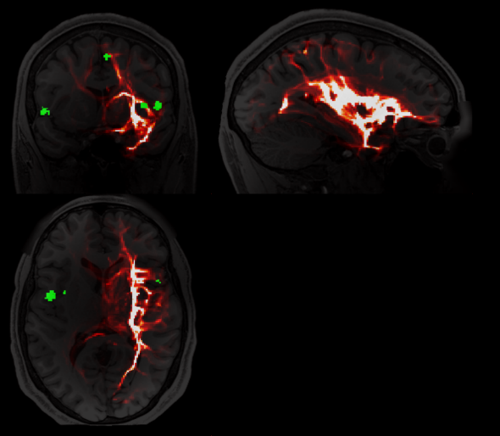
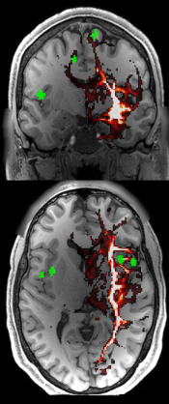
Example Node to Network
Notes:
----- Meeting Notes (11/12/14 11:18) -----
DELETE

Slide 31
Structural connectivity within and across
DMN and CON accounts for 29% of the variance in individual differences in Fluid Intelligence
Default Mode (DMN)
Cingulo Opercular (CON)
Notes:
Effect remains for a spearman correlation
----- Meeting Notes (11/12/14 11:18) -----
look at other measures such as genetics.
put measured on X-Axis
mention z-score

Slide 32
Interpretations
Recent theories have emerged that posit dysfunctional interplay between cingulo-opercular networks and DMN to be the cause of most psychiatric disorders (Menon, 2011)
White matter damage in the CON predicts attenuated DMN deactivation and reduced performance in inhibitory control tasks (Bonnelle, 2012)
Cingulo Opercular has been shown to support a basic domain-independent and externally directed “task-mode”. (Dosenbach, 2007).
  Fluid intelligence is also inherently “domain independent”.
Default Mode reduced activity in individuals with ASD.(Washington, 2014)
  IQ in children with ASD reveals an intellectual disability. (Charman 2011).
Notes:
----- Meeting Notes (11/12/14 11:18) -----
dorsal ACC for intelligence.
performed on data from 60 subjects but released upwards of 500 subejcts. want to replicate in independent sample.

Slide 33
Methodology
Pairwise structural connectivity values
Elastic net regularization with LASSO regression to predict continuous variables
Leave-one-subject-out cross-validation (N=60)
  Predicted each left-out subject (Y) and correlated predicted with actual (Ŷ) (Y vs. Ŷ)
Pairwise Anatomical Connectivity Values
Subjects (N=60)
Cingulo-Opercular Feature Set
Notes:
----- Meeting Notes (11/12/14 11:18) -----
create a new figure that uses less nodes.
creat a slide
Number of features:
Number of Nodes * Number of Nodes -1

Slide 34


The structural scaffolding of functionally defined networks predicts individual differences in cognitive function
Nicco Reggente & Dr. Jesse Rissman
SfN NanoSymposium
Monday November 17,2014

Slide 35
Synopsis
Notes:
Use DTI data –click-
From the human connectom project –click-
To recreate structural equivalents of functionally defined networks –click-
To predict individual differences in cognitive function (particularly fluid intelligence)

Slide 36
Diffusion Tensor Imaging
Calculates the preferred directional of water’s diffusion within each voxel
288 Directions
Mori & Tournier, 2014

Slide 37
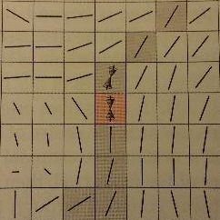
Probabilistic Tractography
For each voxel in a “seed” ROI:
  We can examine the probability of preferred diffusion at each face of the voxel and compute the probability that that preference continues into the neighboring voxel.
We can see if the preference continued along a path that eventually reached a “target” ROI
FSL probtrackx and BESPOST accounts for “crossing fibers”
Nucifora et al., 2008
Mori & Tournier, 2014

Slide 38
Probabilistic Tractography
Whole brain probabilistic tractography maps from a seed region (circled in blue)
Each voxel’s value reflects the “Anatomical Connectivity Index” of that voxel with the seed

Slide 39
Networks of Interest
Notes:
Perhaps, to predict something as domain-invariant as IQ, we need to use not just 1 connection, but look at the connectivity within networks.
----- Meeting Notes (11/12/14 11:18) -----
add petersen citation to this slide
make sure Power and Cole are on there.
our approach involved looking at the connectivity between 264 distinct nodes based on work from the Petersen lab and his team at Washington University who have functionally classified these nodes into a distinct set of networks based on their functional connectivity properties as assesed by a meta analysis.
of particular interest is the CON. Given the functional imaging findings regarding fluid intelligence and overarching
of particular interest.. candidates for predicting fluid intelligence are CON, FPTCN, DMN.

Slide 40
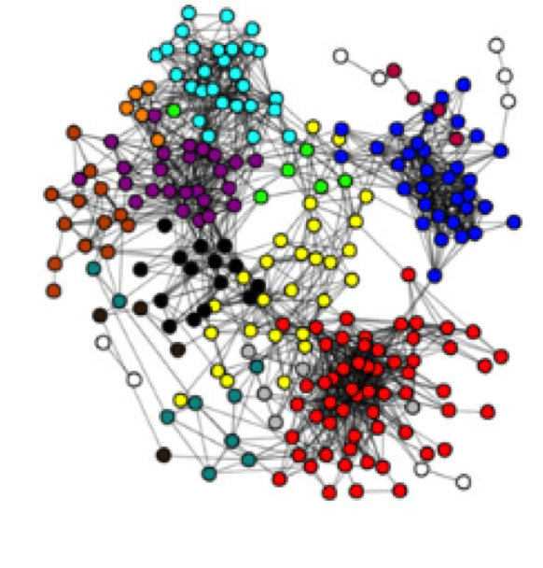
Networks of Interest
Notes:
Perhaps, to predict something as domain-invariant as IQ, we need to use not just 1 connection, but look at the connectivity within networks.
----- Meeting Notes (11/12/14 11:18) -----
add petersen citation to this slide
make sure Power and Cole are on there.
our approach involved looking at the connectivity between 264 distinct nodes based on work from the Petersen lab and his team at Washington University who have functionally classified these nodes into a distinct set of networks based on their functional connectivity properties as assesed by a meta analysis.
of particular interest is the CON. Given the functional imaging findings regarding fluid intelligence and overarching
of particular interest.. candidates for predicting fluid intelligence are CON, FPTCN, DMN.

Slide 41
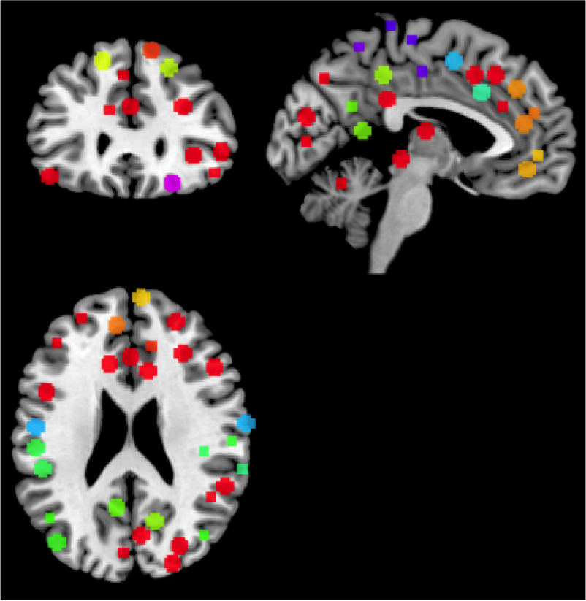
Networks of Interest
Notes:
Perhaps, to predict something as domain-invariant as IQ, we need to use not just 1 connection, but look at the connectivity within networks.
----- Meeting Notes (11/12/14 11:18) -----
add petersen citation to this slide
make sure Power and Cole are on there.
our approach involved looking at the connectivity between 264 distinct nodes based on work from the Petersen lab and his team at Washington University who have functionally classified these nodes into a distinct set of networks based on their functional connectivity properties as assesed by a meta analysis.
of particular interest is the CON. Given the functional imaging findings regarding fluid intelligence and overarching
of particular interest.. candidates for predicting fluid intelligence are CON, FPTCN, DMN.

Slide 42
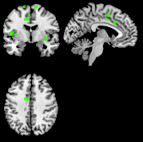
Most important connections
within and across DMN and CON
Notes:
Effect remains for a spearman correlation
----- Meeting Notes (11/12/14 11:18) -----
photoshop the nodes to be color matched
find and label actual regions that were most common
and label which network they were a part of.

Slide 43
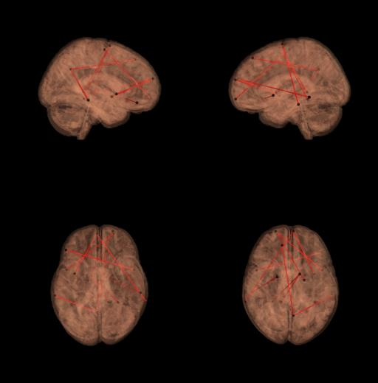
Default Mode’s Structural Connectivity with Cingulo Opercular Accounts for 29% of the variance in individual differences in Fluid Intelligence
Visualization of the most important connections within DMN and across DMN and CON
Default Mode(DMN)
Cingulo Opercular(CON)
Notes:
Effect remains for a spearman correlation
----- Meeting Notes (11/12/14 11:18) -----
photoshop the nodes to be color matched
find and label actual regions that were most common
and label which network they were a part of.

