Slide 1


The Method of Loci revisited:
Virtually augmented memory palaces
ICPS 2017 Symposium
Mnemonic Mechanisms of Mental Navigation:
From the Method of Loci to Grid Cells
Nicco Reggente | 24 March 2017

Slide 2
MoL’s Shortcomings
Compliance
  40% use the MoL even when explicitly instructed to use a familiar environment
  57% when instructed to use a pre-exposed virtual environment
Individual Differences
  Exposure to familiar environments
  Mental Imagery
Legge et al. (2012)
Notes:
First step would be to allow individuals an opportunity to gain familiarity with a shared environment in which it’s impossible to be non-compliant.
If we want to study
First step so that individuals can gain familiarity with a shared environment.
neural correlates during retrieval and this gives us precise measures
change title

Slide 3
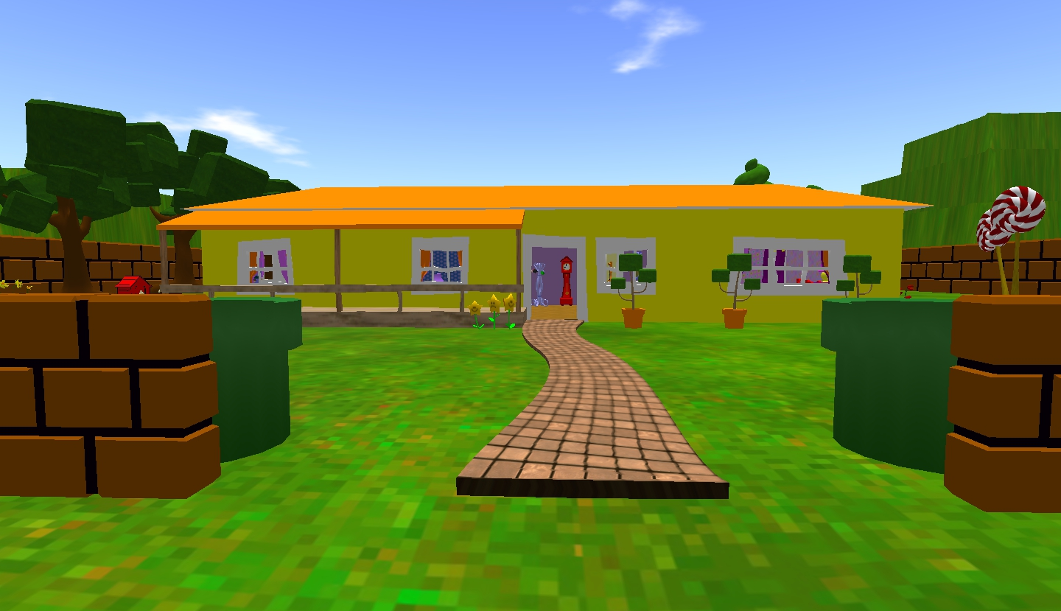
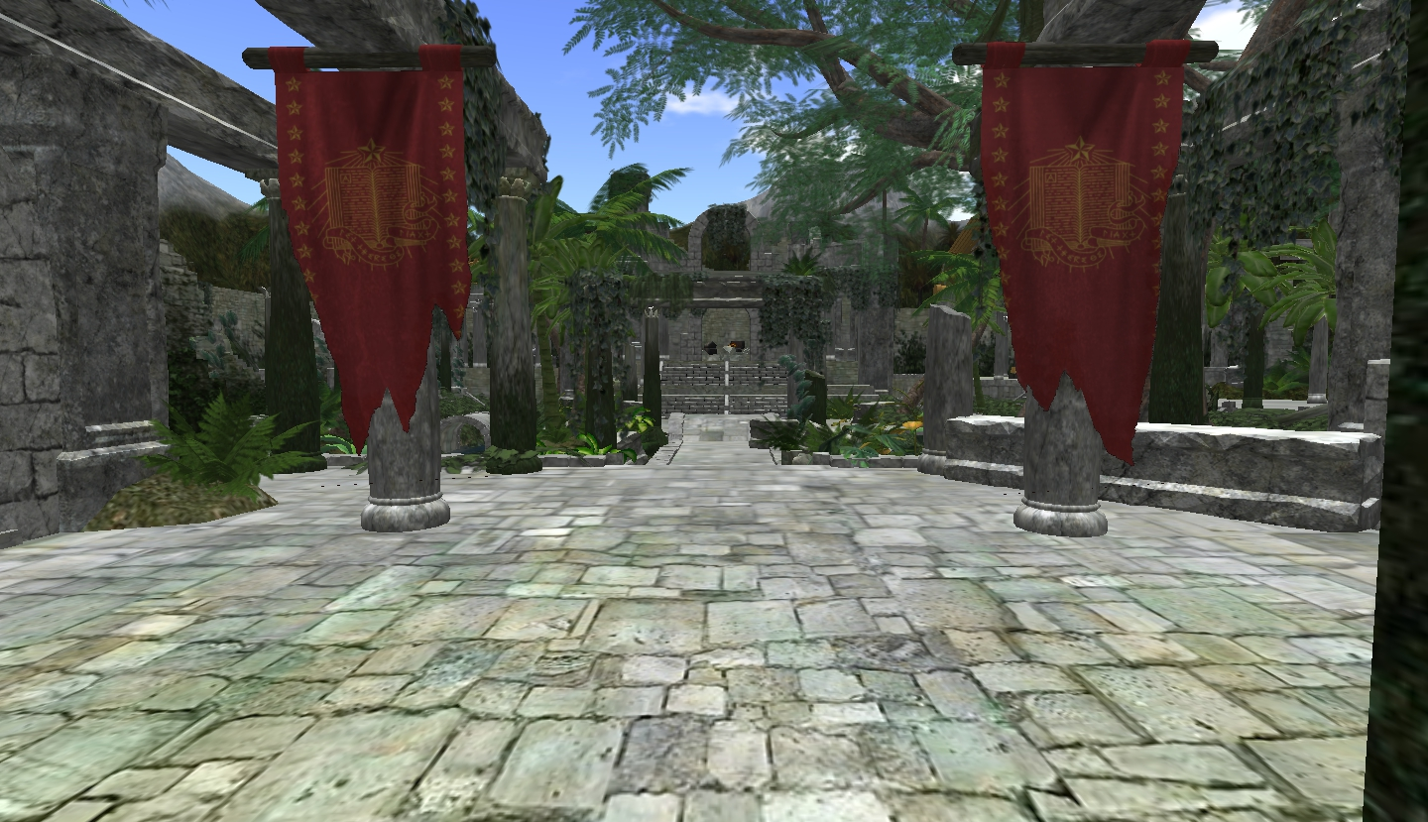
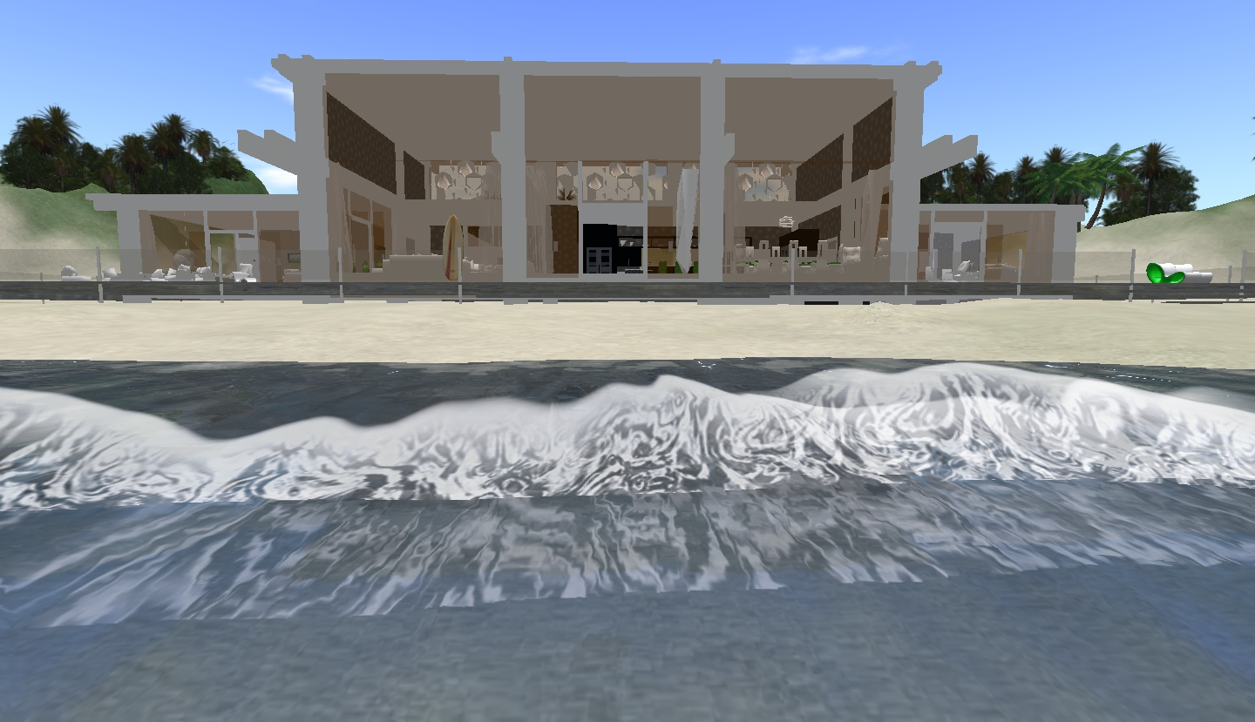
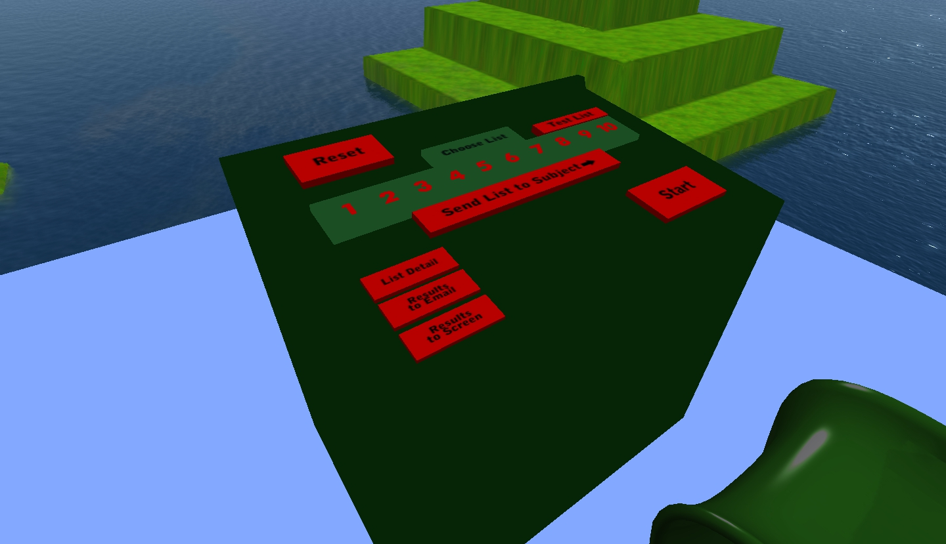
Virtual Memory Palaces
Toon World
Ruin World
Lagoon World
Experimenter Control Platform
Notes:
----- Meeting Notes (3/16/17 11:53) -----
Softwareinterface that allows us as experiments to precisely control which items, how long, where they are seen.
Slower Video
Say that this an example subject placing items

Slide 4
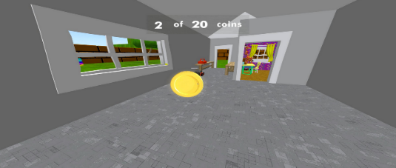
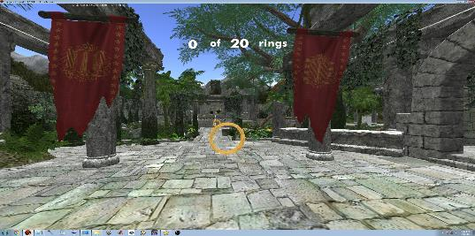
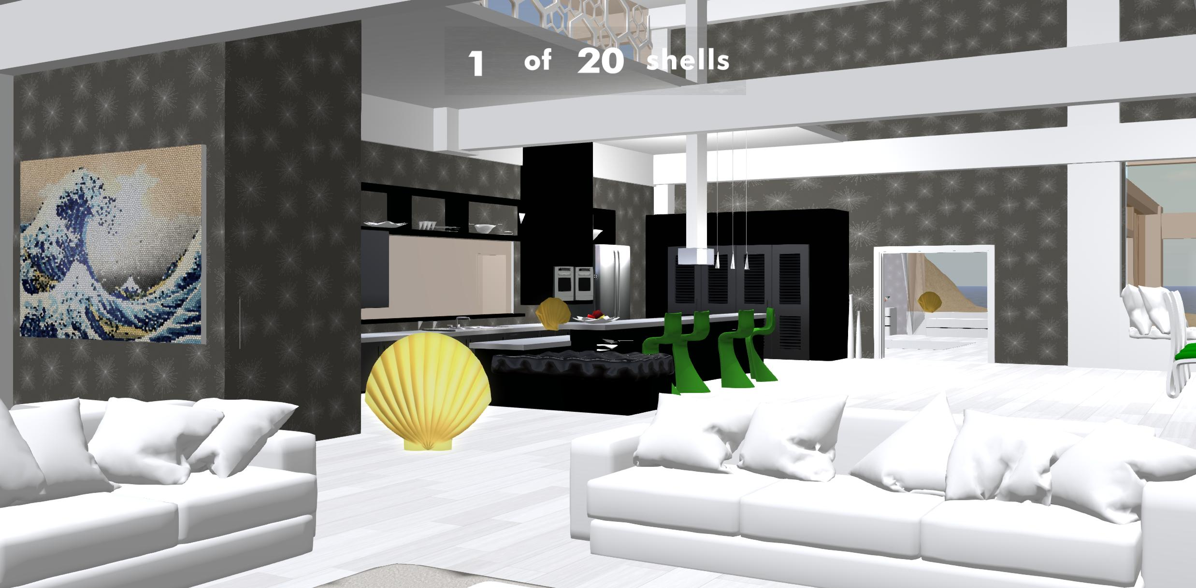
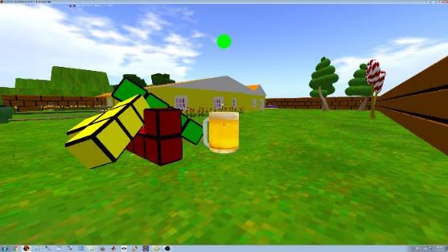
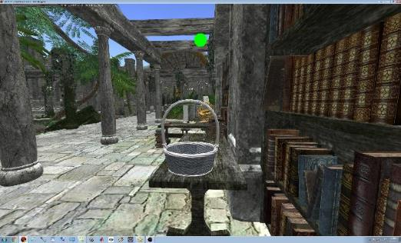
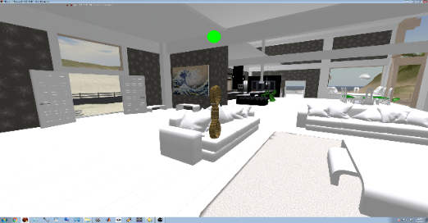
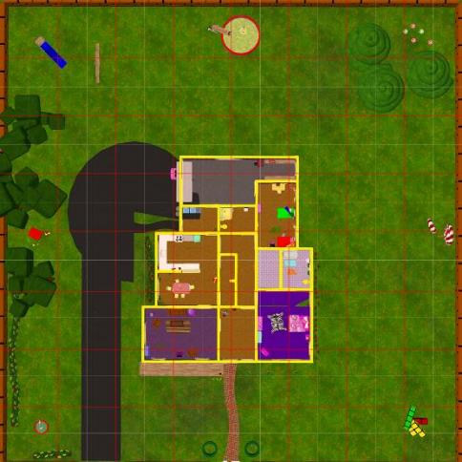
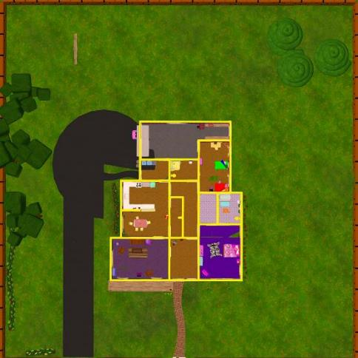
Task Design
Familiarization
Token Collection
20 tokens
5mins x 3 Worlds
Token Collection
20 tokens
3mins x 3 Worlds
Encoding
Encoding
MoL vs. Control
15 Objects x 3 Worlds
Rehearsal
15 Objects x 3 Worlds
Spatial Memory
20 Tokens
15 Objects
8 Landmarks
x 3 Worlds
Recall
Verbal Recall
15 Objects x 3 Lists
Notes:
MoL was briefed on the ancient strategy and that they would be using virtual environments to implement it.
Control was briefed on the “Walk and Learn” strategy that is proven to bolster memory strength based on the active nature of learning.
This way, subjects in both groups were matched for exposure time and expected mnemonic enhancement.

Slide 5
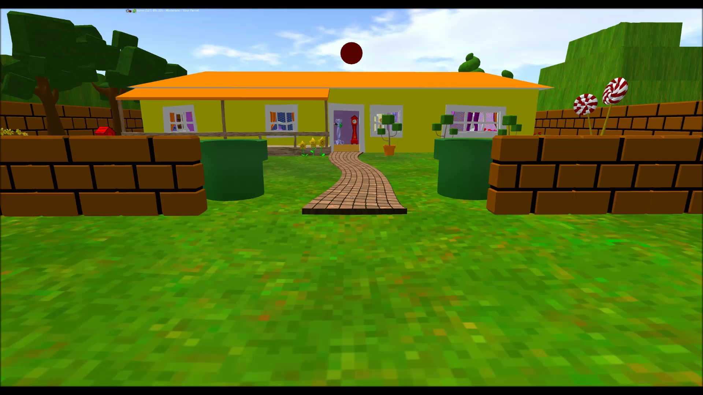
Virtual Memory Palaces
Notes:
----- Meeting Notes (3/16/17 11:53) -----
Softwareinterface that allows us as experiments to precisely control which items, how long, where they are seen.
Slower Video
Say that this an example subject placing items

Slide 6
Behavioral Results
Version 1
2 Worlds; 30s
N=23; MoL=11
***
***
***
*** p<.005
Notes:
----- Meeting Notes (3/16/17 11:53) -----
Comment on what's not there.
Mean number of words Y axis.
animate to reveal correct sequence after.
both subjects encouraged that the mnemonic is matched, etc.
mention that they are near ceiling. remembering nearly all items per list.
order is an important component of the recall emphasis.
for a variety of reasons, we wanted to expand to 3 worlds to replicate. small pilot.

Slide 7
Behavioral Results
Version 2
3 Worlds; 30s
N=11; MoL=5
*
*
*
* p<.05
Notes:
And then we wanted to measure spontaneous contextual reinstatement even if we didnt mention the world
also wanted to get additional trials so introduced a reverse recall.
also changed instructions to more closely match

Slide 8
Behavioral Results
Version 3
3 Worlds; 20s; No Rehearsal
N=25; MoL=12
***
***
*
*
* p<.05 ***p<.0001
Notes:
----- Meeting Notes (3/16/17 12:21) -----
one thing we did was include a rehearsal period
we wanted to see if these effects were strengthened without it
Drop before error

Slide 9
Behavioral Results
Spatial Memory
**
***

Slide 10
Behavioral Results
Control
Object Placement vs. Recall
MoL
R²=.47
Control R²=.27
MoL R²=.2

Slide 11
Behavioral Results
Control
Landmark Placement vs. Recall
MoL
R²=.44
Control R²=.45
MoL R²=.16

Slide 12
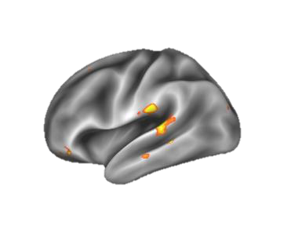
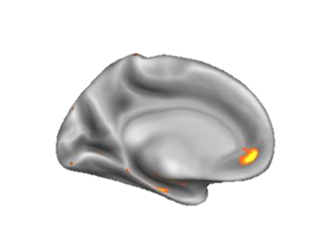
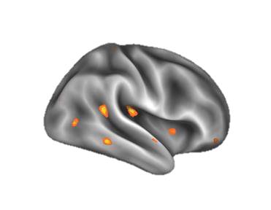
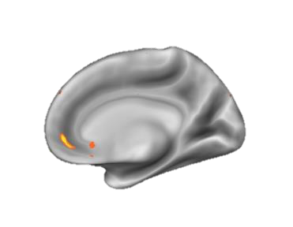
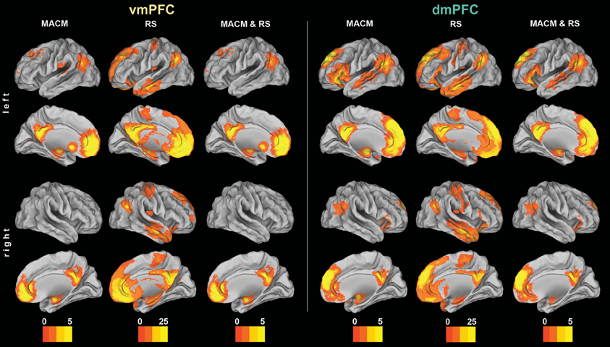
fMRI Results
Decoding Encoding Environment During Verbal Recall
(n=1)
50%
70%
Chance = 33%
Notes:
Make reference to Kondo and Dresler
vmpfc schematic processing and Left parahippocampus
obviously one future direction is to do a full group study
another implementation could be to teach them to learn to do this on their own.
showing them how its like.

Slide 13

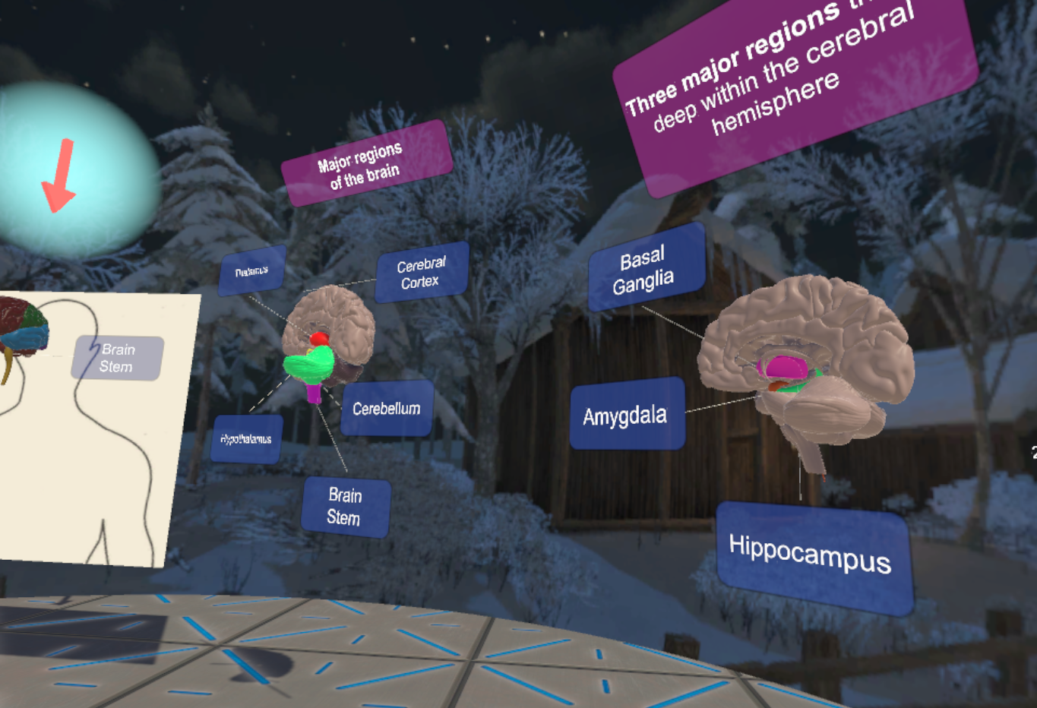
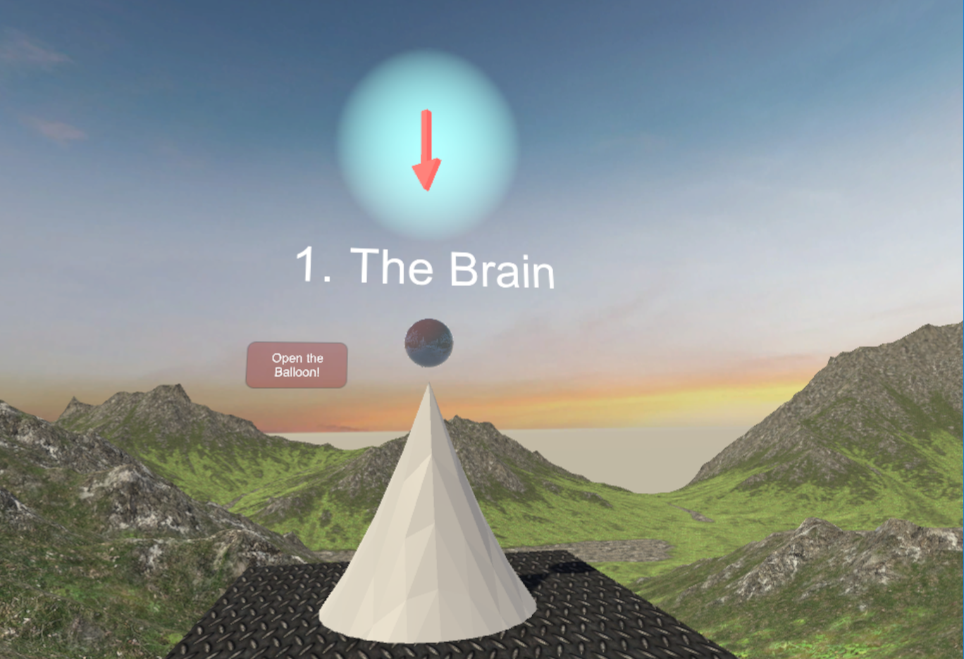
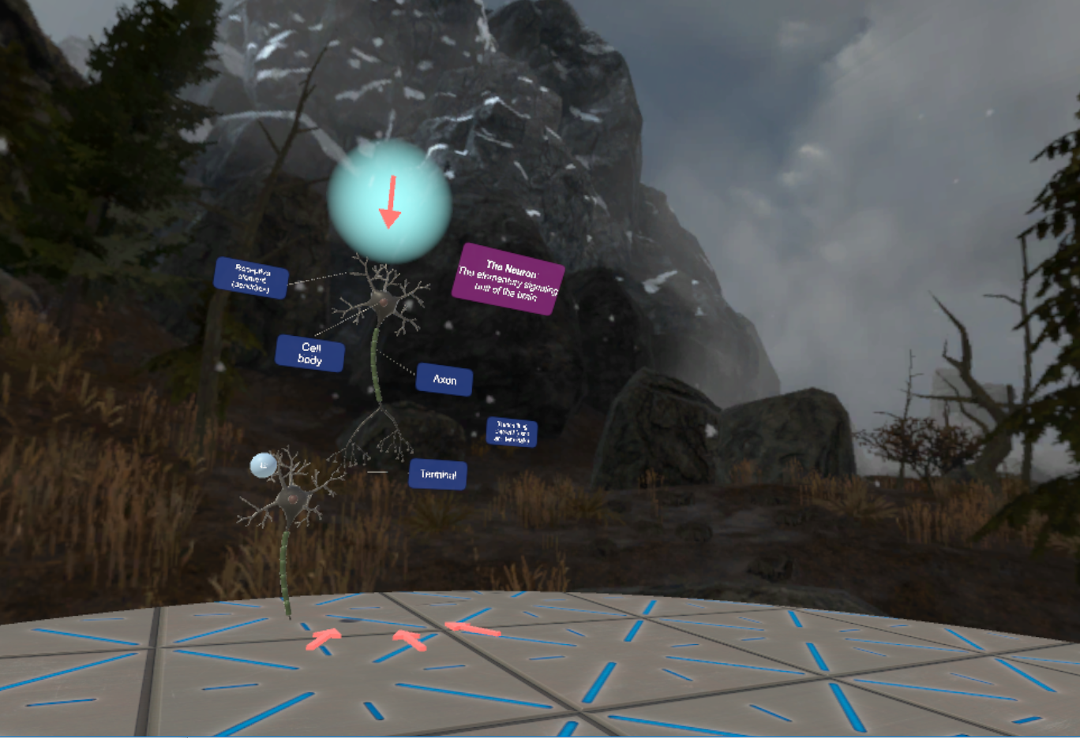
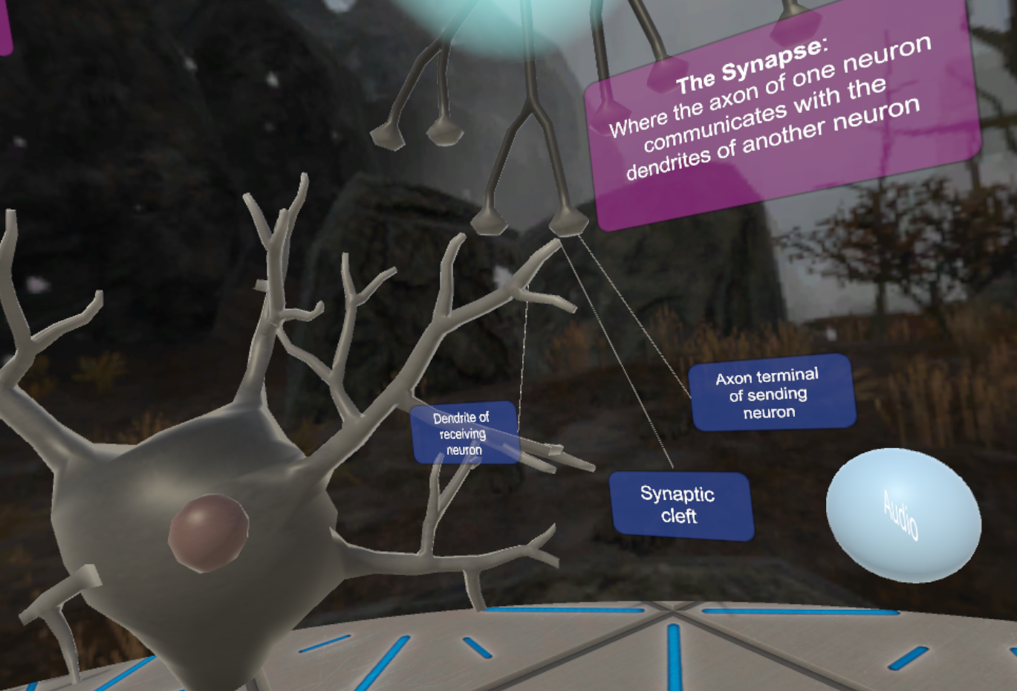
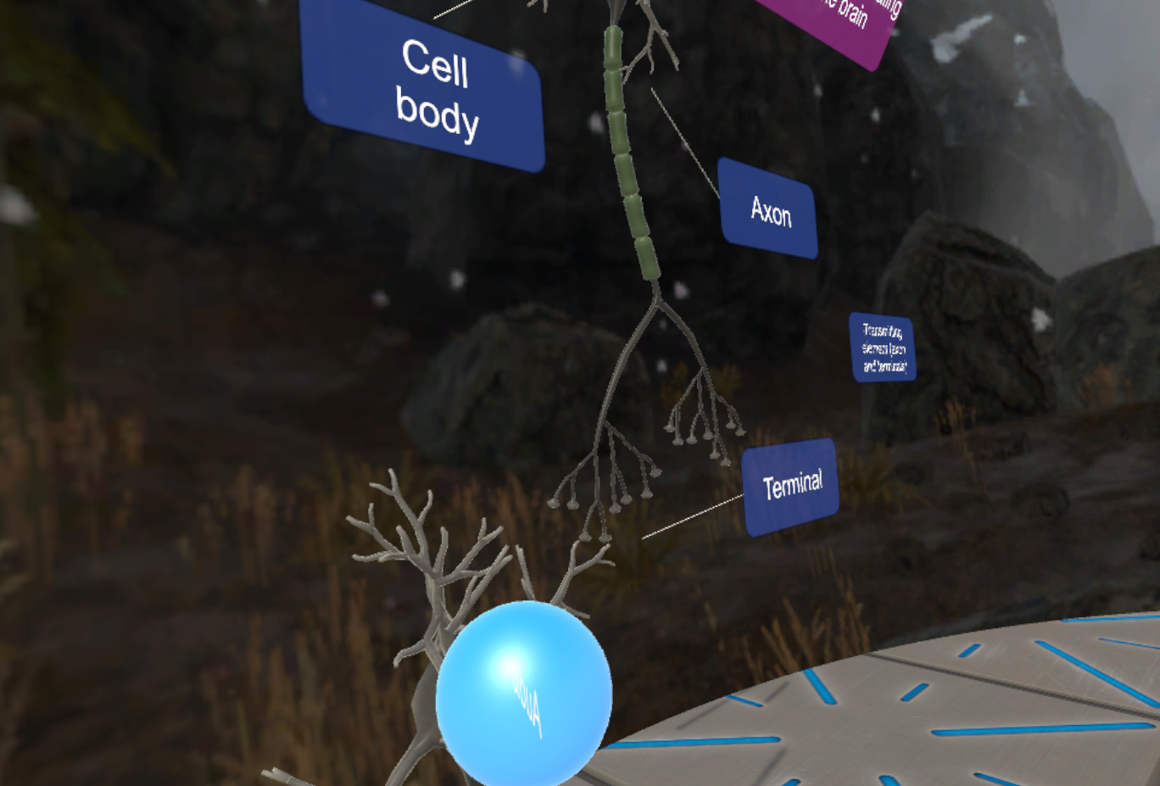

Future Directions
altarvirtual.com

Slide 14







THANK YOU
COLLABORATORS
Jesse Rissman (PI)
Joey Essoe
RESEARCH ASSISTANTS
Hera Baek
Ai Ohno
Alvin Vuong
FUNDING

