Slide 1

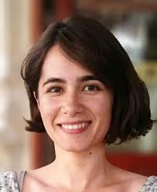
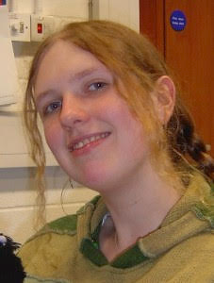
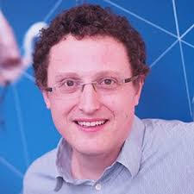
Organizing conceptual knowledge in humans with a gridlike code
Alexandra O. Constantinescu, Jill X. O’Reilly, Timothy E.J. Behrens
Presented on 4/20/17 by Nicco Reggente at UCLA BNS Journal Club

Slide 2
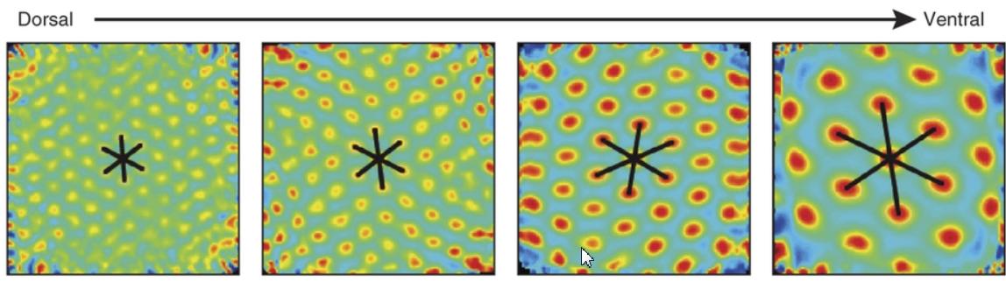
BACKGROUND
Grid cells fire in tessellating patterns about an environment such that a single grid cell would fire in one position in space and then in 6 equidistant peaks in 60-degree outshoots.
Found in MEC and scale by a factor of √2 as one moves along the dorsal-ventral axis.
Hafting, 2005; Buzsaki, 2013; Stensola, 2012

Slide 3
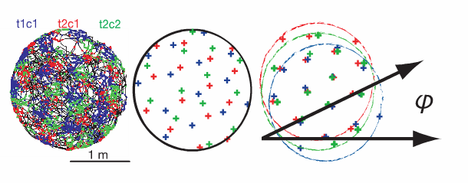
BACKGROUND
Grid patterns of neighboring cells are offset so as to “tile” the environment,
making systematic variation in population activity with position unlikely.
However, the angular orientation of the grids relative to the environment appears to be constant across cells.
Furthermore, conjuctive grid cells selectively fire only in grid positions when the animal is heading in a particular direction
Doeller, 2010
Notes:
The direction preferences of individual cells tend to coincide with one of the six main grid axes.

Slide 4
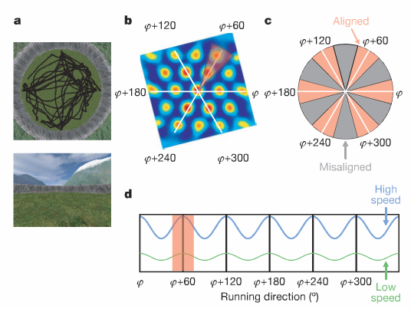
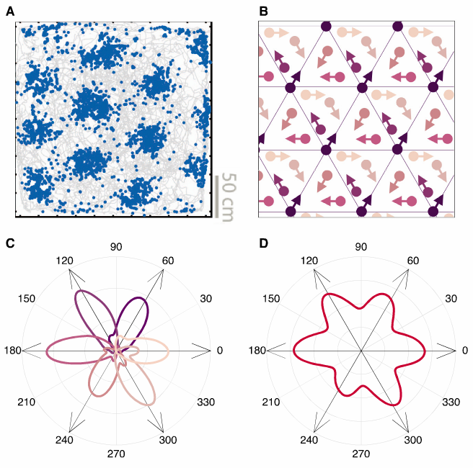
BACKGROUND
This insight, combined with some clever methodology has allowed for VR studies to show that grid-cell-like representations are present in the human brain.
(more on this method later)
Doeller, 2010
Notes:
because grids at different scales are aligned in orientation,any effect of heading direction on bulk population activity present at one scale will remain present when considering all scales
If you can identify this relative orientation to the environment, you should be able to reveal population level activity that increases as a function of the amount of time spent along vectors that maximally overlap with grid fields. Because now you are also recruiting the cells tht are sensitive to direction.
Grid patterns of neighbouring cells are offset so as to “tile” the environment, making systematic variation inpopulation activity with position unlikely.
However:
angular orientation of the grids relative to the environment appears to be constant across cells, whether they are neighbouring or farther apart.
Conjuctive grid cells fire as a function of running direction
Grid cell firing increases with running speed and the spatial orgnaization is more apparent
On half of the data..
They calculated the 6-fold symmetric cosine and sine of each paticipant’s virtual running direction (i.e. cosine and sine with direction periodicity of 60 degrees. Fit this timecourse as two regressors to the BOLD data.
The coefficients were used to calculate the potential grid orientation for each voxel.
Looked for 6-fold symmetric sinusoidal modulation of activity by running direction, aligned to the mean grid orientation using the other half of the data. This orientation varied across subjects.
Coherence of grid orientations was correlated with participant’s spatial memory.
There was also adaptation effects.

Slide 5
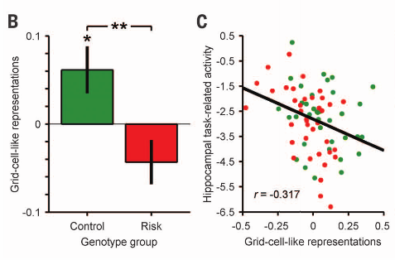
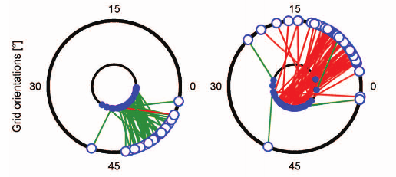
BACKGROUND
Adults with APOE4 (genetic risk for Alzheimer’s disease) show reduced grid-cell-like representations.
Kunz, 2015
Notes:
Reduced grid cell → higher hipocampal activity → carriers

Slide 6
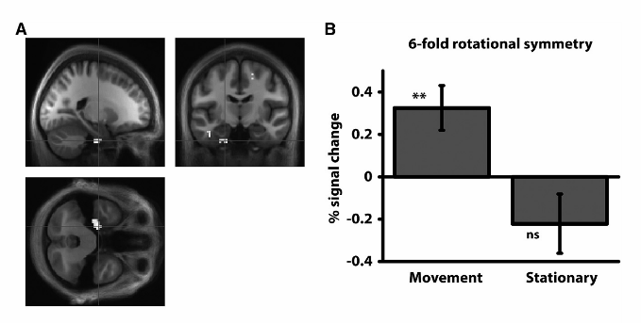
BACKGROUND
Grid-like processing appears even in imagined navigation
Horner, 2016

Slide 7
MOTIVATION
Without an “organizing principle”, nothing has the ability to turn into information.
Space, according to Kant, is the most important, integral, and effective organizing principle.
If there exists a coordinate system for physical space, is that same space also used for abstraction?
Critique of Pure Reason, Kant (1787)

Slide 8
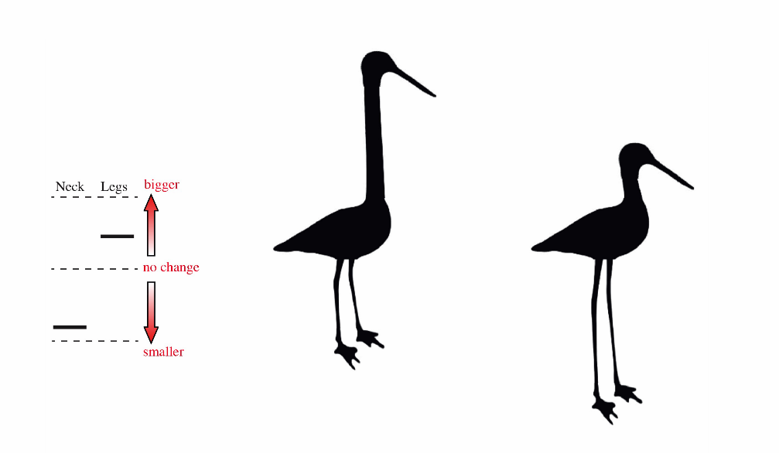
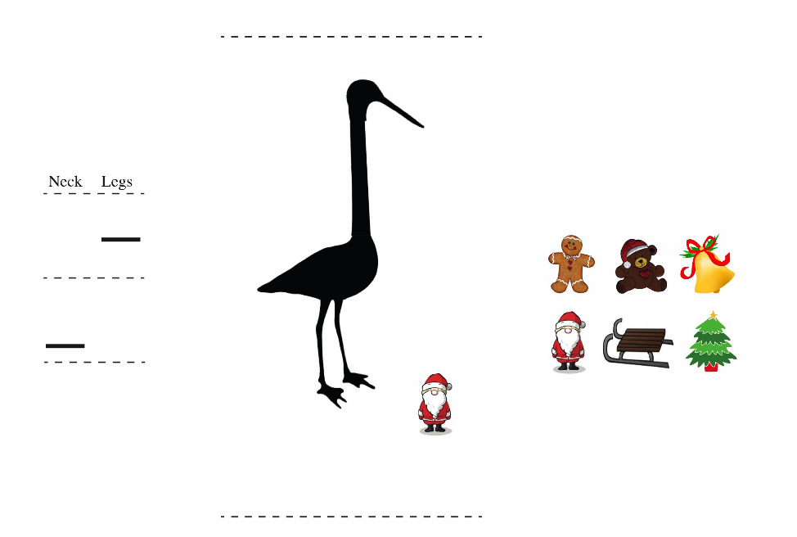
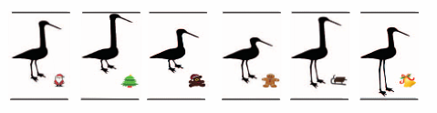
METHODS
Subjects were trained to associate stimuli (birds) with outcomes (Christmas symbols)
Birds varied as a function of two continuous dimensions: neck and leg length
Match Task
Explore Task
Collect Task
Notes:
Stimulus Outcome learning task.
Freely moved
Subjects could morph the birds using a “non-spatial” keyboard. They would choose a ratio and typed it in and the bird morphed in that way.
Match Task then Explore then Collect
Through a match task, they had to use a non-spatial controller to morph the bird silhouette shown on the left side of the screen to match the bird on the right side. They were instructed to move the dimensions simultaneously (instead of separately).
The explore task, they needed to find 6 outcomes. The outcome would pop up next to the bird when they reached it. Analogous to rodent exploration tasks.
The collect task would ask them to start from a random position and pick the neck:legs ratio that would get them to a target outcome.

Slide 9
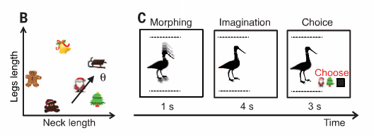
METHODS
With leg length and neck length as axes, the Christmas symbols can be “plotted” on a conceptual coordinate system (Bird Space)
(this was not made explicit to the subject)
XXX
Notes:
In scanner, they saw a video of a bird morphing according to a predefined neck:legs ratio. They were the instructed to imagine the outcome if the bird continued to morph with the same neck:legs ratio.
Asked to imagine the morph continued for the same amount of time as they just saw, with the same ratio.
Orientation of the trajectories for movement in bird space was dissociated from the properties of the visual scene: They made sure that trajectories with the same orientation could be formed by different stimuli, and trajectories with different orientations could pass through the same stimulus.
The trajectories uniformly sampled a 360 degree space.
Subjects were asked to choose which outcome was correct.

Slide 10
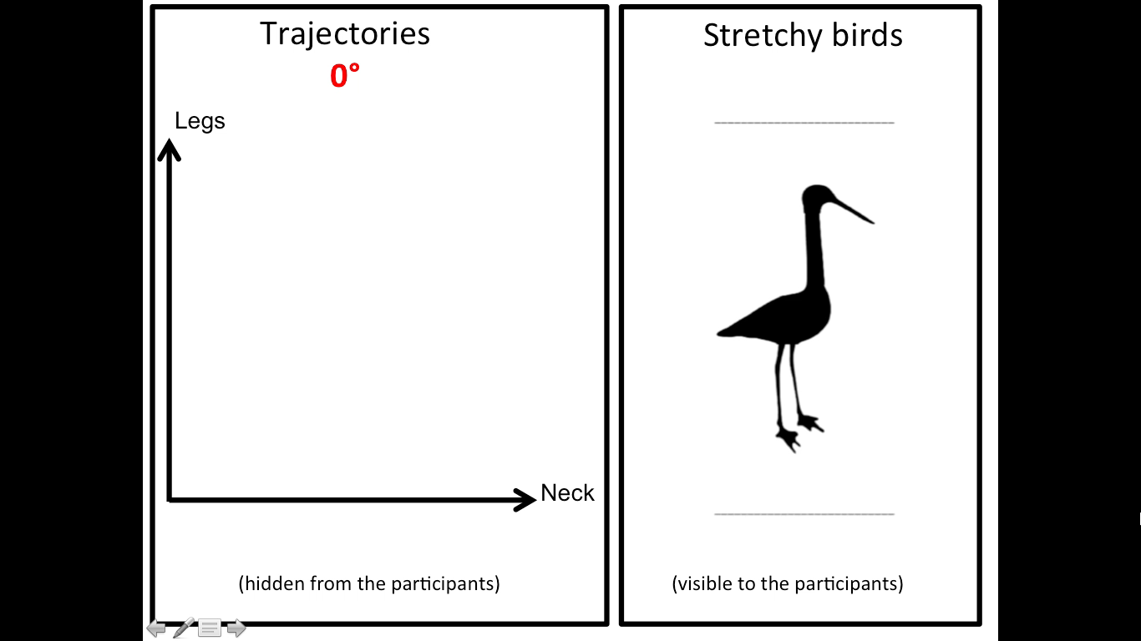
METHODS

Slide 11

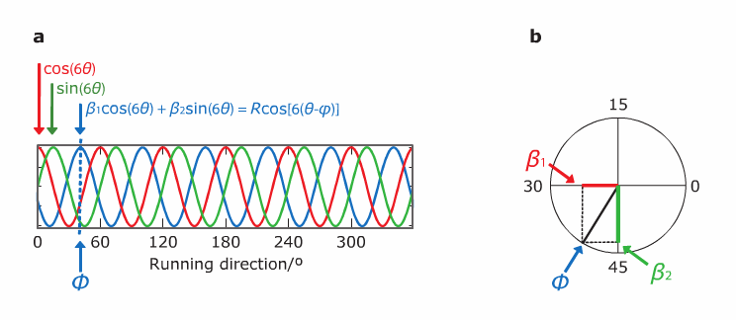

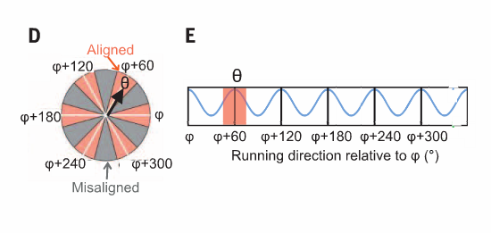
METHODS
and
Two parametrically modulated regressors (sine and cosine of each trajectory in each trial) with a periodicity of 60 degrees were created and submitted voxelwise.
2) Spheres were centered around the peak voxels for an ROI analysis.
3) They then averaged the coefficients for the sin and cosine regressors across all voxels within an ROI to calculate the mean orientation of the heaxagonal grid in that region.
4) They ran 12 regressions for aligned and misaligned trials
5) T-test of the averaged aligned vs. averaged misaligned betas.
Notes:
The pair of sine and cosine functions of the trial’s morph direction, with a frequency of six cycles per 360 degrees.
Linear combinations of a sine and a cosine of the same frequency can explain a sine-shaped modulation of any phase at that frequency.
The goal here is to create subject-specific parameter estimates for each experimental session.
The combination of coefficients estimated for the sine and cosine predictors specifies the phase at which most variance is explained by 6-fold modulation as a function of the direction in bird space.
To get phi, they averaged the coefficients for the sin and cosine regressors across all voxels in the ROI.
After identifying the mean orientation of the hexagonal grid (phi) – different for each subject, you could delineate which trajectories were aligned or misaligned with phi.
Clarify the data split in half.

Slide 12
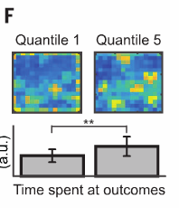
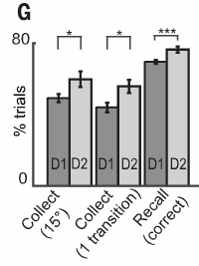
RESULTS
Subjects got better at the task with time. None of the subjects reported conceiving of the relationships between birds or outcomes as lying in a spatial map. They also spent more time in outcome locations during the “explore” task across sessions.

Slide 13
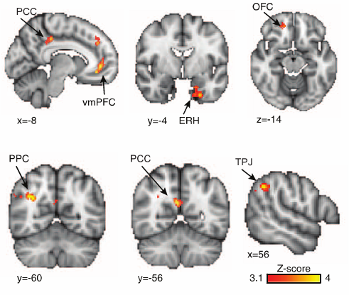
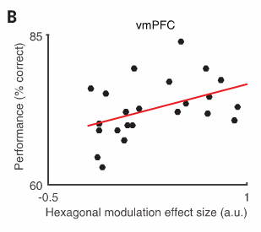
RESULTS
Regions indeed show a hexagonal modulation

Slide 14
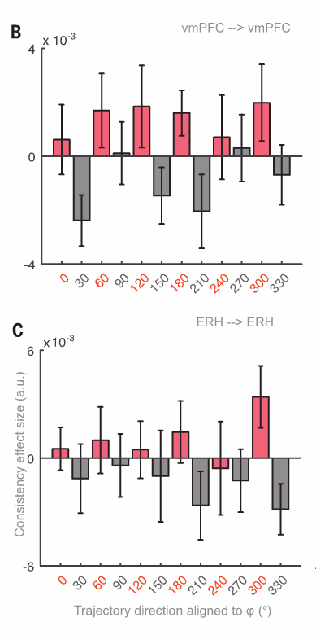
RESULTS
vmPFC and ERC signal is higher for aligned vs. misaligned trajectories
Notes:
vmPFC and ERH signal is higher for aligned vs. misaligned trajectories.

Slide 15
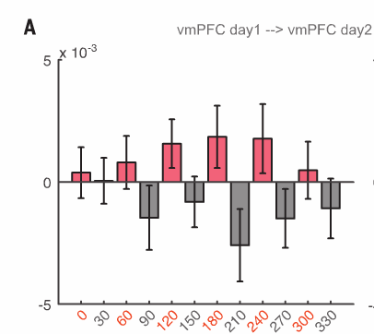
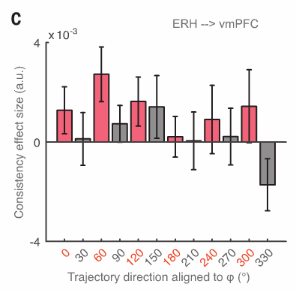
RESULTS
Grid alignment is consistent across both time and regions.
Notes:
Hexagonal consistency between separate sessions was related to behavior.
This is related to performance, not the rate of learning.
There was also hexagonal consistency across ERH and vmPFC, suggesting that different brain regions may contain gridlike activity that is aligned to the same angle.

Slide 16
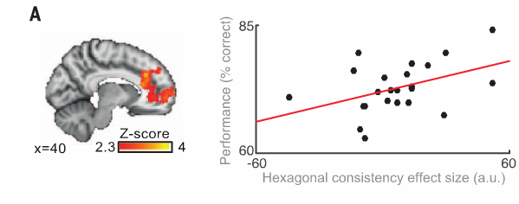
RESULTS
Consistency is correlated with performance.
Notes:
Hexagonal consistency between separate sessions was related to behavior.
This is related to performance, not the rate of learning.

Slide 17
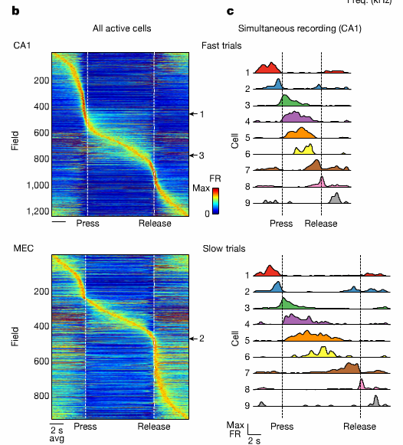
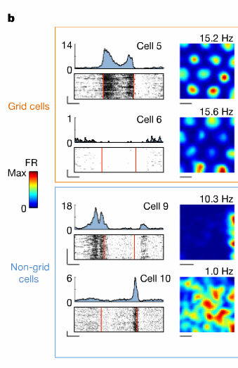
DISCUSSION
Is spatial representation just one example of a more general mechanism for encoding continuous, task-relevant variables?
New research shows that when rats use a joystick to manipulate sound along a continuous frequency axis, there are discrete firing fields at particular sound frequencies.
Is the same true for social relationships?
Color? Time? Taste?
Aronov, 2017
Notes:
Mention Quinoga and Koch concept cells = place cells for discrete phenomena
Changing phenomena, or stimuli that is continuous, might require grid cells.
These frequency cells were only activated when the frequency was behaviorally relevant. The amount of modulation in sound was determined by their “gridness” as determined by a separate foraging task.
The field size also changes as a function of

Slide 18
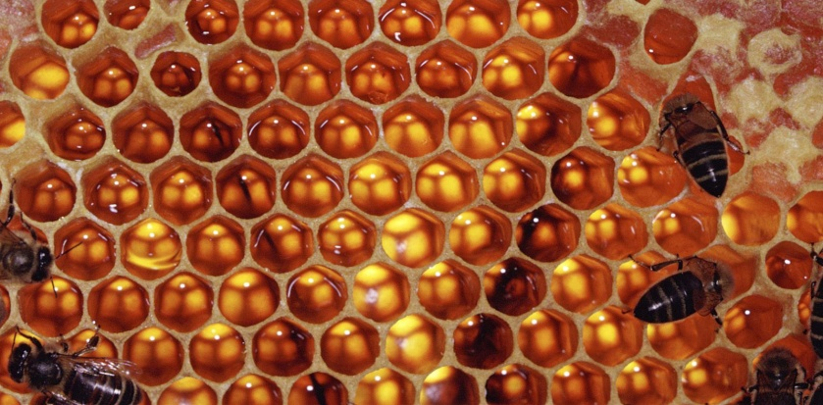
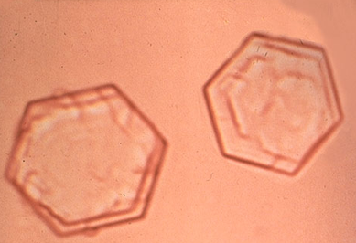
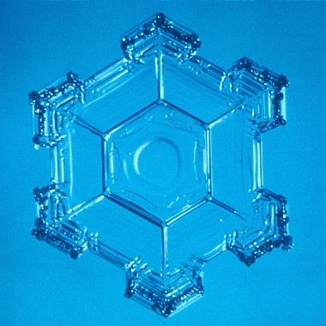
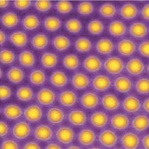
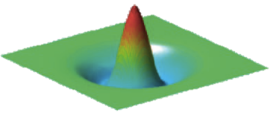
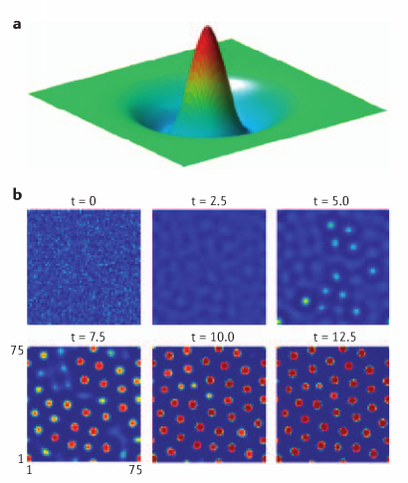
BONUS: WHY GRIDS?
The Honeycomb Conjecture | Mexican-Hat-Connectivity
Varro, 36BC; Kelvin, 1887; Hales, 1999; McNaughton, 2006;
Notes:
The honeycomb conjecture states that a regular hexagonal grid or honeycomb is the best way to divide a surface into regions of equal area with the least total perimeter. The first record of the conjecture dates back to 36BC, from Marcus Terentius Varro, but is often attributed to Pappus of Alexandria(c. 290 – c. 350). The conjecture was proven in 1999 by mathematician Thomas C. Hales, who mentions in his work that there is reason to believe that the conjecture may have been present in the minds of mathematicians before Varro.
Mexican Hat Connectivity (excitatory center with inhibitory surround that levels off with distance (similar to the first derivatives of a sinc function – which is just the Fourier transform of a box function), will allow for spontaneous hexagonal grid patterns

