Slide 1



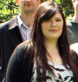




Navigating through digital folders uses the same brain structures as real world navigation
Yael Benn, Ofer Bergman, Liv Glazer, Paris Arent, Iain D. Wilkinson, Rosemary Varley, Steve Whittaker
University of Sheffield, Bar-llan University, UCL, UC Santa Cruz
Nicco Reggente
February 4th 2016

Slide 2
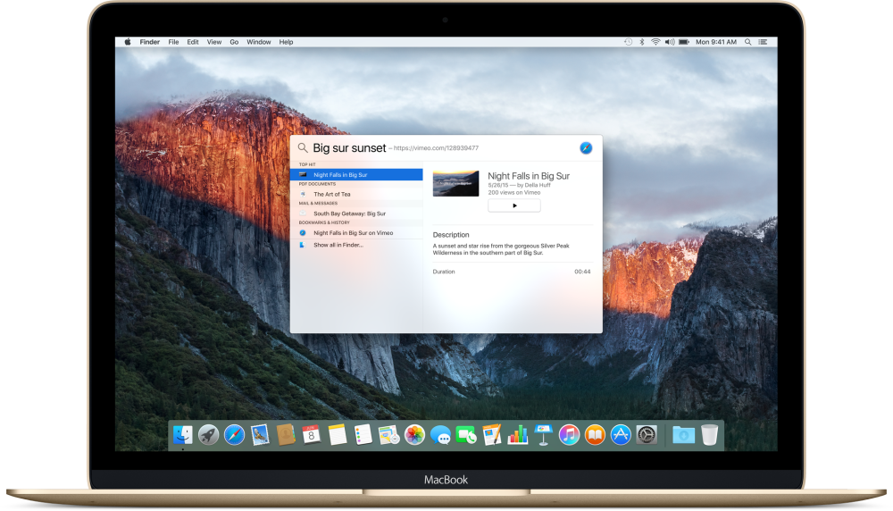
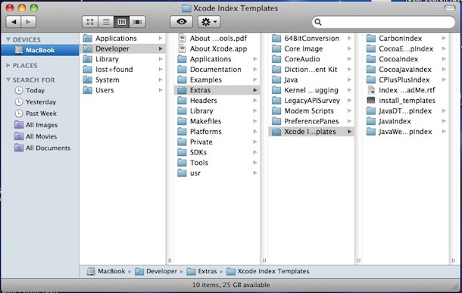
Navigating Personal Information Management
Search
Navigation
a query for specific target item attributes
a manual traverse through organizational hierarchies
Notes:
Downsides to Navigation
1) Multiple folders might be appropriate for one item.
2) Items are occluded from view.
3) Must remember the exact path, which might be hard given too much time between encoding and retrieval.

Slide 3
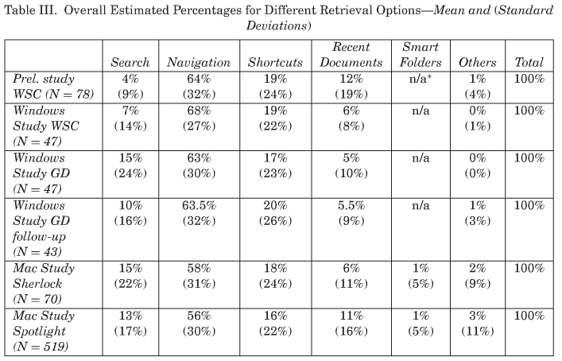
A Preference for Navigation
Folder navigations is tedious:
You must remember the exact path
Items are occluded from view until found
Multiple folders might be appropriate for the same item
Figure from Bergman et al. (2008)
Despite its downsides, navigation is preferred over search
Notes:
Search is used as a “last resort”

Slide 4
A Preference for Navigation?
Navigation remains stable
Search forges variable paths – compromises consistency and reinforcement
Hypothesis
people prefer virtual folder navigation because of its similarities to navigation in the real-world.
Navigation will recruit the same brain structures used to navigate the real world.
Search, alternatively, will compete for linguistic resources.
Notes:
Parahippocampus and retrosplenial for navigation.
Bergman et al found that searching interfered more than navigation with a concurrent task of maintaining words in working memory.
Search would be front lefto-temporal.

Slide 5
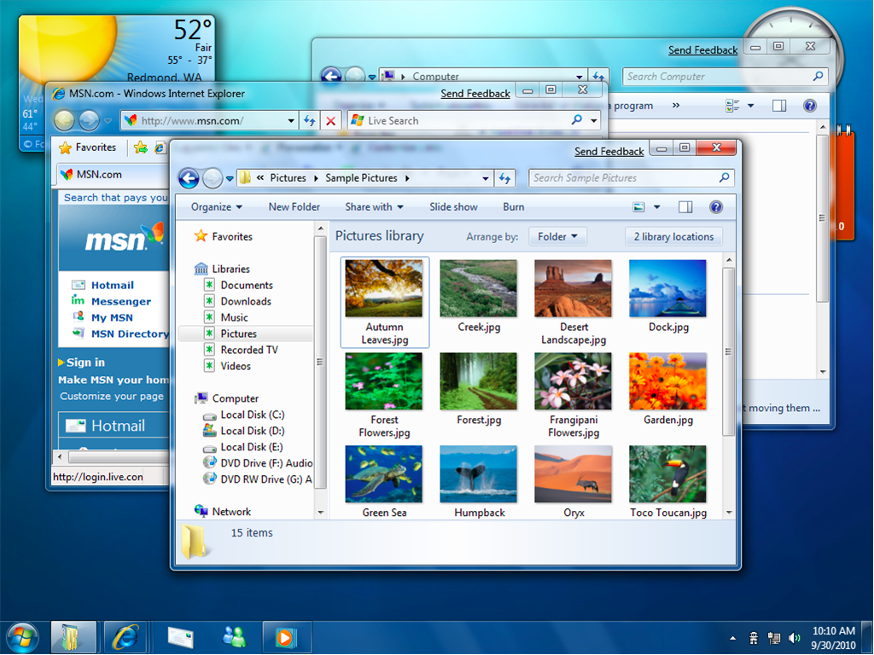
Task Design
Day 1
17 subjects surrendered their personal Windows 7 laptops.
Experimenters installed Python code and screen capture software.
A list of .doc, .xls, .pdf, .ppt files were used to display “target file names” in either the search or navigation task.
Participants practiced the task.
*Only recently accessed files were used
Notes:
Downsides to Navigation
1) Multiple folders might be appropriate for one item.
2) Items are occluded from view.
3) Must remember the exact path, which might be hard given too much time between encoding and retrieval.

Slide 6
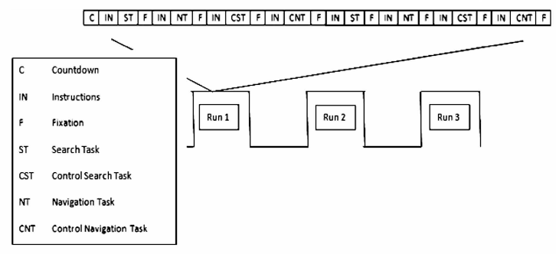
Task Design
Day 2 (fMRI)
Subjects used an MRI-compatible optical mouse and Windows 7 on-screen keyboard to operate their computer that was connected to an LCD screen in the scanner.
4 Conditions (Search, Navigation, Controls), 30 seconds each
Notes:
21 second countdown
6 second fixation
All four conditions appeared twice in each run
Each run was about 7 minutes
TR=3s
1.8 x 1.8 x 4

Slide 7
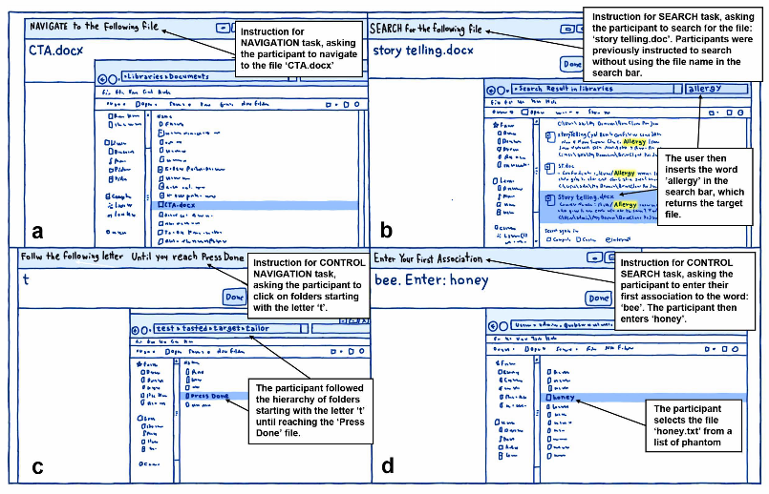
Task Design
Navigation Task
Given the name of the file.
Told to navigate to that file using the file explorer and push “Done”
Control Navigation Task
Given a letter.
Told to follow a hierarchy of folders (depth of 2-7) in a phantom file system that began with that letter.
Finished when they reached a file called
“Push Done”.
30s to complete the tasks. Kept cycling through new tasks if subject finished early
Notes:
control tasks had similar interfaces to the experimental tasks, to allow for the subtraction of
visual, motor and superficial levels of cognitive processing such as basic decision-making (e.g., deciding
which folder to click on), or word-generation (i.e., generating a target word)

Slide 8
Task Design
Search Task
Given the name of the file.
Told to use the search bar for words contained in the file, but not use any words in the filename. They could also search by last date accessed, though no subjects did.
Control Search Task
Given a random word from a list of words that have strong associates.
Told to enter the first word they associated with the presented word and then, after a refresh, select the file with that word as the name.
Notes:
Once they found it. Click the file and press done.

Slide 9
Results
Mean folder depth-structure was 2.54 (SD=.82)
Number of trials per 30s block:
Search = 2.02 (SD=.65); Control = 4.16 (SD=1.15)
Navigation = 3.5 (SD=1.86); Control = 4.31 (SD=2.39)
Success Rate:
Search = 28.48% (SD=18.58%)
Control = 64.47% (SD=13.28%)
Navigation = 27.25% (SD=13.05%)
Control = 54.18% (SD =14.38%)
How was this not 100%?
No behavioral differences across males and females
Notes:
How was the Navigation control not 100%?

Slide 10
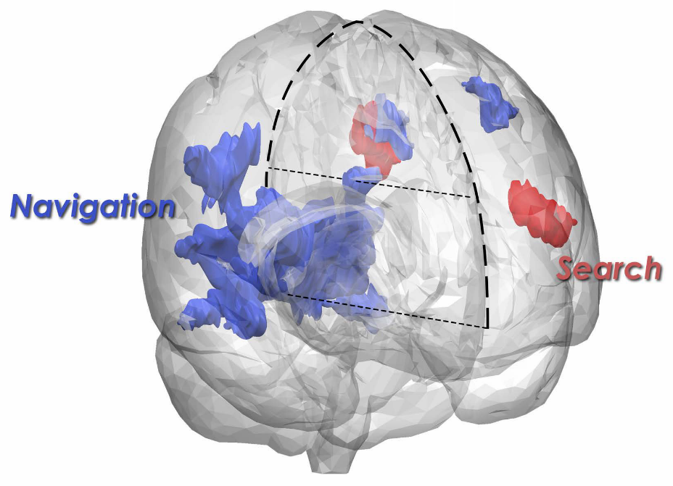
GLM Results
Navigation > Control
Search > Control
(navigation-control) > (search – control) revealed cuneues, precuneus, and posterior cingulate.
(search – control) >(navigation-control) revealed no results
Notes:
The reason for the across task contrast showing little results is that there is some overlap between the two tasks. For example, when people search for a file, they may also have an idea of its location, and when a user navigates to a file, this is likely to require some linguistic engagement such as comparing file names within the target folder

Slide 11
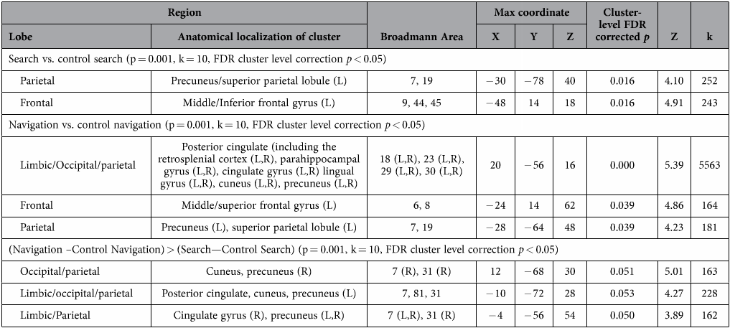
Results
Search recruited linguistic and working memory processing regions
Navigation recruits real-world navigation regions
Notes:
8mm FWHM smoothing.

Slide 12
Discussion
Is this the source of preference for navigation over search?
Is language more effortful and attention demanding than navigation?
Is it because navigation is our most primal computational ability that we default to it?
Navigation recruits different regions depending on spatial strategy. How does that translate here?
Path maps for navigation make sense. Do we not have linguistic maps? Perhaps those are more web-like and less concrete?
If basic lexical retrieval was subtracted out if the activation due to attentional and strategic planning demands of linguistically controlled processing?
Notes:
Wegman 2014 caudate when only one landmark. Hippocampus when relational landmarks.
Iaraia 2003 showing nonspatial recruits caudate. Spatial recruits hippocampus.

