Slide 1




Coupled neural systems underlie the production and comprehension of naturalistic narrative speech
Lauren J. Silbert, Christopher K. Honet, Erez Simony, David Poeppel, and Uri Hasson
Nicco Reggente
&
Jeff Chiang
Presented for Neuroimaging+ Journal Club on Thursday December 4th by
Notes:
A lot of work has been done on speech production and speech comprehension and coupling, but not a lot has been done on coupling on natural speech. This study aims to do that while controlling for utterances as much as possible

Slide 2
Speech Production
Experimental Setup / Design
1 highly trained reference speaker (RS)
  2 Secondary Speakers (SS)
RS verbally told an autobiographical story 12 times in the scanner.
  First time was “spontaneous” (previous study)
SSs told RS’s story
Control nonsense phrases “goo da ga ba la la la fee foo fa” spoken by RS and SSs.
  To the beat of a metronome
Notes:
Nicco:
All speakers concentrated on the reproducibility of the utterances so that each retelling instance was the same as every other one.
Communicative intent was maintained by instructing the speaker to produce each retelling of the story as if for a different friend or audience.
SSs were told to tell RS’s story as if it was their own.
Control allowed for speakers to reliably produce sound that contained no meaning.
All speakers were trained to speak with minimal head motion while lying on scanner during practice sessions.

Slide 3
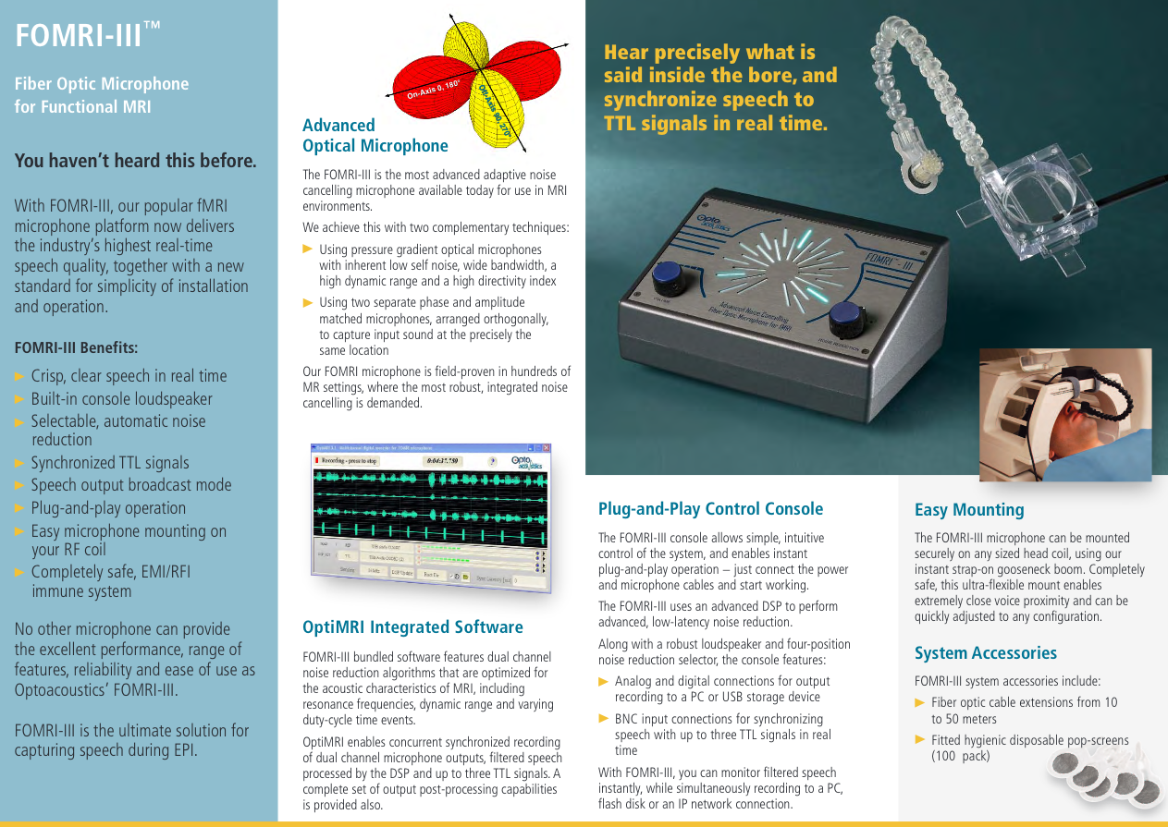
Speech Production
Experimental Setup / Design
Notes:
Nicco:
Two orthogonally oriented optical microphones
Reference captures background noise
Source captures both background and speaker’s utterances.

Slide 4
Speech Production
Preprocessing
Head motions were <1mm
Rigid body alignment to first time point
Signal from “noise ROIs” in white matter and scalp were regressed out.
  Physiological fluctuations + residual motion artifacts
  White-matter (MPRAGE), scalp, eyeball
Notes:
Nicco:
For noise ROIs, calculated first 10 principal components (50% of the variance) across all voxels within each response time course in a given nROI. Usually people just use the mean of the ROI, but this is more conservative.
Then used linear regression to remove those components from each voxel in each subject.

Slide 5
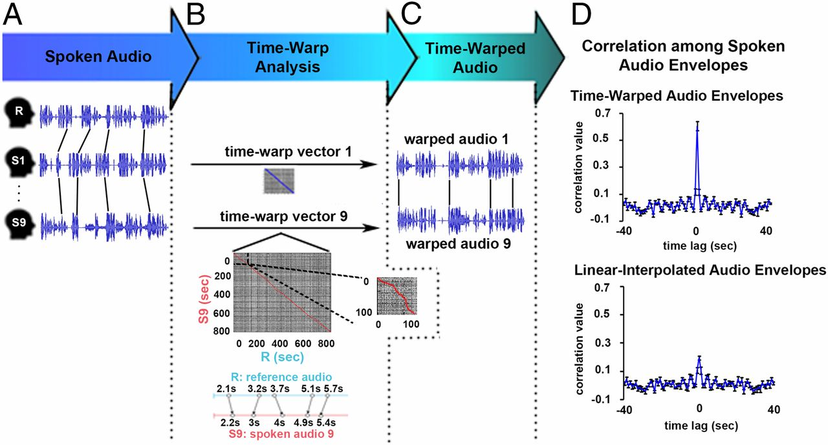
Speech Production
Time-Warp Analysis
Need to temporally align each retelling
Time 1
Time 2
Notes:
Nicco:
In A, the lines between the audio-traces indicate differences in the timing of the same utterances across recordings.
Everything gets matched to the first recording.
Dynamically stretches or compresses different components of the audio envelope to maximize its correlation to the audio envelope of the original production.
Envelope = the variation of the amplitude over time.
The 0-lag peak correlation attests to the temporal alignment across recordings, is increased after applying the time-warping procedure (r=.68 as opposed to r=.18 by linear interpolation.
Only included time-warped retelling runs when the correlation between the two was not an outlier (twice the interquartile range from the median of the correlations). Left them with 25 out of 33 retellings (across subjects– everything was in reference to the Time 1 of Reference Speaker).

Slide 6
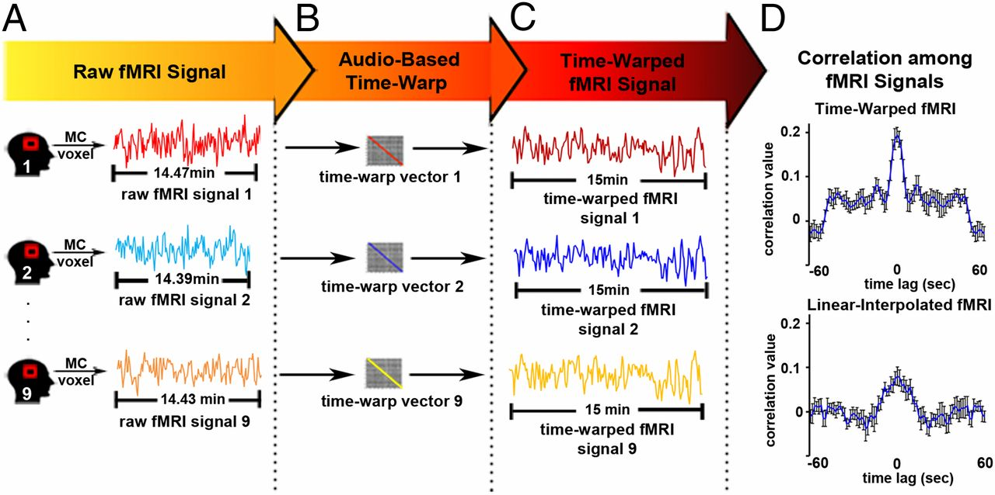
Speech Production
Time-Warp Analysis
Need the BOLD signal to follow
Time 1
Time 2
Notes:
Nicco:
The algorithm produces a mapping from time points in the audio of each retelling to the time points in the audio of the original telling.
This audio-based mapping vector was then applied to the fMRI signals.

Slide 7
Speech Production
Intra-subject Correlation
Assess the reliability of the neural time courses across retellings.
TC1 correlated with mean(TC2:TCN)
Voxel-by-Voxel, exhaustively
Example: motor cortex
Notes:
Nicco:

Slide 8
Speech Production
Inter-subject Correlation
Same as Intra, but reference speaker compared to secondary speakers.
Notes:
Nicco:

Slide 9
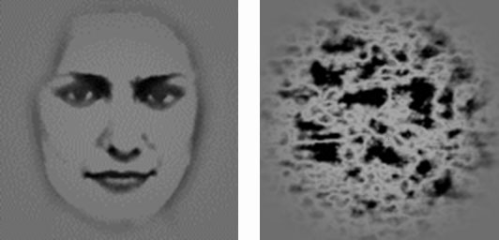
Phase-Randomized Bootstrapping
Used to test for significance of correlations
Generated a null distribution by generating many timeseries from the same power spectrum by varying phase
Notes:
Jeff:
To establish significance on the above metrics, they used this
Why not randomise, e.g. a sign flip test? Why not spearman’s rho? Or Fisher’s R to Z? Maybe because the distribution is not guaranteed to be gaussian because it is not pearson’s R
Figure 1: high pass filtered image on left, phase randomized image on right. They have the exact same power spectrum, surprisingly
SPIE Tyler, Christopher and Chen, Chien-Chung (looking at whether certain features of the face are relevant to face recognition)
Recall K-space, X– roughly frequency encoding, Y roughly phase encoding. So shift points in k-space up vertically.
Presumably this was run due to small N– otherwise regular randomization would suffice?
Presumably phase randomized and generated correlations. Didn’t phase randomize the correlations themselves.

Slide 10
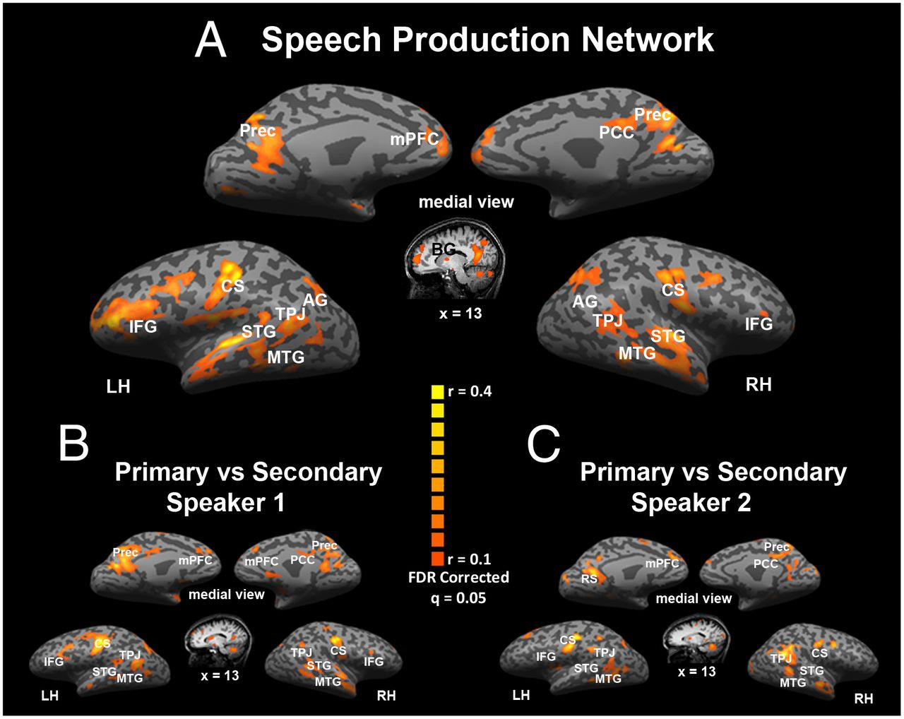
Speech Production
Intra-subject Correlation (Results)
Notes:
Jeff:
SUBJECT 1, across RETELLINGS
Motor speech areas: left and right motor and left and right premotor
Syllabifications: right and left insular
Motor coordination: basal ganglia
Lexical Access and Construction of grammatical strucrues: IFG pars triangularis and pars orbitalis
Speech Comprehension (during production): STG TPJ, MTG, Sylvian fissure
Semantic and social aspects of a story: precuneus, DLPFC, posterior cingulate, mPFC.
ALL BILATERAL

Slide 11
Speech Production
Inter-subject Correlation (Results)
Notes:
Jeff:
This is actors to the original speaker. Similar areas are activated across actors.
HOWEVER, this could just be due to saying words, not specific to the story
Very similar areas in production
Motor cortex, TPJ, MTG, precuneus, left medial frontal, and DLPFC

Slide 12
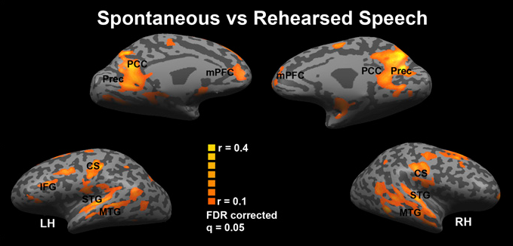
Speech Production
“Spontaneous” vs. Rehearsed (Results)
Of the same story.
When comparing original story (repeated 12 times) to a new, spontaneous story…
they get no significant reliable results from intra-correlations.
Notes:
Jeff:
Within ORIGINAL subject
Reason for this was to ensure that results can be generalized—
Correlated brain response during spontaneous with brain response during rehearsed speech (same story)
No results for a different spontaneous story and the previous rehearsed story
Suggests that the network reliably involved in speech production is tightly tied to the content of the produced speech
This is weird… why are there no motor areas?

Slide 13
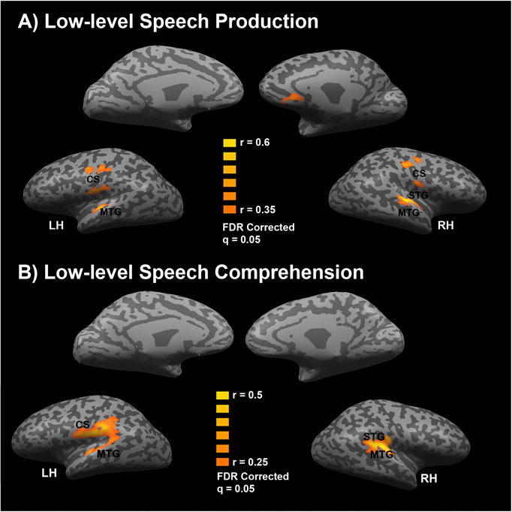
Nonsense Speech Production
Intra-subject Correlation (Results)
Notes:
Jeff:
Separate language production from low level speech production
Subject 1: used intra for each of the repetition runs
Correlating each of the goo goo ga ga (5mins. 8 times)
Only see early auditory cortex and motor corte but no reliability in upper-level speech production areas seen in previous results.
Narrative speech production elicitation of brain responses is conducted by the semantic and grammatical content of the speech produced.
NOW WE’VE IDENTIFIED A SPEECH PRODUCTION NETWORK FOR SPONTANEOUS SPEECH VALIDATED BY THAT ACTORS THAT WERE A REASONABLE PROXY FOR NATURAL SPEECH

Slide 14
Speech Production Network
Notes:
Jeff:
NOW WE’VE IDENTIFIED A SPEECH PRODUCTION NETWORK FOR SPONTANEOUS SPEECH VALIDATED BY ACTORS THAT WERE A REASONABLE PROXY FOR NATURAL SPEECH

Slide 15
Speech Comprehension
11 subjects listened to original, spontaneous story
Used TTL pulse to synchronize story and fMRI acquisition across subjects (basically each TR mapped across time across subjects)
Listened to nonsense phrases
Asked to freely recall story after the scan
  These were evaluated by independent raters
Notes:
Jeff:
INTRASUBJECT CORRELATION OF NONSENSE
INTERSUBJECT CORRELATION TO FIND A SPEECH COMPREHENSION NETWORK
Did an intra subject correlation on production vs comprehension using neural coupling
“Listened to the recording of the story”
Which story? Which speaker? Probably the original

Slide 16
Nonsense Speech Comprehension
Intra-subject Correlation (Results)
Notes:
Jeff:
Correlating each of the goo goo ga ga (5mins. 8 times)
Only see early auditory cortex (more this time, because they were actually listening to something)
We don’t have a map for the story listening, because each subject only listened to the story once. However, they did do an inter-subject correlation

Slide 17
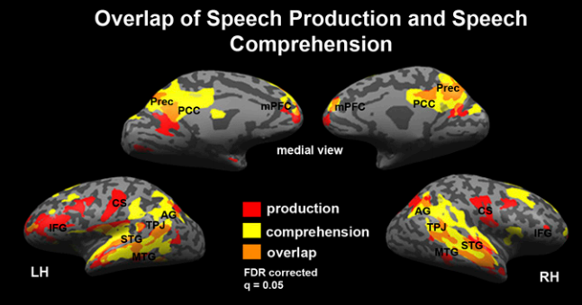
Intra-Subject Correlation maps
Notes:
Jeff:
This is INTER-subject correlation for listeners, and intra-subject for speaker (because the actors were not listened to)
BUT… how did they get the speech comprehension network?
The overlap (orange) between areas that exhibit reliable responses during speech comprehension (listeners, yellow) and areas that exhibit reliable
responses during speech production (speaker, red). Significance was assessed using a nonparametric permutation procedure and the map was corrected for
multiple comparisons using an FDR procedure. In addition, t tests were performed to compare the reliability levels in the production and comprehension maps,
revealing no significant differences between the production and comprehension maps in all overlapping areas

Slide 18
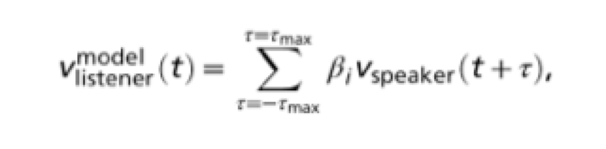
Neural Coupling procedure
GLM of the form:
Notes:
Jeff:
Coupling was essentially a regression, seeing if the neighboring TRs in time for the speaker were predictive of voxel activity in the listener.
Essentially– could the past, present and future TRs in the speaker’s brain predict the timecourse in the linstener’s brain?

Slide 19
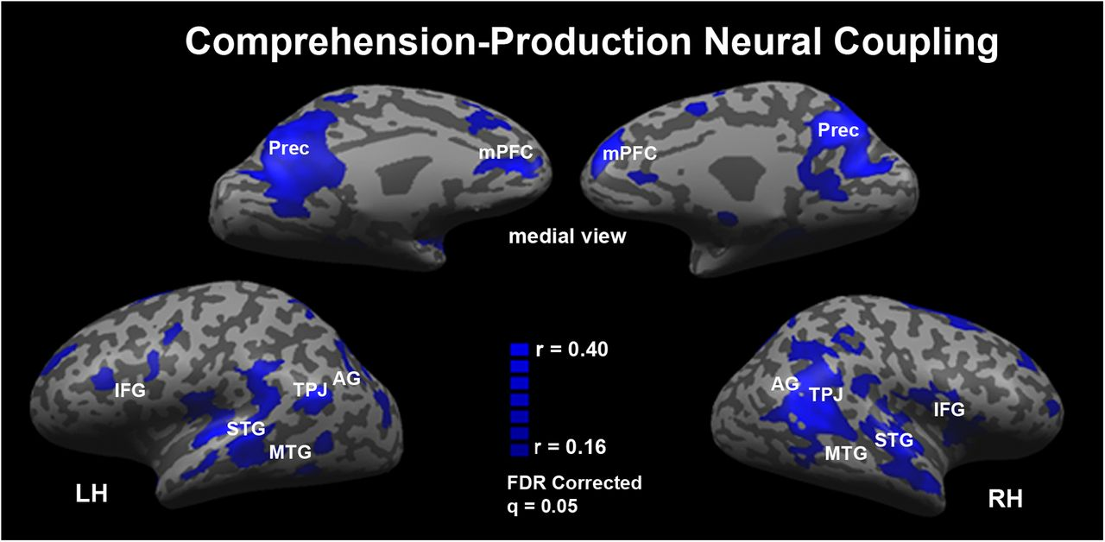
Production-Comprehension areas using Neural Coupling
Notes:
Jeff:
Areas in which the responses during speech production are coupled to the responses during speech comprehension. The comprehension–production coupling includes bilateral temporal cortices and linguistic and extralinguistic brain areas (see Table S1 for a complete list). Significance was assessed using a nonparametric permutation procedure and the map was corrected for multiple comparisons using an FDR procedure.

Slide 20
Neural coupling compared to overlay
Notes:
Jeff:
The areas look more or less the same, which is good for them.

Slide 21
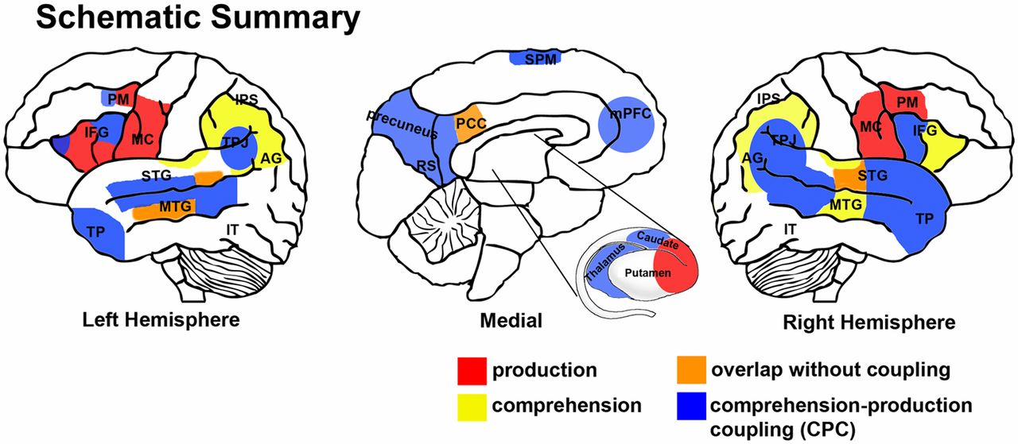
Results Summary
Notes:
Both:
Schematic summary of the networks of brain areas active during real-life communication. Areas that exhibited reliable time courses only during the production of speech are marked in red and include the right and left motor cortex, right premotor cortex, left anterior section of the IFG, right anterior inferior temporal (IT), and the caudate nucleus of the striatum. Areas that exhibited reliable time courses only during the comprehension of speech are marked in yellow, and include the right and left IPS, the left and right posterior STG, and the right anterior IFG. Areas that exhibited reliable time courses during both the production and comprehension of speech (overlapping areas) but in which the response time courses during the production and comprehension of speech did not correlate are marked in orange. These areas include sections of the left and right MTG, sections of the left and right IPS, and the PCC. Areas in which the response time courses during the production and comprehension of speech are coupled are marked in blue. These areas include comprehension related areas along the left and right anterior and posterior STG, left anterior and posterior MTG, left and right TP, left and right AG, and bilateral TPJ; production-related areas in the dorsal posterior section of the left IFG, the left and right insula, and the left premotor cortex; and a collection of extra linguistic areas in the precuneus and medial prefrontal cortices.
Results summary

Slide 22

Discussion
PNAS Direct Submission
Spontaneous Listening Only?
  Rote/boredom effects may have drowned out true “listening” signal.
Neural Coupling of Nonsense?
Include future TR in neural coupling equation?
Notes:
Nicco:
Very similar areas in production
Motor cortex, TPJ, MTG, precuneus, left medial frontal, and DLPFC
What conclusions can we really draw from this paper?
“It was not designed for RH analysis”
Because of TTL pulse, we were getting responses for groups of words.
Presumably speaker listened to herself… so obviously the later TR would be meaningful in predictin

Slide 23
Discussion
They try to directly tackle the problem of “natural speech”
Alternate methods to existing ones (Phase randomized bootstrap, neural coupling)
  Though they might be reinventing the wheel…
Notes:
Moral of the story– don’t get too enticed by a cool title and abstract.

Slide 24
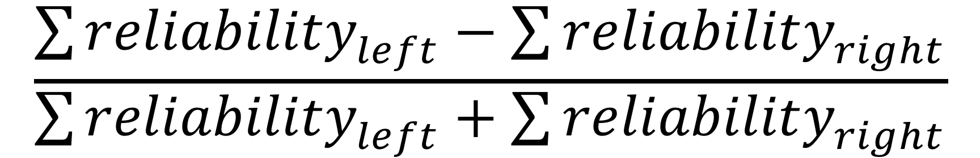
Speech Production
Intra-SC Lateralization Index
A way to quantify reliability of a hemisphere in an exploratory analysis.
Notes:
Jeff:
, LI, for each brain region. We define LI = (Preliabilityleft − Preliabilityright)/(Preliabilityleft + Preliabilityright), where re- liability is defined as the average reliable responses in each of the speaker’s brain areas across repeated speech acts. The values yielded ranged between −1 and 1, with +1 being purely left re- liability and −1 being purely right reliability. The reliability was calculated on the regions of interest (ROI) level to overcome misalignment of homological areas across the two hemispheres in Talairach space.Motor speech areas: left and right motor and left and right premotor
What is “reliability?”
reliability is defined as the average reliable responses in each of the speaker’s brain areas across repeated speech acts
“This was not designed to look at RH activation”
Syllabifications: right and left insular
Motor coordination: basal ganglia
Lexical Access and Construction of grammatical strucrues: IFG pars triangularis and pars orbitalis
Speech Comprehension (during production): STG TPJ, MTG, Sylvian fissure
Semantic and social aspects of a story: precuneus, DLPFC, posterior cingulate, mPFC.
ALL BILATERAL

Slide 25
Lateralization Index
“Reliability” = average reliable responses (correlations) in ROIs.
What exactly is an average correlation?
Notes:
Jeff:
, LI, for each brain region. We define LI = (Preliabilityleft − Preliabilityright)/(Preliabilityleft + Preliabilityright), where re- liability is defined as the average reliable responses in each of the speaker’s brain areas across repeated speech acts. The values yielded ranged between −1 and 1, with +1 being purely left re- liability and −1 being purely right reliability. The reliability was calculated on the regions of interest (ROI) level to overcome misalignment of homological areas across the two hemispheres in Talairach space.Motor speech areas: left and right motor and left and right premotor
What is “reliability?”
reliability is defined as the average reliable responses in each of the speaker’s brain areas across repeated speech acts
“This was not designed to look at RH activation”
Syllabifications: right and left insular
Motor coordination: basal ganglia
Lexical Access and Construction of grammatical strucrues: IFG pars triangularis and pars orbitalis
Speech Comprehension (during production): STG TPJ, MTG, Sylvian fissure
Semantic and social aspects of a story: precuneus, DLPFC, posterior cingulate, mPFC.
ALL BILATERAL

