Slide 1





Using virtual reality and fMRI to unveil the neural correlates of enhanced mnemonic retrieval
UCLA Cognitive Science Society
November 17, 2015
Nicco Reggente

Slide 2
Overarching Concept
______________________________________________
Individuals vary in their mnemonic abilities.
What are the neural correlates responsible for this variability?
Can we use these insights to unveil fundamental principles of encoding in the human brain?

Slide 3
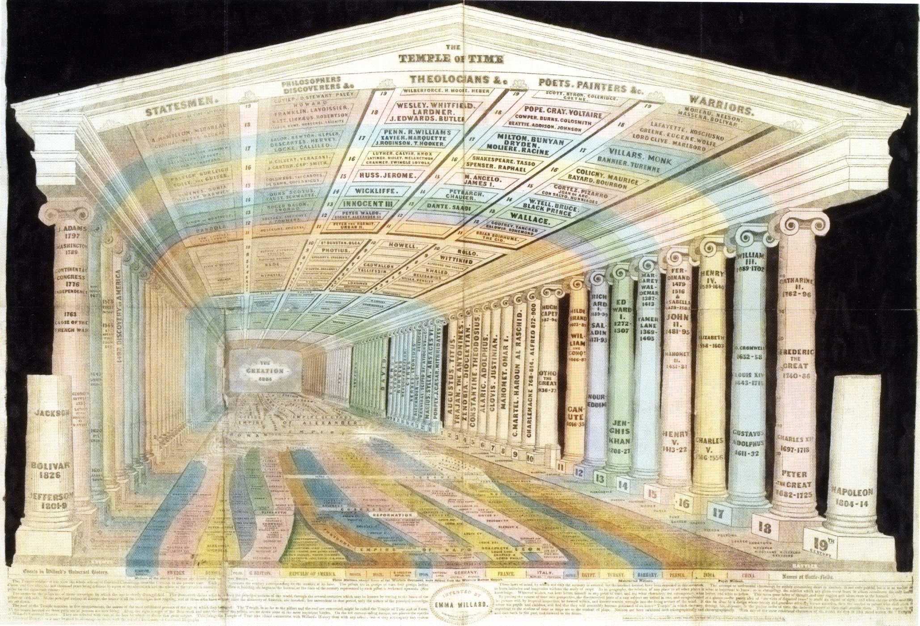

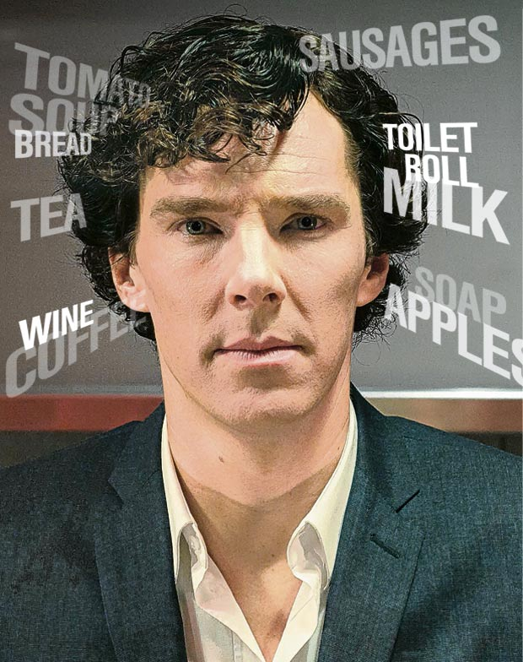
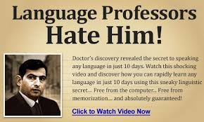
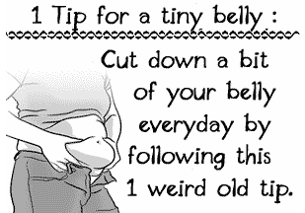

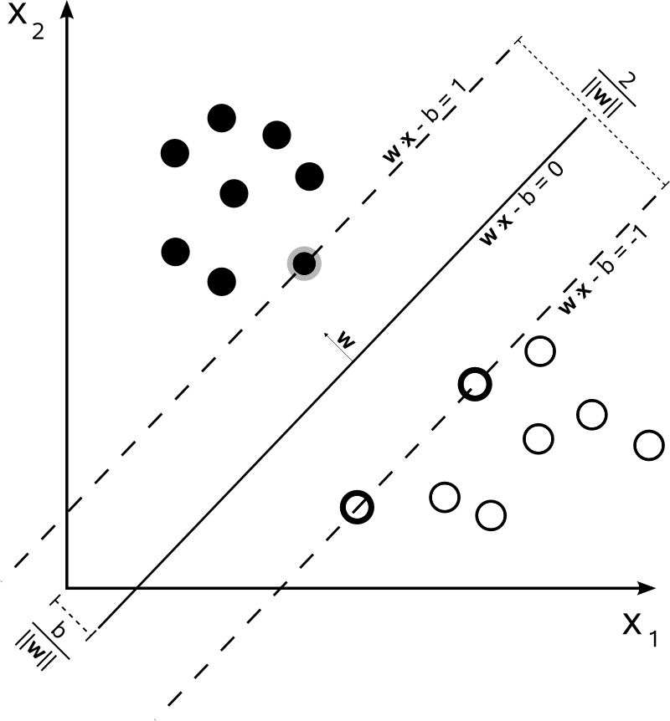
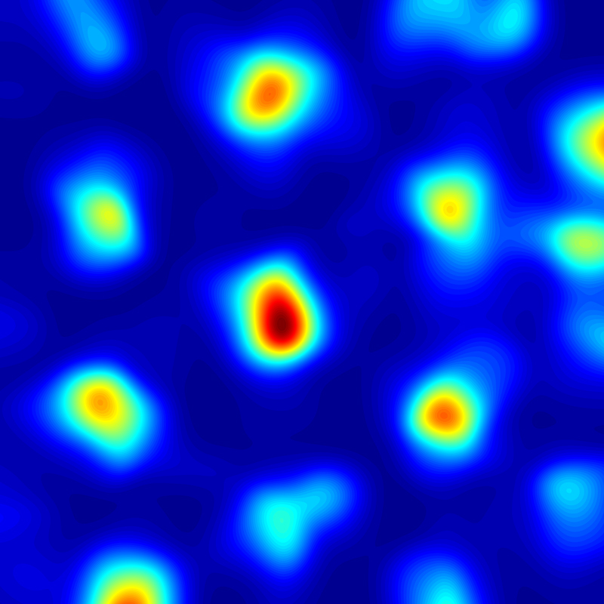
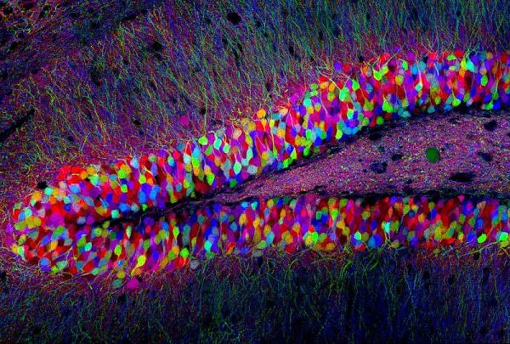
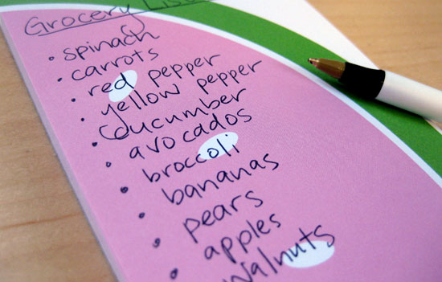
Overarching Approach
______________________________________________
- Systematically enhance memory
- Identify neural correlates of this enhancement
?
- Postulate as to how common neural mechanisms permit spatial and
non-spatial memory

Slide 4
Hypothesis
______________________________________________
If the binding of items to their spatial context is responsible for the effectiveness of the MoL, then an individual’s ability to “bring back” the appropriate encoding environment during recall should serve as a predictor for memory strength.
Notes:
The effectiveness of the Method of Loci is driven by a conscious exploitation of the remarkable vividness of our visuospatial memories by using spatial environments as scaffolding for memorizing non-spatial content.
However, a formal confirmation of such hypotheses is not without…--click-

Slide 5
Method of Loci Limitations
______________________________________________
Individuals vary in their ability to conjure up vivid memory palaces
Confounded controls
No objective measure of spatio-temporal contextual reinstatement.
Compliance
Notes:
If I give instructions to implement the MoL in the classic manner that I just described, people will naturally vary in their ability to conjure up memory palaces. Some may be large and rich with fantastical elements, others small, dull, or boring.
Second, if we had controls that were just instructed to memorize items, its hard to say that spatiotemporal binding is the crux of the effect. The effect could just be drive by picturing the object or thinking about it in an abstract way…
Furthermore, we’d have no way of objectively addressing the degree to which subjects, during recall, would be bringing back to mind the spatial context of the list of items they encoded. That is….we can’t directly test our hypothesis.
Lastly, if we want to allow for this technique to impact society or education in some capacity, it needs to a makeover. Many people are aware of its capabilities, but still don’t use it. If we made it easier to approach, perhaps more people would take advantage of it!
Fortunately, there is a methodology that has a solution to all of these….

Slide 6
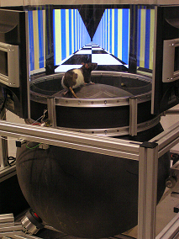
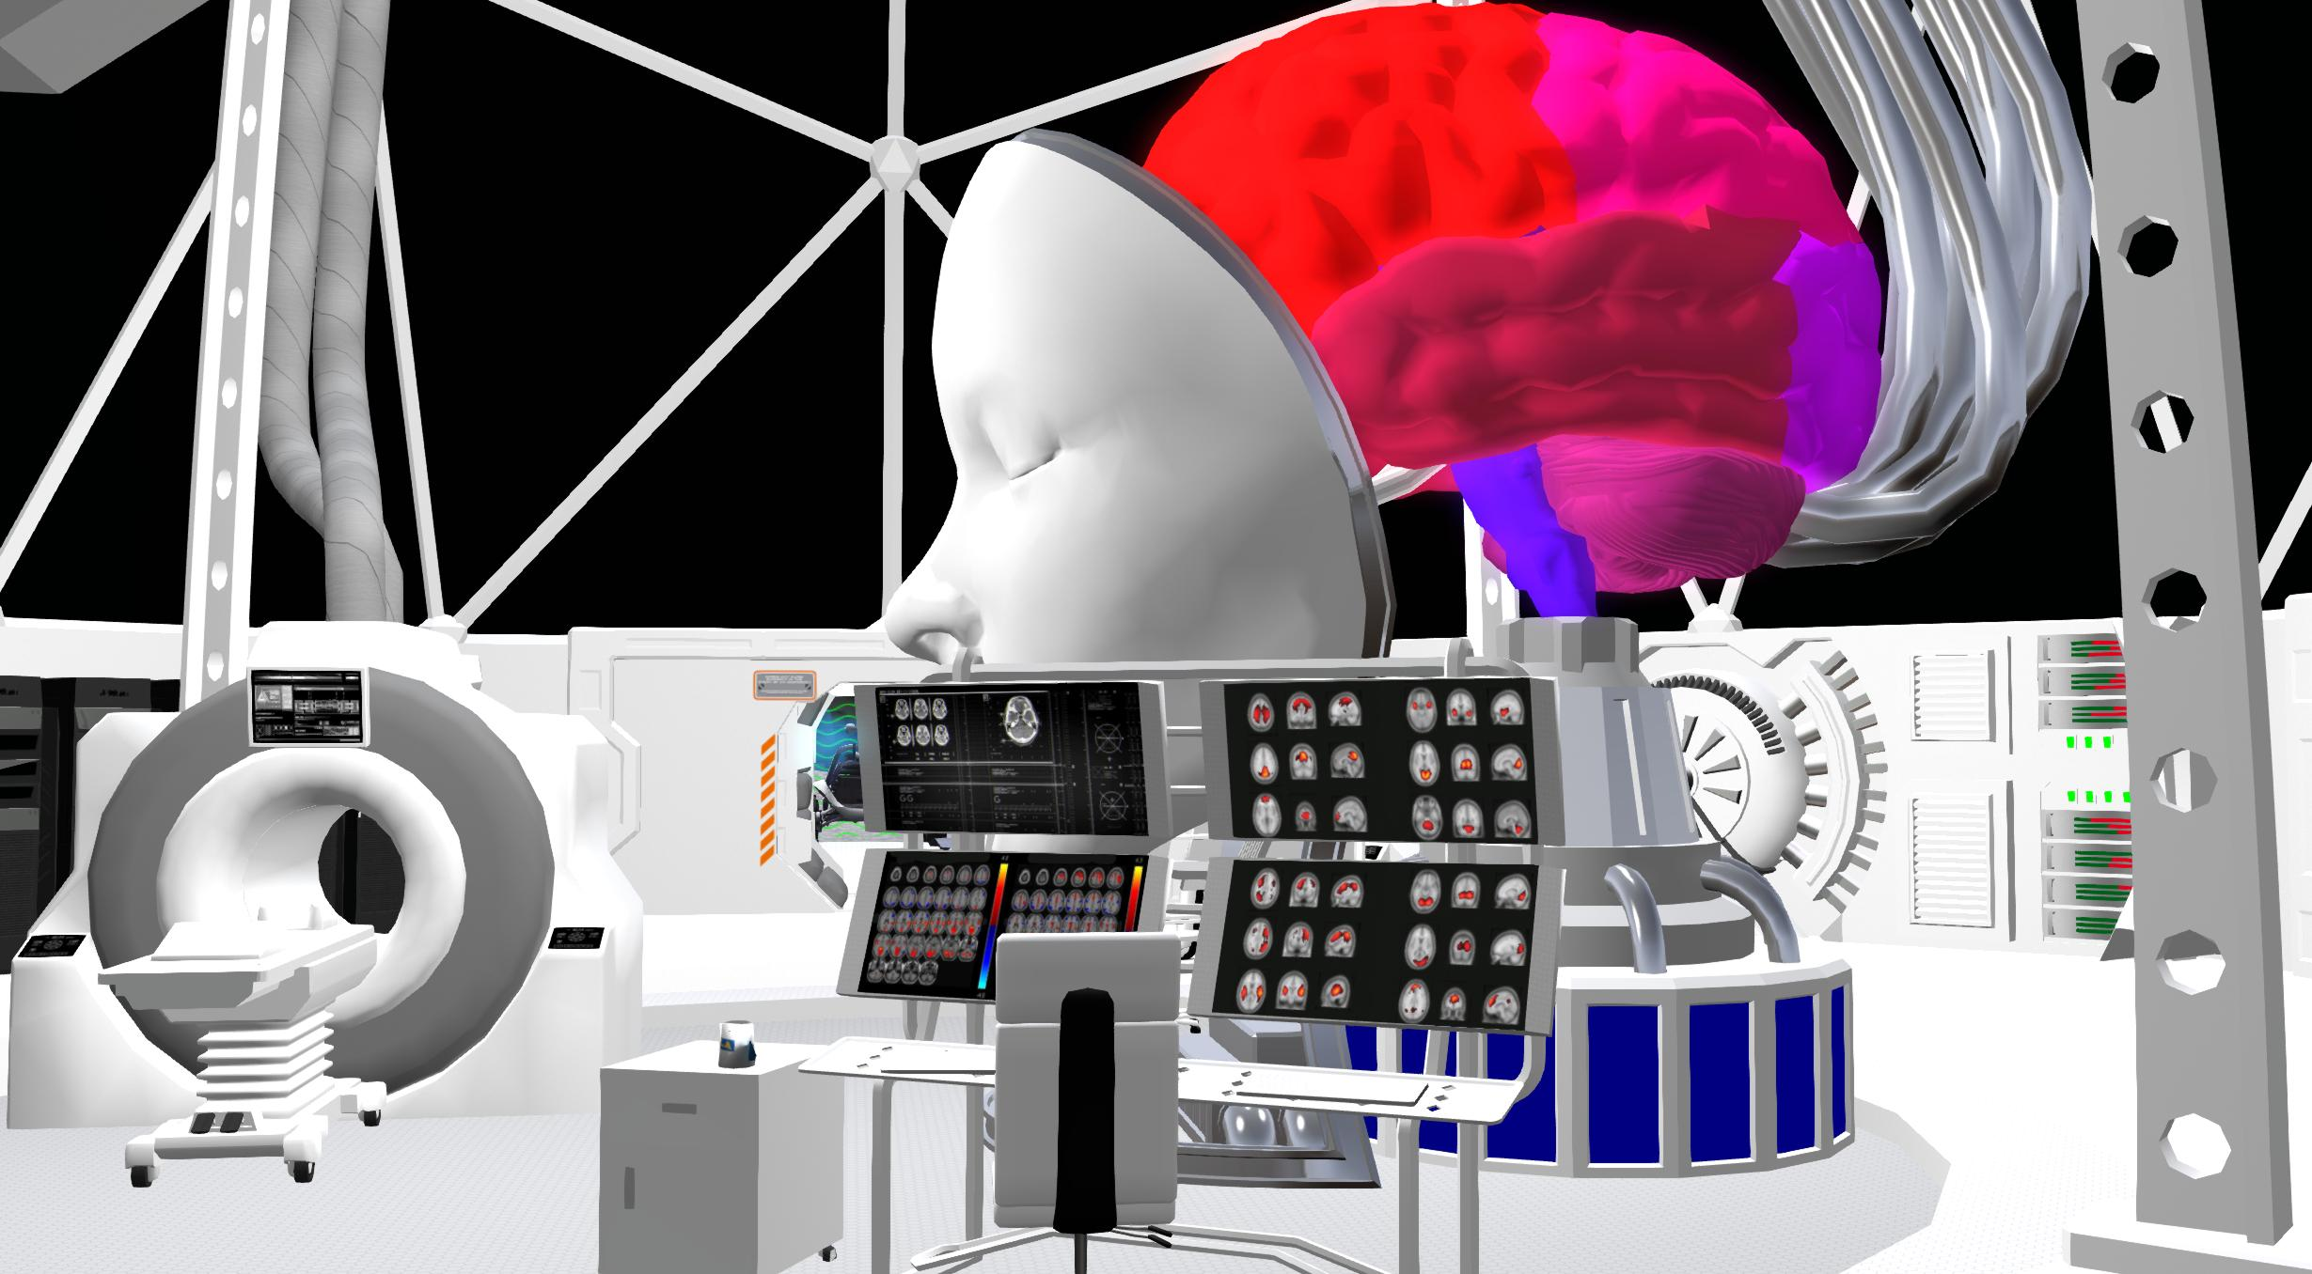
Virtual Reality
______________________________________________
Operationalization
Fantastical Elements
Subject / Experimenter Control Trade-Off
Ease of Use
Notes:
Virtual reality, a technique being used by rodent researchers for quite some time to reveal profound insights into the spatial menominc processes in the brain….allows us to:
Operationalize the MoL by creating “virtual memory palaces”
All the same size, all varying in context, all with fantastical elements that allow for interaction.
Now…we know the memory palaces and provide the same ones to each subject.
The subjects get to feel in control, but the experimenters put limits.

Slide 7
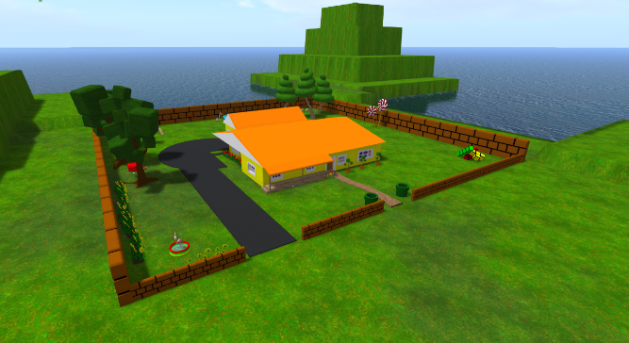
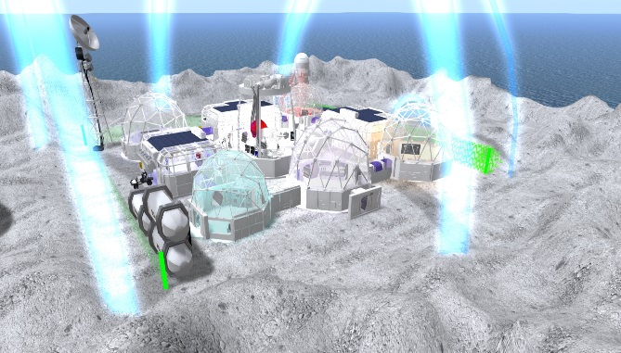
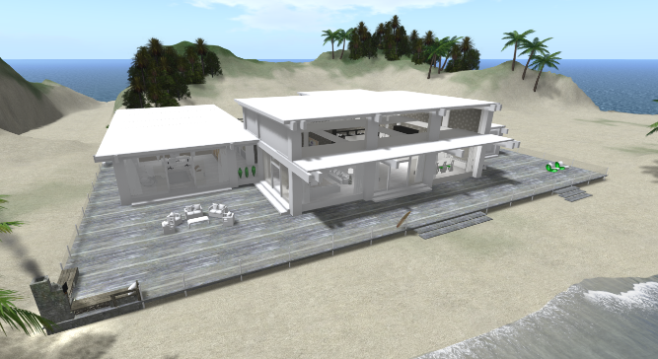
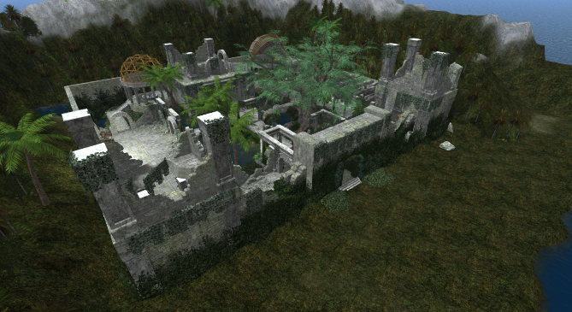
Systematically Enhance Memory
______________________________________________
Create virtual environments

Slide 8
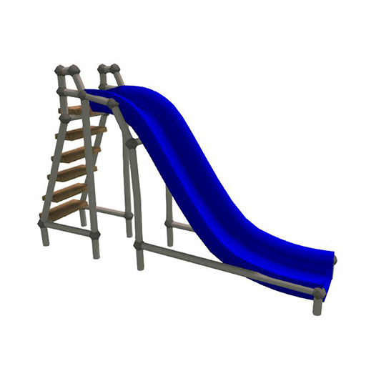
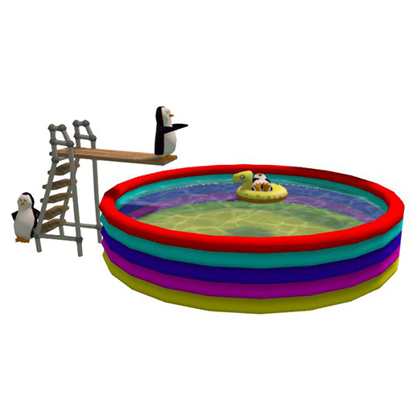
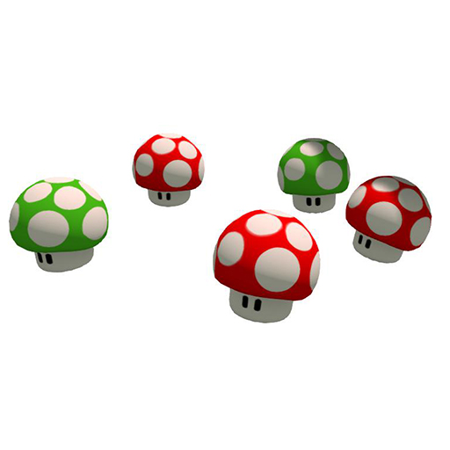
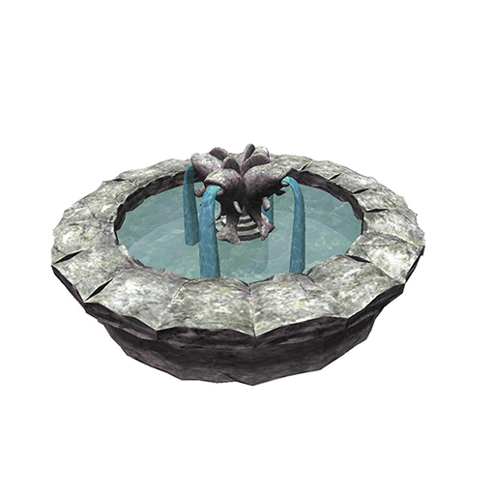
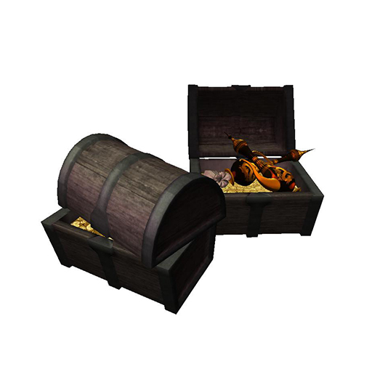
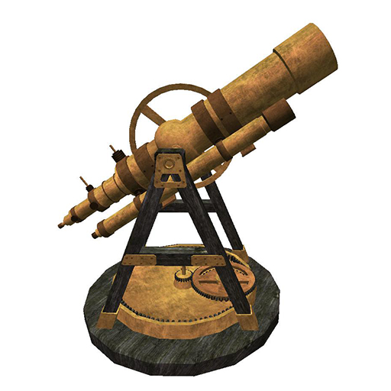
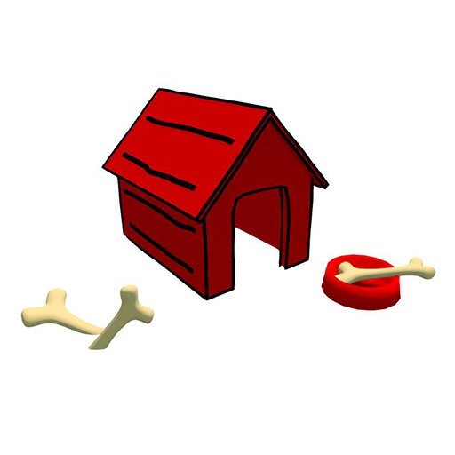

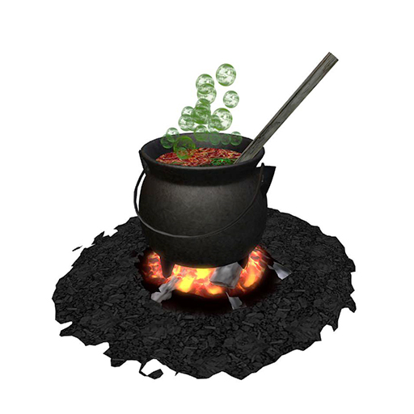
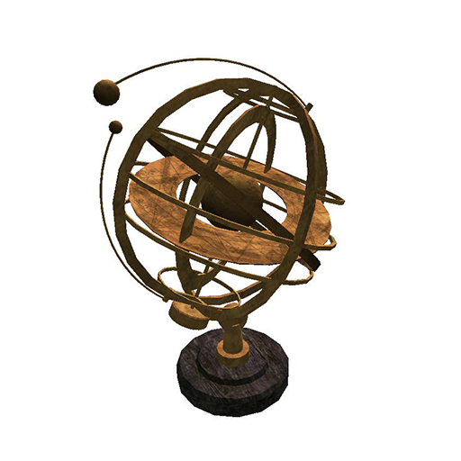
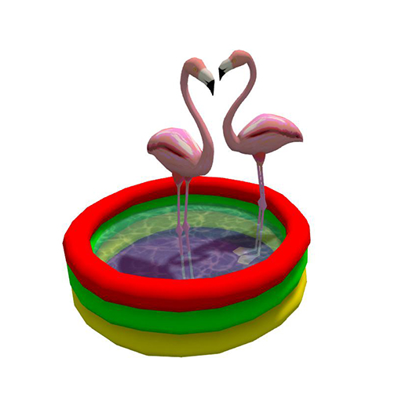
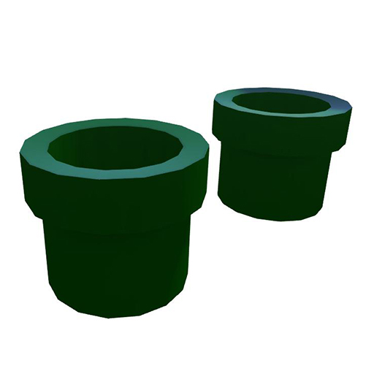
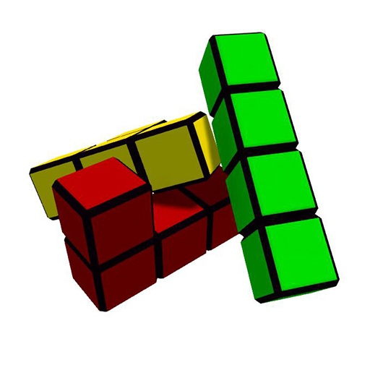

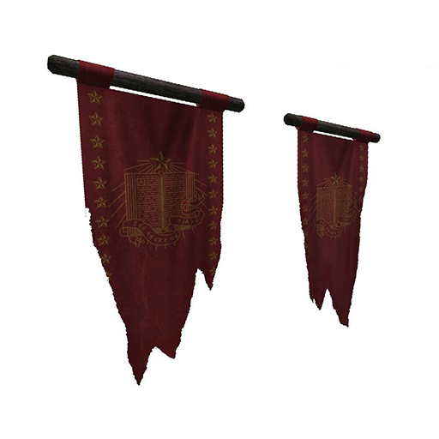
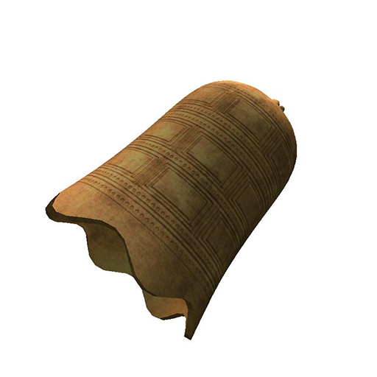
Systematically Enhance Memory
______________________________________________
Embed Landmarks
Toon Landmarks
Rune Landmarks

Slide 9
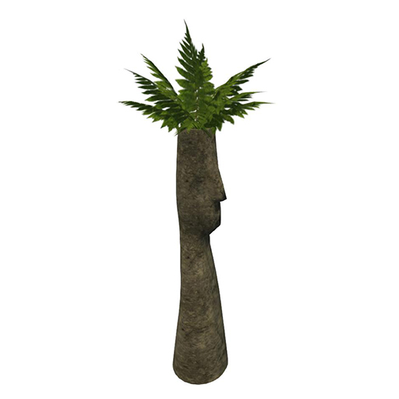
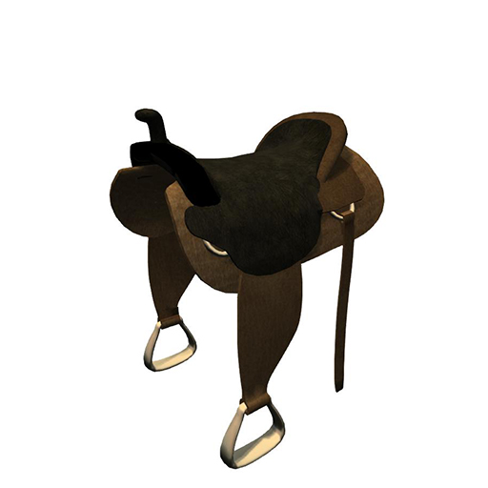
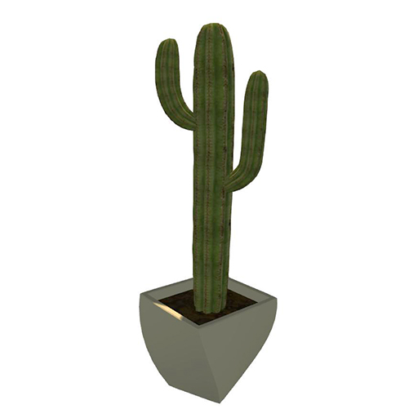
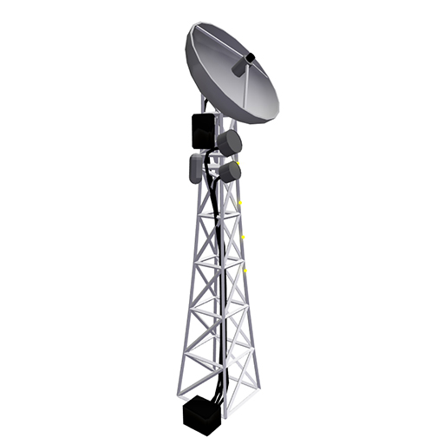
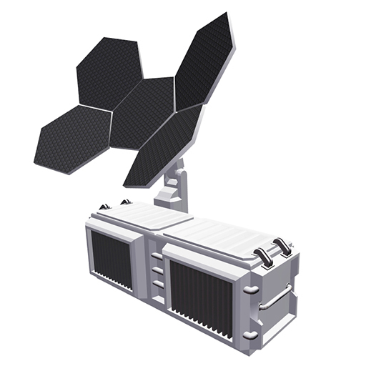
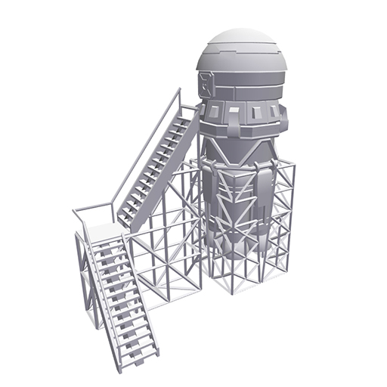
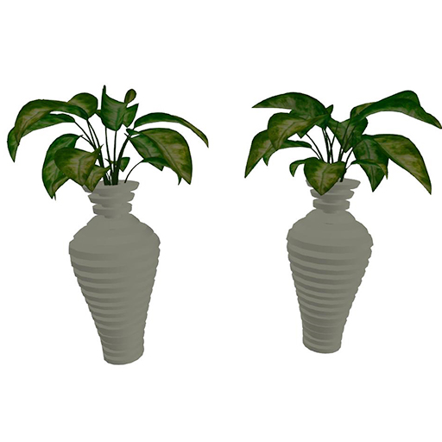
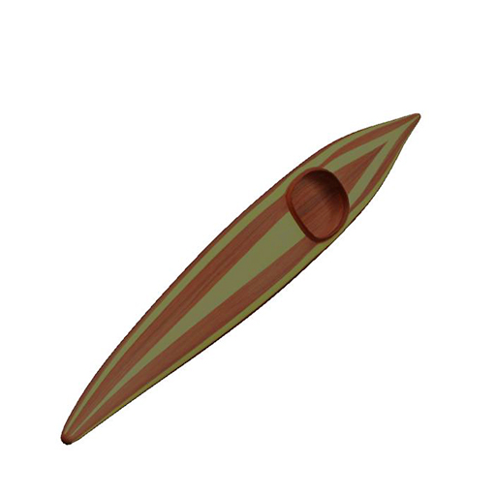
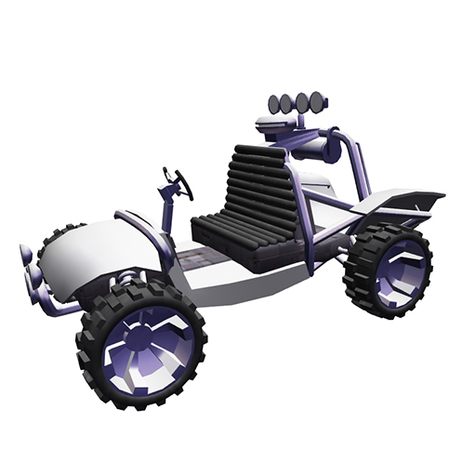
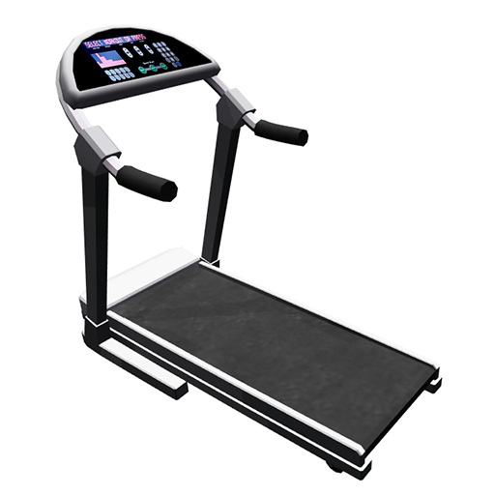
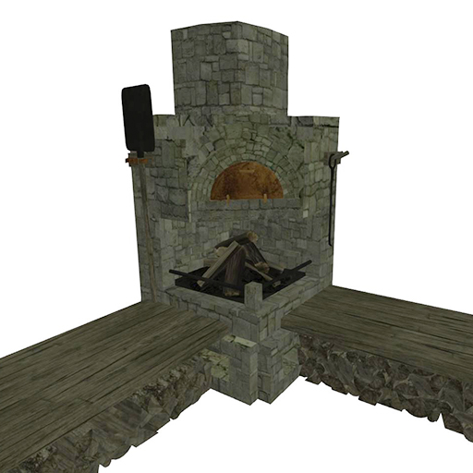
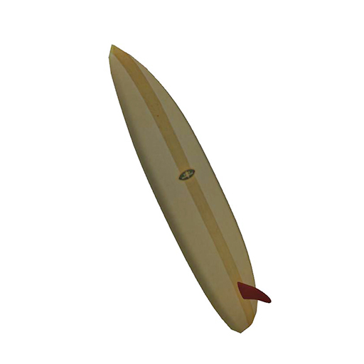
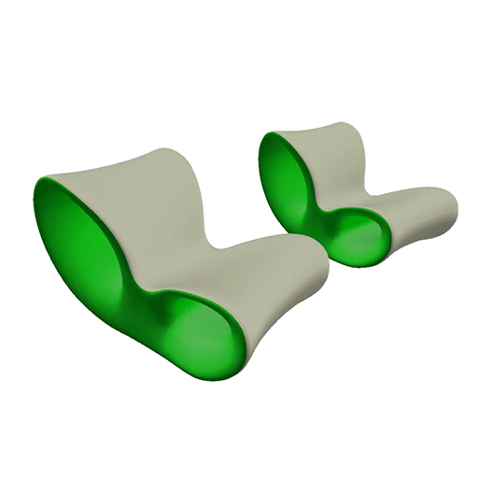
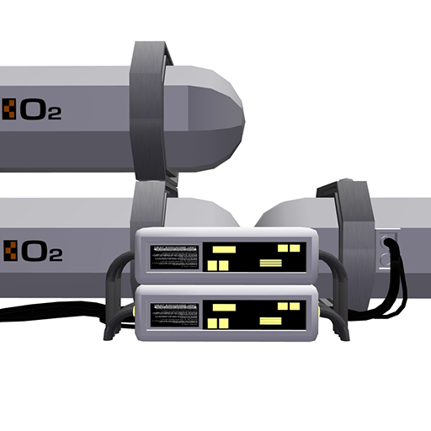
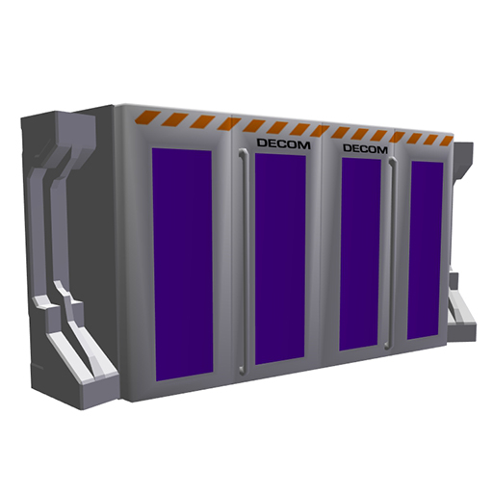
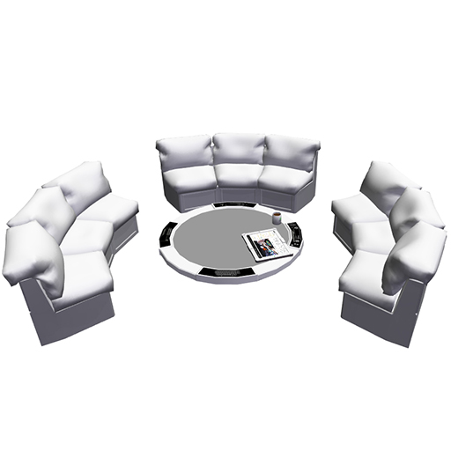
Systematically Enhance Memory
______________________________________________
Embed Landmarks
Lagoon Landmarks
Moon Landmarks

Slide 10
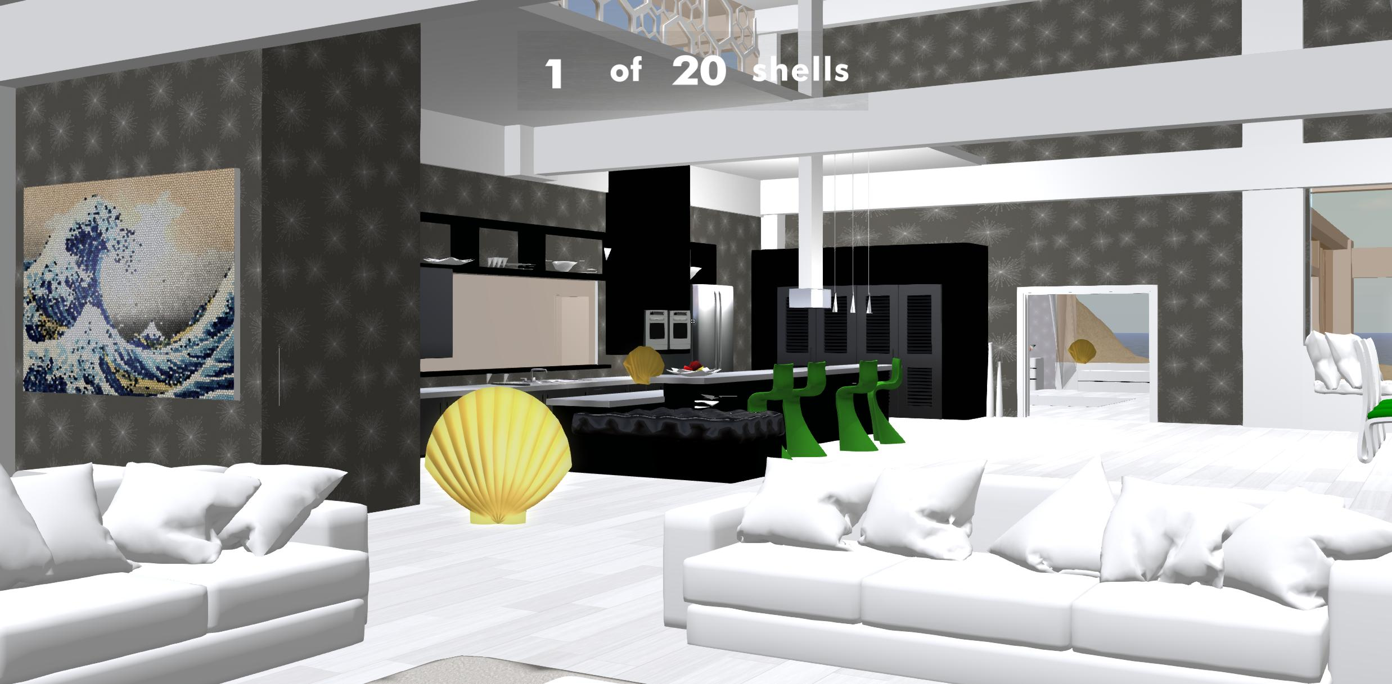
Systematically Enhance Memory
______________________________________________
Ensure Even Exploration: Token-Collection Task
Notes:
Explain what controls would do.

Slide 11
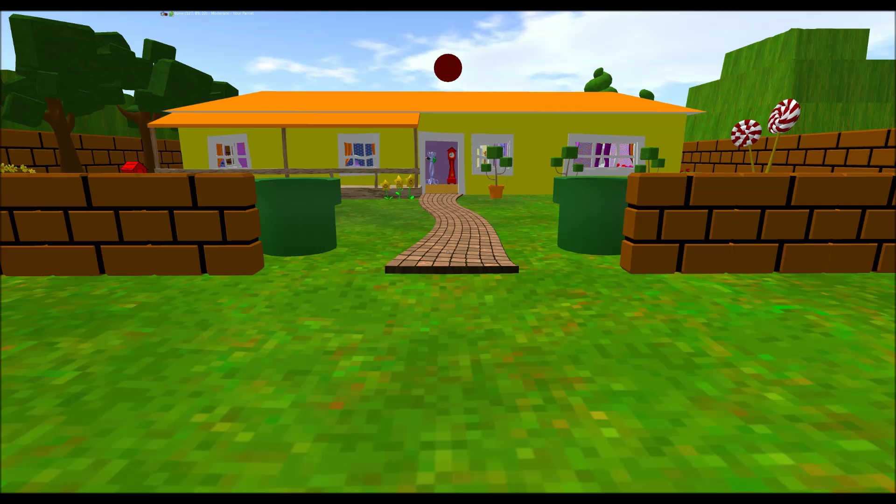
Systematically Enhance Memory
______________________________________________
Create “placement” software
Notes:
Explain what controls would do.

Slide 12
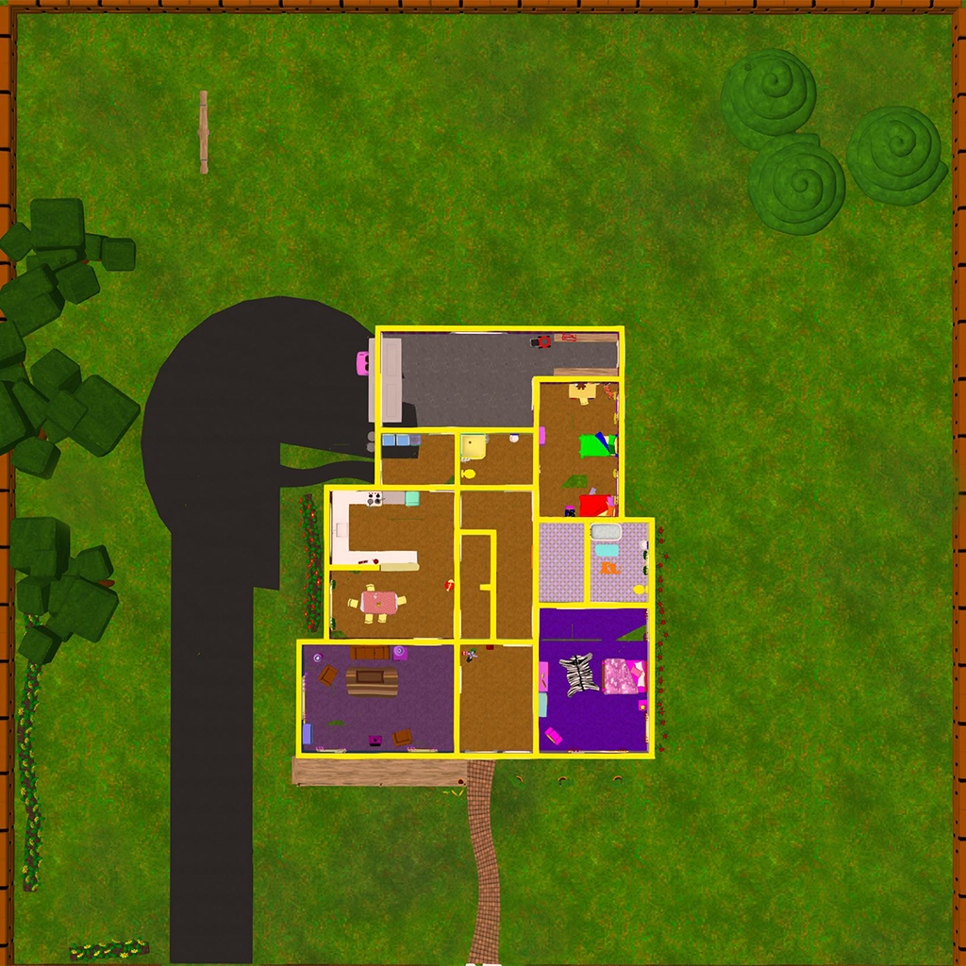
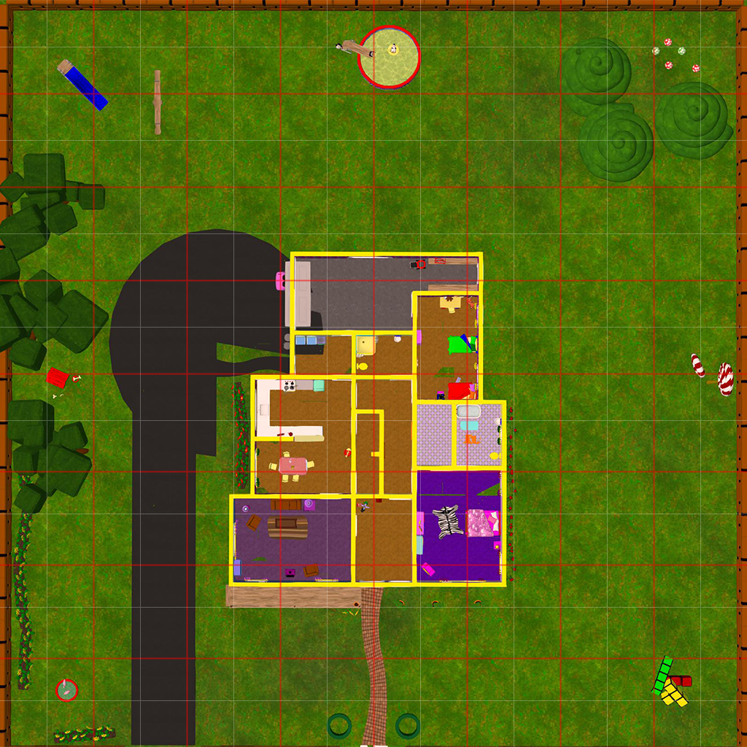
Systematically Enhance Memory
______________________________________________
Assess Allocentric Spatial Memory
Notes:
Never get to see. Infer allocentric from ego

Slide 13
Generalized Study Design
______________________________________________
Token Collection
Memorization
MoL Group: instructed on MoL and to use the environment as their “vritual memory palace and “place” objects
Control Group: instructed to implement a “walk and learn” strategy
Rehearsal by Screen-Capture
Spatial Testing
Free Recall
Notes:
This study design was just to make sure that it works before we go on to test our more direct hypotheses.

Slide 14


2 Worlds Behavioral Results (n=22)
______________________________________________
Notes:
Just wanted to make sure it replicates the classic technique…..

Slide 15
3 Worlds Behavioral Results (n=11)
______________________________________________
Notes:
Just wanted to make sure it replicates the classic technique…..

Slide 16
Hypothesis
______________________________________________
If the binding of items to their spatial context is the driving force behind the effectiveness of the MoL, then an individual’s ability to “bring back” the appropriate encoding environment during recall should serve as a predictor for memory strength.
Pilot
Question: Can we decode the contents of an individual’s mental imagery?
Notes:
So, we know from classic experiments that the MoL works. What we are concerned with here is testing our particular hypothesis regarding how it works.
The idea is that if subjects are recalling information that they learned in virtual environments while outside of those environments, can we predict, from their brain activity, which of the environments they were in when they encoded that information? And if so…does the degree of that decoding ability scale with their memory strength?
So, first we needed to establish if we could decode which environment a subject was imagining themselves in in order to establish an “upper bound” of sorts for when we attempt to decode, during recall, which world they encoded the information in.
--click—
So, we started out with a pilot to answer exactly that question.

Slide 17
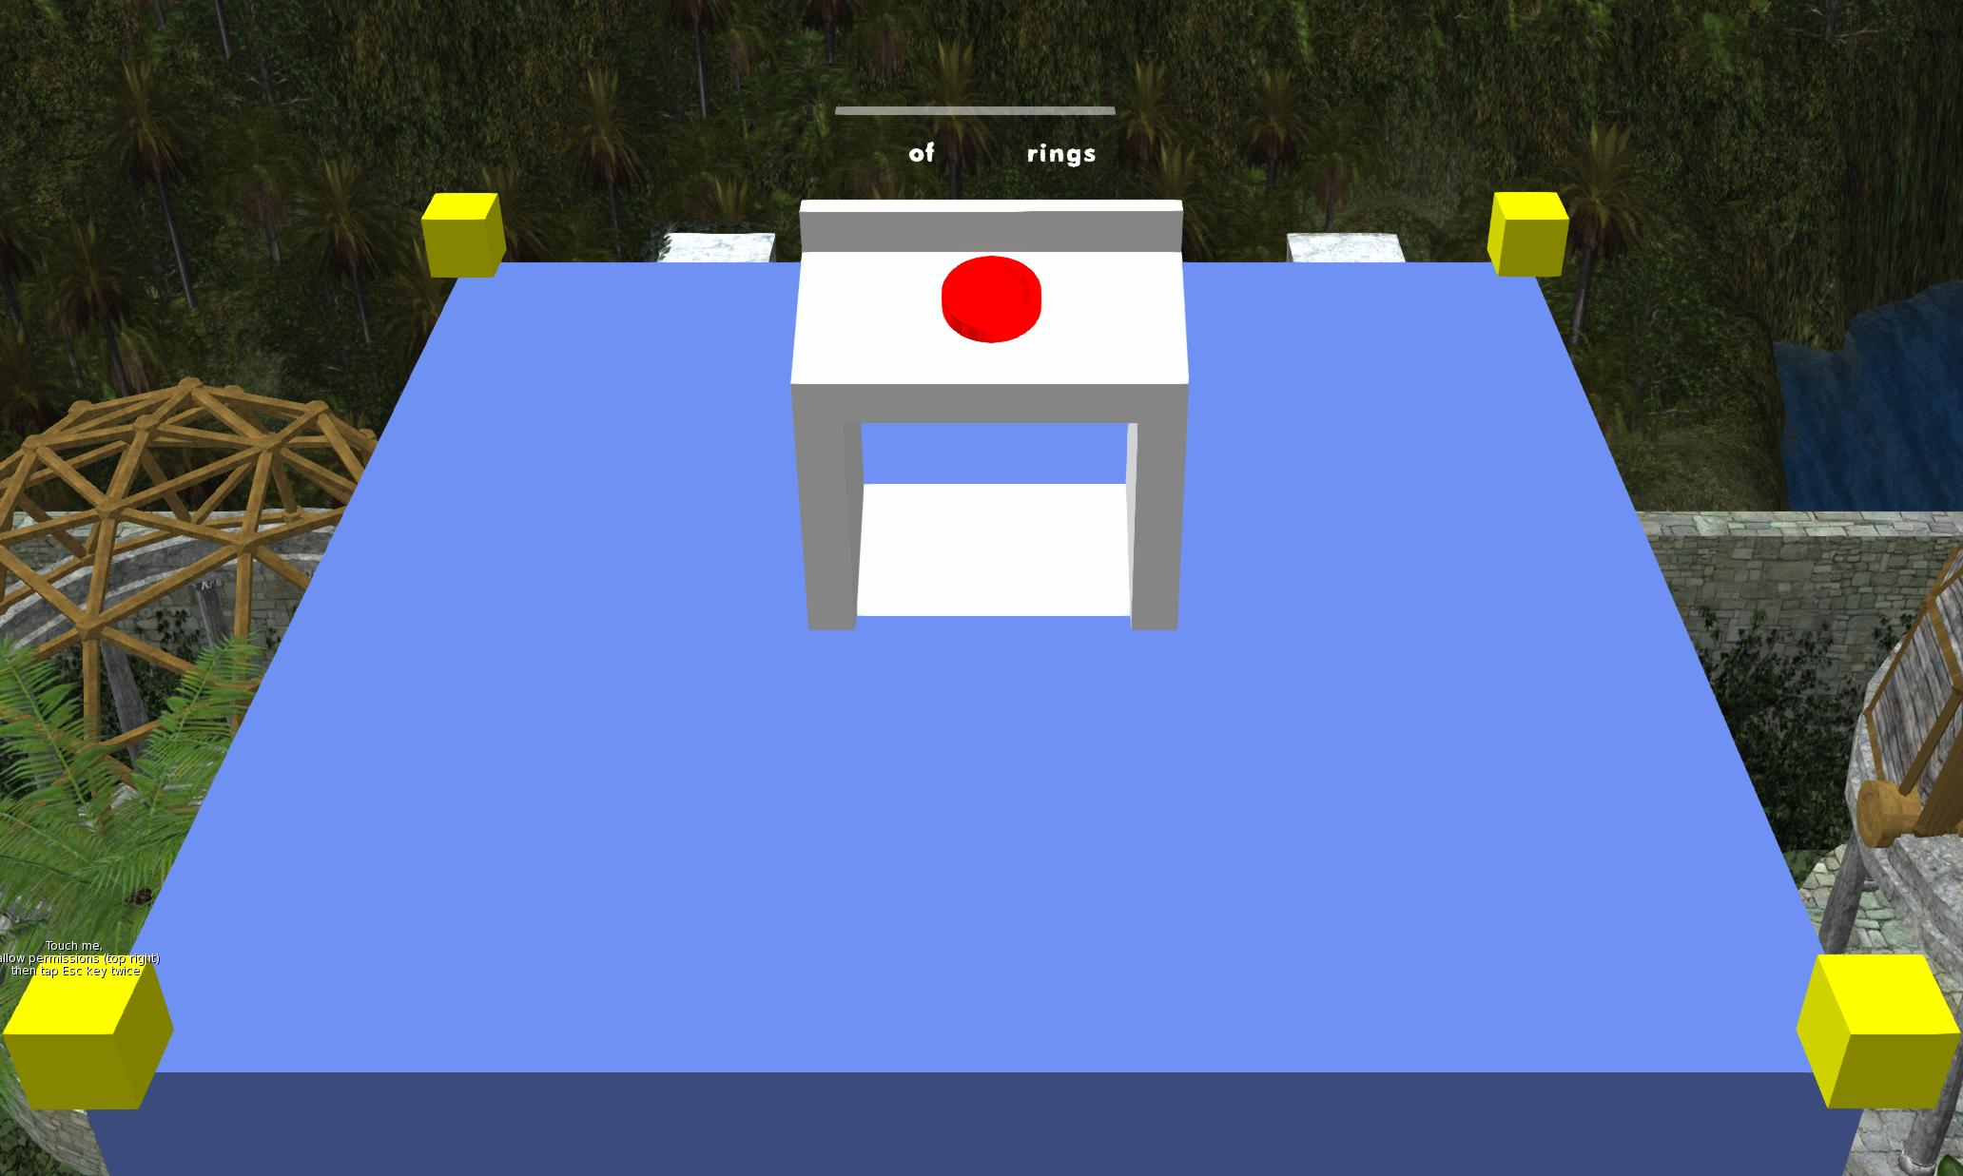
Pilot
______________________________________________
Day 1 Design
Token Collection Task
Please head over to the Treasure Chests landmark.
Now go to the Red Flags landmark, and make sure that you pass the Sun Plaque landmark on the way.
Guided Navigation
Notes:
Menmonics like memory palace WORK, people just don’t use them. Compliance is the major issue

Slide 18
Pilot Study Design
______________________________________________
Day 2(In Lab)
More Guided Navigation
Please head over to the Horse Saddle landmark.
Now, please head in a circle around the perimeter of the map, back to the Horse Saddle. However, make sure that the first landmark you pass is the Giant Cactus.
Spatial Testing

Slide 19
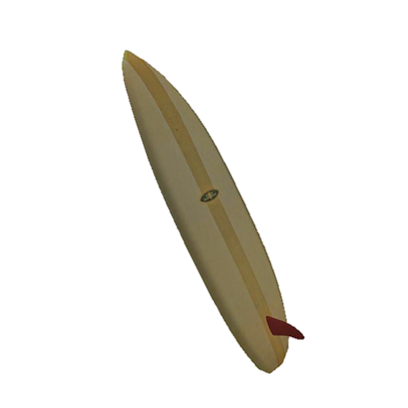

Pilot Study Design
______________________________________________
Day 2(In Scanner)
Video Viewing
Mental Imagery
Lagoon World
Starting
(Full Circle)
1st Landmark

Slide 20
Pilot fMRI Methods
______________________________________________
32-Channel head coil with optimized settings (from a pilot-pilot)
Multi-Band Acquisition with an Acceleration Factor
Whole Brain: 2.2mm voxel size in 1.5s
Support Vector Machines Searchlight
Notes:
With RSA we can show areas that are maximally dissimilar when viewing one world vs. another or when viewing one direction as opposed to another.
It assumes that the the pattern of BOLD activity within a set of voxels should be dissimilar
With SVM we can see which set of voxels provide the most predictive power in being able to predict in an unseen brain state what world the subject is viewing or imagining and what direction they are heading.

Slide 21



Which World Are They Viewing?
______________________________________________
When someone is viewing 30s videos of their avatar traversing virtual environments, which areas of the brain contain information pertaining to the context of that world? If we were to look at a pattern of local brain activity, could we predict which world the subject was viewing? Chance would be 33%. These images are thresholded at 38% - 50%
When we average over all subjects…
When we look only at males…
When we look only at females…

Slide 22



Which Direction Are They Viewing?
______________________________________________
Now, what about when subjects are imagining themselves moving about three different virtual environments? If we were to look at a pattern of local brain activity, could we predict which world the subject was imaging? Chance would be 33%. These images are thresholded at 38% - 50%
When we average over all subjects…
When we look only at males…
When we look only at females…

Slide 23



Which World Are They Imagining?
______________________________________________
Which regions of the brain encode the trajectory about which a person is viewing their avatar move about an environment? If we were to look at a pattern of local brain activity, could we predict which direction the subject was viewing? These classifications looked at directionality irrespective of which world the subject was in. Chance would be 50%. These images are thresholded at 55% - 60%
When we average over all subjects…
When we look only at males…
When we look only at females…

Slide 24



Which Direction Are They Imagining?
______________________________________________
Now, what about when a subject is imagining themselves traversing about a virtual environment? If we were to look at a pattern of local brain activity, could we predict which direction the subject was imagining themselves moving about the environment? These classifications looked at directionality irrespective of which world the subject was in. Chance would be 50%. These images are thresholded at 55% - 60%
When we average over all subjects…
When we look only at males…
When we look only at females…

Slide 25



Can We Decode Imagery From Perception?
______________________________________________
What areas of the brain contain information about environment context during viewing that then express similar information during mental imagery? These regions could be thought of as “re-expressing” the original viewing-patterns during imagery. In order to identify regions with such a profile, we trained a classifier on viewing data, labeled by world, and tested it on imagery data. Chance would be 33%. These images are thresholded at 38-50%.
When we average over all subjects…
When we look only at males…
When we look only at females…

Slide 26

Can We Decode Imagery From Perception?
______________________________________________
What areas of the brain contain information about trajectory direction during viewing that then express similar information during mental imagery? These regions could be thought of as “re-expressing” the original viewing-patterns during imagery. In order to identify regions with such a profile, we trained a classifier on viewing data, labeled by directionality, and tested it on imagery data. Chance would be 50%. These images are thresholded at 55-60%.
When we average over all subjects…
No Regions
When we look only at males…
No Regions
When we look only at females…

Slide 27

Identify Neural Correlates
______________________________________________
If the binding of items to their spatial context is the driving force behind the effectiveness of the MoL, then an individual’s ability to “bring back” the appropriate encoding environment during recall should serve as a predictor for memory strength.
  We can decode the contents of an individual’s mental landscape.
  Can we decode during recall?
Which patterns are available during recall that allow us to predict not only which environment the information was encoded but also which encoding strategy was used?
Notes:
Our pilot answered the question that we can in fact decode the contents of a mental imagery, so we can now test the degree to which we can decode environmental context as subjects recall information that was encoded within these
That is…. Identify the neural correlates of implementation of the MoL technique.

Slide 28


Future Directions
______________________________________________
Increasing immersion/presence to create more robust effects

