Slide 1
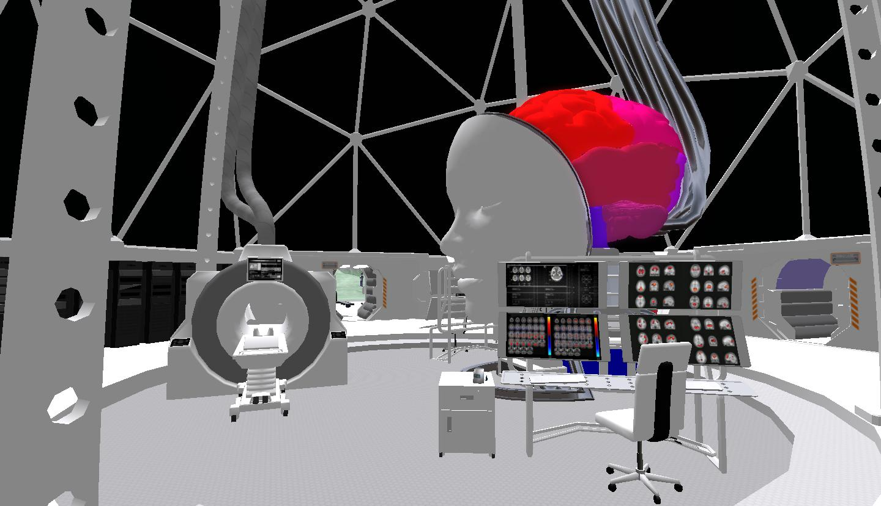
Decoding the contents of mental navigation: A virtual reality and fMRI study
Nicco Reggente | CSSA | April 23, 2016

Slide 2
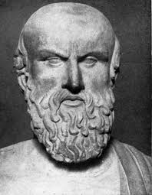
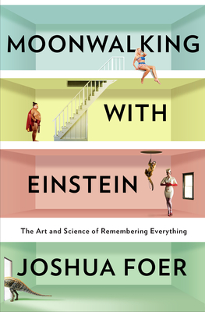
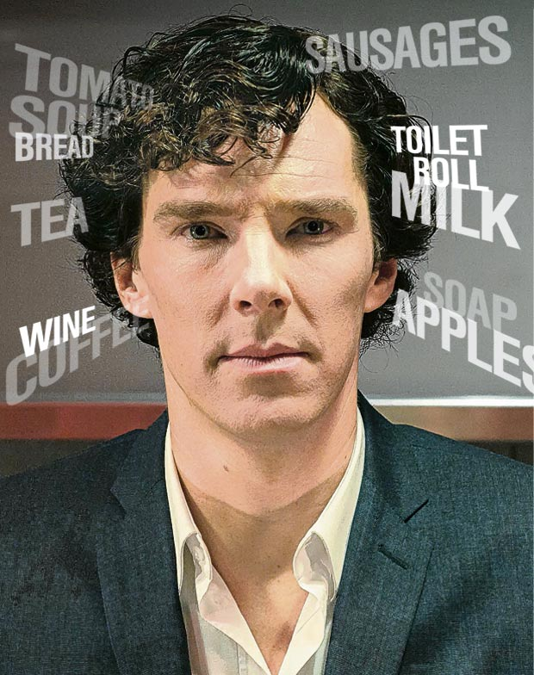
Motivation
My research is focused on the Method of Loci, a spatially founded mnemonic technique that can quadruple your memory for lists of items.
We hypothesize that this is because the brain recruits its oldest and most advanced neural architecture: that which processes spatial navigation.
When people recall items that were encoding using this method, there should be a great deal of contextual reinstatement.

Slide 3
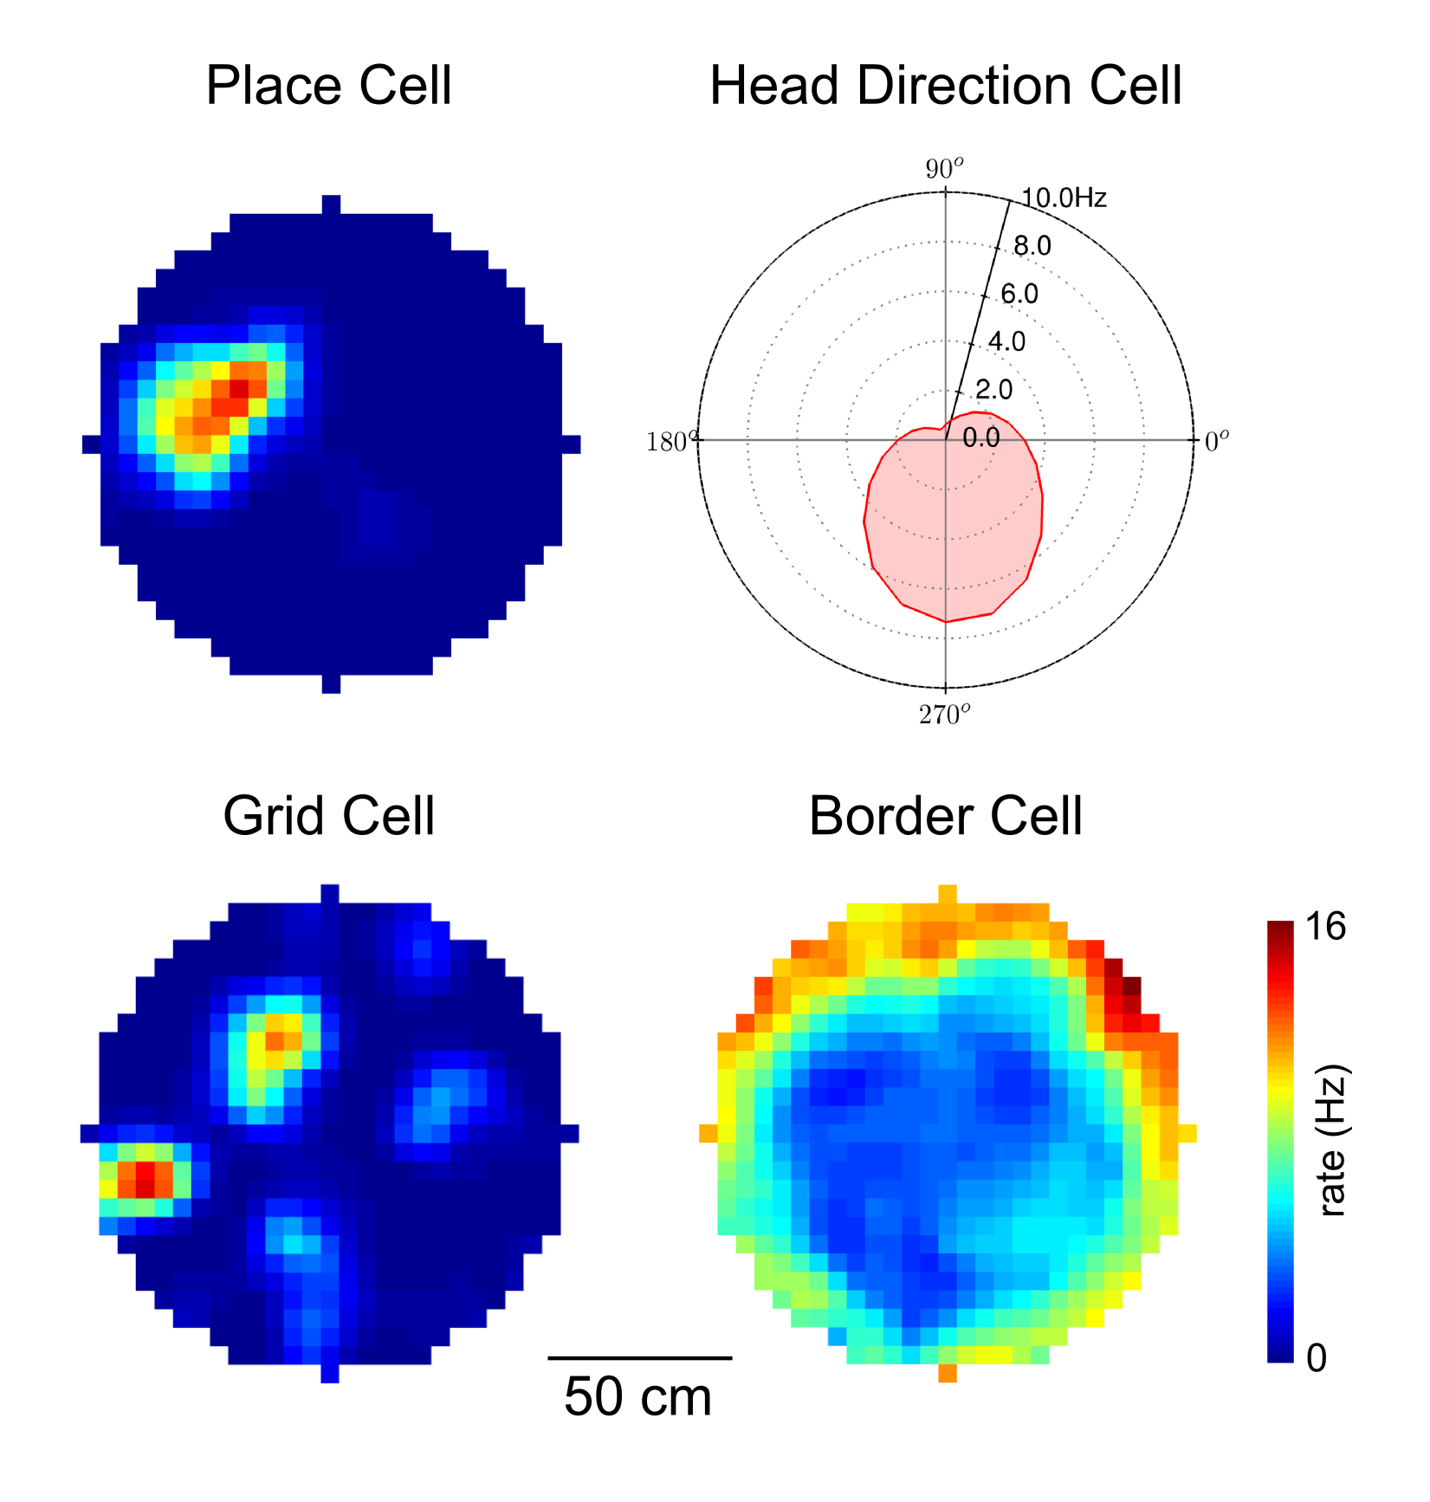
Motivation
We know a great deal about the neural systems supporting navigation.
However, can we measure contextual reinstatement?
We needed to design a pilot task to determine.

Slide 4
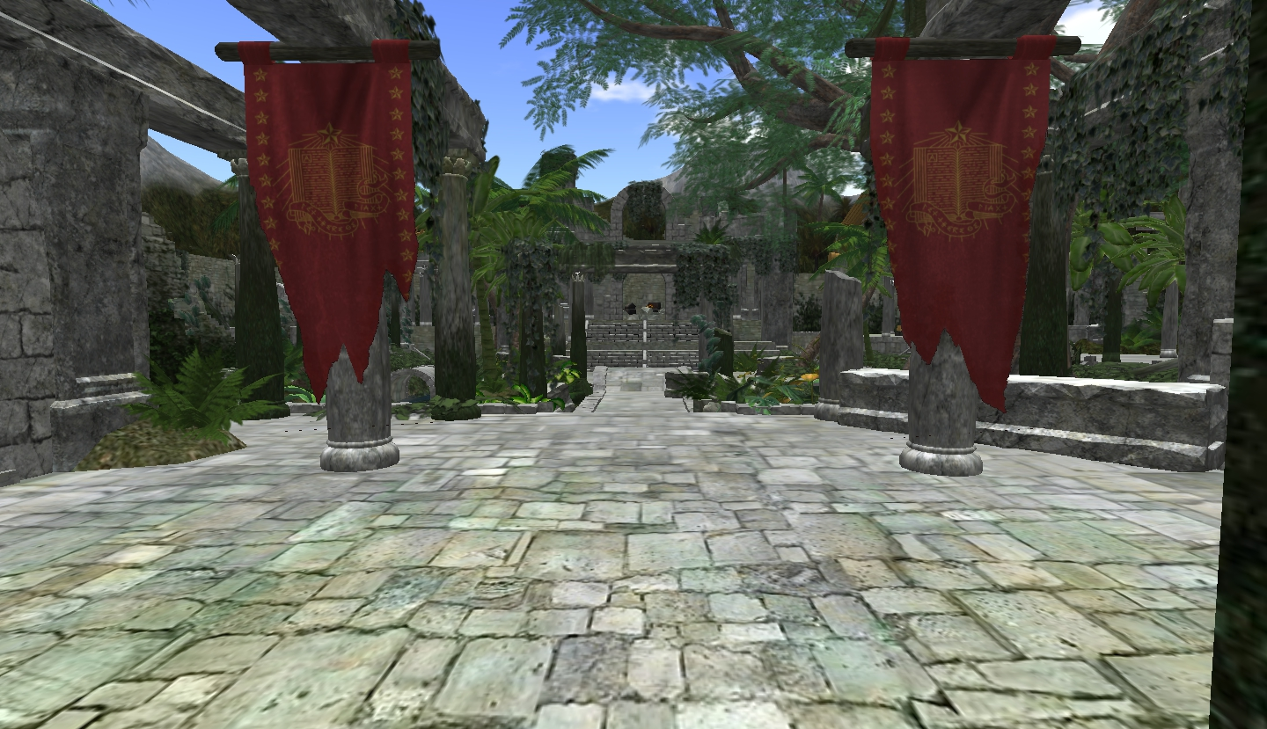
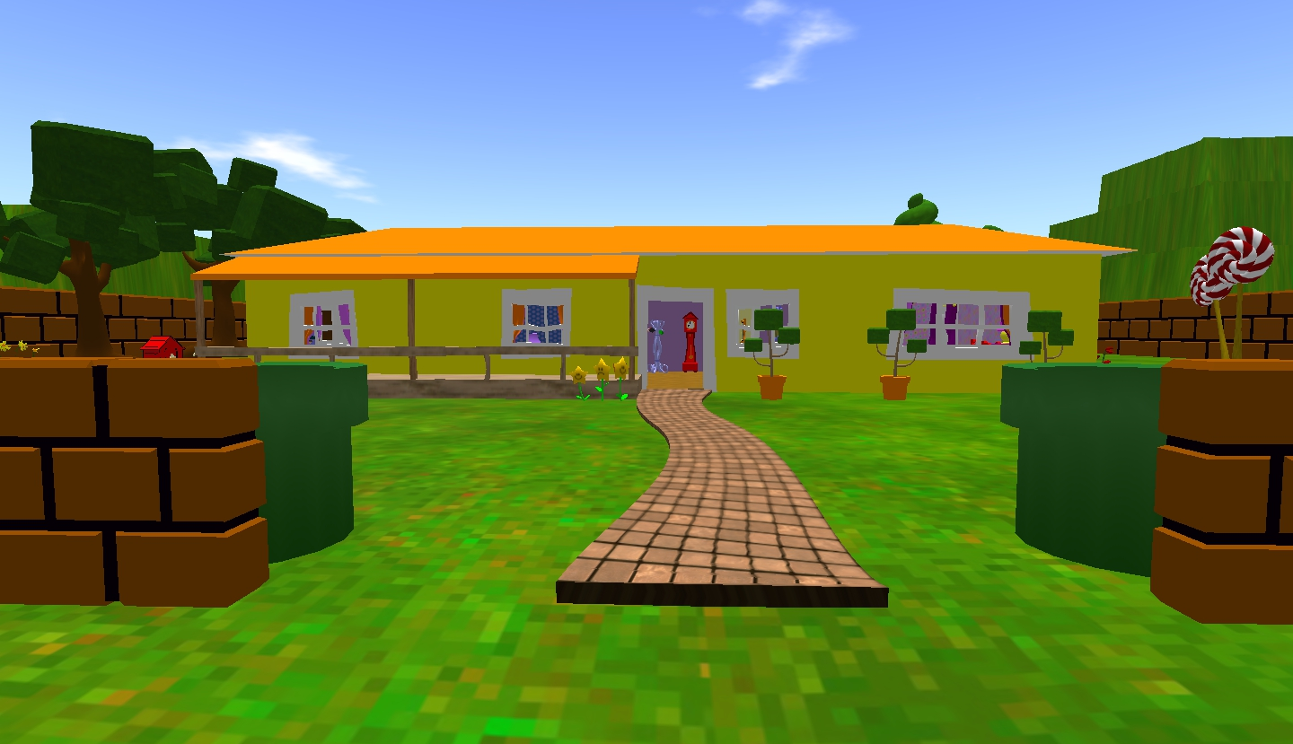
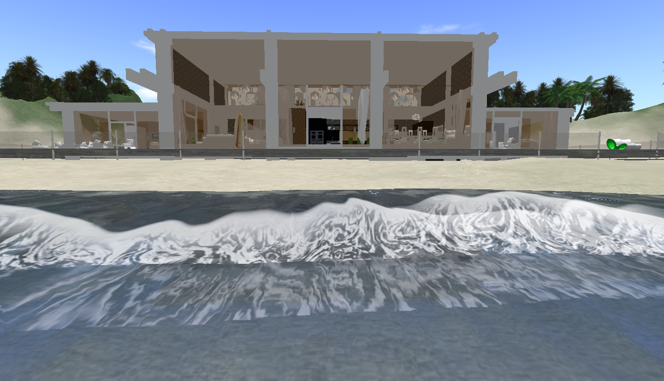
Distinct Virtual Environments
VR is based in Open Sim
Matched for size and lighting
Ruin World
Toon World
Lagoon World

Slide 5
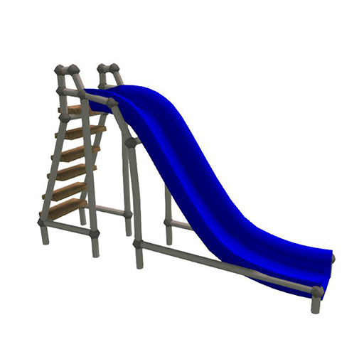
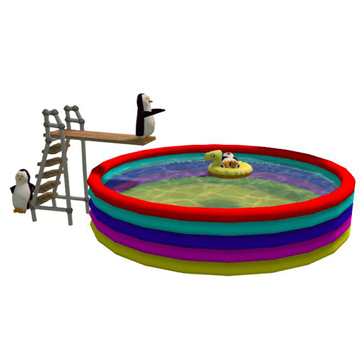
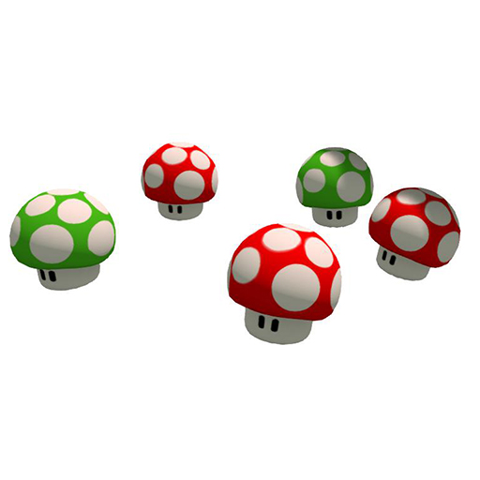
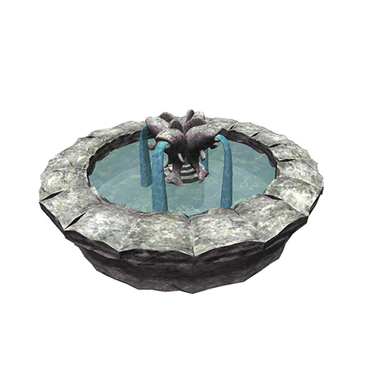
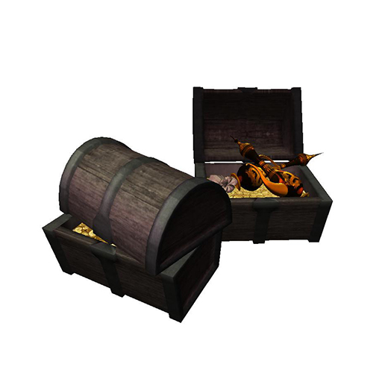
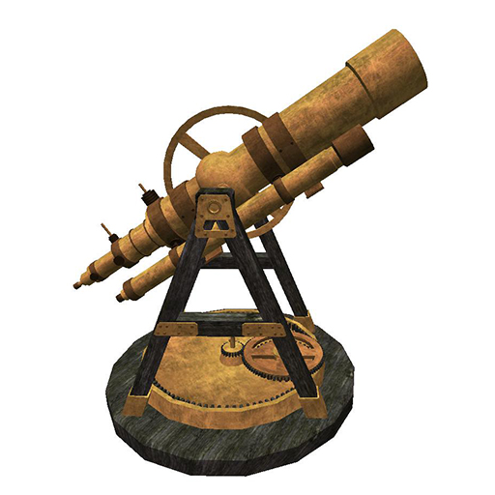
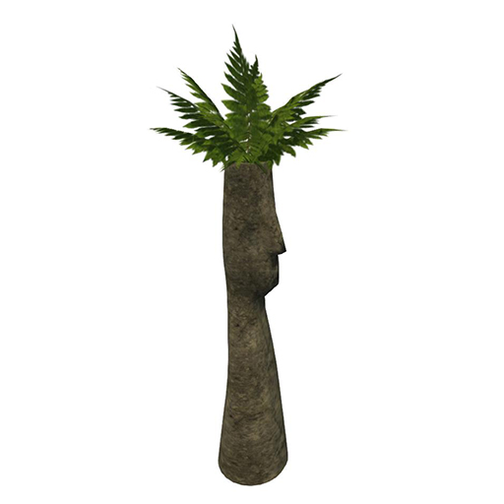
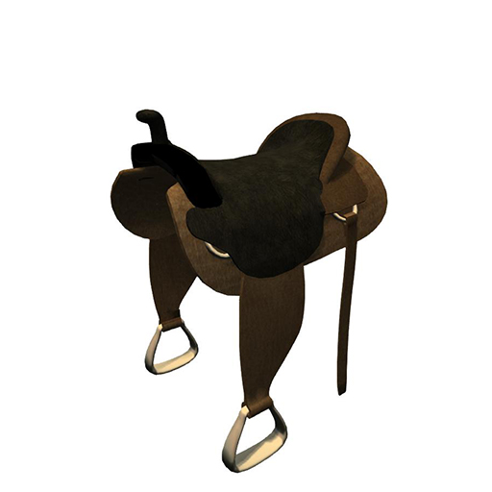
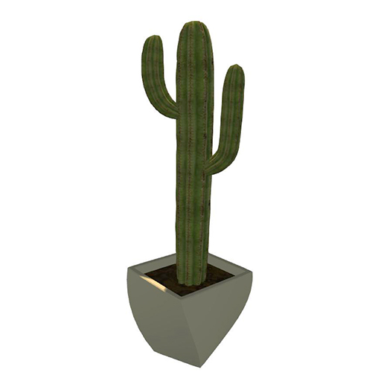
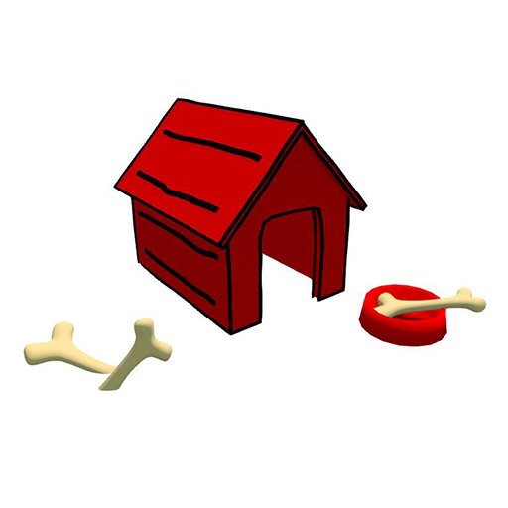

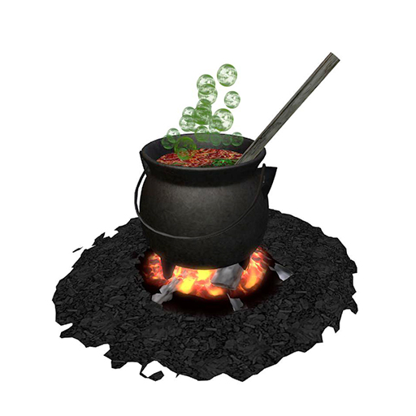
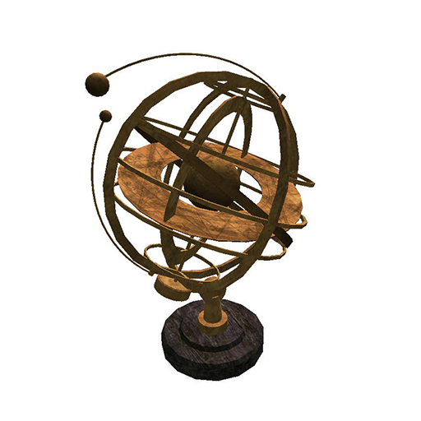
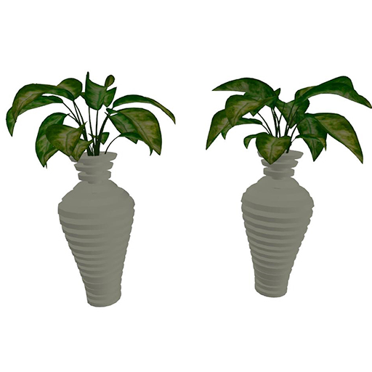
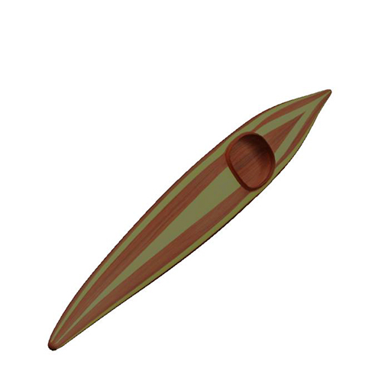
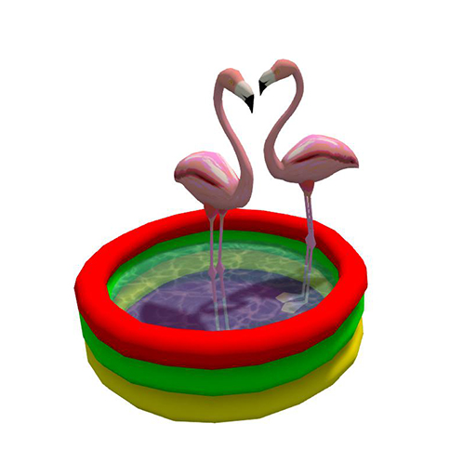
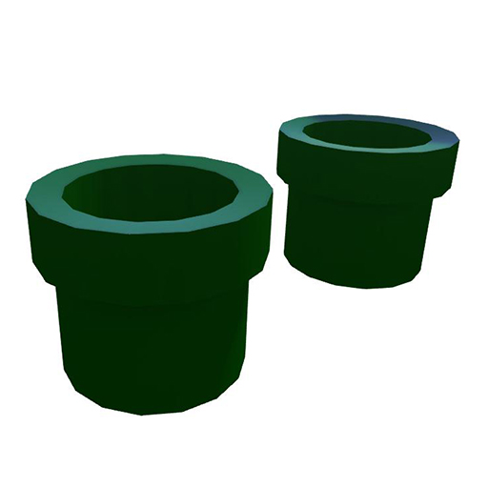
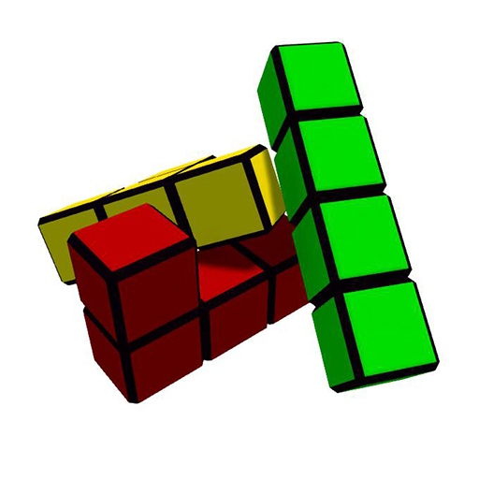


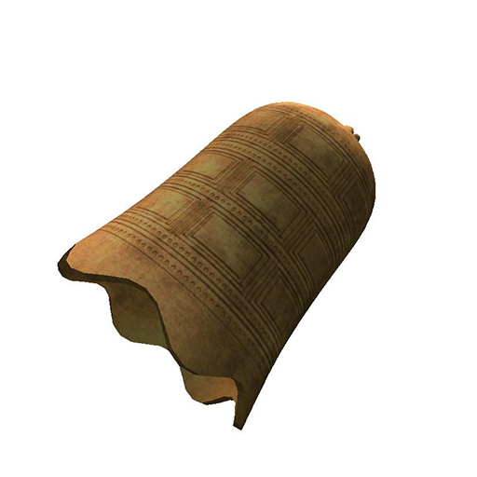
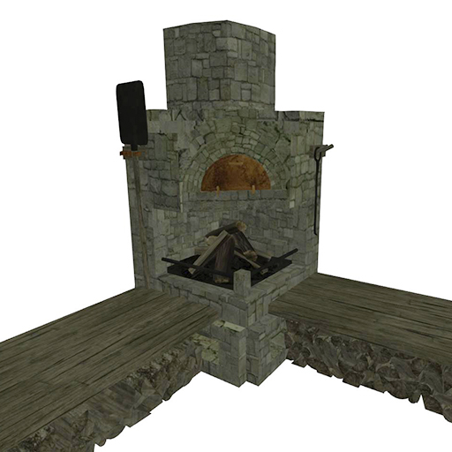
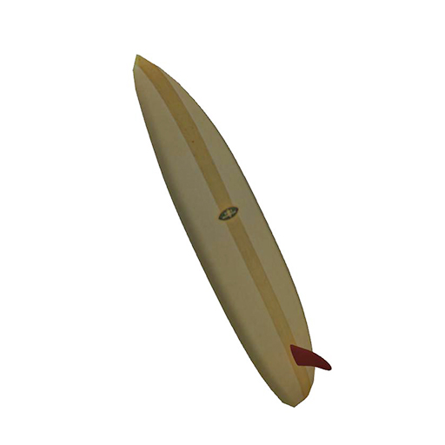
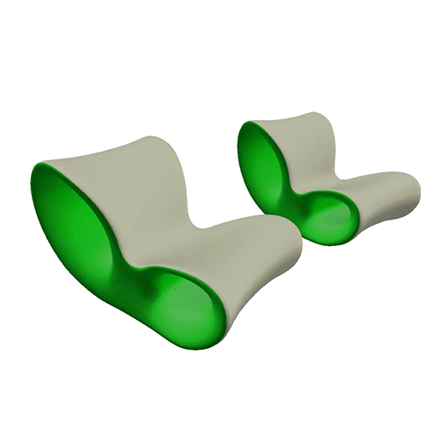
Landmarks
8 Landmarks at the cardinal perimeter points

Slide 6
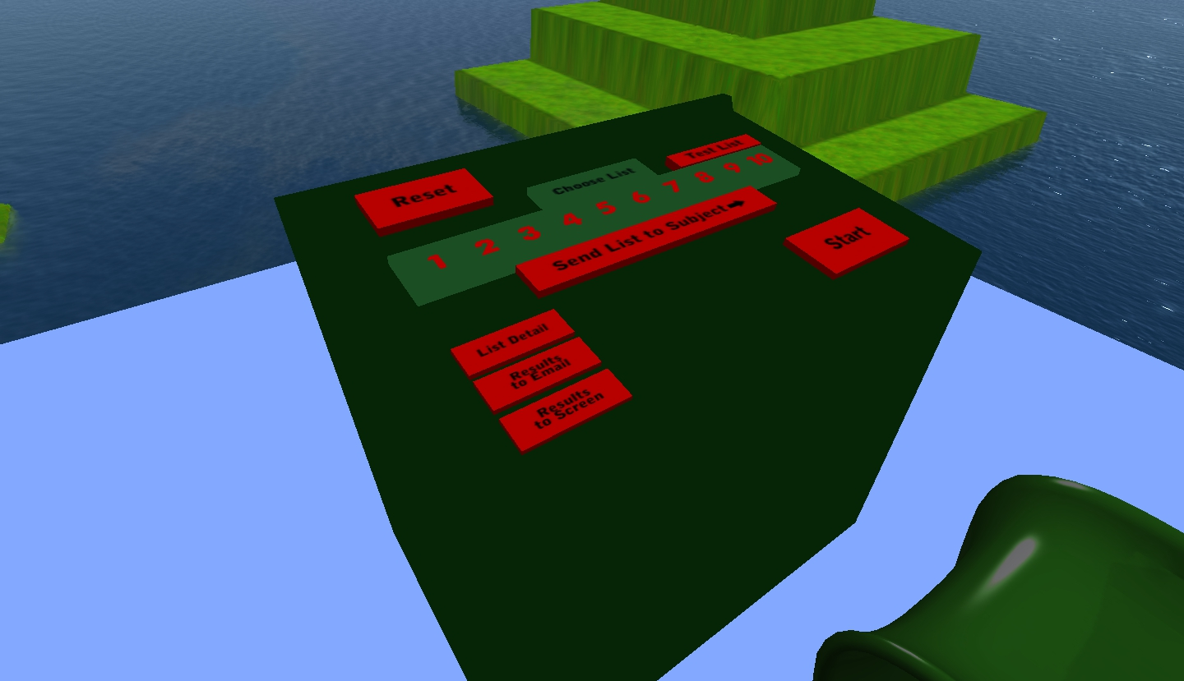
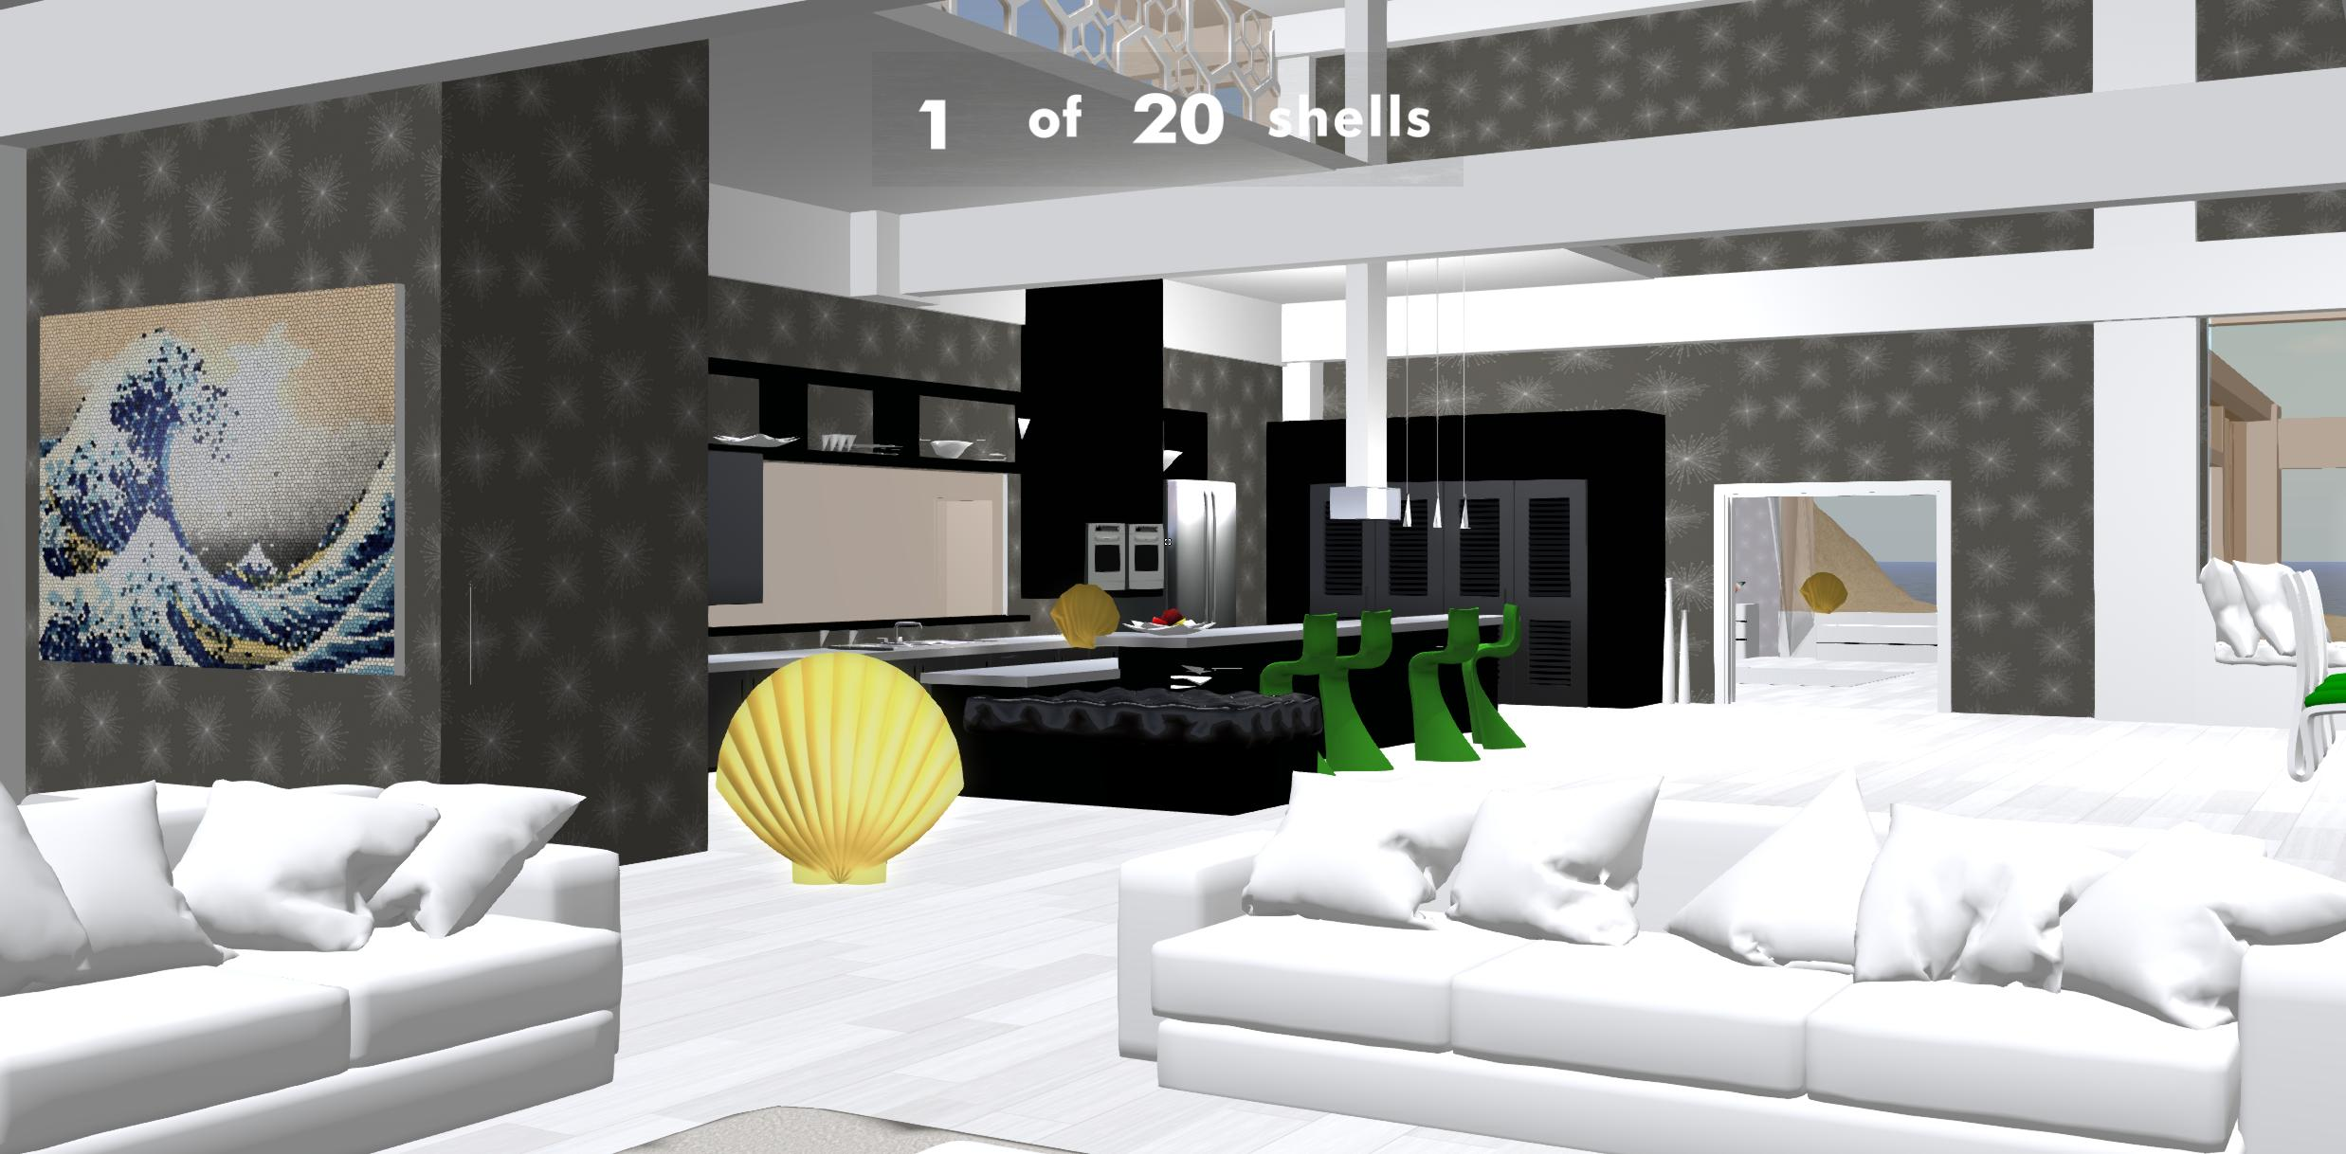
Exploration
Custom Control Panel
Even-Exploration Token Task
Experimenters retain the ability to render objects throughout the environment for collection.
Experimenters can upload lists of objects to be rendered in front of the subject as they navigate.

Slide 7
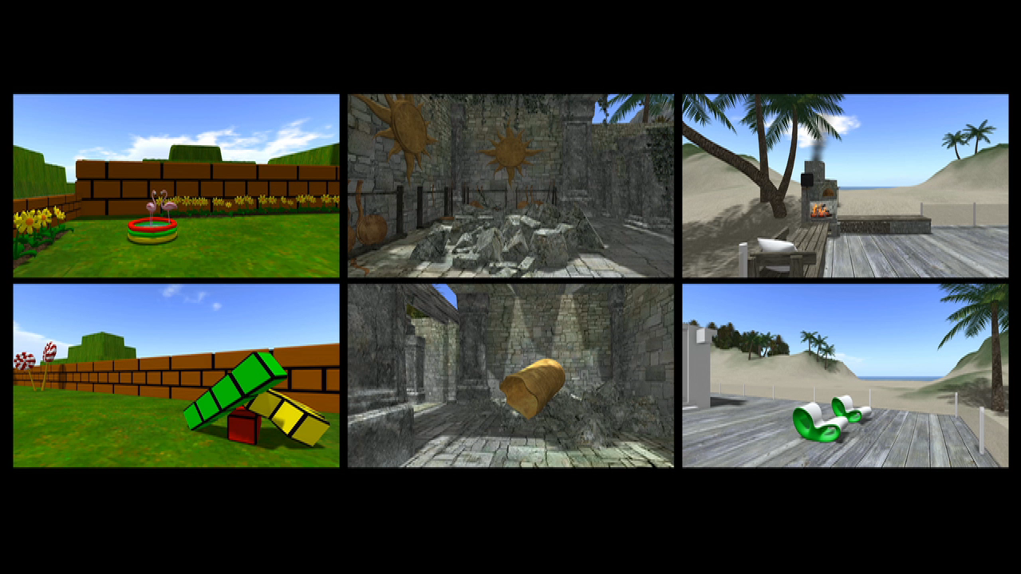
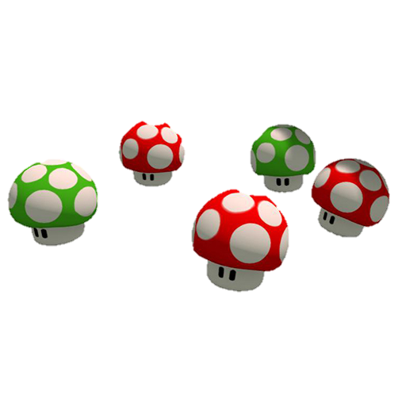

Design
Day 1: Coin Collection, Practice Navigating
Day 2: More Navigation Practice + fMRI(Video Viewing and Mental Imagery)
30s Video Clips
Mental Imagery Instructions
Toon World
Start
Next

Slide 8
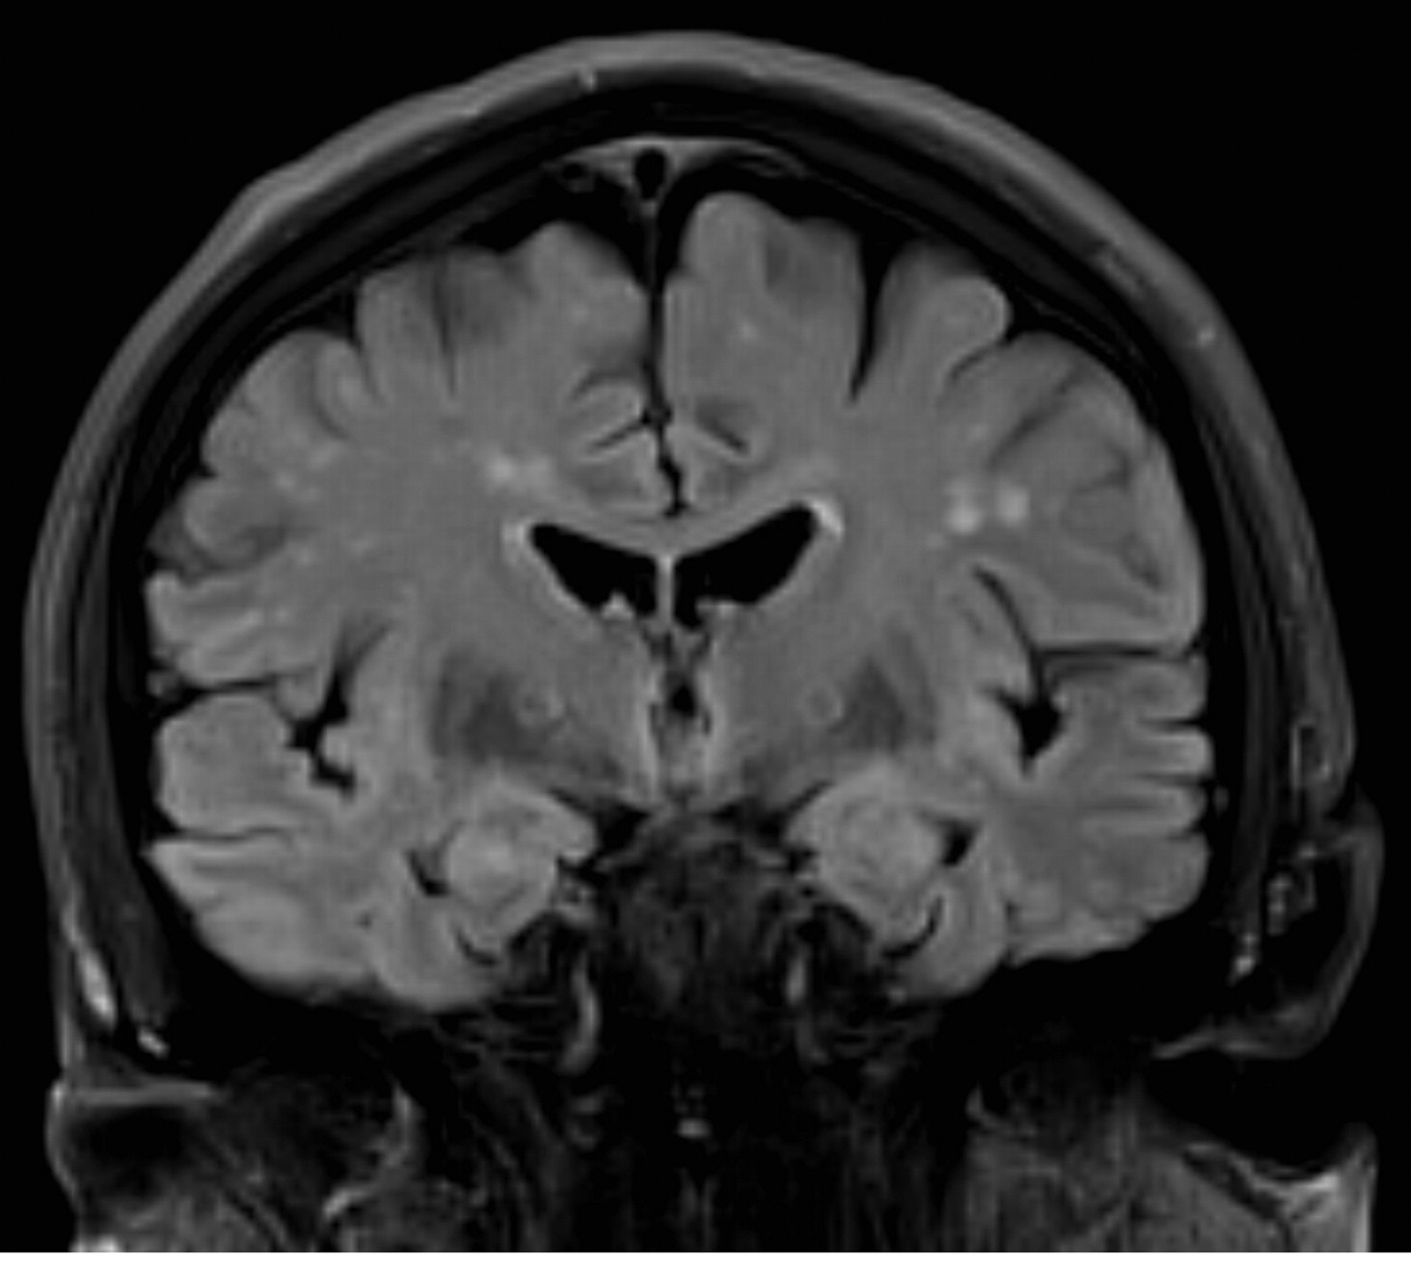
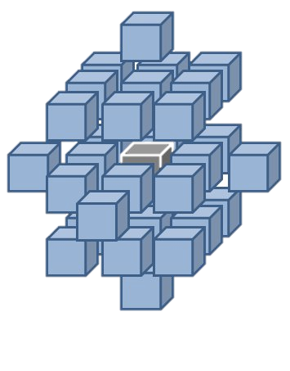
Analysis
Support Vector Machine within a Searchlight Brain Mapping Approach

Slide 9
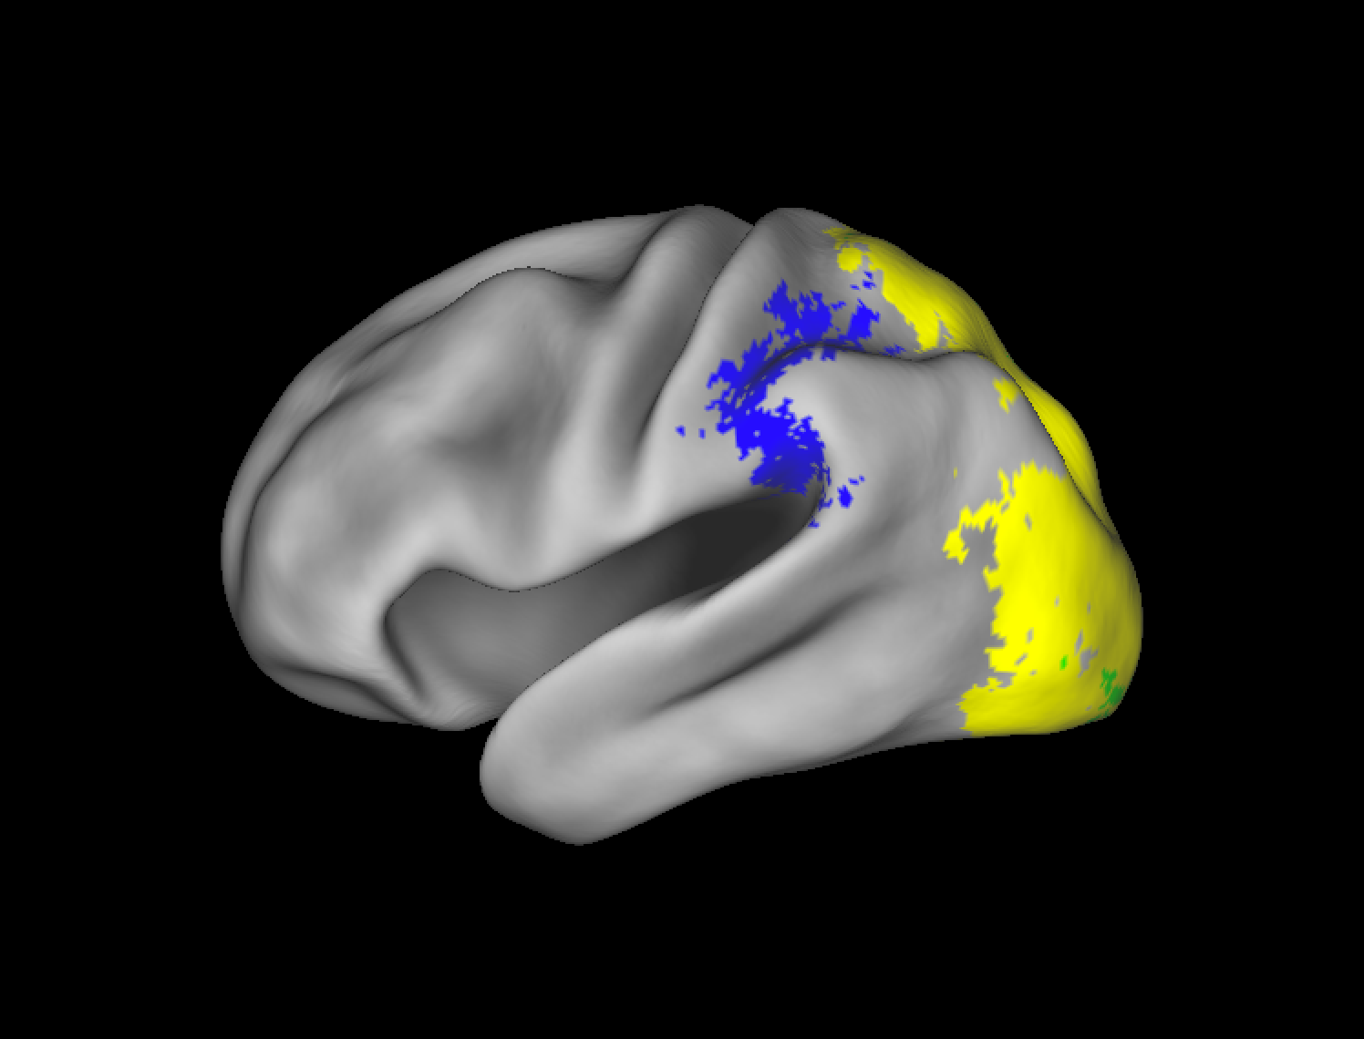
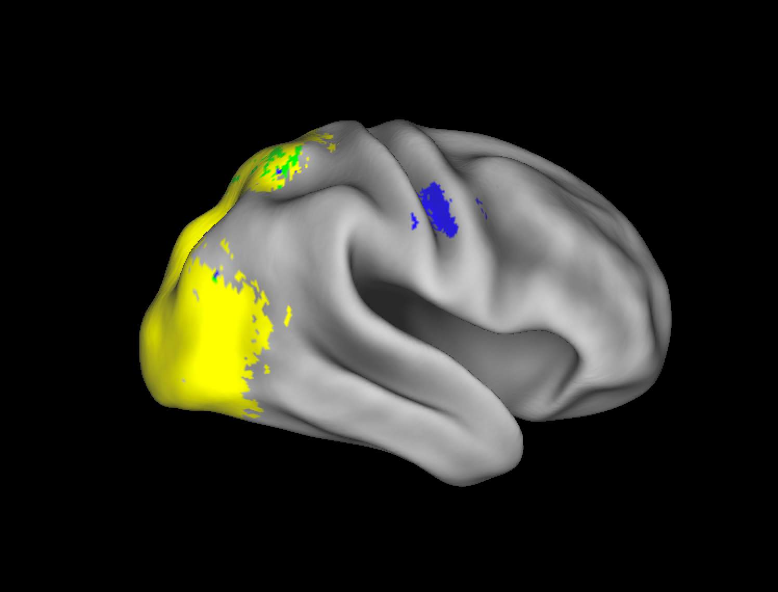
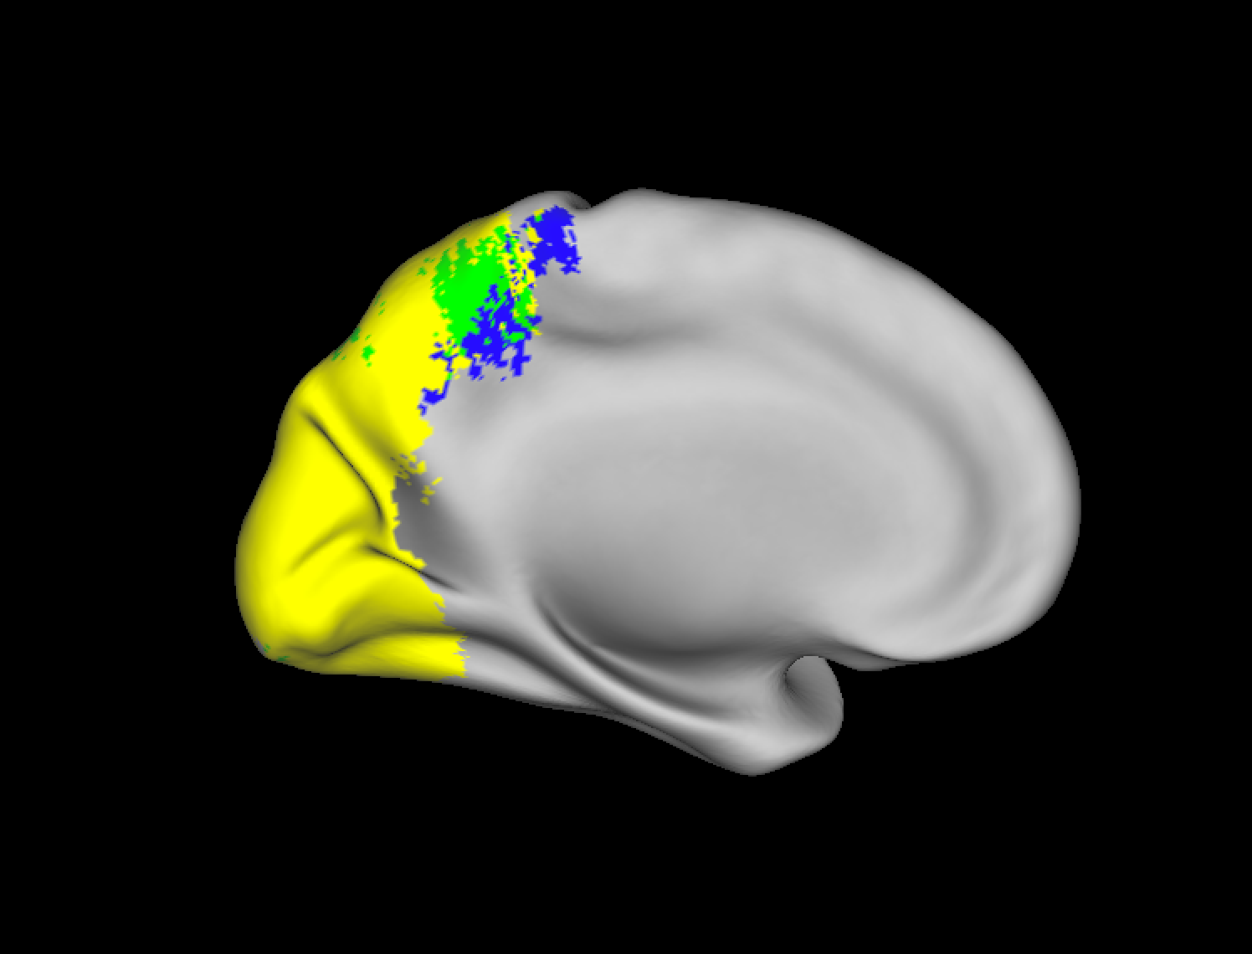
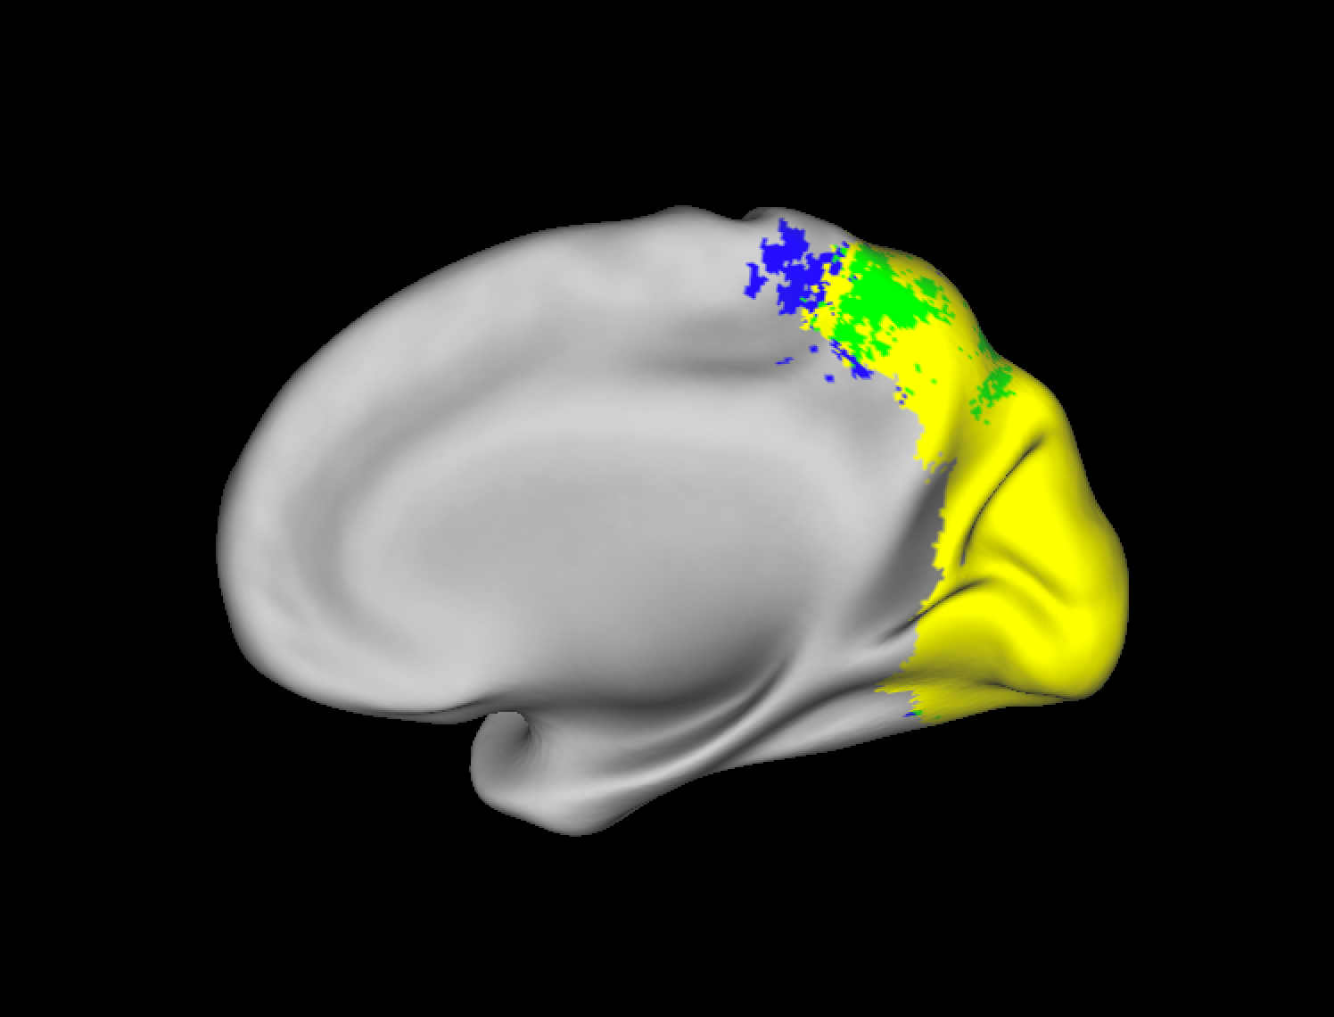
Results
Decoding Which World
Viewing Only
Imagery Only
Both

Slide 10
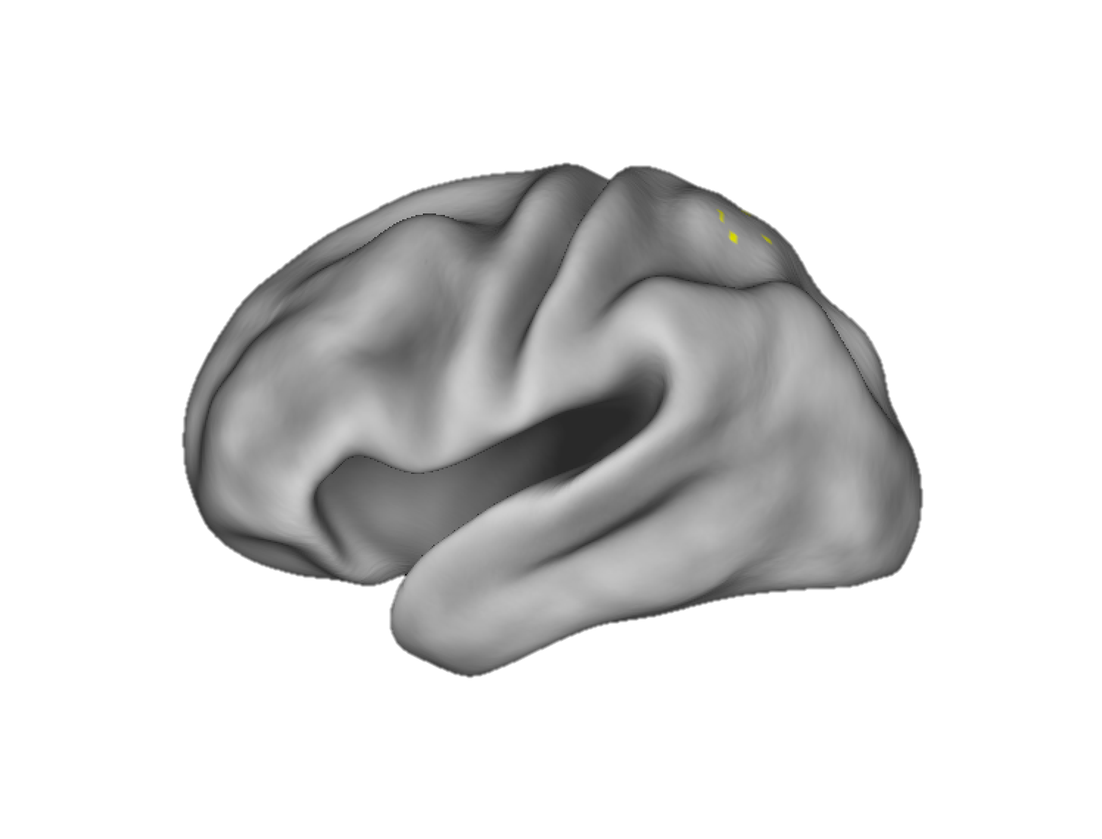
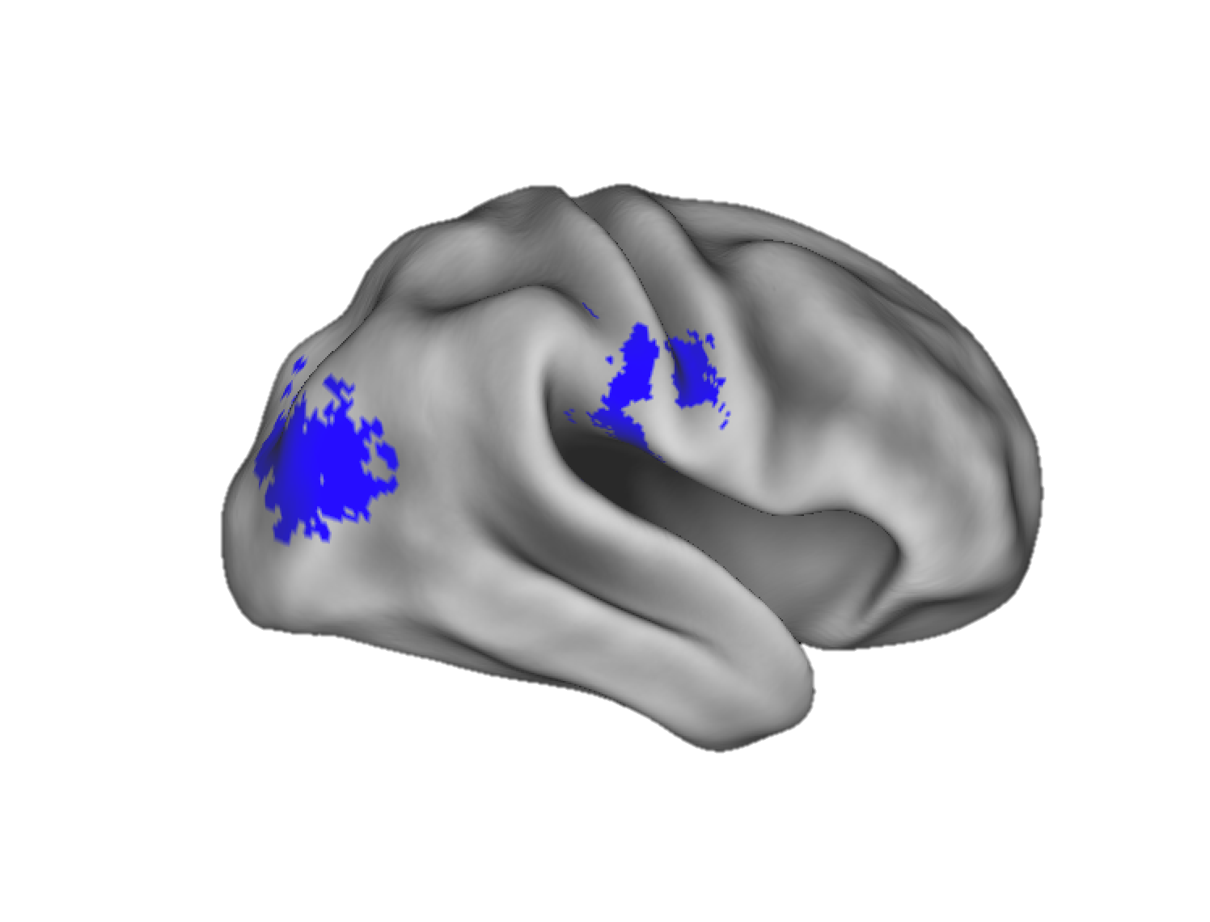
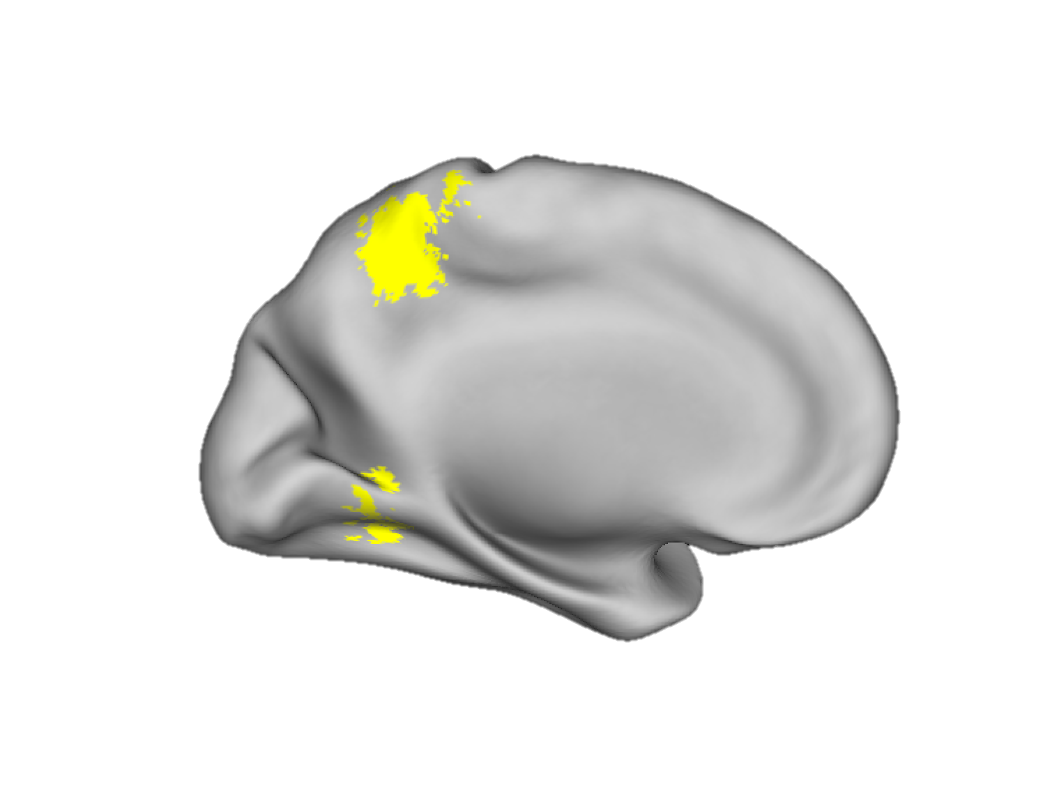
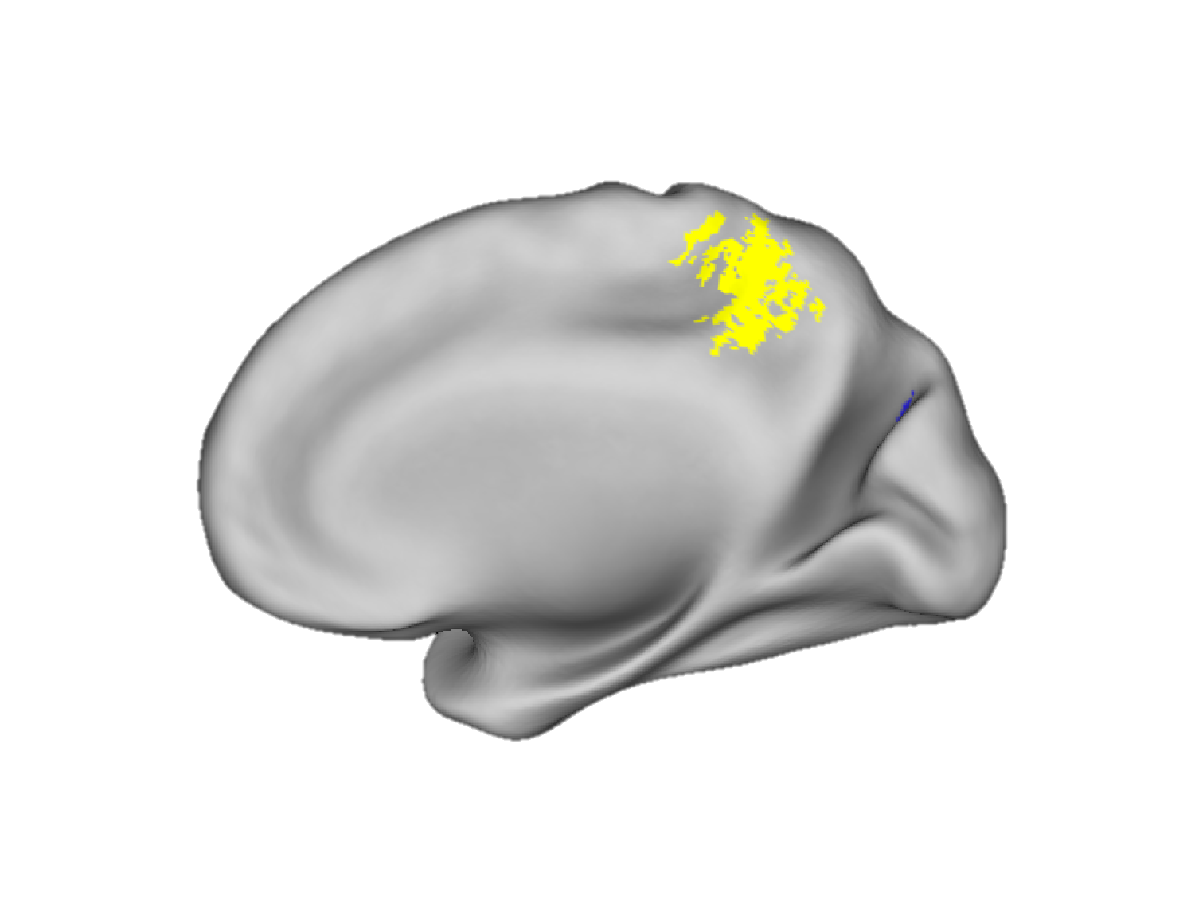
Results
Decoding Which Direction
Viewing Only
Imagery Only
Both

Slide 11
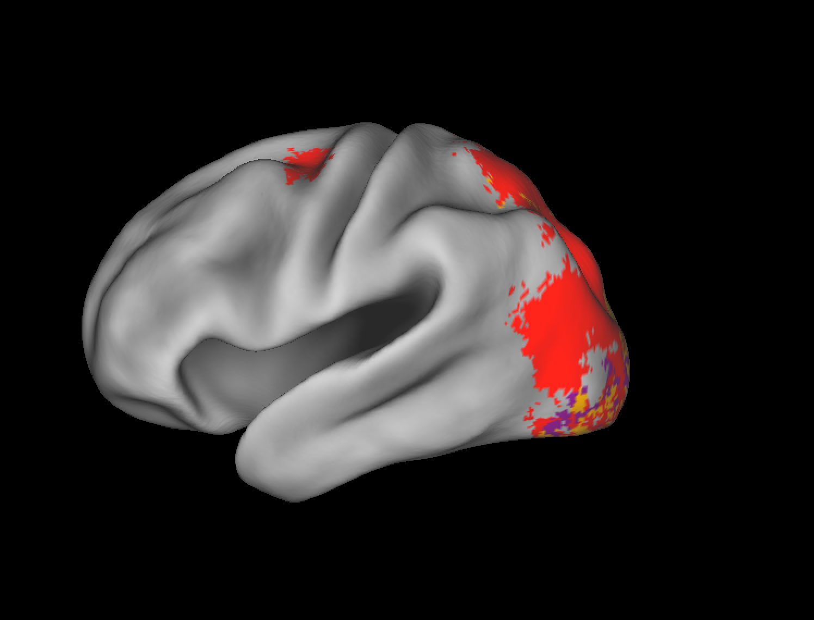
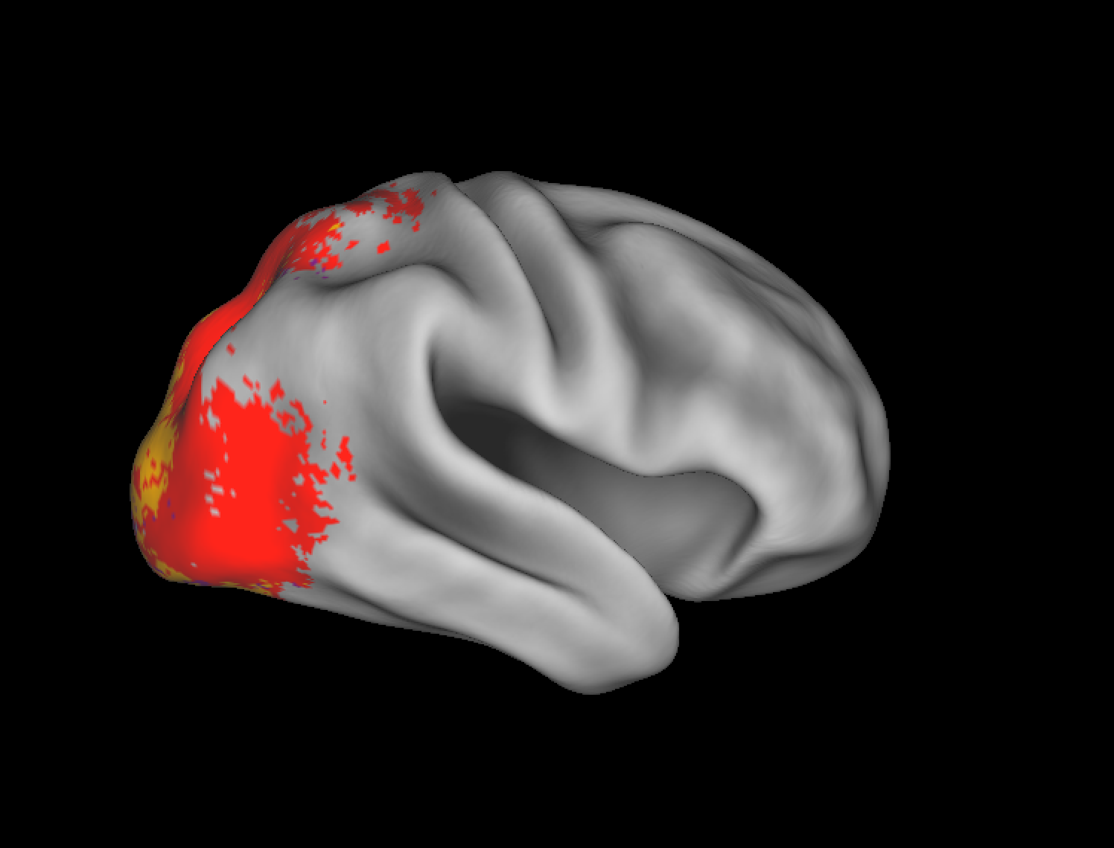
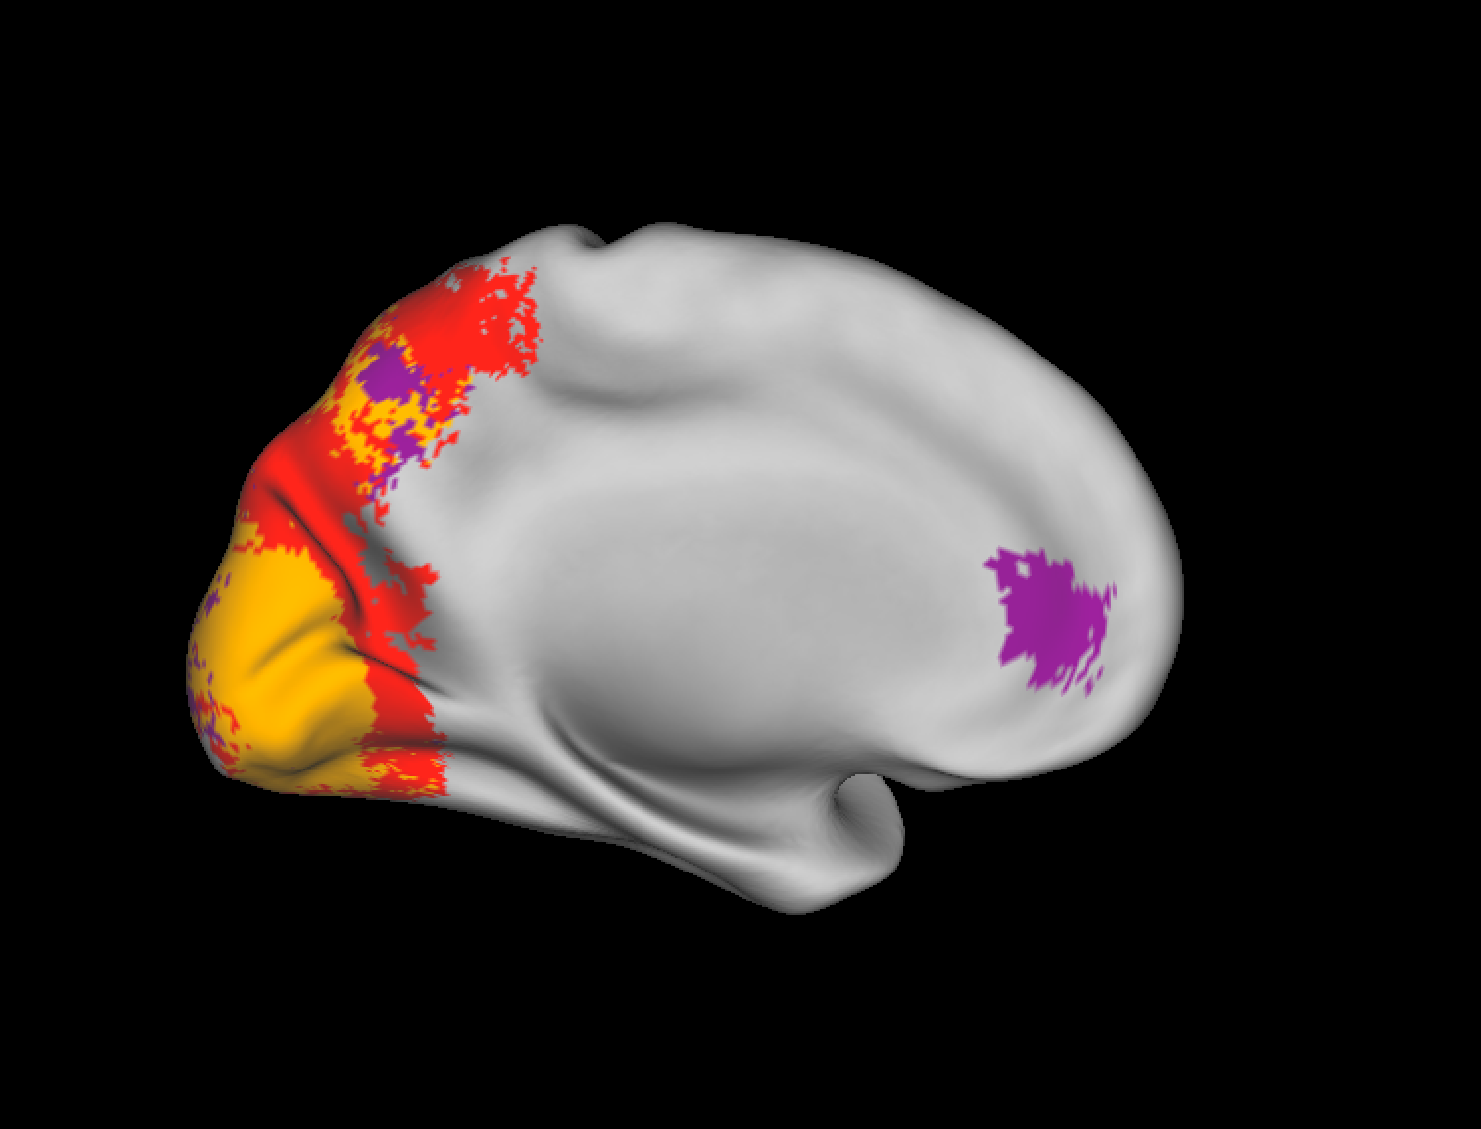
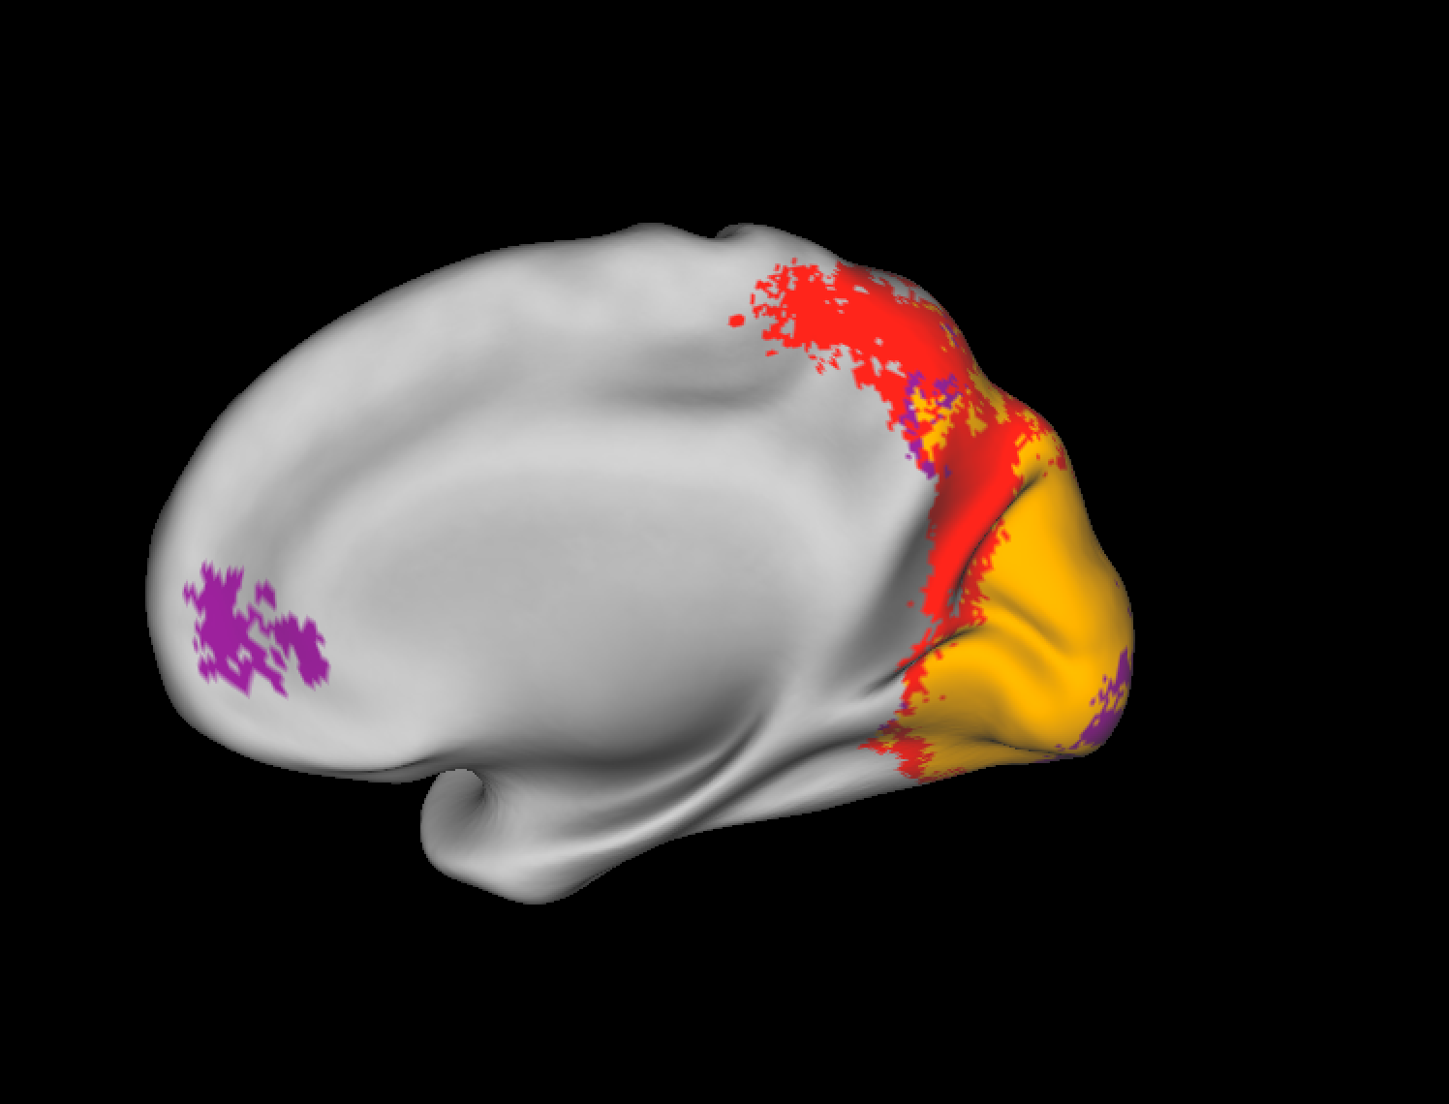
Results
Decoding Which World (Viewing Gender Effects)
Males Only
Females Only
Both

Slide 12
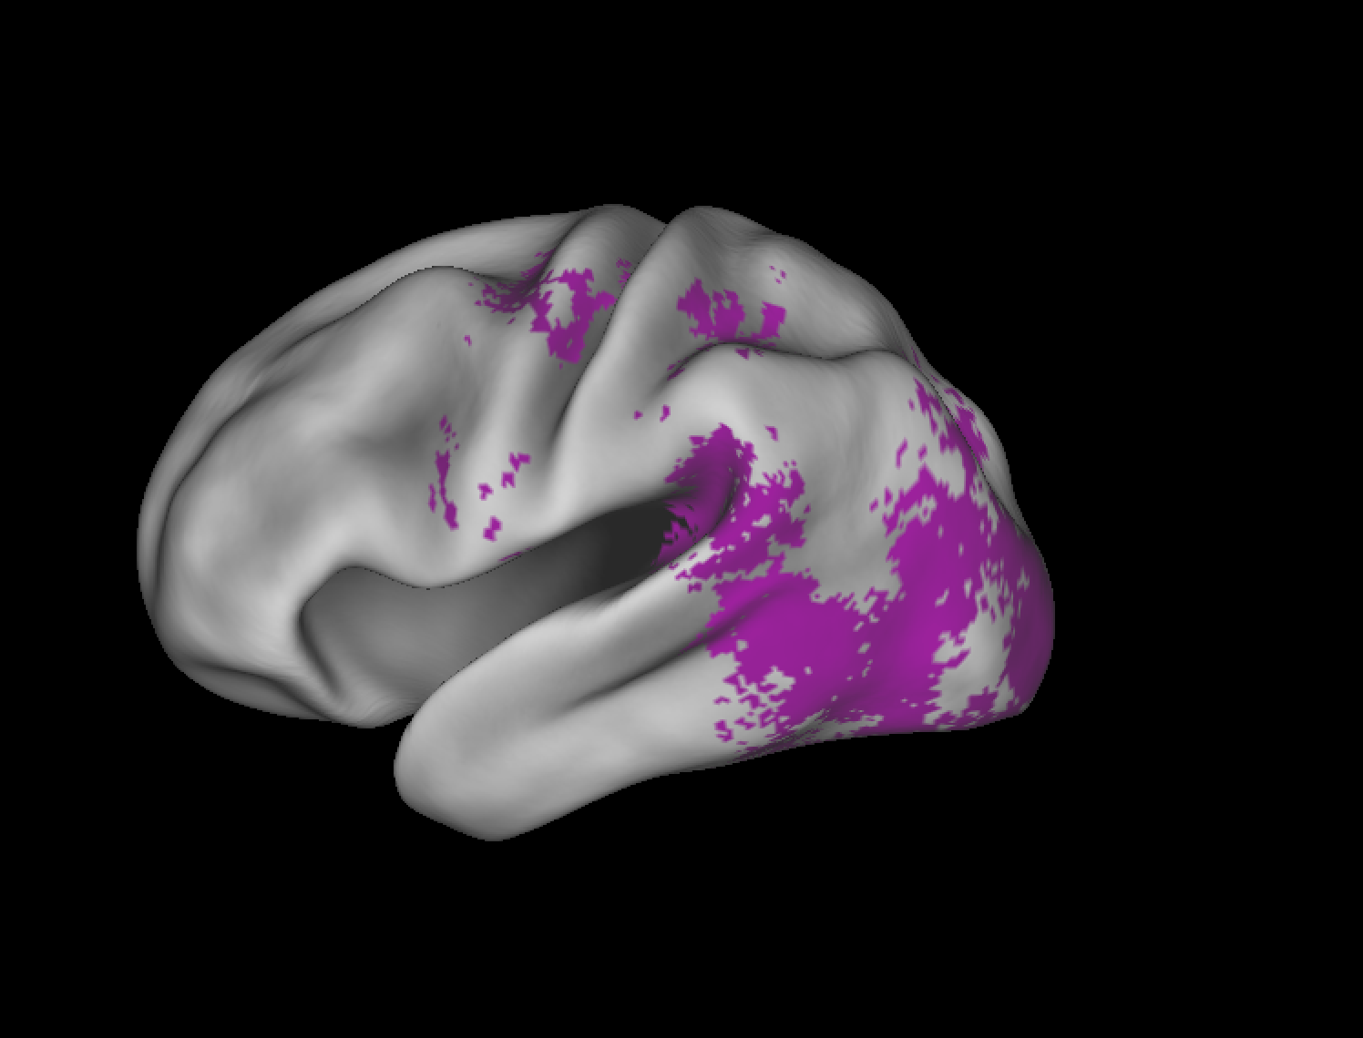
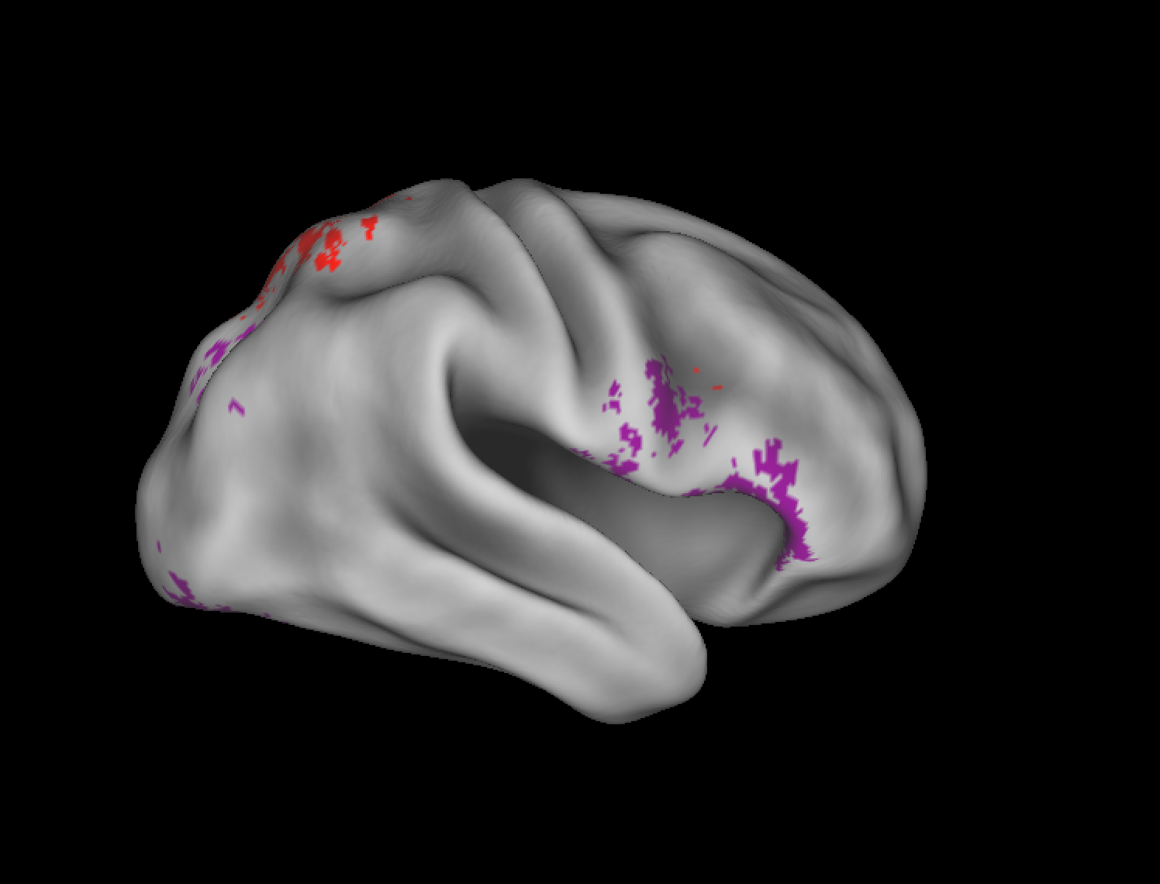
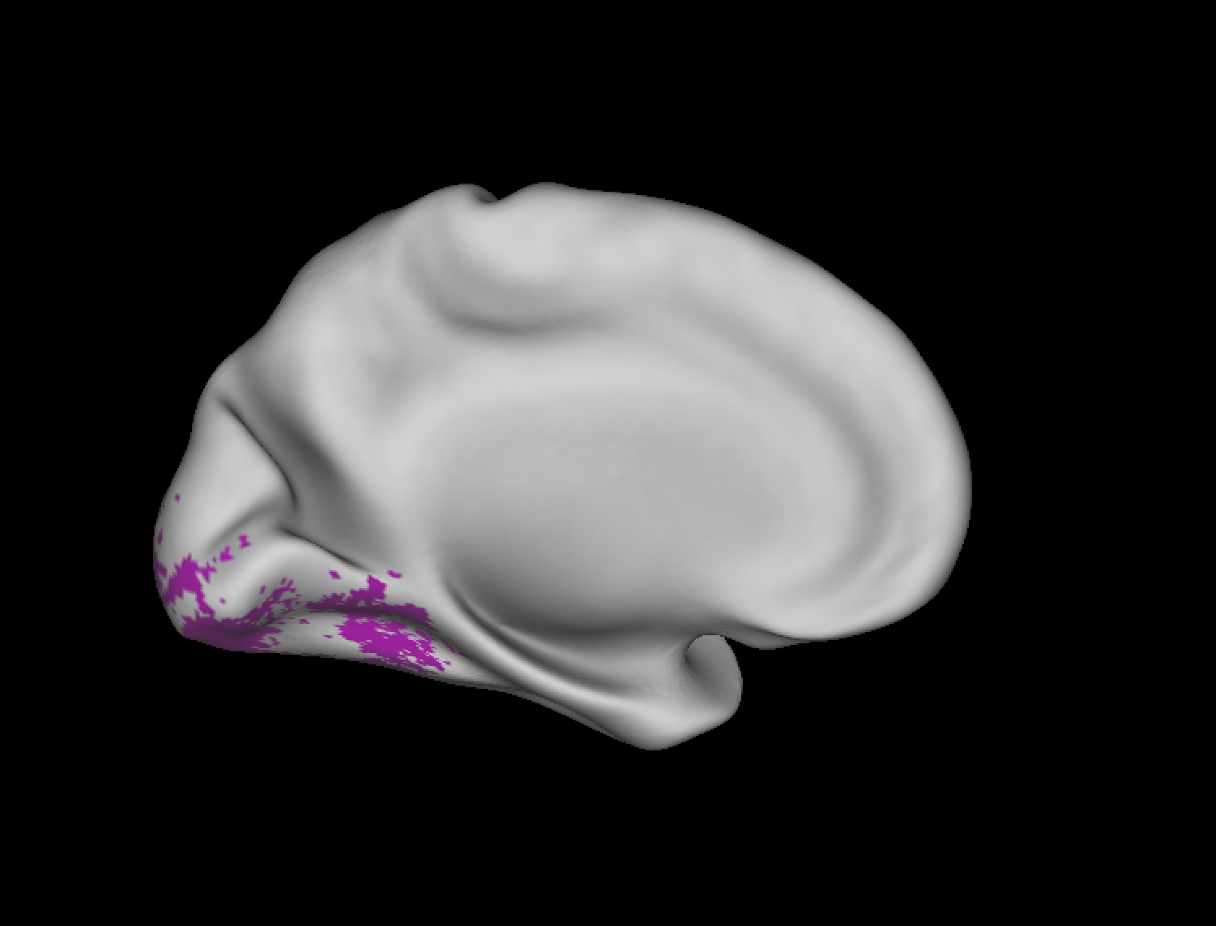

Results
Decoding Which World (Imagery Gender Effects)
Males Only
Females Only
Both

Slide 13
Discussion
We CAN decode which environment a person is imagining, especially within genders
We can also decode which direction they are moving about the environment, irrespective of environment

