Slide 1
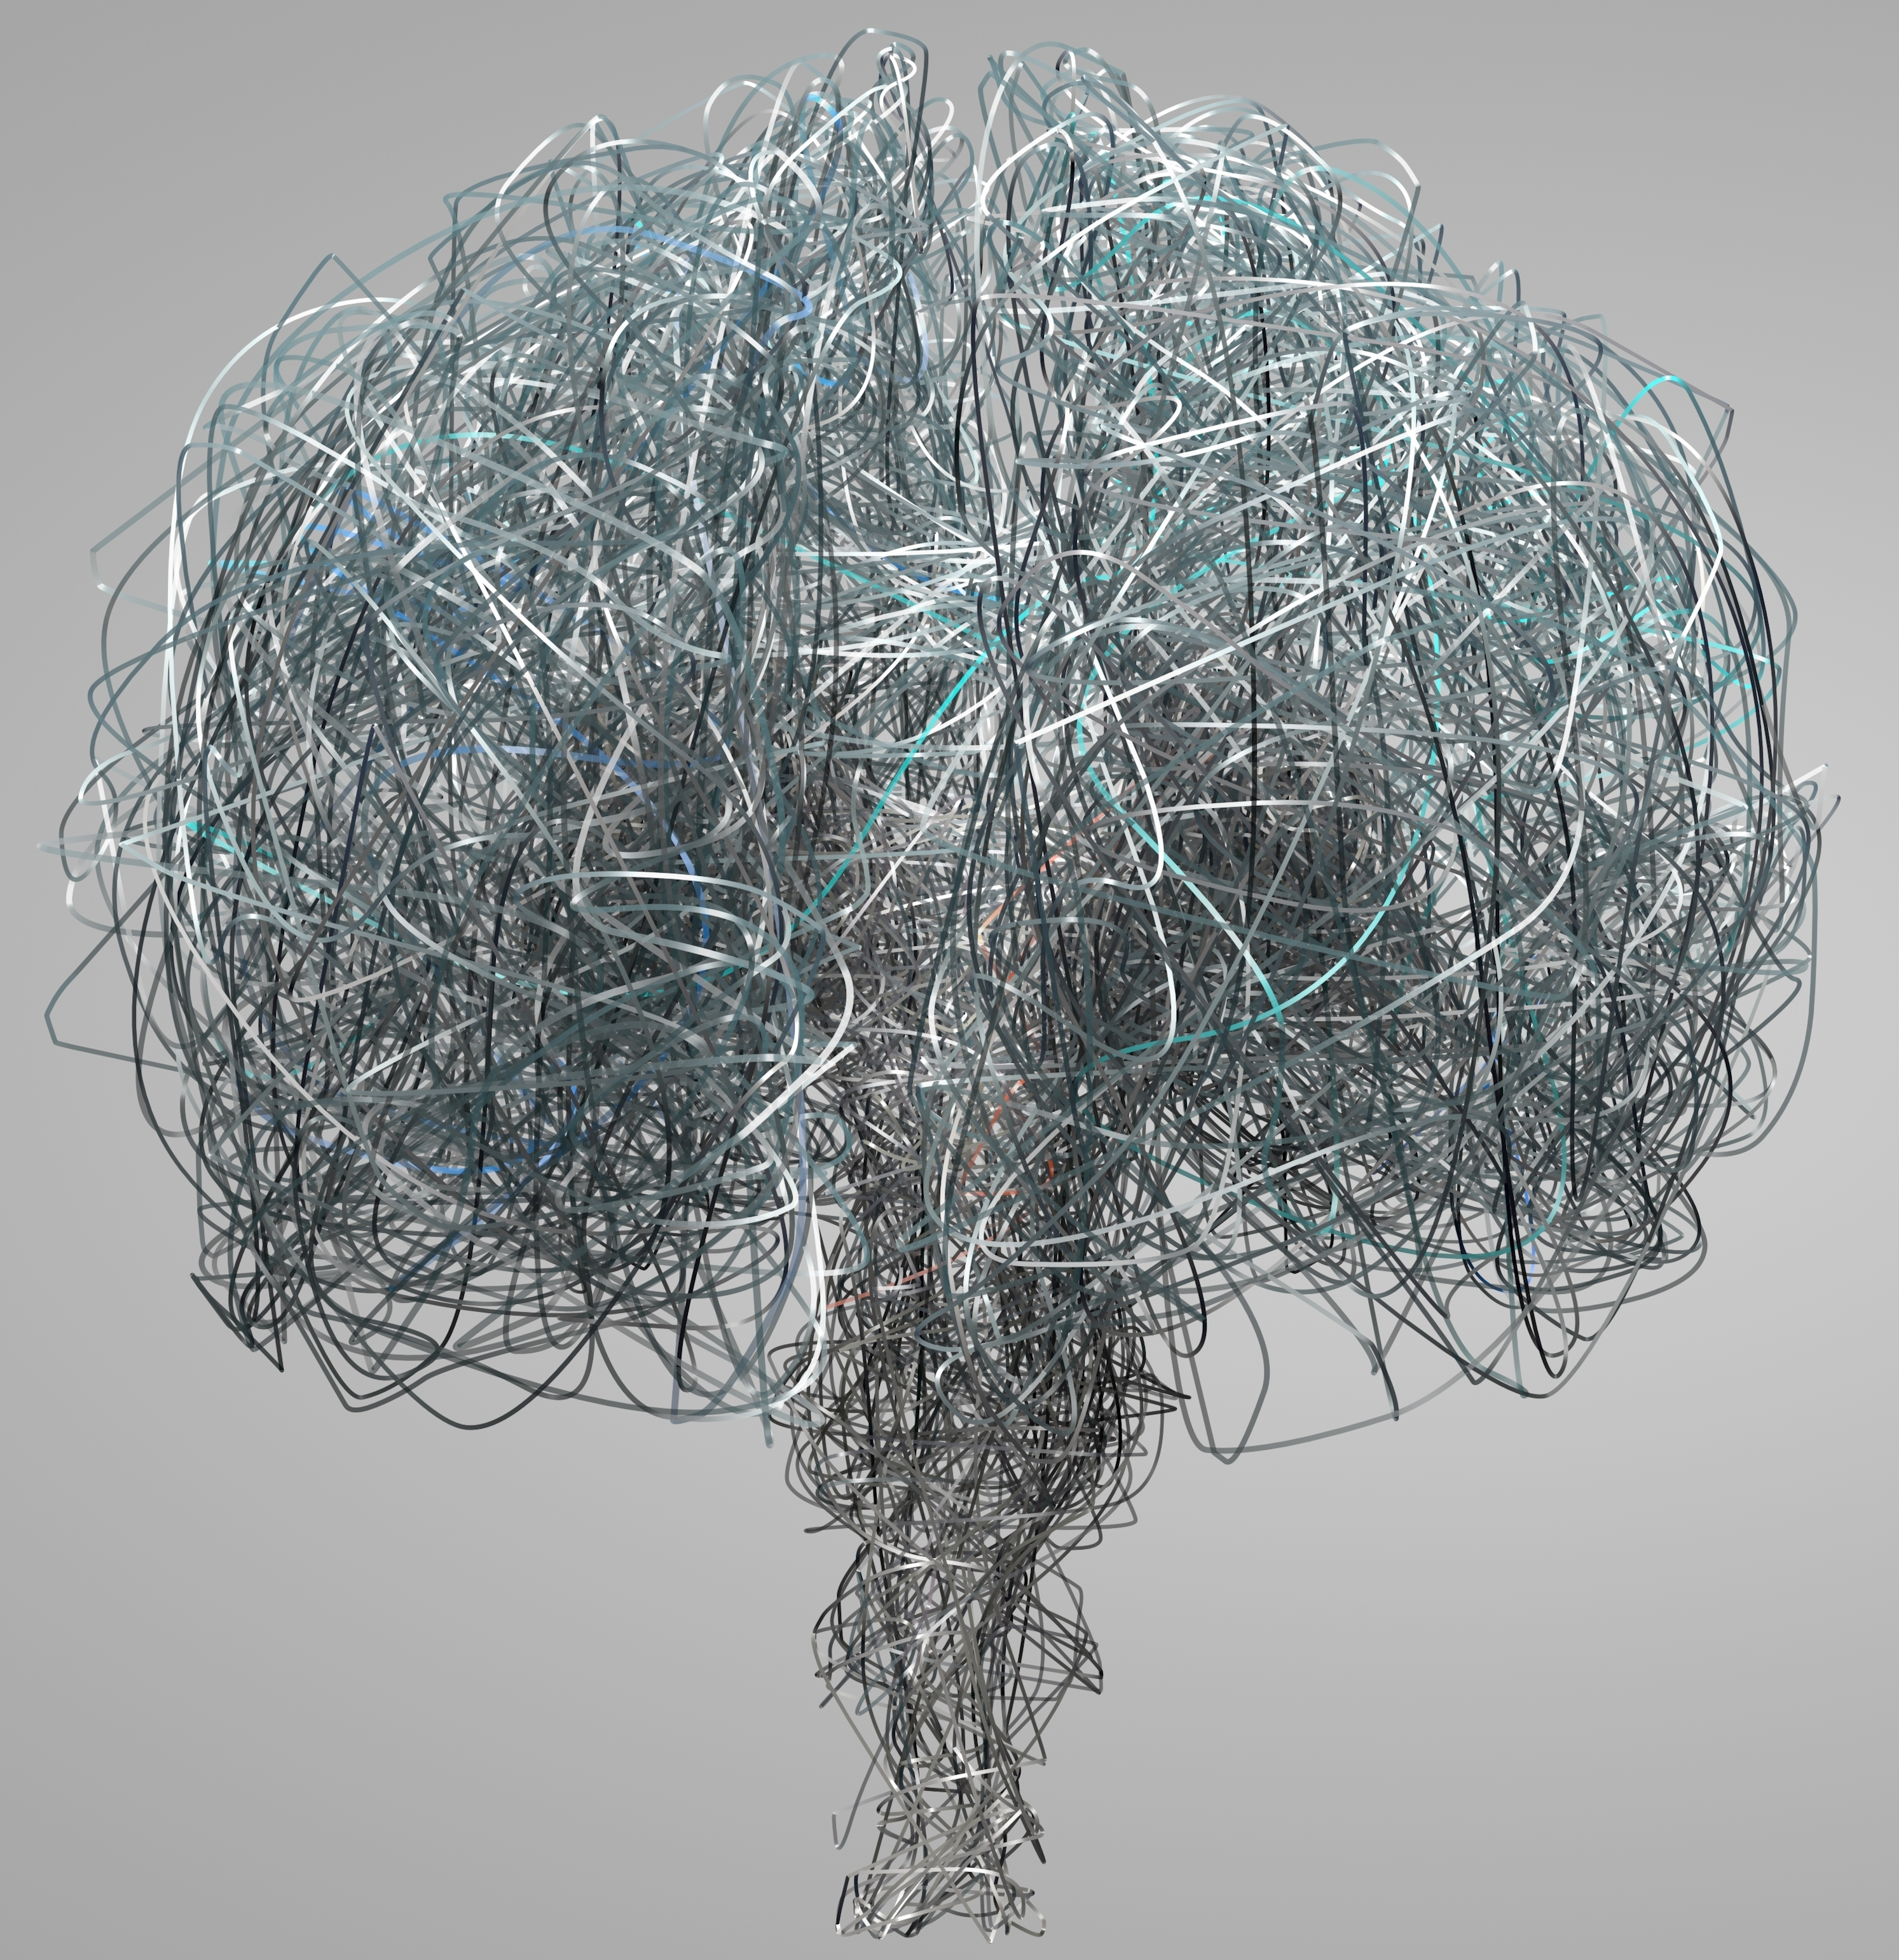
Deduction reduction
How the mere wiring of your brain predicts your intelligence.
Nicco Reggente

Slide 2
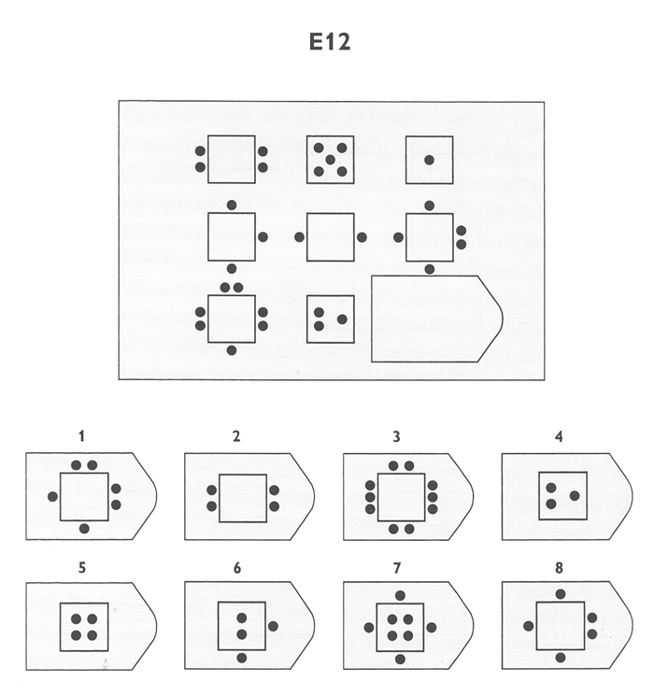
Fluid Intelligence
Notes:
People vary in their intelligence. This elusive “g-factor” has classically been associated with academic achievement (SAT and GRE), self discipline, religion, socioeconomic status, and even happiness.
Anthropologists and psychologists have long tried to find predictors. Genetics seem to at least be a minor predictor. At best, they can identify one gene that, if present, can give you a 1 point boost in IQ.
That plays well with the general consensus that people believe intelligence to be a fixed trait. And it seems to be true. Despite years of cognitive training, it is often times hard to yield any improvement on intelligence tests.
Thus, your ability to solve this [click] instance of a classic intelligence-measuring puzzle series called the Ravens Test could dramatically affect where you fall along the continuum of the human experience.
However, by identifying the source of intelligence within the brain, we open up new doors where we could potentially optimize, and entrain our brains to be “more intelligent”.
Enter Human Brain Mapping….[click]

Slide 3
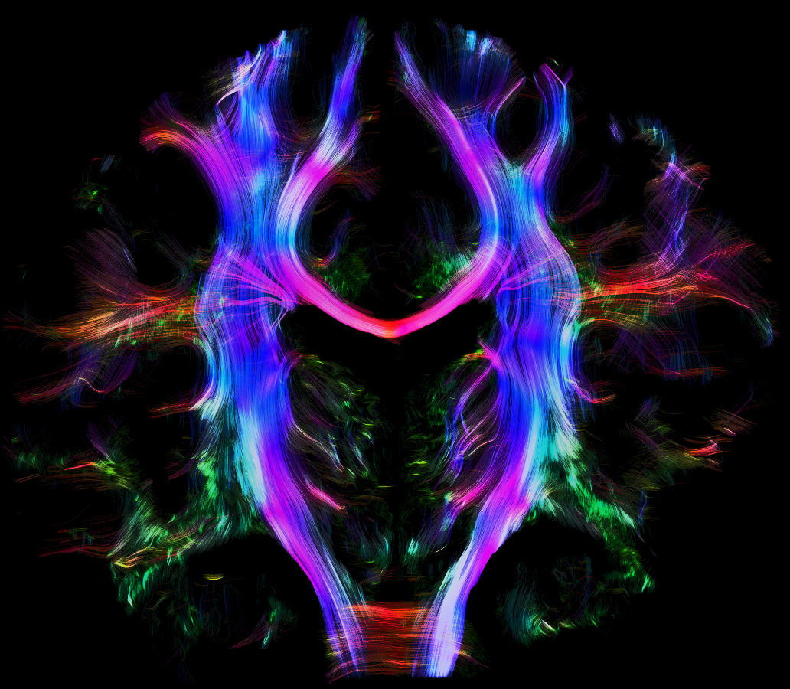
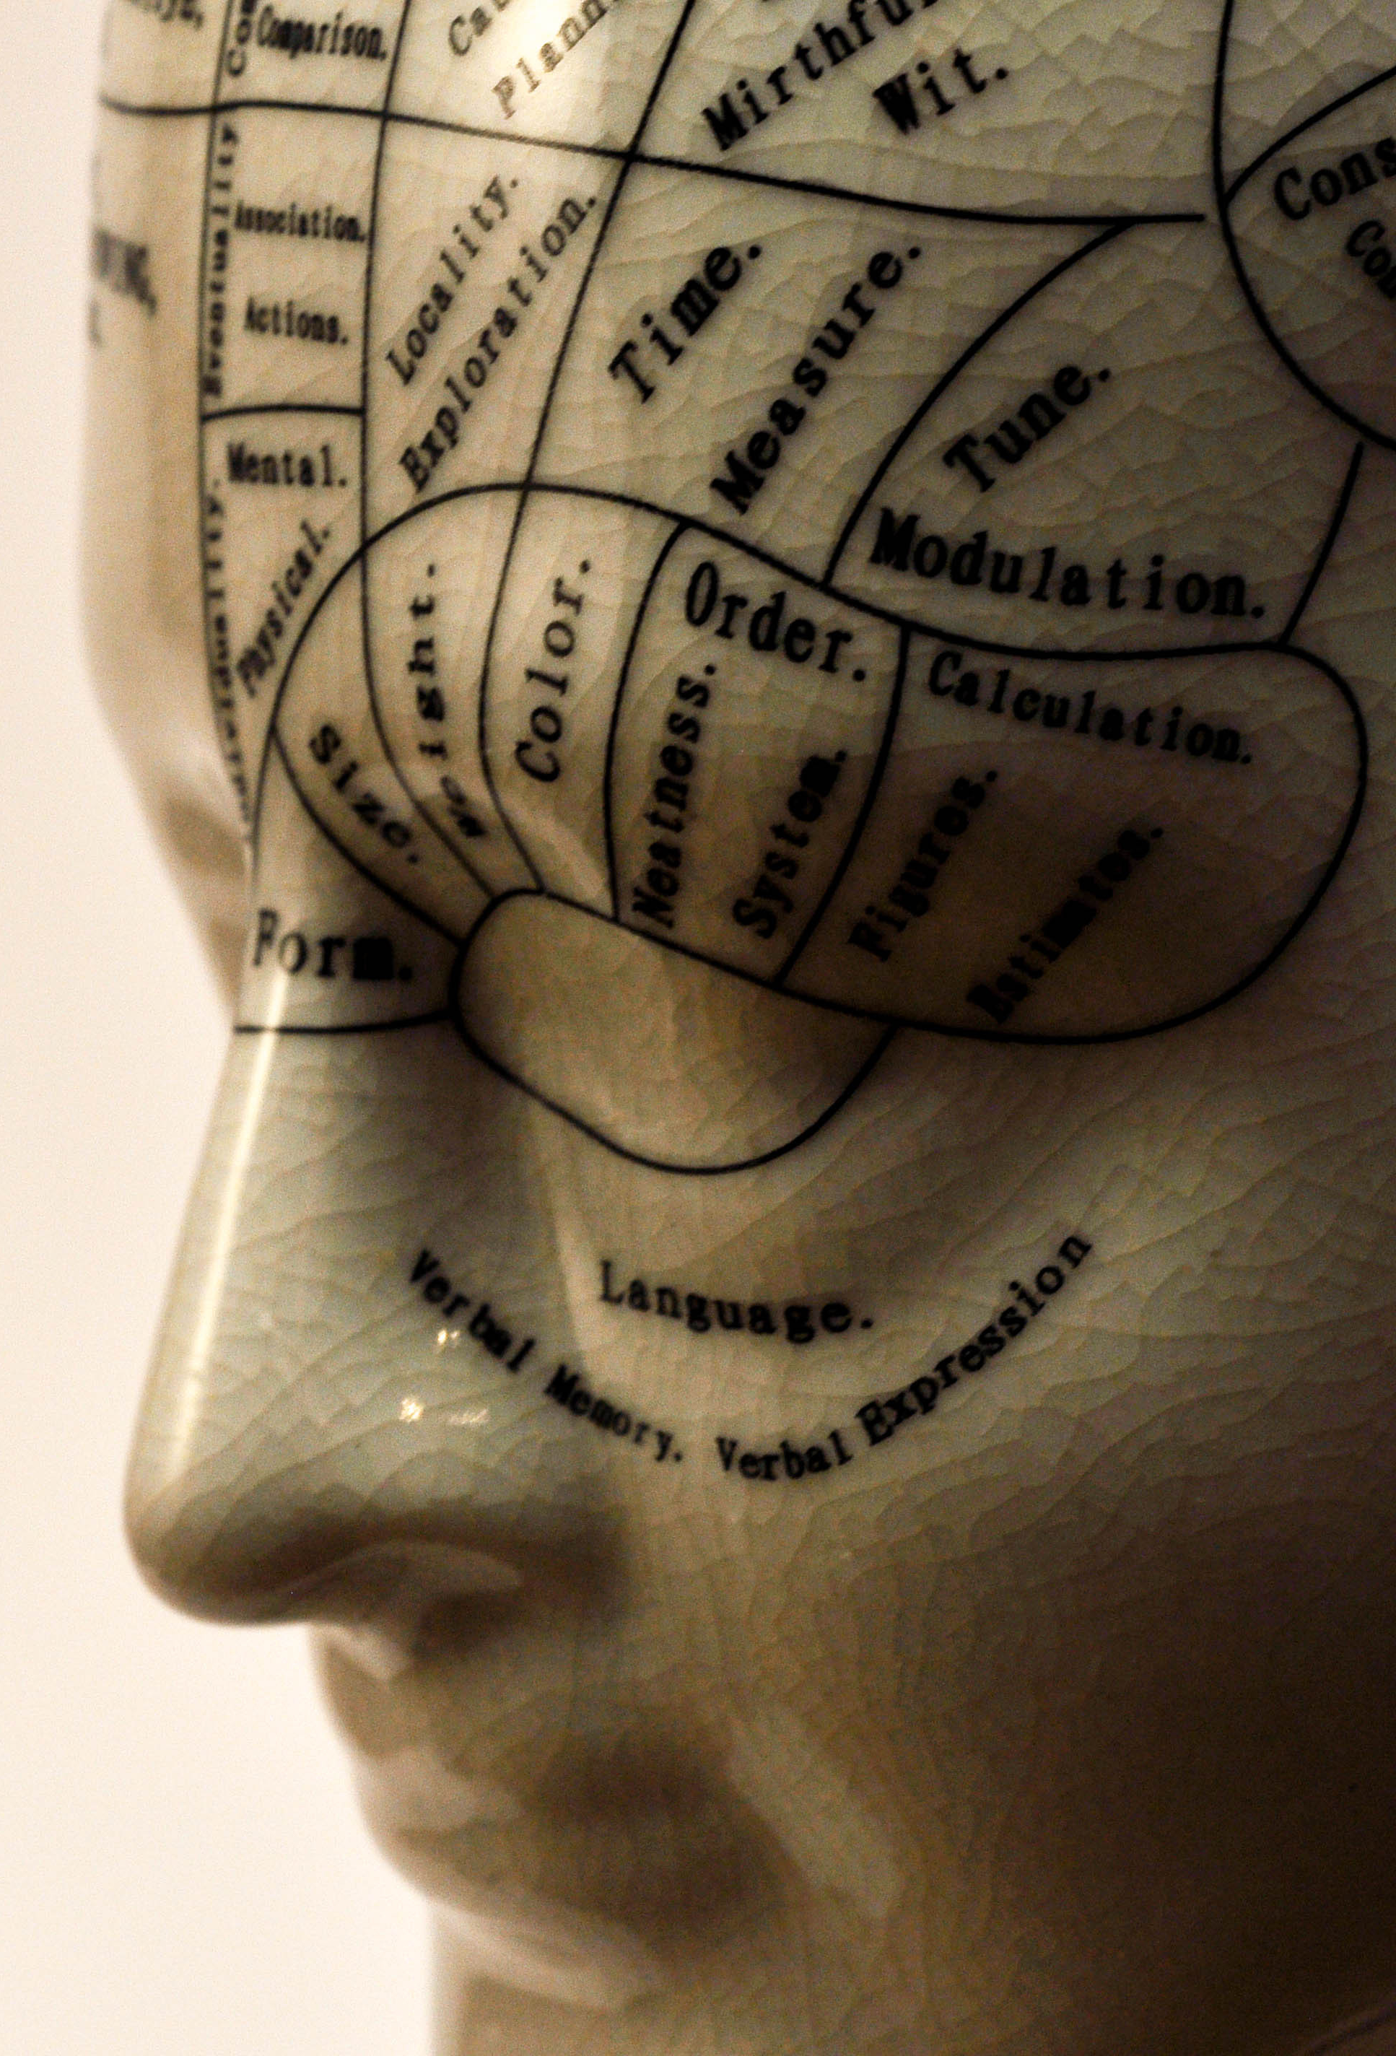
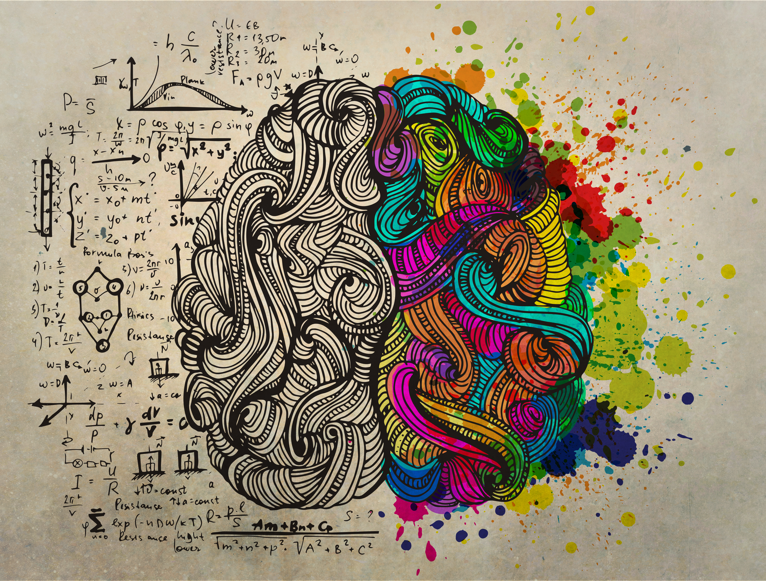

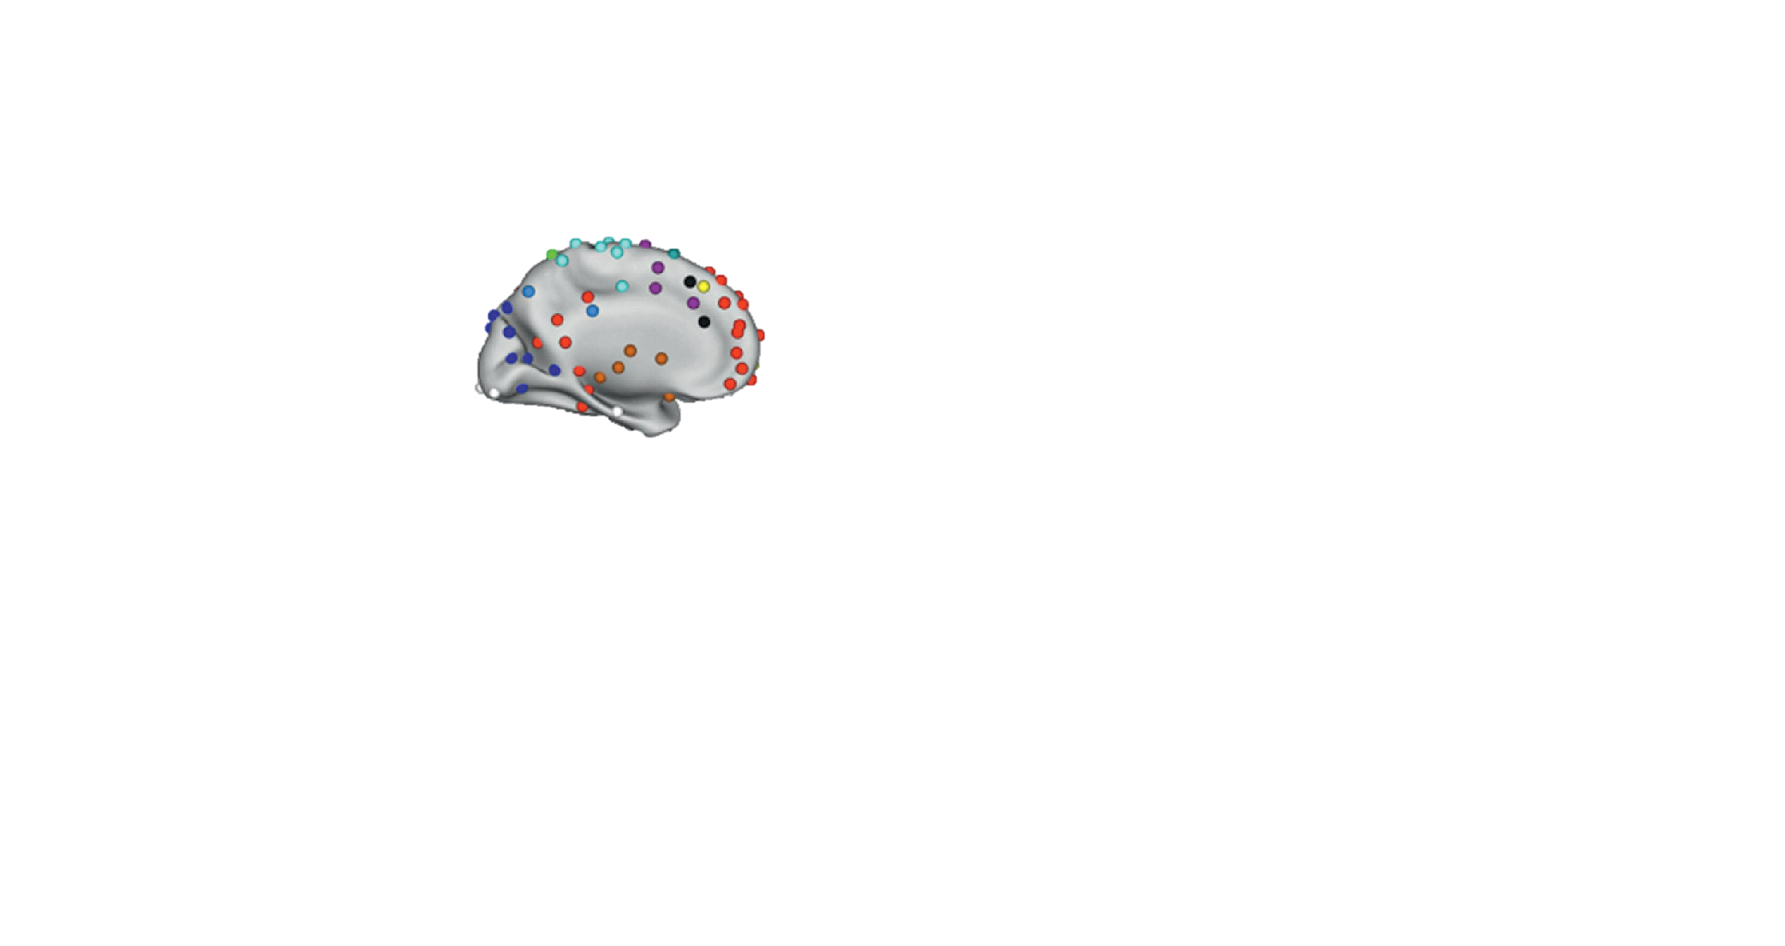
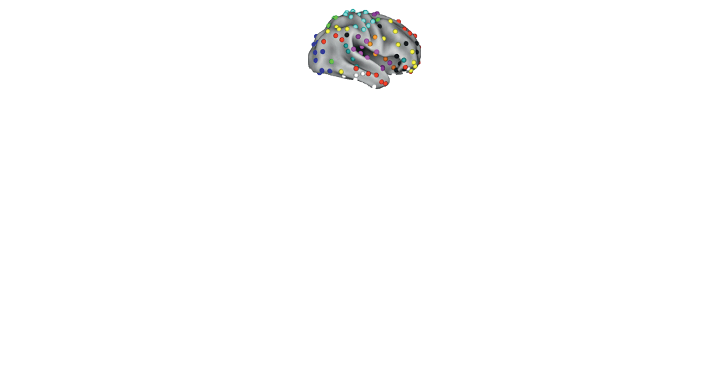
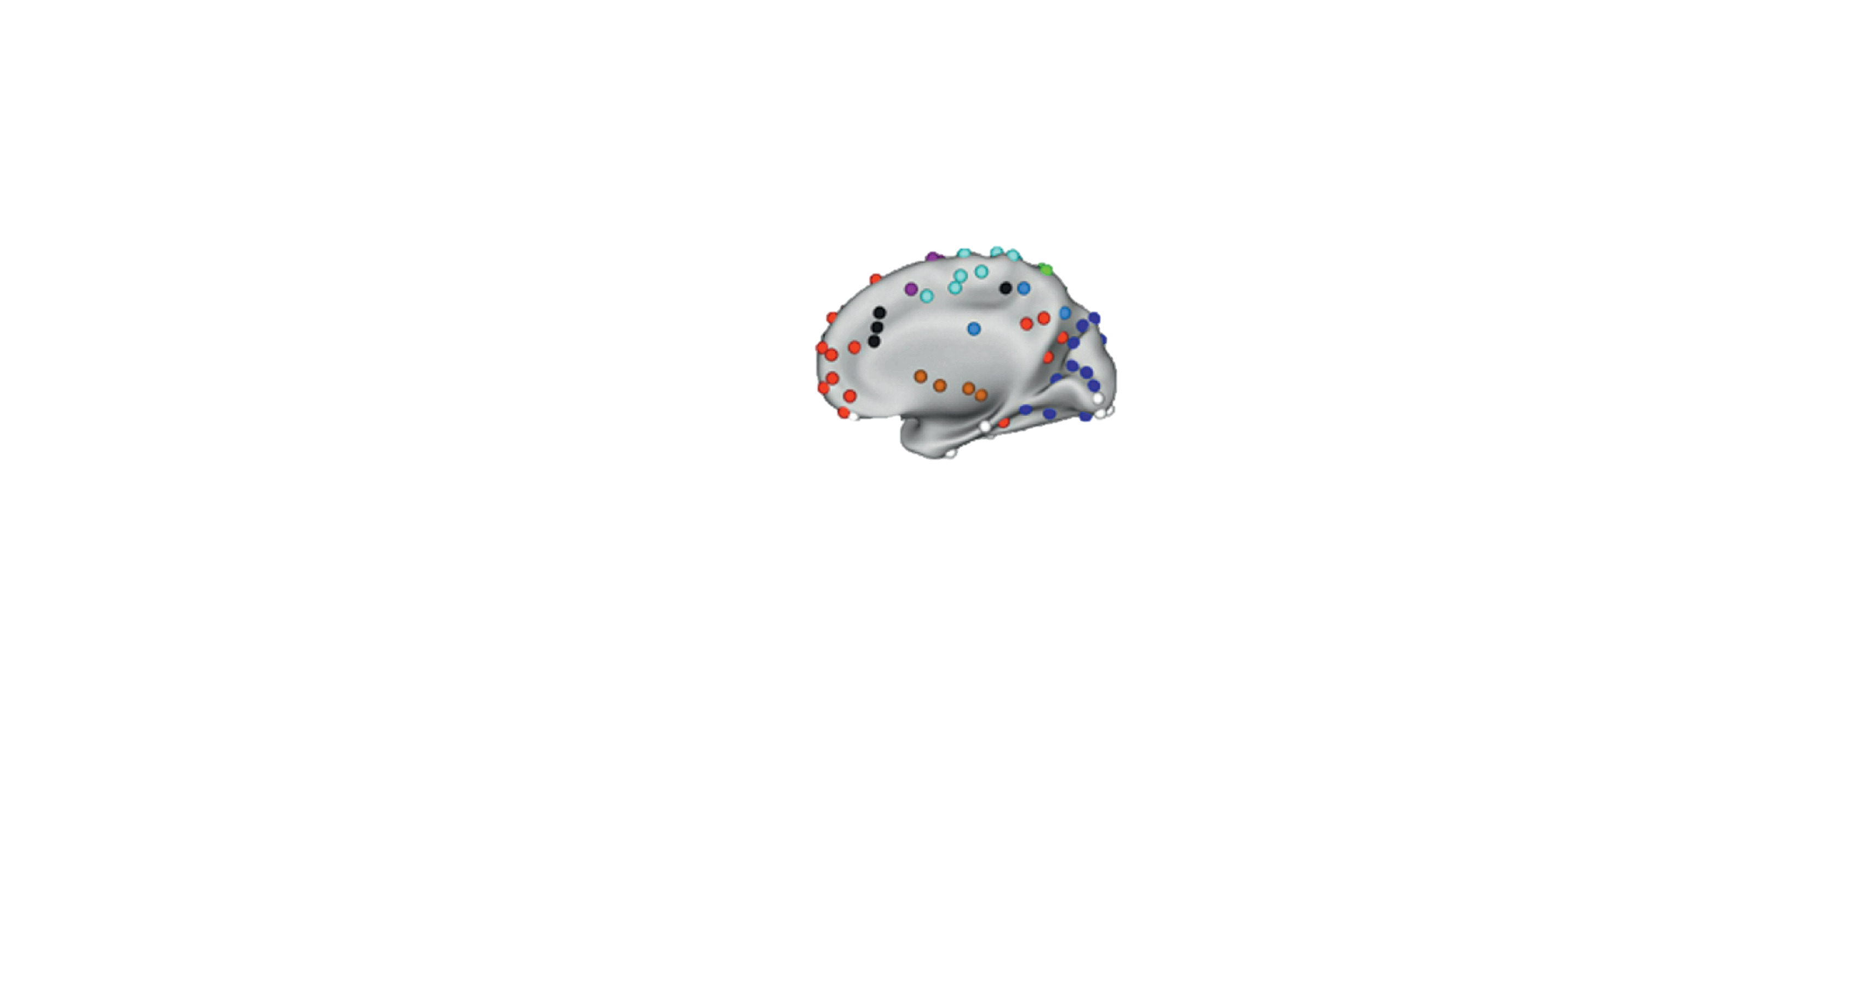
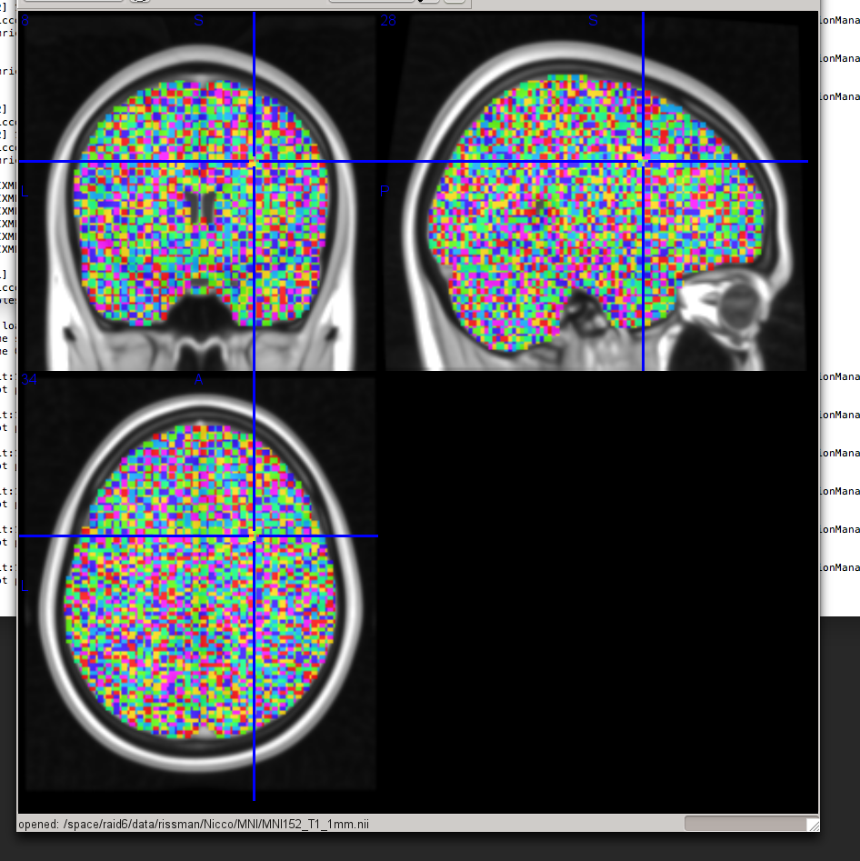
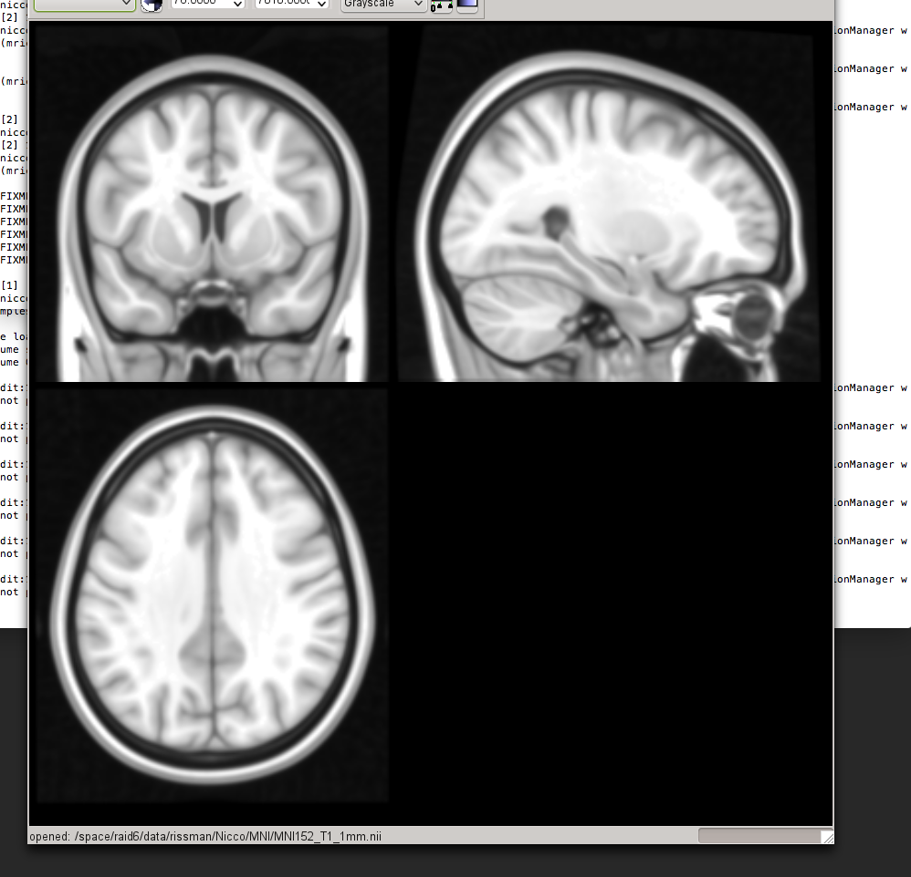
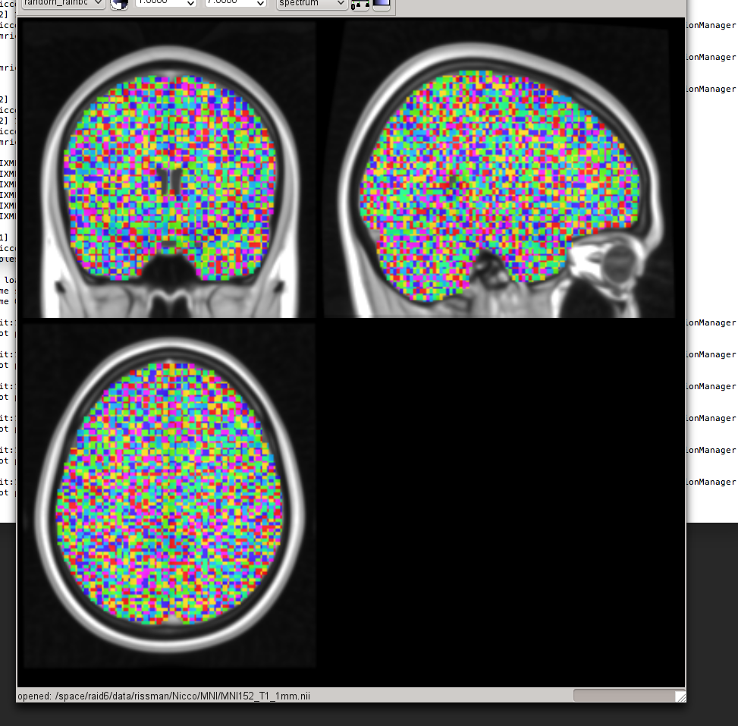
Human Brain Mapping
Notes:
Since 1810, humans have been methodically attempting to associate particular regions of the brain (in this case, the scull) with particular functions.
[click]
With the advent of MRI, we are now able to get pictures of the brain, divvy it up into millions of little 3D pixels, and track local activity within the brain.[click x3]
[click]
This has allowed researchers to reveal all sorts of task-specific activity, like the notion that the left side of the brain is logical and the right, artistic.
[click]
More impressively, researchers have been able to identify small nodes within the brain responsible for certain functions.
Despite years of searching, a specific hub responsible for intelligence has yet to be identified. That is, I hypothesize, because there simply isn’t one.
However, I believe that by examining how tightly wired disparate regions in the brain (i.e how well they can communicate with each other) are can serve as a predictor of fluid intelligence.
Fortunately, [click] we can measure this with a specific type of MRI scan called “Diffusion Tensor Imaging”, which essentially measure the flow of the water across the brain to infer underlying architecture.

Slide 4
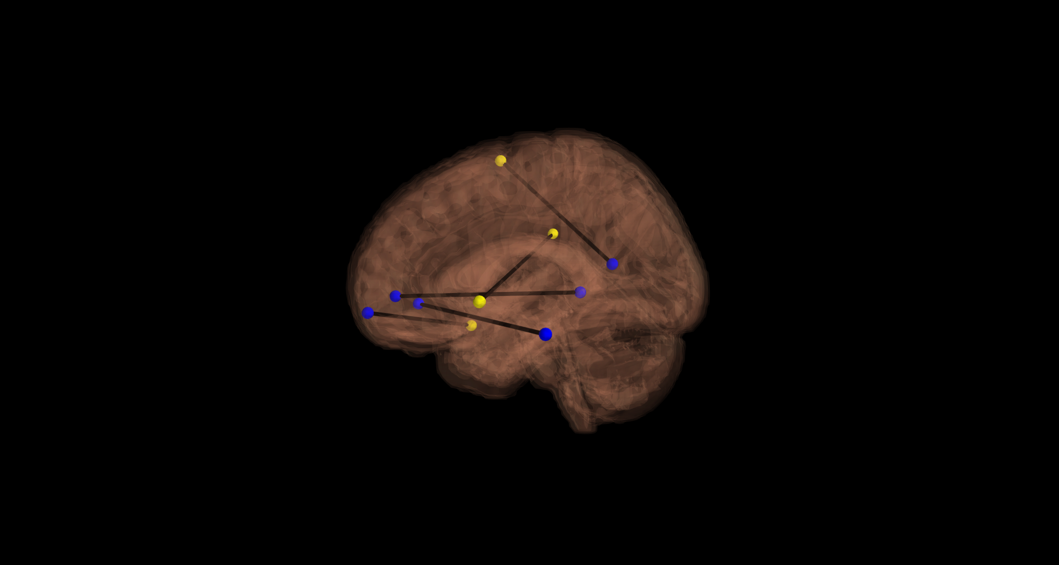
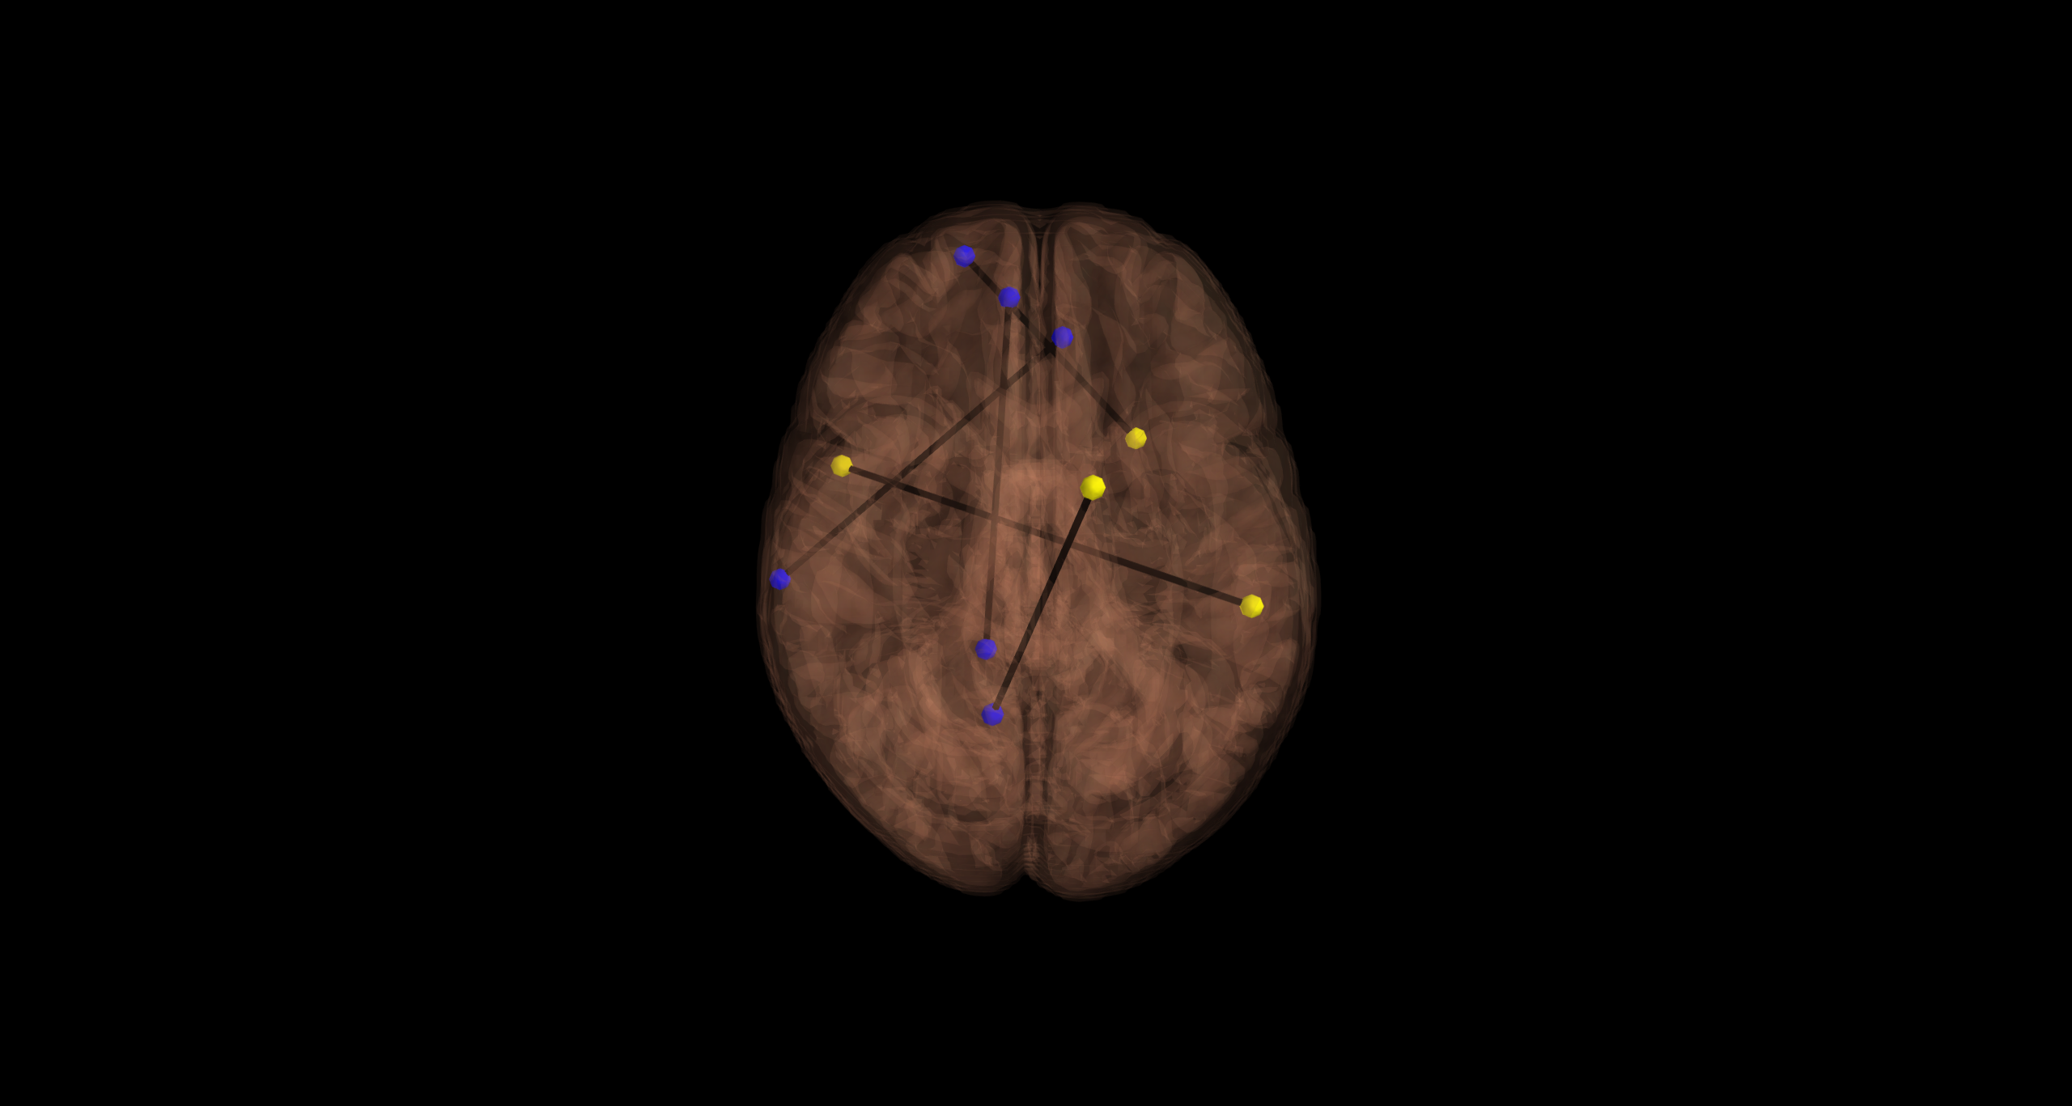
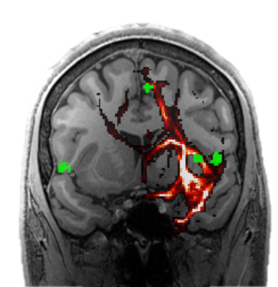
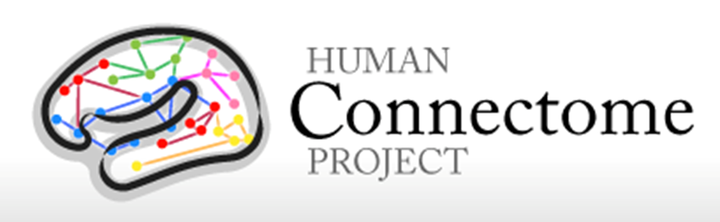
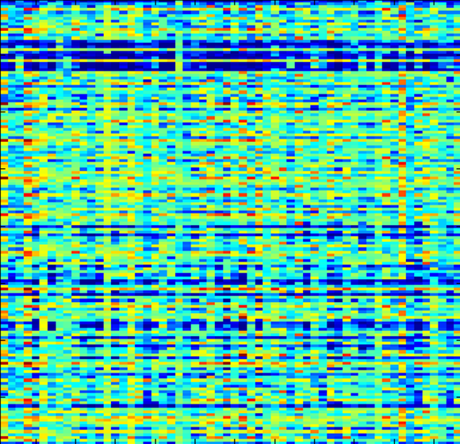

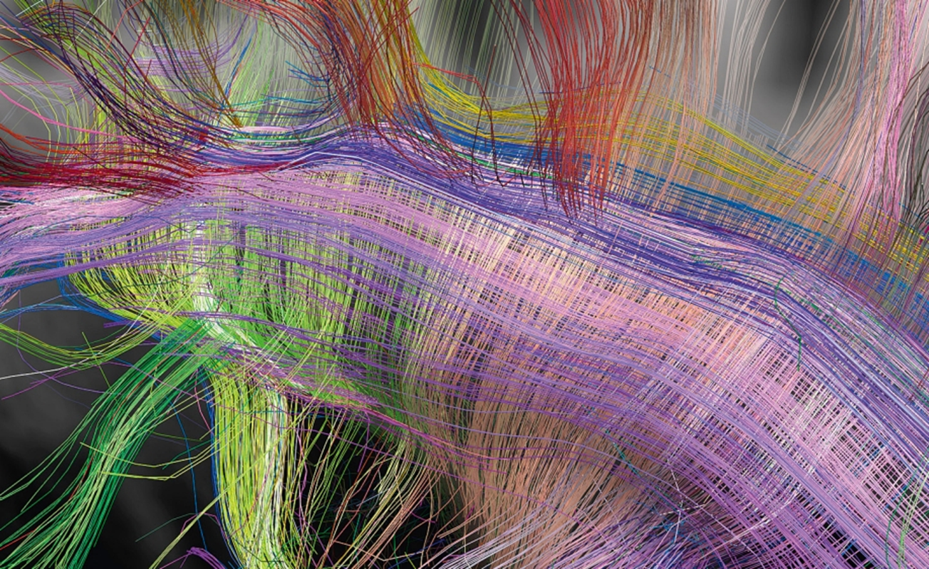
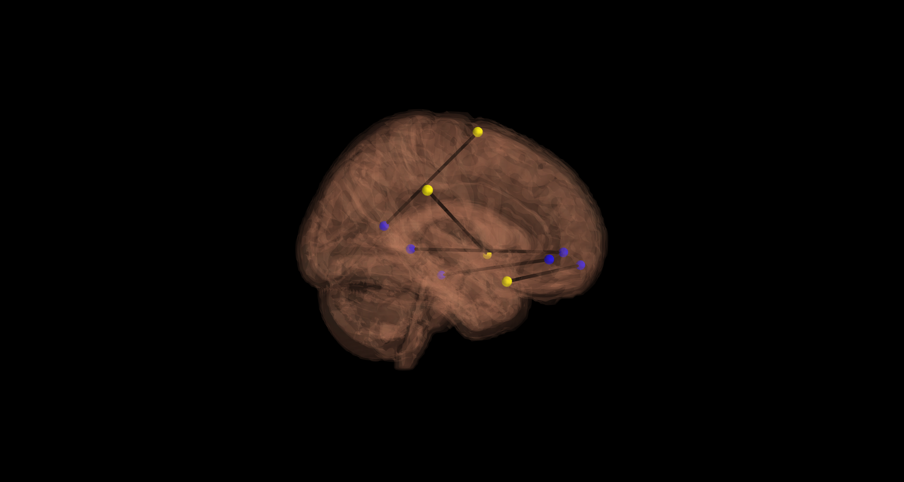
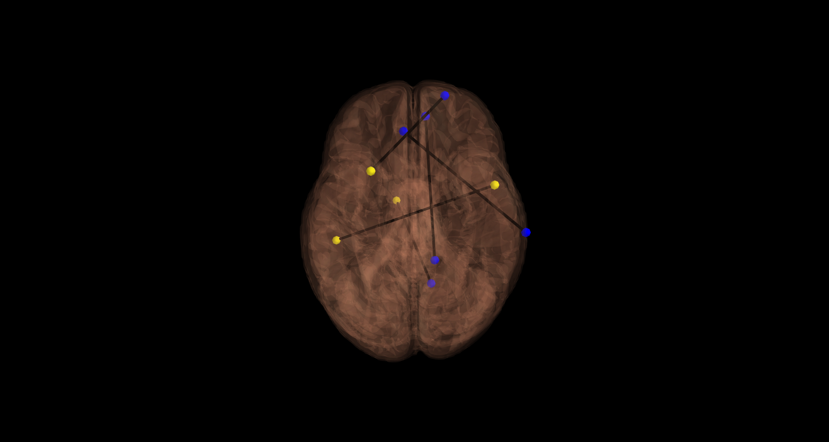
9% explained by the general size of your brain.
27% predicted by this model.
Predicting Intelligence
Actual Fluid Intelligence Scores (Y)
Notes:
The Human Connectome Project has made publicly available hundreds of human brain imaging data,
[click]
including high-resolution Diffusion Tensor Imaging data
In addition, for each participant, they provided their performance on the Ravens Test – a proxy for their fluid intelligence.
[click]
By performing an advanced series of “tracking algorithms”, we were able to create a dataset that measured how well discrete regions in the brain that are responsible for cognitive control and internally directed cognition were interconnected.
I hypothesized that this “network-wide” [click] connectivity could predict intelligence.
[click]
In my opinion, the true test of a hypothesis is whether you can predict the unknown. So, much like how Google predicts what you are about to type into their search engine, we used machine-learning algorithms to recognize the unique pattern of connectivity associated with different degrees of intelligence and then looked at new subjects’ data and tried to predict their intelligence.
And it worked…
[click]
Thus, just by examining the movement of water across discrete regions in the brain, we can infer their connectivity, and in turn…one’s intelligence.
And these are those regions.
[click]

