Slide 1
Multivariate resting state functional connectivity predicts response to cognitive-behavioral therapy in obsessive-compulsive disorder
Reggente, N., Moody, T.D., Morfini, F., Sheen, C., Rissman, J., O’Neil, J., Feusner, J.D.
Nicco Reggente | Neuro+ | January 26 2018

Slide 2
Introduction / Motivation
Obsessive Compulsive Disorder
  Recurrent intrusive thoughts (obsessions) and/or repetitive behaviors (compulsions)
  1-2% of the population with poor quality of life.
Yale-Brown Obsessive Compulsive Scale
  Eligible if they scored at least a 16
Cognitive-behavioral therapy
  Exposure and response prevention (ERP) based
  Moderate to high effectiveness
  Time intensive (90-min sessions, 5 days per week, 4 weeks)
  Prediction of Response
    No studies to date.
Notes:
Some have found that small-worldness in resting state was associated with trajectory of OCD symptoms 12 months after CBT. Small worldness also increased pre-to-post CBT.
Others showed that there are significant changes in FPTCN, CON, Somato-Motor, and Visual.

Slide 3
Methods
N=42
Waitlist (N=21)
Resting State fMRI & YBOCS
4-weeks Intensive CBT
Resting State fMRI & YBOCS

Slide 4
Methods
Resting State
  7 minute, 3mm isotropic
Preprocessing
  Motion-corrected
  Band-pass filtered
  Global Signal Regression
  CSF Signal Regression
Patient Screening (2 removed)
  Framewise Displacement (FD)
    >.3 excluded
  Root-mean squared change in volume-to-volume BOLD (DVARS)
    > 2 SD excluded

Slide 5
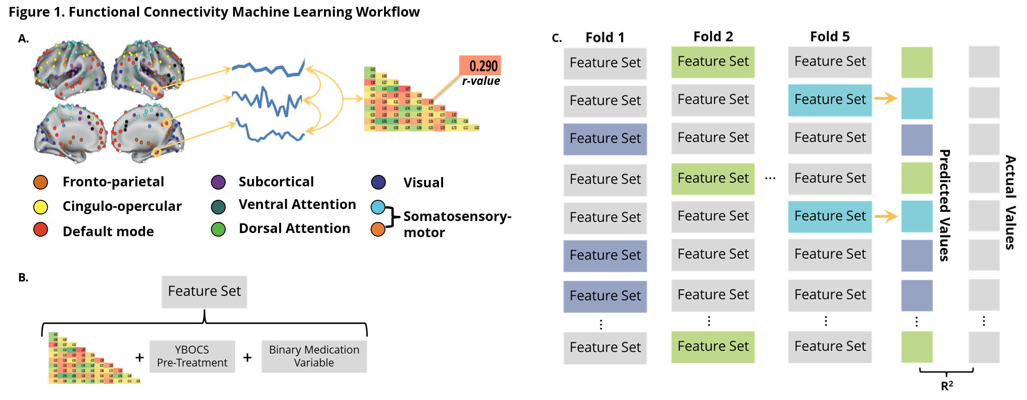
Methods
Regress Out: age, sex, illness duration, IQ (WASI Scores)
Notes:
Mention the addition of the Amygdala from Harvard Oxford.
Amygdala has been seen to show some predictive power in treatment response.
Least Angle Regression (LARS) algorithm on N-1 to optimize the penalty parameter.
Then 10 subjects left out cross-validation (25%).

Slide 6
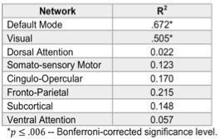
Results
R-value to Student’s t-distribution
Values with p<.006 (Bonferroni, 8 Networks) sent to Bootstrap (10k)

Slide 7
Results

Slide 8
Results
Top 5% of connections with the highest magnitude beta-coefficients

Slide 9
Results

Slide 10
Follow-up Analyses
Pre-Treatment Resting State vs. Pre-Treatment YBOCS
Post-Treatment Resting State vs. Post-Treatment YBOCS
To establish that results were specific to predicting treatment response rather than merely reflecting OCD symptom severity.

Slide 11
Results

Slide 12
Results

Slide 13
Follow-up Analyses
Response vs. No Response
  Response = YBOCS decrease > 35% & CGI-I of 1 or 2
  SVM (nu-SVC, c=1)
  Leave-10-out cross-validation
  Balanced training classes
  10 iterations, average accuracy
Significance determined by the binomial inverse of the cumulative distribution function to identify the smallest number of correct classifications (n^{k}) necessary.
Notes:
Clinical Global Impression – Improvement Scale
1 – very much improved
2 – much improved
3 – minimally improved
4 – no change
5 – minimally worse
6- much worse
7 – very much worse

Slide 14
Results

Slide 15
Follow-up Analyses
Waitlist
  Prediction of YBOCS after waiting (n=21)
Prediction of Other Measures
  Hamilton Anxiety Scale (HAMA)
  Montgomery-Asberg Depression Rating Scale (MADRS)
Including Motion / Comorbidity to feature set
No Functional Connectivity

Slide 16
Results
Only minimal improvement (increase from 67% to 70%) in the DMN when adding dummy coded combordity for anxiety / depression.

Slide 17
Discussion / Future Directions
Once extended and replicated, this method could help guide treatment options
Labeling of responders from expert consensus, seems to have a neurobiological basis.
Potential of certain individuals’ DMN to adjust towards a more adaptive state, allowing one’s thoughts to escape the loop of self-referential processing and to switch to externally-oriented, goal-directed cognition.
  Evaluative dimensions about the self (not good enough, not pure, not devout)

Slide 18
Discussion / Future Directions
Emotionally charged stimuli can upregulate visual processing (for adaptive behavior in most cases).
Misattribution of emotional valence to non-threatening to non-task-related stimuli could cause pathological upregulation of visual processing dedicated to those stimuli.
Visual systems in some patients may be more amenable to rewiring that could help impede the DMN’s rumination on these stimuli.
The post-treatment results could relfect the Visual Network changing its connectivity with the amygdala to prevent such processes.

Slide 19
Reggente, N., Moody, T.D., Morfini, F., Sheen, C., Rissman, J., O’Neill, J., Feusner, J.D. (2018) Multivariate resting state functional connectivity predicts response to cognitive-behavioral therapy. In Press. Proceedings of the National Academy of Sciences.
THANK YOU

Slide 20
APPENDIX

Slide 21
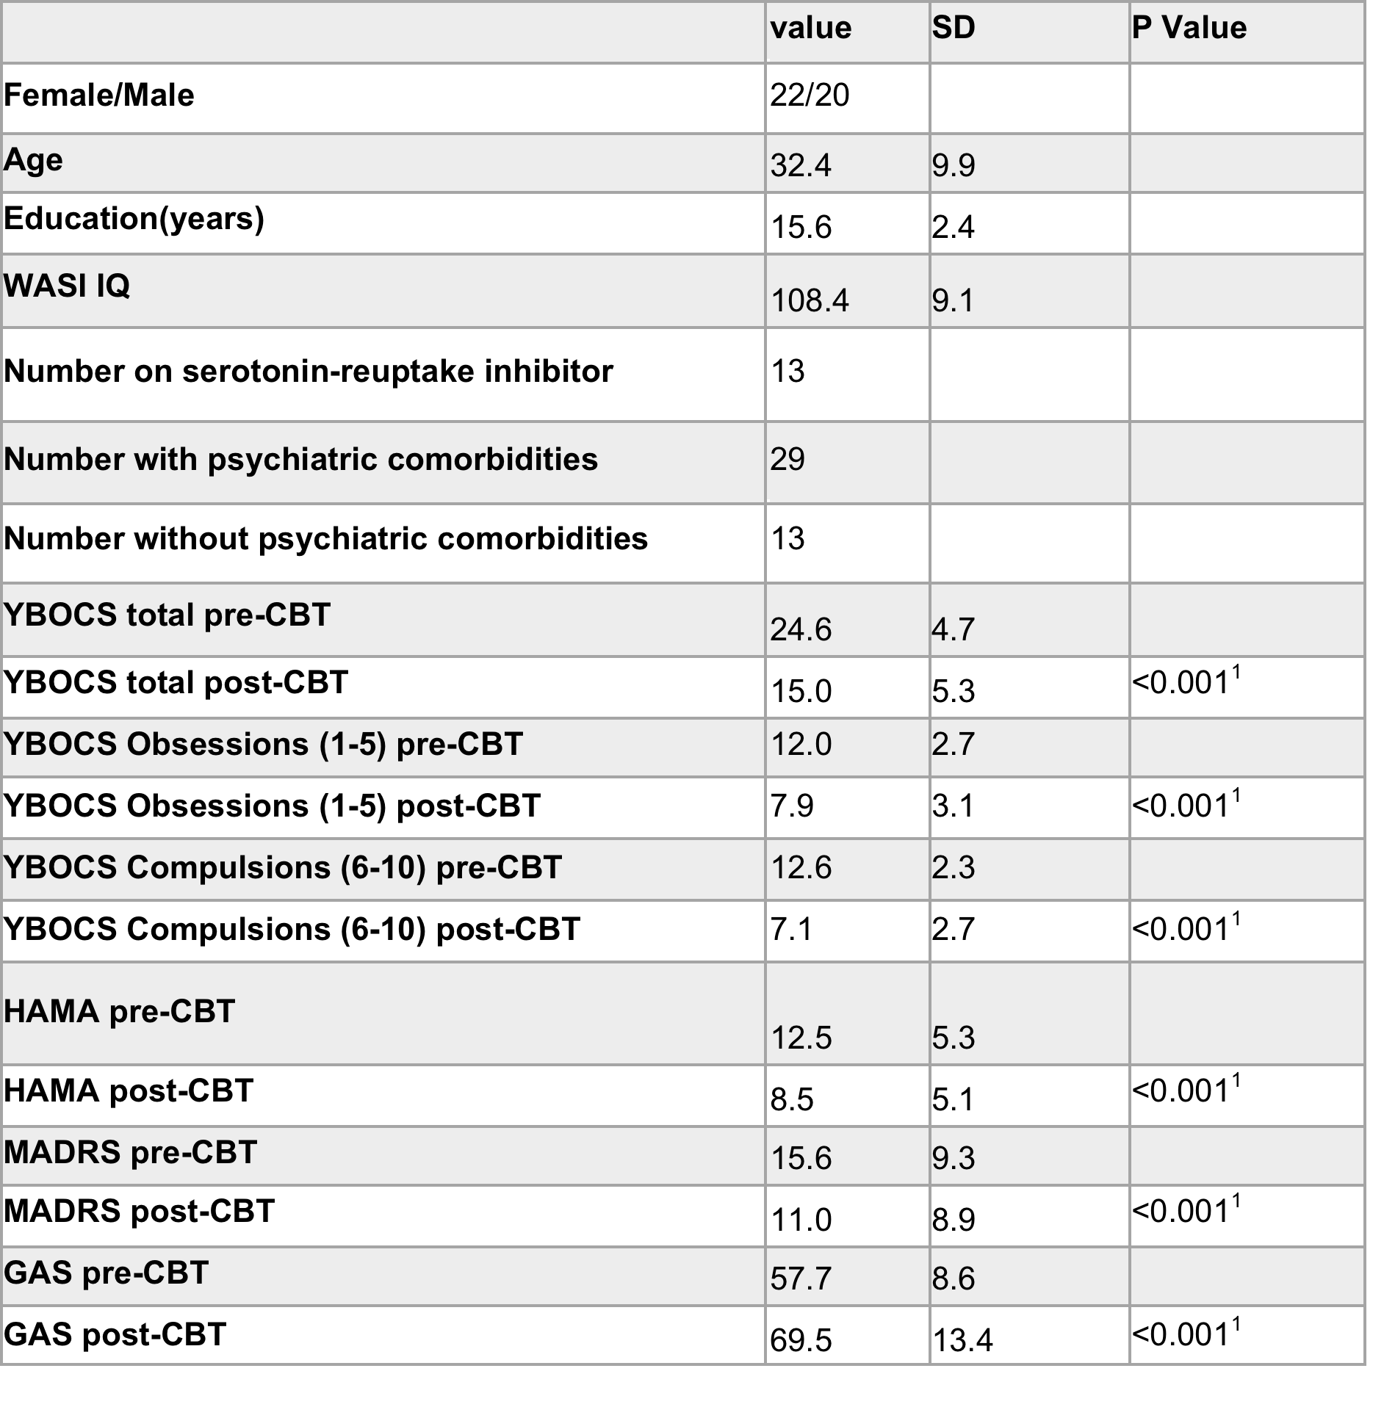
More

Slide 22
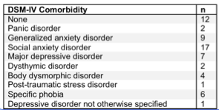
More

