Slide 1

Does functional MRI detect activation in white matter?
A review of emerging evidence, issues, and future directions.
Jodie R. Gawryluk, Erin L. Mazerolle, Ryan C. N. D’Arcy
Presented by Nicco Reggente on March 12, 2015
UCLA Neuroimaging+ Journal Club

Slide 2
Motivation
There is a 50:50 ratio of white to gray matter tissue, but only 27 published reports of white matter BOLD activation.
DTI and functional connectivity alone are limited by the fact that neither evaluates the functional dynamics directly within white matter pathways. Information transfer?
Investigating the functional dynamics of white matter would substantially broaden current approaches to the study of brain connectivity.
Reveal insights as to how regions within brain networks interact to support complex cognitive functions.

Slide 3
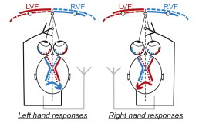
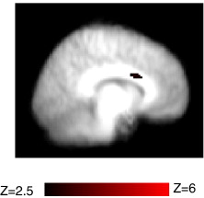
Previous Reports
Poffenberger paradigm reveals anterior corpus collosum inovlvement
Light to hemi field
Respond with ipsi/contra hand

Slide 4
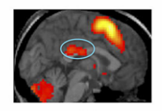
Previous Reports
Sperry task reveals involvment of the splenium of the corpus collosum
Word stimuli (→ L hemisphere)
Face stimuli (→ R hemisphere)
Present briefly to R/L hemifield
Interhemispheric tranfer

Slide 5
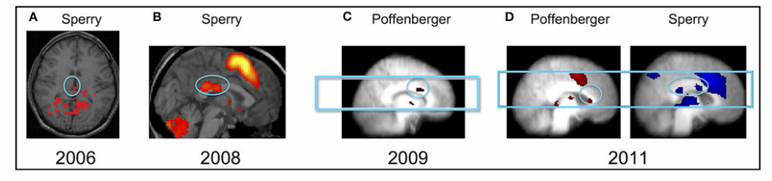
Previous Reports
Functionally distinct white matter activations

Slide 6
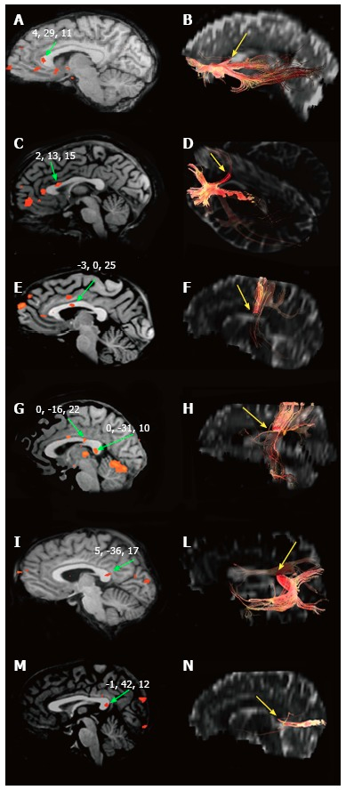
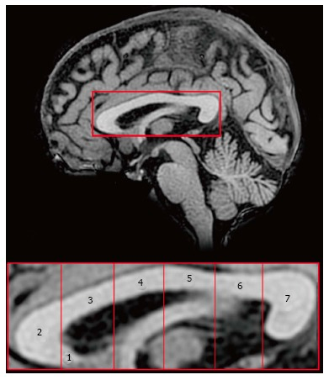
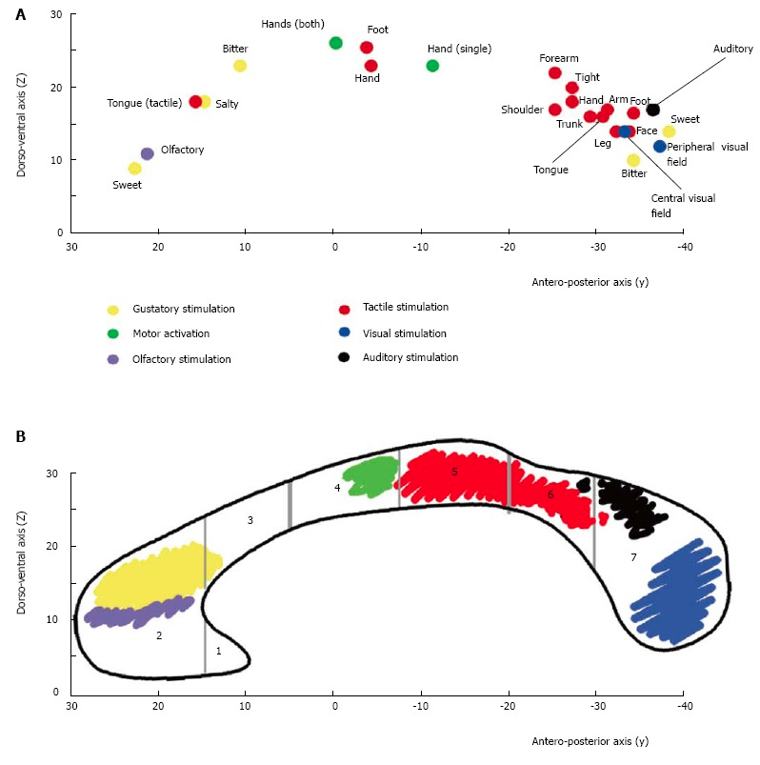
Previous Reports
A / B: Focus evoked by olfactory stimulation and callosal fibers connecting primary olfactory cortices
C / D: The same for gustatory stimuli and areas
E /F: Motor task and motor cortex
G / H: Hand tactile stimulus and somatosensory cortex
I /L: Auditory stimuli and cortex
M /N: Visual stimuli and cortex

Slide 7
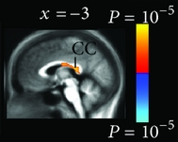
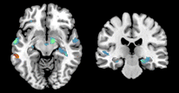
Previous Reports
Corpus Collosum activity seen during:
Sign Language sentences with inflectional morphology
Acupuncture
activation in the genu of the corpus callosum here may be indicative of greater information flow between the two hemispheres for inflectional morphology sentences

Slide 8
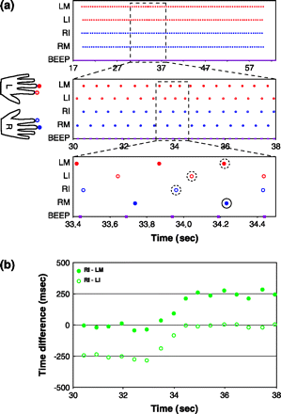
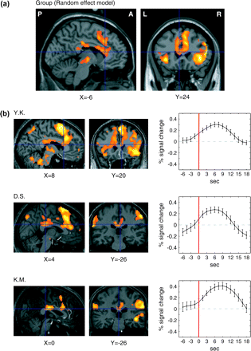
Previous Reports
Corpus collosum activation associated with interhemispheric interactions
during bimanual coordination.

Slide 9
Previous Reports
Negative signal change in optic radiations contralateral to visually stimulated hemisphere

Slide 10
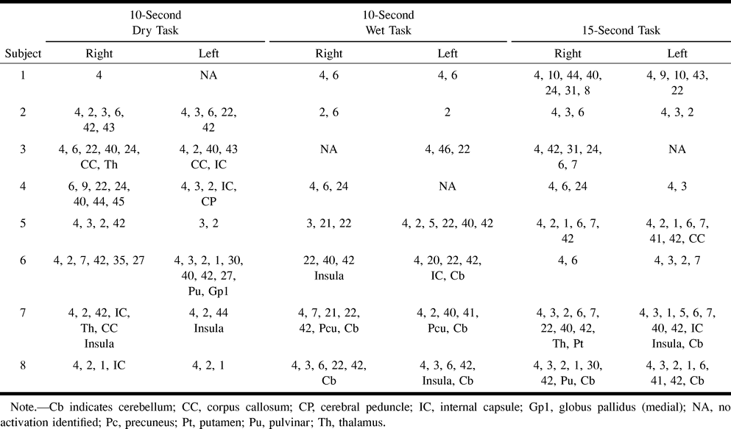
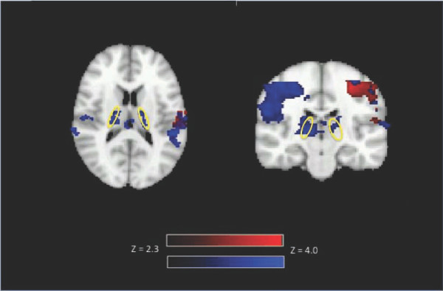
Previous Reports
Internal Capsule detected in:
Swallowing
Finger Tapping

Slide 11
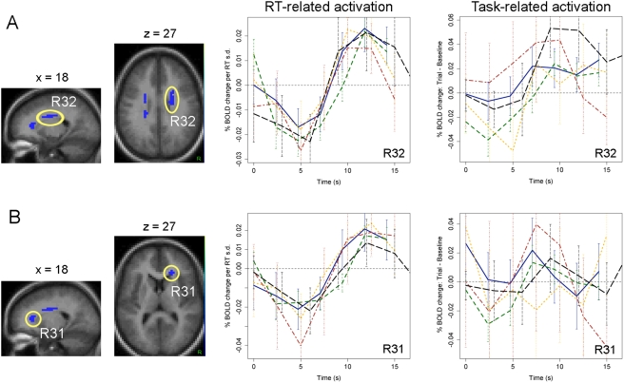
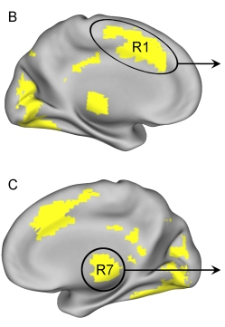
Previous Reports
Trial-by-trial reaction time differences show BOLD correlates in:
Corpus Collosum
Corona Radiata

Slide 12
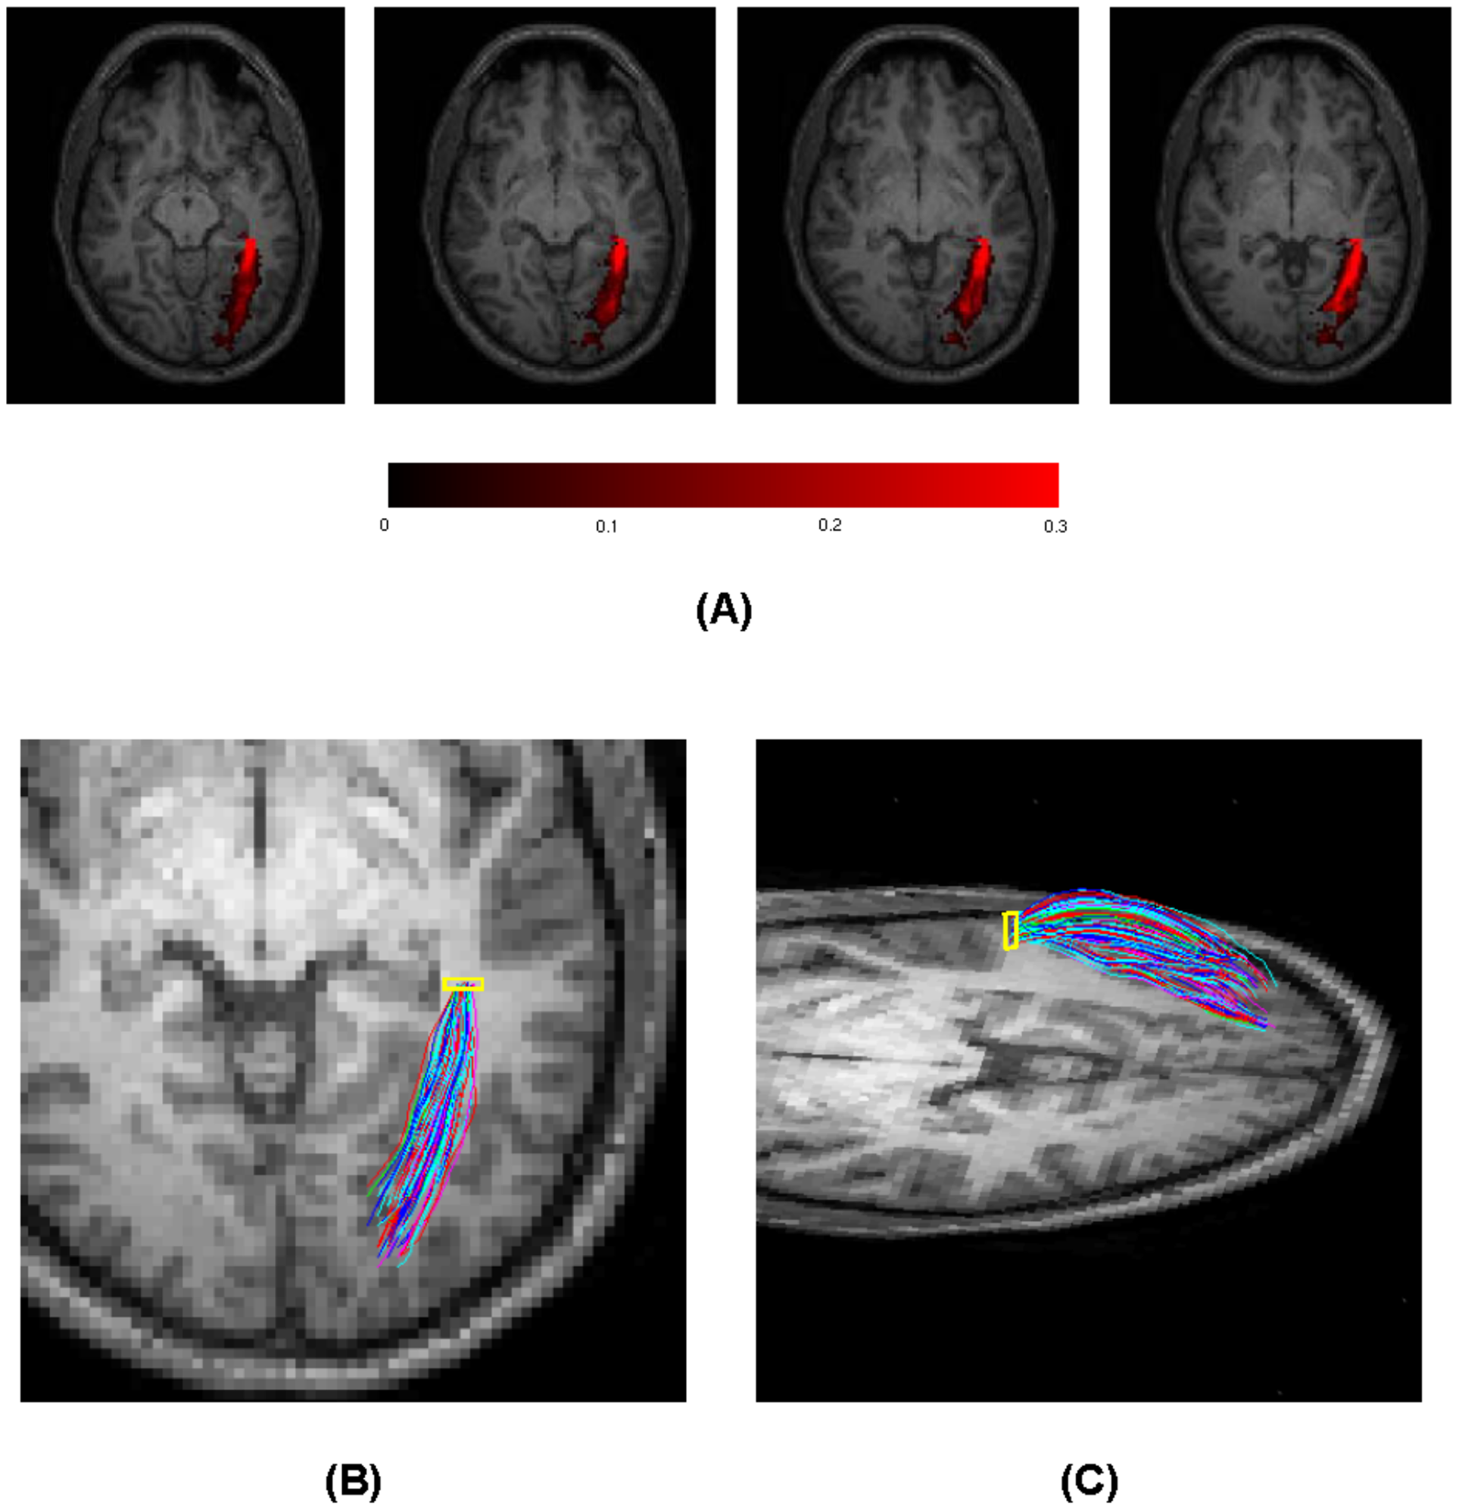
Previous Reports
Functional Connectivity in white matter during rest
Evaluate the strength of functional connectivity within white matter tracts,
which were defined using DTI tractography.
Functional connectivity was significantly greater for voxels within the same white matter tracts than for random voxels (matched distance from the seed).

Slide 13
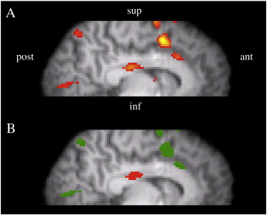
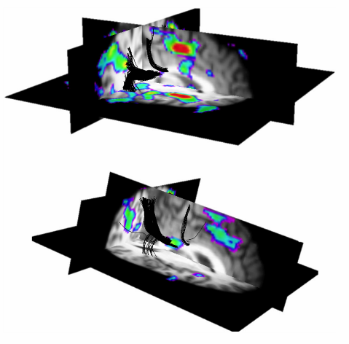
Previous Reports
Activated regions of the corpus callosum were structurally connected to
the functional network of gray matter regions involved in the task.

Slide 14
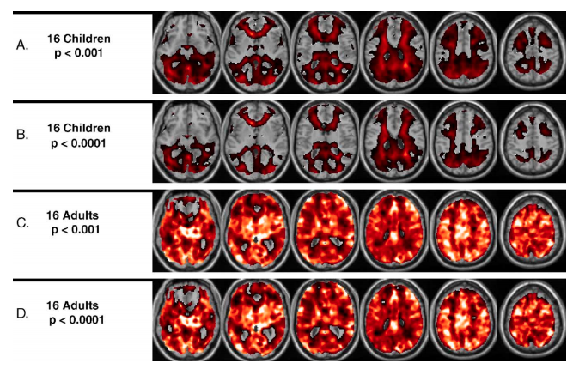
Previous Reports
Hemodynamic changes can be detected in white matter during vascular changes,
such as breath-holding tasks or hypercapnia
Thus, there is evidence that white matter has the vascular capacity to
support hemodynamic changes that are detectable with fMRI

Slide 15
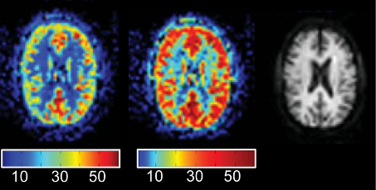
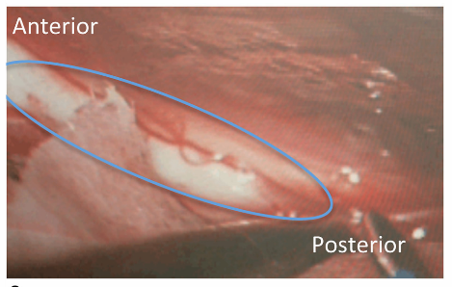
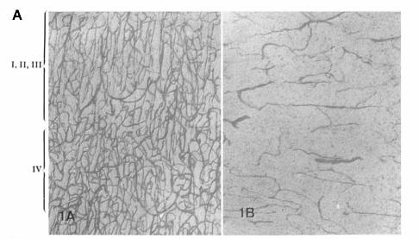
Limiting/Contributing Factors
Venous vessel size is equal across white and grey matter, but density for white is half that of grey, thus resulting in lower CBF and CBV
Confirmed that white matter blood flow is 1/10 – 1/3 that of gray matter by perfusion MRI imaging with arterial spin labeling (ASL)
99-761 microvessels/mm² 10-192 microvessels/mm²

Slide 16
Limiting/Contributing Factors
BOLD is traditionally thought to track local field potentials (LFP), which reflect post-synaptic potentials(PSP).
PSPs account for less than 1% of the energy demands in white matter.
The primary type of neural activity in white matter is spiking.
Spiking is associated with energy-dependent ion pumps used in maintaining the resting potential.
So…how can we link BOLD responses to spiking?

Slide 17
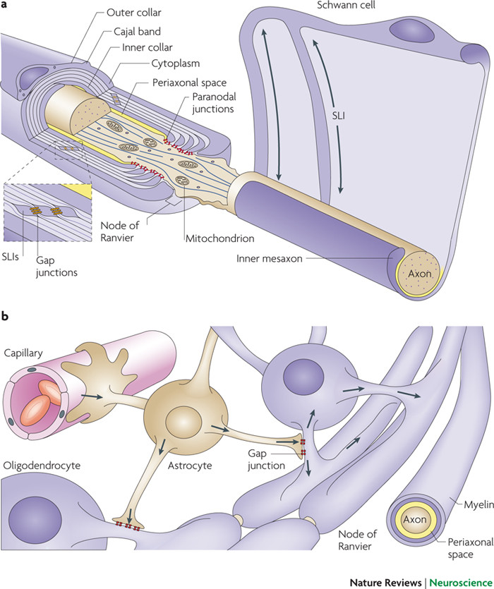
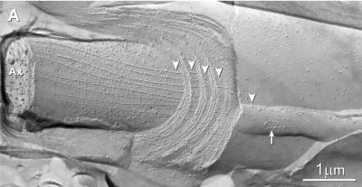
Contributing Factors
Astrocytes perform a similar function (K⁺ siphoning) in white matter as they do in grey matter.
Astrocyte expression of K⁺ channels is localized to perivascular end feet and on processes located within myelinated axon bundles.
K⁺ is transported across layers of myelin via gap junctions and are taken up by astrocytes
Astrocytes release K⁺ perivascularly, which relaxes the smooth muscles of the arterioles surrounded by the astrocyte’s end feet → hemodynamic change.

Slide 18
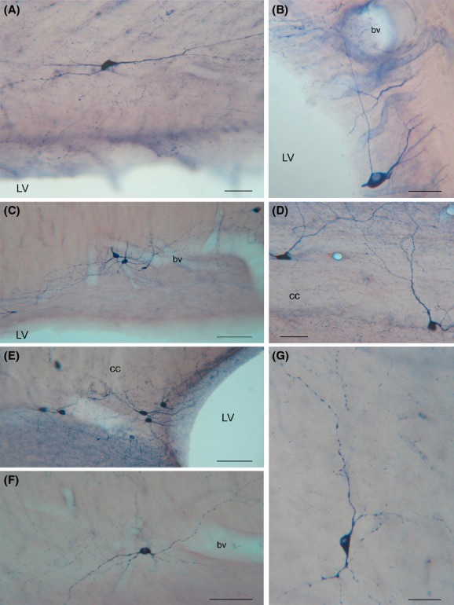
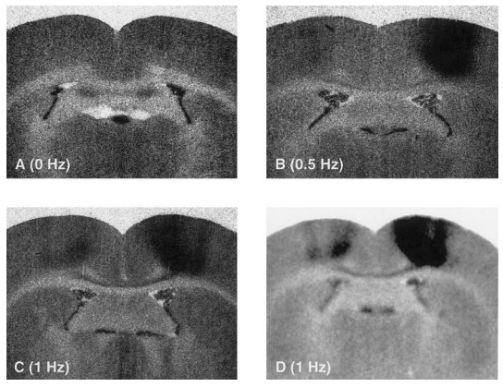
Contributing Factors
Nitric Oxide (NO) producing neurons are found throughout the corpus callosum.
NO is a powerful vasodilator (a perfect transducer of neuronal signals into vascular responses)
Increased glucose uptake in the corpus collosum associated with electrical stimulation of a cortical region with callosal projection. Scales with Frequency.

Slide 19
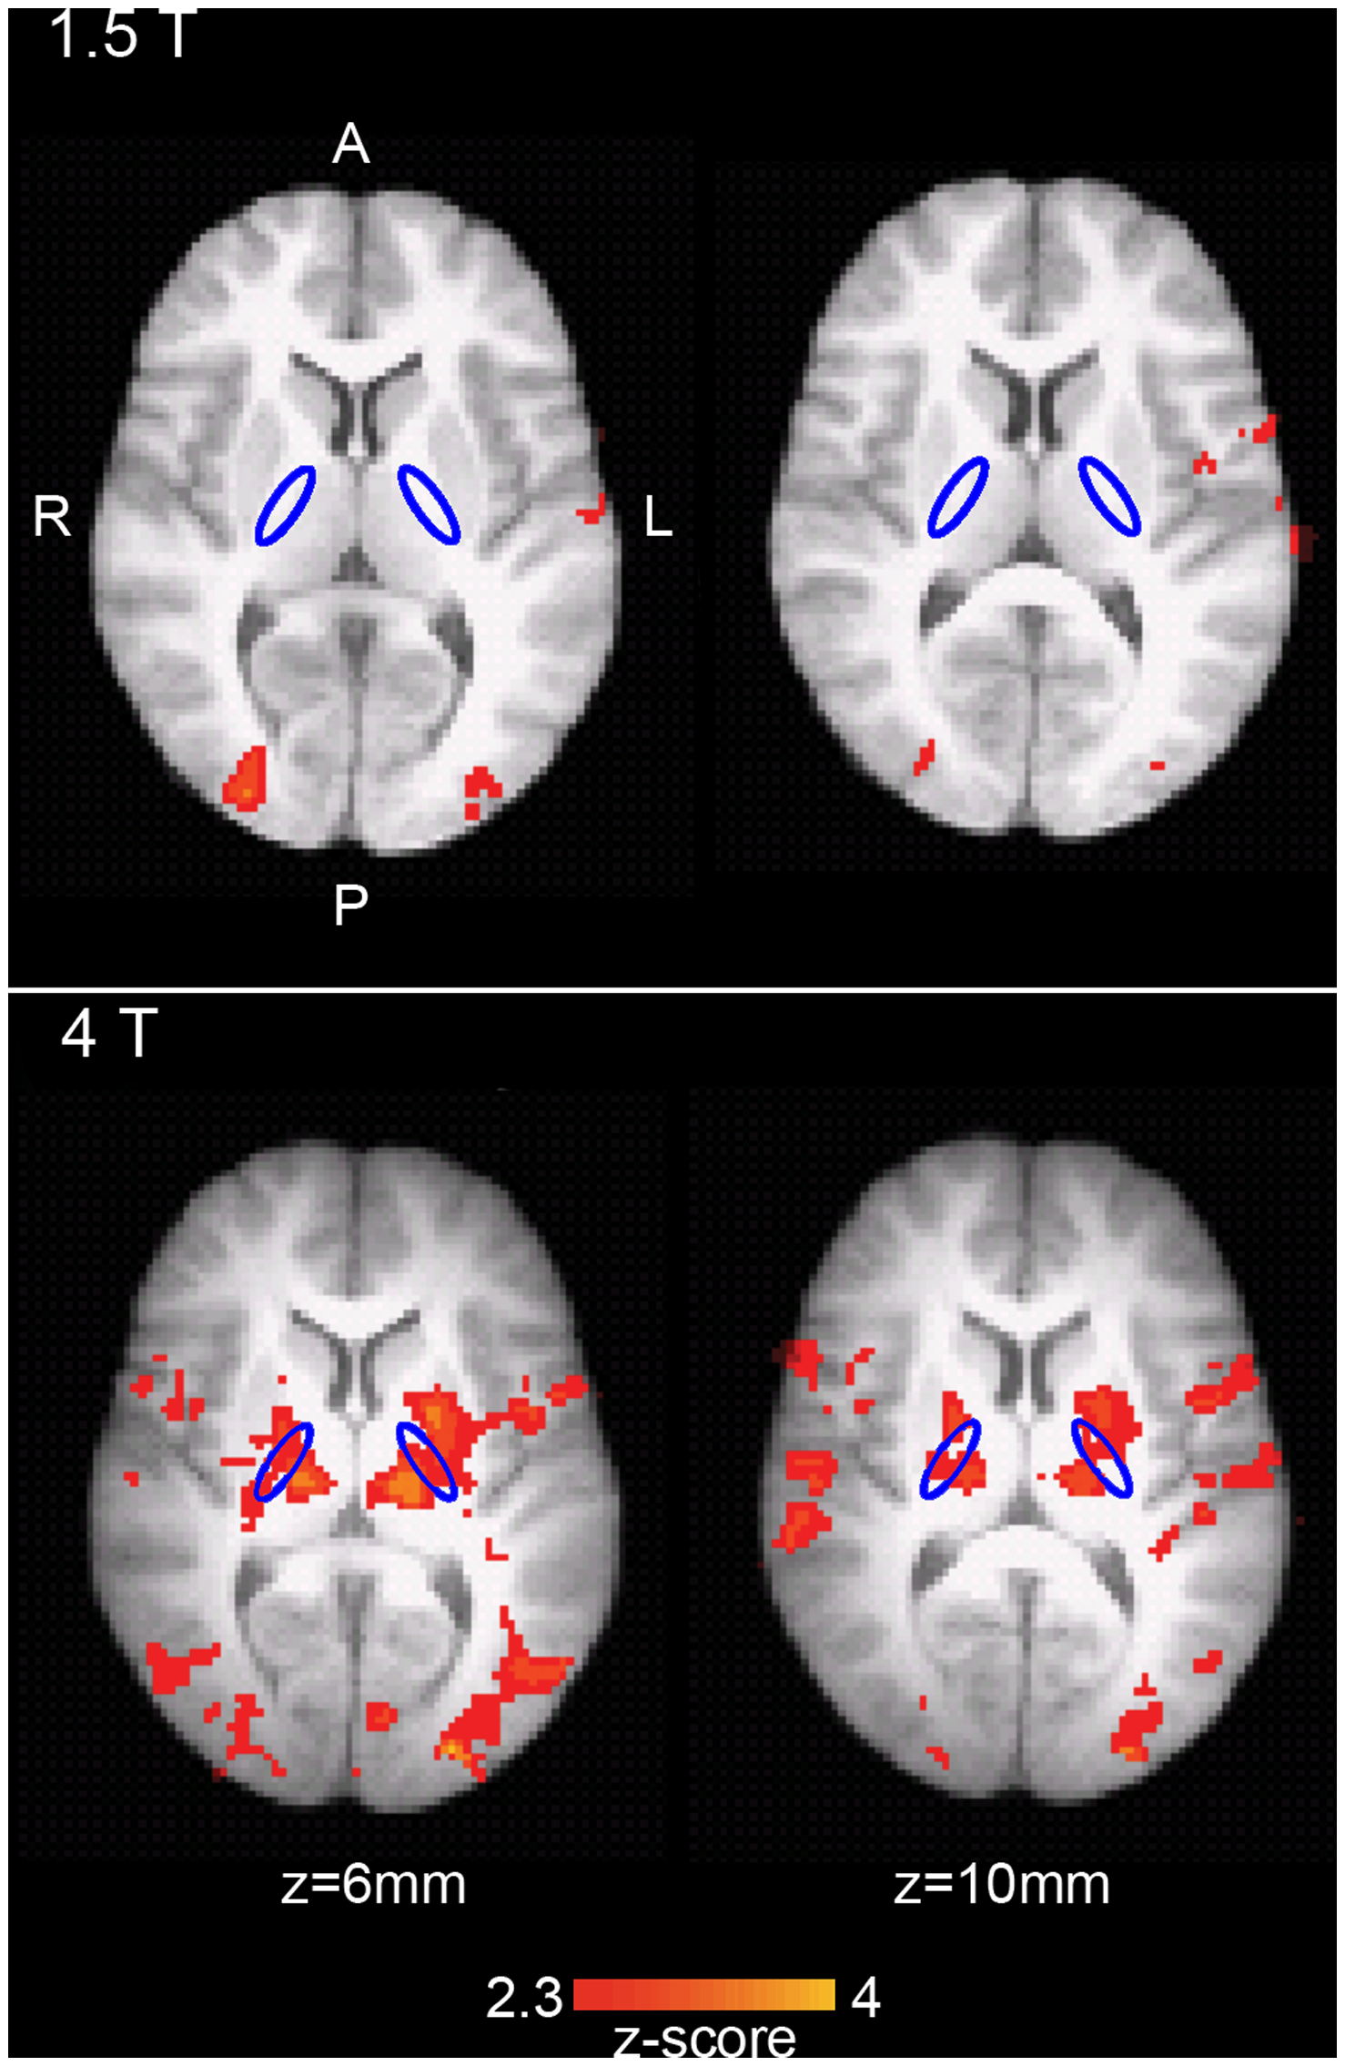
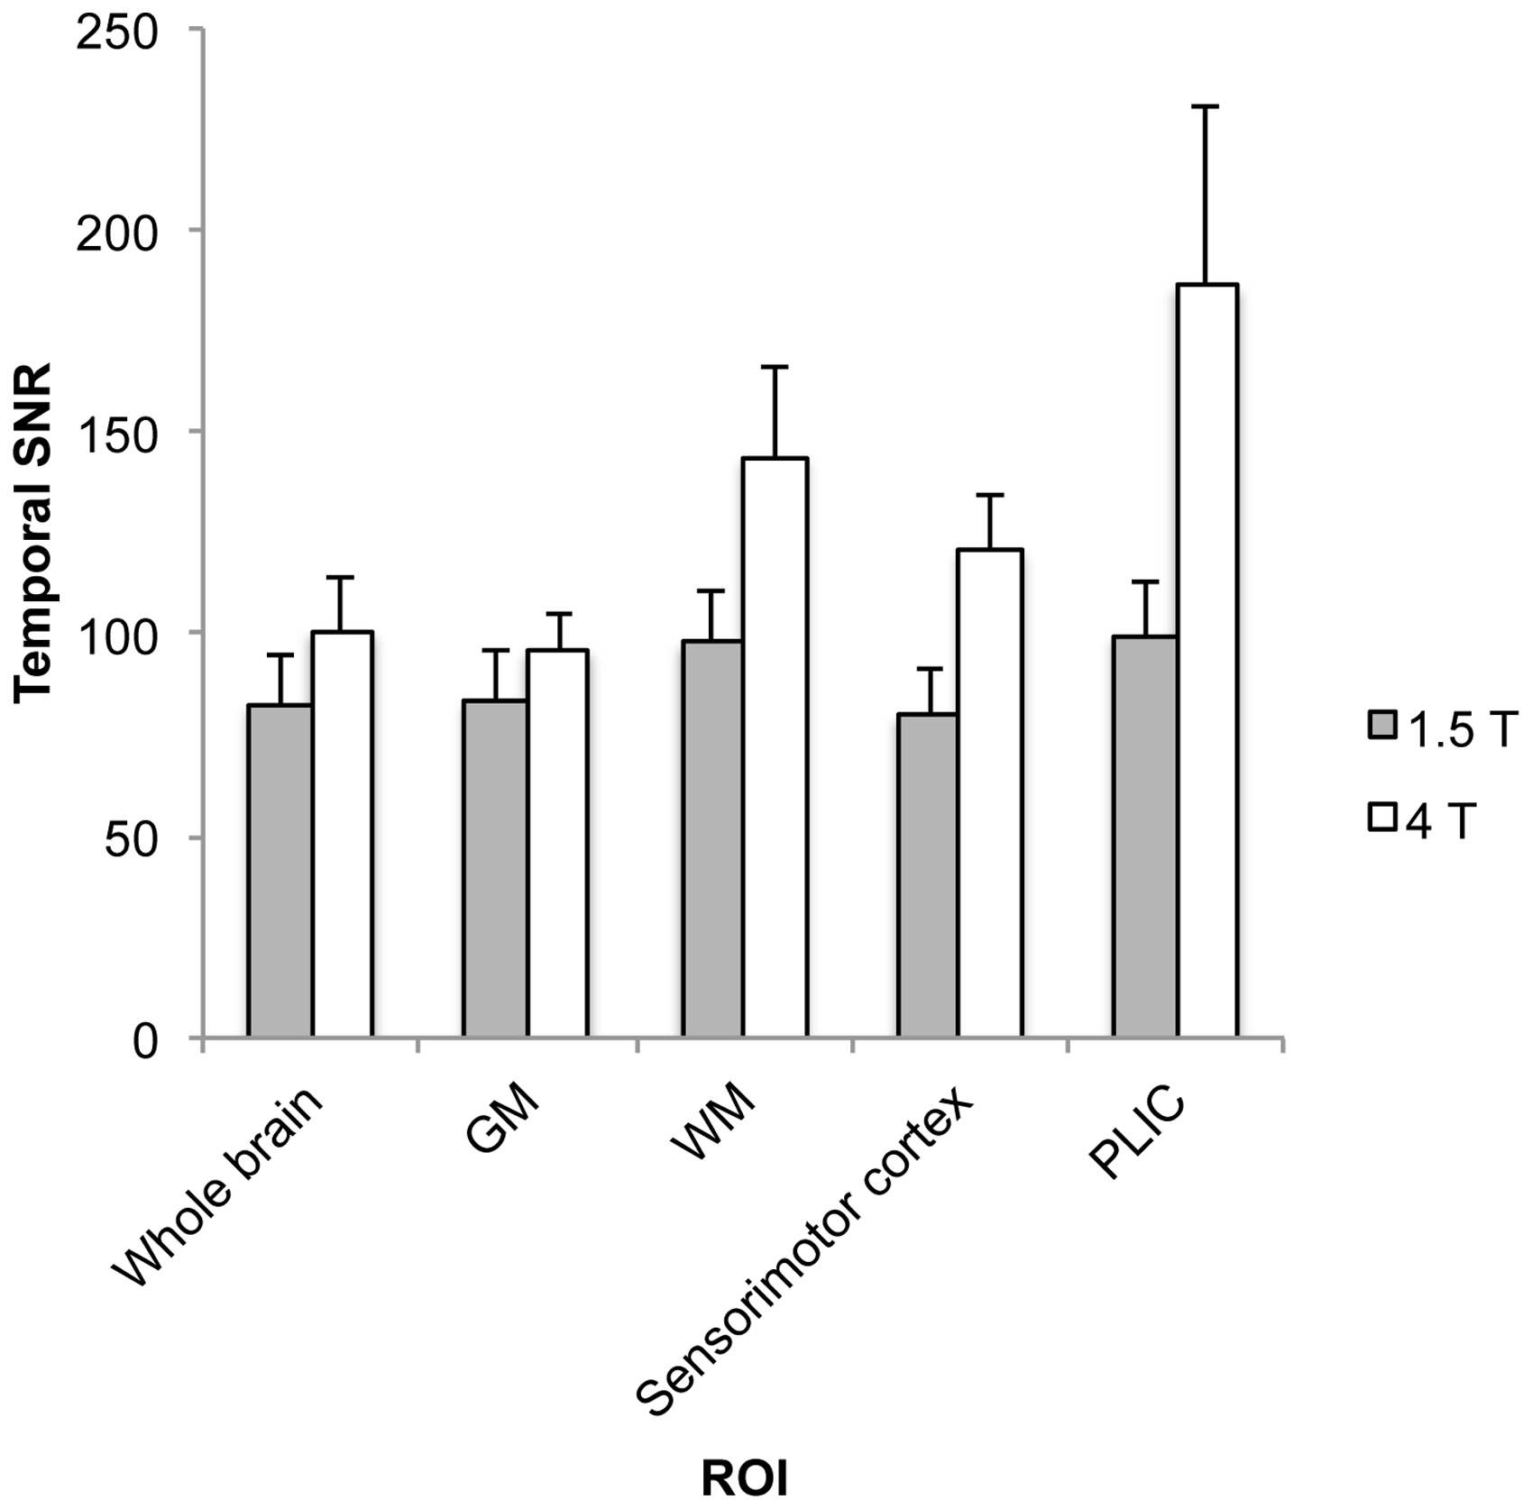
Limiting Factors
Sensitivity increases with field strength re greater for white matter than gray matter
Fractional changes in fMRI signals may be greater when baseline flow is lower, such as in white matter.

Slide 20
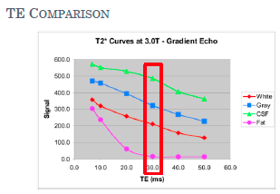
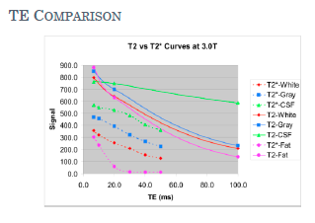
Limiting Factors
Our TE is optimized for Grey Matter
Credit – Dr. Martin Monti, UCLA (2013)

Slide 21
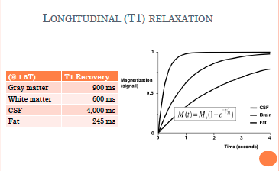
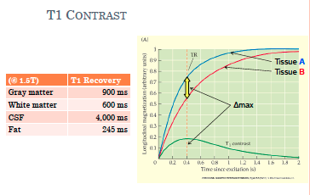
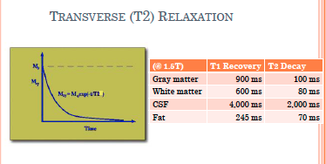
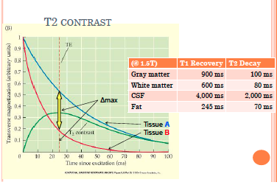
Limiting Factors
Our T2* is optimized for gray matter
Credit – Dr. Martin Monti, UCLA (2013)

Slide 22
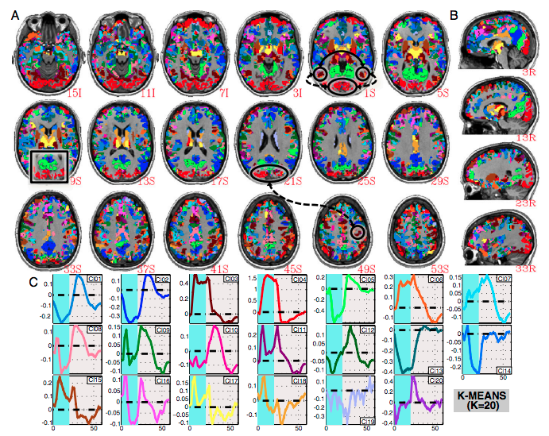
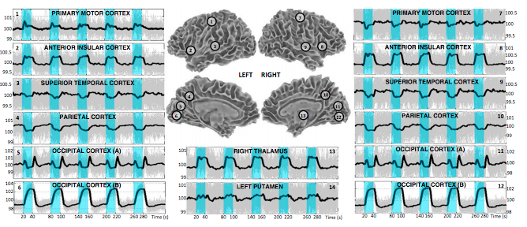
Limiting Factors
The HRF varies between regions, with some researchers saying it’s the same as the canonical HRF, where others demonstrate slower responses in white matter. This could result in a systematic underestimation of white matter activation.

Slide 23
Limiting Factors
Experimenter expectations may bias fMRI studies away from making new and unexpected discoveries.
White matter signals are typically used as a nuisance regressors and/or thresholds for significant activation.
Decreases in white matter activation is a sanity check for denoising.

Slide 24
Limiting Factors
What could cause an increase in artifactual activation in a manner specific to white matter such that selectively discounting signals in white matter could be a valid approach?
Motion?
Partial Volume?
Physiological Noise?
Task-correlated motion is artifactual, especially at tissue boundaries.
Regions of deep white matter, which can be cm away from tissue boundaries, may be particularly insensitive to such artifacts.
Not expected to be white-matter specific.
Especially after smoothing, fMRI activation in white matter could be the result of signal contamination from nearby subcortical structures.
Functional consistency in previous reports.
Activation seen in white matter could not be solely explained on the basis of gray matter partial volume.
Task-correlated respiratory/cardiac artifacts are seen in attention/emotion
Most problematic near large vessels.
tSNR is greater in white matter compared to gray.
Notes:
T=threshold

Slide 25
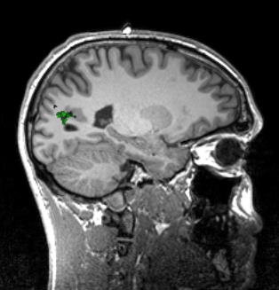
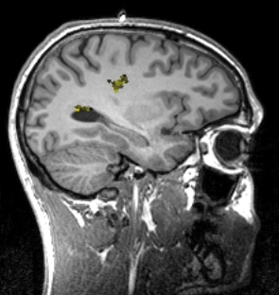
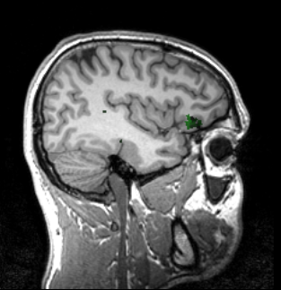
Future Directions
Symbol Digit Modalities Test is a sensitive measure of processing speed that is associated with white matter integrity.
Activation is localized to the corpus callosum and internal capsule.
This could be a clinical bio-markers.
Detect activation in the brain’s connections to
reveal interactions that support complex cognitive functions.
TRs 1:3 [Averaged]
TRs 4:7 [SpatioTemporal]
TRs 8:10 [averaged]

Slide 26
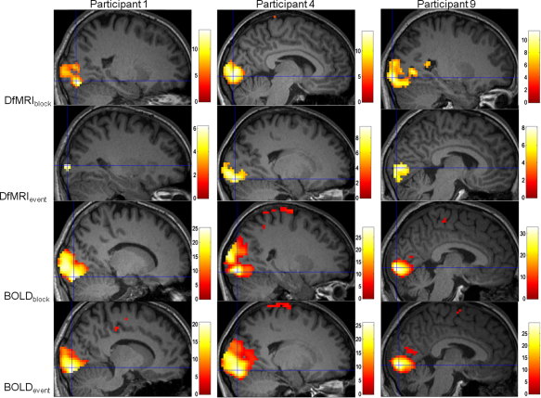
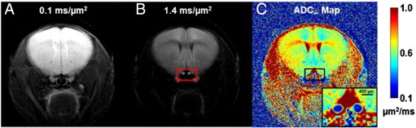
Additional Insights
Diffusion as a functional contrast (DfMRI)
mechanism has been reported for gray/white matter
Optic Nerve
Thought to represent structural changes induced by neural activity-related cell swelling.
If there are activity dependent changes, then it’s warranted that energy from blood is needed to fuel this process that occurs on a surprisingly small timescale
Notes:
By inserting “diffusion” gradient pulses in the MRI sequence (corresponding to low b values), one may crush the contribution of the largest vessels (with high D* values associated with fast flow) in the BOLD signal and improve the spatial resolution of the activation maps
water flowing in randomly oriented capillaries (at the voxel level) mimics a random walk (“pseudo-diffusion”

Slide 27
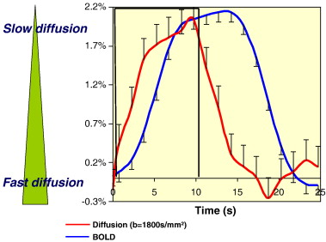
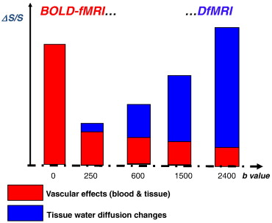
Additional Insights
Diffusion as a functional contrast (DfMRI)
mechanism has been reported for gray/white matter
Intravoxel incoherent motion
In biological tissues, these motions include molecular diffusion of water
and microcirculation of blood in the capillary network.
Notes:
By inserting “diffusion” gradient pulses in the MRI sequence (corresponding to low b values), one may crush the contribution of the largest vessels (with high D* values associated with fast flow) in the BOLD signal and improve the spatial resolution of the activation maps
water flowing in randomly oriented capillaries (at the voxel level) mimics a random walk (“pseudo-diffusion”

Slide 28
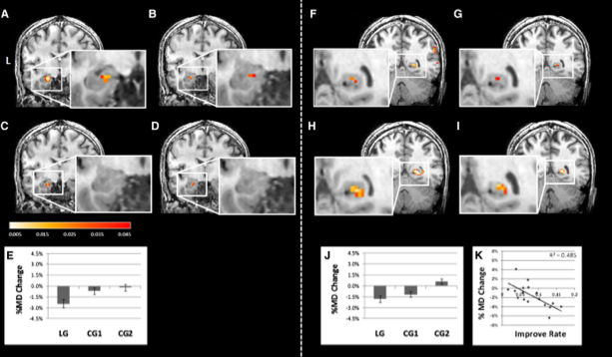
Imaging Findings
What They Found
Patterns of DTI Changes In The Procedural Learning Group:
  Reduction in MD in the left hippocampus.*
  Reduction in MD in the L/R parahippocampus.*
  Increase in FA in the left parahippocampus and:
    Right supramarginal/angular cortex
    Right superior temporal gyrus
    Right amygdala
    Left pulvinar
Patterns of DTI Changes In The Active Control Group
  Moderate differences(reduction in MD) in parahippocampus as compared to the passive group.
* Negatively Correlated With Improvement Rates In Lap Times
Main Effect: “We discovered that 2hr of training on a spatial navigation task results in MRI changes indicative of structural plasticity in specific brain regions.”
Notes:
Indicative of improvement alongside the reduction in MD and FA
The actual cause of the MD is unknown without histological evidence, which

Slide 29
Additional Insights
In vivo DTI quantitation in brain can be interfered by vascular factors on the order of few percentages
It has been demonstrated quantitatively that the cerebrovasculature and hemodynamic changes induced by hypercapnia substantially altered MD, radial diffusivity, axial diffusivity and FA quantitation. Accompanied with CBF and CBV elevations, diffusivity measurements were elevated and FA decreased.
The extent of changes was observed to be tissue dependent, whereby GM had greater changes in MD, axial diffusivity and FA, and a smaller change in radial diffusivity compared to WM.

