Slide 1
Neurocognitive Determinants of Memory Enhancement
A dissertation prospectus presentation given in partial satisfaction of the requirements for the degree of Doctor of Philosophy in Cognitive Neuroscience at UCLA on June 13, 2017
Nicco Reggente, M.A.

Slide 2
MOTIVATION
The enhancement of cognitive functions, particularly memory, has been a driving force of both biological evolution and conscious pursuit since the emergence of human cognition.
By keeping a perspective that follows the thread of the evolutionary pressures placed on humans across their history, modern researchers can craft operationalized paradigms geared towards exploiting the neural resources that were originally engineered to overcome such pressures.
Notes:
Jacobs, 2006
Jacobs, 2013
Buzsaki and Moser, 2013

Slide 3
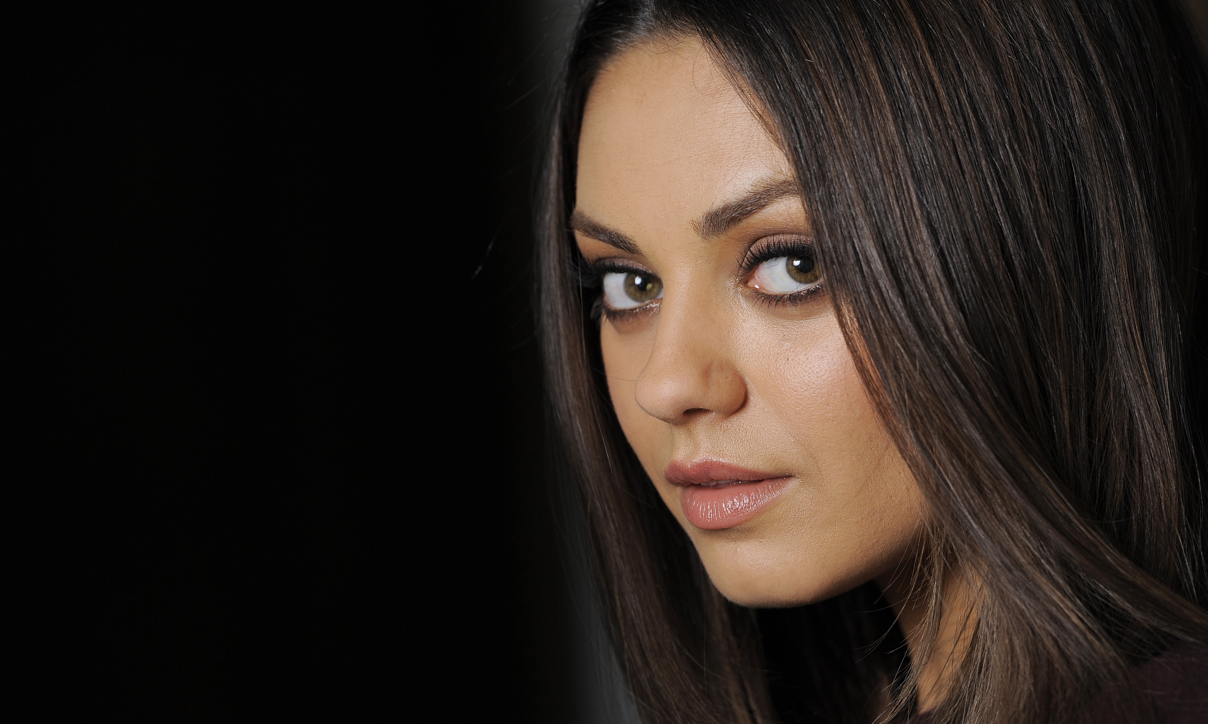

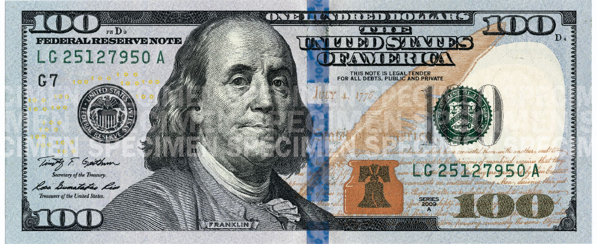
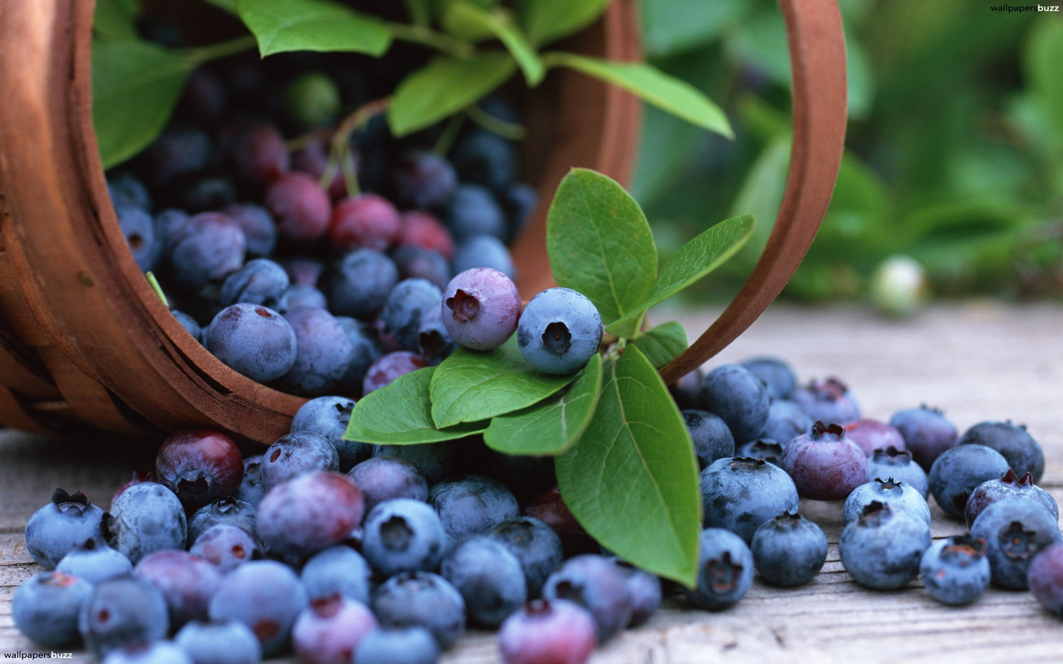
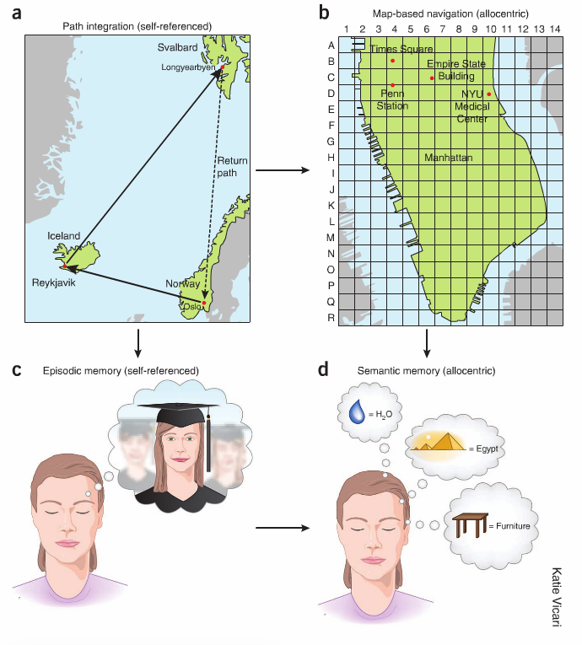
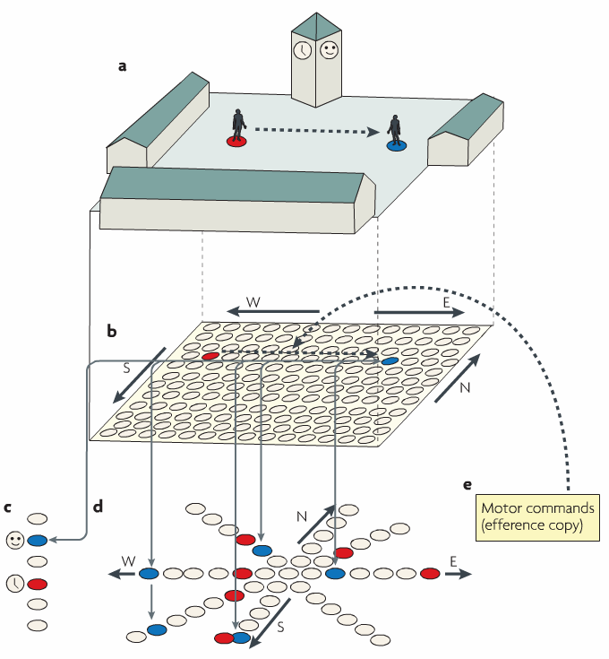
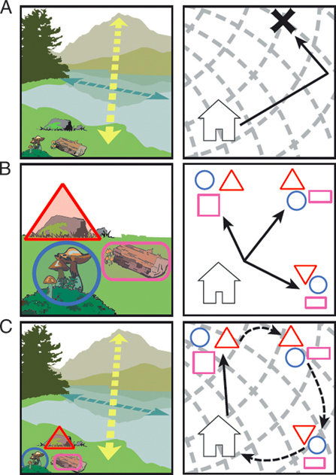
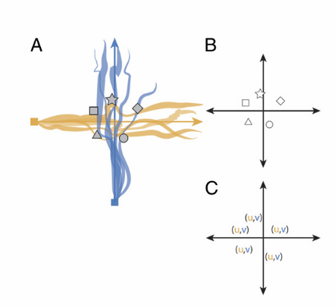
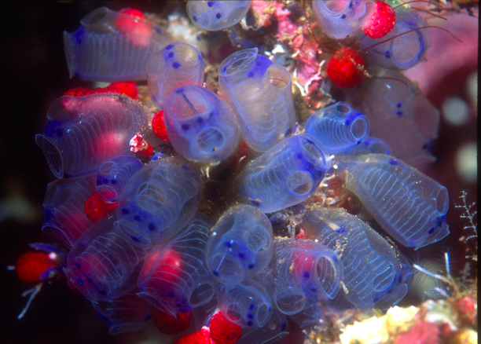
INTRODUCTION
This research focuses on leveraging evolutionarily pertinent systems in the brain to systematically enhance memory
Reward (Value Directed Remembering)
Spatial Processing (The Method of Loci)
Notes:
Jacobs, 2006
Jacobs, 2013
Buzsaki and Moser, 2013

Slide 4
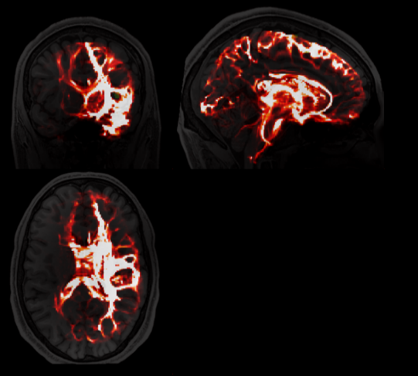
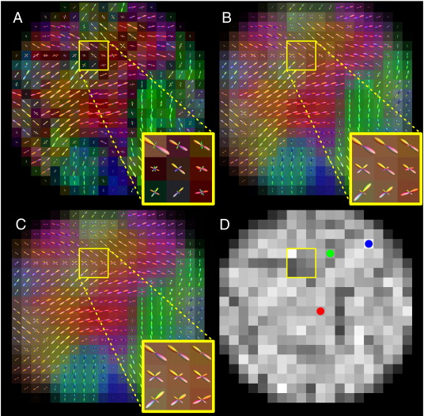
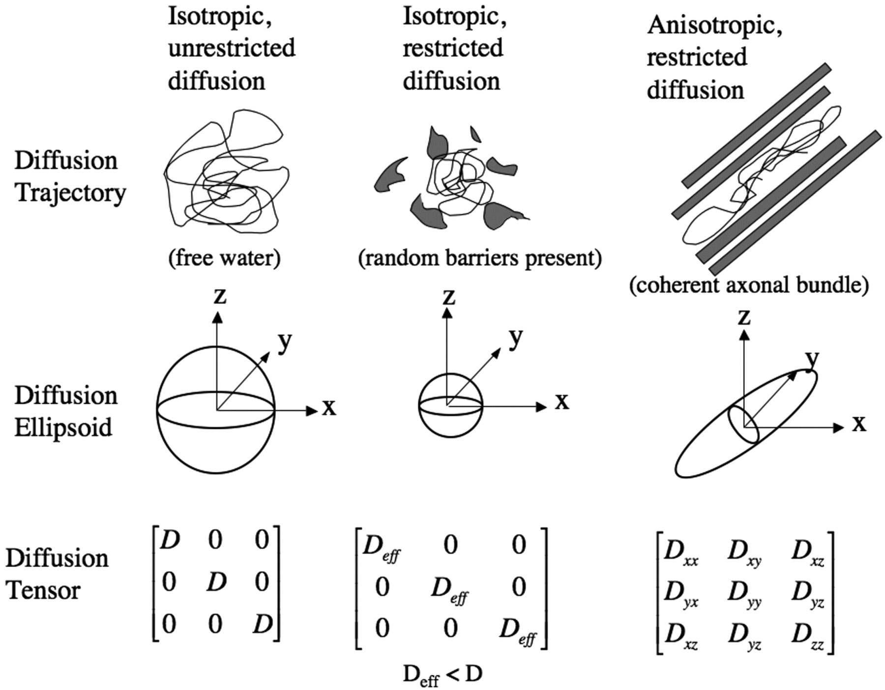
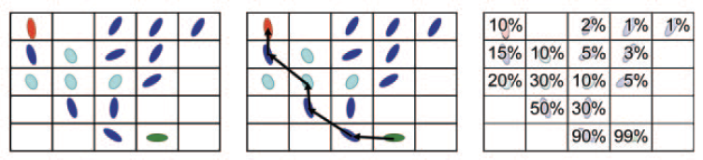
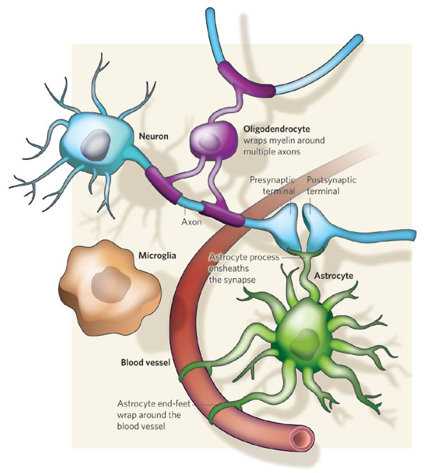
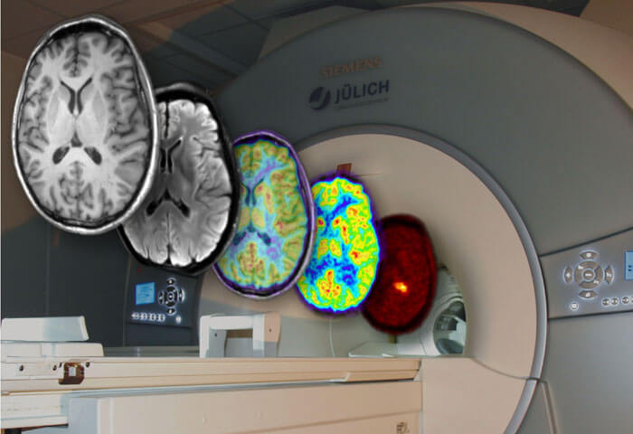
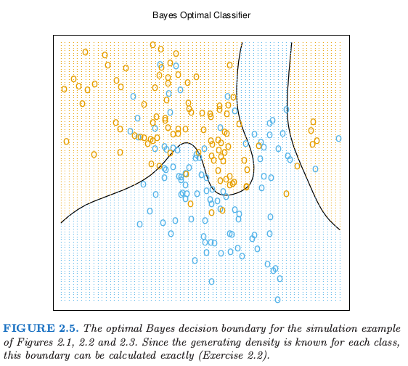
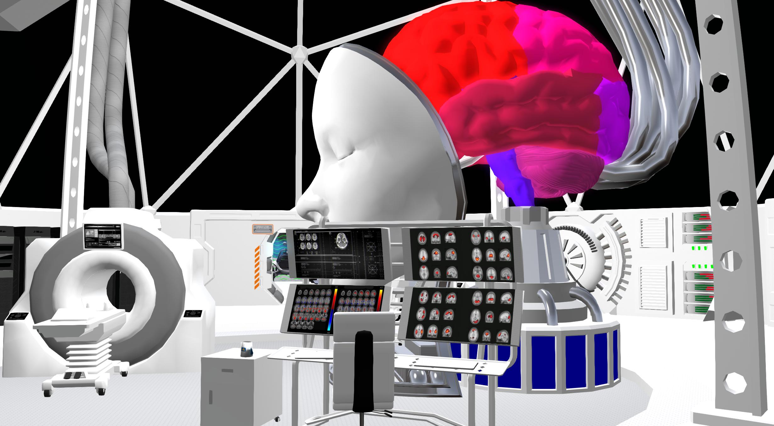
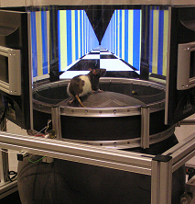
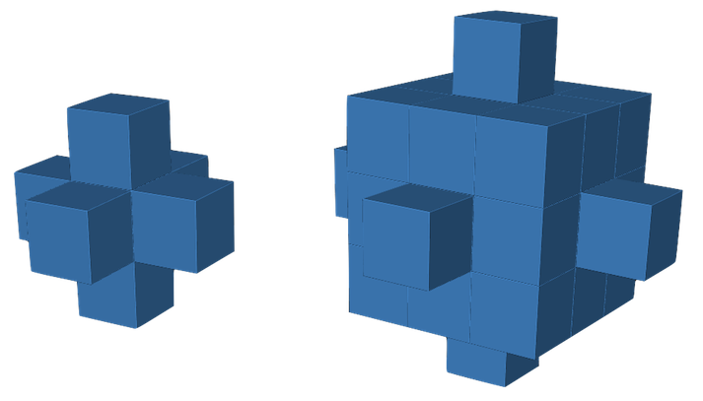
TOOLS USED

Slide 5
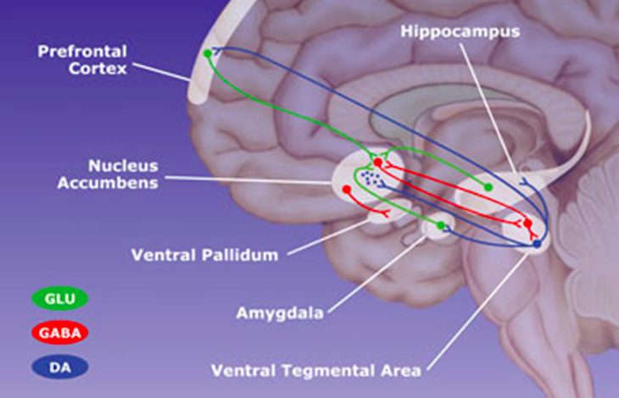
CHAPTER 1 : INTRODUCTION
High value items can lead to increased activation of the mesolimbic dopamingeric reward circuit, including the nucleus accumbens (NAcc) and ventral tegmental area (VTA), which in turn results in up-regulation of medial temporal lobe encoding processes and better memory for the high value items.
Value cues may also trigger the use of elaborative semantic encoding strategies, which depend on interactions between frontal and temporal lobe structures.

Slide 6
CHAPTER 1 : METHODS
12
2s
+
5 runs
24 trials/run
High values: {10,11,12}
Low values: {1,2,3}
Free recall after each run
Jittered [3-6.75s]
Word
3.5s
+
1.5s
Vowel
Consonant
Task

Slide 7
CHAPTER 1 : METHODS
Number of High Value Words Recalled
Number of Low Value Words Recalled
Actual Score – Chance Score
Selectivity Index =
Ideal Score – Chance Score

Slide 8
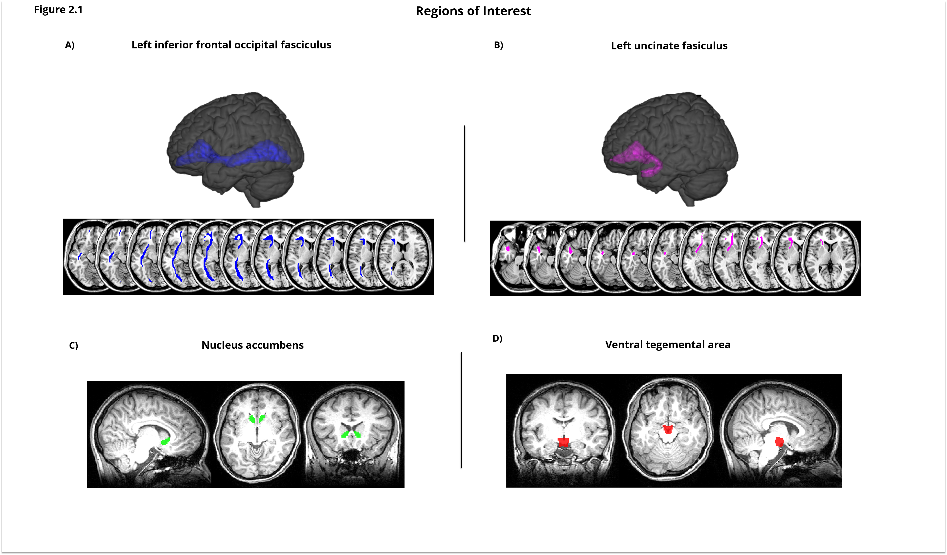
CHAPTER 1 : METHODS

Slide 9
CHAPTER 1 : RESULTS

Slide 10
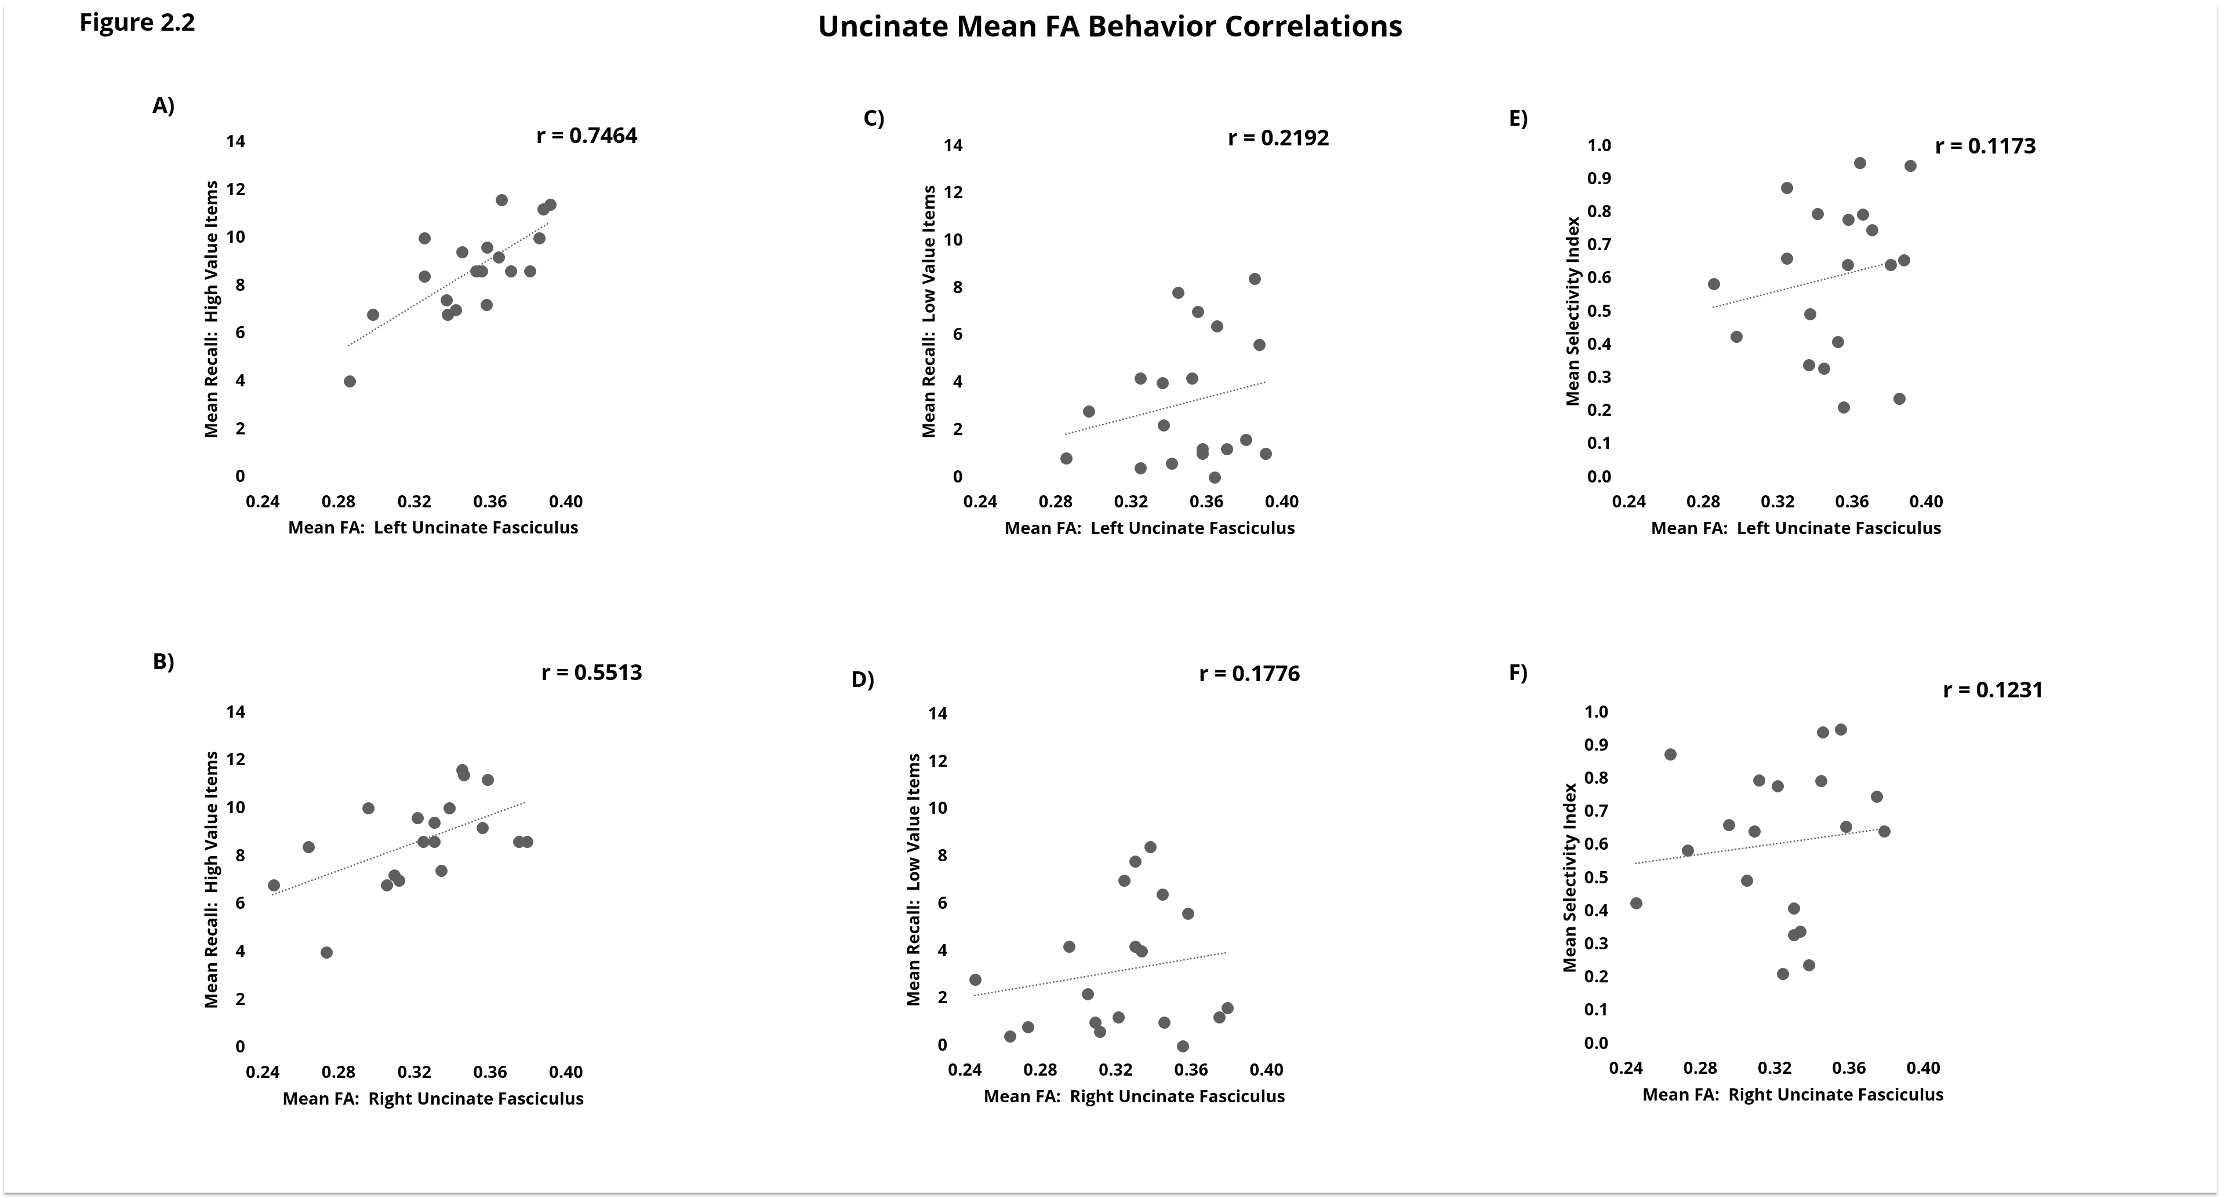
CHAPTER 1 : RESULTS

Slide 11
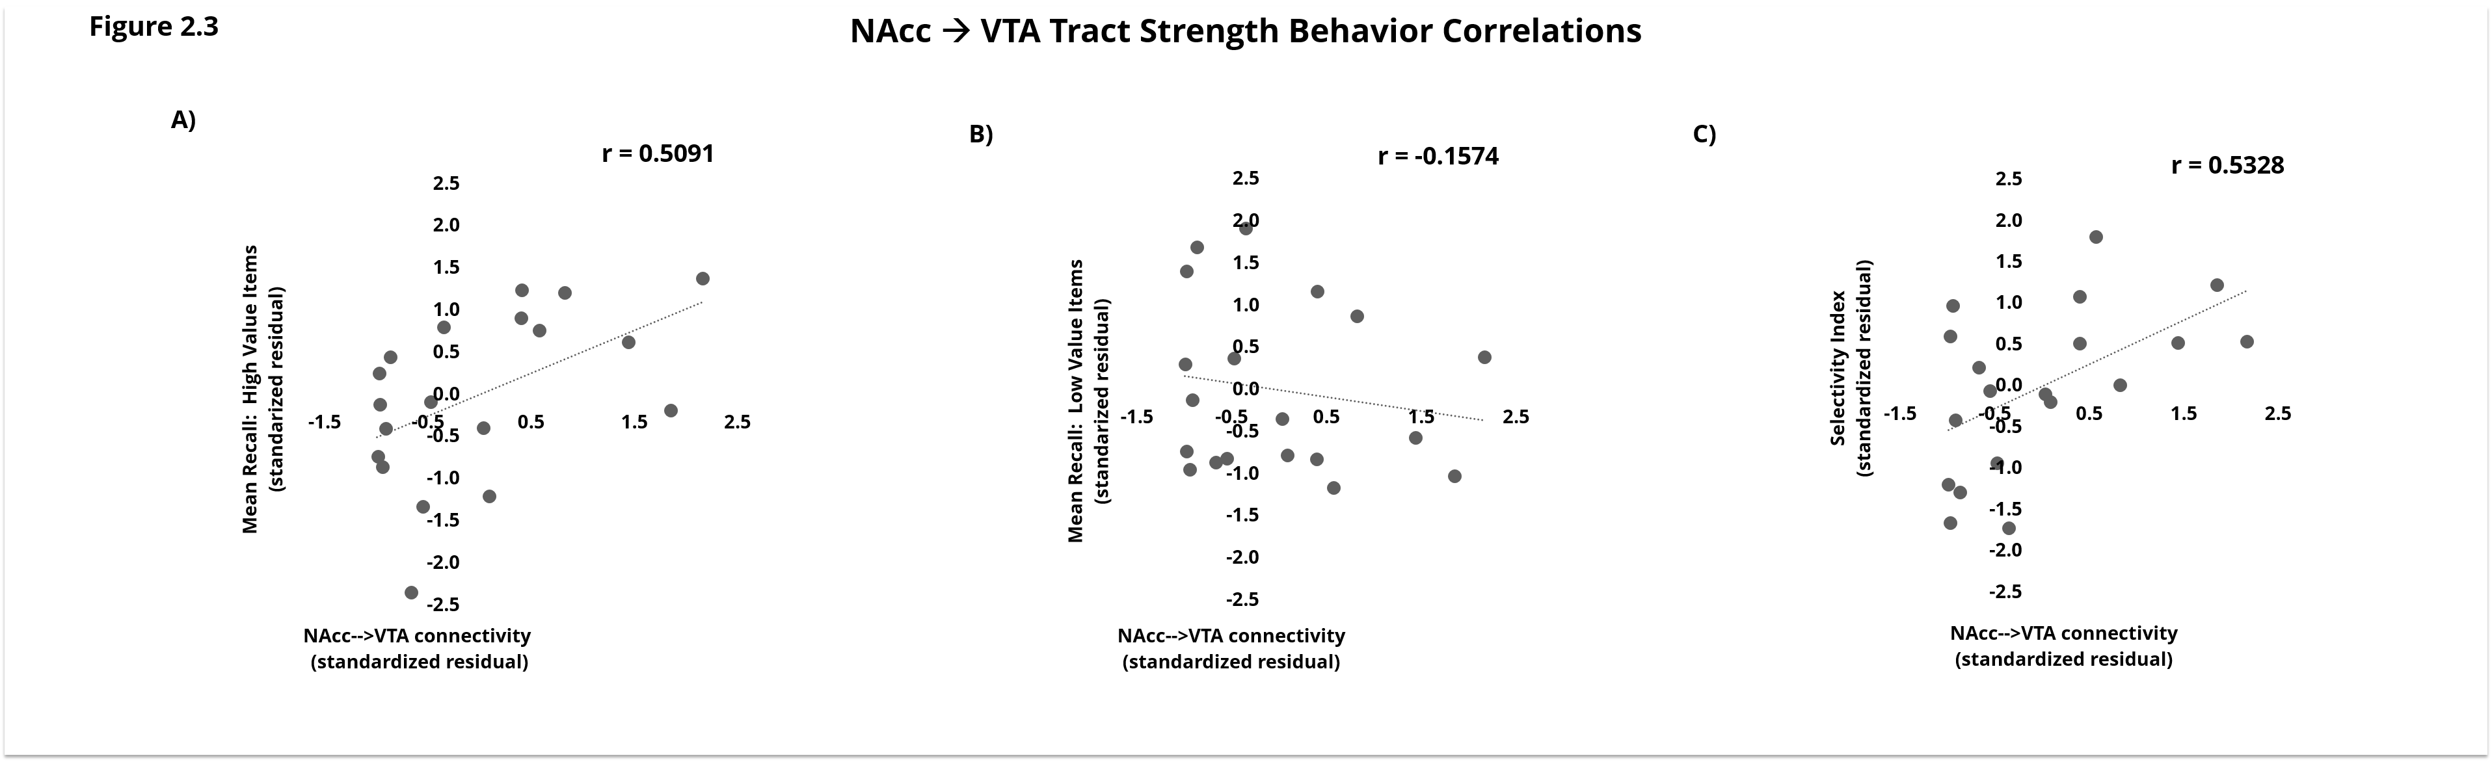
CHAPTER 1 : RESULTS

Slide 12
CHAPTER 2 : MOTIVATION
We hypothesized that the binding of information to a spatial environment was the driving factor that underlies the efficacy of the Method of Loci.
If that’s the case, then there should be a substantial amount of
contextual reinstatement during recall.
The testing of this hypothesis mandates a quantifiable metric
of contextual reinstatement.
The following study sought to assert the possibility of obtaining such a metric.

Slide 13
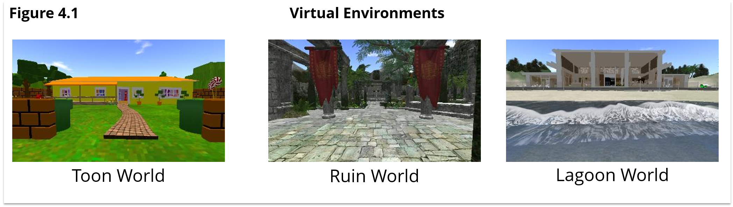
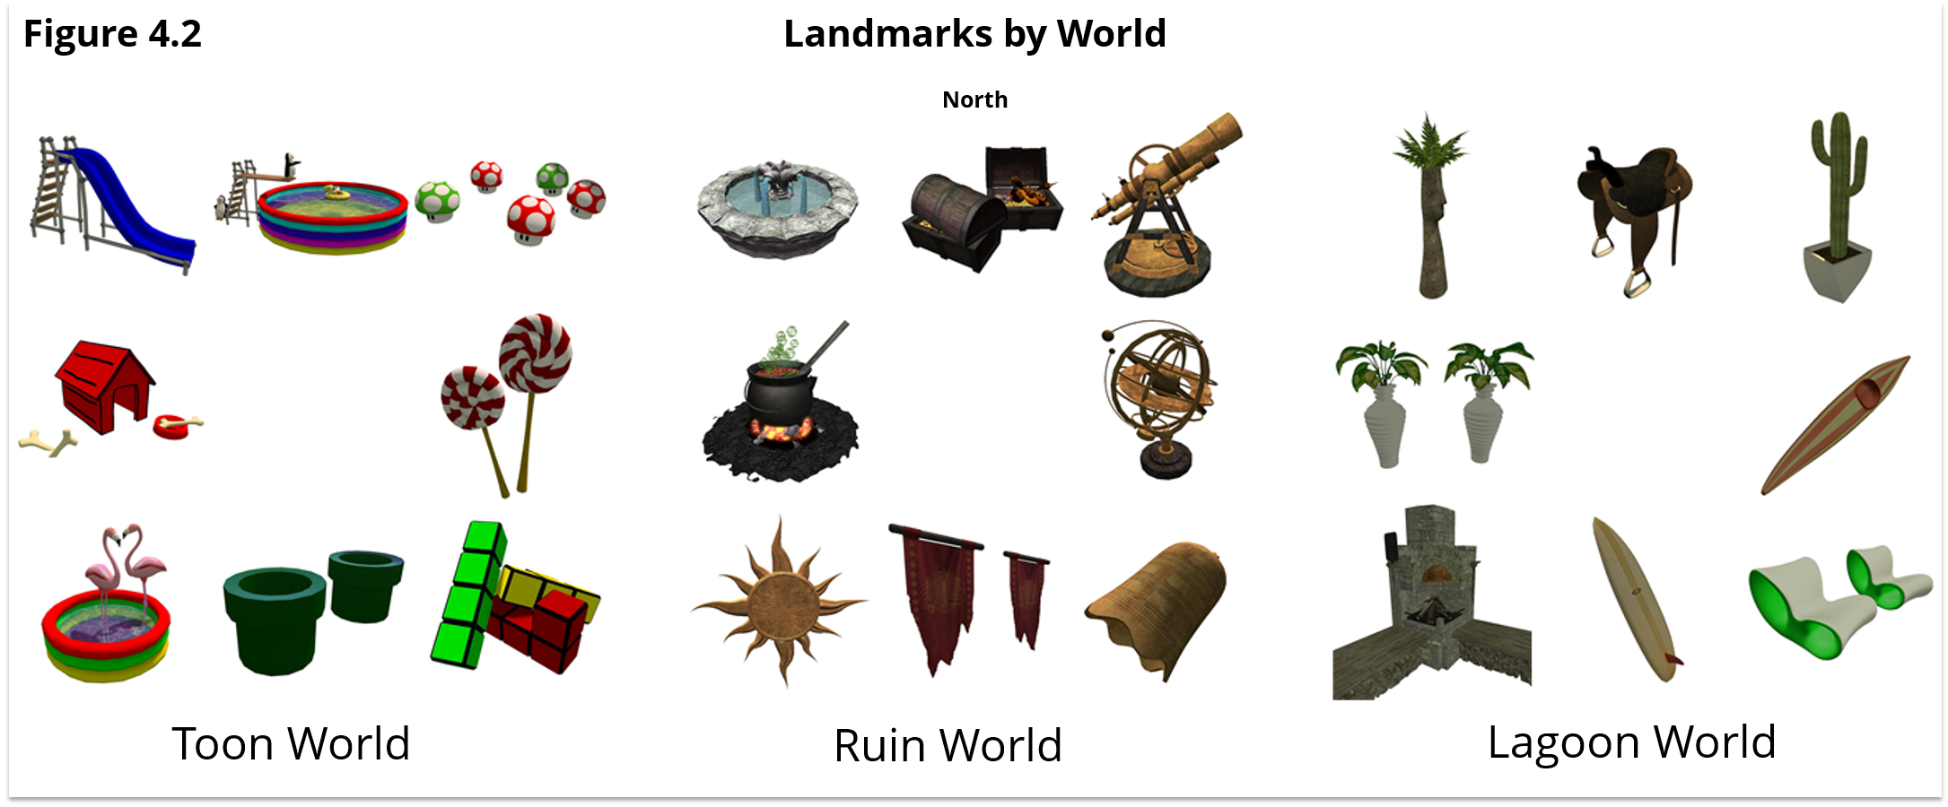
CHAPTER 2 : METHODS

Slide 14
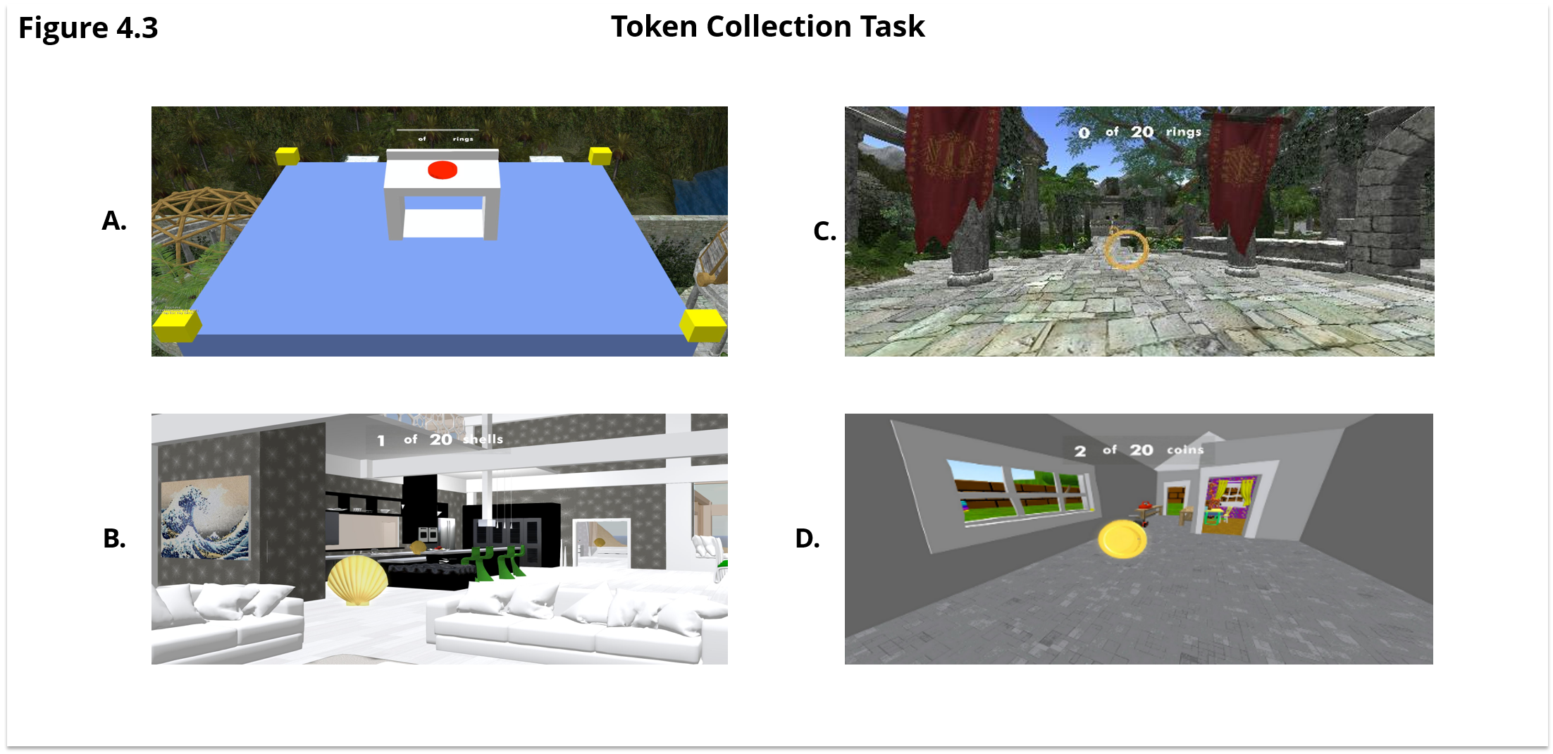
CHAPTER 2 : METHODS

Slide 15
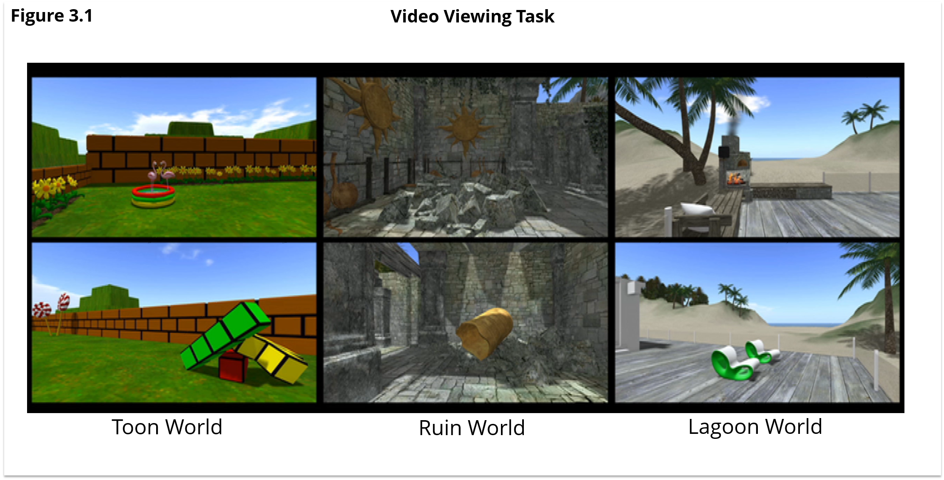
CHAPTER 2 : METHODS

Slide 16
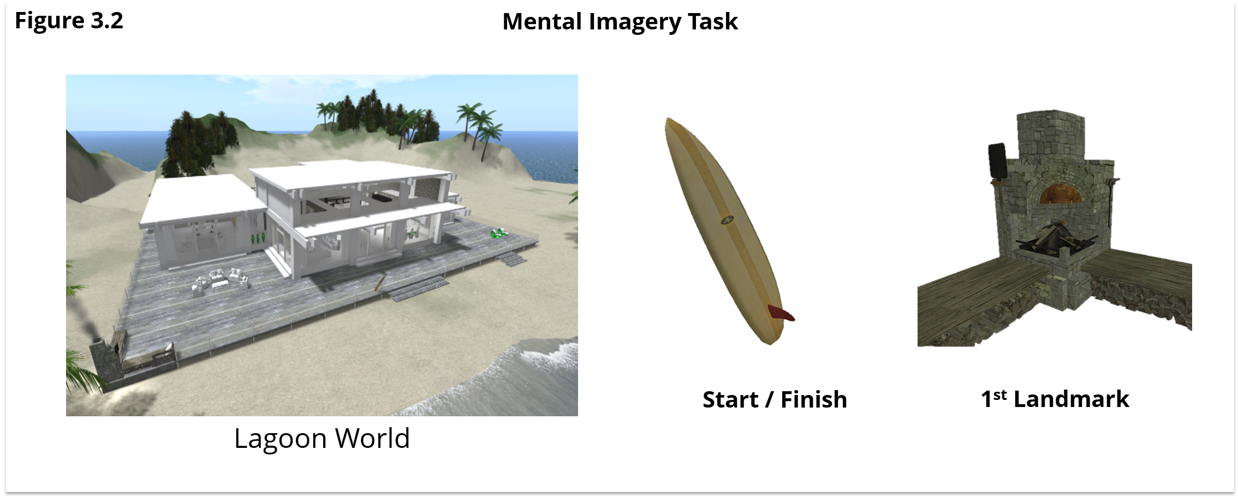
CHAPTER 2 : METHODS

Slide 17
CHAPTER 2 : METHODS
Middle 1/3rd of BOLD time courses averaged
Searchlight
Leave-one-run-out Cross Validation
“Bait and Switch”

Slide 18
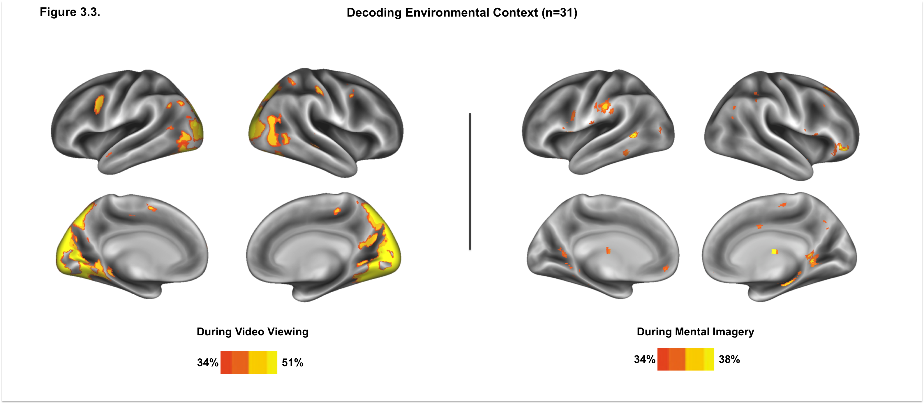
CHAPTER 2 : RESULTS

Slide 19
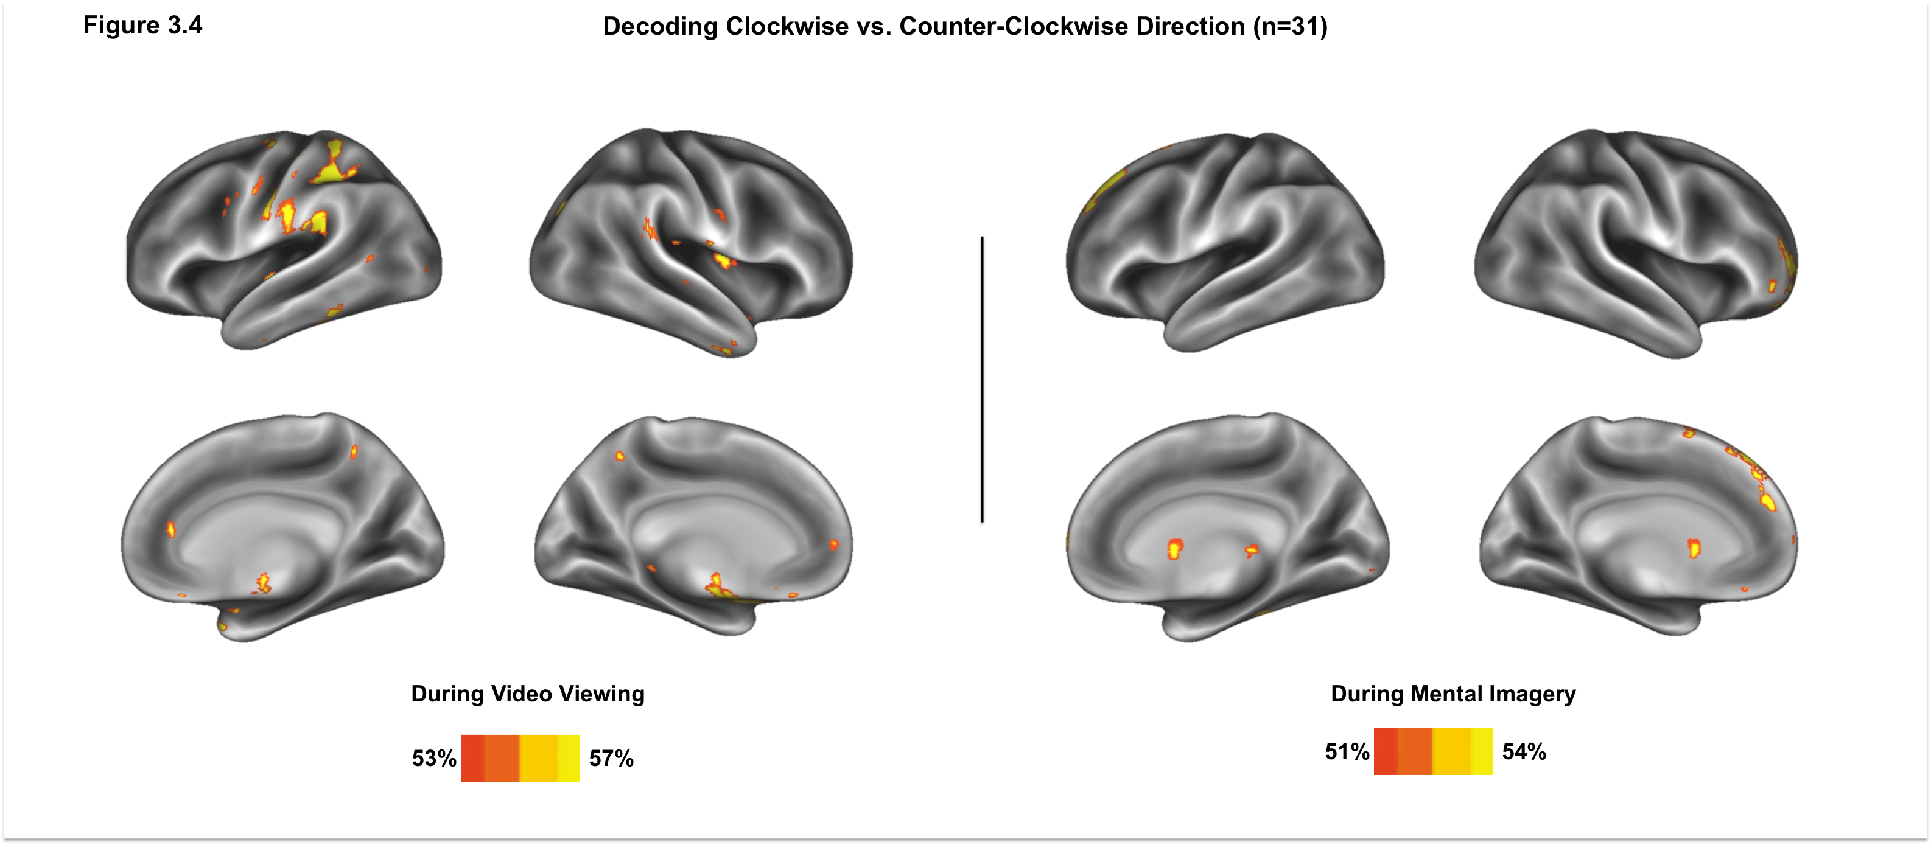
CHAPTER 2 : RESULTS

Slide 20
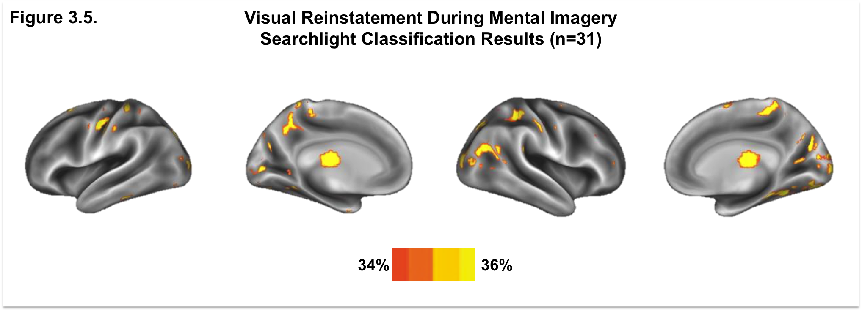
CHAPTER 2 : RESULTS

Slide 21
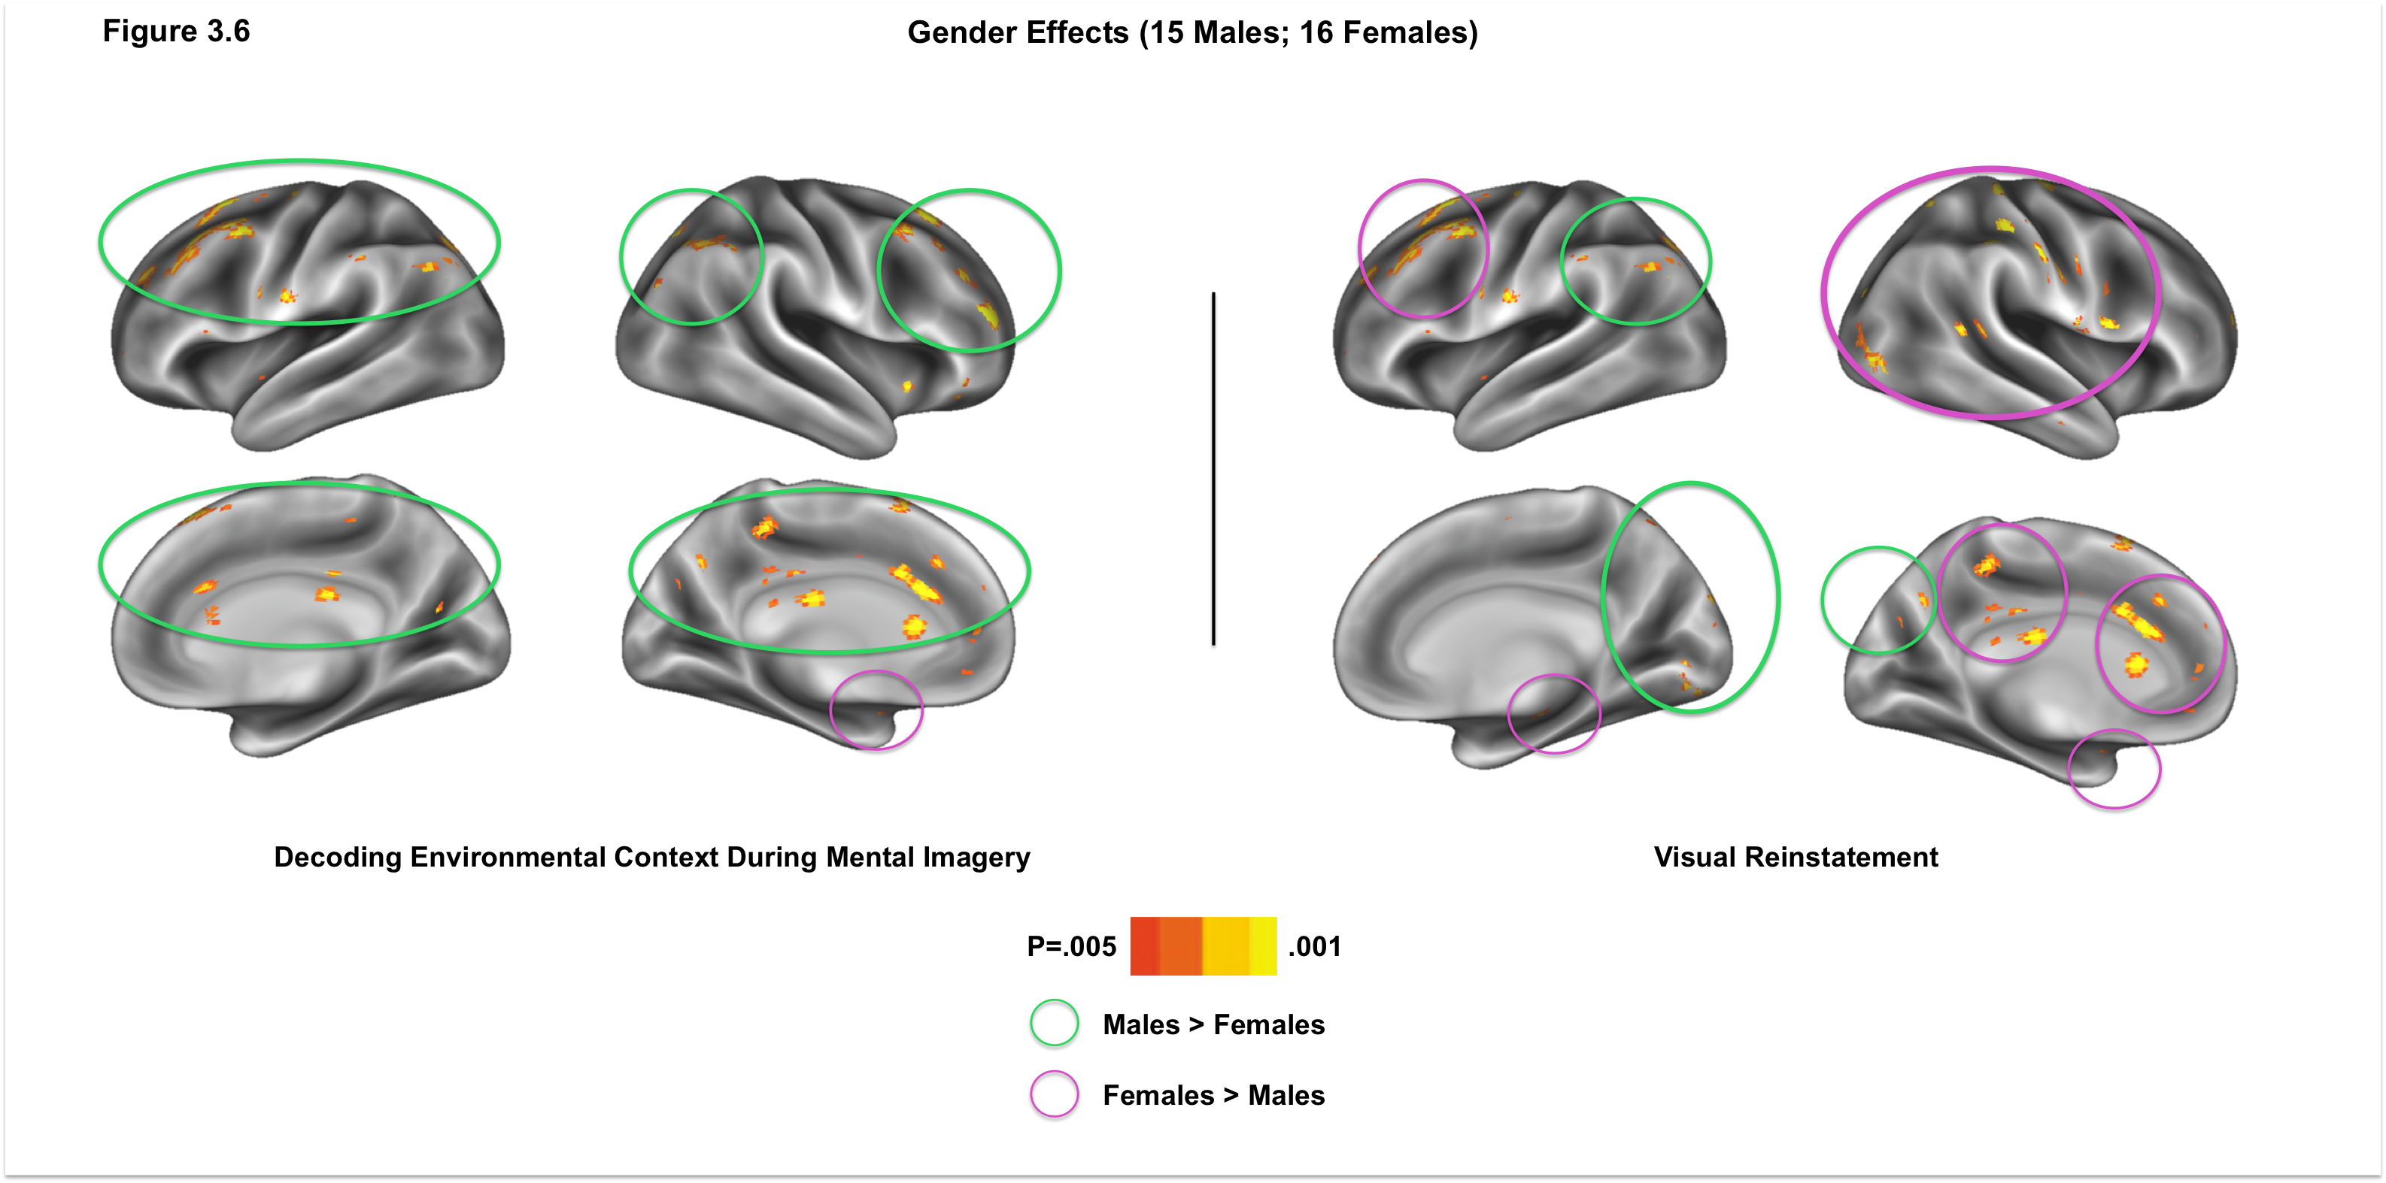
CHAPTER 2 : RESULTS

Slide 22
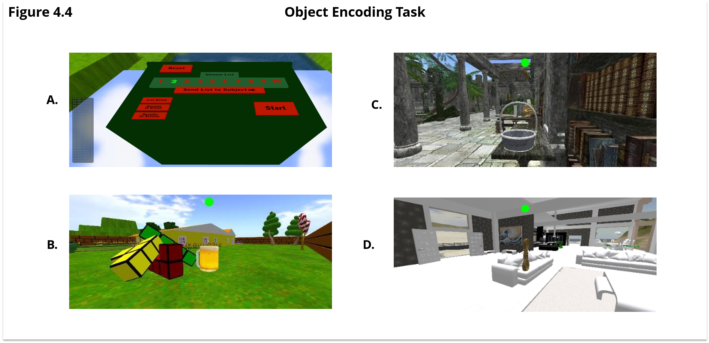
CHAPTER 3a : METHODS
Token collection
Encoding Instructions: Method of Loci vs. “Walk and Learn”

Slide 23
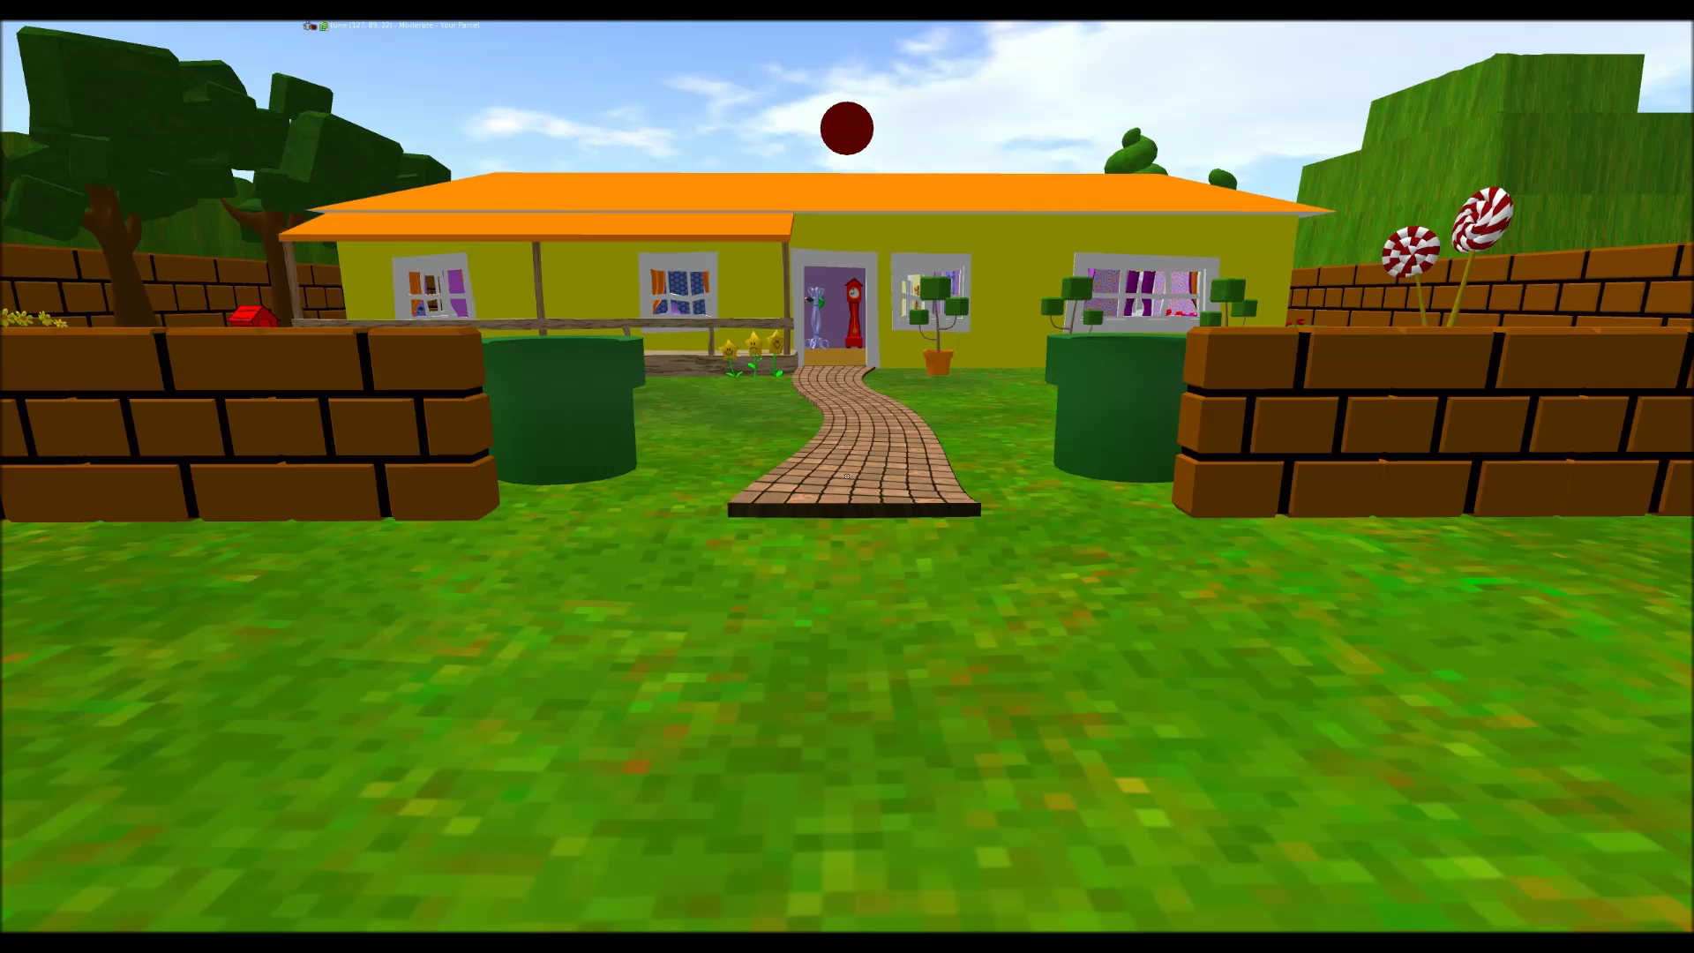
CHAPTER 3a : METHODS

Slide 24
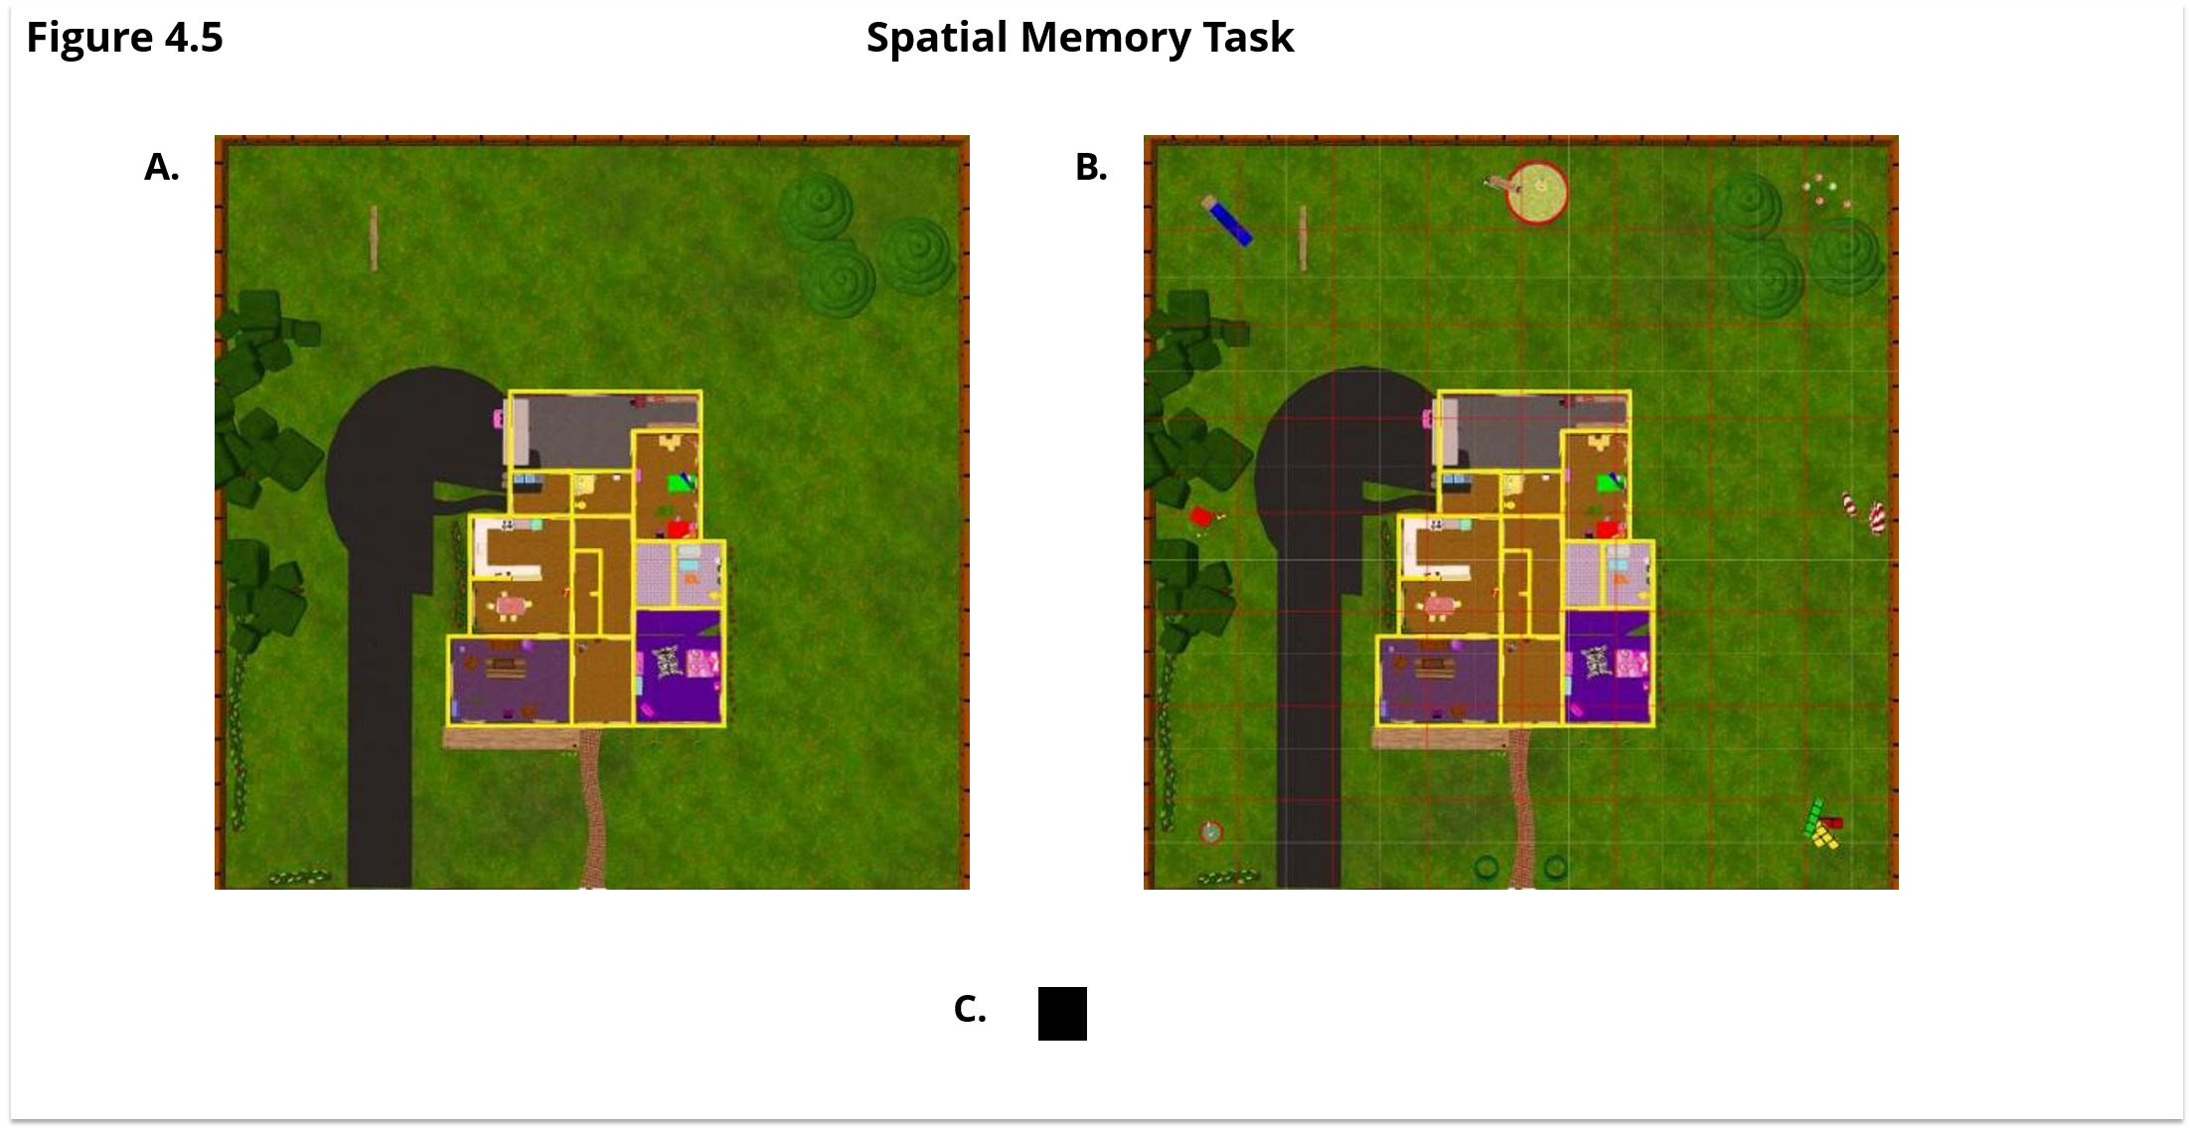
CHAPTER 3a : METHODS
Verbal Recall

Slide 25
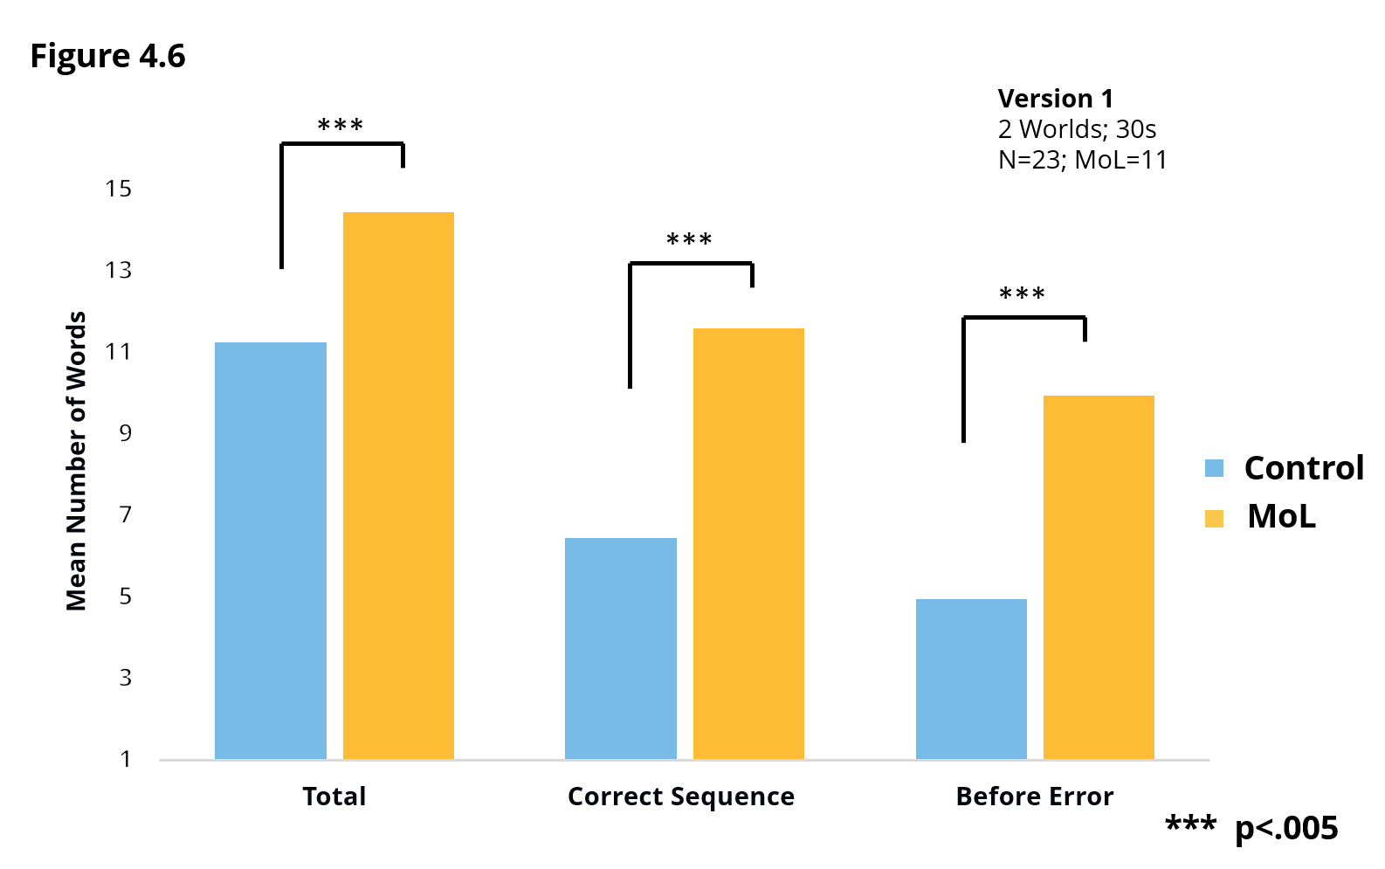
CHAPTER 3a : RESULTS

Slide 26
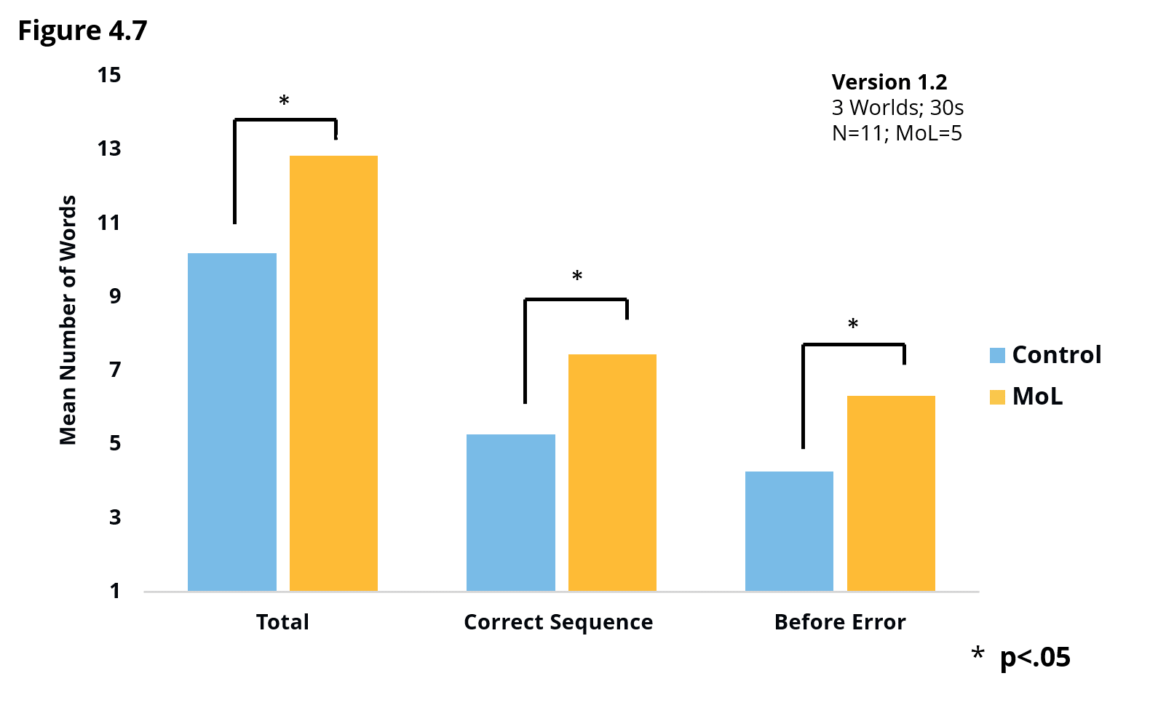
CHAPTER 3a : RESULTS

Slide 27
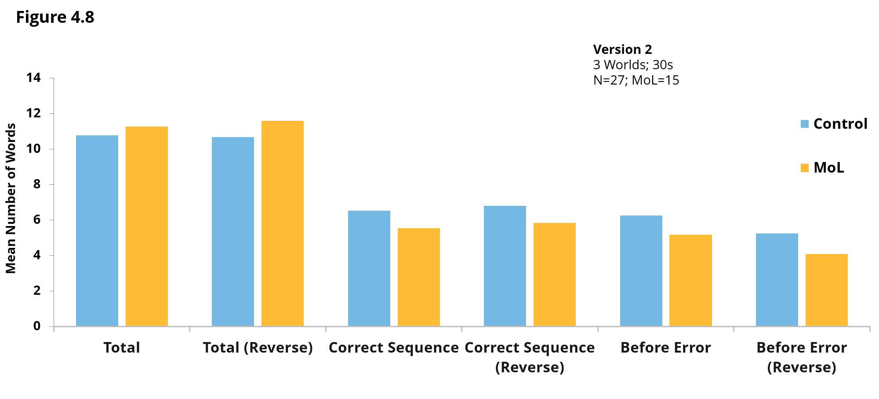
CHAPTER 3a : RESULTS

Slide 28
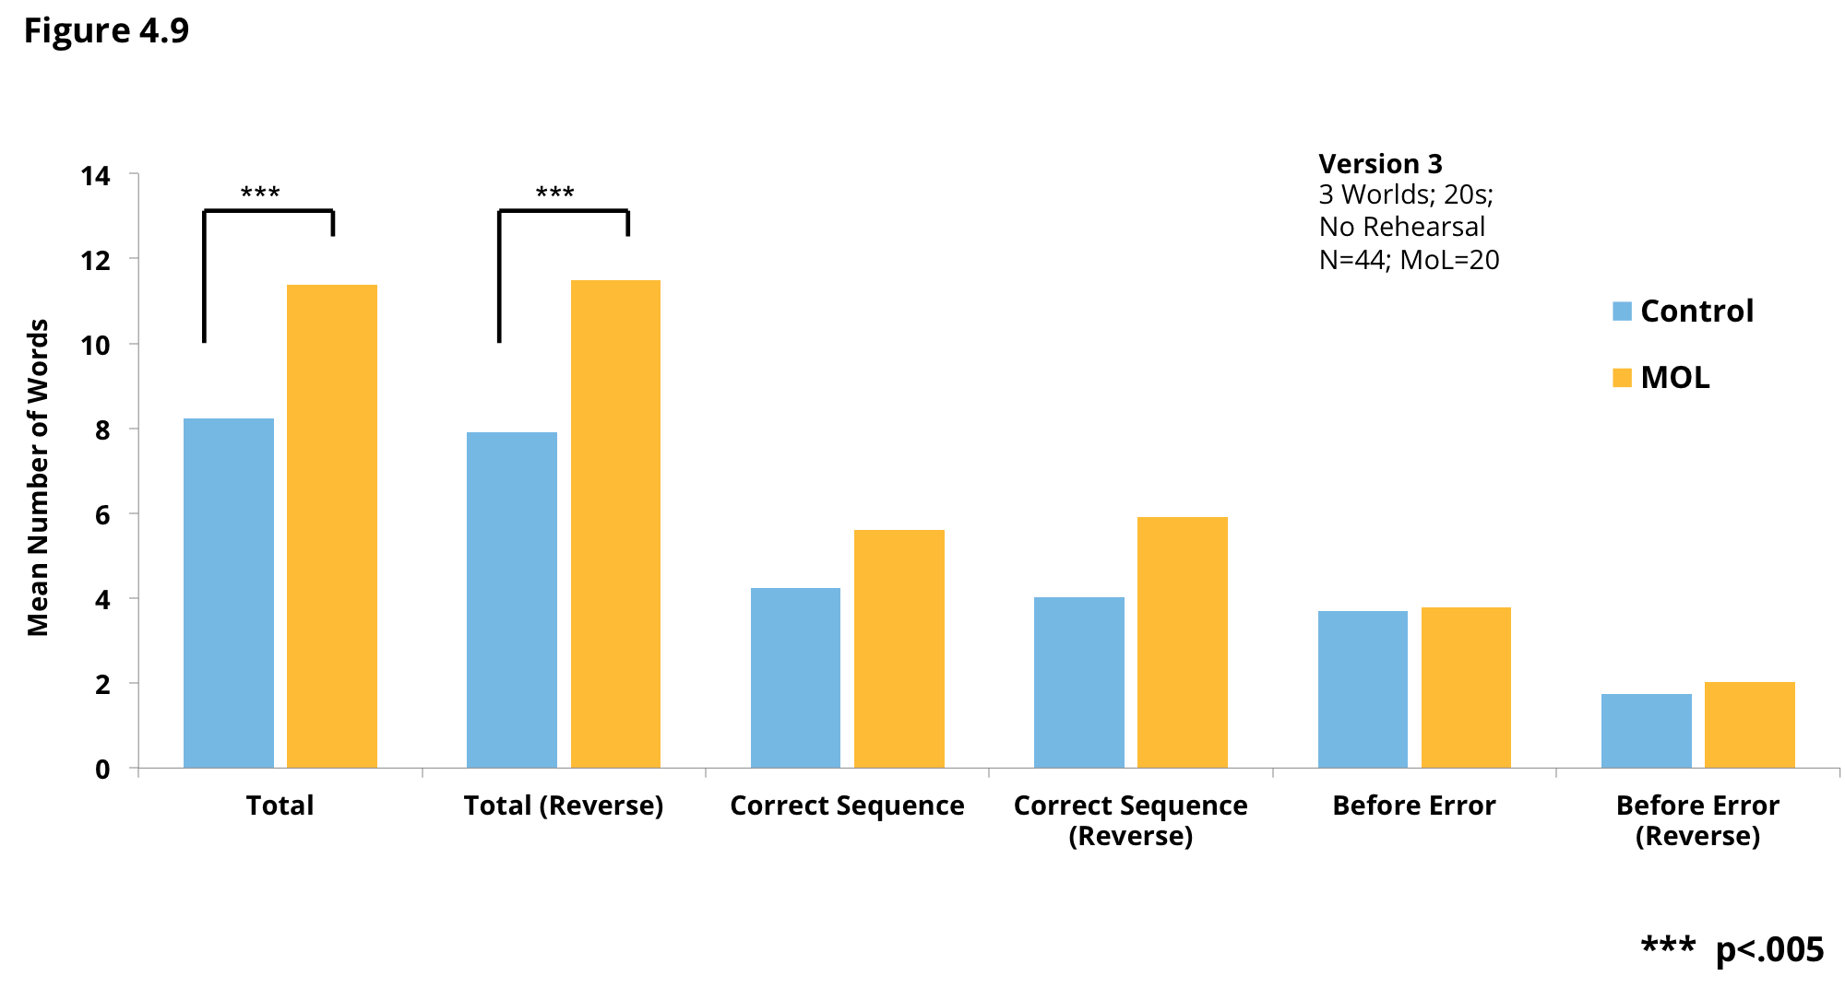
CHAPTER 3a : RESULTS

Slide 29
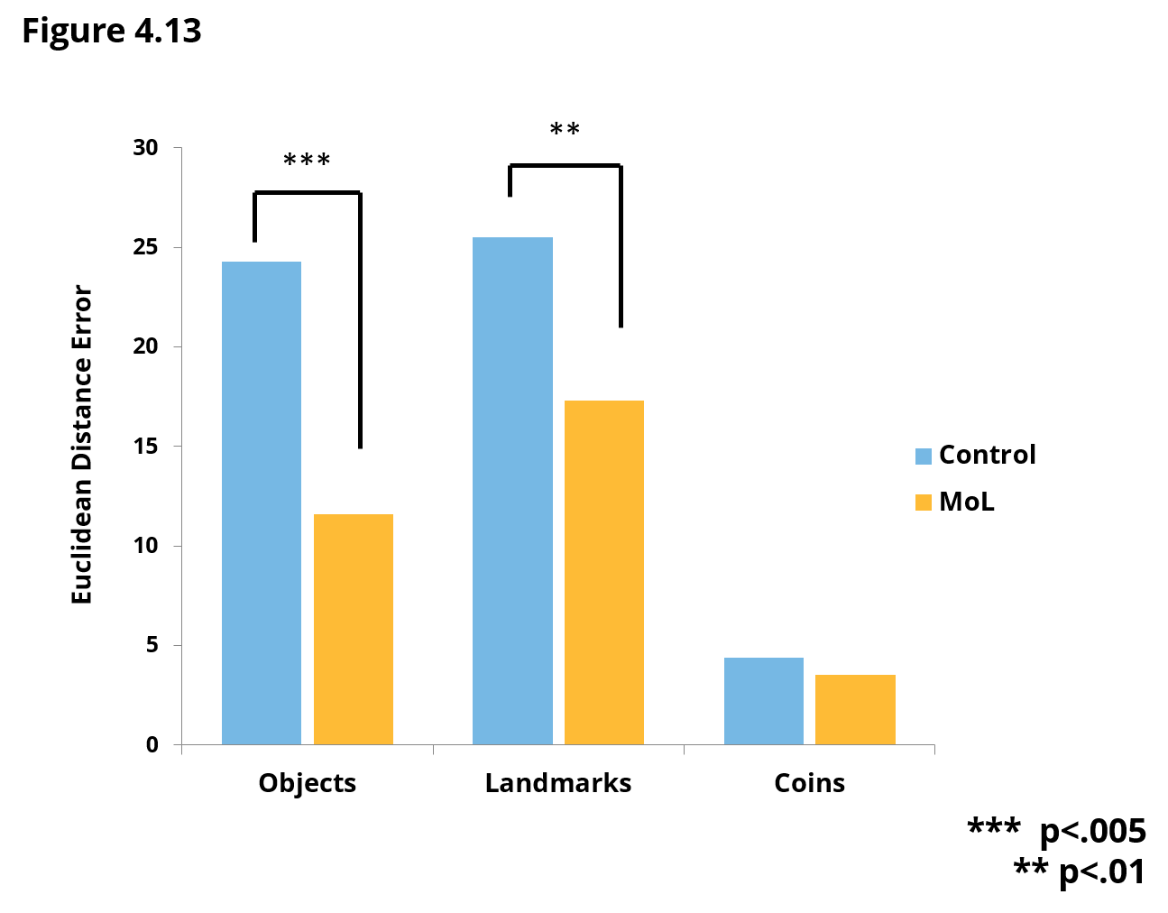
CHAPTER 3a : RESULTS

Slide 30
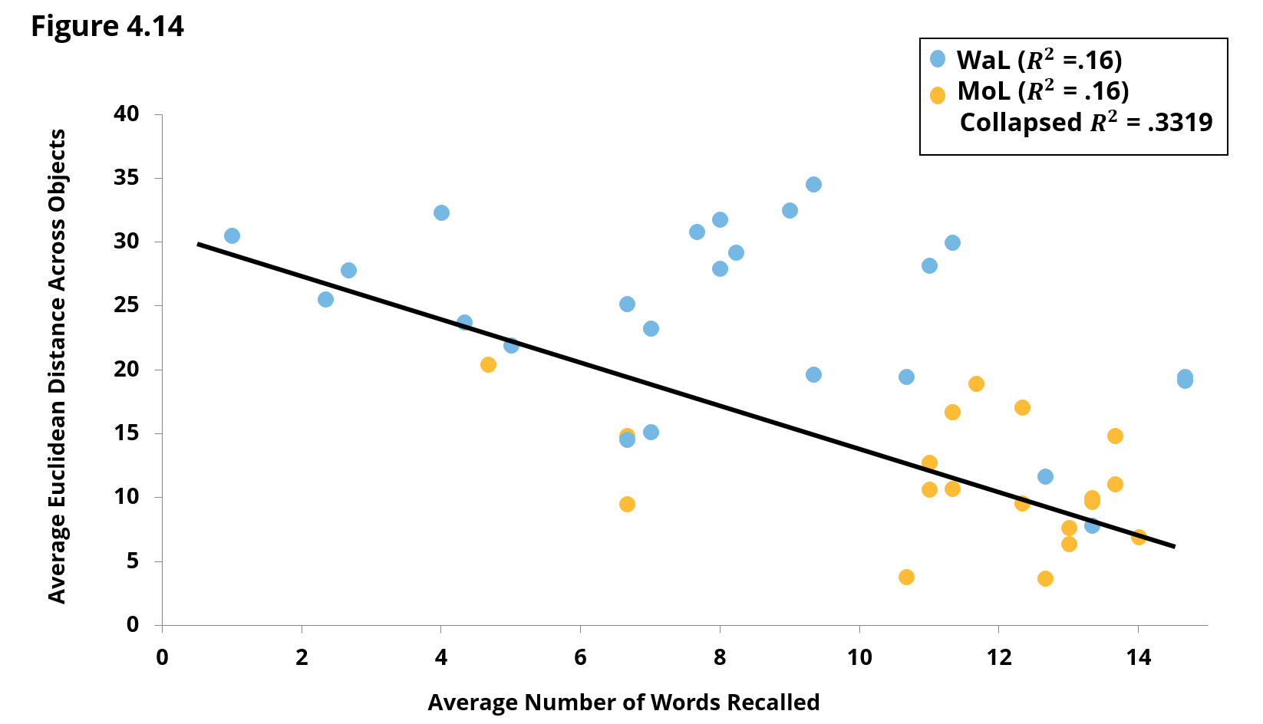
CHAPTER 3a : RESULTS

Slide 31
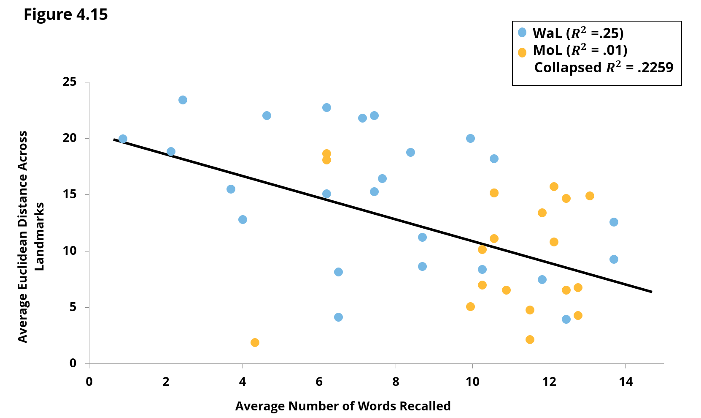
CHAPTER 3a : RESULTS

Slide 32
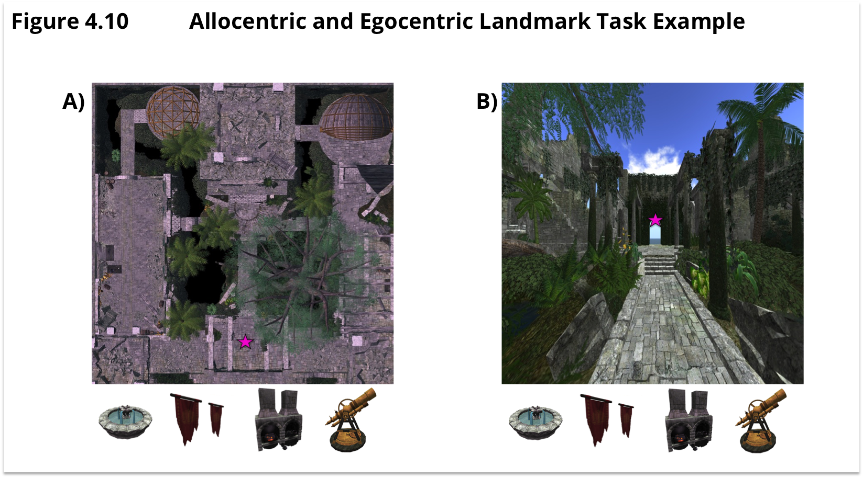
CHAPTER 3b : METHODS

Slide 33
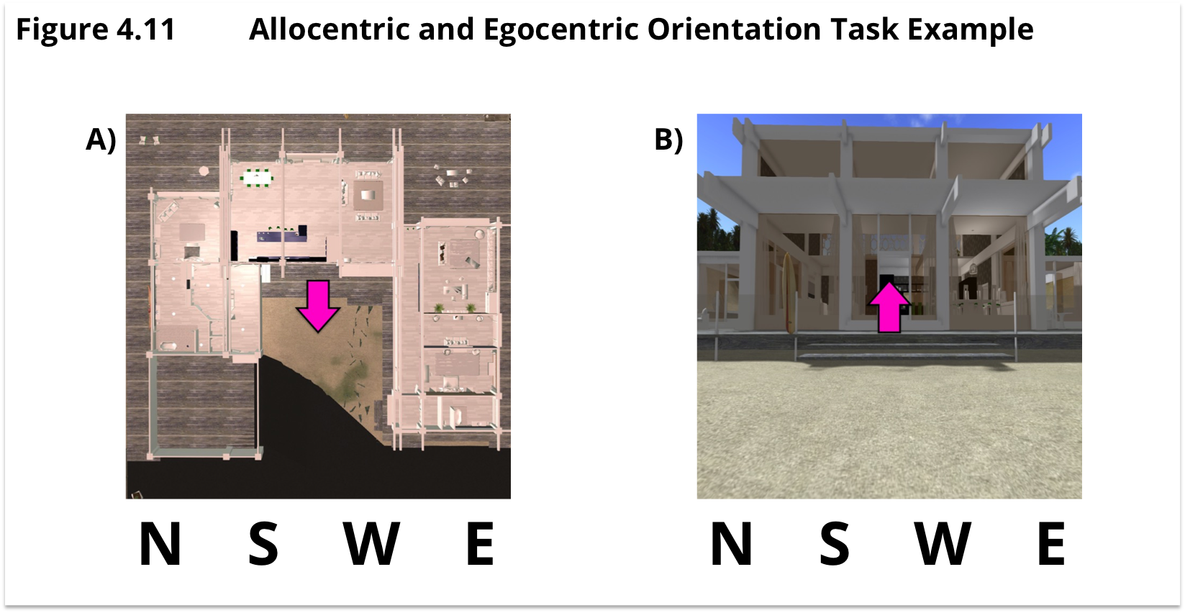
CHAPTER 3b : METHODS

Slide 34
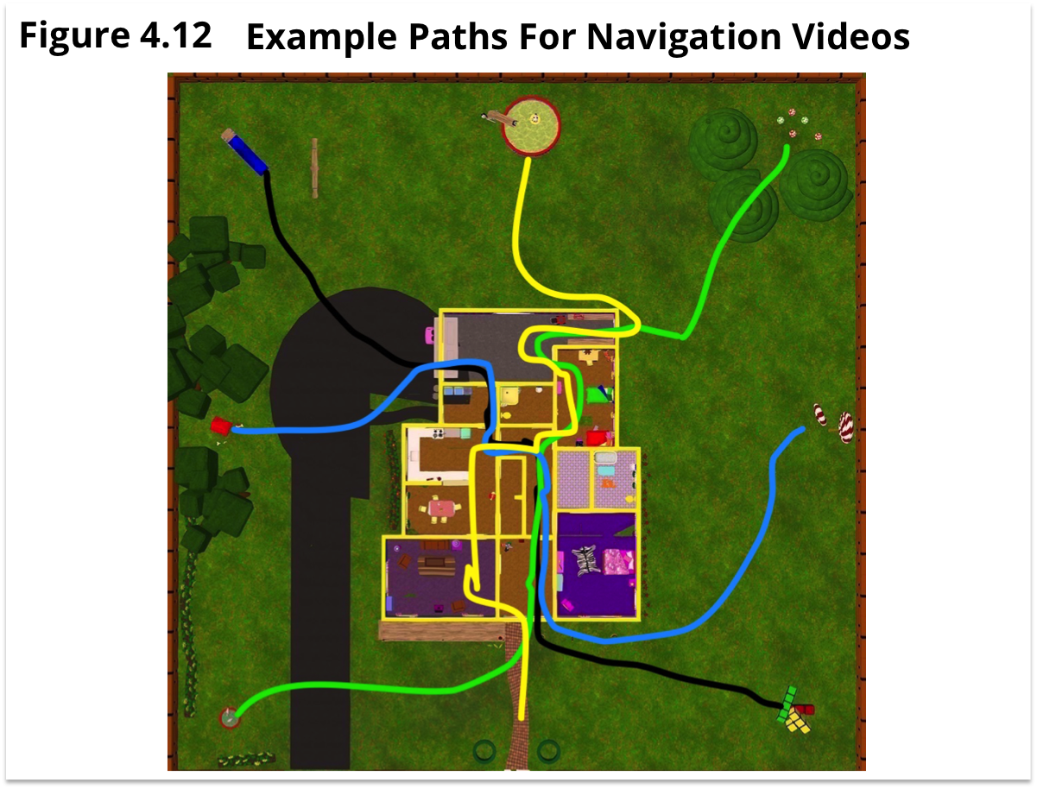
CHAPTER 3b : METHODS

Slide 35
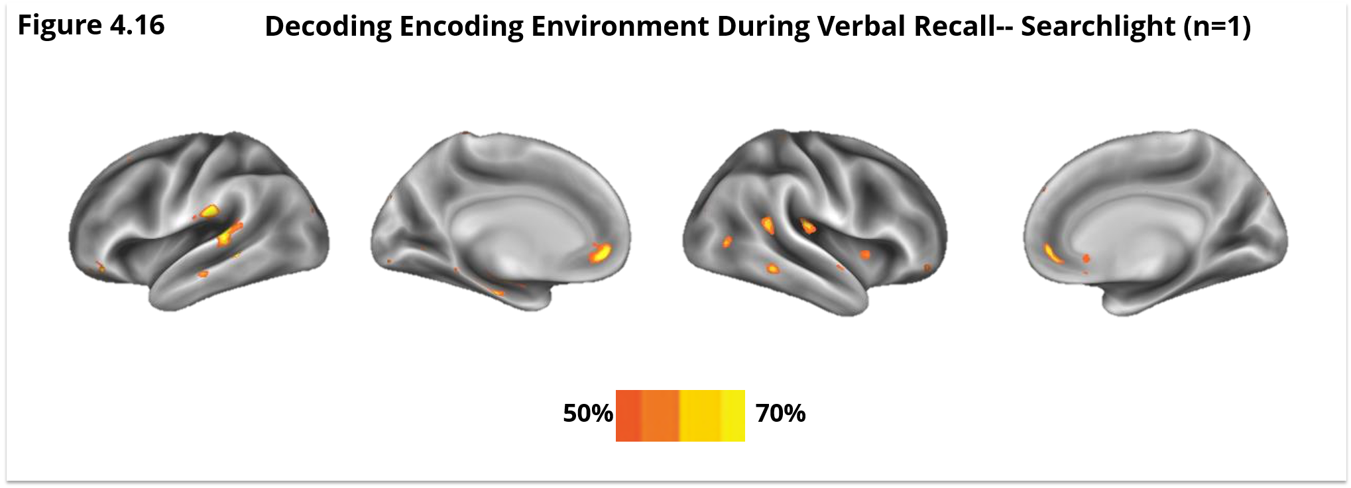
CHAPTER 3b : RESULTS

Slide 36
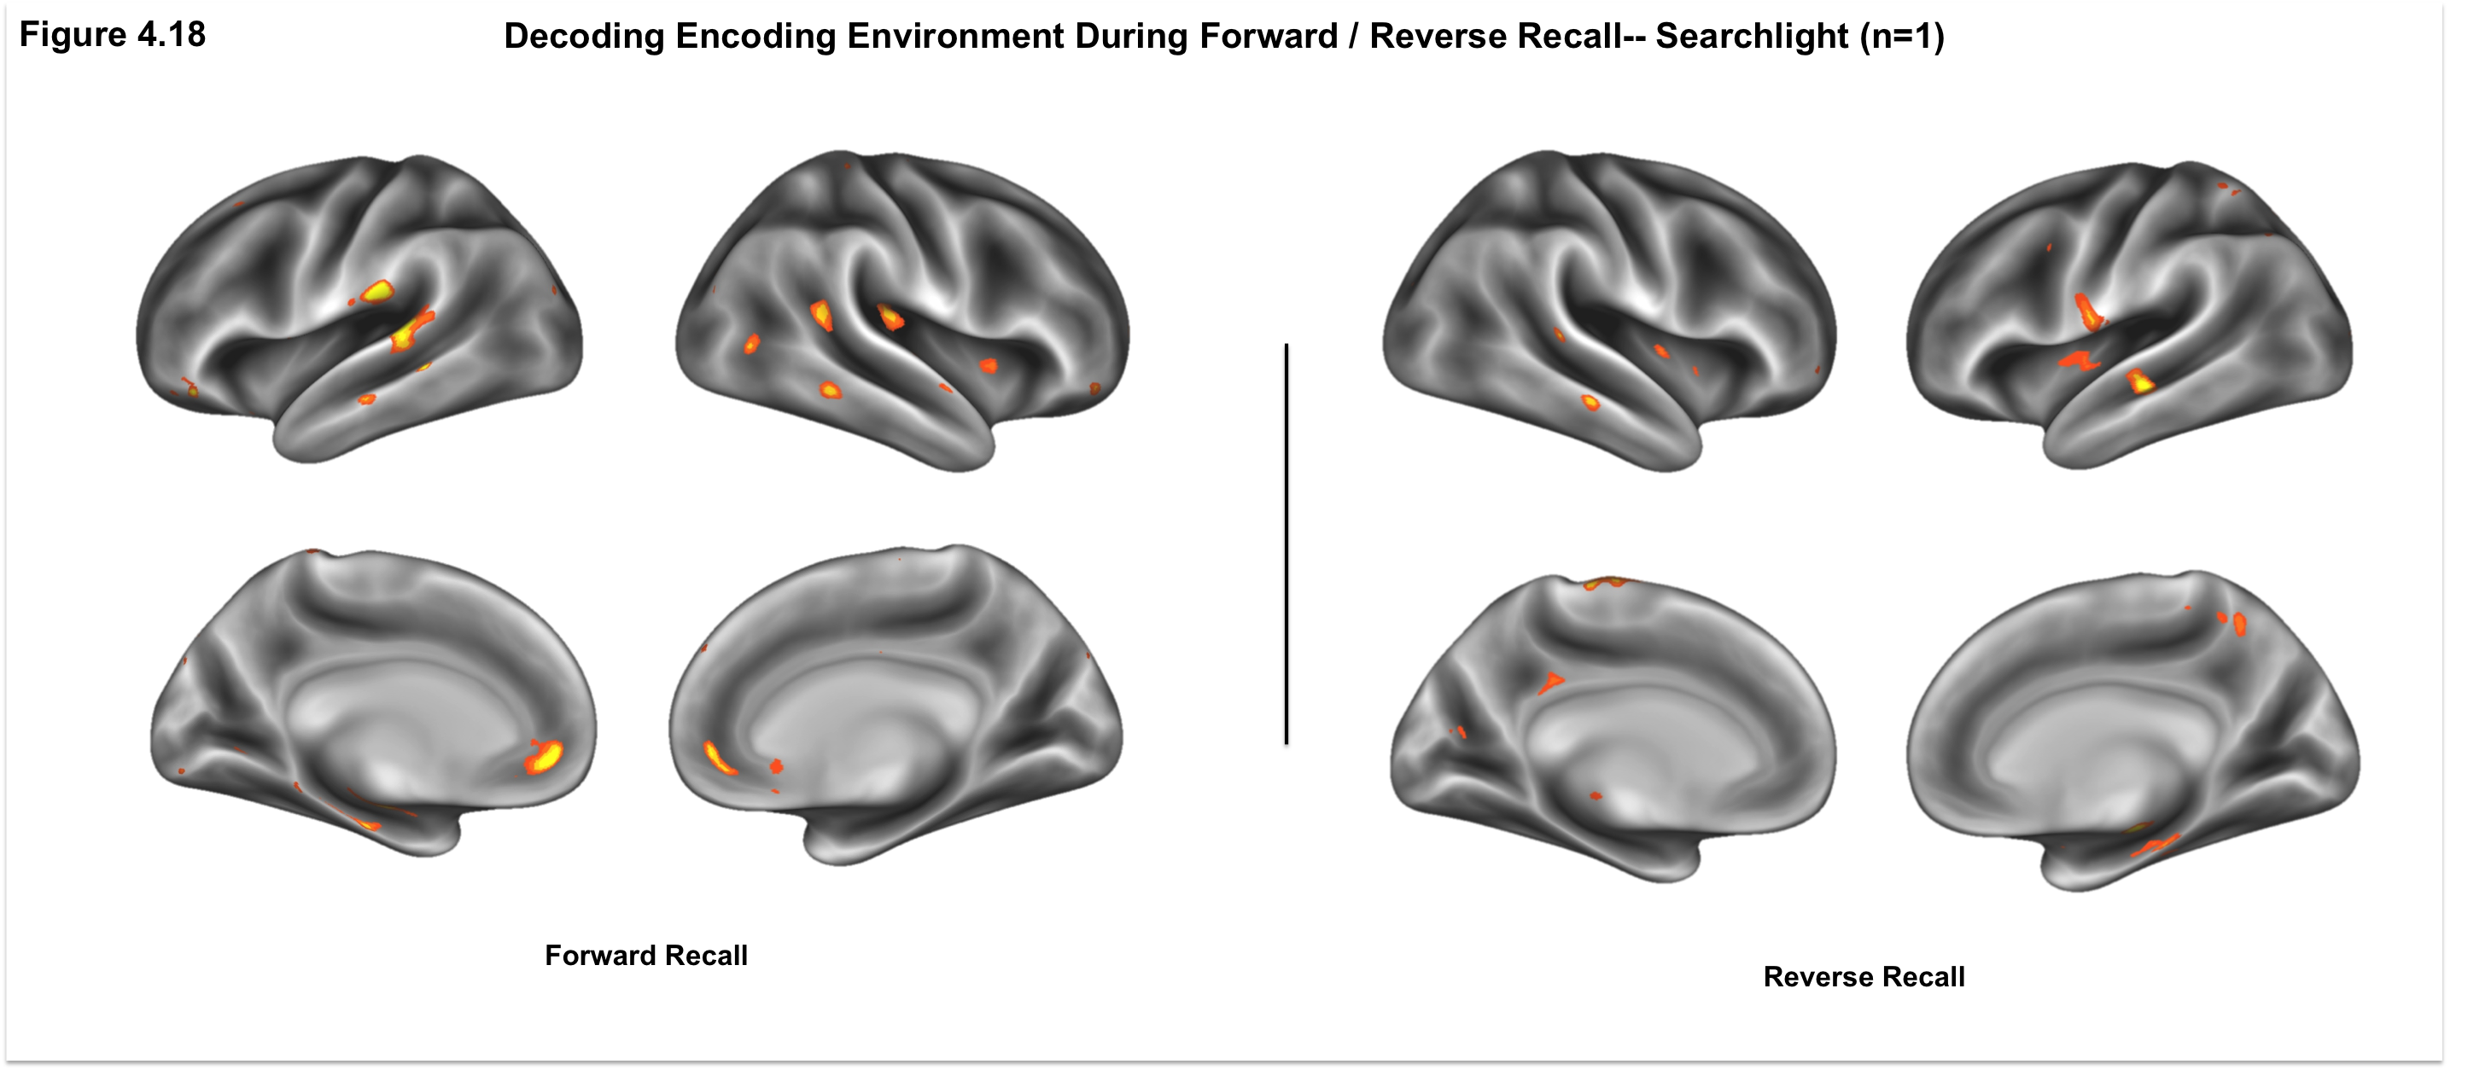
CHAPTER 3b : RESULTS

Slide 37
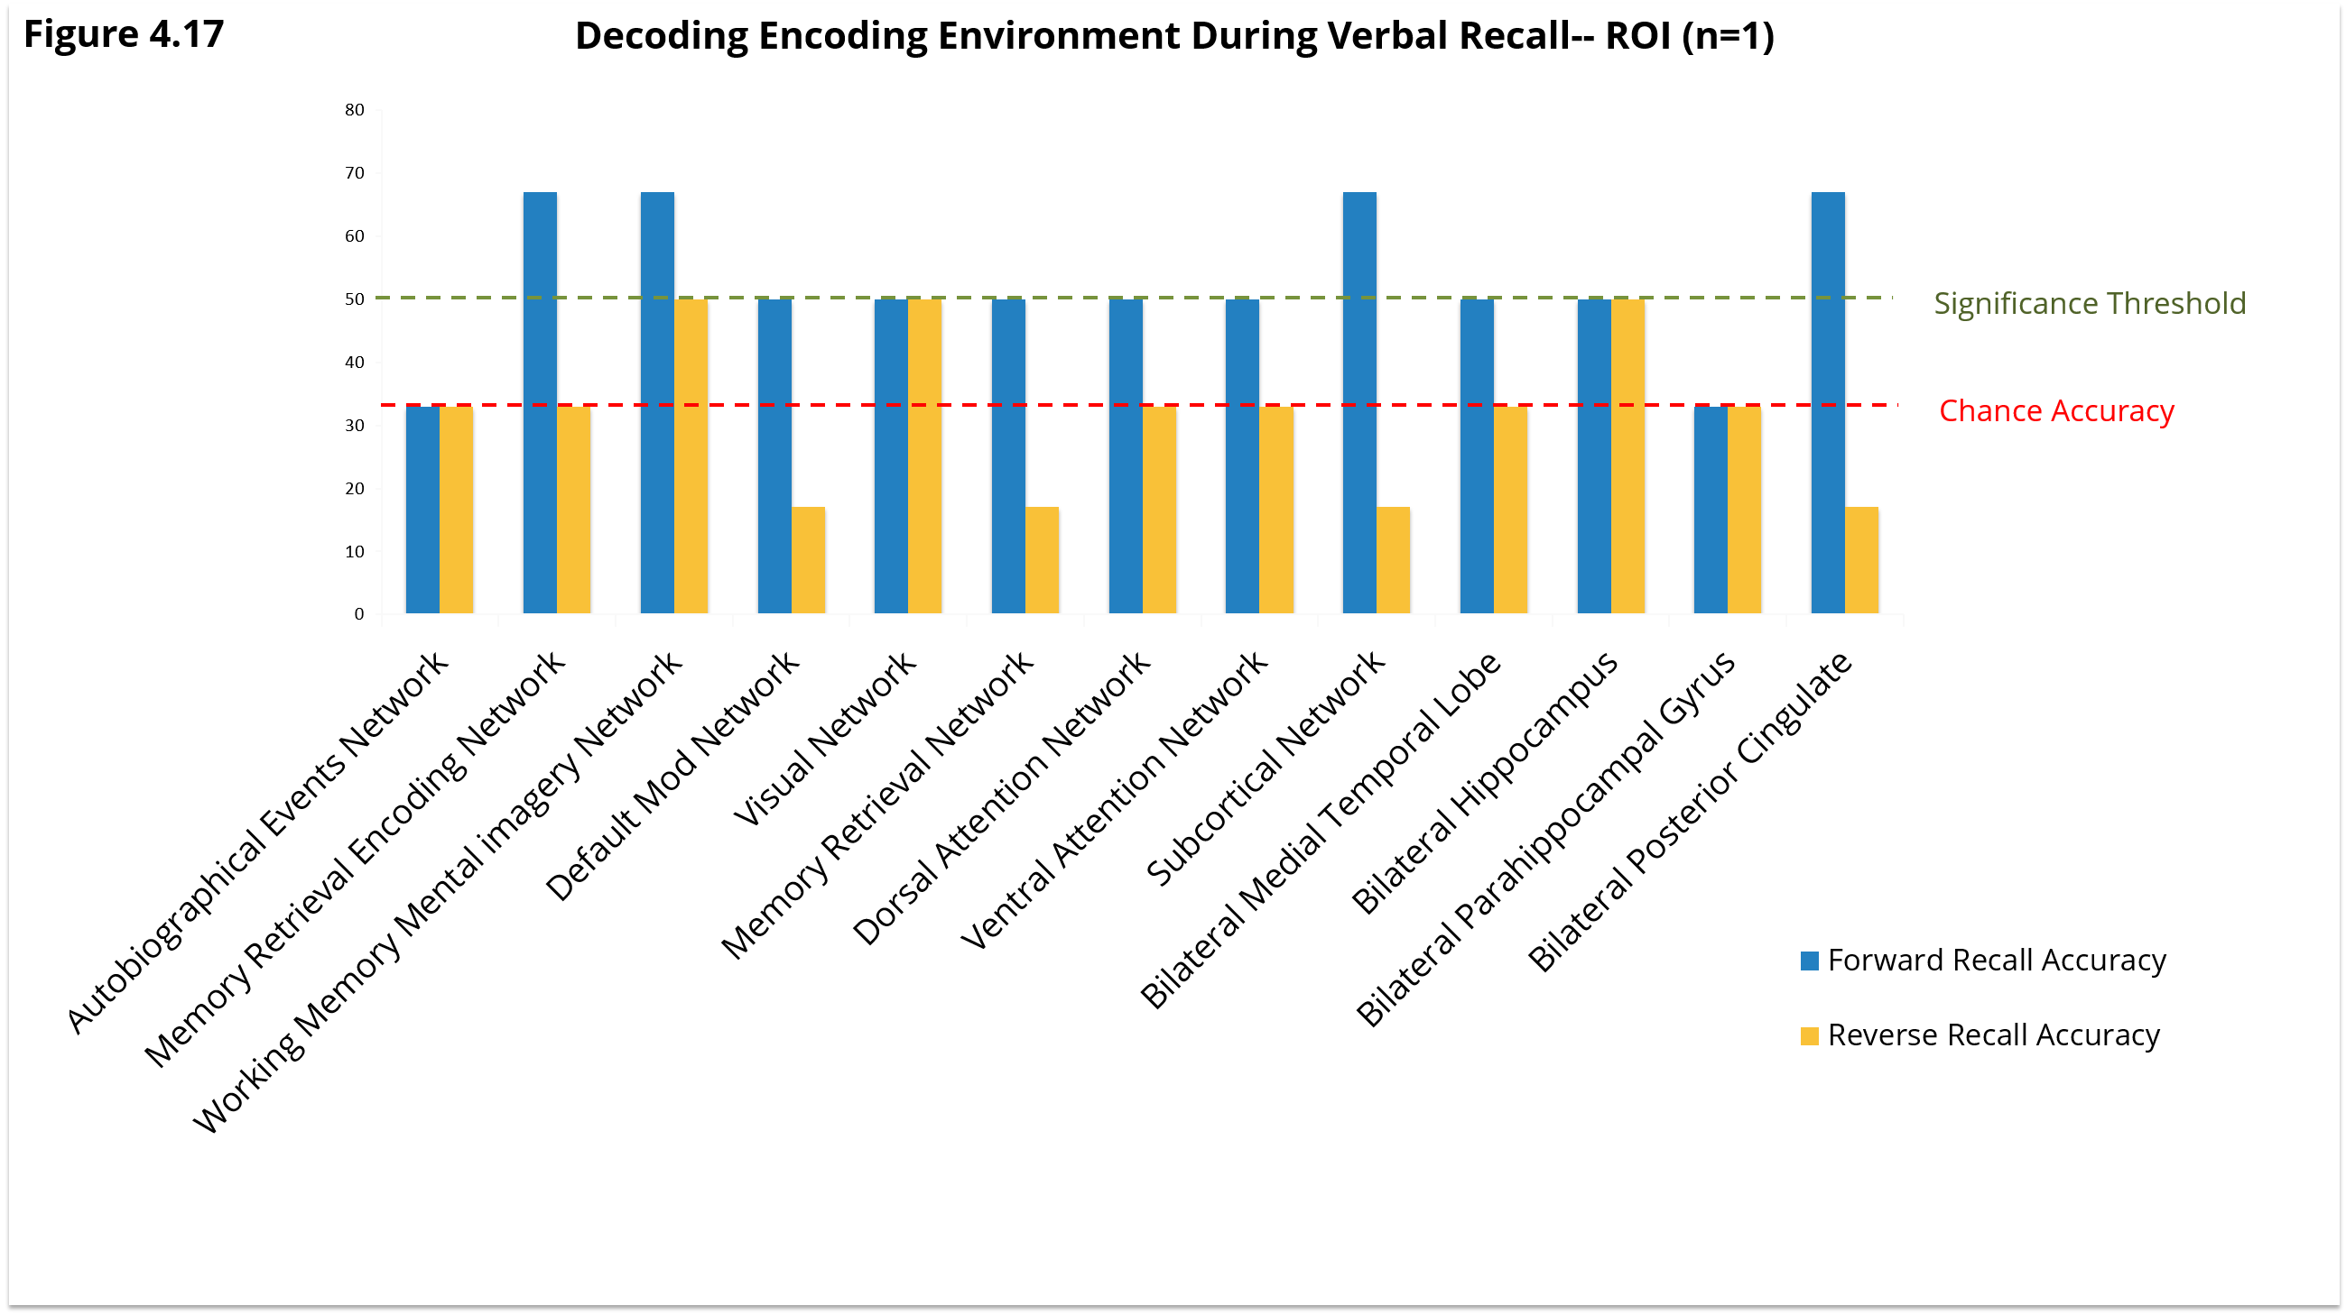
CHAPTER 3b : RESULTS

Slide 38

PROPOSED WORK
The aforementioned work represents an easy and reliable way to reap the benefits of the Method of Loci using Virtual Reality.
However, encoding multiple lists of objects within the same environment is ripe for interference.
While VR allows for an infinite number of discrete fantastical environments to be rendered, doing so is time consuming.
Reusing the same virtual environment for the encoding of multiple lists of material would be ideal.
Most memory champions use a “clean out” method in order to reuse the same memory palaces.

Slide 39
PROPOSED WORK
What’s the most efficient way to encode within the same environment?
Clean Out
1) Subjects follow their previous encoding path with digital guidance and view each object “dissolving” after entering a radius around the object.
  2) An additional group of subjects would be instructed to clean out the memory palace in their mental imagery.
Elaborative Encoding
  3) Subjects follow their previous encoding path with digital guidance and place a new object alongside the previous object to encourage an interaction between the objects.
Passage of time
  4) After recall and rehearsal, subject takes a break. They receive no explicit cleaning instructions. They then encode a new set of objects in the same virtual environment.

Slide 40
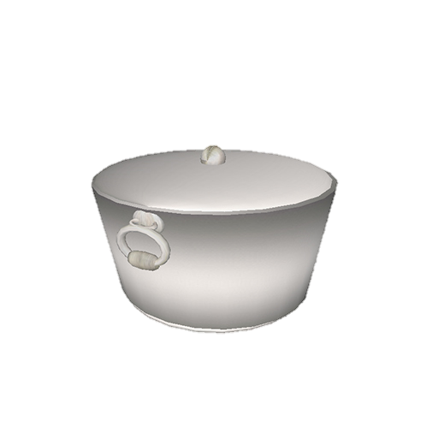

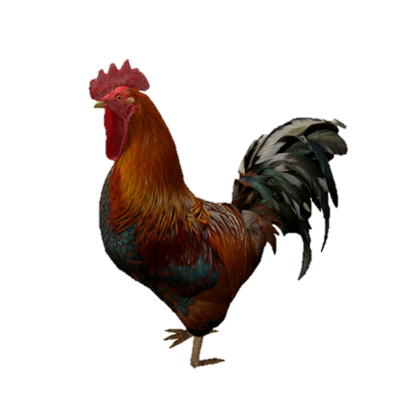
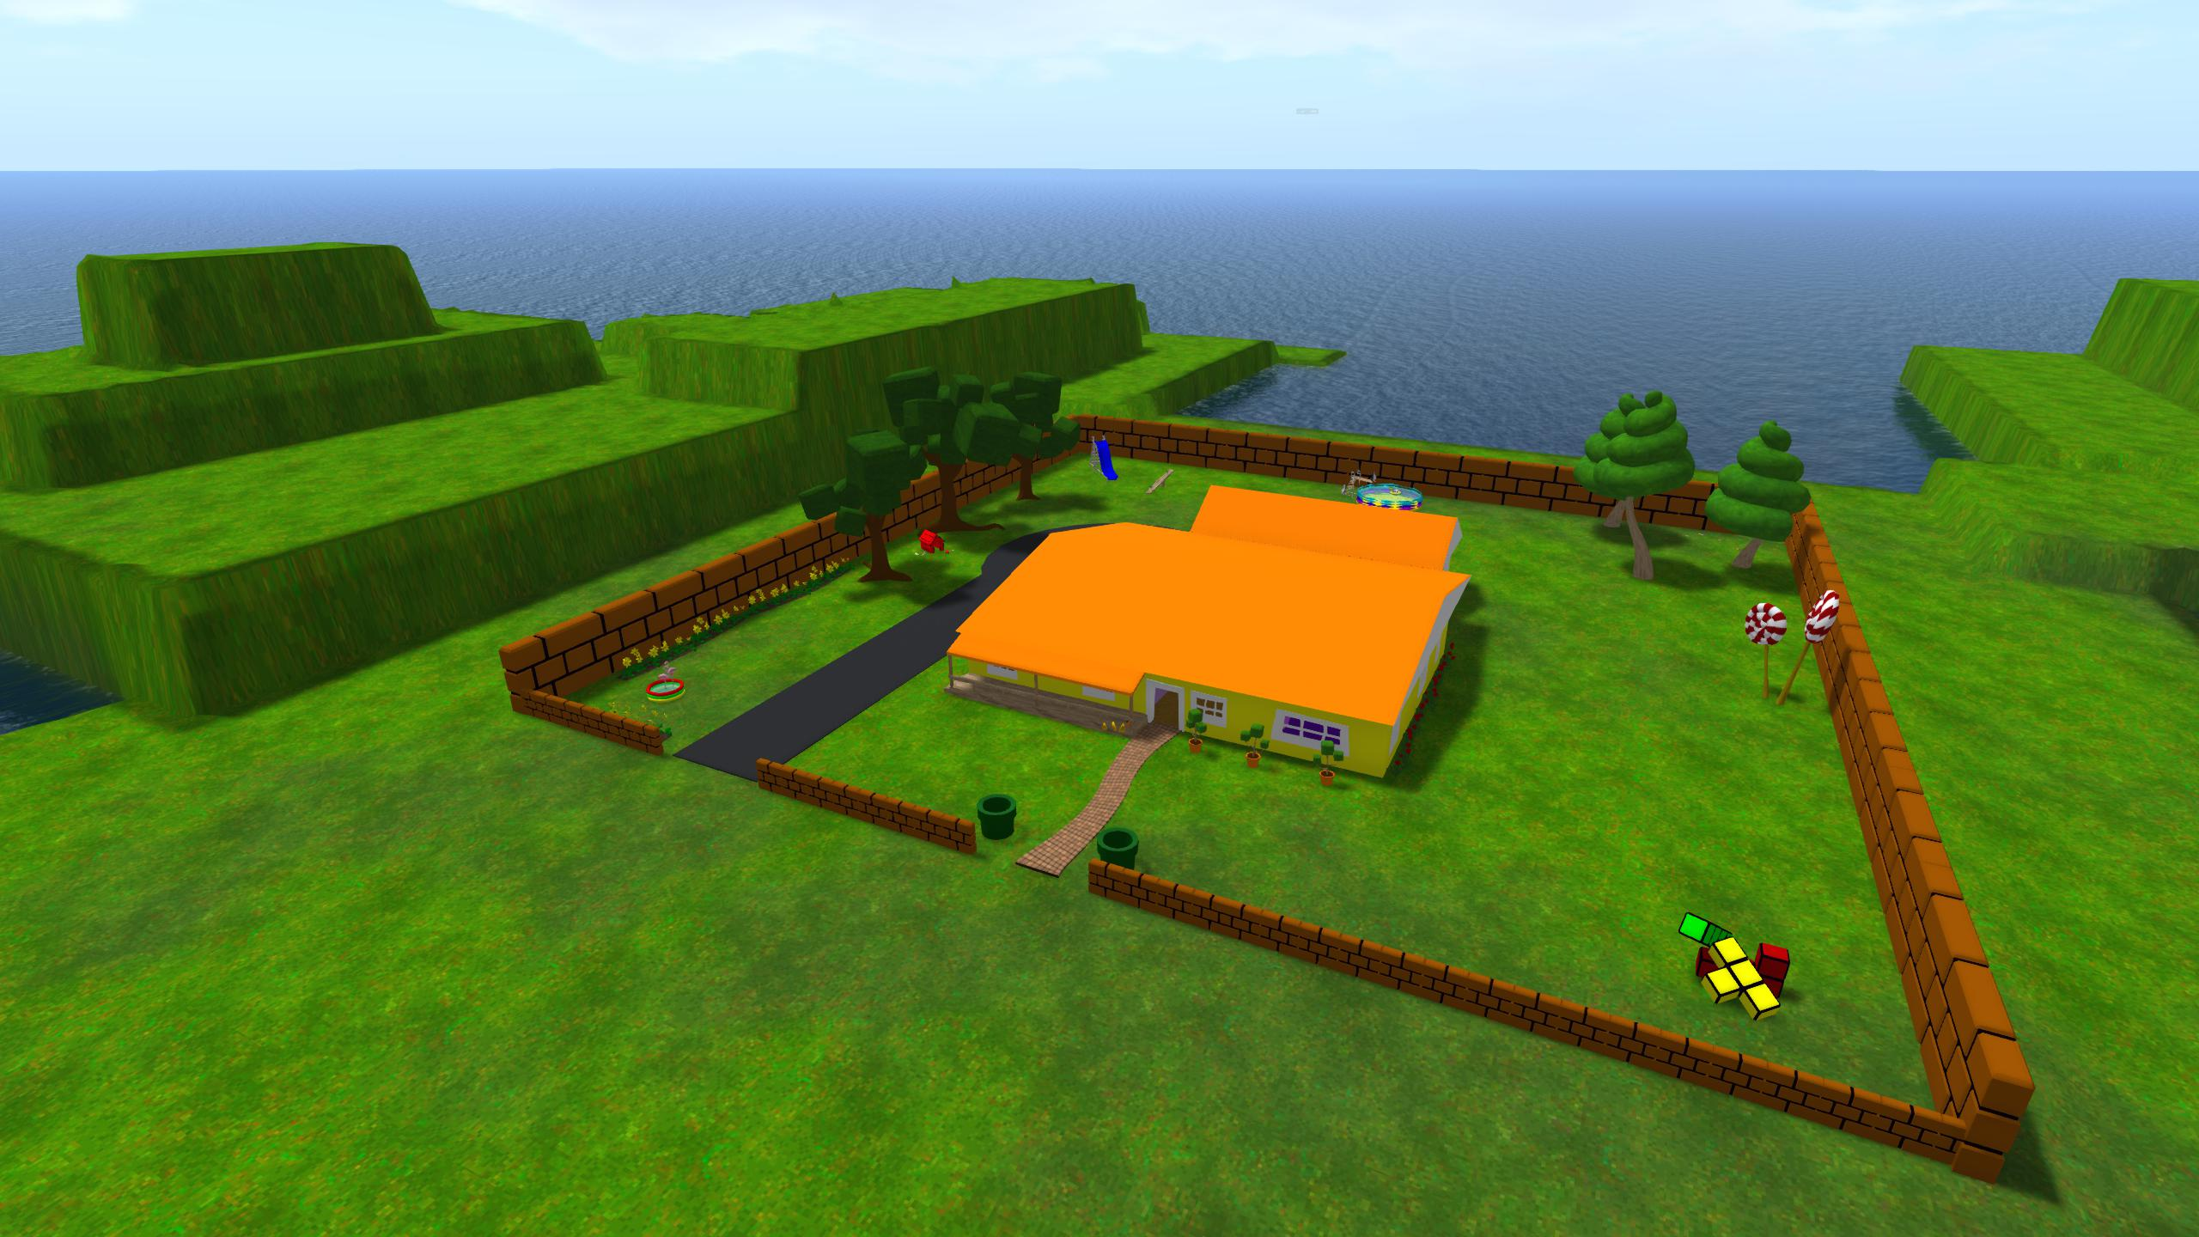






PROPOSED WORK
Introduce elaborative encoding and ask…which is better? Cleanout, EE, or just time?
Test
Delay or Mental Cleanout
…

Slide 41
PROPOSED WORK
Test
Virtual Erase
…

Slide 42
PROPOSED WORK
Introduce elaborative encoding and ask…which is better? Cleanout, EE, or just time?
Test
Elaborative Encoding
…

Slide 43

PROPOSED WORK
Subjects would follow a trail of footsteps to where they placed previous items and either watch them dissolve or place a new item so as to elaborative encode the pair.

Slide 44
PROPOSED WORK
Familirization
Encoding 1
Verbal Recall 1
"Clean Out"
or
"Elaborative Encoding“
or
“Delay”
Encoding 2
Verbal Recall 2
Spatial Memory Test 1
Spatial Memory Test 2
Verbal Recall 1
Spatial Memory Test 1

Slide 45
PROPOSED WORK
Anticipated results following 3 lists of encoding

Slide 46
PROPOSED WORK TIMELINE
September 2017
Finish software changes to accommodate dissolve / reappearance / virtual guidance
January 2018
Collected 30 usable subjects (2.5months on average)
May 2018
Analysis completed
3 manuscripts submitted
Defend

Slide 47
PUBLICATIONS
Reggente, N., Cohen, M.S., Zheng, Z., Castel, A.D., Knowlton, B.J., Rissman, J. (2017) Memory recall for high value items correlates with individual differences in white matter pathways associated with reward processing and fronto-temporal communication. In Preparation.
Reggente, N., Moody, Teena D., Morfini, F., Sheen, C., Rissman, J., O’Neil, J., Feusner, J. (2017) Prediction of response to cognitive-behavioral therapy in obsessive-compulsive disorder: a multivariate analysis of resting state functional connectivity. In preparation.
Moody, T., Cheng, G., Morfini, F., Sheen, C., Naza, R., Reggente, N., O’Neil, J., Mechanisms of cognitive-behavioral therapy for obsessive- compulsive disorder involve robust and extensive increases in brain network connectivity. Translational Psychiatry. In press.
Peiper, N.C., Gourdet, C., Reiman, A., Reggente, N., Meinhofer, A., Novake, S.P. (2017) Interactions between dispensary staff and medical cannabis patients. Under review at Substance Abuse: Research and Treatment (Cannabis special issue)
Zheng, Z. S., Reggente, N., Lutkenhoff, E., Owen, A. M., & Monti, M. M. (2017). Disentangling disorders of consciousness: Insights from diffusion tensor imaging and machine learning. Human Brain Mapping, 38(1), 431-443.
Rissman, J., Chow, T. E., Reggente, N., & Wagner, A. D. (2016). Decoding fMRI signatures of real-world autobiographical memory retrieval. Journal of cognitive neuroscience.
Westphal, A. J., Reggente, N., Ito, K. L., & Rissman, J. (2015). Shared and distinct contributions of rostrolateral prefrontal cortex to analogical reasoning and episodic memory retrieval. Human brain mapping.

Slide 48
PRESENTATIONS AND POSTERS
  Essoe, J. K.-Y., Reggente, N., Baek, H. Y., Ohno, A. A., Mehta, P., Vuong, A., & Rissman, J. (2017, April). Making VR learning "stick": contextually supported transfer and long-term retention. In K. Bullock & B. Kateb (Chairs), Virtual reality clinical neuroscience. Symposium conducted at the Society for Brain Mapping & Therapeutics (SBMT) Annual World Congress, Los Angeles, CA.
  Reggente, N. (2017) Bringing The Method of Loci to the mass market with virtual reality presentation software. Symposium talk to be presented at International Convention of Psychological Science, Vienna, Austria
  Essoe, J. K.-Y., Reggente, N., Ohno, Baek*, Y. H., Ohno, A.*, & Rissman, J. (2017). Distinctive Virtual Reality Contexts Bolster Long-Term Retention of Interference-Prone Materials. Abstract accepted for poster presentation at the Asociation for Psychological Science Annual Convention, Boston, MA.
  Essoe, J. K.-Y., Reggente, N., Ohno, A. A.*, Baek, H. Y.*, Rissman, J. (2017). Distinctive virtual reality contexts bolster long-term retention of interference-prone materials. Abstract accepted for oral presentation at the Context and Episodic Memory Symposium, Philadelphia, PA.
  Essoe, J. K.-Y., Reggente, N., Baek, H. Y.*, Ohno, A. A.*, Mehta, P.*, Vuong, A.*, & Rissman, J. (2017). Long-term retention of vocabulary in two phonetically similar foreign languages is aided when learning occurs in highly distinctive virtual reality environments. Poster to be presented at the Cognitive Neuroscience Society, San Francisco, CA.
  Reggente, N. (2017). Enhancing memory through virtual reality memory palaces. Talk presented at The Quale Symposium in Los Angeles, CA.
  Johnson, M. Pochon, J.B., Reggente, N., Webster, J., Rissman, J. (2016) Brain network connectivity of a world record contender for simultaneous blindfold chess. Poster to be presented at Society for Neuroscience, San Diego, CA
  Feusner, J.D., Reggente, N., Moody, T.D., Morfini, F., Rissman, J., O’Neil, J. (2016) Prediction of response to cognitive-behavioral therapy in obsessive-compulsive disorder: a multivariate analysis of resting state functional connectivity. Poster presented at American College of Neuropsychopharmacology Hollywood, FL.
  Reggente, N.,, Essoe, J., Mehta, P.*, Ohno, A.*, Rissman, J. (2016) The Method of Loci revisited: Memory enhancement by way of virtually augmented memory palaces. Poster presented at the International Conference on Memory, Budapest, Hungary
  Vuong, A.*, Reggente, N., Rissman, J. (2016). Neural correlates of fluid intelligence via functional and structural network connectivity measures. Poster presented at UCLA’s Psychology Undergraduate Research Conference, Los Angeles, CA
  Ohno, A. A.*, Baek, H. Y*., Mehta, P. S*., Yu Villa, J.*, Hughes, G. M.*, Ekanayake, R.*, Sanchez-Prak, A.*, Vuong, A.*, Shiboski, H.*, Reggente, N., Essoe, J. K.-Y., Rissman, J. (2016). Does Presence/Immersion Confer an Advantage in Learning in Virtual Reality? Poster presented at Stanford Undergraduate Psychology Conference, Stanford, CA and at the UCLA Undergraduate Research Week, Los Angeles, CA.
  Reggente, N., Essoe, J.K., Rissman, J. (2016). Mapping neural representations of heading direction and environmental context during imagined navigation of learned virtual environments Poster presented at Cognitive Neuroscience Society, New York, NY.
  Reggente, N., Essoe, J.K., Jevtic, I., Rissman, J. (2015). Decoding the contents of perceived and imagined navigation through virtual reality environments. Poster presented at Organization for Human Brain Mapping, Honolulu, HI.
  Reggente, N. (2015) Deduction reduction: How the mere wiring of your brain predicts your intelligence. Presented at UCLA’s Grad Slam Competition, Los Angeles, CA.
  Cornali, C.*, Reggente, N., Rissman, J. (2015). The predictive power of functional network connectivity in cognitive function. Poster presented at UCLA's Psychology Undergraduate Research Conference.
  Ohno, A.*, Niño, C.*, Hunter, K.*, Mehta, P.*, Baek, H.Y.*, Essoe, J., Jevtić, I., Reggente, N., Rissman, J. (2015). The Method of Loci revisited: Memory enhancement by way of virtually augmented memory palaces. Poster to be presented at UCLA's Psychology Undergraduate Research Conference.
  de Bruin, D., Foos, F., Odegaard, B., Reggente, N., Shams, L. (2015). The gorilla revisited: The influence of temporal synchrony on unconscious multisensory integration. Poster to be presented at UCLA's Psychology Undergraduate Research Conference.
  Reggente, N., Rissman, J. (2014). The structural scaffolding of functionally defined networks predicts individual differences in cognitive functions. Talk presented at Society For Neuroscience Nano-Symposium, Washington, D.C.
  Westphal, A.J., Monti, M.M., Reggente, N., Yazdanshenas, O., & Rissman, J. Episodic memory retrieval benefits from a less modular brain network organization. Talk presented at Society For Neuroscience Nano- Symposium, Washington, D.C.
  Zheng, Z., Reggente, N., Lutkenhoff, Monti, M. (2014) Structural connectivity between the thalamus and fronto-temporal regions predicts level of awareness in disorders of consciousness. Poster presented at Society For Neuroscience, Washington, D.C.
  Kommers, C.*, Raccah, O.*, Reggente, N., Rissman, J.(2014) Individual differences in working memory performance as a function of the local integrity and regional connectivity of the hippocampus. Talk presented at UCLA's Research Week; Talk presented at UCLA’s Psychology Undergraduate Research Conference; Poster presented at UCLA’s Science Poster Day. Poster presented at Society For Neuroscience, Washington, D.C.
  Lin, D*., Essoe, J.K-Y., Tran, J.*, Zhou, J.*, Mutter, J.*, Frostig, D.*, Yang, J.*, Reggente, N., Rissman, J.(2014) The effects of sleep quality on virtual reality learning and overnight forgetting. Poster presented at UCLA's Psychology Undergraduate Research Conference.
  Zheng, Z., Reggente, N., Lutkenhoff, Monti, M. (2014) Disentangling disorders of consciousness: Insights from diffusion tensor imaging and multivariate analyses of coma recovery patients. Poster presented at Cognitive Neuroscience Society, Annual Meeting, Boston, MA.
  Nikolaidis, A., Reggente, N., Goatz, D., Hurley, K., Westphal, A., Rissman, J., Kramer, A.F. (2014) Predicting individual differences in cognitive gains from videogame training using multivariate analysis of fMRI functional connectivity patterns. Poster presented at Cognitive Neuroscience Society, Annual Meeting, Boston, MA.
  Reggente, N., Cohen, M.S., Zheng, Z., De Shetler N.G., Castel, A.D., Knowlton, B.J., Rissman, J. (2013) Memory recall for high value items correlates with individual differences in white matter pathways associated with reward processing and fronto-temporal communication. Poster presented at Society For Neuroscience, San Diego, CA.
  Reggente, N., Cohen, M.S., Zheng, Z., De Shetler N.G., Castel, A.D., Knowlton, B.J., Rissman, J. (2013) Memory recall for high value items correlates with individual differences in white matter pathways associated with reward processing and fronto-temporal communication. Poster presented at Brain Research Insitute’s Annual Neuroscience Poster Session Los Angeles, CA.
  Westphal, A.J., Reggente, N., Ito, K., Fortuna, W.H., Nawabi, Y., Milstein, M., & Rissman, J.(2013) Characterizing common and dissociable involvement of medial temporal lobe regions during episodic source memory retrieval and analogical reasoning. Poster presented at Society For Neuroscience, San Diego, CA.
  Westphal, A.J., Reggente, N., Ito, K., Fortuna, W., & Rissman, J. (2013) Decoding cognitive task sets from rostral prefrontal cortex function connectivity patterns. Poster presented at Organization for Human Brain Mapping, Seattle, WA.
  Westphal, A.J., Reggente, N., Nawabi, Y., & Rissman, J. (2013). Shared and distinct contributions of rostral prefrontal cortex to analogical reasoning and episodic memory retrieval: Insights from fMRI functional connectivity and multivariate pattern analyses. Poster Presented at Cognitive Neuroscience Society Annual Meeting, San Francisco, CA.
  Ito, K., Westphal, A.J., Reggente, N., Fortuna, W., & Rissman, J. (2013) Hippocampus across task-contexts: Localized activity and network connectivity. Poster presented at the Psychology Undergraduate Research Conference, Los Angeles, CA.
  Rissman, J., Chow, T., Hardekopf, K., Reggente, N., Greely, H.T., and Wagner, A.D. (2011). Decoding real- world autobiographical retrieval experiences with fMRI multi-voxel pattern analysis. Talk presented at the Society for Neuroscience Annual Meeting, Washington, D.C.

Slide 49
Other Work
More analyses
Directionality in the environment (i.e. heading North vs. South vs. West vs. East) as opposed to clockwise vs. counter.
Functional connectivity decoding across subjects in fMRI version of Chapter 3
Other studies
Predicting intelligence using FC and DTI on HCP data
Replicate Chapter 1 in older adults
tDCS during incidental encoding

Slide 50






OTHER WORK

Slide 51




ACKNOWLEDGEMENTS

Slide 52
THANK YOU

