Slide 1
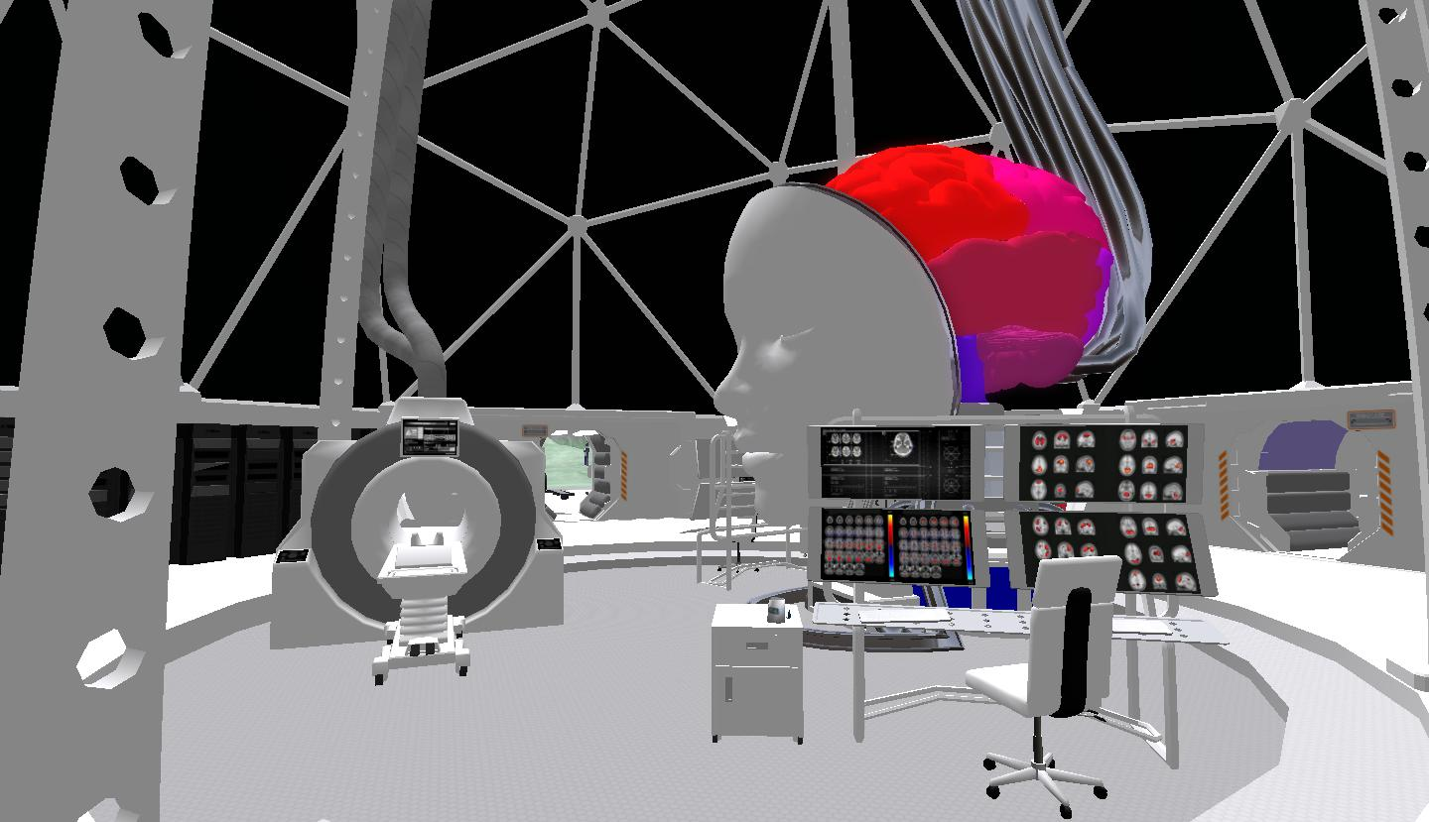
Enhanced Mnemonic Retrieval
Insights from Virtual Reality and fMRI
Nicco Reggente
Suthana Lab Meeting
March 15, 2016

Slide 2
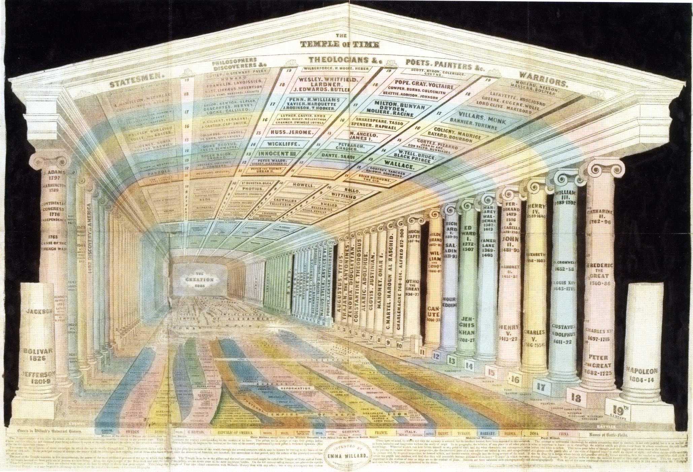
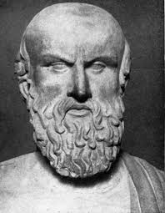

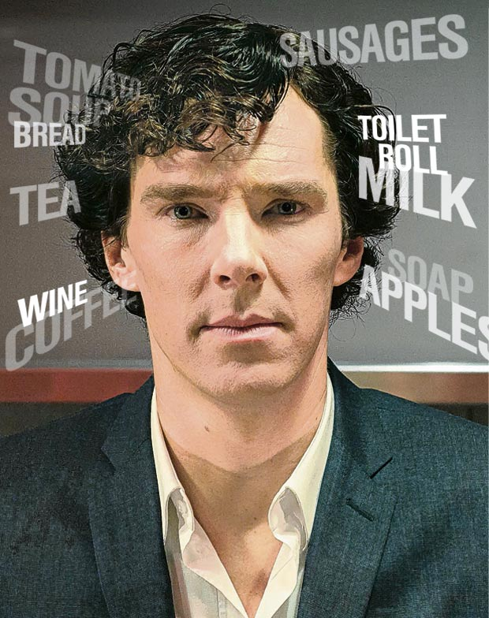
The Method of Loci

Slide 3
Strengths and Shortcomings
Bower (1970) showed a 7-fold increase in ordered retention.
With only 13s of exposure, subjects could remember 38/40 items, in order, the next day. (Ross & Lawrence, 1968)
Exposure to familiar environments varies across subjects.
No objective measure of spatiotemporal contextual reinstatement
No one, outside of memory experts, uses it.

Slide 4
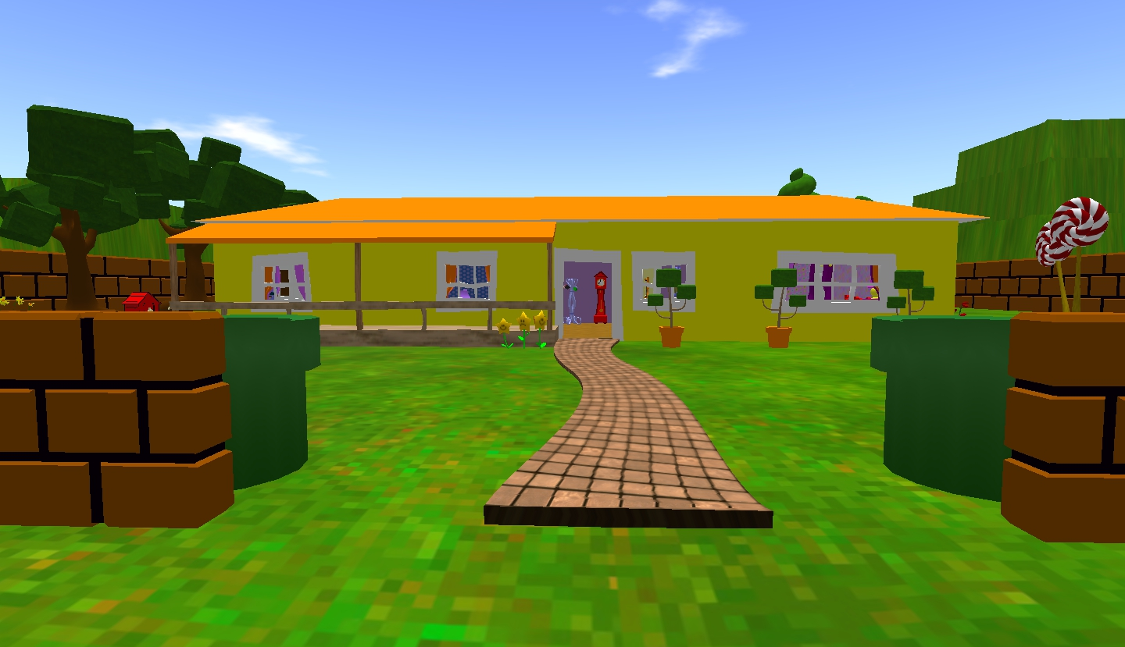
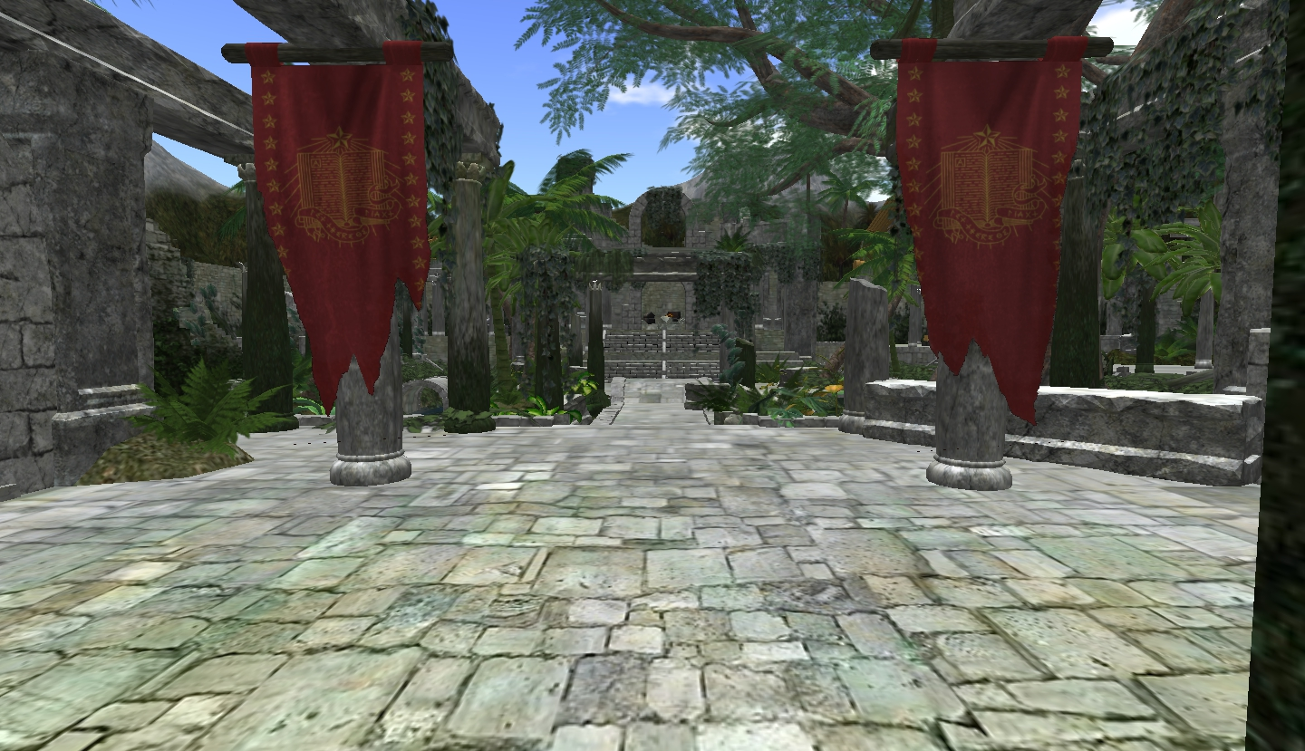
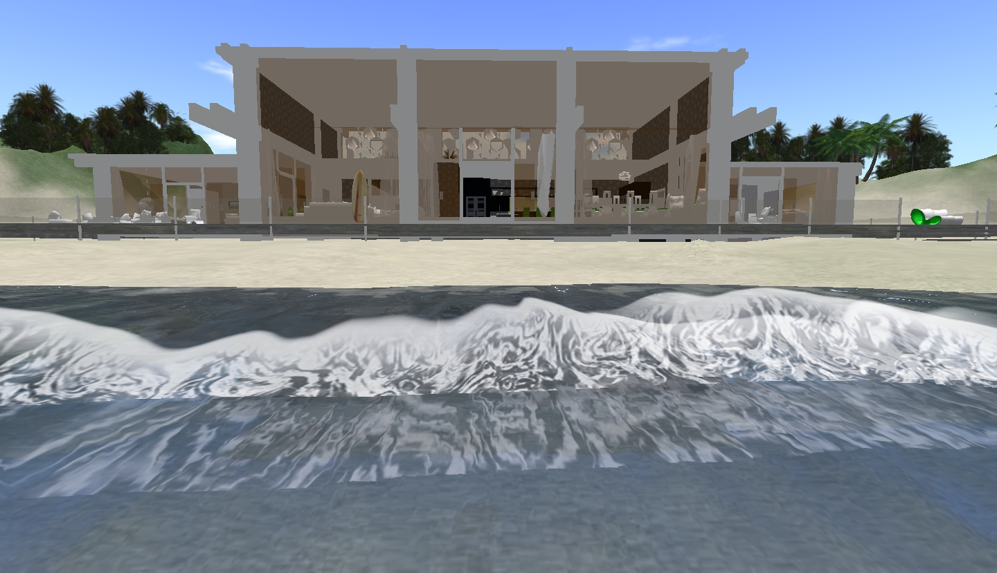
MoL’s Virtual Makeover
Toon World
Ruin World
Lagoon World

Slide 5
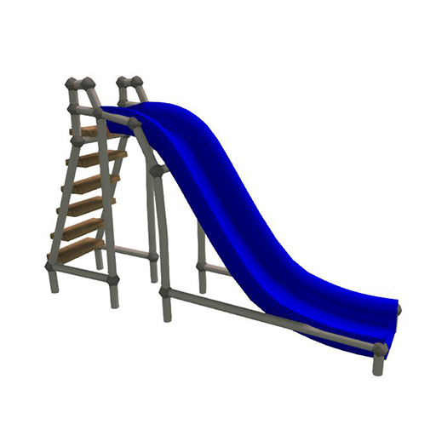
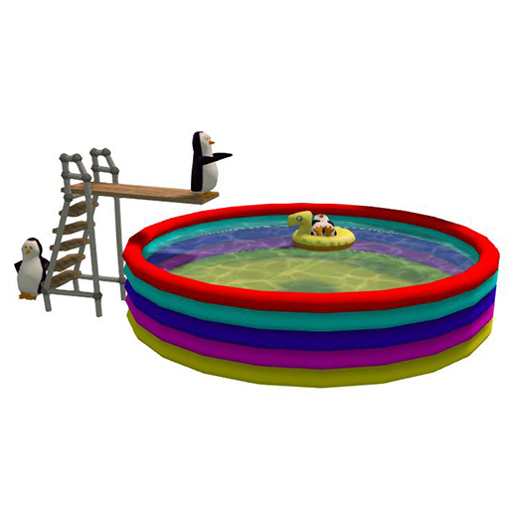

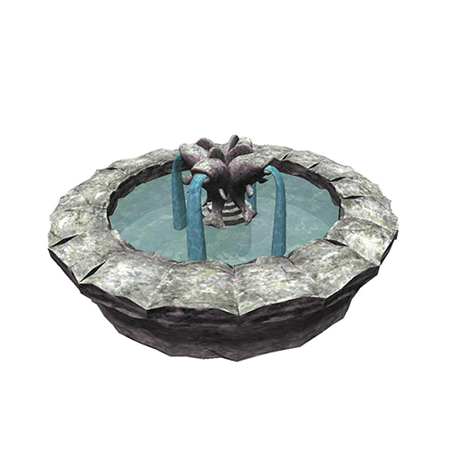
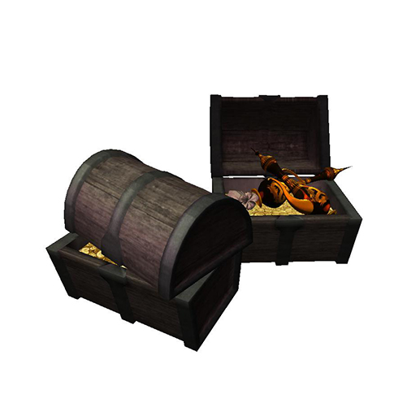
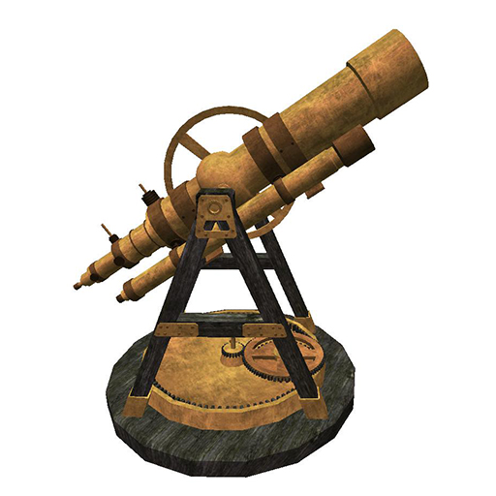
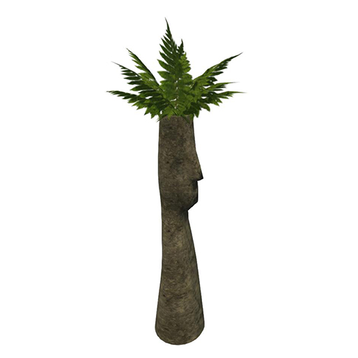
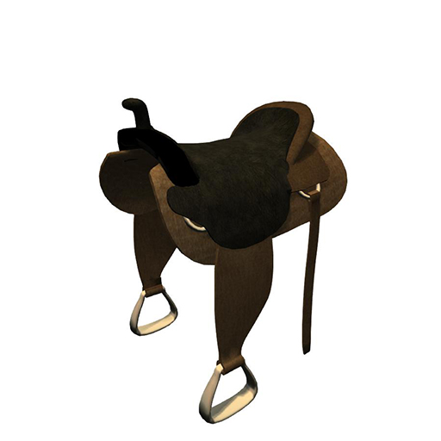
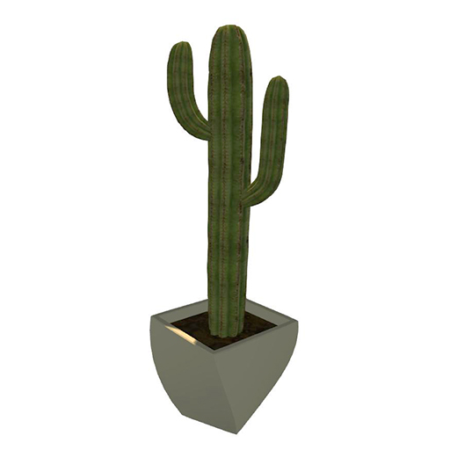
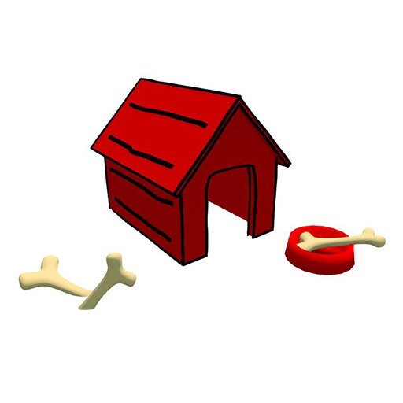
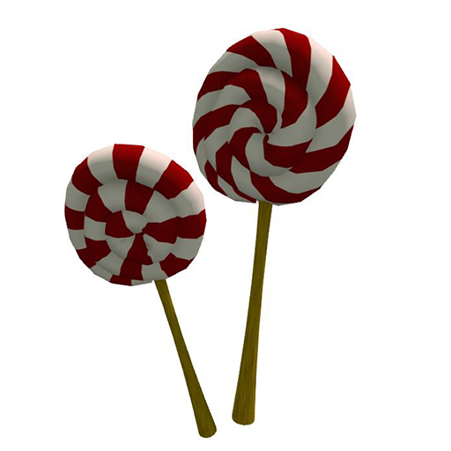
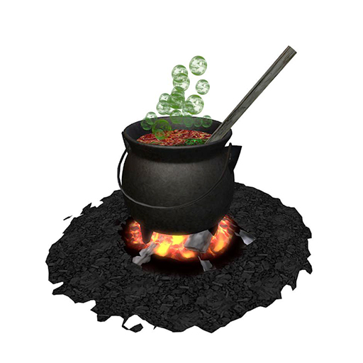
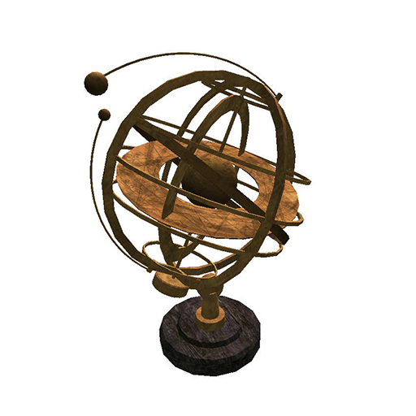
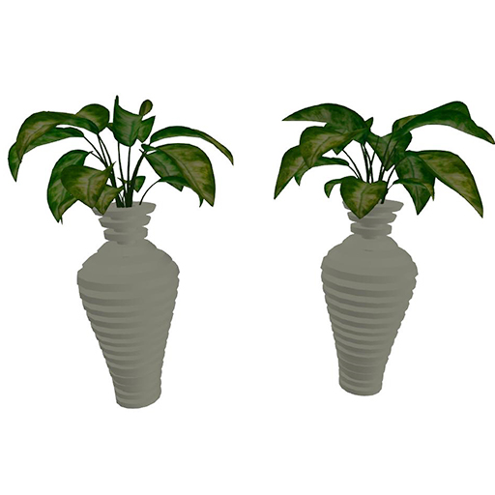
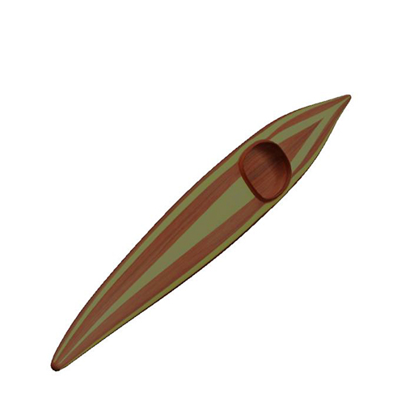
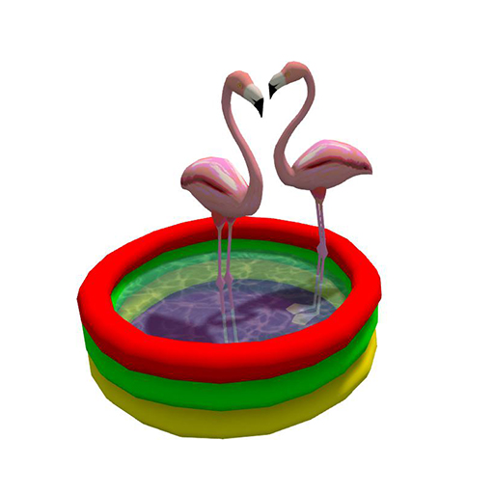
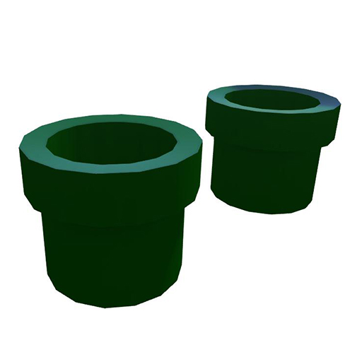
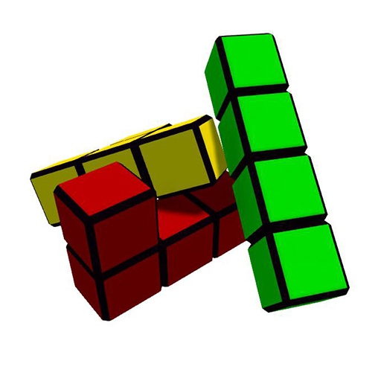

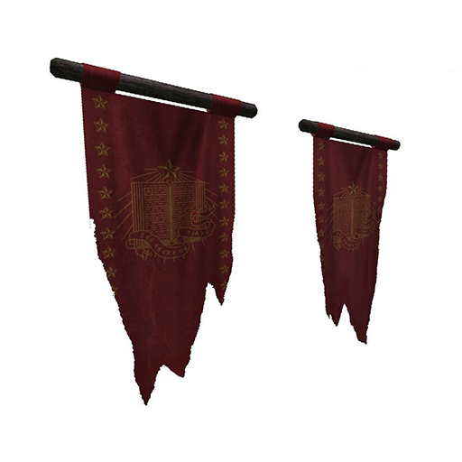
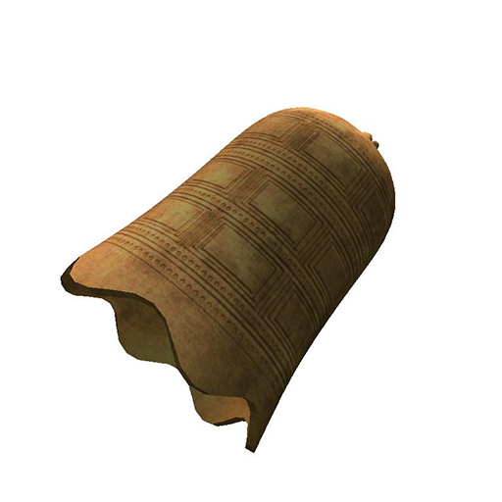
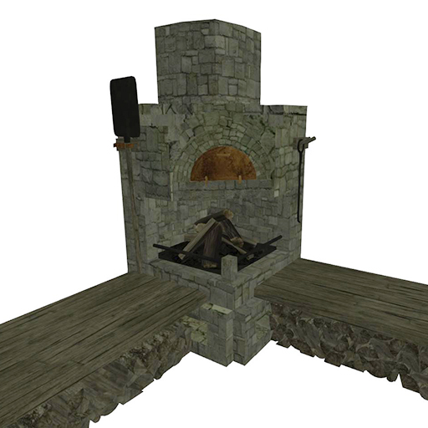
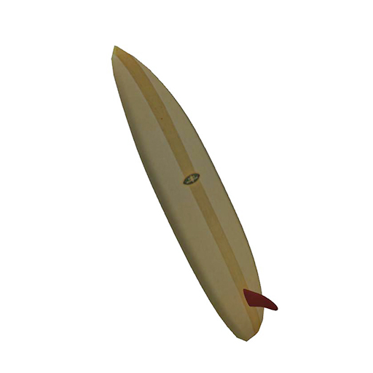
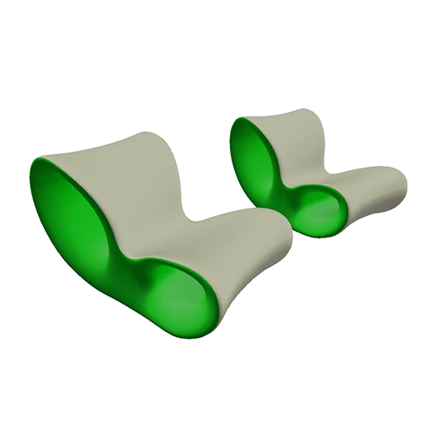
MoL Virtual Setup
8 Landmarks at the cardinal perimeter points.

Slide 6
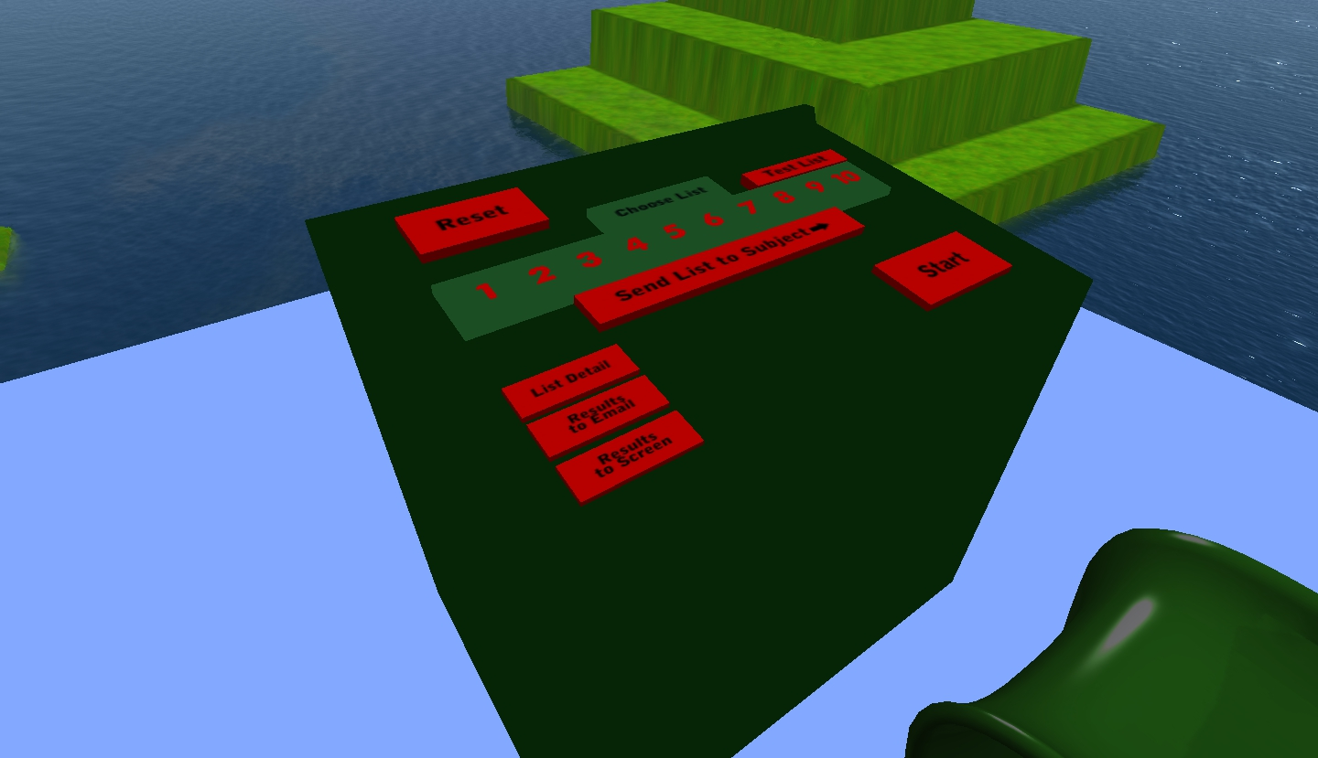
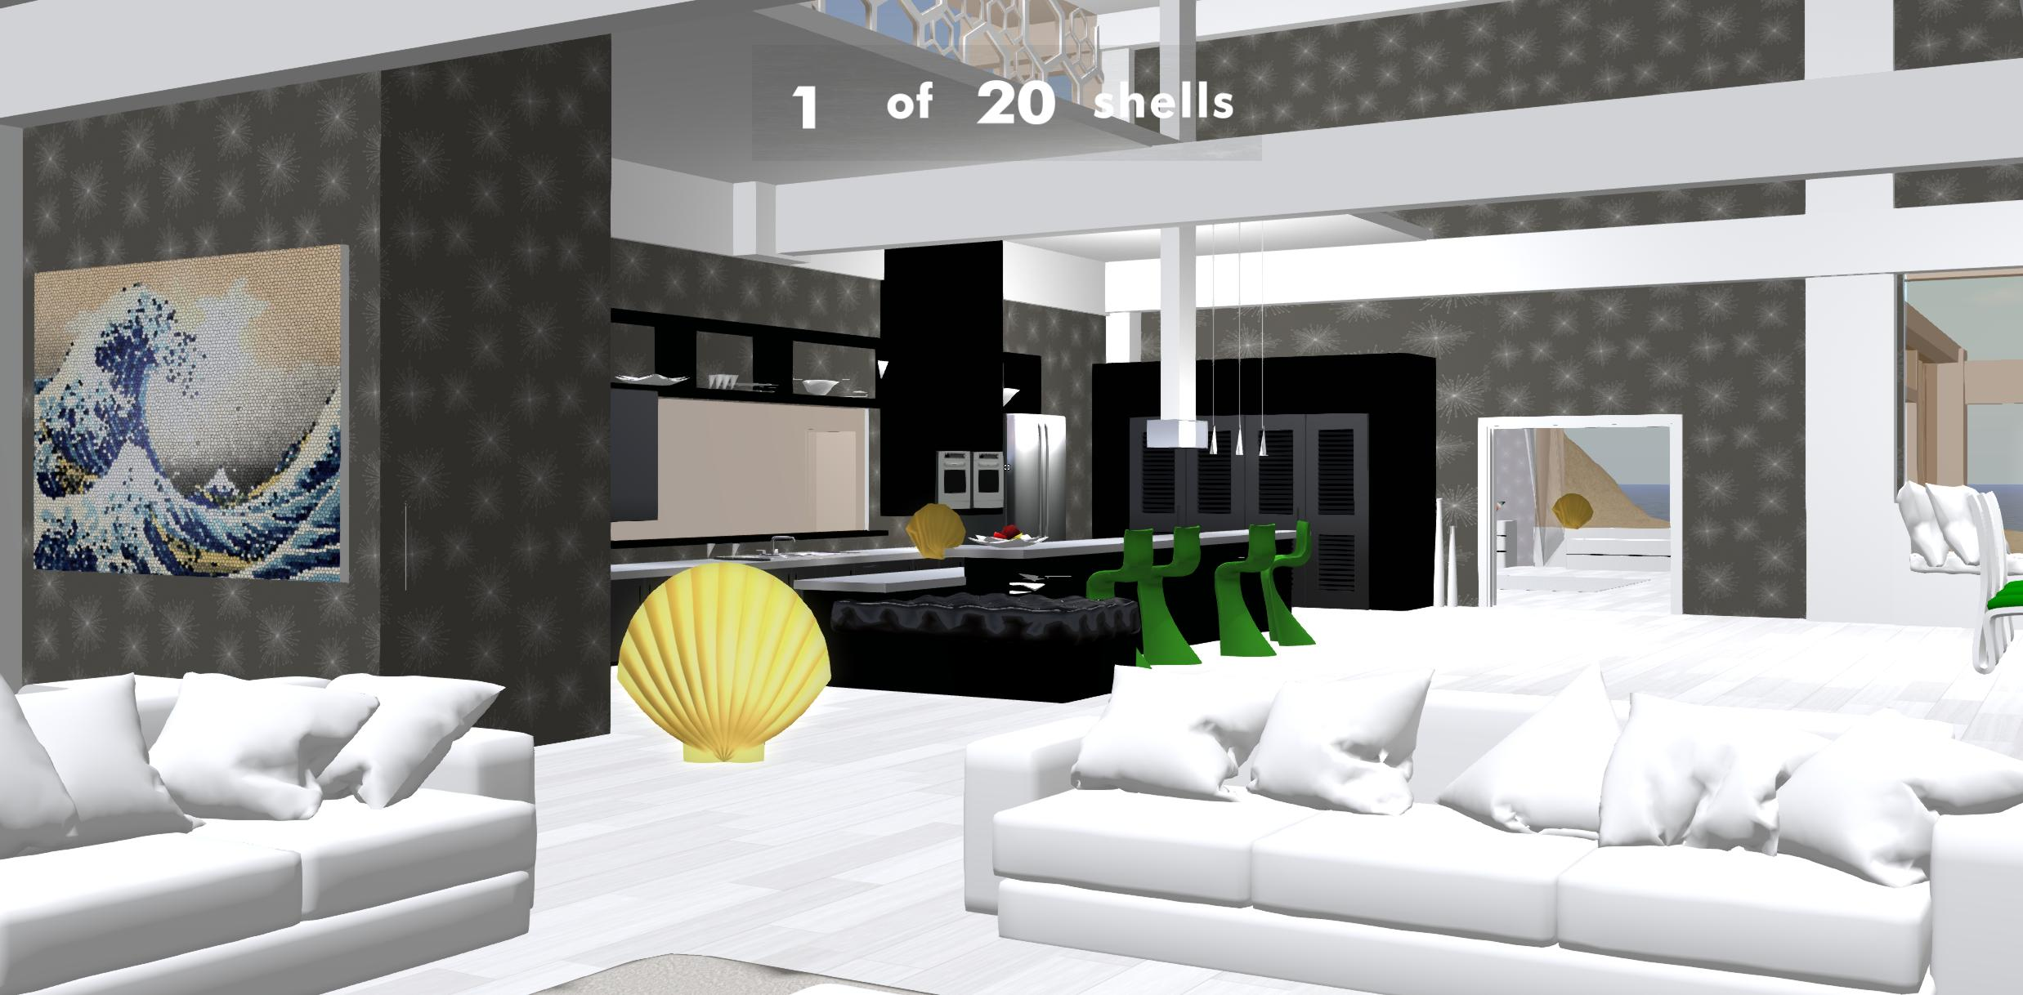
MoL Virtual Setup
Custom Control Panel
Even-Exploration Coin Task
Experimenters retain the ability to render objects throughout the environment for collection.
Experimenters can upload lists of objects to be rendered in front of the subject as they navigate.

Slide 7
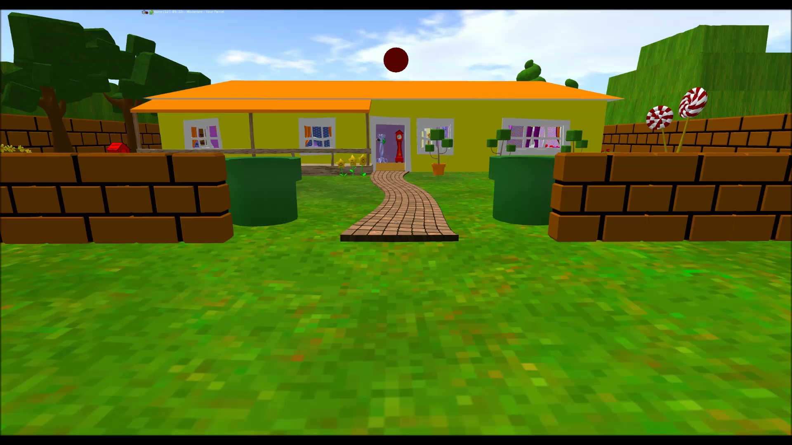
MoL Virtual Setup

Slide 8
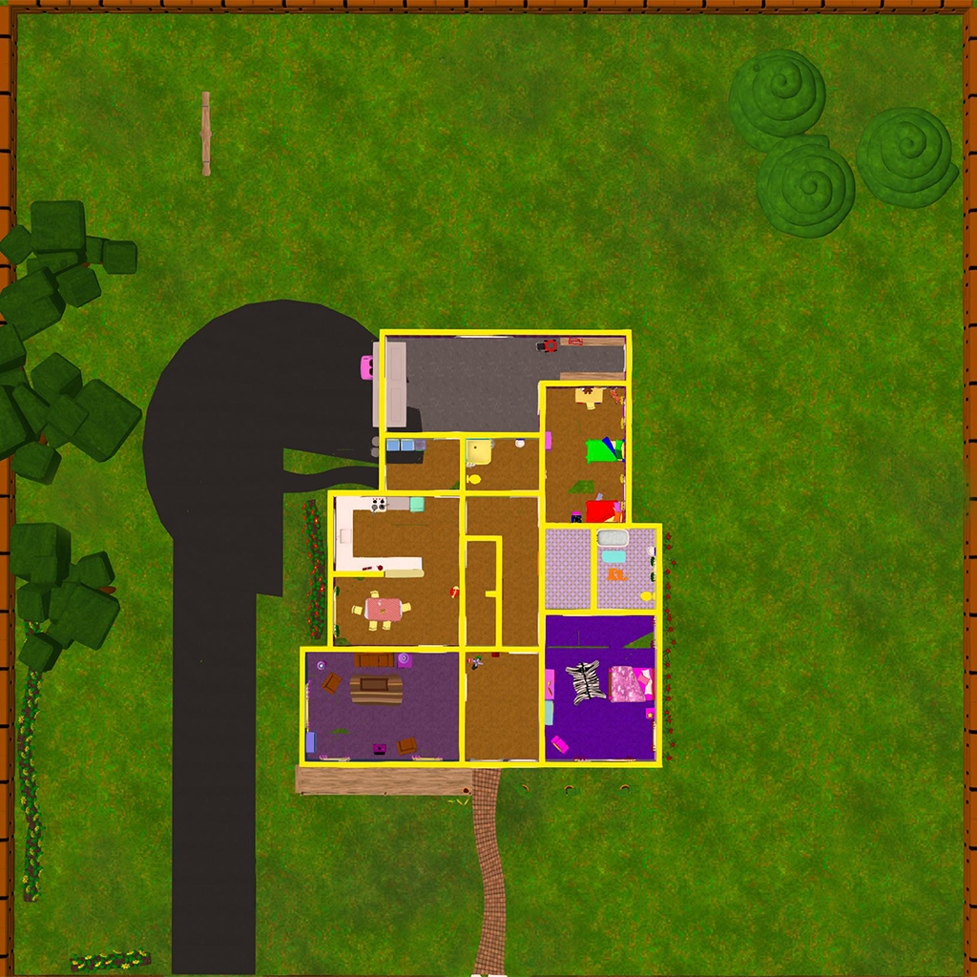
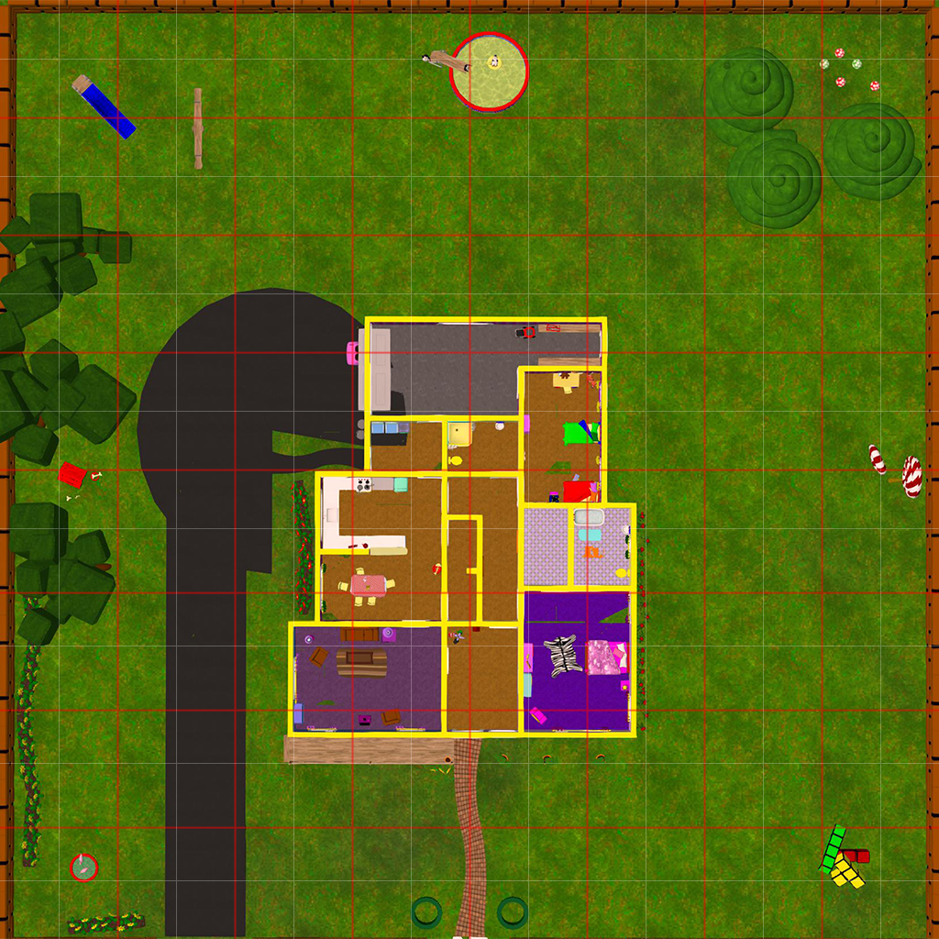
MoL Virtual Setup
64 x 64 Grid allows for object and landmark testing.

Slide 9
Behavioral Recall Findings
2 Worlds. 15 Objects Each
# Words Recalled
# Words Recalled In Order
# Words Recalled Before Error

Slide 10
Behavioral Recall Findings
3 Worlds. 15 Objects Each
# Words Recalled
# Words Recalled In Order
# Words Recalled Before Error

Slide 11
Neural Hypotheses
If the binding of items to their spatial context is responsible for the effectiveness of the MoL, then an individual’s ability to “bring back” the appropriate encoding environment during recall should serve as a predictor for memory strength.
…Can we decode the contents of a subject’s mental imagery?

Slide 12
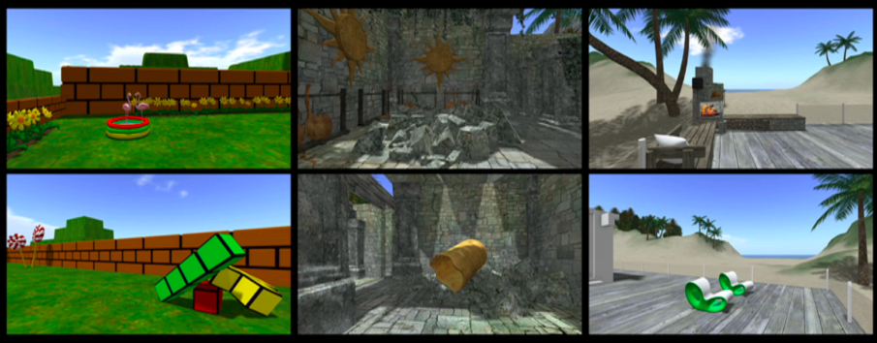

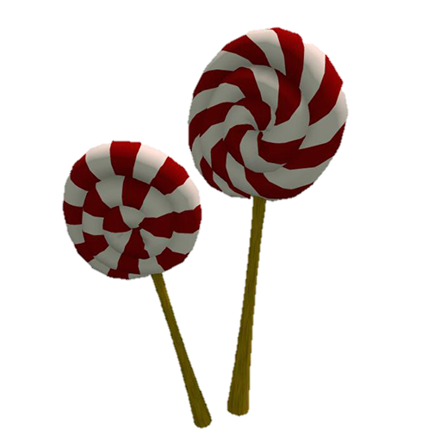
Pilot
Day 1: Coin Collection, Practice Navigating
Day 2: More Navigation Practice + Video Viewing and Mental Imagery
30s Video Clips
Mental Imagery Instructions
Toon World
Start
Next

Slide 13
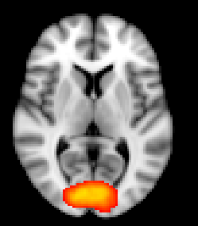
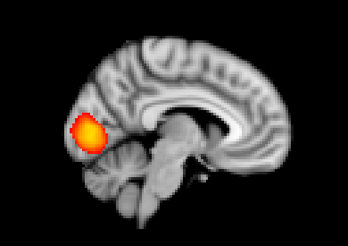
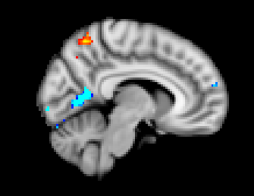
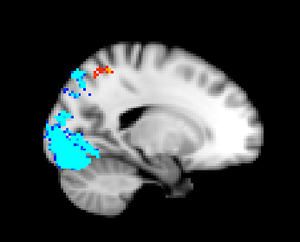
Pilot Results
Decoding Which World (Searchlight; Chance =33%)
63% using Viewing Data
43% using Imagery Data
Males differ from Females
We can also decode “Which Direction” from viewing and imagery data!

Slide 14
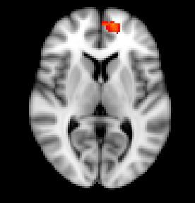
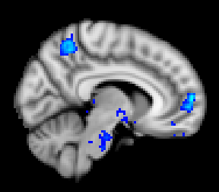
Pilot Results
Train Visual, Test Imagery
Which regions express the same pattern of activity during imagination as they did at viewing?
Achieve 43% accuracy in Males and Females

Slide 15
fMRI Experimental Design
Same as Behavioral except lists are named by person, not World.
Subjects are routinely oriented to know North, South, West, and East
Free Recall (Cue is List Name)
Reverse Free Recall
Allocentric / Egocentric Tasks
Localizer

Slide 16
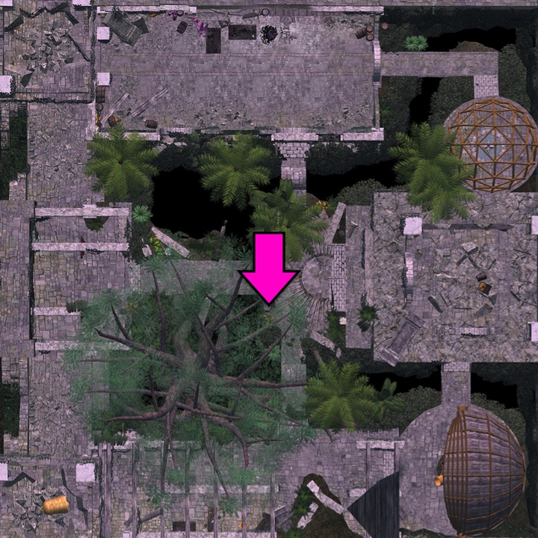
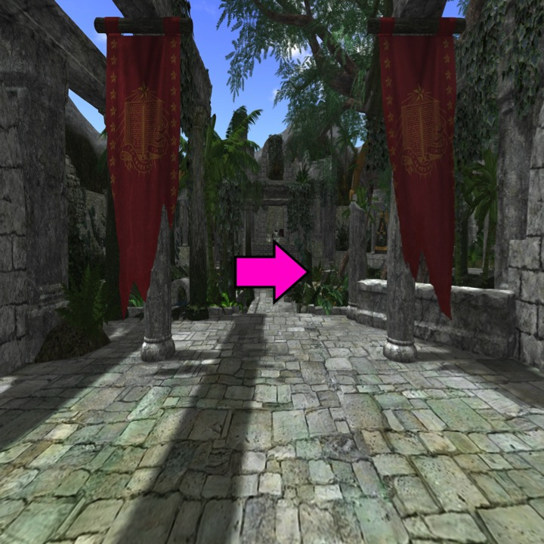
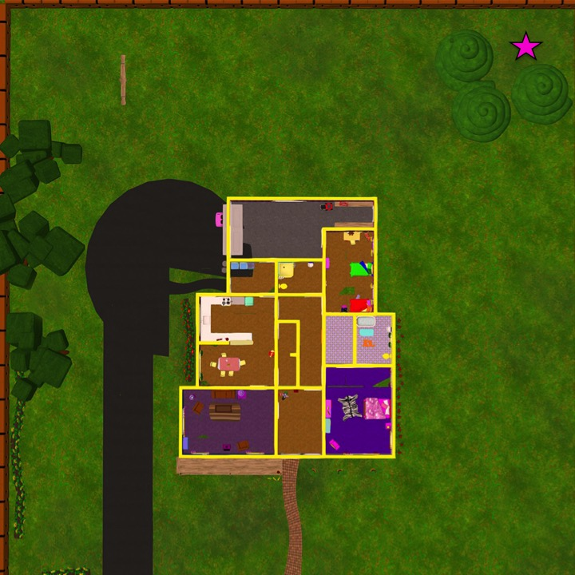
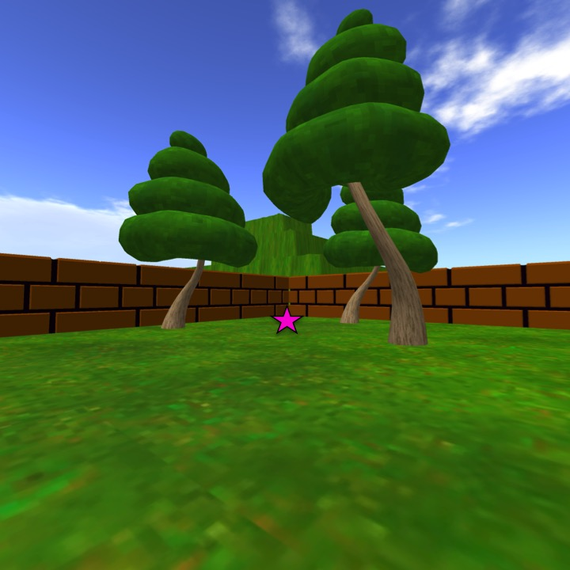
fMRI Experimental Design
Allocentric
Egocentric
Bearning
N
S
W
E
Spatial Memory

Slide 17
Planned Analyses
Is contextual reinstatement driving retrieval strength?
  Train for world-identity from localizer, Test during recall or RSA
Which areas show increased activity during enhanced mnemonic recall?
  Across subject MVPA and fcMVPA during recall
Dissociable processes for completing Egocentric vs. Allocentric tasks

Slide 18
Future Directions
Behavioral: Rich vs. Sparse Spatial Context, 2D vs. 3D, Volition vs. Passive
Constantinescu et al. (2015)

