Slide 1
Measuring the Immeasurable: Consciousness and MRI
Presented on April 28, 2015
UCLA Psych 88SA
Nicco Reggente

Slide 2
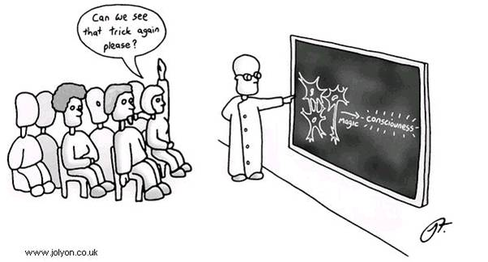
Introduction
Man’s oldest question: How does a meat machine, like our brains, allow for subject experience?
  Other than assistance from concepts like emergence and what it is like, no one knows.
With neuroimaging, we can, at the very least, elucidate the neural underpinnings responsible for gradations of conscious experience.

Slide 3
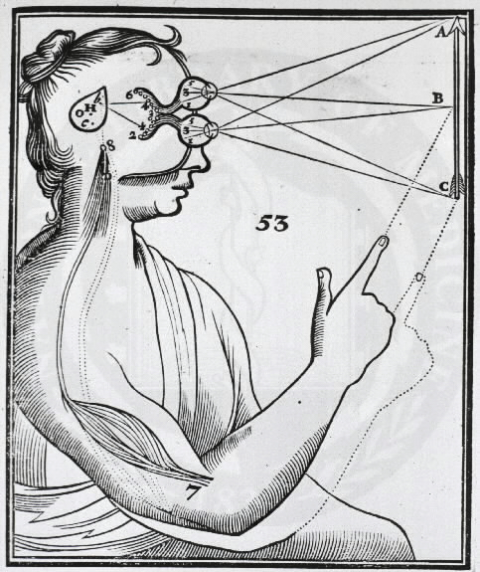

Motivation for Brain Mapping
Associating particular regions of the brain with specific function has been the goal of neuroscience since the advent of phrenology.
Rene Descartes famously postulated that the pineal gland, due to its unique lack of laterality, was the “seat of the soul”.

Slide 4
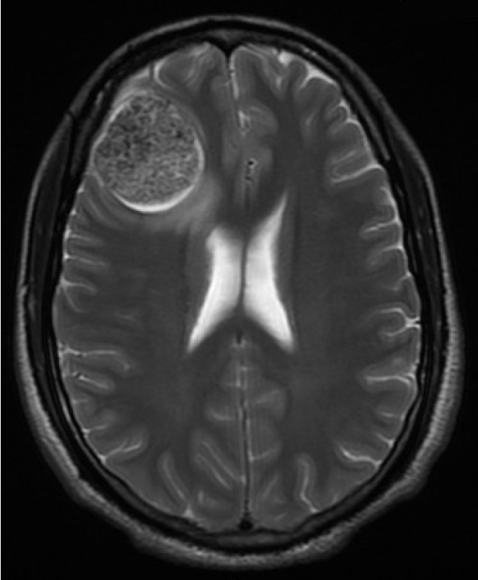
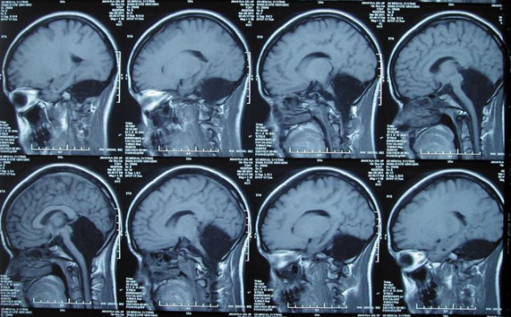
Magnetic Resonance Imaging (MRI)
MRI affords researchers with the opportunity to get “brain pictures” by observing relative differences in magnetic resonance properties across the brain. For example, gray matter, white matter, fat, CSF, bone, etc. all have different local resonance properties.
Can reveal structural anomalies (e.g tumors) or absences.
  Correlate these anomalies with facets of conscious experience
Huge frontal cortex tumor. Reduced inhibition control. Still conscious.
Missing entire Cerebellum. Reduced motor coordination. Still Conscious.

Slide 5
Functional MRI (fMRI)
Associating any one structure of the brain with consciousness seems naïve.
Instead, the temporally synchronous activity of distributed brain regions should be more insightful.
fMRI affords research with the ability to gather a “time series” of brain pictures that can track local activity.

Slide 6
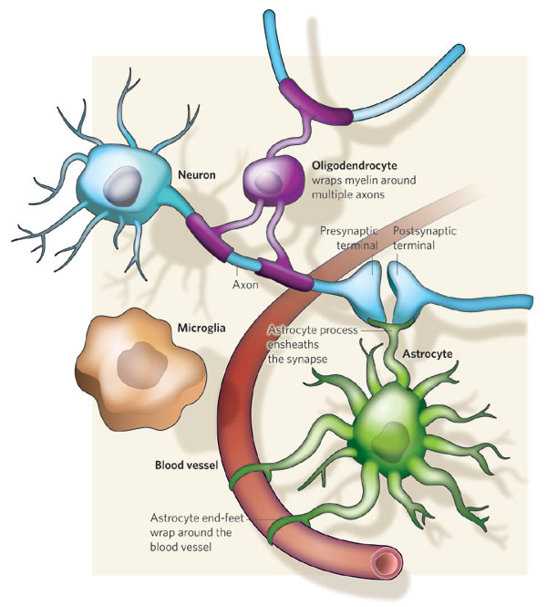
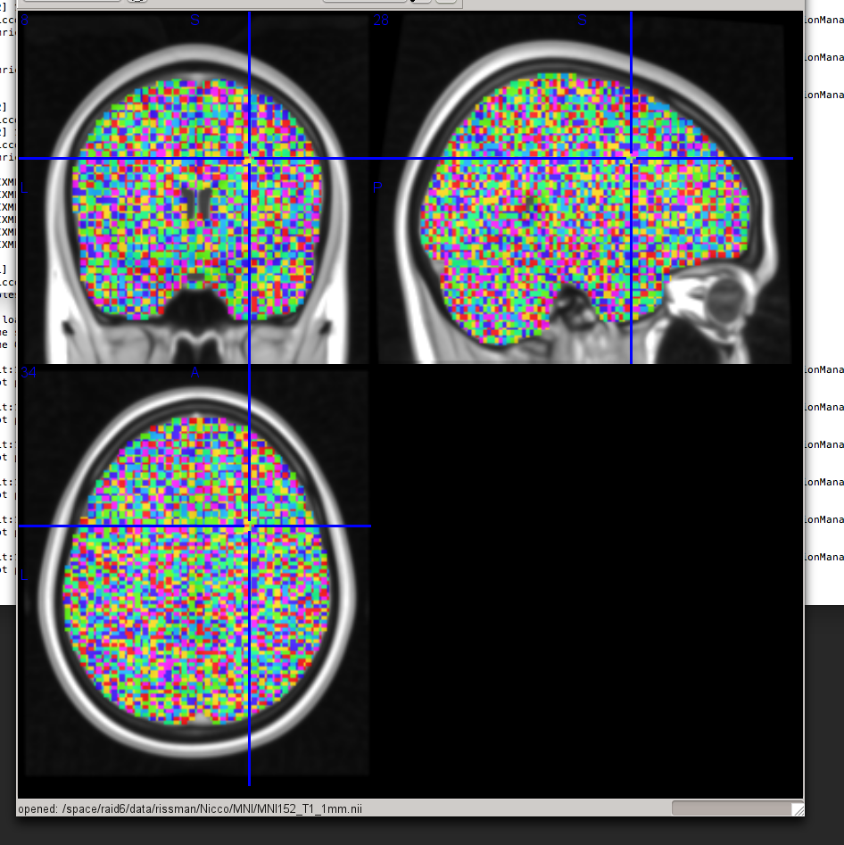
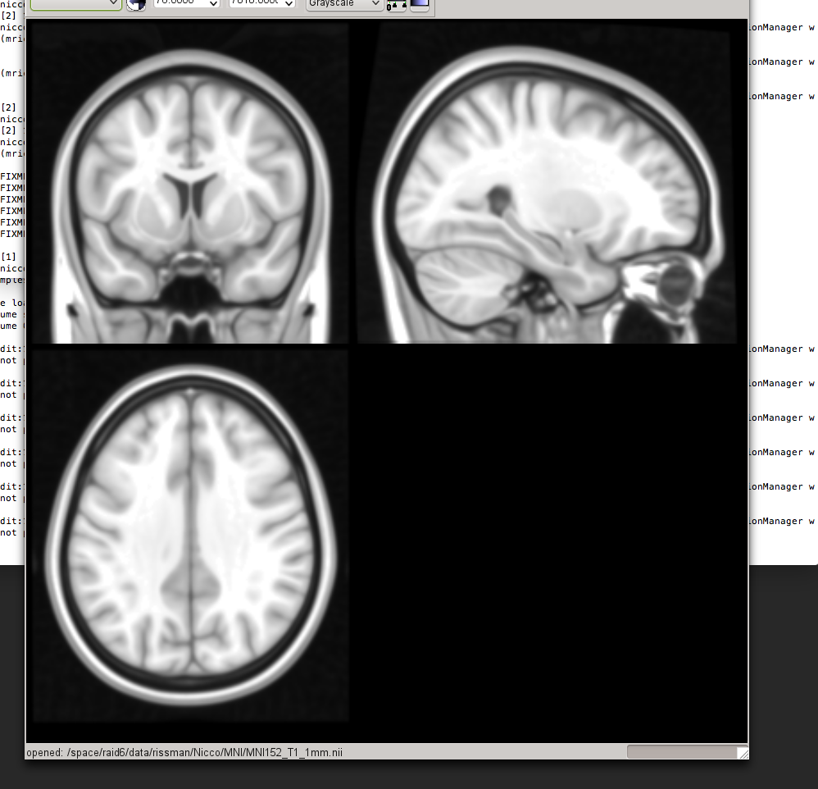
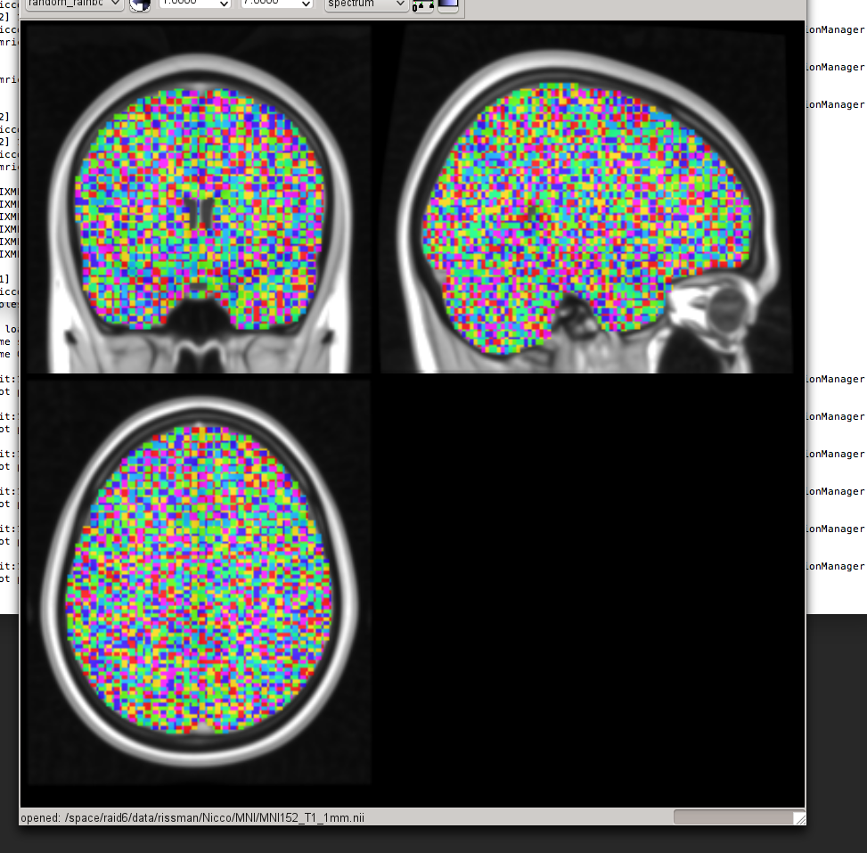
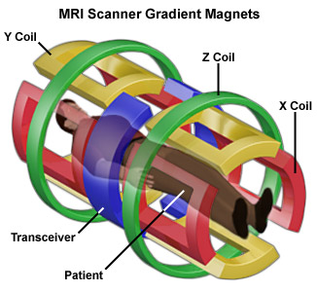
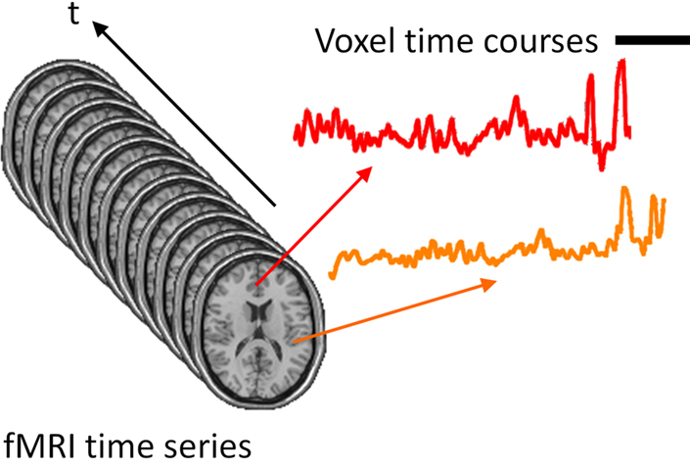
Functional MRI (fMRI)

Slide 7
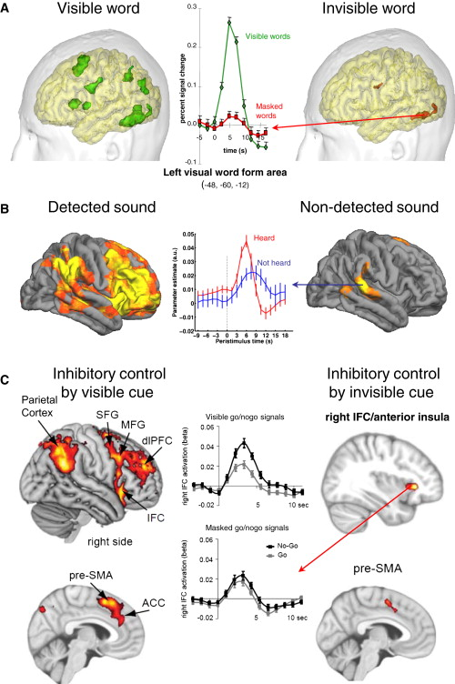
fMRI and Consciousness
With sensory input remaining constant, we can observe the neural differences when light that hits the retina reaches conscious awareness compared to when it is invisible or not-detected.
Notes:
Figure 1. fMRI Measures of Conscious Access
(A) An early fMRI experiment contrasting the fMRI activations evoked by brief presentations of words that were either readable (left) or made invisible by masking (right) (adapted from Dehaene et al., 2001). Nonconscious word processing activated the left occipito-temporal visual word form area, but conscious perception was characterized by (a) an intense amplification of activation in relevant nonconscious processors, here the visual word form area (left occipito-temporal cortex; see middle graph); (b) an additional spread of activation to a distributed, though restricted set of associative cortices including inferior parietal, prefrontal, and cingulate areas.
(B) fMRI study of threshold-level noises, approximately half of which were consciously detected (Sadaghiani et al., 2009). Bilateral auditory areas showed a nonconscious activation, which was amplified and spread to distributed inferior parietal, prefrontal, and cingulate areas (for similar results with tactile stimuli, see Boly et al., 2007).
(C) fMRI study of inhibitory control by a visible or invisible cue (van Gaal et al., 2011). Subjects were presented with masked visual shapes, at the threshold for conscious perception, some of which occasionally required inhibiting a response (go/no-go task). Small activations to the nonconscious no-go signal were detected in the inferior frontal and preSMA cortices, but inhibitory control by a conscious no-go signal was associated with fMRI signal amplification (see the difference between no-go and go signals in middle graphs), and massive spread of the activation to additional and more anterior areas including prefrontal, anterior cingulate, and inferior parietal cortices.

Slide 8
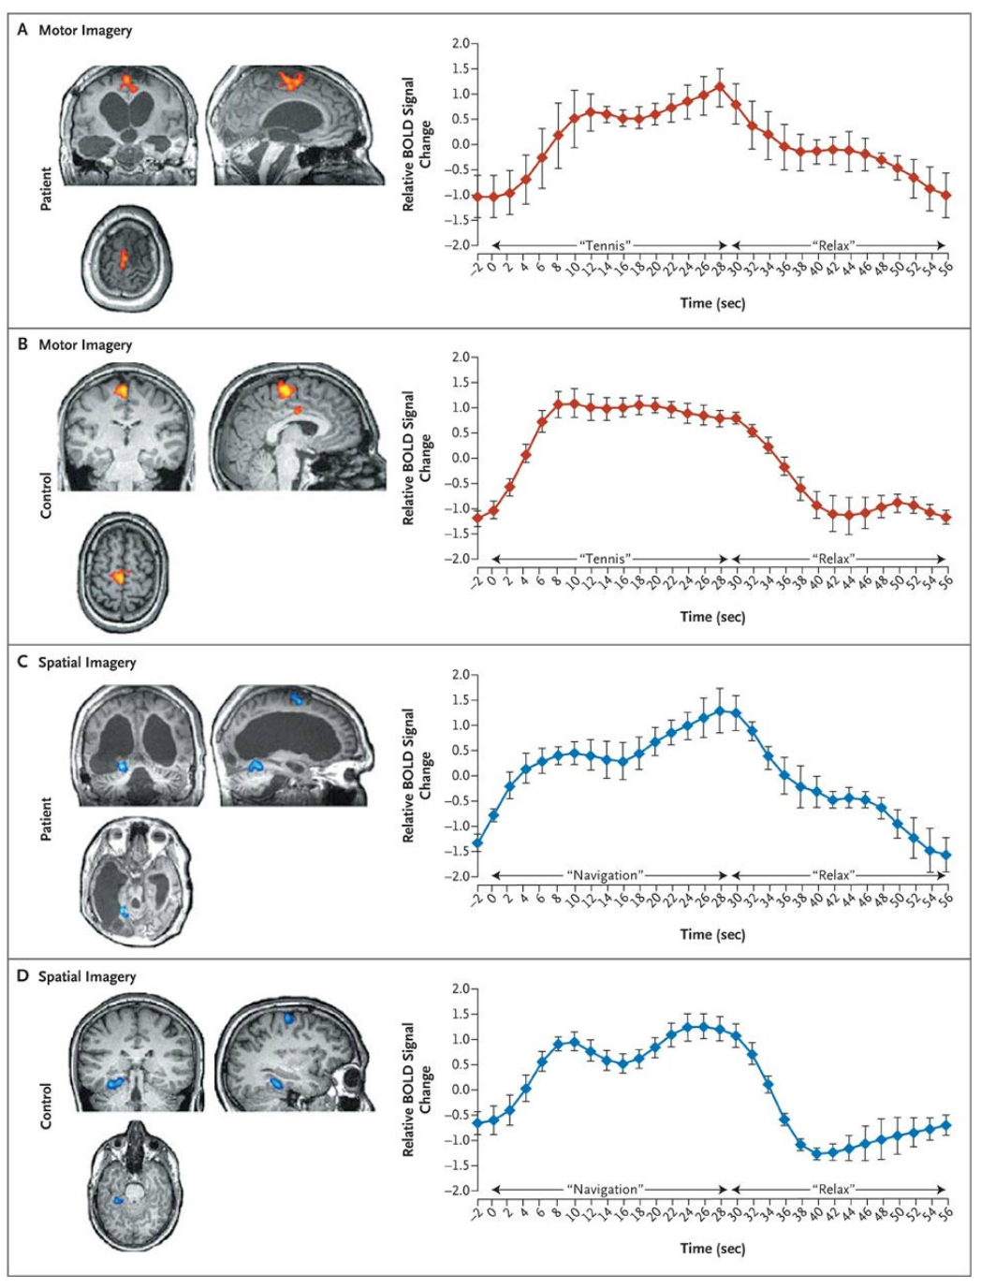
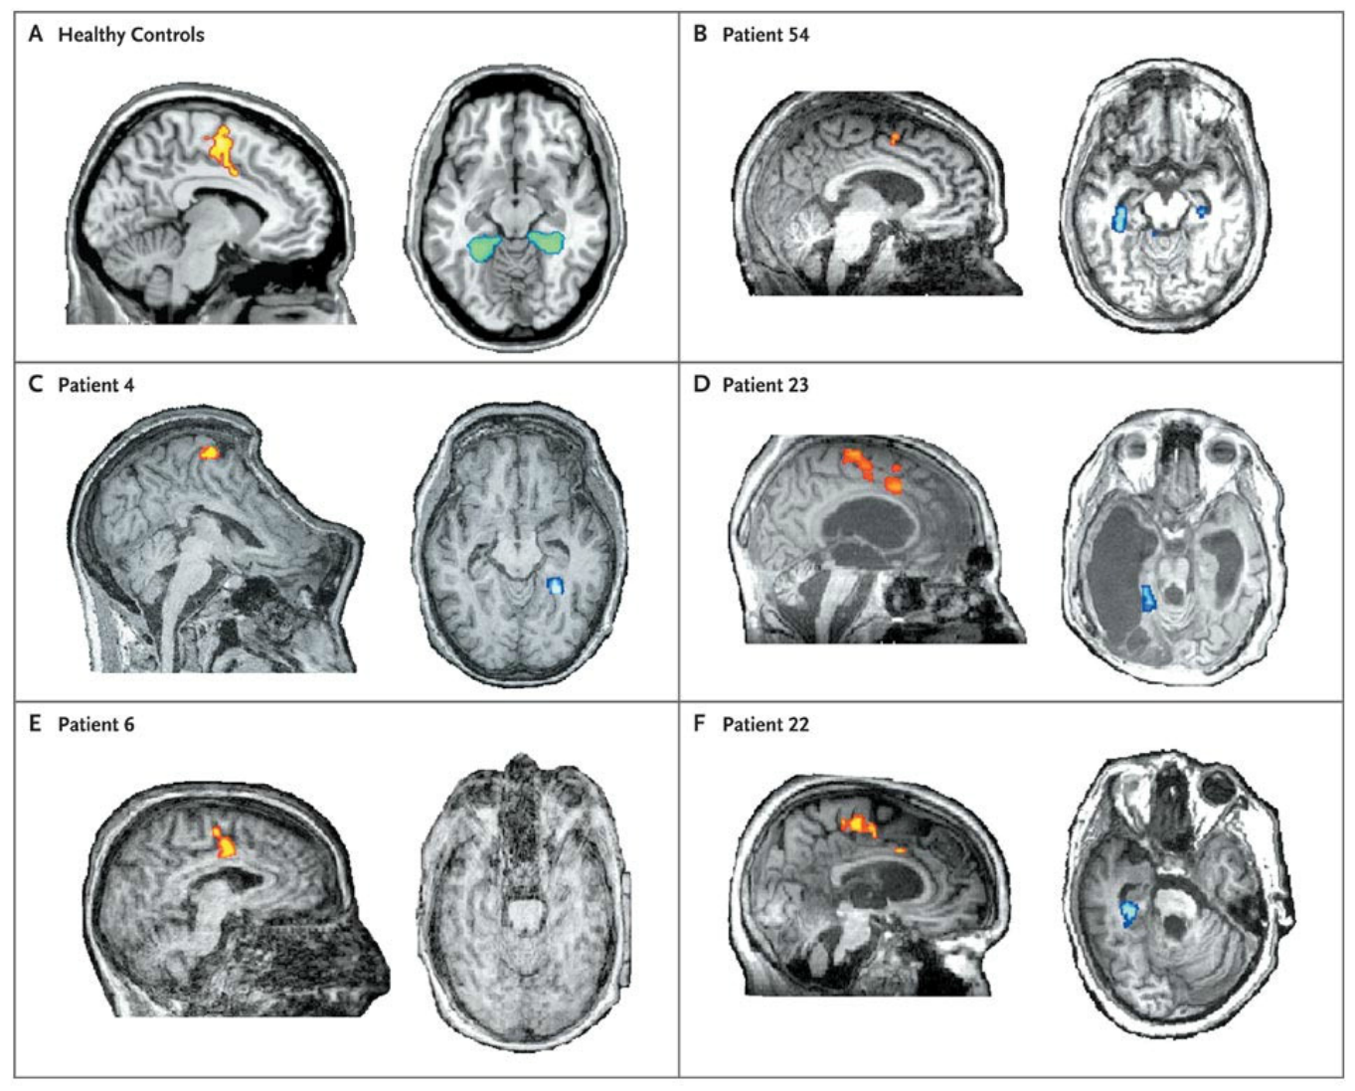
fMRI and Consciousness
What about people with severe damage to motor output regions?
Could they be conscious and incapable of communicating the results of their sensory percept?
Notes:
While in the functional MRI scanner, all patients were asked to perform two imagery tasks. In the motor imagery task, they were instructed to imagine standing still on a tennis court and to swing an arm to “hit the ball” back and forth to an imagined instructor. In the spatial imagery task, participants were instructed to imagine navigating the streets of a familiar city or to imagine walking from room to room in their home and to visualize all that they would “see” if they were there.
participants were asked a yes-or-no question (e.g., “Do you have any brothers?”) and instructed to respond during the imaging session by using one type of mental imagery (either motor imagery or spatial imagery) for “yes” and the other for “no.” The nature of the questions ensured that the investigators would not know the correct answers before judging the functional MRI data.
Among the 54 patients, we identified 5 who could willfully modulate their brain activity
. For all 48 questions in the communication task, the correct answer was determined with 100% accuracy by comparing the activations shown on the communication scans with the activations shown on two localizer scan

Slide 9
Diffusion Tensor Imaging (DTI)
Why wouldn’t someone be able to recruit brain regions responsible for such cognitive tasks?
Is there a common connectivity fault that prevents information from reaching cortical processing regions?
DTI, an advanced form of MRI, allows one to inspect the local directionality of water-flow.

Slide 10
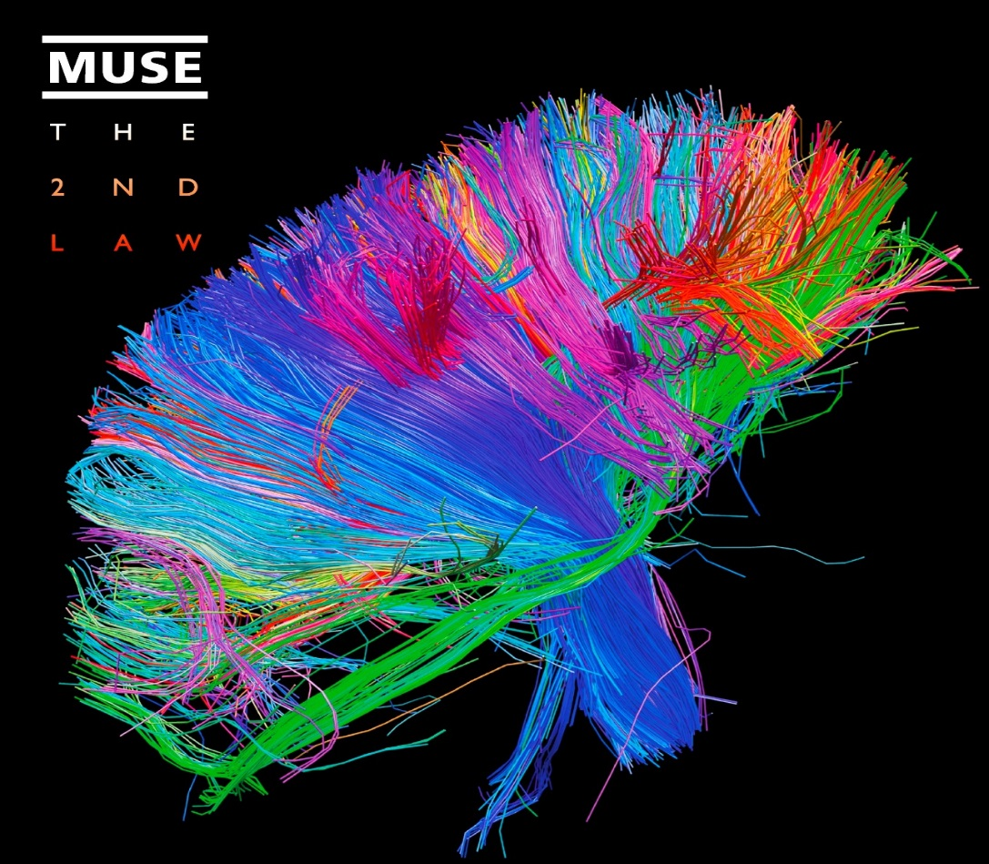
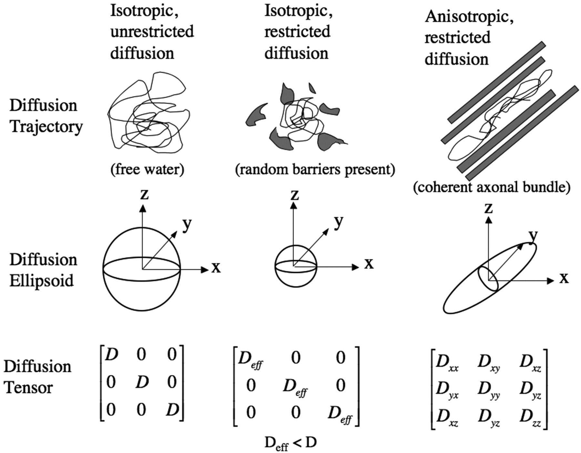
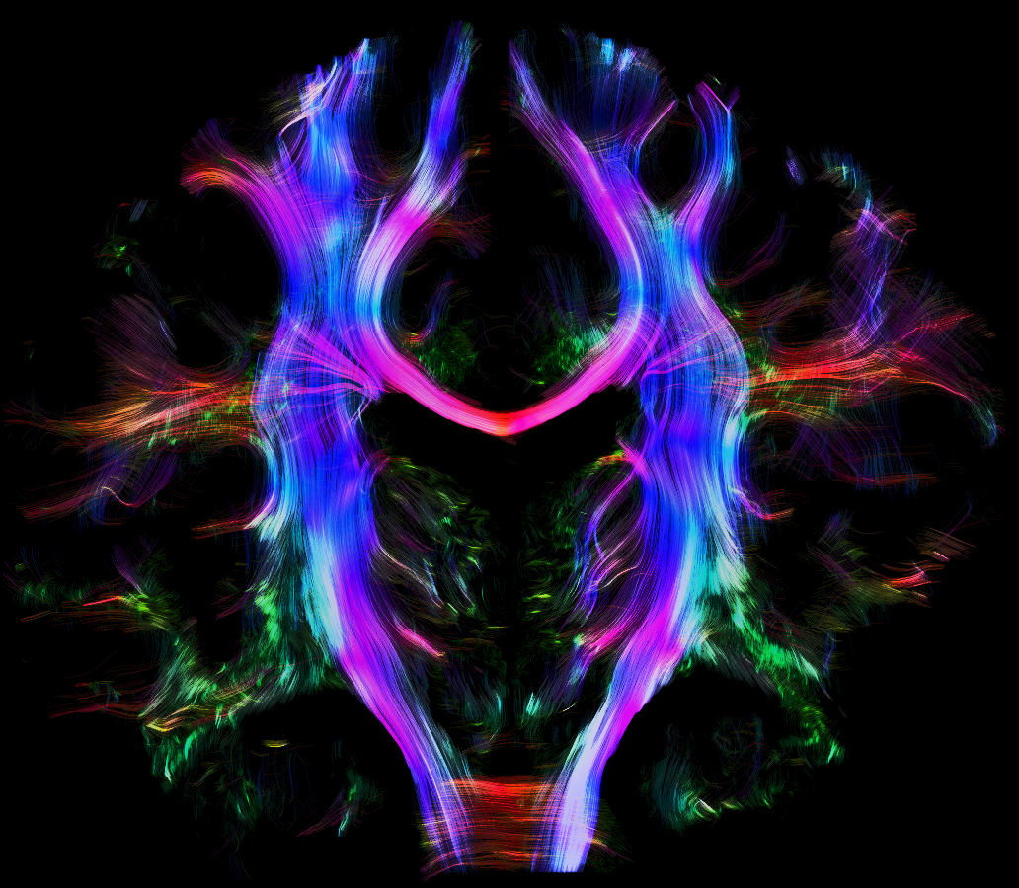
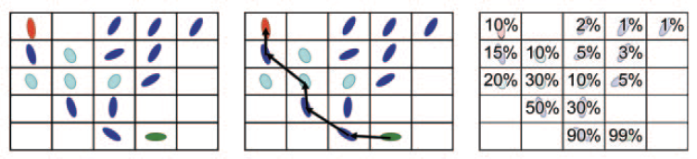
Diffusion Tensor Imaging

Slide 11
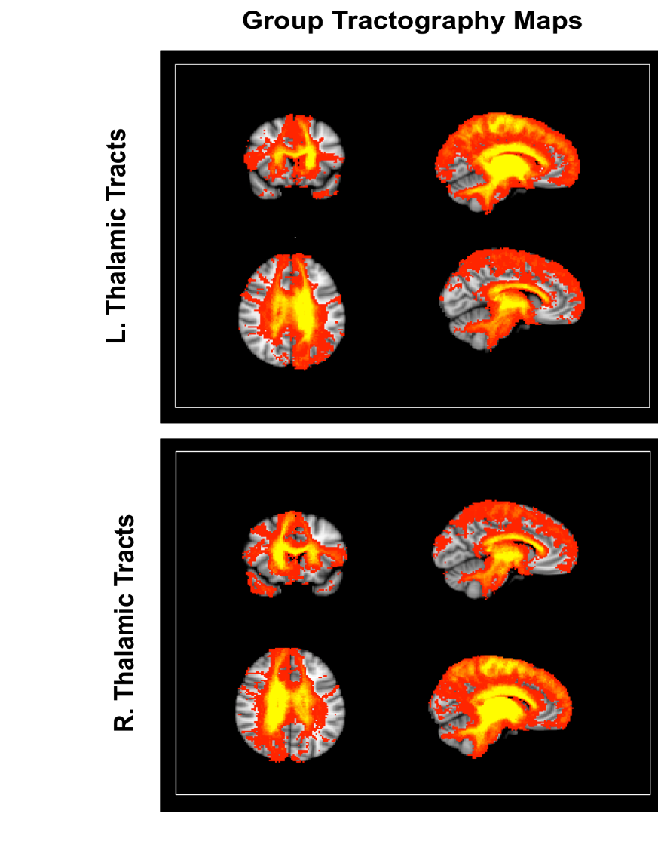
DTI and Consciousness
For each voxel in the Thalamus, we tracked probable connectivity paths with the rest of the brain.
End Result: whole-brain maps where each voxel represents the probability of its reciprocal connectedness with the Thalamus.
For patients with gradations of disorders of consciousness:
  Vegetative State
  Minimally Conscious State -
  Minimally Conscious State +

Slide 12


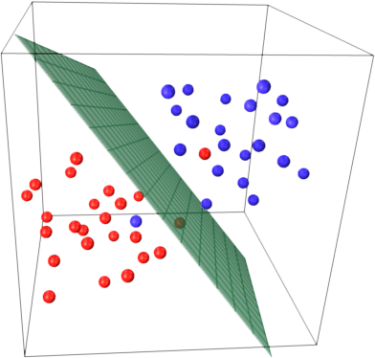
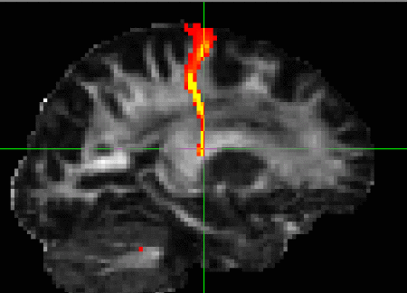
Machine Learning

Slide 13

DTI and Consciousness

Slide 14

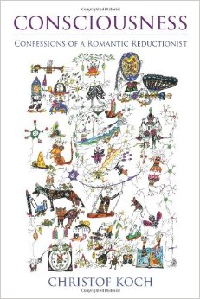

Resources

